Slide 1
Agenda
INDIA OPPORTUNITY
OUR INVESTMENTS & INNOVATIONS
DATA CENTER INDIA FOOTPRINT
AI-READY
DATA CENTERS
AI POWERED OPERATIONAL EXCELLENCE
NEW CAMPUSES OVERVIEW
YOUR PARTNER
OF CHOICE

Slide 2
EMPOWERING
INDIA’S AI AMBITION
Sify Overview
Mission Critical Networks
AI-ready
Data Centers
AI Cloud,
Hybrid IT
Digital
Services
Robust
Security

Slide 3
INDIA OPPORTUNITY
INDIA
ECONOMY
INTERNET
ECONOMY
DIGITAL INFRASTRUCTURE
PEOPLE AND DEMOGRAPHICS
Fastest growing large economy – 7% GDP growth
India set to add $1 trillion to its GDP every 1.5 years over the next six years, reaching $10 trillion by 2032
90+ unicorns, 3rd largest ecosystem of startups
700 million connected people
Largest market for many leading Hyperscalers in terms of users
50% connected population indicating significant headroom for growth
Per capita data consumption growing– 24 GB projected to grow to 62 GB
Leading public digital infrastructure stack leading B2C and B2B2C technology adoption– Aadhar, UPI and Jan Dhan
Bharatnet driving rural broadband penetration
Projected to add 800+ MW of data center capacity with 5.7 billion USD investments in pipeline by 2027
Leading Hyperscalers with large investments in India
80% of enterprises moving from in-house data centers to cloud and colocation by 2027
70% of the population of India is below 40 years
Largest employee base for leading Fortune 500 companies outside their home country
Skilled workforce – IT and now initiatives to skill around AI

Slide 4












KEY INDUSTRY DRIVERS
Through time
1.0
Web
2.0
Digital transformation/
emergence of cloud
3.0
Pandemic induced accelerated digital transformation
4.0
GenAI, Cybersecurity, IoT
3x
2,500+
2x
2,000+
1,600+
1,200+
India DC Capacity (MW)
800+
500+
50+
300+
By Technology
2G rollout
3G rollout
4G rollout
Artificial Intelligence
Increasing digitalization
Cybersecurity
Rise of Internet
Rapid Smartphone adoption
Sharp reduction in data prices
Accelerated adoption of cloud
Roll-out of 5G & increased bandwidth
IOT

Slide 5







Future of Digital Enterprise
SCALABILITY
PRODUCTIVITY
SECURITY
ICT ecosystem
AI/ML
Predictive analytics
Hybrid IT
Hybrid Work
Enterprises are converging to secure, scalable end-to-end data center, network and digital
Notes:
Need for a Scalable and Hardened Technology Infrastructure is inevitable for a future ready digital enterprise:
1. Scalability:
Scalability is vital for growing businesses, allowing them to easily expand their IT infrastructure to support new workloads, markets, or customers.
A flexible and scalable ICT ecosystem helps enterprises respond to changing market dynamics and demands.
Scalability ensures that businesses can maintain performance even as data volumes and processing needs increase, particularly with AI, machine learning, and cloud-based applications.
As businesses evolve, they require infrastructure that can grow with them. Scalability ensures that enterprises can expand their digital footprint without disruptions. By leveraging a robust ICT ecosystem, companies can flexibly adjust their resources to meet new demands, whether they're launching new products, entering new markets, or dealing with fluctuating workloads. This ensures long-term resilience and growth.
2. Productivity:
AI/ML and predictive analytics are revolutionizing productivity by providing data-driven insights that improve decision-making and operational efficiency.
Automated processes and advanced analytics allow businesses to stay ahead of the curve, optimizing performance and reducing human error.
Integrating AI and ML into business processes enhances the ability to anticipate future trends, risks, and opportunities.
Productivity is no longer just about output—it's about smart output. AI/ML and predictive analytics empower organizations to make data-driven decisions that significantly boost efficiency. By adopting these technologies, businesses can unlock insights from vast datasets, predict trends, and streamline operations, allowing them to stay competitive in a rapidly changing environment.
3. Security:
In a hybrid IT and work environment, security is a top priority as businesses integrate both on-premise and cloud-based systems.
As digital transformation accelerates, enterprises must secure their networks, applications, and data from evolving threats.
The future of enterprise security focuses on building secure end-to-end environments that cover hybrid IT infrastructure and support remote or hybrid work setups.
Security is fundamental in today's hybrid IT landscape, where enterprises must manage data across both cloud and on-premise systems. As work environments evolve, with remote and hybrid models becoming the norm, safeguarding sensitive data and ensuring operational continuity are critical. A comprehensive, secure infrastructure is vital to maintaining trust and protecting business integrity in a constantly shifting digital environment."
Overall Theme:
This underlines the holistic approach businesses must adopt, ensuring that their infrastructure is not only scalable and productive but also secure. End-to-end solutions that cover data centers, cloud, networks, security and digital platforms will be key to staying competitive in the future digital enterprise landscape.

Slide 6
Innovating TO STAY Relevant
1995-2005
Internet Revolution
2006-2011
Data Explosion
2012-2020
Cloud Innovation
2021 onwards
Digital Acceleration
2025 onwards
The Age of AI
Sify 1.0
Sify 2.0
Sify 3.0
Sify 4.0
Sify 5.0
RETAIL INTERNET SERVICE PROVIDER
ENTERPRISE SERVICES COMPANY
DIGITAL ICT SERVICES PROVIDER
(cloud@core)
DIGITAL TRANSFORMATION PARTNER
(digital@core)
AI – POWERED
INNOVATION
PARTNER (innovation@core)
First private
ISP in India
Launch of MPLS &
Data Center services in India
Launch of Enterprise Cloud platform & Hybrid Cloud services
Launch of end-to-end
Digital services
Launch of AI-Driven Digital Solutions
From revolutionizing consumer internet in the 90s to leading AI-powered innovation for Enterprises

Slide 7
OUR Investment PHILOSOPHY
Roadmap to expand Data Hubs, Add AI Ops & GPUs
Digital
Services
  Skilled workforce to support modern technologies
  Services across the digital spectrum
  Embeded AI
  Secure by design
3000+ SMEs across platform automation, modern apps, AI/ML, DC, Cloud, Networks, Security
Infinit AI, Infinit FSO, SaaS & Industry solutions
  Modern cloud platform – x86 & GPU support
  Ample data stores for data explosion
  Cybersecurity Operations Centers
  Cloud Management Platform for efficient operations
CloudInfinit^{+AI} , GPU as a Service
Hybrid Cloud Infrastructure
Infinit CMP, Cloud Anywhere Edge Cloud
Infinit MNS platform, NOC
Global SOC, MSS, Infinit Security
Cloud,
AI & Security
  AI ready data centers
  Core and Edge data centers for edge use cases
  Certified and compliant
  Focus on sustainability
14 DCs, 227+ MW IT power
407+ MW by 2025. 10+ Edge DCs
Scalable to 970+ MW
231+ MW RE Power
AIOps, AI Ready, Liquid cooling
Data
Centers
Network
Infra
  Reliable national network backbone
  On-demand capacities
  Deep Distribution Capillarity
  Open Cable Landing Stations for subsea cables
1700+ Cities, 3700+ PoPs
Fiber coverage 24+ Metros
3 CLS, 8 International POPs
Sify OnNet- automated Ent WAN
Notes:
1400+ Digital Networks
350+ Cloud
450+ Modern Apps & AI/ML,
100+ Cybersecurity,
100+ Platform automation,
500+ Technology Integration

Slide 8

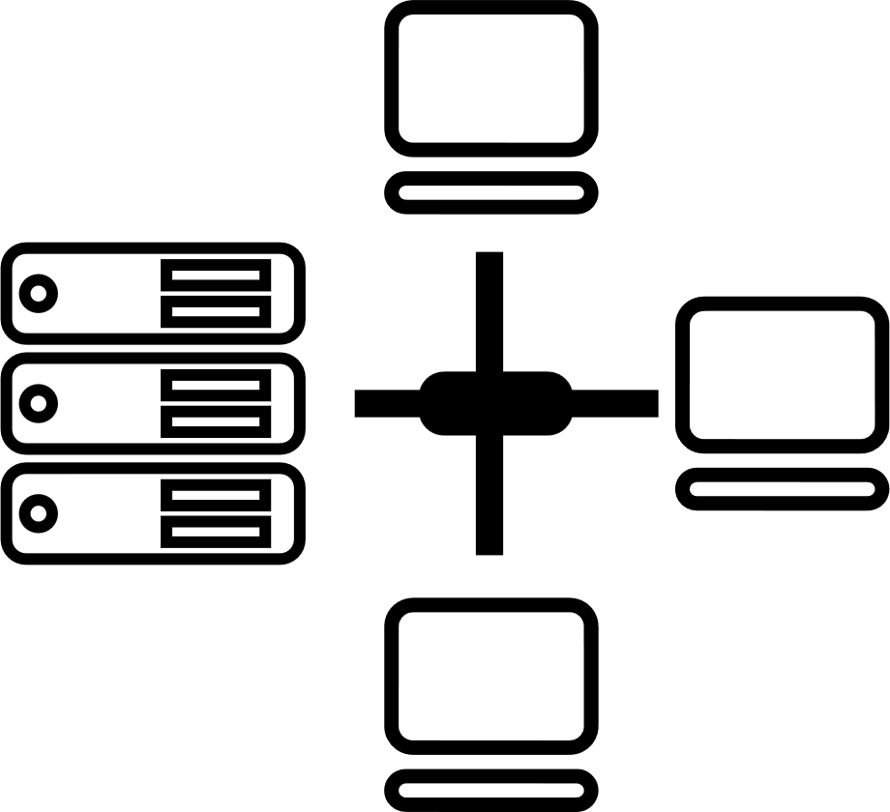

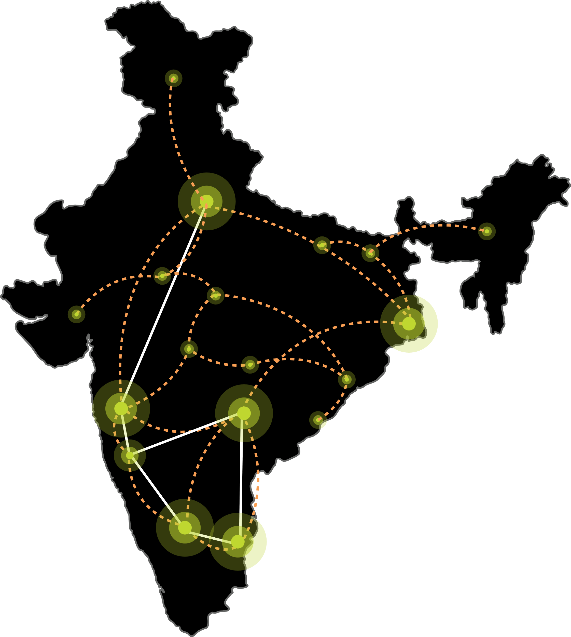






Our DIGITAL INFRASTRUCTURE & PLATFORMS
India’s Top 10 Banks, Top 4 Manufacturing, 3 Major Hyperscalers, Global Social Media, OTT, Security Players, and 10,000+ Enterprises trust Sify.
Metro Networks
Fiber access
Connected Buildings
Interconnected DCs
Express Long-Haul Backbone, High Bandwidth and Low Latency across Key Locations
Network
Infra Services
Network Digital
Managed Services
NOIDA 02
NOIDA 01
SAARC Gateway, Kolkata
Data Center
Colo Services
CloudInfinit^{+AI}
GPU Cloud
MUMBAI 03 RABALE
KOLKATA 01
MUMBAI 02 AIROLI
MUMBAI 01 VASHI
CLS, Versova, Mumbai
HYDERABAD 02
HYDERABAD 01
Cloud & IT
Managed Services
Security
Managed Services
CHENNAI 02
BENGALURU O2
CHENNAI 01
BENGALURU 01
CLS, Siruseri, Chennai
Digital Apps
Managed Services
Industry Apps
Managed Services

Slide 9
Sify AI Overview
The Sify portfolio offers a comprehensive range of AI services, designed to build and operate solutions that boost business productivity and competitiveness. With agile, flexible infrastructure and secure, cutting-edge platforms, Sify offers everything needed to empower your AI journey.
AI-READY
Networks
High capacity, ultra-low
Latency
Data Centers
High-density hosting for
AI workloads
CloudInfinit^{+AI}
High performance compute with GPU as a service
Platform
Develop and Deploy AI models &
services
Learning
Training modules with Companion Labs to build AI solutions
Security
Proactive Detection, Defense & Rapid Response
From Infrastructure to innovation, Sify empowers your AI journey
Notes:
The rise of Generative AI has ignited a push for operational excellence and transformative user engagement across industries. Yet, AI ambitions face familiar and new challenges, demanding a seamless approach to explore, experiment, and execute AI projects effectively.

Slide 10

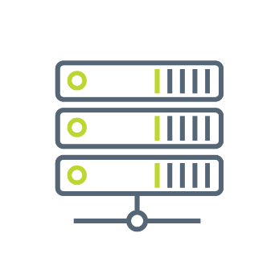

SIFY GROUP COMPANIES
NETWORK
SERVICES
DATA CENTER
COLOCATION SERVICES
CLOUD & DIGITAL
SERVICES
Sify Technologies Ltd.
Sify Infinit Spaces Ltd.
Sify Digital Services Ltd.
Innovation led by Sify Ventures
Your digital bridge for transformation, built on world class digital infrastructure, platforms and services

Slide 11
INDIA’S DATA CENTER PIONEER
AI-READY, HYPERSCALE, HYPERCONNECTED, GREEN, EDGE, DATA CENTER CAMPUSES
SHARAD AGARWAL, CEO

Slide 12


Why are we excited - Explosion in compute and storage demand
AI Growth Trends
Generative AI Workload Explosion
Global AI market
Projected Growth:
CAGR of 37.3%, reaching $1.8 trillion by 2030. (Source: Gartner)
Large Language Models (LLMs) like OpenAI's GPT and Google's Gemini require high-performance compute environments.
APAC AI market
Projected Growth:
CAGR of 28.58%, reaching approximately $298.40 billion by 2030. (Source: Statista)
Demand for hosting AI training and inference workloads is expanding across Asia-Pacific and Middle Eastern regions, driven by increased digital transformation initiatives. (Source: JLL)

Slide 13
India: A Data Center Hub
Data Center power capacity will rise from 950 MW in 2024 to 1,800 MW by 2026
KEY DRIVERS
Digital Economy Expansion
Increased Data Consumption
Cloud & Emerging Tech: AI, 5G, Edge Solutions
Growth Segments: GDC/GCCs
30+ Cities- Tier 2 and 3
Government policy & Regulatory Frameworks
Source: Research Firms

Slide 14
our focus areas
AI-Ready Infrastructure
  Power, Cooling, Network, Server Hall
  Specialized Hardware-GPUs, TPUs for HPC
  Advanced Liquid Cooling
Scalability and Modular Designs
Edge Computing and Decentralization
  Modular Data Centers with BTS capabilities
  Horizontal and Vertical expansion
  Proximity to End-Users
  Hybrid Cloud Integration
Sustainability and Operational excellence
Enhanced Security and Compliance
  Green Initiatives
  Energy Optimization
  Blending Automation
  Zero-Trust Architecture
  Global Regulations and Compliance

Slide 15

Our DATA CENTER FOOTPRINT- 6 Major metros
CHANDIGARH 01
EDGE | 14 MW
NOIDA 01
Noida
10.8MW
NOIDA 02 CAMPUS
Tower B
43+ MW
Tower 1
11.5 MW
Tower 2
9.6 MW
Tower 3
BTS
LUCKNOW 01
EDGE |14 MW
Tower A
43+ MW
Tower C
43+ MW
1st Tier 3
in 2000
Tower 4
8.1 MW
Tower 5
43+ MW
Tower 6
40+ MW
Q2 2025
MUMBAI 01
Vashi
0.9 MW
Tower 7
40+ MW
Q3 2025
Tower 8
40+ MW
Tower 9
40+ MW
Tower 10
40+ MW
KOLKATA 01
2.2 MW
Tower 11
40+ MW
Q3 2025
Tower 12
40+ MW
Q4 2025
MUMBAI 02
Airoli
5.4 MW
HYDERABAD 02 CAMPUS
(FAB CITY)
MUMBAI 03 CAMPUS (RABALE)
HYDERABAD 01
Financial Dist.
14.4 MW
5 Blocks
Current Plan: 26-52 MW each
AI Optimized Plan
Up to ~500MW
BANGALORE 02 CAMPUS (AEROSPACE PARK)
BANGALORE 01
Electronic City
7.6 MW
Tower 1
20+ MW
Q2 2025
Tower 2
20+ MW
CHENNAI 02 CAMPUS (SIRUSERI)
CHENNAI 01
Tidel Park
3.6 MW
Tower A
43+ MW
Tower B
43+ MW
Tower C
43+ MW
Operational
In Development
Planning
All Power references are Design IT Power at Full Capacity
All Power references are Design IT Power at maximum Capacity

Slide 16


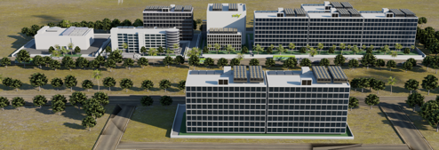
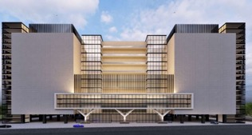
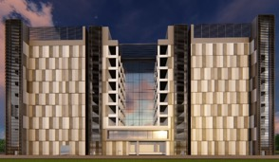
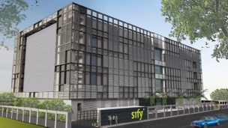
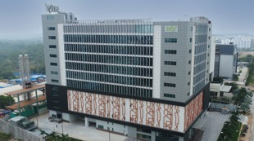
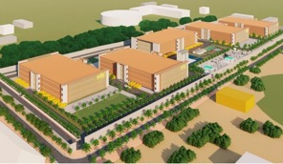
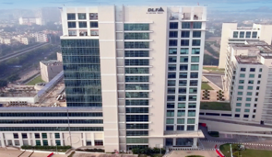
AI-READY, hyperscale, Hyperconnected, Green,
Data Center campuses
India’s 1st Nvidia DGX Ready Air-Cooled DCs
March 2022
India’s 1st Nvidia DGX Ready Liquid Cooled DCs
August 2024
Mumbai 03, Rabale
IT Power: 377+ MW
Noida 02
IT Power: 130+ MW
Chennai 02, Siruseri
IT Power: 130+ MW
5 Towers Operational
4 Towers In Development
3 Towers in Planning
1 Tower Operational
2 Towers in Planning
1 Tower Operational
2 Towers in Planning
Bengaluru 02
IT Power: 40+ MW
Hyderabad 01, Financial Dist.
IT Power: 14.4+ MW
Hyderabad 02, Fab City
IT Power: 250+ MW
Kolkata 01, DLF IT Park New Town
IT Power: 2.2+ MW
In Development
Operational
Planning
Operational
14 DCs - 227+ MW IT power | 407+ MW by 2025 | Campuses scalable to 970+ MW with BTS | 231 MW Green Power

Slide 17
Edge data center footprint. Rollout planned over 2-3 years
Low latency, easy access and faster content delivery in non-metro locations, ensuring seamless data processing and superior customer experience.
CHANDIGARH 01
Oct 2025
NOIDA 02
NOIDA 01
LUCKNOW 01
June 2025
JAIPUR 01
PATNA 01
NAGPUR 01
GUWAHATI 01
AHMEDABAD 01
3.6-14.4 MW Tier 3 data centers with diverse carriers, ISPs, Transit nodes, IXs and CDN.
Leverage Sify’s extensive Network presence; connect with Sify NLD fabric.
The data center consumption and interconnections driven by the pull of anchor tenant.
INDORE 01
RANCHI 01
SAARC Gateway, Kolkata
BHOPAL 01
KOLKATA 01
MUMBAI 03 RABALE
VISAKHAPATNAM 01
MUMBAI 02 AIROLI
BHUBANESWAR 01
MUMBAI 01 VASHI
VIJAYAWADA 01
RAIPUR 01
CLS, Versova, Mumbai
HYDERABAD 02
HYDERABAD 01
COCHIN 01
CHENNAI 02
BENGALURU 02
CHENNAI 01
BENGALURU 01
CLS, Siruseri, Chennai
Construction
Design
Planning
Notes:
Special Economic Zones, IT resources, IT outsourcing companies are going into tier 2 cities. We need to build digital infrastructure for AI in these locations. AI training needs more investments, that can happen in the large metros, AI inferencing is cost effective which you can build in tier 2 cities. We have a plan to begin with 10-20 locations in Tier 2 and 3 cities leveraging our Pan India Network and DC footprint.

Slide 18
Your trusted data center partner
Sify is a LEADER in the IDC MarketScape Data Center Services India, 2024
Mission Critical Customer Experience
2 Decades of Operational Experience
Future-ready
Data Centers
Trusted
Partner
3 out of 4 Hyperscalers
Global OTT & social media players
India’s top 10 banks
Global InfoSec security providers
600+ customers across all major industries
100% uptime
Best Practices covering Safety, Security, Availability, Excellence
PUE & WUE prediction and optimization
Certifications: Information Security, EHS, PCI-DSS, SOC 1 SOC 2, NVDIA, MeitY, IGBC
Mega campus approach for long term scalability with BTS
Next Gen Data Center design & operations.
AI ready infra with liquid cooling solutions
AI/ML platform enabling faster decision-making
Up to 70% Green Power available
1st commercial Data Center provider in India since year 2000
Data Center, Networks Digital and Security services under one roof
Reliability for services
Flexibility for customer requirements
Ensuring accountability, reliability, flexibility and choices through our innovative designs and services

Slide 19
INDIA’S DATA CENTER PIONEER
GENERATION 3 DATA CENTERS & OUR AI-READINESS
ROOPESH KUMAR, HEAD DATA CENTER ENGINEERING

Slide 20
Future ready data center architecture
CUSTOMIZABLE & MODULAR INFRA
ENGINEERED FOR AI WORKLOADS
MULTI LAYERED NETWORKS
Multi tower campuses with Vertical and Horizontal expansion to support future business growth
Designed for 200 kW/rack high density racks. 6.3m floor to floor height, 2100 kg/m² load bearing capacity
Multi-tier fiber and copper for low-latency deployments, supporting high-capacity network bandwidth of 600 Gbps
RELIABLE
POWER SUPPLY
SUSTAINABLE
OPERATIONS
On premise 110, 220, 230 kV substation with 48 hours of fuel storage with redundant supply contracts
Liquid & Air-cooling solutions, 60% renewable energy, ESG best practices and automation led continuous monitoring
Ensure business continuity, maximize uptime, resilient connectivity and sustainability
with RAS designed scalable digital infrastructure

Slide 21





OUR AI READY Data CenterS
Power
Scalable and robust power infrastructure
Tolerant to dynamic load variations
Redundant distribution systems
Support multiple water temperature scenarios
Support different cooling methodologies
Cooling
High-capacity fiber and copper network
Multiple paths, dual meet-me-rooms, and distribution
Network
Purpose-built data center buildings
Structural design to meet local codes and seismic rating
Server Hall
Designed and built to accelerate your AI Adoption

Slide 22
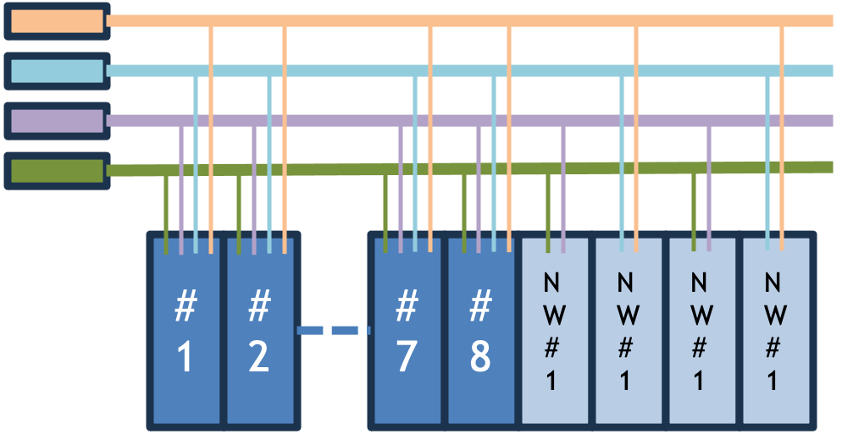
AI-ready Data Centers: Power
Sub Station
Transformer
Switch Gears
UPS
Power Distribution
Busway/ PDU
Rack PDU
Diesel Generator
Battery
Typical Power Distribution for AI Data Centers
On site 220 KV substation connected to national grid for highly reliable power supply
Facility power scalability up to 300 MW
Redundant Power Transformer and Switchgears for the MV (medium voltage) distribution
Redundant Distribution and Switchgears for the low voltage (LV) distribution
N+N or 4N3 (for three bus requirement by certain AI racks) rack power distribution
32 A to 63A 3 ph power with Up to 8 cables / Busways per rack
AI workload racks Power Distribution
Scalable power infrastructure with high redundancy for maximum reliability

Slide 23

AI-ready Data Centers: COOLING
Up to 40KW Racks Range of water temperature up to 22ºC | Up to 60KW Active or Passive RDHX Range of water temperature up to 22ºC | Up to 80KW Range of water temperature up to 40ºC | Up to 132KW Range of water temperature up to 40ºC | Up to 200kW Range of water temperature up to 45ºC
Air to Air to Water | Air to Air to Water | Liquid to Air to Water | Liquid to Water (Refrigerant to Water) | Liquid to Water (Refrigerant to Water)
PAHU
RACK
RDHX
RACK
PAHU
AHX
RACK
WHX
RACK
R A C K
Liquid Immersion
Direct to Chip
CDU
Direct to Chip
CDU
CDU
All our Gen3 Data centers can support all the above cooling technologies

Slide 24
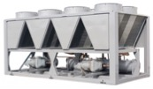
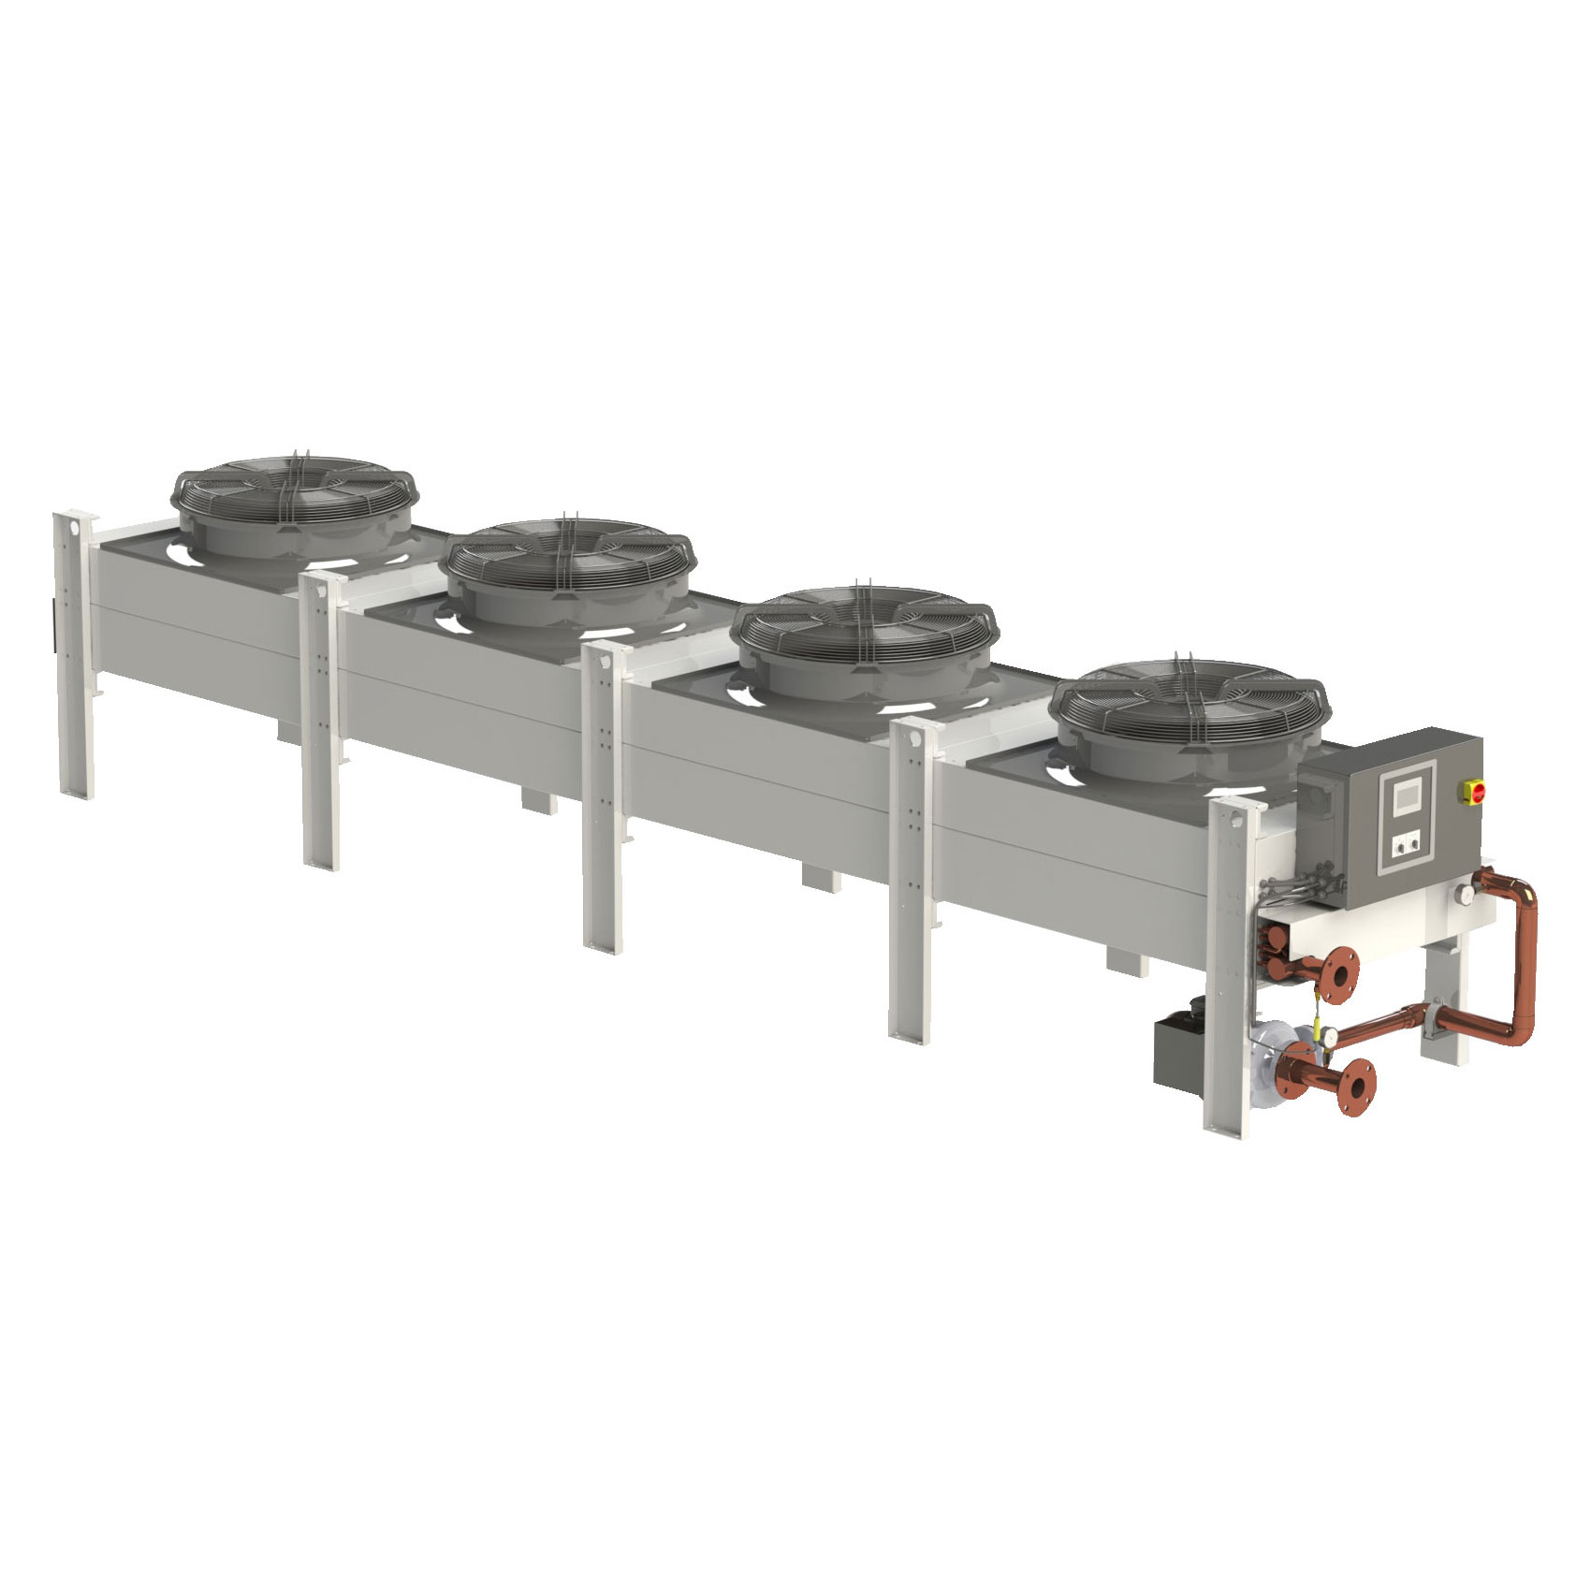
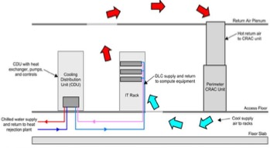
AI-ready Data Centers: Cooling
Liquid Cooling Technologies
Air Cooled Chiller
Rear Door Heat Exchanger (RDHx)
Dry Cooler/Adiabatic Cooler
All Liquid Cooling systems that requires water temperature of 20 deg C to 24 Deg C supported by the chiller-based HVAC infrastructure
Various air-cooling systems for the server hall
Liquid cooling system that needs higher water temperature, general ask is 30º C to 40º C
All Gen3 DCs are feasible for provisioning the required infrastructure
Significant savings in PUE due to elimination of compressors for cooling
Direct to Chip Liquid Cooling (DCLC)
Liquid Immersion Cooling (LIC)
Fault Tolerant Hybrid model using air-to-air and/or air-to-liquid cooling methodologies in single rack
Redundant Water Distribution system for both Chilled and warm water
Compatible with all leading Coolant Distribution Unit (CDU) manufacturers for precise supply of water pressure, flow rate, and temperature
Unique water distribution system without the use of CDU to deliver precise pressure, flow, and temperature for specific AI chips
Supports scattered high-density AI racks with standalone liquid distribution equipment (e.g. side car or AHX)
Fully Integrated Building Management System
Fault-tolerant, hybrid cooling systems with precise liquid distribution for high-density racks

Slide 25
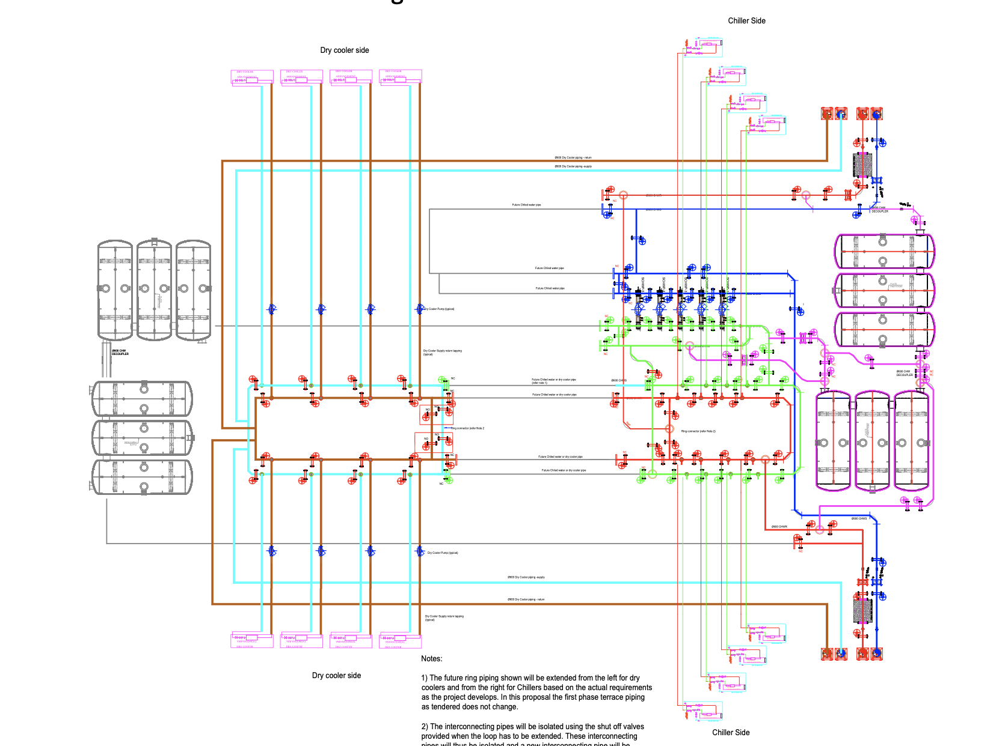
AI-ready Data Centers: cooling
Sify’s Unique Design – Hybrid Cooling Infrastructure
Hybrid water distribution
Provision for warm water and chilled water for various cooling workload
Modular expansion either from dry cooler side or chiller side and/or both
Piping network is in designed as add on modules for seamless expansion of warm water and chilled water distribution
Provision to introduce standalone dry cooler systems for smaller, or independent floor or specific applications such as two-phase liquid immersion system etc
Intelligent monitoring system suing SCADA and PLC supported by AI/ML software tool
Warm Water Distribution Riser A
Dry Coolers
Chillers
Chilled Water Distribution Riser A
Dry Coolers
Chillers
Chilled Water Distribution Riser B
Warm Water Distribution Riser B

Slide 26
AI-ready Data Centers: cooling
Sify’s Unique Design – Hybrid Cooling Infrastructure
Hybrid water distribution
Provision for warm water and chilled water for various cooling workload
Modular expansion either from dry cooler side or chiller side and/or both
Piping network is in designed as add on modules for seamless expansion of warm water and chilled water distribution
Provision to introduce standalone dry cooler systems for smaller, or independent floor or specific applications such as two-phase liquid immersion system etc.
Intelligent monitoring system suing SCADA and PLC supported by AI/ML software tool
Warm Water Distribution Riser A
Dry Coolers
Chillers
Chilled Water Distribution Riser A
Dry Coolers
Chillers
Chilled Water Distribution Riser B
Warm Water Distribution Riser B

Slide 27
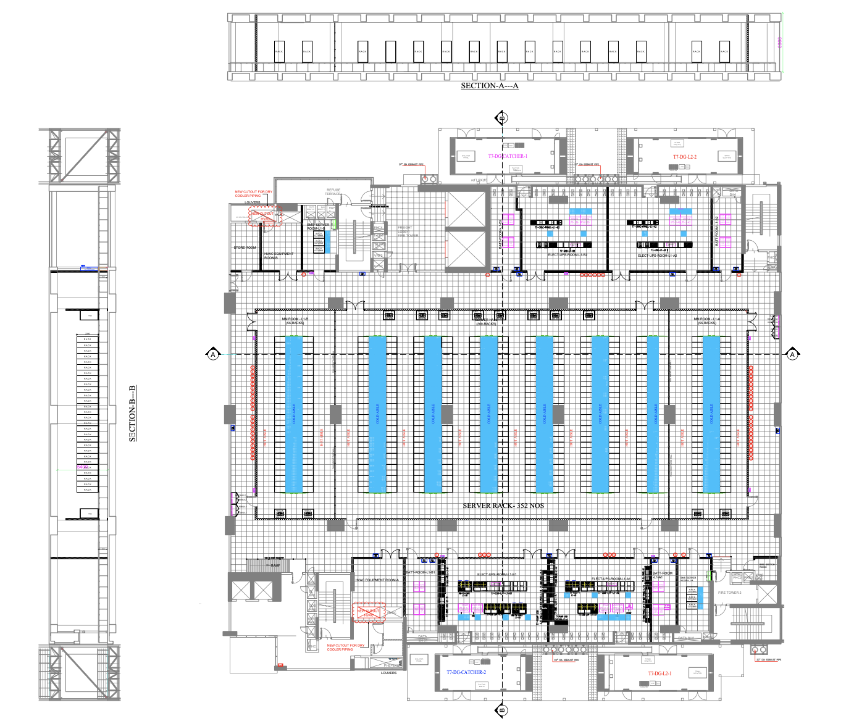
AI-ready Data Centers: server hall
Server hall supports perimeter cooling via PAHUs or FWU
Compatible for both Cold Aisle and Hot Aisle containments
Liquid to Liquid cooling for DCLC racks or Liquid Immersion Racks using CDUs and without CDUs
Dual pipelines for redundant water supply
Equipment redundancy in N+1, N+2 or N+N based on customer requirements
Supports high density racks with floor load bearing capacity of 2100kg/SqMtr, feasible even for larger LIC racks
6300mm slab to slab room height, for multi layer network and power distribution systems
Warm Water Distribution Riser A
Chilled Water Distribution Riser A
Liquid Cooling Infrastructure
(CDU, LIC, RDHx)
Air Cooled Infrastructure
(PAHU, FWU, RDHx)
Chilled Water Distribution Riser B
Warm Water Distribution Riser B

Slide 28
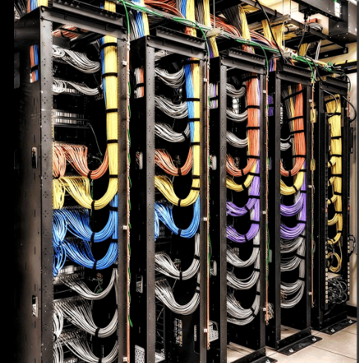



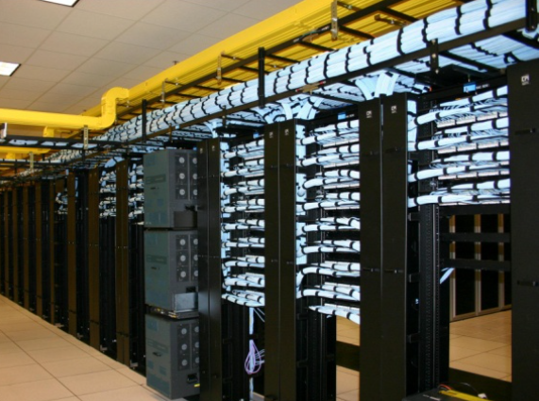



AI-Ready Data Centers: network
Multi-tier Network
Reliable Network Access
Cross-Connectivity
Multi-tier Fiber and Copper for low latency Infini-band like deployment
Cluster based rack placement
High capacity intra rack and inter rack network
Multiple Fiber routes to the building and MMRs at each tower of the DCs.
Enables connect for DR, NDR, FDR deployments
Access via high capacity 600 gbps networks
Lower TCO as expensive network bandwidth not required
Carrier Neutral
Meet-Me-Room
Access to Clouds Internet Exchanges & Cable Landing stations
90% of fiber links are from non Sify Telcos
Extension simplified with in-campus wiring and is a low capex option for all Telcos
MDF(Network Closet) in every floor, connected to MMR via network risers
Separate access to telco MMRs for O&M in the BTS
Proximity to Internet exchanges, Hyperscale, OTT, Social Media
Access to Cable landing station
High capacity, robust connectivity, and cost-effective bandwidth
Notes:
Access via high capacity 200 gbps + networks
Multi-tier Fiber and Copper for low latency deployments with high capacity 200 Gbps+ networks.
Cluster based rack placement
High capacity intra rack and inter rack network

Slide 29
AI-ready Data Centers summary
SERVICES | CHALLENGES | SOLUTION |  | SIFY READINESS
POWER | Quality, Uninterrupted Power | Grid level feeder on 220kV or above |  | 220kV onsite substation
POWER | Block power to support larger AI rack cluster | Design power clusters including UPS, Busbars that support larger power blocks, usually up to 1000KW per row |  | Each power blocks is in 2160kW
HYBRID COOLING TECHNOLOGIES | Any one type of cooling such as DX or Chilled water doesn’t support varying AI rack environment | Data center to support wider range of water temperature, usually from 18 deg C to 40 deg C |  | Supports multiple cooling technology such DX, Chillers and Dry Coolers
WATER DISTRIBUTION | Precise flow, pressure and temperature, controlled water distribution | Design the water distribution with the help of CFD analysis and design appropriate control systems |  | Supports CDU based and non-CDU based water distribution, delivering precise water parameters
WATER QUALITY | Maintain accurate level of water quality parameters | The primary and secondary water parameters to be maintained for efficient heat transfer and clog free distribution |  | Multistage water management system including chemical treatment to maintain the water parameters
BUILDING INFRASTRUCTURE | Adequate floor loading and height | Design buildings that supports high floor loading, and space for multilayer overhead infrastructure |  | Buildings comply with latest building codes, 6.3 meters room height, 2100kg floor loading
NETWORK | Redundant and scalable backbone and internet connections | Large capacity, inter data center, inter city and internet gateway |  | Network supports its data center with all types and capacities of network. Low latency connects to Hyperscale Clouds, OTTs, IXs
Strategically designed framework to enable and optimize hosting for AI Workloads
Notes:
Roopesh, Girish- 15 mins

Slide 30
INDIA’S DATA CENTER PIONEER
AI POWERED OPERATIONAL EXCELLENCE
GIRISH DHAVALE, CTO

Slide 31






Operational Philosophy
Zero
Availability Incidents
Zero
Redundancy Incidents
Zero
Security Incidents
Enhance infrastructure with automated failover systems to ensure uninterrupted operations.
Penalty-proof SLAs by proactively testing and documenting redundancy systems.
AI-driven anomaly detection to monitor cyber and physical security in real-time.
Zero
Safety Incidents
Zero
Carbon Footprint
Zero
Defects
  Transparent safety dashboard to track incident-free days and improvements.
RE 100 (carbon neutral by 2030), Contracted 231 MW green power, ASHRAE, IGBC, carbon abetment policy, low PUE/WUE.
Real time visibility & measurability across operations, predictive maintenance, cross-functional quality audit team.

Slide 32
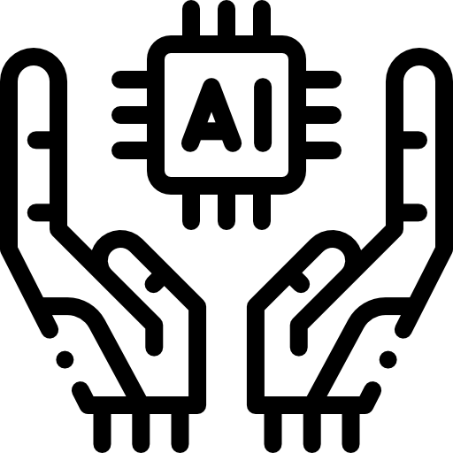
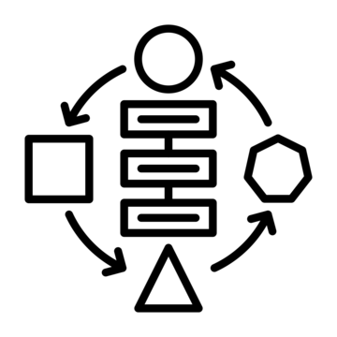




Zero Availability incidents
  Designed for
  AI & Power dense workloads
  Stringent
  Procedures
  Strong Org. structure, Skill set mapping and training, ITIL Framework
Building, Power, Cooling, Network
SOP, EOP, BCP to deliver 100% uptime
  Global Command Control Center powered by AI
  Monitor critical parameters and share proactive insights
  24x7 Rapid-response teams dedicated to minimizing downtime
  Enhance infrastructure with automated failover systems to ensure uninterrupted operations
.
Proactive strategies and AI-driven operations to guarantee uninterrupted availability and peak performance

Slide 33




Zero redundancy incidents
  Penalty-proof SLAs by proactively testing and documenting redundancy systems
  Dual power feeds and cross-connects for critical systems.
  Multiple Fiber paths to the campuses with MMRs to ensure network stability
  Design simulation drills under extreme scenarios
.
Built-in resilience to safeguard uptime, optimize performance, and eliminate redundancy risks

Slide 34
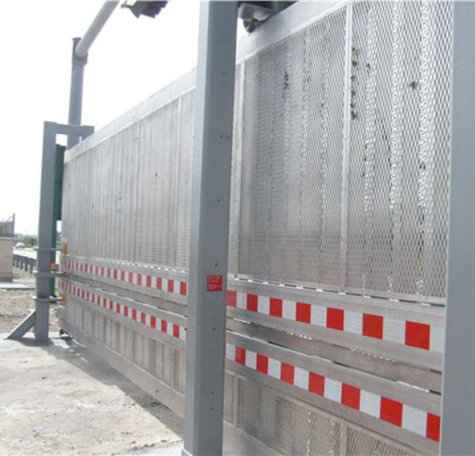
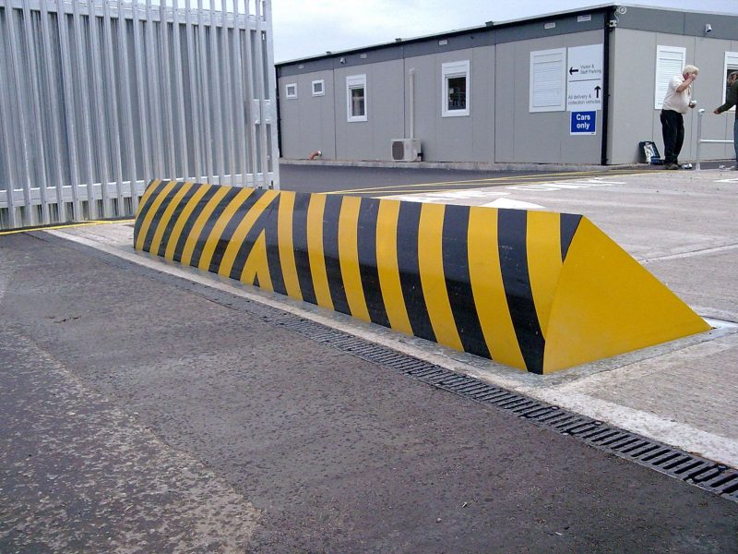
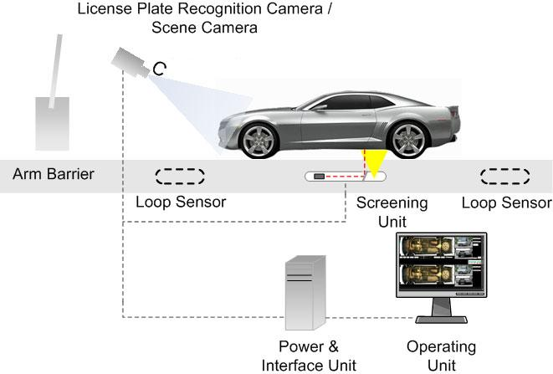
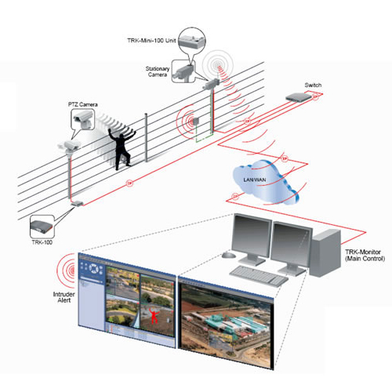
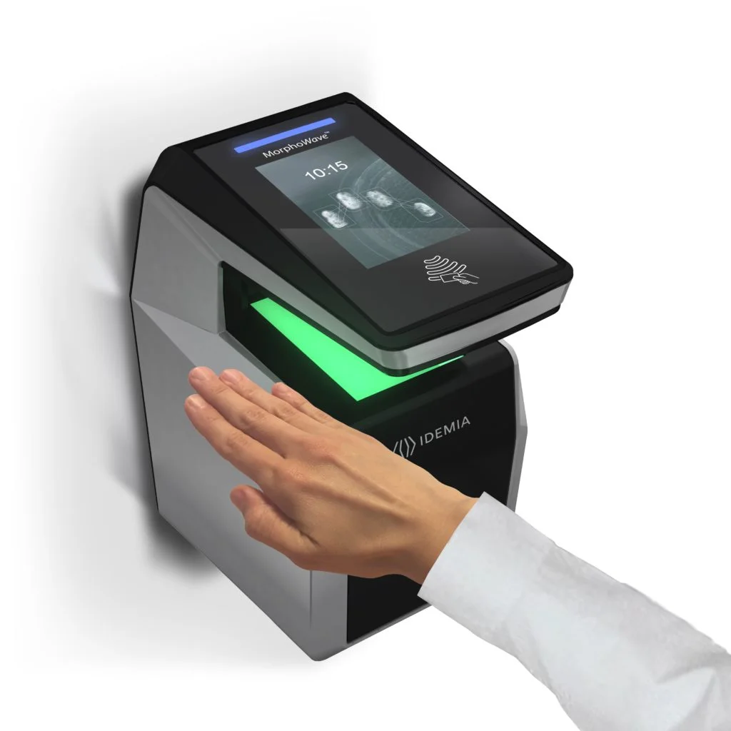

Zero Security Incidents
K8 Rated
Boundary Wall
Truck
Rejection
Automatic
Road Blocker
Under Vehicle Surveillance System (UVSS)
Perimeter intrusion detection system (PIDS)
Advanced Security Software
Anti-Terrorism/Force Protection (ATFP) US DOS standard; designed to stop a 15000-pound vehicle at 40MPH
The truck entry path is designed in a way unauthorised trucks are rejected and exited without entering the compound
  K8 rated road blocker - manually operated once the UVSS clears the vehicle. Can also be automated once the UVSS system completes the vehicle scan and found normal
  Provides automatic vehicle inspection, real-time monitoring, threat detection, image archiving, and integration with other security systems to enhance security protocols by thoroughly inspecting and capturing high-resolution images
  Video Analytics
  Facial Recognition
  Integrated access and visitor management
  Realtime access control dashboard
  Contactless Palm Reader
  Electric pulse, gives a non-hazardous shock to people trying to climb to disable them and give alarm with the incident location.
  Integrated with CCTV system – fixed zoom camera immediately takes images, PTZ will turn towards the incident area, with popup alert, audible alarm, email alert, and SMS to security officers
10-tiered physical and electronic security powered by automation and 24x7 surveillance

Slide 35









Zero SAfety Incidents
EHS Policy
Safety Culture
Safety Training
Toolbox Talk
Safety Permit Procedure
Tools Inspection
Safety Checklist
Safety Audits
Transparent safety dashboard to track incident-free days and improvements
A safety-first culture with proactive measures to ensure a risk-free and compliant work environment

Slide 36


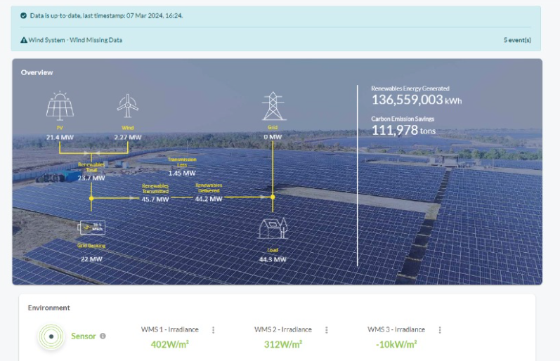


Zero Carbon Footprint: ESG FOcus
Data Center MEP
Sustainable Processes
High efficiency for Equipment even at low utilization levels
Selection of equipment with high energy saving parameters
Right redundancy levels
ASHRAE Guidelines. IGBC
ISO 14001 Environmental Certification
Carbon abetment policy
Low PUE, WUE
Green Power Contracts
Future Roadmap
Contracted 231 MW Green power via Power Purchase Agreements
Additional nation-wide Green power for future projects. ~500MW planned to meet long-term sustainability goals
To become RE100 (Carbon Neutral) by 2030. 29% GHG emission reduction by FY2025
Exploring options to secure up to highest RE penetration for Sify DCs, as permitted by regulation
  Targeting high level of Renewable Energy penetration by year 2025
Driving sustainability from BASE BUILD - POD - PROCESS

Slide 37
AI roadmap DATA CENTERS
COGNITIVE
Improved Service level
Reduce lead time
PREDICTIVE
Value
3
Improved Service level
Reduce lead time
CONNECTED
“New services and business models”
Improved visibility
Enhance productivity
2
“Self optimizing response”
Offer as value added service with core products
Phase
“Predict what will happen”
1
Digital feedback, auto-Ticket generation & resolution
“Understand causes and impacts”
“See what is happening”
ML data models
“Define data and sources”
“Get plugged in”
Time series/ Historical data and data object model
Telemetry dashboards for CXO, Ops & Process
BMS, ERP, Serviceability data
Edge Gateways & Cloud data model
Time

Slide 38



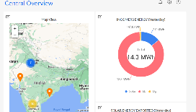


Applying ai in our data centers
Real time visibility:
into operations, assets, people and process. Better resource utilization across rack space, power, RE, cooling, security and cross connects
Measurability:
in operations basis predefined conditions or SOPs. Resource capacity utilization and trend analysis. KPI based service contract renewals. Usage based Infra resource planning
Predictability:
in failure and downtime. Preventive maintenance of assets, AMC contract realization. Demand forecasting and capacity planning
Enhanced Efficiency:
in capacity utilization, PUE, WUE, DG power fuel, UPS power, DC carbon footprint, service and support efficiency
Site Equipment
Hardware Connectivity
Operation Command Center
POWER
Multiple Energy meters
3rd party Integration - ERPs & tools
Chiller Plant
Busway Sensors
OPC
DG
IOT Cloud with AI/ML Algorithms
API
Multiple PACs/ CRAH/ AHU
UPS
Ops Equipment
Safety & Security Equipment
Smart IO interface
OPC
Internet
Temperature & Humidity Sensor
Wireless/ Wired
Ethernet
IOT Gateway
UPS-1
L2 switch
Dashboard
OPC
Centralized dashboards, tickets and reports accessed via Laptop, Tablet, Mobile etc.
TX
Transformers (LT & HT)
CMMS (Manual Ops Data)
API’s
Solution Components
Increased Savings
on PUE
Improved
equipment uptime
Increased Person hour
savings monthly
Reduction in operating costs
Notes:
Remove numbers, generic

Slide 39
Global Command and Control Center (GC3)
GC3 @ NOIDA 02
DCs and EDGE DCs in North and Northeast
Backbone of our Data Center Operations​
Real-time anomaly detection and
root cause analysis​
Automated alerts and intelligent
escalation mechanisms​
Proactive risk mitigation to
prevent downtime​
Efficient energy and
infrastructure optimization​
Seamless remote management of
edge and core data centers
GC3 @ MUMBAI 03
DCs and EDGE DCs in West and Central India
GC3 @ CHENNAI 02
DCs and EDGE DCs in South India
A Unified Digital Nerve System
Together, our three GC3s form a highly resilient, AI-driven, and incident-ready digital nerve system, reinforcing our commitment to delivering high-performance, secure, and scalable data center services across India.

Slide 40

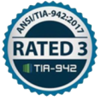














COMPLIANCE AND CERTIFICATIONS
MEITY Cloud Empanelled
India’s 1st Nvidia DGX Ready Air Cooled DC since 2022
Rated 3: Concurrently Maintainable Site Infrastructure
Data Center, Cloud &
Managed Services
IT Service Management
Telecom Data Center & Managed Services
India’s 1st Nvidia DGX Ready Liquid Cooled 130/KW/rack DC since 2024
Hosting Partner
PCI DSS
SOC 1 Type II
SOC 2 Type II
World’s international standard for occupational health and safety
Business Continuity Management System
Environmental Management system
Green Building
SAP Certified In Hosting Services
SAP Certified In Cloud Services
SAP Certified In SAP HANA Operations Services
SAP Certified In Application Management Services

Slide 41
Trusted data center partner
10,000+ India’s leading enterprises trust Sify’s DC, Cloud, Network, Security and Digital services.
600+ Top enterprises across industries power on Sify’s Data Centers.
Multiple global hyperscale CSPs continue to expand their presence in India with Sify’s AI ready Data Centers
India’s top 10 Banks are using Sify’s integrated Data Center and Network services
India’s leading conglomerate chose Sify Data Center to host critical apps across its multiple companies - Power, Ports, Gas, Civil Infra, Logistics
Accelerating strategic expansion of a global cloud security company by collocating in Sify’s Data Centers at Mumbai, Noida and Chennai
Colocation in Sify’s multiple DCs, CDN services and edge DC connectivity enable global OTT & Social Media Network to improve performance and reach
2 of the leading Global FMCG companies, India’s retail chain and top 2 logistics companies in India rely on Sify’s Data Centers

Slide 42
Sify Data Center Advantage
Hyperscale, Hyperconnected, Green, Edge, AI-ready
RAS based design for future ready infrastructure
Liquid & Air-Cooling ready Data Centers, up to 200 kW power/rack
14 DCs, 227+ MW IT power, expanding to 407+ MW by 2025. 10+ Edge DCs
Hyperconnected, Carrier-neutral and Rich Interconnect ecosystem
India’s Data Center Powerhouse for over 2 decades
3 of 4 Hyperscalers, Global OTT & Social media players,
India’s Top 10 banks,
and 600+ enterprises…
Campuses scalable to
970+ MW with BTS capabilities
AI/ML led operational excellence with 100% uptime
Enhanced 10 levels of security with automation
231 MW renewable energy contracted
Sify is a LEADER in the IDC MarketScape Data Center Services India, 2024
Notes:
Operational- as is ready: 227.7 rounded to 227 (included tower B Noida, Chen 02)
Expanding: operational + development: 407.7 rounded to 407 MW
Scalable to: expanding to, operational + development+ planning: 970.5, 970 MW

Slide 43
New Data center campuses

Slide 44
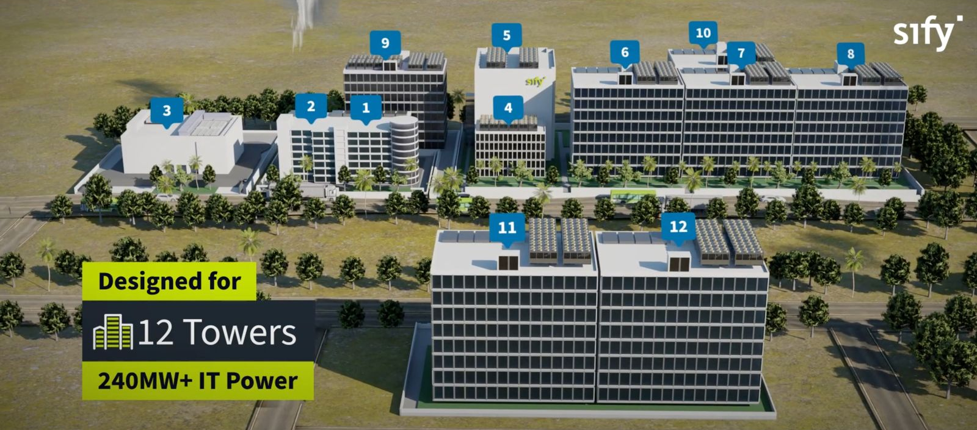
Overview: MUMBAI 03 MEGA CAMPUS, RABALE
OUR LARGEST AI-READY HYPERSCALE DATA CENTER CAMPUS
Hyperscale &
AI-Ready Infrastructure
99 MW RE
ESG best practices, Up to 70% RE power
Tower 5 Live with
43+ MW IT capacity
Dedicated
on-site 110, 220 kV
GIS substation (N+1)
Designed for
12 towers
377+ MW IT Power
Option of 7
Built To Suit Towers for 280+ MW
K8-rated
perimeter wall with 10 level secure access control
5 Towers Operational
4 Towers In Development
3 Towers in Planning
Cloud onramp to 3 Hyperscale cloud providers
4 dedicated fiber entry paths with multiple telcos
Mega campus supports a robust ecosystem of multiple Hyperscalers, Network Nodes, IP Exchanges, and ISPs
Notes:
RE at 58%

Slide 45
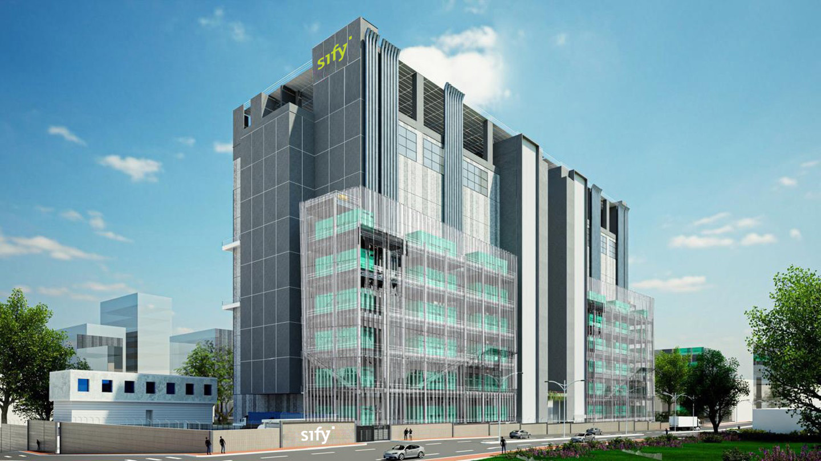
tower 11 & 12 pre bookings open: 80+ MW built to suit

Slide 46
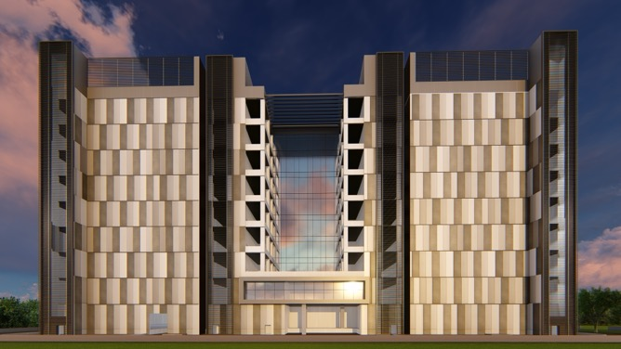
Overview: Chennai 02 Data Center Campus, SIRUSERI
LARGEST AI-READY, IGBC PLATINUM RATED GREEN DATA CENTER CAMPUS IN SOUTH INDIA
A
B
C
Hyperscale &
AI-Ready Infrastructure
IGBC Platinum Certified.
ESG best practices, 70% RE eventually
Vertical & Horizontal expansion
Dedicated
on-site 230 kV
GIS substation (N+1)
130+ MW IT capacity in 3 Data Center Towers
Scalable, resilient, hyperconnected, secure and green
K8-rated
perimeter wall with 10 level secure access control
Option of 2
Built To Suit Towers for 86+ MW
Integrated Transpacific CLS designed for 4 cables with over 2 Petabyte capacity
4 dedicated fiber entry paths with multiple telcos

Slide 47
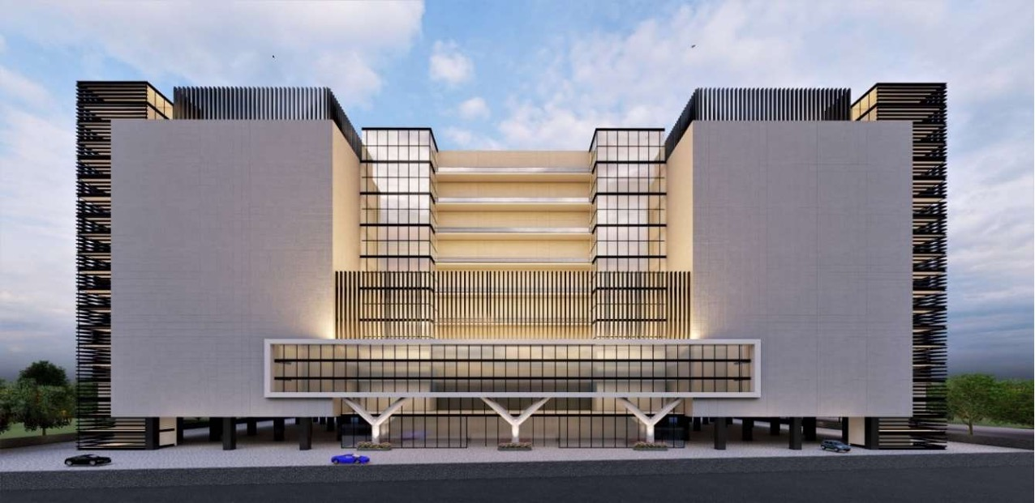
Overview: Noida 02 Data Center Campus
LARGEST AI-READY HYPERSCALE DATA CENTER CAMPUS IN NORTH INDIA
Hyperscale &
AI-Ready Infrastructure
IGBC Gold Certified.
ESG best practices, 70% RE power eventually
A
B
C
Vertical & Horizontal expansion
Dedicated
on-site 220 kV
GIS substation (N+1)
130+ MW IT capacity in 3 Data Center Towers
Scalable, resilient, hyperconnected, secure and green
K8-rated
perimeter wall with 10 Level secure access control
Option of 2
Built To Suit Towers for 86+ MW
4 Hardened Fiber Routes connecting NOIDA 01 DC, enabling low latency access to Hyperscalers,
OTT, Content & Security providers

Slide 48
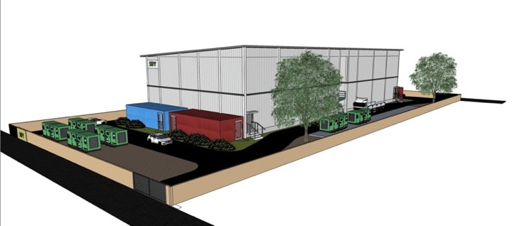
Overview: Lucknow 01 Edge Data Center
ELEVATE YOUR EDGE EXPERIENCE
14+ MW IT capacity in 2 Data Center building blocks
IGBC certified
ESG best practices
Dedicated
Dual feeder power supply
Hyperscale &
AI-Ready Infrastructure
Multi level perimeter and internal security layers
Standalone purpose-built prefab shell
Fast, Agile, Local, Efficient, and Secure
Customised designs with vertical and horizontal expansion
3 dedicated fiber entry paths with multiple telcos
  Interconnect for various Content Creators, TELCO IP Transit nodes, IXs and ISPs

Slide 49
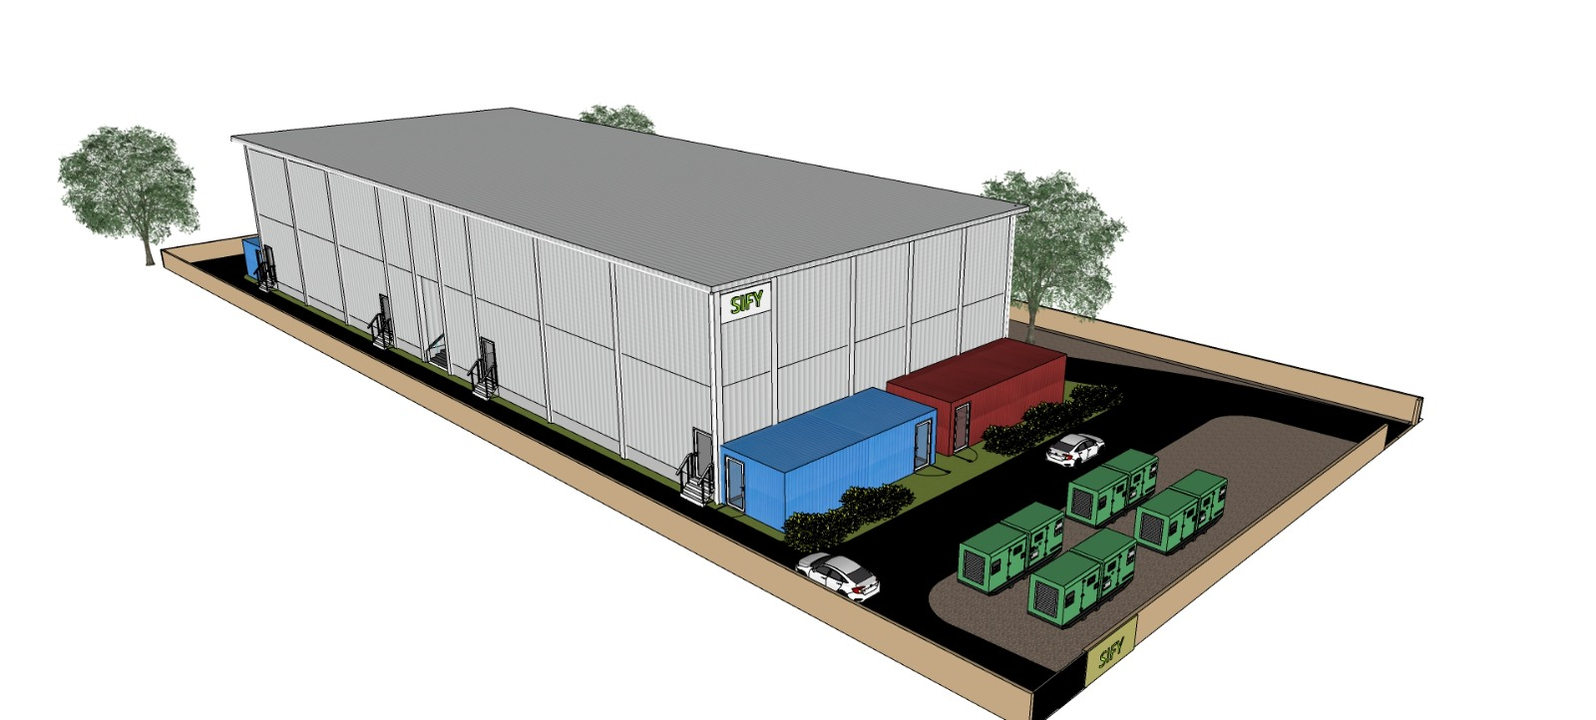

AI-READY, Modular scalable Edge Data centres
True modular and scalable design
Horizontal and/or vertical scalability
Server Hall Module: up to 120 standard rack positions
Power Module: in multiples of 600kW
Service Module: Operations & Logistics
Typical total IT power capacity from 1200kw to 3600kw
4.5-meter height, 1500kg floor loading
Expandable per Land area available
Deployment 8-10 months from contract
EL A2+B2
EL A1+B1
SM1
L1
SH2
SH1
L0
Our modular edge data centers can scale up to 14.4 MW and can be deployed in 6-9 months

Slide 50
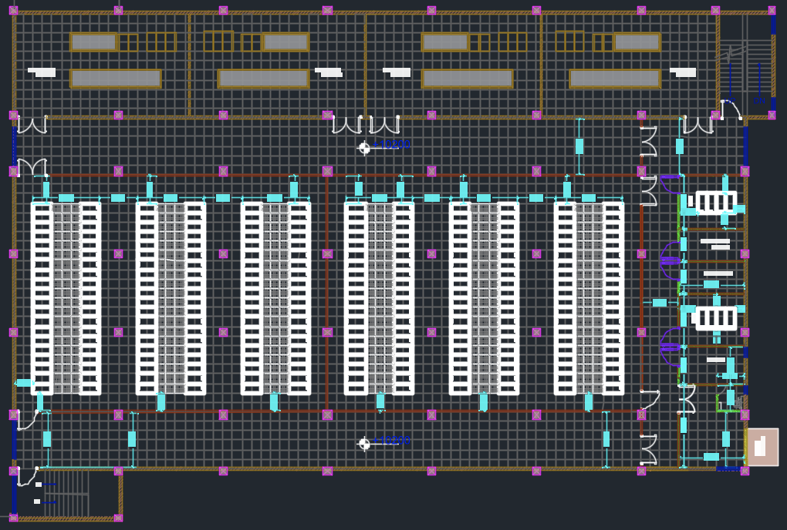
Overview: sify pico edge data center
Two server hall modules per floor
Each server hall module supports upto 120 racks
20 racks and 6 rows per floor. The aisle are 3 tiles
Each floor has 2 MMRs, Operations room, de-box or staging room
Two electrical modules support each server hall module
Server hall modules can be connected or independent modules
The foundation design to support up to G+2 deployment.
Rest rooms and pantry at every floor
Fire exits and escape routes as per local codes
EL A2+B2
EL A1+B1
SM1
L1
SH2
SH1
L0
Our modular edge data centers can scale up to 14.4 MW and can be deployed in 6-12 months

Slide 51
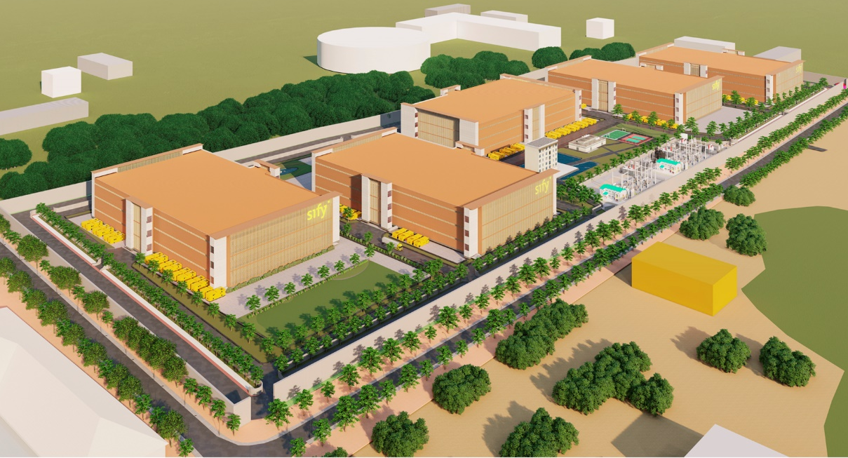
ABOUT Hyderabad 02 (with ~500MW potential)
While we are hunting for another location for a GigaWatt campus, we have 50-acre land in Hyderabad that can be scaled up to 500MW
  Location
Power Availability
  Potential
  Highlights
  Plot No 36, FabCity Road, Hyderabad, Telangana 501359
  17°11'44.1"N, 78°30'22.1"E
  Inside a developed industrial park owned by Telangana government agency TSIIC
  Adjacent to a Hyperscaler AZ
  Multiple 220KV and 400KV substation sources within 4-14 Kilometres
  Day 1 Launch power of 15MW from 33KV substation within the industrial park; Design includes 2 Substations for long-term
  Access to Renewable Power via Open Access mechanism is Telangana government priority - Government Order is expected
  Sify designed 5 buildings with G only (26MW each) or G+2 structure (52 MW each) - 260MW total per current plan
  Higher density design with liquid cooling would increase the potential to up to ~500 MW, with similar footprint
  Fully under Sify control – robust existing backbone network connectivity due to Hyperscale proximity
  Campus Master Plan completed - Ready for custom design and development
  Under a supportive policy regime and easy-to-do-business administration / jurisdiction

Slide 52







CIO Choice 2025 for
AI Ready Data Centers
Best Future-Proof Data Center Project
Award for Sustainability
Innovation in Data Center
India’s 1st Nvidia
DGX Ready Liquid &
Air Cooled DCs
Best in
Services Industry
DC Services India & ​Managed Cloud Services APAC ​
Managed Network Services - MQ
Tried Tested Trusted
Your digital infrastructure partner for over 25 years
Network
Infra Services
Network Digital
Managed Services
Data Center
Colo Services
CloudInfinit^{+AI}
GPU Cloud
Cloud & IT
Managed Services
Digital Apps
Managed Services
Industry Apps
Managed Services
Security
Managed Services
Thank You

Slide 53
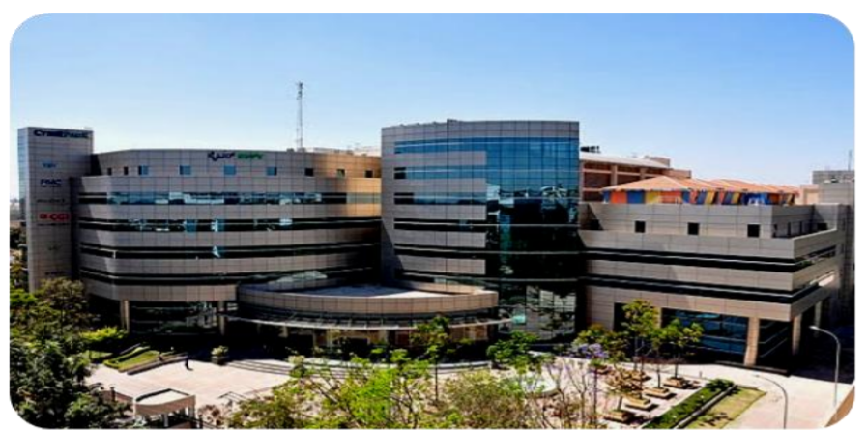
Overview: BANGALORE 01, electronic City
IT power capacity of 7.6 MW
Addressing market segments like IT/ITeS, E-Com, Retail, Media, Healthcare, BFSI
Enterprise-grade Sify CloudInfinit services to enable hybrid cloud adoption
Carrier-neutral facility, dual Meet-Me-Rooms with multiple IX, ISPs
Offers colocation & managed services, DRaaS, and CDN services

Slide 54
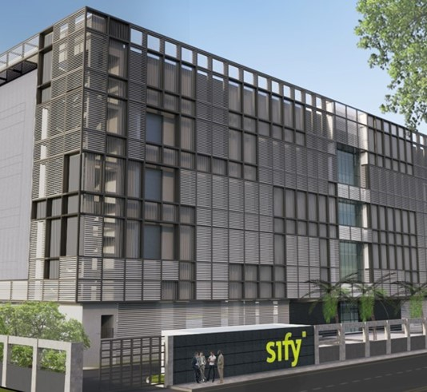
SIFY BANGALORE 02 data center
Designed to host ecosystem of Network Nodes, Enterprise Customers, IP Exchanges, and ISPs scalable up to 40 MW IT capacity​
Dedicated high voltage substation for high availability power
Multiple options for Private power and Renewable power
State of the art AI&ML enabled BMS deployment
ADDRESS: Mahadeva Kodigehalli, Bengaluru, Karnataka, India
Notes:
40+ MW of IT capacity with 18 pods of 2.16 MW each

Slide 55
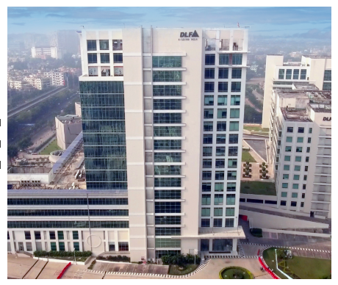
Overview: Kolkata 01, Newtown
IT power capacity of 2.2 MW
Addressing market segments like Manufacturing, BFSI, Govt, PSUs, IT/ITeS
Nodal location for service delivery to neighboring SAARC countries
Carrier-neutral facility, dual Meet-Me-Rooms with multiple IX, ISPs
Offers colocation & managed services, DRaaS, and CDN services

Slide 56




Key Challenges shaping data center strategies
AVAILABILITY OF POWER
MODERN COOLING TECHNOLOGIES
“By 2028, more than 70% of enterprises will alter their data center strategies, due to limited energy supplies, a major increase from less than 5% in 2023”
“By 2027, AI workloads will consume nearly 50% of data center compute power, making liquid cooling essential to support the increasing demands of AI-driven infrastructure”
SUSTAINABILITY
SCALABILITY
“By 2027, 75% of organizations will have a data center sustainability program, up from less than 5% in 2022, driven by cost optimization and stakeholder pressures”
“By 2026, 75% of organizations will prioritize scalable IT strategies to support growth initiatives like entering new markets and launching products”
Source: Gartner forecasts

Slide 57
YOUR INDIA PARTNER OF CHOICE

Slide 58


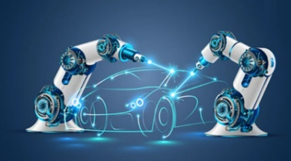







Empowering Industries to accelerate ai & digital adoption
BANKING
Insurance
Manufacturing
Retail
E-COMMERCE
Ensuring secure digital banking
Enabling faster
claim processes
Building smart digital factories
Enhancing in-store experiences
Creating intuitive
user experiences
Healthcare
PHARMACEUTICALS
MEDIA & ENT
EDUCATION
IT & ITES
Driving innovation in patient care
Faster medicine creation and delivery
Elevating digital streaming
Empowering digital learning for all
Digital Transformation for the change catalysts
Employees Key Customers
1400+
Digital Networks
350+
Managed Cloud
400+
Modern Apps + AI/ML
100+
Platform Automation
100+
Cyber Security
100+
Enterprise Apps
500+
Technology Integration
400+
GTM Specialists
500+
Cloud & Security Clients
600+
Data Center
Clients
700+
Managed Network Clients
3000+
Network Infra
Clients

Slide 59
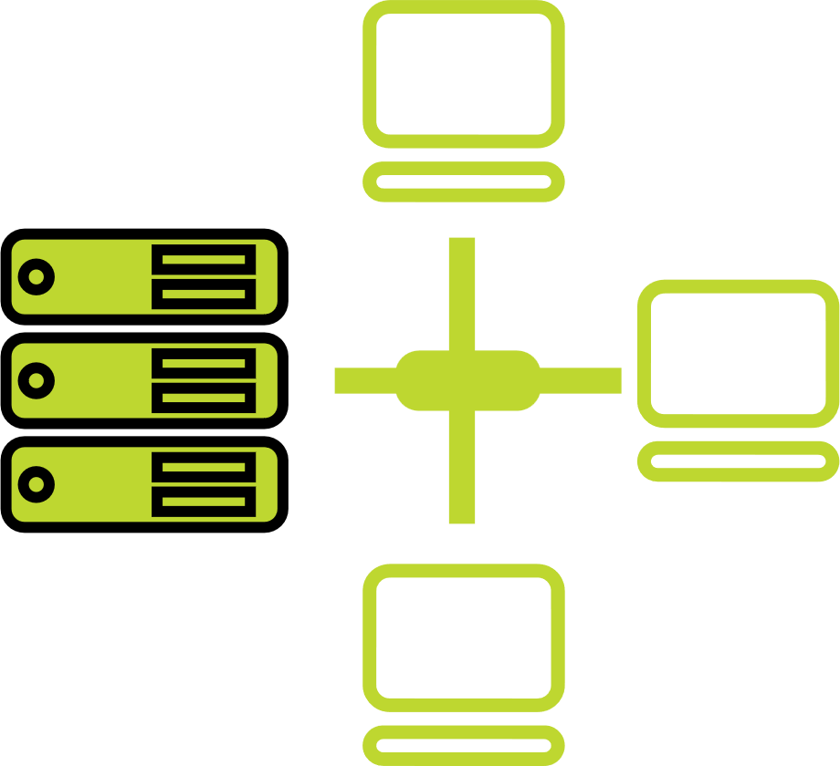




one-stop engagement for enterprises’ digital pursuits
Network
Infra Services
Network Digital
Managed Services
Data Center
Colo Services
CloudInfinit^{+AI GPU Cloud}
Cloud & IT
Managed Services
Enterprise connectivity- WAN, NLD
Edge Connect- Pvt 5G, Wi-Fi
Global Cloud Connect, DC Interconnect
International POPs, Cable Landing Stations
Network transformation and consolidation
Managed Secure Networks- SDWAN, SASE, DDOS protect
Campus & Branch Networks
Smart Edge
Captive & Hybrid NOC services
Network Observability
CaaS & Collaboration Services
AI ready
Hyperscale Cloud adjacency
RAS Design
Liquid Cooling
Hyperconnected
Built-to-suit
AIOps
Renewable Energy
Managed Public/Private Cloud
GPU as a Service
Cloud Anywhere-Edge Cloud
BCP- DRaaS
Regulatory and compliance ready
Hybrid Cloud Assessment, Migration and Managed Services
Multi Cloud Platform
Hyperscale Cloud services AWS, Azure, GCP, OCI
End-to-End IT Managed Services
Networks
Data Centers
Cloud & IT
Digital Apps
Managed Services
Industry Apps
Managed Services
Security
Managed Services
25 years
of digital
trust…
Digital
Infinit AI/ML Platform
Infinit Full Stack Observability
App Modernization & DevSecOps
Retail Intelligence- Forum Digital
Digital Assessment, AI Learning & XR
Consulting, Support, Maintenance, and Upgrades
Microsoft
Oracle
SAP
Security
Cybersecurity assessment and managed services
MSS, MDR & GRC
Global SOC
AI/ML driven Security Assurance

Slide 60
Sify: the right partner for you in india
RIGHT
ASSETS
RIGHT
ATTITUDE
RIGHT
EXPERIENCE
Network
Data Center
Engineering / IT Skills
Innovative and Flexible
Execution at Speed
Fully Aligned Strategy
Proven Ability to Partner with Global Organizations
25 Years of Success Delivering on Promises
ALL THAT’S ”LEFT” IS THE NEXT CHALLENGE. CHALLENGE US!

