Slide 1
Sify MANAGED
Security Services
Securing enterprise IT for
over 2 decades
Feb 2025

Slide 2
Cyber Kill-Chain: Planning and Executing A Cyber Attack
The cyber kill chain is a concept used in cybersecurity to describe the stages that an attacker goes through to compromise a target system
Attack Preparation
Penetration
Attack & Persistence
Weeks in Advance
Within Seconds
From Here On…
Look for potential victims
Collect relevant social data
Build, find or buy your weapon of choice
  Exploit kit, Malware package
Adapt to your specific needs
Package for delivery
Bypass detection
Convince the victim to open your crafted file
Bypass system security control
Install your malware
Wait for your malware to “call home”
Instruct it what to do on the victim’s computer
Continuously monitor its progress
Reconnaissance
Weaponization
Delivery
Exploitation
Installation
Command & Control
Act on Objectives
  Recognize the target and vulnerabilities that can be exploited
  Generate / choose the attack vector
  Send the harmful payload to the target
  Attain elevated execution privileges
  Deploy the malware onto the compromised host
  Create a communication channel
  Collecting or corrupting data, lateral movement, and exfiltration

Slide 3
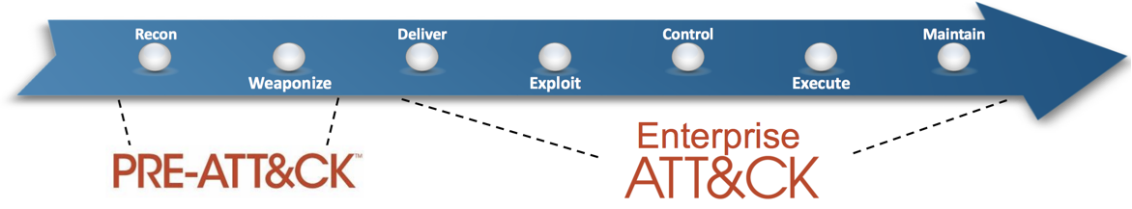
MITRE ATT&CK
ATT&CK stands for “Adversarial Tactics, Techniques, and Common Knowledge”
A globally-accessible knowledge base of adversary tactics and techniques, categorized into an easily-consumable model.
Based on real-world in-the-wild observations of actual adversary behavior.
Purposefully focused on the adversary and the behaviors they exhibit, tools they use, and actions they perform.
Community driven and updated by MITRE quarterly based on new things being seen and reported in the wild.
Priority Definition
  Planning, Direction
Target Selection
Information Gathering
  Technical, People, Organizational
Weakness Identification
  Technical, People, Organizational
Adversary OpSec
Establish & Maintain Infrastructure
Persona Development
Build Capabilities
Test Capabilities
Stage Capabilities
Initial Access
Execution
Persistence
Privilege Escalation
Defense Evasion
Credential Access
Discovery
Lateral Movement
Collection
Exfiltration
Command and Control
The ATT&CK matrix is a powerful tool to measure current defense coverage

Slide 4
Cyber Kill-Chain: Successful Defense
Pre-Compromise
Compromise
Post-Compromise
Reconnaissance
Weaponization
Delivery
Exploitation
Installation
Command & Control
Act on Objectives
  NGFW
  Data Identification
  PAM
  DDoS
  DLP
  NGFW
  IDAM
  NAC & ZTNA
  Data Classification
  Email Security
  IDAM
  Endpoint Encryption
  NGAV, EDR & XDR
  NGFW
  Anti-Phishing
  IDAM
  SWG & ZTNA
  NGAV, EDR & XDR
  KMS / HSM
  NAC
  DAM
  EASM & Brand/Dark Web Monitoring
  Email Security
  Perimeter & Core Firewall
  ZTNA
  MDM
  ZTNA
  DLP
  DNS Security
  NGAV, EDR & XDR
  DDoS
  Deception
  ATP
  ATP
  ATP
  NSPM
  Endpoint Encryption
  ATP
  PAM
  IDAM
  ZTNA
  Endpoint Encryption
  IDAM
  Email Security
  IDAM
  WAF
  ZTNA
  DNS Security
  ZTNA
  SIEM, UEBA & SOAR

Slide 5
Defence in Depth
Perimeter
Security Layer
Network
Layer
Authentication Layer
Application
Layer
Endpoint
Layer
Risk Management Practices
  Firewalls
  Intrusion Detection and Prevention Systems (IDPS)
  DDoS
  Anti APT
  Network Segmentation
  Virtual Private Networks (VPNs)
  Proxy
  Multi-Factor Authentication (MFA)
  Secure Coding Practices
  Web Application Firewalls (WAFs)
  Email Security
  NGAV & EDR
  Mobile Device Management
  Patch Management
  Vulnerability Assessment
  Penetration Testing
Data
Layer
Access
Control Layer
Monitoring and Detection Layer
Incident Response and Recovery Layer
Physical
Security Layer
Security Awareness and Training Layer
  Data Encryption
  Data Loss Prevention (DLP)
  Database Activity Monitoring (DAM)
  IAM and Role Based Access Control (RBAC)
  Privileged Access Management (PAM)
  Security Information and Event Management (SIEM)
  Security Analytics
  Network Detection & Response
  File Integrity Monitoring
  Incident Response Plan
  Backup and Disaster Recovery
  Physical Access Controls
  Employee Training

Slide 6








Security Managed Services: overview
Cyber Security
Advisory Services
Design &
Build Services
Operate &
Protect
Cloud Security &
Policy Management
Security Platform
as a Service
Managed Security
Services
Managed Detection & Response
Governance Risk & Compliance (GRC)

Slide 7
Sify Security Services: High Level View
Cybersecurity Advisory
Services
Security Platform as a Service (SPaaS)
Security Operations Centre
(SOC)
Cybersecurity advisory services involve understanding and assessing the security landscape of an organization's IT infrastructure and applications.
SPaaS is cloud-based service model that provides comprehensive security solutions and capabilities to organizations on a subscription basis
SOC involves Monitoring and Management of IT Security landscape to enhance an organization's security posture.
Offerings
Offerings
Offerings
Gap analysis
Compliance analysis
Threat Intelligence
Vulnerability Assessment & Penetration Testing (VA & PT)
  Vulnerability Assessment
  Penetration Testing
  Web Application Testing
  Mobile Application Testing
Next Generation Firewall (NGFW)
Web Application Firewall (WAF)
Load Balancer (LB)
Global Server Load Balancer (GSLB)
Privileged Access Management (PAM)
Vulnerability Management
NextGen Antivirus (NGAV)
Endpoint Detection & Response (EDR)
Multifactor Authentication (MFA)
Log Management
Security Information and Event Management (SIEM)
Managed Security Services(MSS):
Perimeter, Network, Endpoint, Application, Data & Cloud Security
Identity and Access Management (IAM)
Managed Detection & Response (MDR):
Security Information and Event Management (SIEM)
Threat Monitoring and Analysis
User and Entity Behaviour Analytics (UEBA)
Threat Intelligence
Incident Response and Investigation
Threat Hunting

Slide 8







SECURITY MANAGED SERVICES: FRAMEWORK
Comprehensive Managed Security Services from Edge to Cloud Deployments
Single solution provider covering DC, Network, Cloud, App, Hosts and Data
Offering Shared/On site/Hybrid Services to manage diverse solution portfolio with customized support models
Integrated seamlessly with other managed services in the ITSM platform to provide a unified view with faster ticket resolution
SLA driven Security Services by virtue of SASE & Security providers hosted in Sify DCs
AI/ML driven continuous Security Assurance Monitoring, & Automated Incident Management
Real-time monitoring through multiple feeds, to safeguard all the systems and sensitive information
Correlate security inputs to business context and current threat insights for Auto remediation
Governance, Risk & Compliance Assurance
Identify security vulnerabilities across your digital IT infrastructure and remediate with Sify’s advanced managed services
Enable organizations to meet regulatory and compliance requirements: SEBI, RBI, IRDA, ISO27001…
Customers
Sify SOC
Service Management Portal
Service Fulfilment
Service Assurance
Provisioning & Orchestration (SOAR)
Request
Event
Incident
Problem
Change
Asset Mgmt.
CMDB
Service Mapping
Monitoring / Management (MSS)
Detection (MDR)
Governance Risk & Compliance (GRC)
Tools
Performance & Availability
IAM
SIEM
UEBA
EDR
NBAD
Vulnerability Assessment
Penetration Testing
OS & Application Patch Management
Security Product Consoles
Threat Intelligence
Security Audits
Firewall, IDS/IPS, ATP, RA VPN, WAF, SWG, SASE. DDoS, DNS Security
NGAV
DLP, Email Security
CASB, PAM, MFA
User | Device
Branch | WAN
DC
Any Cloud
Security Controls

Slide 9

Security Delivery Credentials
20+
2.5 Million/Y
5 Million/Y
30+
Security Operations Experience
Security Incidents
Alerts
OEM Solutions & Platforms Integration
300+
10+
15000+
200+
MSS (250+)
MDR Captive (10)
MDR Shared / Hybrid (15)
GRC(25)
Customers
Compliances
ISO 27001, 17,18, ISO 9000, TL 9000, ISO 20000, MEITY, MHCE, SSAE, PCI-DSS-C,
SOX, SOC 1, SOC 2, SOC 3
IT Assets
Skilled Associates

Slide 10



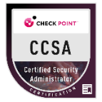
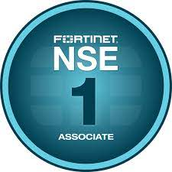
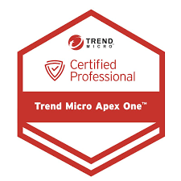




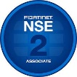

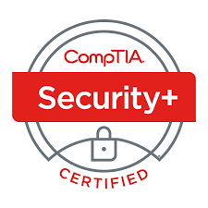

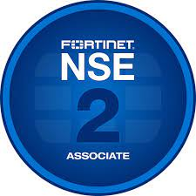
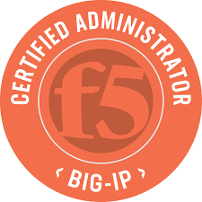
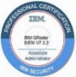



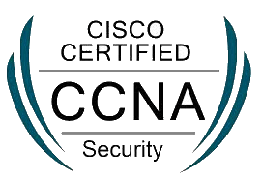



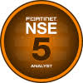


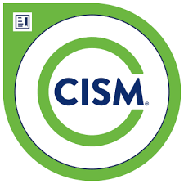
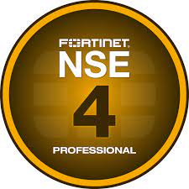




Security Team Certifications
MDR
VA & PT
MSS

Slide 11












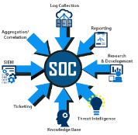
Security Operations Centre: Delivery Model
Captive SOC
Remote SOC
Hybrid SOC

Slide 12



















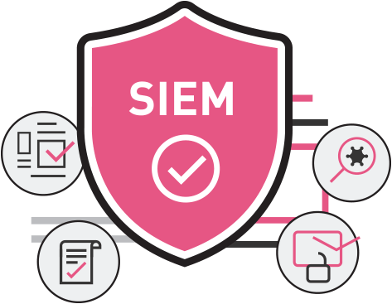


Security as a Service: For the Cloud
Security Services for any Cloud
Cloud Native
Security Services
Market Place
Web App
Firewall
Network
IPS
VPN GW
Privileged Access Management
Vulnerability
Mgmt.
Cloud DDOS
Protection
Endpoint Detection & Response
Log Mgmt.
SIEM
Multifactor
Authentication
Security Controls as a Service - From Sify Cloud

Slide 13
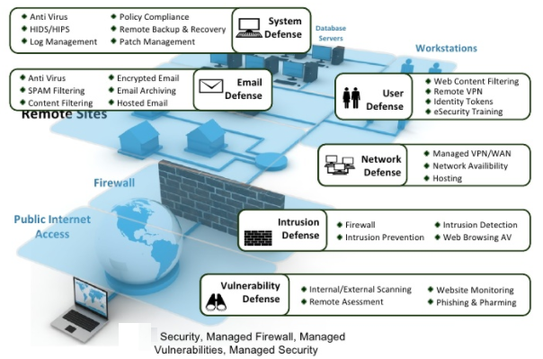
Managed security services

Slide 14




New Age Cloud security platform: Unified view
Secure Access Service Edge (SASE)
Secure Web Gateway (SWG)
Cloud Security Posture Management (CSPM)
Zero Trust Network
Access (ZTNA)
Cloud Access Security Broker (CASB)
Cloud Applications
Websites
Public Cloud Environments
Managed
Unmanaged
Private apps
Private apps
Private Cloud
(data center)
API
Protection
Risk Insights
Reverse Proxy
Cloud-Native Proxy
IaaS Storage-Scan
&
Cloud Security Assessment
Zero Trust Network Access
Security Cloud
CASB-API
NG Secure Web Gateway
CSPM
Private Access
NewEdge
Users from unmanaged devices
Users from managed devices
Single console
for security administrators

Slide 15
Sify MDR: Threat Detection and Incident Response
Collect & Normalize
Classify
& Enrich
Detect & Correlate
Investigate & Respond
Collect
Detect
Respond
Automatic Discovery
State
Monitoring
Performance Monitoring
Risk
Monitoring
Behavioral Analytics
Investigation
Response
Servers
Hardware / OS Configs
Availability & Performance Summary
Device Risk Score
User
Incident Dashboards
External Ticket Integration
Devices
User / Identity Mapping
Uptime & Round-Trip Response
Threat Intelligence
Device
MITRE ATT&CK
Automated Response Actions
Endpoints
File Integrity Monitoring
CPU and Memory
Geolocation
Service / App Logs
Threat Hunting
iSOAR Playbooks & Workflows
Users
Vulnerability Assessment
Network Interface Utilization
SLA & Escalation
Network Logs
Multi-User Case Management
Case Notes & Timeline
Applications
Business Services Impact
Synthetic Transaction
False Positive Reduction
Network Flow
Multitenant &
Granular RBAC
Reporting

Slide 16




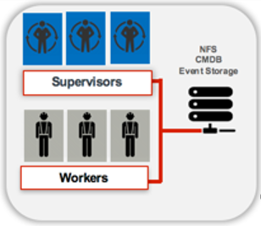


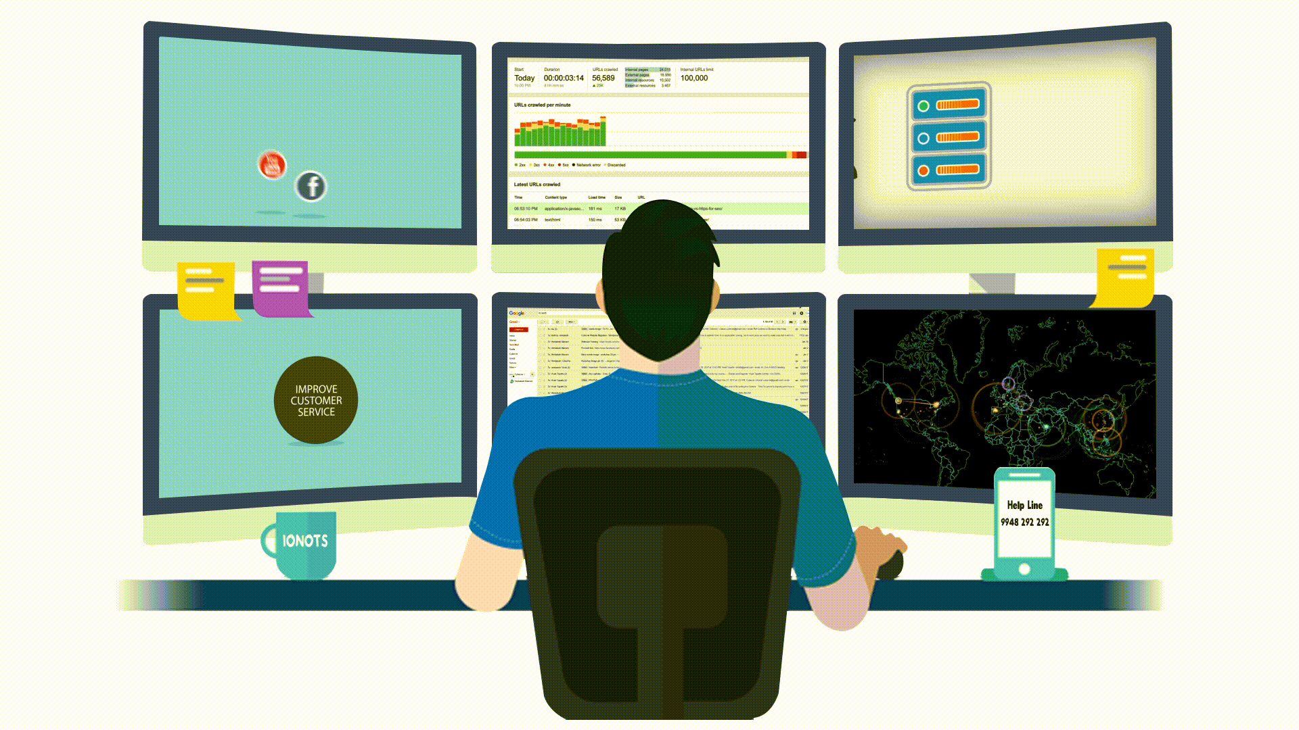






Sify MDR Platform: High-Level ARCHITECTURE
Customer Premise
(Log Sources)
DC: Airoli
DR: Bangalore
Sify SIEM Platform
Cloud Platform
Reports
Threat & Vulnerability Events
Incident
Monitoring
Threat
Hunting
End Point Security Events
Log Collector
Access &
Application Security Events
Investigate & Respond
Collect & Normalize
Sify Security Operations
- - - VPN Secure Connectivity - - -
- - - Secure Connectivity – (Tunnel) - - -
Classify
& Enrich
(NX Log Agents, Syslog, API)
Data Protection Events
On-Prem DC
Detect & Correlate
System and Application Events
Security Advisories
Threat
IOC/IOA
Log monitoring & Event Analysis Events
ITSM
Behavior Analytics
Risk
Scoring
Threat Intelligence
Incident Notification to Customer
Sify MDR

Slide 17

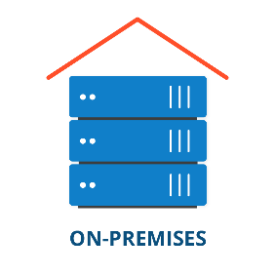
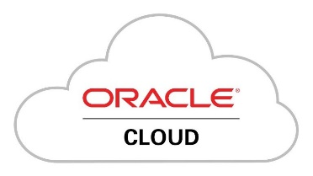


Sify MDR: Multi-Cloud Security Monitoring & Automated Response
Infrastructure
Access Control
Applications
Data
VM/OS Logs
Audit Logs
Identity Logs
Audit Logs
Admin Logs
Policy Deny Logs
Data Access
EMR/EHR Logs
Storage Logs
VA scanner Logs
Email server Logs
SharePoint Logs
box Logs

Slide 18
Sify’s NextGen MDR Platform: Highlights
Scale-as-you-grow architecture and licensing
Device based licensing with unlimited EPS
Single-pane-of-glass management and control
Features including dashboards, analytics, incidents, configuration management database (CMDB), and administration are accessed via an intuitive, web-based GUI.
Performance and availability monitoring, such as CPU, memory, storage, and configuration changes extend the functionality of the platform and deliver additional contextual data for use-case correlation.
Better incident detection with reduced incident impact
800+ Out of the Box Correlation Rules
Reduced Mean Time to Detect (MTTD) and Mean Time to Respond (MTTR).
Security Analytics helps hunt for threats and indicators of compromise (IOC).
Cloud Scale Architecture
Real-Time Event Correlation and Analytics
Real-Time Configuration Change Monitoring
Cross Correlation of SOC and NOC Analytics
Identifies external and internal threats faster and enables threat hunting and compliance monitoring.
450+ out of the box connectors for devices and applications integration

Slide 19
Sify’s NextGen MDR Platform: Highlights …CONTD
Reporting
NetFlow Collection and Analysis
Advanced Features
Advanced Application Log Monitoring
Registry Change Monitoring
File Integrity Monitoring
Installed New Software Detection
Threat Intelligence
Integrated commercial and open-source threat intel feeds
Security Advisories bulletin
Security Orchestration, Automation and Response (SOAR)
Automated incident response management
Alert Triage automation
Automated workflows & remediations
Network Detection & Response
3000+ Out of the Box Reports includes wide range of compliance auditing and management reports including PCI-DSS, HIPAA, SOX etc. and MITRE ATT&CK framework-based reports.
User and Device Risk Scoring
Business Services Dashboard

Slide 20
Operations
Incident Management Service
SIEM Administration Service
Analysis, Reporting and Dashboard
Periodic and
On-Demand Service
  Monitor alerts and policy exceptions (security events)
  eliminate false positives and benign triggers
  Escalate security Incidents
  Provide remediation recommendations
  Perform root cause and impact analysis
  Fine tune/optimize existing correlation rules
  Incident handling
  Creating Incident Tickets
  Tracking progress of open Tickets
  Managing the Ticket to resolution / closure
  Providing escalation and exception handling for Tickets
  Closing the Ticket upon resolution
  Provide software-level management for the SIEM System components
  Verify data collection and log continuity
  Manage user access including user and group permission
  Review SIEM System disk space usage
  Perform archival management and retrieval
  Provide problem determination / problem source identification for SIEM System
  Review SIEM vendor announcements
  Manage SIEM System update alerts
  Schedule and test application upgrade
  Generate daily and weekly reports
  Review and analyse reports
  Investigate anomalous data
  Perform analysis of potentially harmful security alerts
  Create Incident Tickets bases on qualified security event
  Incorporate findings in weekly briefings and monthly operational reviews
  Log sources additions
  Customer Parser Creation
  Periodic correlation rules addition
  Threat Intel feeds integration
  Threat advisories
Use Case Engineering
  Asset based use cases
  Threat based use cases
  Business use cases
  SIEM alerts

Slide 21


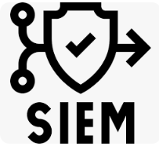










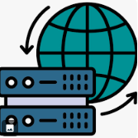

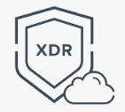










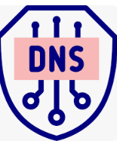
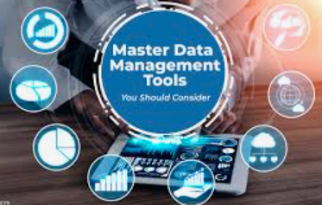

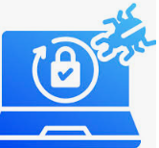

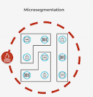






Layered Security Controls: Integrated solution
Data Security
Network Security
Endpoint Security
IAM And GRC
MDR
Firewall with
UTM features
Key Management
SIEM
Firewall Central
Manager and Log Analyser
IAM
SOAR
Encryption
DDOS
Anti-Virus
MFA
Web Security/
Proxy Gateway/
Content Filtering
EDR
UEBA
Data
Classification
Network Detection &
Response
PIM/PAM
XDR
Data Loss
Prevention
Data Loss
Prevention
Network Security
Policy Manager
IDAM
TI
File Integrity
Monitoring
Data Base Activity
Monitoring
Network Access
Controller
Vulnerability
Assessment
Brand
Monitoring
DNS Security
MDM
Cloud Access
Security Broker
Penetration
Testing
Log
Management
Micro segmentation
Endpoint
Encryption
Security
Consultation
EASM
Data Right
Management
ZTNA
WAF

Slide 22
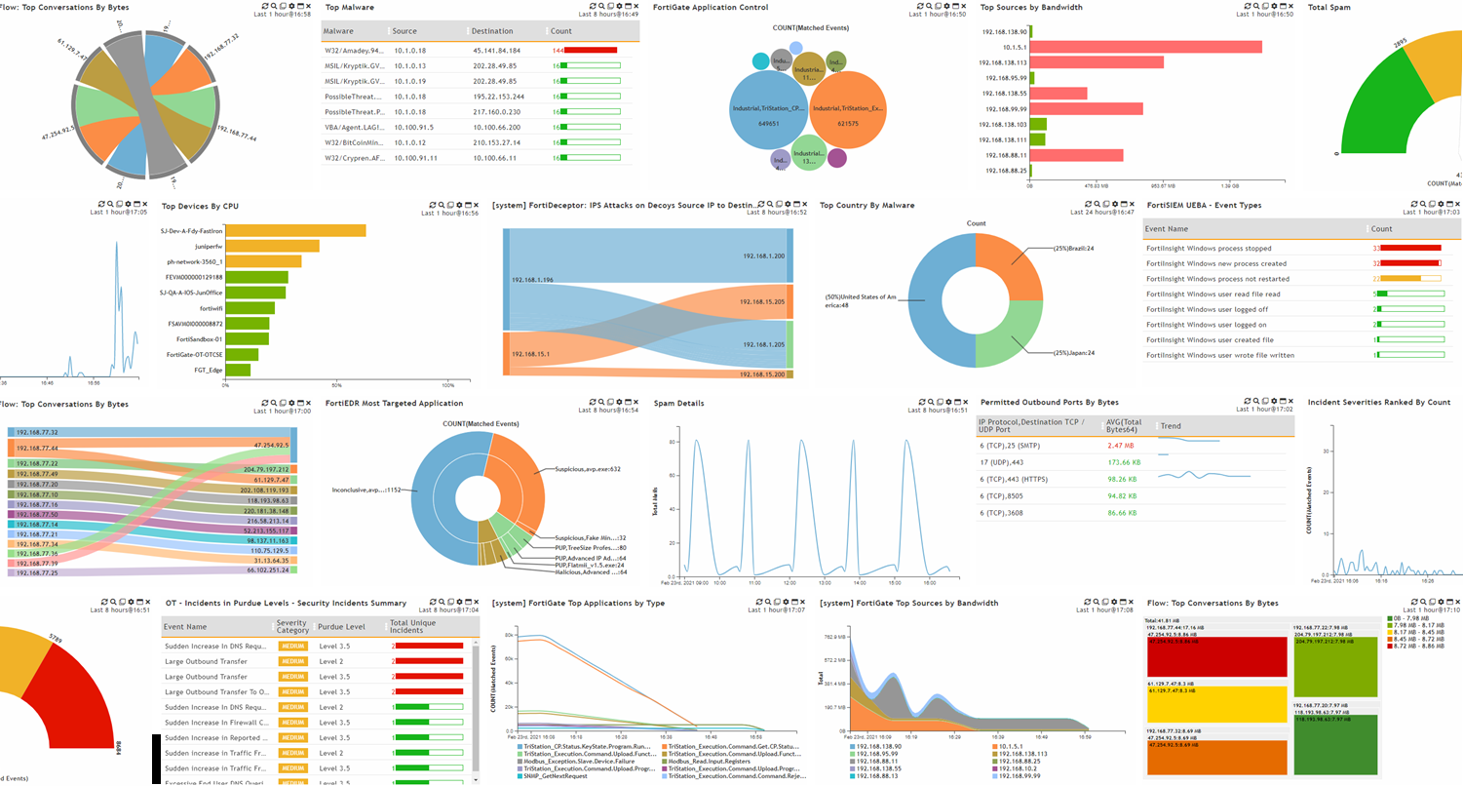
Sify MDR: Dashboards & Reports

Slide 23
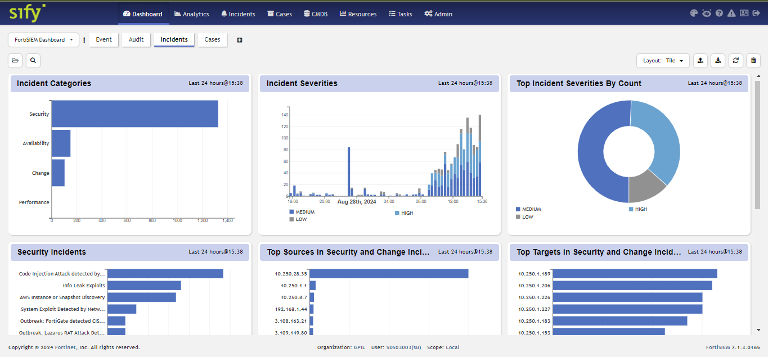
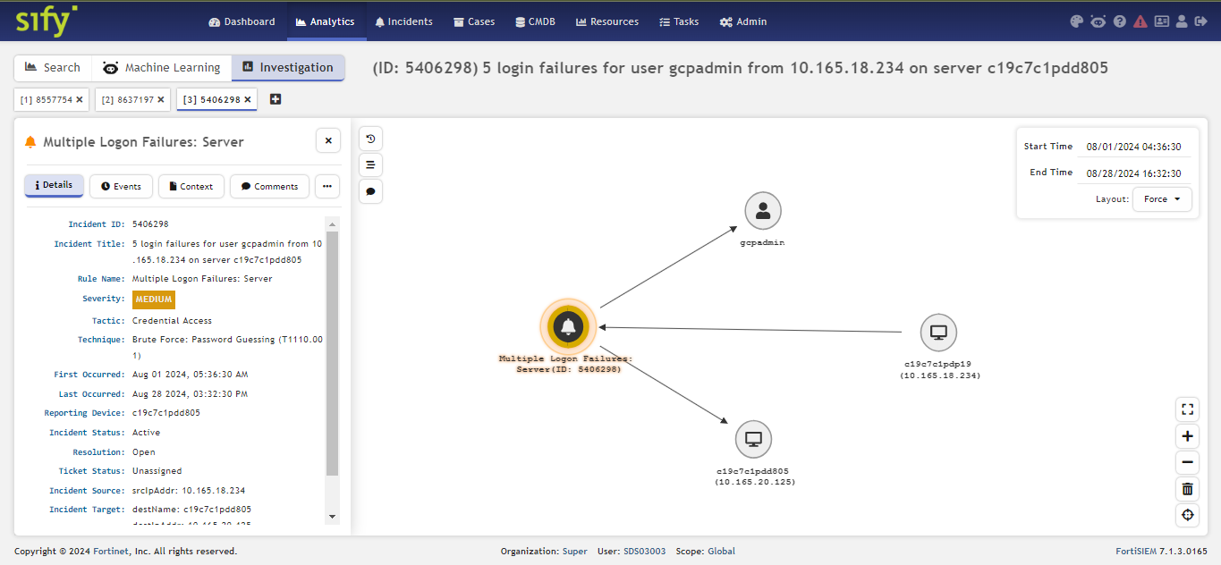
Dashboard and Investigation

Slide 24
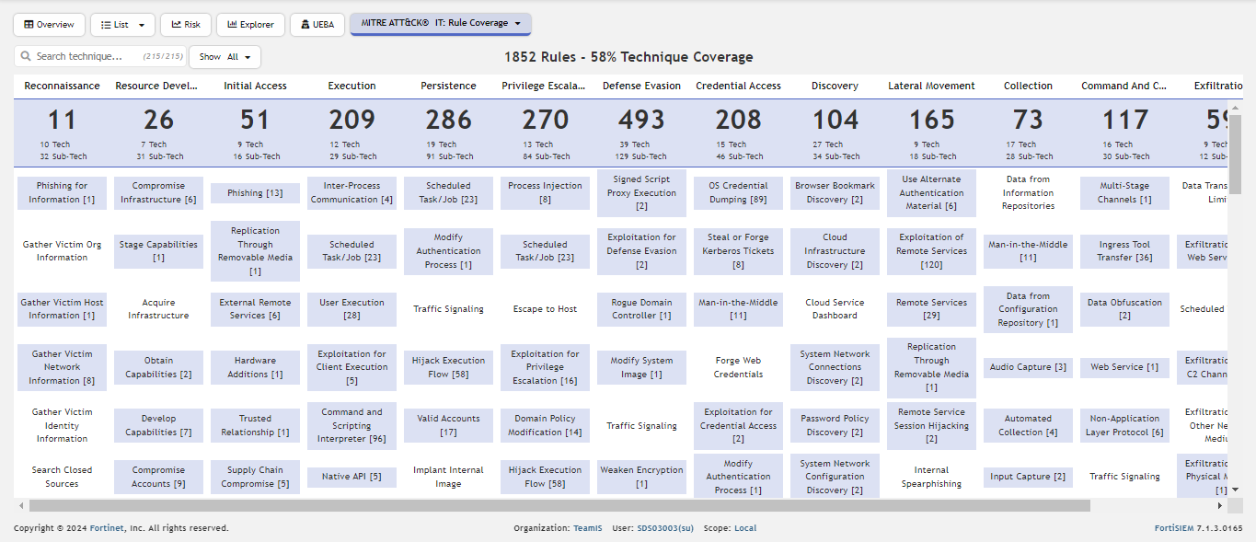
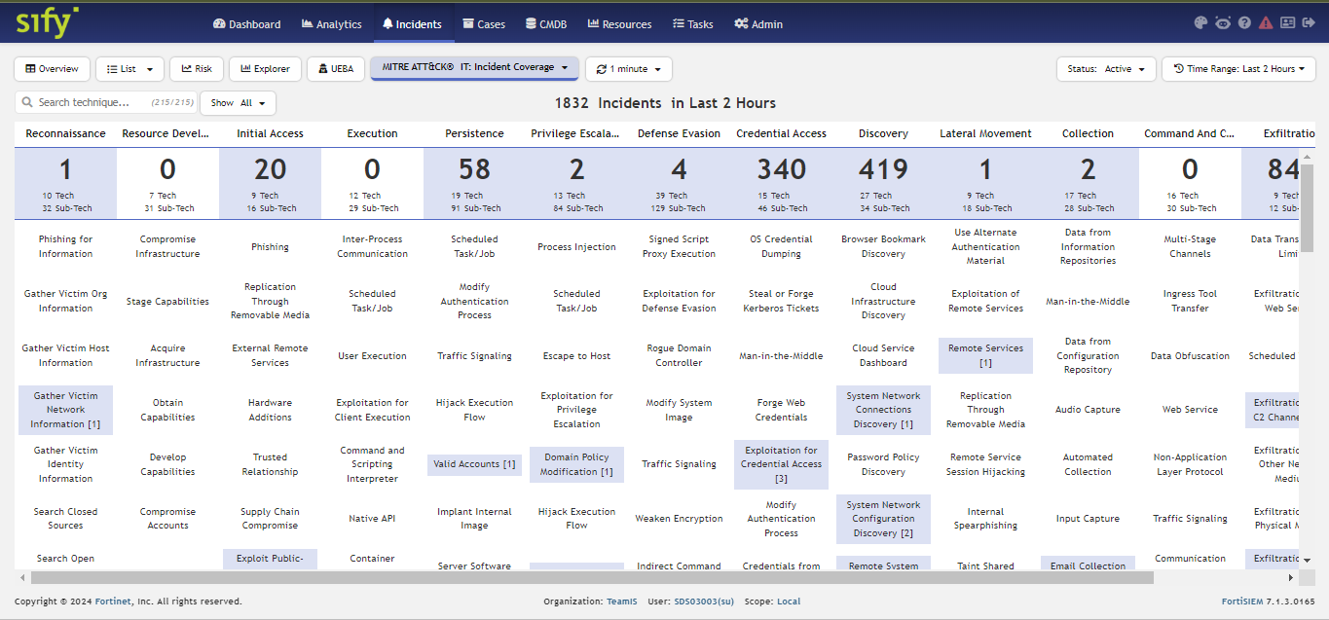
MITRE ATT&CK Rule and Incident Mapping

Slide 25
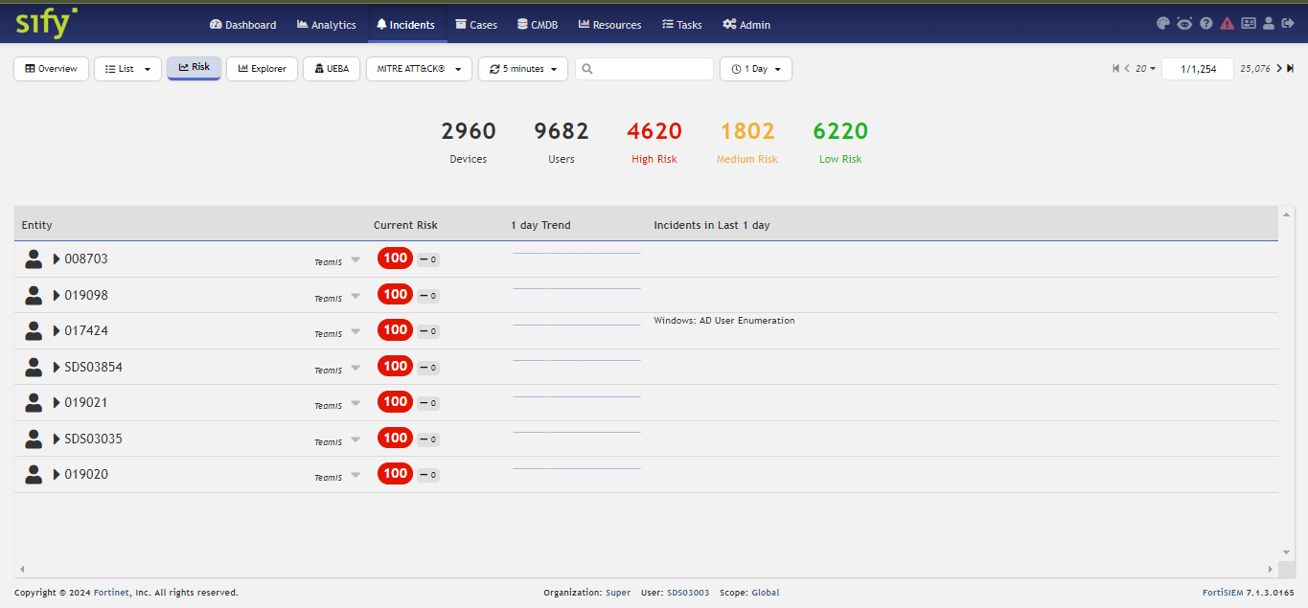
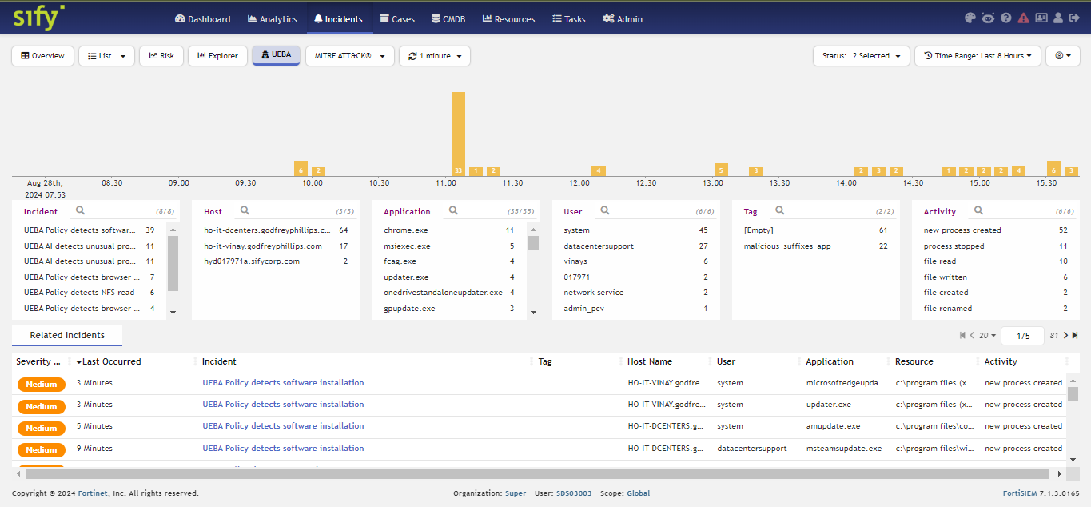
User & Devices Risk Scoring and User Entity & Behavioral Analysis

Slide 26
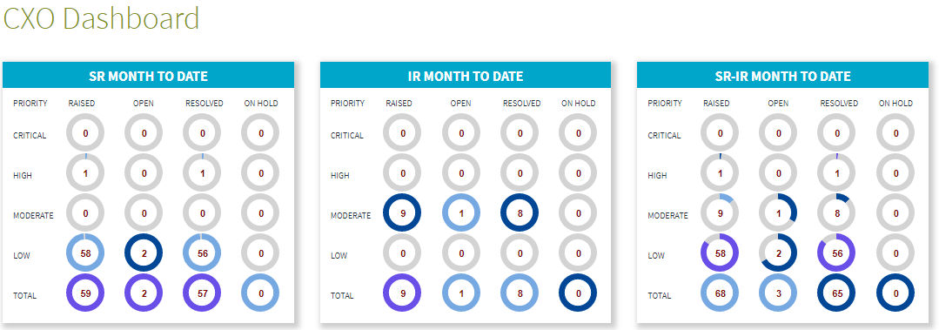
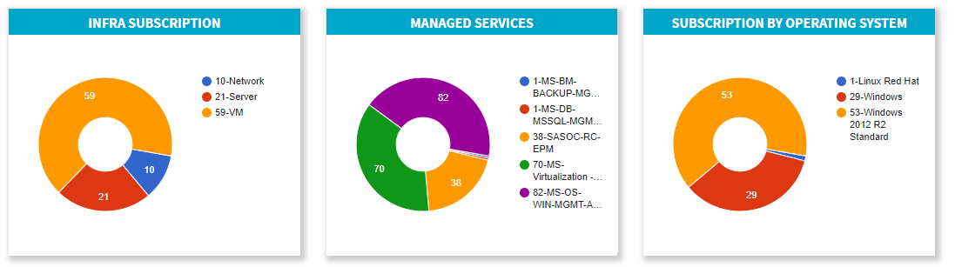
Sify ITSM Customer CXO Dashboard

Slide 27
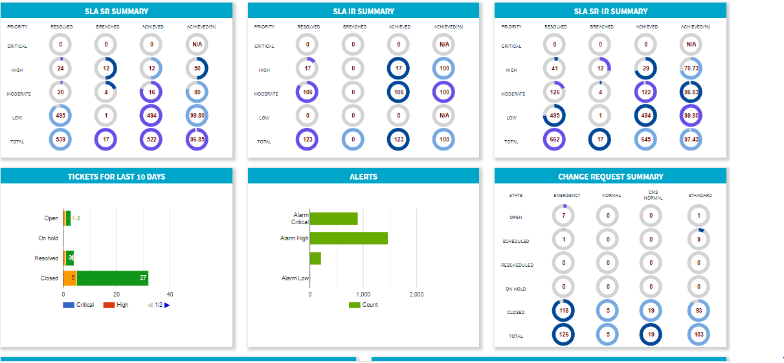
Sify ITSM Customer CXO Dashboard

Slide 28
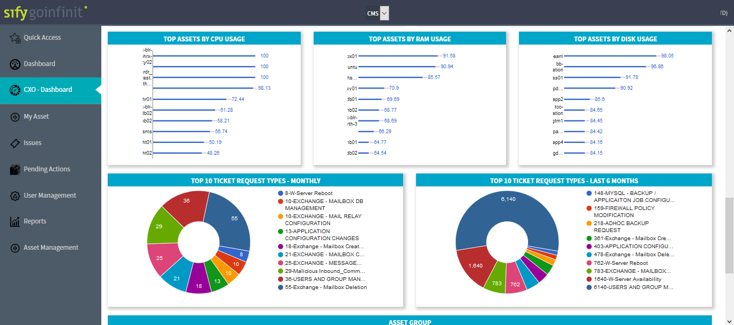
Sify ITSM Customer CXO Dashboard

Slide 29
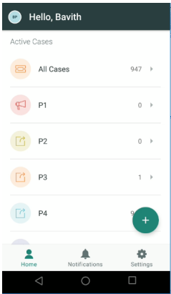
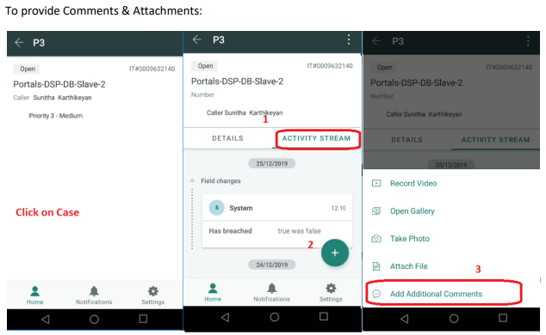
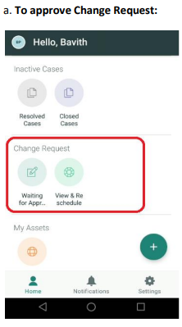
Sify ITSM Mobile App

Slide 30

What makes sify a UNIQUE partner FOR Security Services
Less
Hardware
People
Licenses
Single partner for Security Services across DC/Cloud/WAN/End-User
Catalogue Driven & Optimized Hybrid SOC delivery model
Security Posture Enhancement
By implementing the right security framework
TOOLS
PROCESS
INNOVATION
Best of Breed MSSP/MDR/GRC Tools
Protect, Detect & Response Services
Productivity improvement
with Automation and Event co-relation
Full suite of ITIL service elements, process compliance
SLA based service with real time measurement & dashboards

Slide 31





INSURANCE Regulatory BODY
Client Challenge
Value for Client
In the digital era and new-age competition, the Client faced difficulties in retaining its focus on delivering quality service to its existing customers & gaining thrust in the market.
Scale-as-you-grow architecture and licensing​
Device based licensing. ​
Add more devices as per need.​
No need to bother about EPS anymore.​
With wide infrastructure client has faced challenges in creating visibility & gaining controls over the security posture which is spread across the country.
Lack of security experts inhouse in identifying the bad actors and quickly initiate response based on the attack vector & stages.
Single-pane-of-glass management and control​
Features including dashboards, analytics, incidents, configuration management database (CMDB), and administration are accessed via an intuitive, web-based GUI.​
Performance and availability monitoring, such as CPU, memory, storage, and configuration changes extend the functionality of the platform
Proposed Solution
MANAGED SECURITY SERVICES
SOC Model
Managed Security Services
Better incident detection with reduced incident impact​
Identifies external and internal threats faster and enables threat hunting and compliance monitoring.​
Reduced Mean Time to Detect (MTTD) and Mean Time to Respond (MTTR).​
Security Analytics helps hunt for threats and indicators of compromise (IOC).​
Managed Detection & Response
Security Posture Visibility ​
Response Automation
Security orchestration, automation and response
Insider Threat Management
User and entity behavior analytics
Reporting​
Wide range of compliance auditing and management reports including PCI-DSS, HIPAA, SOX etc.​
MITRE ATT&CK framework-based reports.
Sify Confidential

Slide 32





India's major pharmaceutical company
SIEM, UEBA & SOAR
Provided AI & ML-based Security Analytics platform
TO automatically mitigate threats with reduced MTTD and MTTR
Project Objective
To build Security Information And Event Management (SIEM) solution which supports threat detection, compliance and security incident management through the collection and analysis (both near real-time and historical) of security events, as well as a wide variety of other event and contextual data sources
Integrated Value and Outcome
Central SOC operated from Chennai with platform hosted at Airoli and Bengaluru for DC and DR respectively
Simplified licensing which is device based hence predictable billing avoiding. No need to bother about EPS spikes anymore.
Meets next generation SOC requirements with the addition of UEBA and SOAR.
MITRE ATT&CK framework-based threat mapping.
Wide range of compliance auditing and management reports including PCI-DSS, HIPAA, SOX etc.
Value for Client
Sify provides the complete next generation SIEM components for customer to meet their security monitoring and compliance requirements. Customers benefit with the single pane of glass visibility for their hybrid and multi-cloud infrastructure security monitoring with improved MTTD and MTTR.
Value for Sify
Long term partnerships and It will help Sify understand their vertical in depth to create more opportunities, a good reference to onboard new customers in the Industry.
Managed Detection & Response
Sify’s Uniqueness
To keep up with ever-evolving cyber threats, Sify’s Technology Innovation Center works continuously to improve security processes and solutions.
Project Model
Platform as a Service (PaaS) Model
Competition
Managed Security Service Providers
Sify Confidential

Slide 33
NGAV & EDR
World's leading glass manufacturer
Secured with machine Learning based threat detection and response technology
To protect against threats & sophisticated attacks
Project Objective
Providing ultimate endpoint security platform that combines NGAV, for prevention, and EDR to detect the malicious activities that might make their way around the antivirus. This combination gives organizations confidence for both prevention and detection against even the most advanced, targeted attacks. The NGAV analyzes the behavior and threats on a single endpoint while EDR consolidates the data across all endpoints to provide a full picture of potential threats.
Integrated Value and Outcome
Central SOC operated from Chennai.
Simplified licensing.
Meets next generation endpoint protection requirements with AI & ML capabilities.
MITRE ATT&CK framework-based threat mapping.
IOA behavioral prevention
Value for Client
Sify provides the next generation endpoint protection suite for customer to protect their endpoint devices from threats and sophisticated attacks delivering them the complete visibility of the threat from the start till end. This solution is delivered and managed from cloud ensuring protection of the endpoints on and off network
Value for Sify
Long term partnerships and It will help Sify understand their vertical in depth to create more opportunities, a good reference to onboard new customers in the Industry.
Managed Security Services
Sify’s Uniqueness
To keep up with ever-evolving cyber threats, Sify’s Technology Innovation Center works continuously to improve security processes and solutions.
Project Model
Platform as a Service (PaaS) Model
Competition
Managed Security Service Providers
Sify Confidential

Slide 34
Privileged Access Management
a leading manufacturer
Sify is trusted for SECURING its privileged access management
to authorize and govern the privileged users, based on their roles and responsibilities
Project Objective
Sify helps organizations with Privileged Access Management solution to reduce organization’s attack surface, and prevent, mitigate, the damage arising from external attacks as well as from insider threats or negligence. The central goal is the enforcement of least privilege, defined as the restriction of access rights and permissions for users, accounts, applications, systems, devices and computing processes to the absolute minimum necessary to perform routine, authorized activities.
Integrated Value and Outcome
Central SOC operated from Chennai.
Pay only for privileged user count and get unlimited device integration
Secure access to administrative users to manage respective endpoints
Session recording to track administrative changes
Automated password refresh cycles to manage compliance
Custom administrative access workflow for access authorization
Value for Client
Sify provides a highly effective Privileged Access Management solution that helps in managing, controlling and monitoring privileged user activities whilst implementing the principle of ‘least-privilege’
Value for Sify
Long term partnerships and It will help Sify understand their vertical in depth to create more opportunities, a good reference to onboard new customers in the Industry.
Managed Security Services
Sify’s Uniqueness
To keep up with ever-evolving cyber threats, Sify’s Technology Innovation Center works continuously to improve security processes and solutions.
Project Model
Platform as a Service (PaaS) Model
Competition
Managed Security Service Providers
Sify Confidential

Slide 35





SIFY AS a TRUSTED Security services PARTNER
Sify is trusted by a leading manufacturer for securing their end- to-end IT Infrastructure and enhance their security posture with continuous monitoring, management and security audits
Sify helps a major pharmaceutical sector customer with AI & ML based Security Analytics platform and automatically mitigating threats resulting in reduced MTTD and MTTR
Sify helps secure the Financial platform hosted on public cloud accessed by several retail customers for a major NBFC with security controls at various layers along with Detection and Response services.
World's leading glass manufacturer secured with Machine Learning based threat detection and response technology protecting against sophisticated threats and attacks
Sify helps assess and mitigate the cyber security risks for a leading financial institute's IT estate

Slide 36









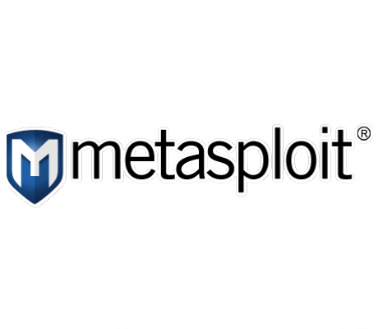




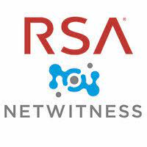
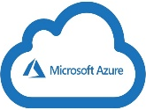






























OEM Partners & Tools
Network Security
Host
Security
Data
Security
Mobile Security
IAM
MDR
VA & PT
Cloud Native
Notes:
CLOUD SECURITY

Slide 37



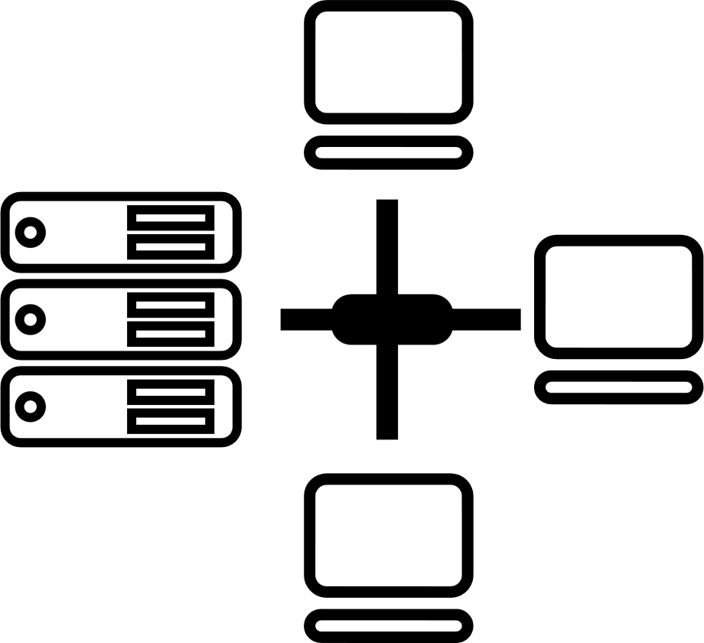






Tried Tested Trusted
Your digital infrastructure partner for over 23 years
Network
Infra Services
Network Digital
Managed Services
Data Center
Colo Services
CloudInfinit
Ent Cloud Infra
Cloud & IT
Managed Services
Digital Apps
Managed Services
Industry Apps
Managed Services
Security
Managed Services
Thank You

