Slide 1
UNLOCK THE POWER OF CLOUD &
IT MANAGED SERVICES
Feb 2025

Slide 2
AGENDA
IMPACT OF CLOUD ON DIGITAL GOALS
DIFFERENT STAGES OF CLOUD JOURNEY
SIFY CLOUD & IT MANAGED SERVICES
CASE STUDIES

Slide 3
Impact of cloud on customers digital goals
REQUIREMENTS FOR DIGITALIZATION
Modernize IT
Develop & Scale the NEW
Transform IT Operations
2
Maximized automation, standardization, harmonization of support functions or standard value chain functions
Insight driven predictive capabilities
3
Modernize IT
Digitalize Customer Experience
Application Portfolio assessment (strategy)
Modernization – Consolidate, Retire/ De-commission
Cloud Readiness
Transform IT Operations
1
Develop & Scale the NEW
Agile/ DevOps – Liquid applications with rapid prototyping and quicker releases to market
Cloud First – Digital mode of operations, as a service and straight to the Cloud
Digitalize operations

Slide 4
Project archetypes & Key Buyers
Major Deal Archetypes
Key Buyers
Description
Run-Transformation-Run (Entire Estate)
Take over client’s entire estate & run, Transform IT (and Business)
CXO
Living Systems
Transformation-Run
Cloud powered IT/Business transformation and Run
Complex App Migration
Migrate Complex/Mission Critical Business Apps/Platforms
CIO
LOB
Rapid Low-Cost Migration
Rapid Migration of workloads to VMs
Focused App Migration
New Implementation
New Systems build with Cloud native technologies
Data-Driven Migration & Transformation
Data Workload modernization, Data Strategy led new data platform build
CIO
CDO
Data Journey
Data Workload Lift & Shift
Rapid Migration of Data workloads
Modern Infra
Infrastructure Modernization
CIO
DC rationalization/modernization, Hybrid Cloud Infra
Land & Expand
Cloud Land & Expand
Land a small team/project to establish a position & then expand
HOD

Slide 5
Relevant to right Outcomes for our customers
Tactical IT related Outcomes
Strategic Business Outcomes
IT Performance- ITSM, FSO, CMP
Cost predictability- CI Cloud, Sovereign, GCC, SAP
Resiliency- MSOC, Cloud Security & DRaaS
Regulations & Audit- GRC
Compliance- GRC
Utilization rates- CMP
And more…
Revenue growth- Hybrid Cloud Services
Profitability- FinOps
New customer acquisition- AI Cloud, Edge Cloud
Customer satisfaction- CMP
Time to market- Hybrid Cloud Services
Competitiveness- FinOps
And more…
Cloud solutions have traditionally been optimized for centralized deployments
Distributed and verticalized use cases now drive cloud innovations with a demand for demonstrable business value

Slide 6
How Sify aligns to Different Stages of customers Cloud Journey
Journey to cloud
Journey in Cloud
Modernization
Organizations considering Cloud adoption
Organizations in cloud looking for efficiency in operations & costs
Organizations in cloud looking forward to digital adoption
Challenges:
App stratification
Contract models- Reserve Instance & Pay as you Grow
Cloud model-IaaS/SaaS/PaaS/Public/Private
Visibility & Transparency
Cost control
Challenges:
Billshock- Increasing Opex due to excessive bills
Chargeback- Compensating more than expected
Multi-cloud management- Unable to manage multiple clouds from unified dashboard
Challenges:
App Modernization
Automation
Microservices
Cost control
Solution:
Assessment
Business partnerships, Hyperscale CSPs
Migration
AI/ML led cloud management platform
FinOps
Solution:
FinOps
CMP- Chargeback
CMP- Unified visibility
AI/ML-Led Automation
Solution:
App assessment & rearchitecting
CMP- AI/ML led automation
Bare metal as a Service,
DevSecOps & K8S
AI Cloud
FinOps

Slide 7
Industry adoption In Different stages of cloud journey
Journey to cloud
Journey in Cloud
Modernization
Organizations considering
cloud adoption
Organizations in cloud looking for efficiency in operations & costs
Organizations in cloud looking forward to digital adoption
BFSI
Small & Medium Banks
Capital Market
Insurance
Asset & Investment Mgt
Large Banks
Fin Tech
MRD
Utility
Mid size Manufacturers
Retail
Discrete MFG
Logistics
E-commerce
Aero Tech, Agri Tech
Automobiles
Life Sciences
Healthcare
Biochemical
Pharmaceuticals
Health Tech
Education
Universities
Learning & Training Centers
Edu Tech
Media & Ent
Print Media
Production Houses
Digital Media
OTT Players
IT/ITeS
BPOs/KPOs
System Integrators
Software Development
Infrastructure OEMs
Security OEMs
Telecom & ISPs

Slide 8
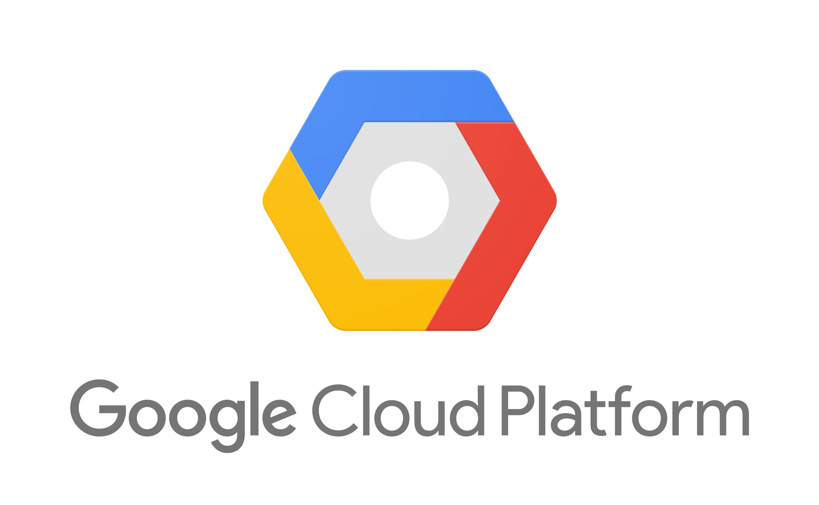
HYBRID MULTI-CLOUD delivery model
Hybrid workload placement drivers
Striking the perfect balance
Public
Cloud Drivers
Private
Cloud Drivers
Innovation
Speed
Regulatory
Data Gravity
Consumption
Scale
Performance
Existing Investment
Elastic Workloads
Fixed Workloads
Public Cloud Providers
Hybrid Cloud

Slide 9
Sify cloud & Managed services

Slide 10
Cloud & IT managed Services - portfolio
Sify CI Enterprise Managed Private /Hybrid Cloud
Hyperscale Cloud Services (AWS, OCI, GCP, Azure) & Hyperscale adjacent DC
Assessment led architecture design, build services for multi/hybrid IT solution
Migration best practices for minimal services disruption
Comprehensive security framework- preventive, corrective & detective
Resiliency and data protection solutions and services
Multi cloud management platform providing unified visibility & cost control
Cloud enhanced services
AI/ML, Microservices,
Analytics

Slide 11
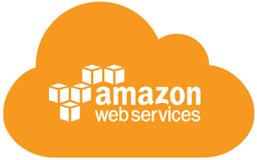
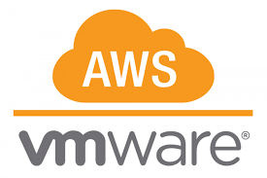
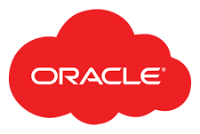
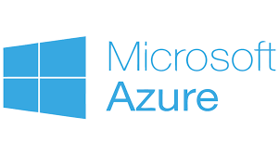
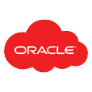
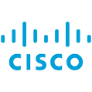
Why Sify- by infrastructure to adopt cloud
Best of breed performance with Hybrid Cloud configuration
Efficient integrations with extended ecosystems
Compliance with data sovereignty
Business continuity with resilience
Simplicity with self service
Operational efficiency with reduced IT administration
Cost reduction with
on-demand bursting to public clouds
Hybrid Cloud
Hyperscale Clouds AT VERY LOW LATENCY
Express Route
RABALE DATA CENTER (Cloud Adjacent)
DC INTERCONNECT
Hybrid Cloud
Direct Connect
Sify Cloud Connect
Partner Interconnect
Managed Services
Hybrid Multi Cloud Management Platform
Far DR
AIROLI DC ^{(Near Cloud / DR)} - Enterprise Multi Tenant Cloud ^{AT MINIMAL LATENCY}
Colo
Sify MULTI-CMP driven | AIOps Platform for Managed Services
FAR DR READY
SEC - SAP GRID
CI Community
GCC –Make-in-India
CI Trading Cloud
Hyderabad Data Center
Notes:
Sify USP and strength is integrated service stream of Sify Cloud and low latency Cloud connect to Public cloud

Slide 12
Why sify by platform to enable cloud
Sify CloudInfinit is a comprehensive cloud computing platform that provides a wide range of cloud services designed to meet the diverse needs of businesses, from startups to large enterprises.
Infrastructure as a Service (IaaS)
Platform as a Service (PaaS)
Software as a Service (SaaS)
Managed
Services
Predictive costs across catalog - No bill shock &
No egress costs
SIFY CLOUDINFINIT ENTERPRISE PLATFORM
Various Sovereign cloud landscapes, such as Banking, Trading, and Make-In-India Cloud
ENTERPRISE SAP GRID
SOVEREIGN CLOUD
GCC CLOUD
Regulatory and compliance-ready POD: SEBI, RBI, IRDA, MeitY empaneled to meet Data Localization
Enable Hybrid Cloud adoption with low latency interconnect to Colo & Hyperscalers

Slide 13
Why Sify for High performance GPU AS a service
Our cloud platform is now elevated to meet demands of deep learning, machine learning, AI training, inferencing...
With Nvidia's advanced GPUs, get unparalleled performance, high network throughput & low latency, crucial for AI workloads.
High-Performance
Infrastructure
Optimized for
AI Workloads
High Network Throughput &
Low Latency
Powered by Nvidia's state-of-the-art GPUs, Sify CloudInfinit^{+AI} offers exceptional computational power, enabling rapid AI model training and efficient inferencing.
Tailored specifically for deep learning and AI applications, the platform supports complex algorithms and large datasets, enhancing the accuracy and speed of AI operations.
Enable low latency interconnect to Hyperscalers and other Data Centers supporting all Hybrid Cloud deployment data sources
State-of-the-Art Data Centres
Scalability, Flexibility & Security
Enhanced Collaboration
Hosted within Sify's top-tier data centers, CloudInfinit^{+AI} delivers secure, dependable, and scalable computing resources, supported by Sify’s extensive network and infrastructure expertise.
Offers scalable resources to support growing AI workloads, allowing to expand seamlessly while maintaining robust data security and compliance with industry standards.
By integrating Nvidia’s technology with Sify’s CloudInfinit^{+AI}, businesses can leverage advanced AI tools and frameworks, fostering innovation and accelerating time-to-market
Democratizing access to high-performance computing, driving innovation and efficiency for organizations

Slide 14
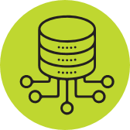
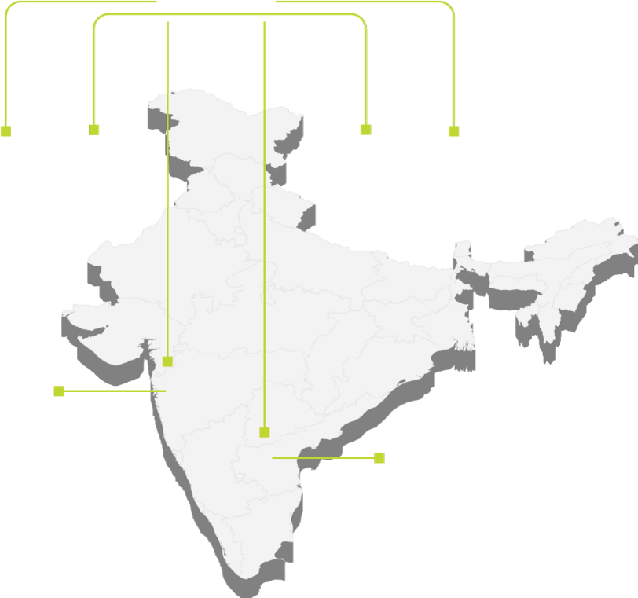
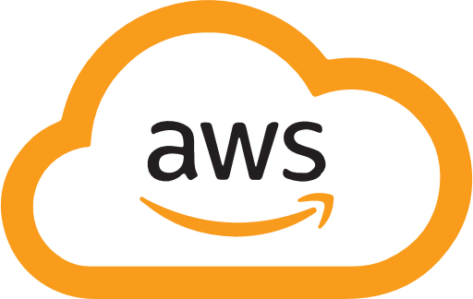
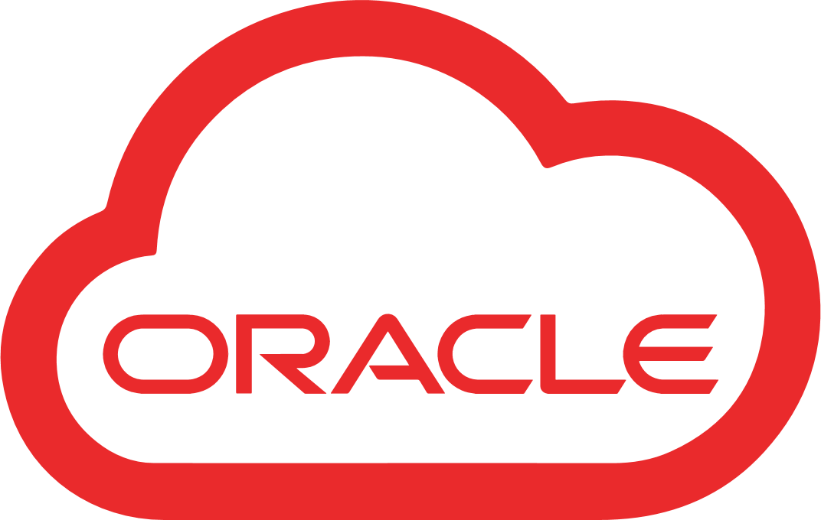
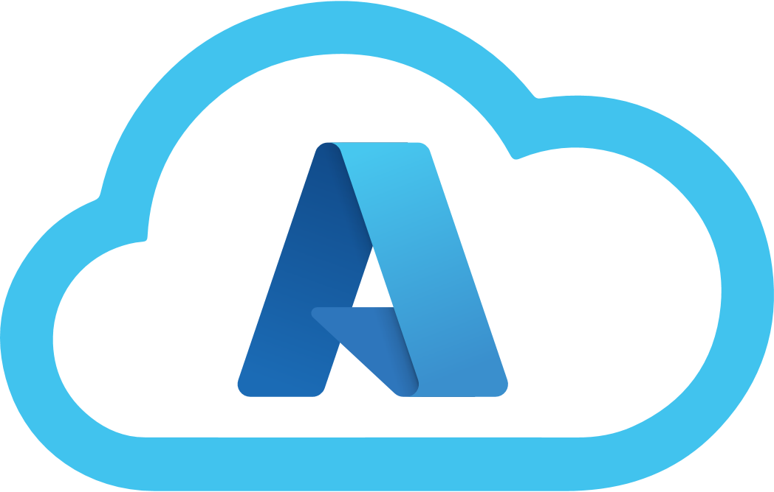
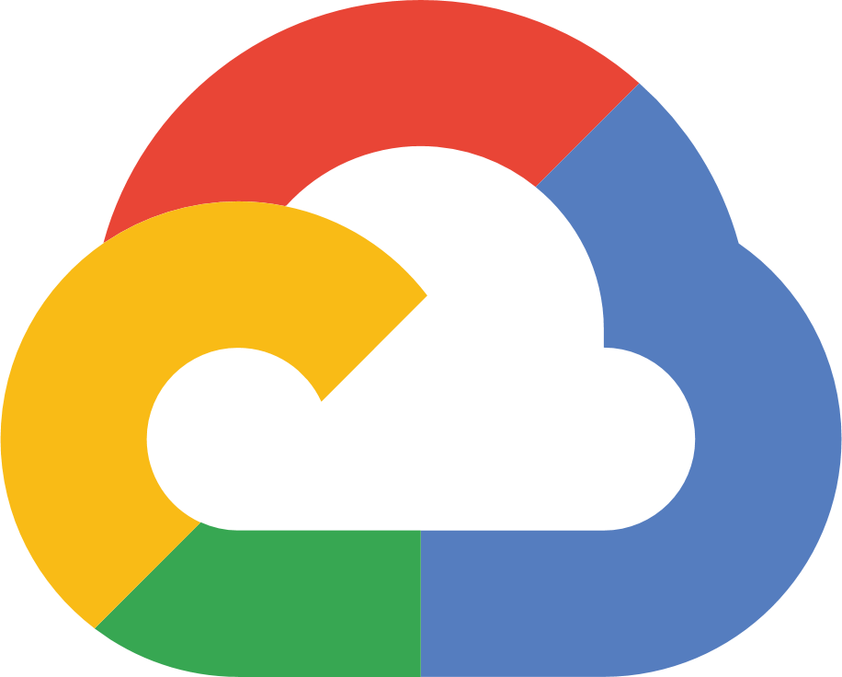
Why sify for CLOUD ANYWHERE
Integrated single pane of orchestration and managed system
SIFY CMP
Sify CloudInfinit delivery from Mumbai & Bengaluru data centers
Sify Cloud
Anywhere Global
Integration ready with other data centers in India and Global
Seamless integration to any of the availability zones across public cloud providers
Build, Deploy, Integrate and Manage distributed architecture to customer DC or branch locations or Edge Cloud
Sify CloudInfinit
Mumbai
Sify CloudInfinit
Bangalore

Slide 15
Why sify for cloud efficient operations
Sify InfinitCMP ensures better visibility, control and governance across multi clouds.
Provisioning
Orchestration
Configuration
Billing / Chargeback
Systems Management
Capacity
Cost Management
Cloud Management Platform
(Action & Automation)
Cloud Administrators
One-click blueprint deployment of distributed workloads across multi-clouds
Self Service
APIs
SEC Anywhere
Resource Dashboard and governance from a single portal for all clouds
DevOps Management
Unified Dashboard
Role(Profile) Based Access
Automation
Blueprints
Policy Engine
Security & Compliance
App & DevOps
FinOps:
AI/ML driven real-time observability to optimize and control cloud costs
Dashboard
Request / Change
Event / Incident
Monitoring
Discovery
ITSM
(Engagement & Records)
All Users
Unified analytical view on overall utilization, trending, resource planning and security assessment
Native Tools
AI / ML
One interface to manage all cloud accounts and chargeback across tenant and clouds
CxO Users
Automation
SLA
HA / DR
Knowledge Base
Logs
Users
Core Platform
POD
Notes:
CMP's Building blocks illustrate various services' capabilities, supporting, provisioning, configuration management, automation, blueprints and cost management.
All the CMP configuration parameters are synced with ITSM for seamless integration and life cycle management of platform
The CMP is designed to support diverse user profiles.

Slide 16
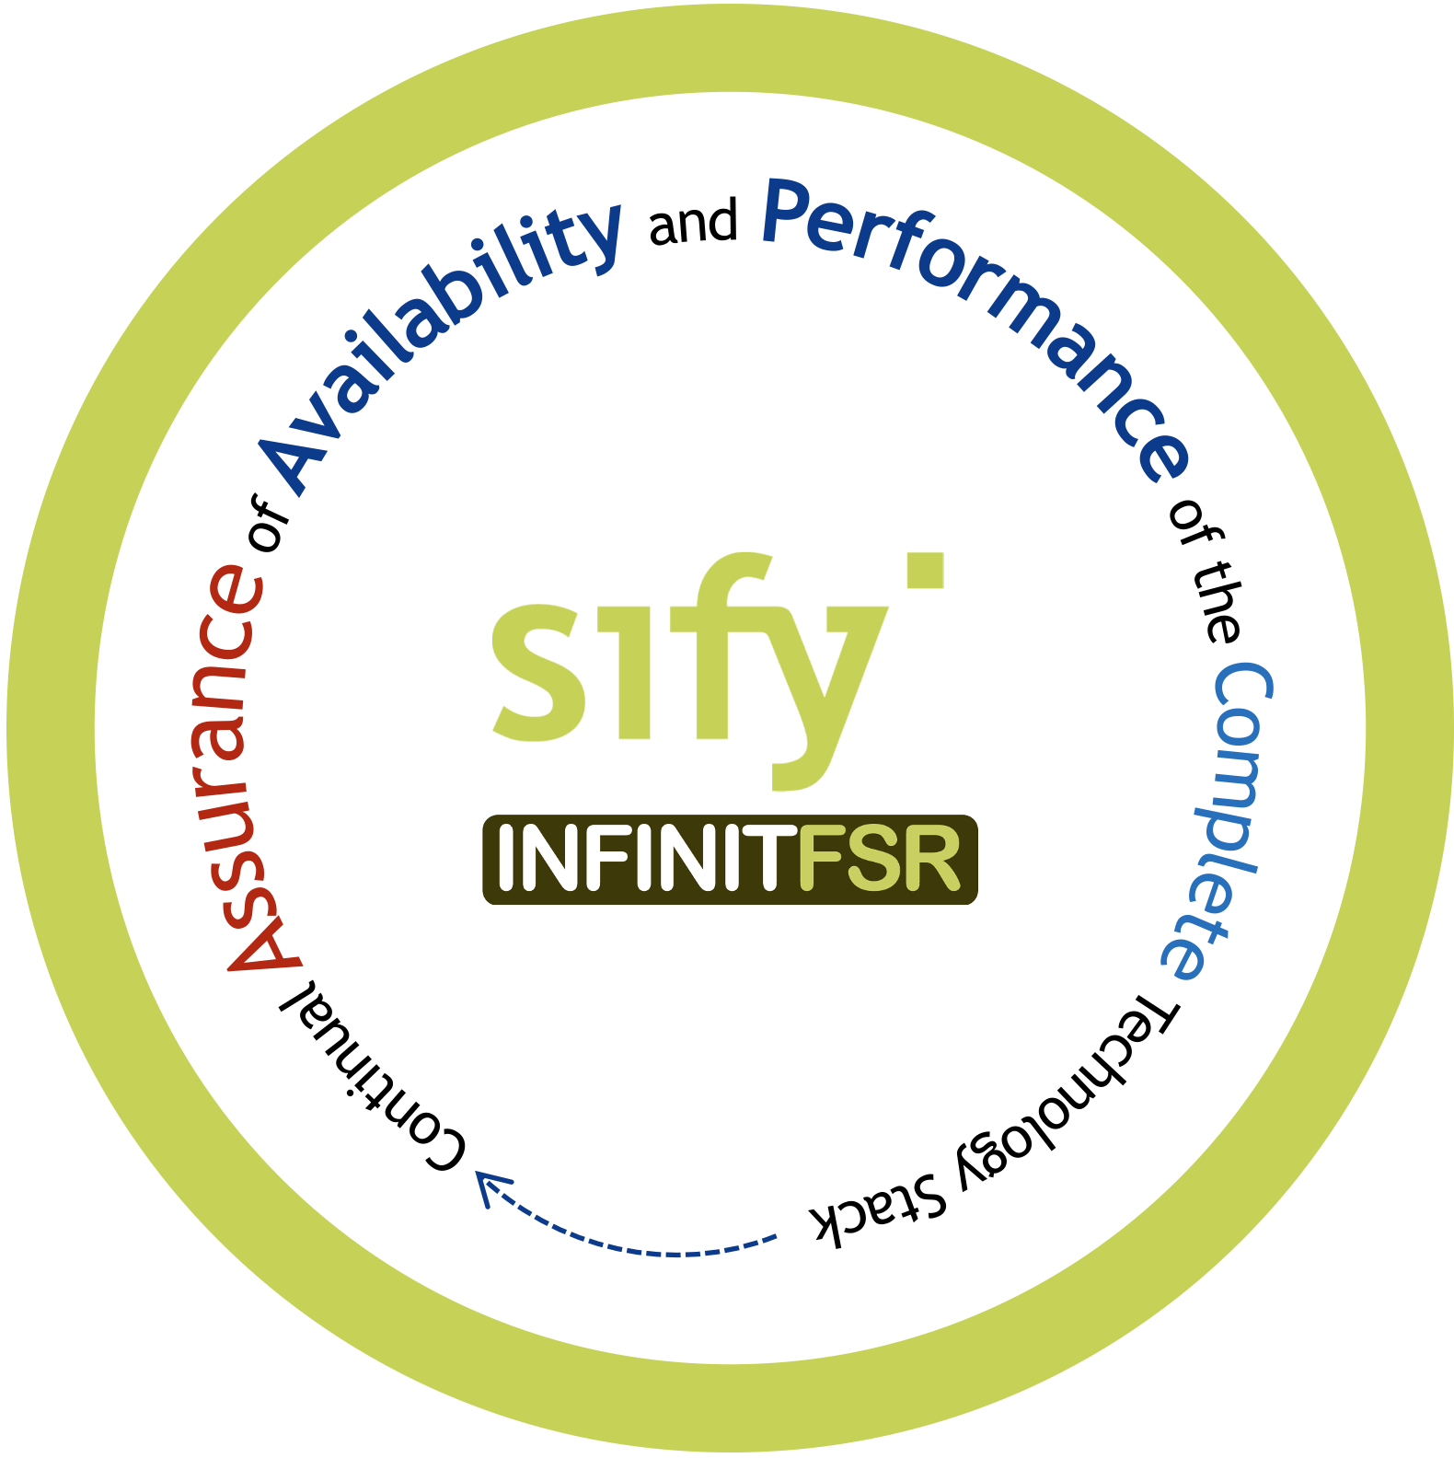
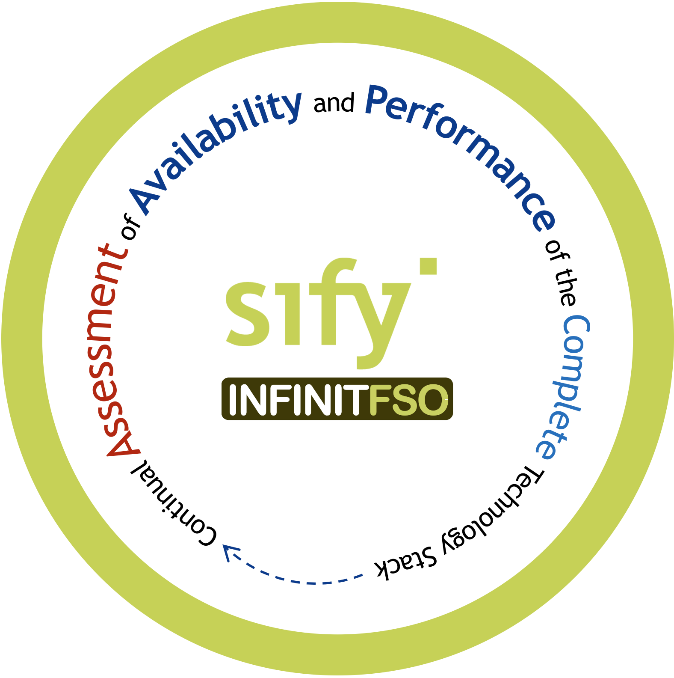
Why sify for ai enabled cloud adoption
Service Management and Visualization Dashboard
4
Prediction, Prevention, and Remediation of Business Service Availability and Performance Issues
Network Performance
Multi Cloud FinOps
App Security Services
App Performance
App Resource Optimization
...
BATCH
Real Time Predictive Insights Multi Domain Telemetry
3
AI OPS
Asset Dependency Map Generation
X-MELT
STREAM
2
1
Telemetry - Metrics, Event Logs, Traces From All Sources
NET OPS
IT OPS
SEC OPS
APP OPS
Notes:
Slide 336

Slide 17
Why sify for resilient cloud adoption
Comprehensive Managed Security Services from Edge to Cloud Deployments
Single solution provider covering DC, Network, Cloud, App, Hosts and Data
Offering Shared/On site/Hybrid Services to manage diverse solution portfolio with customized support models
Integrated seamlessly with other managed services in the ITSM platform to provide a unified view with faster ticket resolution
SLA driven Security Services by virtue of SASE & Security providers hosted in Sify DCs
AI/ML driven continuous Security Assurance Monitoring, & Automated Incident Management
Real-time monitoring through multiple feeds, to safeguard all the systems and sensitive information
Correlate security inputs to business context and current threat insights for Auto remediation
Governance, Risk & Compliance Assurance
Identify security vulnerabilities across your digital IT infrastructure and remediate with Sify’s advanced managed services
Enable organizations to meet regulatory and compliance requirements: SEBI, RBI, IRDA, ISO27001…
Customers
Sify SOC
Service Management Portal
Service Fulfilment
Service Assurance
Provisioning & Orchestration (SOAR)
Request
Event
Incident
Problem
Change
Asset Mgmt.
CMDB
Service Mapping
Monitoring / Management (MSS)
Detection (MDR)
Governance Risk & Compliance (GRC)
Tools
Performance & Availability
IAM
SIEM
UEBA
EDR
NBAD
Vulnerability Assessment
Penetration Testing
OS & Application Patch Management
Security Product Consoles
Threat Intelligence
Security Audits
Firewall, IDS/IPS, ATP, RA VPN, WAF, SWG, SASE. DDoS, DNS Security
NGAV
DLP, Email Security
CASB, PAM, MFA
User | Device
Branch | WAN
DC
Any Cloud
Security Controls
Notes:
We adhere to a structured framework that consists of three distinct layers: assurance, tools, and security controls.
Within the SOC, there are three separate teams: MSS (Makers), MDR (Checkers), and GRC (responsible for IT security audits, VA & PT services). These teams collectively extend their oversight and supervision of security controls, regardless of their geographical locations, as illustrated in the lower right corner of the screen.
The assurance layer encompasses the closely integrated IT Service Management (ITSM) platform, which aligns with ITIL standards, and the Security Orchestration, Automation, and Response (SOAR) platform.
Structured framework covering Assurance, Tools, and Security controls
SOC powered MSS (Makers), MDR (Checkers), and GRC (IT security audits, VAPT services)
Geo agnostic with complete visibility of all security controls and centrally managed
Security Orchestration, Automation, and Response (SOAR) platform
Assurance layer includes an ITSM platform as per ITIL standards

Slide 18
Cloud & IT MANAGED SERVICES FRAMEWORK
Customers
Sify Delivery Team
Single partner for Managed Services across Digital IT
Operational Excellence driven by Automation
Proactive Assurance, Predictive Analytics & AIOps
Customer-centric Service Delivery model
Service Management Portal
Service Fulfilment
Provisioning, Orchestration & Service Assurance – Sify Multi-CMP
Request
Event
Incident
Problem
Change
Asset Mgmt.
CMDB
Service Mapping
AI/ML Tools
Sify Monitoring Tool
Data Store
Discovery & Mapping
Monitoring
Business Services Dashboard
Automation
Event Management
AIOps
Data
Visualization
Backup
Polled
Logs
Agents
API
Patch Management
Syslogs
VA / PT
AV
SIEM
API
Agents
DR
Any Cloud
Operations Support Systems

Slide 19
Sify services complementing hyperscale CSPS
DC Build & Maintain; DRaaS for BCP; Cloud Advisory along with Managed Services
DC & Cloud Strategy
Hyperscale Cloud Infra; Backup & DR
Cloud Migration Services; Kubernetes;
SAP Expertise & Managed Services
App Migration & Modernization
Infra/App Modernization or Migration
Security
Best in Class Cloud Security
Controls
SOC; Managed Security Services
Sify’s Alignment
Hyperscaler’s Alignment
Automation, Chat Bots, Digital Workflows; Digital Asset Management
Customer Experience
Innovate faster with AI/ML & data analytics
Innovation
at Core
Prepackaged Industry solutions BFSI/ CPG/ Retail, Media, Mfg. etc.
Industry Led Solutions to enhance Org’s Digital Initiatives
Workplace Modernization
Licenses, Migration, Implementation & Managed services
Workspace suite

Slide 20
Sify Cloud & IT Managed Services capabilities & strengths
Comprehensive Discovery & Assessment for Cloud adoption
Controlled & Phased -Migration for any to any cloud
Implementation & Consolidation to arrive at a desired state architecture
Multi-Cloud, Service & Cloud Optimisation Management
Continuous & Unified Security and Compliance Automation
AI powered Managed Services
Cloud Economics (Hybrid-Cloud, Multi-Cloud continuous cost optimization)

Slide 21
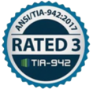
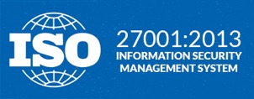
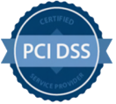
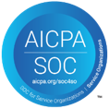
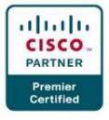
COMPLIANCE AND CERTIFICATIONS
MEITY Cloud Empanelled
India’s 1st Nvidia DGX Ready Air Cooled DC since 2022
Rated 3: Concurrently Maintainable Site Infrastructure
Data Center, Cloud &
Managed Services
IT Service Management
Telecom Data Center & Managed Services
India’s 1st Nvidia DGX Ready Liquid Cooled 130/KW/rack DC since 2024
Hosting Partner
PCI DSS
SOC 1 Type II
SOC 2 Type II
World’s international standard for occupational health and safety
Business Continuity Management System
Environmental Management system
Green Building
SAP Certified In Hosting Services
SAP Certified In Cloud Services
SAP Certified In SAP HANA Operations Services
SAP Certified In Application Management Services

Slide 22
Sify: your TRUSTED CLOUD and Managed Services PARTNER
A leading healthcare provider chose Sify’s Cloud@Core platform for the digital transformation of patient care services while saving 33% on cloud costs.
India’s largest power utility company chose Sify’s Cloud@Core platform with business-outcome-based model to scale their service to 25 million+ subscribers.
Sify’s integrated hybrid cloud solutions modernized 80% of the business applications of a retail giant with zero service disruption.
Global steel leader chose Sify to assess and migrate its business-critical SAP workloads to a Hyperscaler at near-zero downtime.
Sify helps a life insurance major transform digitally with AI/ML, cloud-native applications, and modern DevOps toolchains by unlocking the power of hybrid cloud on a Hyperscaler.
Ensured 35% TCO reduction and 3X performance to fast-track digital transformation and bring business resiliency to a major NBFC with multi cloud.

Slide 23
MANAGED SERVICES for the largest steel company
Transforming the core and innovate faster with ERP modernization
Innovation at the Edge
Business Continuity & High Availability
Work from Anywhere
Use Cases
Edge line Data Center
DR on Colo/Cloud
ZTNA
SD-WAN
Backup on cloud
SD-WAN
SAP on Cloud/Colo
Managed Wi-Fi & Sensors
SD-WAN
GWS/M365
Project Objective
SAP Basis Support & Carveout services
AI/ML Powered Automation
Managed Security Services (SIEM, MDR, GRC)
End Point Security
Managed IoT gateway
CASB
Collab as a service
Full Stack Observability
DMS- Forum
Managed IT Services (Links, NOC, SOC, Cloud, ITOps)
Sify Services
ERP modernization, enabling faster digital adoption
Support for IoT devices, scalability, support for decentralized application
High availability IT systems, Risk and Compliance, Redundancy & failover, data replication
Enhanced connectivity & security for remote sites & users with better user experience
Benefits

Slide 24
MANAGED SERVICES FOR SMALL/MEDIUM BANKS AND NBFCS
Thinning the Core
Digital offerings extending service portfolios
Regulation needs
Geographical expansion
Use Cases
Hybrid IT offerings with ISV & Strategic partners
Data in Motion & Rest Security services
ZTNA
NDR / FDR as a Service or Hosted
App & Infra Security
SD-WAN
CBS infra Hosting
SASE
Brand monitoring
GWS/M365
Project Objective
Peripheral Biz app cloud
Enterprise Cloud for peripheral DB & object storage
AI/ML Powered Automation
Cloud Security services
End Point Security
SASE
Collab as a service
Full Stack Observability
Managed IT Services (Links, NOC, SOC, Cloud, ITOps)
Sify Services
Agile & faster GTM
Digital banking
Business continuity & compliance
Multi-tier banking
Benefits

Slide 25
MANAGED SERVICES FOR a large MEDIA organization
Low-cost enterprise cloud for peripheral workloads with hyperscaler adjacency and NSE BSE pops
Predictive RCA with operational efficiency improving customer experience
Resilient content with intelligent security and network services
Monetization of digital asset enabling new revenue stream
Use Cases
DAM- Tenovos
CASB
Full Stack Observability
Project Objective
Managed security & Network services
Hybrid Cloud
AI/ML Powered Automation
Image Management
Sify CI Landing- Cloud adjacency
Multi Cloud Management- CMP
NSE/BSE Links as a service
Sify Services
Low Latency,
Cost optimization
MTTR Improvement, Multi platform management & Cost control
Security Risk Mitigation, Network wide data protection
Simpler asset lifecycle management
Benefits

Slide 26
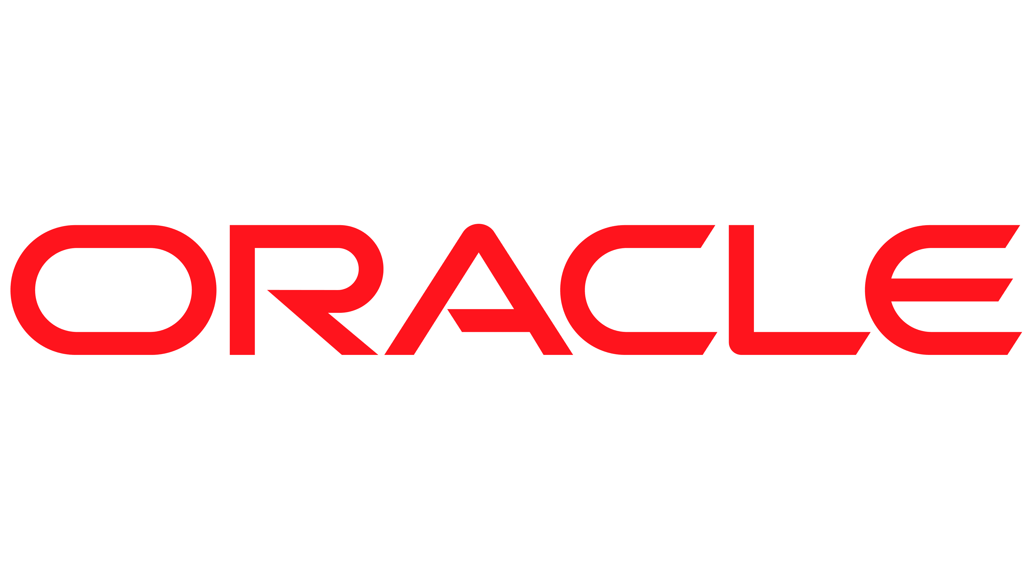
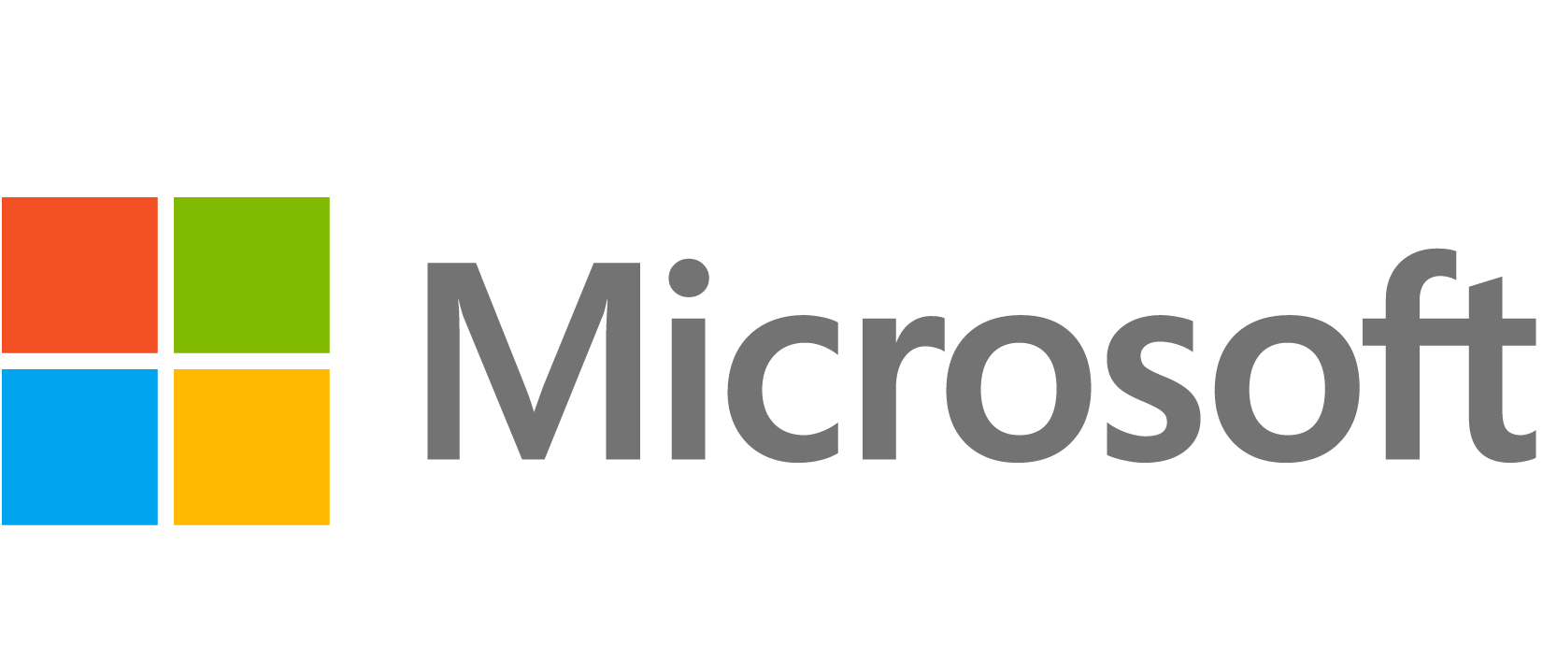
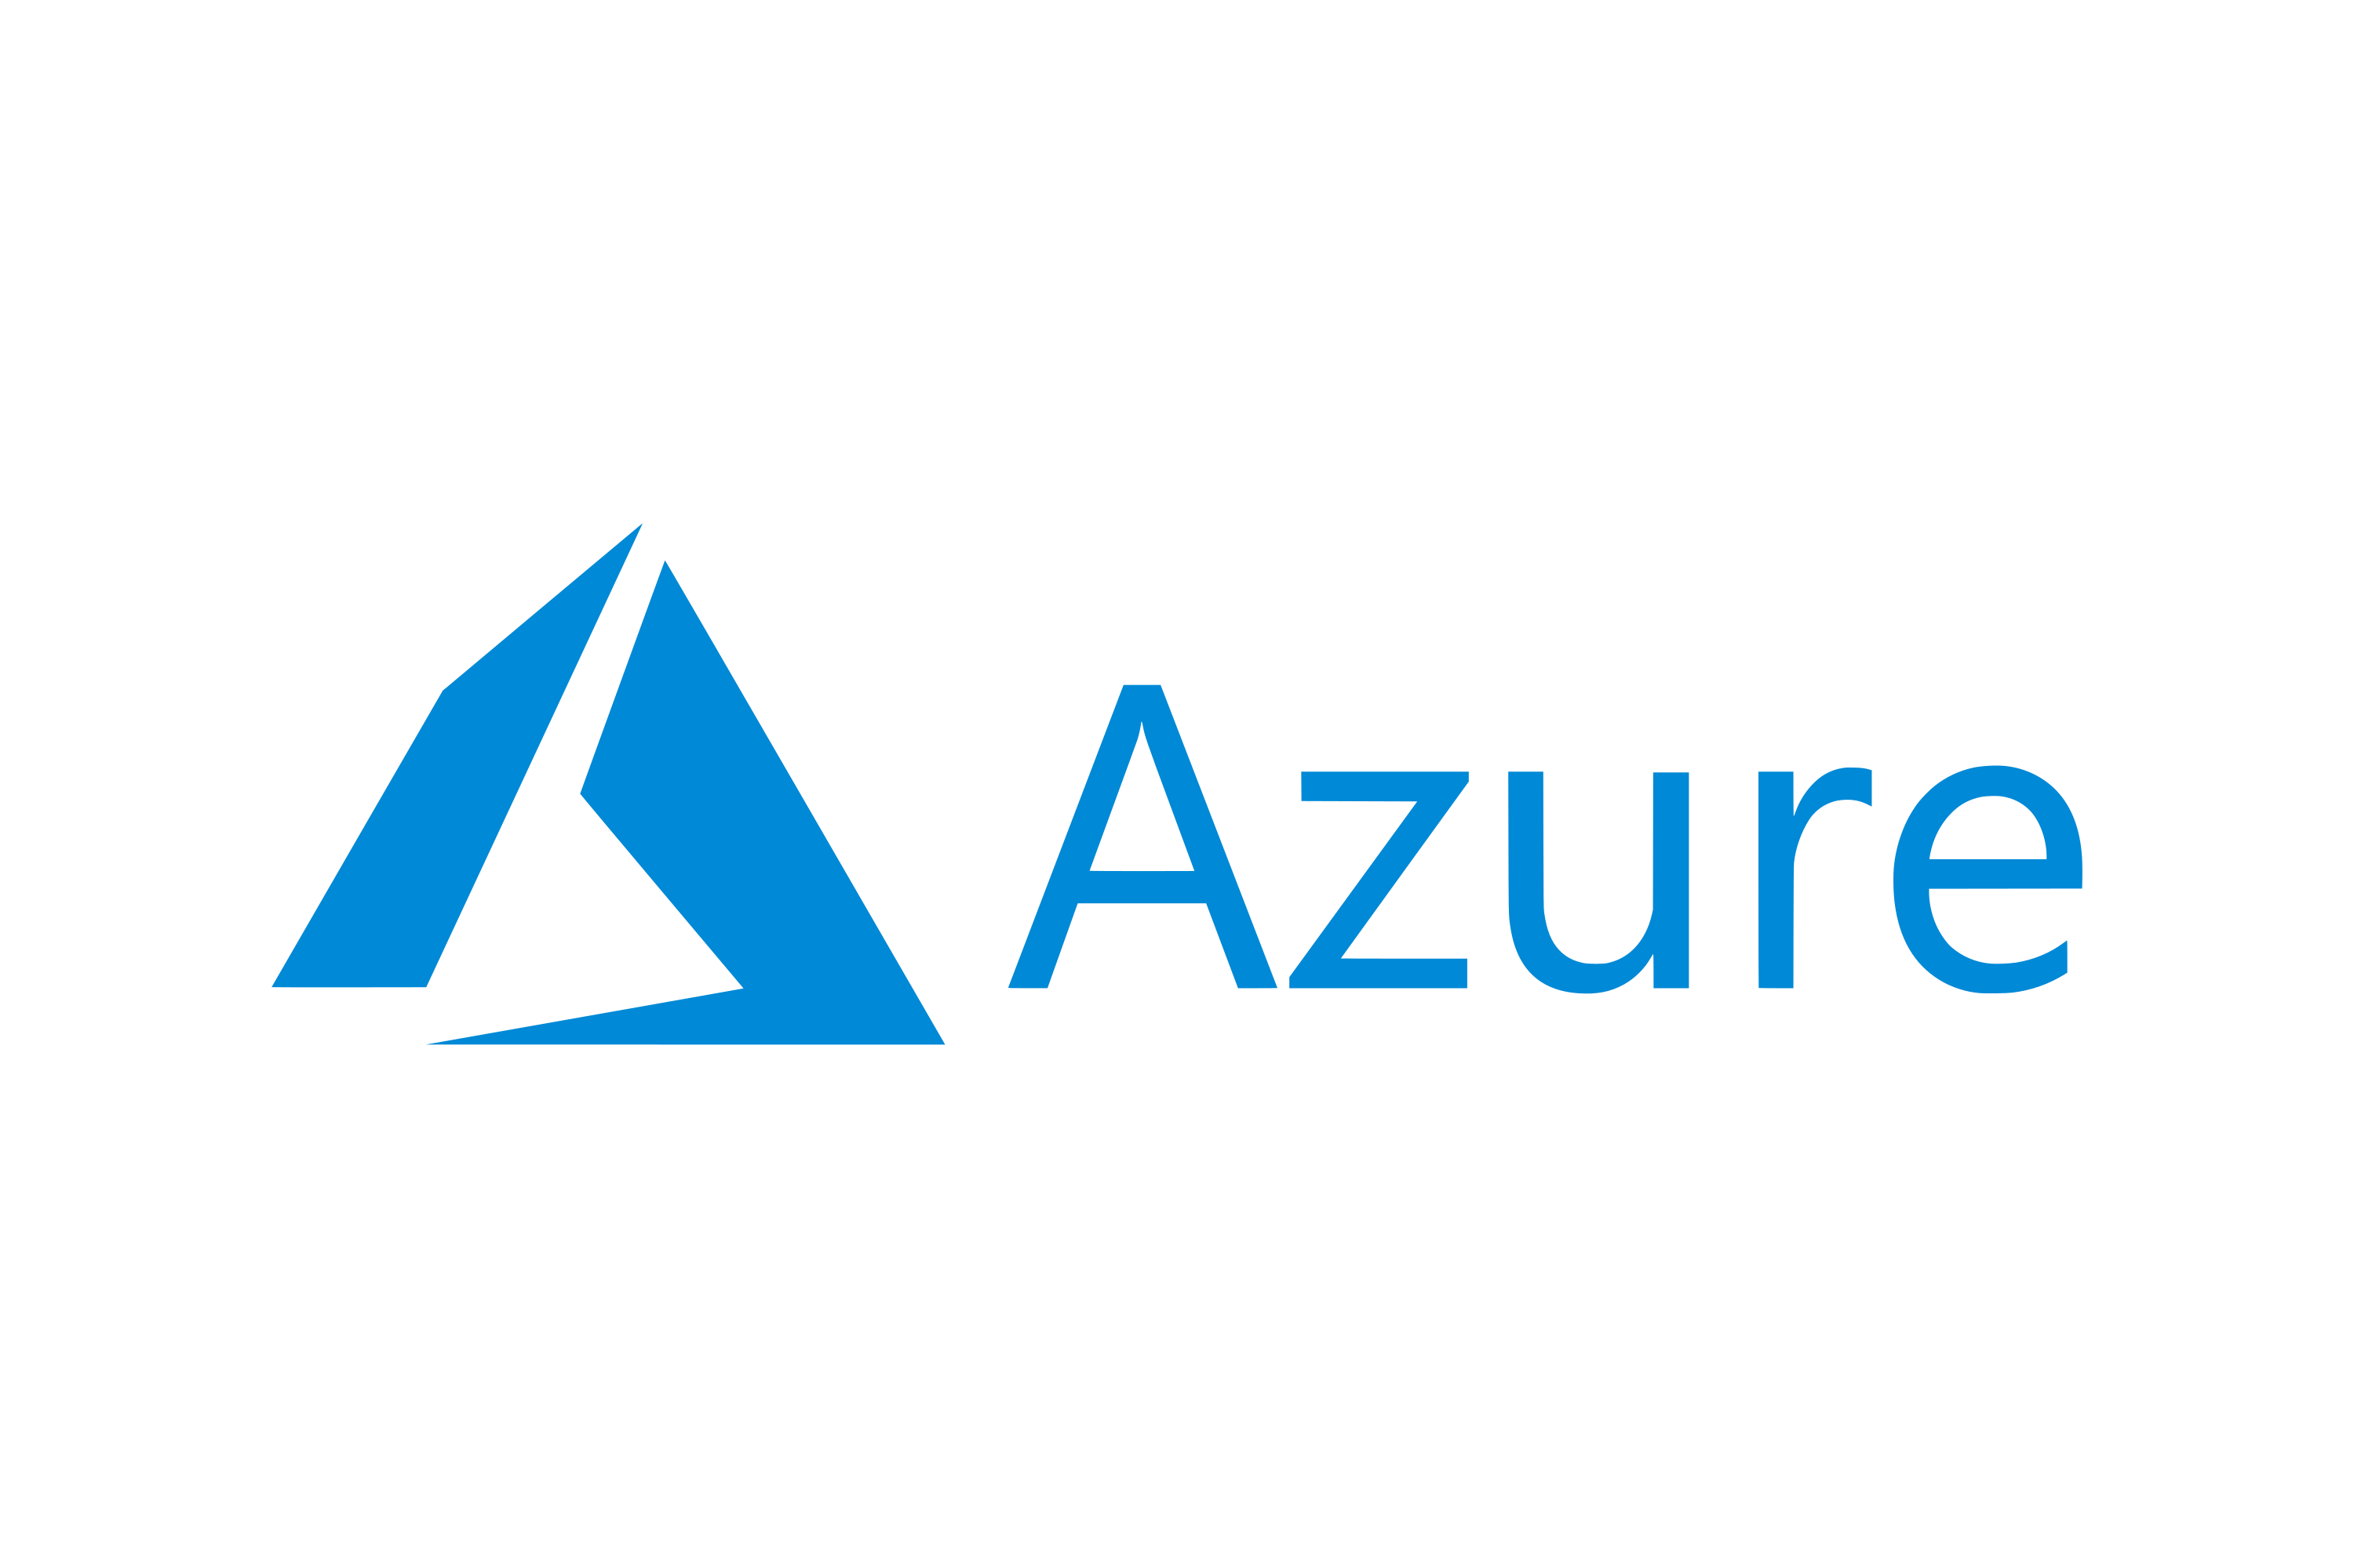
Sify - A complete cloud partner enabling digital services
HYBRID CLOUD
MANAGED EDGE & IOT
CLOUD STRATEGY
MANAGED SECURITY SERVICES
AI / ML
based Automation
CLOUD EVOLUTION
& MIGRATION
CLOUD & DATA CENTER MANAGEMENT & OPTIMIZATION
EDGE
CLOUD
NETWORKING
DIGITAL WORKPLACE & COLLABORATION
INTELLIGENT
INDUSTRY-LED
INVISIBLE

Slide 27
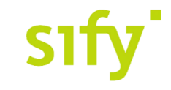
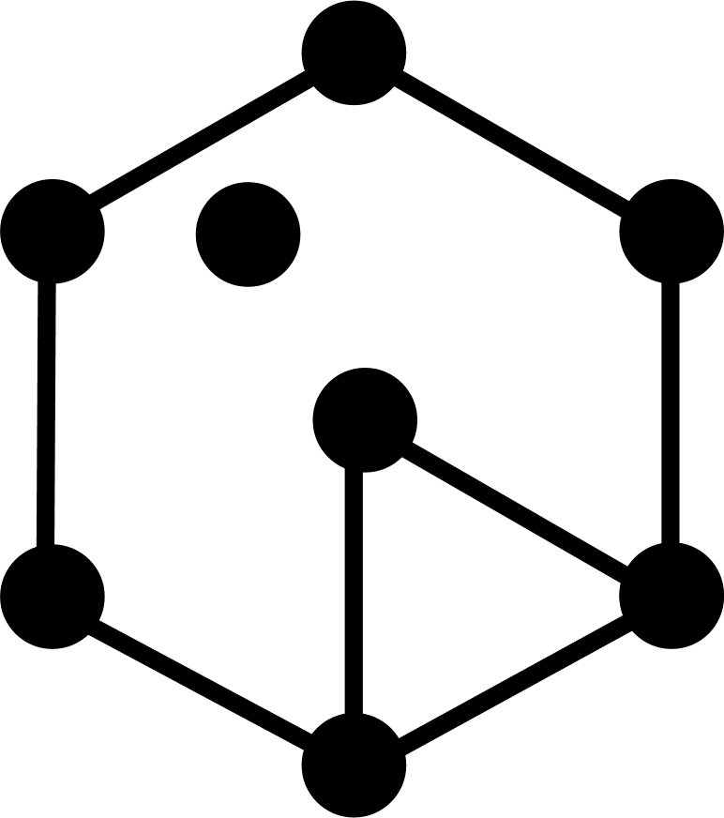
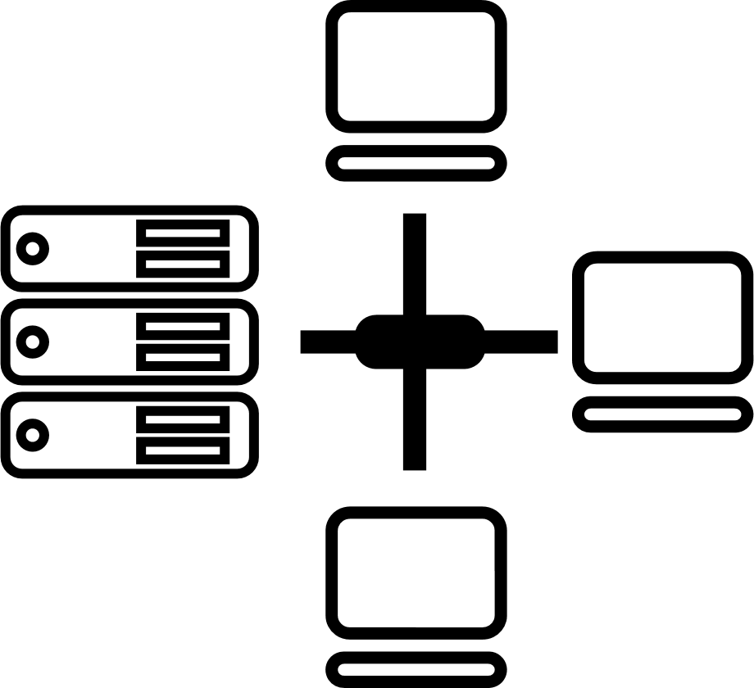
CIO Choice 2025 for
AI Ready Data Centers
Best Future-Proof Data Center Project
Award for Sustainability
Innovation in Data Center
India’s 1st Nvidia
DGX Ready Liquid &
Air Cooled DCs
Best in
Services Industry
DC Services India & ​Managed Cloud Services APAC ​
Managed Network Services - MQ
Tried Tested Trusted
Your digital infrastructure partner for over 25 years
Network
Infra Services
Network Digital
Managed Services
Data Center
Colo Services
CloudInfinit^{+AI}
GPU Cloud
Cloud & IT
Managed Services
Digital Apps
Managed Services
Industry Apps
Managed Services
Security
Managed Services
Thank You

Slide 28
Download Sify - IDC Spotlight Paper on
‘Hybrid/Multicloud Management: Road to Successful Digital Transformation’
Overview
Infrastructure Modernization:
Role of Cloud Technologies
Unified Management is Key to a Successful Hybrid/Multicloud Strategy
Cost Control Challenges While Spending on Digital Infrastructure
Application Modernization is a Key Imperative
Essential Guidance: Partnering with the Right Service Provider
Scan here

Slide 29
ITSM – Service Life Cycle management
CMDB
Change
Problem
Reports
Utilization
Service Request
Incident
CMDB and Service Mapping
Auto ticket assignment, priority, SLA, Assignment groups
Email to tickets and native API ticket integration
Automation for service request
Entitlements Incident, Change and Problem Management
Service Health view by Asset Groups
Service Health – Top utilization
Top Alerts, Top resources, Top Ticket
Performance
Availability

Slide 30
Incident Management Automation
Proactive / Reactive
Manual
Automated
Incident Identification
Categorization
Response
Periodization
Diagnose
Escalation
Resolution
Closure
Incident Logging
Automated
Manual
Automated
Manual
Automated
Manual
Automated
Manual
Automated
Manual
Automated
Manual Automated
Manual
Automated

Slide 31
AI led operations with outcomes
IT Landscape Visibility
Challenges
Asset Discovery & Dependency Mapping with topology views
Increasing Noise,
Missed Outages Alerts
Delayed Resolution
01
Predictive Insights
05
02
Alert Noise Reduction
Predictive Analytics using logs analysis & Anomaly detection with enhanced ML capabiltiies
AI OPS
Cross domain Alert Correlation & Noise Reduction
04
03
Reduced MTTR
Proactive Service Improvement
Quicker resolution by reducing Mean Time To Identify any issues across multiple domains
Capacity Resource Utilization and trends for analysis

Slide 32
AI & automation Driven Operations
Alert Correlation & Noise Reduction
IT Landscape Visibility

Slide 33
What is Sify CI multi-CMP
Sify Multi-CMP simplifies orchestrating, automating and managing resources and services across multiple Public cloud providers and Private clouds
Sify Multi-CMP is designed to provide a unified interface for managing multi-cloud and hybrid cloud environments, helping organisations optimise their cloud usage, costs, and real-time observability
Sify Multi-CMP is integrated with ITSM and Monitoring System for Service Assurance, Managed Services and SLA

Slide 34
Sify CI multi-CMP KEY FUNCTIONALITIES
Resource Provisioning, Automation & Orchestration
Simplified consistent provisioning interface for Sify Cloud and Public Clouds
Resource provisioning, modification for all clouds with role-based access controls
Guest OS automation for managed services and monitoring
Multi-CMP Blueprints
Automates the process of provisioning Cloud Infrastructure resources
Predefined blueprint simplifies initial network configuration
Simplified complex network configuration like Site-To-Site VPN Connection between two clouds
Terraform based Custom Blueprints and DevOps API are fully supported
Unified Interface for Multiple Cloud Providers, Accounts, Regions
Consolidated resources listing and management across regions and accounts
Provider-specific / Resource Group based views
Instance current state like Running, Stopped with the ability to perform actions.

Slide 35
Sify CI multi-CMP KEY FUNCTIONALITIES
Multi Cloud Visibility and FinOps
Dashboard, Reports & Analytics
Summary of Resources across accounts, regions, clouds
Comparison of cloud consumption across clouds
AI/ML driven Cloud Cost Optimization
Security & Identity
Identity Service facilitates Single-Sign-On for CMP, ITSM, FinOps Ports
Role Based Access, controls user’s access and operations on resources across clouds
Simplified firewall policy management
Integrated ITSM and Monitoring System
Public Cloud Networks are peered with Sify Network and Monitoring systems.
Monitoring Agents in instances detect anomalies, raise auto-ticket
ITSM portal simplifies user’s Service Requests & Incident Requests

Slide 36
FinOps Advantages
Unified Multi-Cloud Management
AWS, Azure, GCP, OCI, IBM cloud in single PAN
ML-powered insights
Intelligent information enable quick decision
Advanced chargeback
Efficient & Easy internal team cost distribution
Auto Assessments
Granular cost drill-down
Empowered teams - Quick decision
Real Time Info, With In Team Communication
FINOPS PRODUCT CODE
Smart resource shutdown
Enable to Save cost

Slide 37
People capability around various Technology stack: Infra & tools
OS & Applications
Backup
Database
Storage
Virtual Infra & Cloud
Network
DR Tools

Slide 38
People capability around various Technology stack : Security
Network Security
Host Security
Data Security
Mobile Security
IAM
MDR
VA & PT

Slide 39
Sify CI multi-CMP: Resource Orchestration & management
Simplified and consistence interface across the public cloud providers to manage cloud resources Network, Compute, Storage with minimal learning curve
Hybrid Multi-Cloud Visibility Dashboard
Simplified User Access Management
Summary view of resources provisioned across accounts, regions, and clouds (Compute, Network, Storage, DB etc. )
One interface to manage all cloud accounts with their operations like Start, Stop and Edit Tags
View filter by region, by account, by attributes
Role Based Access control for multi-cloud resources and its operations
Each type of resource access like Create, Read, Update and Delete are defined as a discrete permission
Flexible UI is provided to filter the permission set and choose them for ex: Gateway lists all types of permission for Internet Gateway, NAT Gateway, Service Gateway etc across multiple clouds
Private and Public Cloud resources can be created, modified and decommissioned across hybrid multi-cloud
Guest OS customization post provision like OS-Hardening, Monitoring agent installation, configuration etc.

Slide 40
Sify CI multi-CMP: Blueprints
Predefined Terraform blueprint simplifies initial network configuration with appropriate access / firewall policies. DevOps Ready Blueprint Deployment: Blueprints (Both predefined / custom) can be accessed using REST/JSON based API calls.
A predefined blueprint simplifies complex network configurations like Site-To-Site VPN Connections between two clouds.
Sify Multi-CMP Terraform Blueprint library will support to install, configure, and manage resources
Users can upload their custom blueprint in Terraform Syntax to deploy cloud resources in Sify Multi-CMP
Life-Cycle activities like provision, update and decommission are supported by simplified API calls
Your CI/CD pipeline can incorporate Blueprint APIs for continuous delivery
Your Git repository can be specified as a source for blueprint code instead of frequently updating and uploading the code

Slide 41
Sify CI multi-CMP: Integrated ITSM & Monitoring System
CMP is integrated with ITSM and Monitoring System for Service Assurance, Managed Services, SLA.
Cloud resources peered with Sify Monitoring systems for end-to-end observability.
Monitoring instance detects anomalies and raises automatic tickets in ITSM.
ITSM Service Requests & Incident Requests are integrated into Sify Multi-CMP.

Slide 42
Cloud Resource Provisioning and Management
Simplified and consistence interface across the cloud providers to manage all type of cloud resources Network, Compute, Storage with minimal learning curve.
Private and Public Cloud resources can be created, modified and decommissioned from Sify CMP.
Guest OS customization post provision like OS-Hardening, Monitoring agent installation, configuration etc.
Instance information is updated in ITSM CMDB for resource life-cycle-management.

Slide 43
Cloud Visibility Dashboard
Summary view of resources provisioned across accounts, regions, and clouds
(Compute, Network, Storage, DB etc. )

Slide 44
UNIFIED Interface Multi-CLOUD
Manage cloud multi-region, multi-account, multi-cloud distributed resources using a unified interface.
Consolidated view of cloud resource ex: AWS EC2 instances across all regions and AW’S accounts.
One interface to manage all cloud accounts with their operations like Start, Stop and Edit Tags.
View filter by region, by account, by attributes

Slide 45
User Access Management
Role Based Access control for multi-cloud resources and its operations simplifies user access management.
Users are assigned with Role to control their access to resources across cloud.
For example, Multi-Cloud Compute Admin facilitates a user to manage all compute resources across clouds, but denies access to other resources like network, database.
Each type of resource access like Create, Read, Update and Delete are defined as a discrete permission.
Any kind of Custom Role can be defined by specifying set of required permission.
Flexible UI is provided to filter the permission set and choose them. Ex: Gateway lists all types of permission for Internet Gateway, NAT Gateway, Service Gateway etc across multiple clouds.

Slide 46
Single Sign On for CMP, FinOps & ITSM

Slide 47
Sify CMP Blueprints 1/2
Predefined blueprint simplifies initial network configuration with appropriate access / firewall policies.
A predefined blueprint simplifies complex network configurations like Site-To-Site VPN Connections between two clouds.
Sify CMP Terraform Blueprint library will support to install, configure, and manage resources
Users can upload their custom blueprint in Terraform Syntax to deploy cloud resources in Sify-CMP

Slide 48
Sify CMP Blueprints 2/2
DevOps Ready Blueprint Deployment: Blueprints (Both predefined / custom) can be accessed using REST/JSON based API calls.
Life-Cycle activities like provision, update and decommission are supported by simplified API calls
Your CI/CD pipeline can incorporate Blueprint APIs for continuous delivery.
Your Git repository can be specified as a source for blueprint code instead of frequently updating and uploading the code.

Slide 49
Account Onboarding, Discovery and ITSM
Bi-directional resource discovery for complete CMDB synchronization and resource governance.
For AWS Cloud, SNS Topic and subscription are created automatically to get notifications on any resource modification; For other clouds, CMP performs periodic discovery.
All resources’ current configuration is synchronized in ITSM – CMDB for Service-Assurance, and ticket functionalities.
Discovered resources are used to auto-fill input parameters in the blueprint provisioning interface.

Slide 50
Real-time observability showing spending
Customer scenario: Cloud enterprise wants to understand their cloud consumption across different categories such as instances, storage, networking, containers, scaling groups, and services. In addition they want to understand how much cloud waste there is in each category. They used to use scripts and manual methods to figure these out, and each time it would take them months.
With Sify Multi-CMP FinOps
Large amount of pricing and utilization data are analyzed in real time showing cloud consumptions in instances, storage, networking, containers, scaling groups, and services.
Cloud waste in each category is also shown.
Users can also find cost trends and utilization trends for each resource in the drill-down.

Slide 51
Chargeback and budgeting
Customer scenario: Government entity, which has many organizational sub-units, needs self-service reports for sub-unit level consumption for chargeback and budgeting analysis. They use multiple clouds, in particular AWS, MS Azure, Kubernetes, etc.
With Sify Multi-CMP FinOps
Administrator can easily group cloud resources (including Kubernetes constructs and cloud services) from multiple clouds using FinOps Financial Domain.
Each financial domain represents one organizational sub-unit, with chargeback/showback and budgeting capabilities. Shared cost allocation enabled.
Forecast of future consumptions.
Real-time budget alerts sent via emails or ticketing systems such as ServiceNow and PagerDuty.
Role-based control access allowing for organizational unit stakeholder(s) to self-service on FinOps to understand their consumptions and pay their share of cloud costs.

Slide 52
Rightsizing cloud resources
Customer scenario: After lift-and-shift from on-prem to the cloud, many cloud resources are over-provisioned. Cloud enterprises need full knowledge of utilization trends and recommendations to make the right decision.
With Sify Multi-CMP FinOps
Each instance has a few recommendations with risk level specified for rightsizing.
Users can make the determination by looking at the resource utilization trends over a chosen time period.
Rightsizing also applies to other cloud resources such as storage, containers, and more.
Notes:
Roku - $400K waste of storage per month
Glocal - % of savings for
T3 instance types -> AMD chip-set instance -> 30 - 40% of savings
ApTech - > 60% of savings

Slide 53
Save cloud costs on non-production environments
Customer scenario: The DevOps team leaves their non-production cloud instances on 24/7. Research shows that these instances are sitting idle about 76% of time on average. The company needs an automated way to start up and shut down the instances at proper times.
With Sify Multi-CMP FinOps
Our ML-based algorithms study the usage pattern of each of the instances and make recommendations for smart startup and shutdown schedules.
These startup and shutdown schedules can be applied on individual instances or a group of inter-related instances (Service Domains)
These schedules, once applied, automatically executes accordingly.

