Slide 1


EMPOWERING INDIA’S
AI AMBITION
AI READY NETWORK
INFRASTRUCTURE
FEB 2025

Slide 2




future ready network backbone
Hybrid
Access Strategy
Cloud and
AI Ready
Designed for Mission Critical Networks
Automation
Pan-India wired and wireless enterprise connects across 1700+ Cities, 3700+ PoPs
1,20,000 Kms of Fiber coverage across 24+ Metro Cities
Dark fiber economic model with nation-wide regulatory compliance
Edge strategy to augment 10+ tier 2 cities, interconnect with NIXI across 20+ cities- 32+ MN eyeball access
National long-distance network connecting 5 major cities
Doubled national long distance network capacity from 300G to 600G
66+ interconnected DCs, 99.999% guaranteed availability
>1 ms latency connectivity to major hyperscalers enabling hybrid deployments
Fully meshed backbone for resiliency
3 CLS: Mumbai, Chennai, Kolkata serving global customers
Coastal subsea systems interconnecting India-West to India-East
8 international PoPs, global partnerships with Telecom Carriers and Internet Exchanges
Sify OnNet: India’s first automated enterprise WAN
On Demand network infrastructure services
Powered by AI/ML based operations with dual NOCs
Reliable connectivity for mission critical networks, AI applications and hyperscale CSPs

Slide 3
Sify NETWORK BUSINESS
Sify network business provides connectivity to following segments:
Carriers and Hyperscalers
Large enterprises with a specific focus on highly distributed businesses such as banks, insurance, retail
Mid market and SMB
Over 3000+ customers and over 100k locations connected across the country
Business offering based on providing both connectivity infrastructure as well as value added services such as:
Network management
Security – SDWAN/SASE
Fully licensed carrier and provides services under:
NLD and ILD – provides both domestic and international private line services
ISP – Internet
VNO for Voice

Slide 4




SERVICES PORTFOLIO
Global Interconnects:
London, Marseille, New York, Los Angeles, Singapore, Hong Kong, Dubai
Local Interconnects:
7 locations in India
India’s most expansive network 1700+ cities with >3700 POPs
Full mesh nX 100G backbone with diverse infra protection
Multiple access media options:
Fiber, Fixed Wireless, Offnet
Infrastructure and Services
Ethernet Services
Business Internet Services
IPVPN Services
Cloud Connect Services
MEF E-line compliant & VLAN-based EVPL Services across India
Transport to Asia, Europe, Middle East
In-country Peering with all content providers/telcos
IPT to Asia, Europe and North America @ 500 G+
Performance SLAs with peering in Europe, North America, Asia
QOS and CSC support for easy integration and service extension
Local interconnect w/ all telcos for diverse access
High-availability services to AWS, Azure, Google, Oracle
Resilient interconnects in Chennai, Mumbai, Delhi, Bengaluru and Hyderabad
Notes:
Network Product 1 (Hyper-reach WAN) -- details and facts
DN : Still a bit text-heavy; edit down if possible. Some suggestions below.

Slide 5
NETWORK BACKBONE
Enterprise centric design
Facility level redundancy in all major cities
Path & Provider Diversity
Design led choice of underlying operators
Standardizing to nX 100G Architecture in All Tier 1 POPS in India, SG, Europe
Redundant infra stacks in all global POPs
Submarine cables with diverse landing stations
Carrier neutral POPS with rich density of 3rd party access providers
Service Segregation
Aggregation of DCs, Cloud Enterprises and ISPs
Built largely on telco (capacity) and fiber leases
Network services aggregated over multiple service providers to support resiliency and coverage
IP and DWDM layer electronics owned by Sify
Focus over the last 2 decades has been on controlling the customer access – wireless and now wired

Slide 6










GLOBAL NETWORK
Telehouse East
London
60 Hudson
Interxion MRS1
One Wilshire
New York
Marseille
Los Angeles
DataMena
Mega-i
Dubai
Mumbai
Hong Kong
Chennai
Singapore
Equinix SG1
Singapore
Equinix SG1
EIG
TIC
APCN2, SJC
EIG, IMeWe
I2i, SJC, ASE
RNAL+FAST, IACS+ Jupiter
TGN-A
EIG, GBI/MENA, SeaMeWe4
SeaMeWe4
RNAL+FAST, IACS+ Jupiter

Slide 7



CABLE LANDING STATIONS
Sify DC, Kolkata
SAARC terrestrial gateway
Design for 20Tbps capacity
Interconnects with Nepal, Bangladesh, Myanmar and Bhutan
Versova, Mumbai
Commenced operations in 2012 with GBI/MENA
Blue Raman landing in Q4’24
Expandable for 2 more systems
DCI to all Mumbai DCs
Siruseri, Chennai
RFS Q2, 2026
Design for 4 cable systems
Distributed architecture with scalable SLTE hosting

Slide 8
Wired ACCESS – HYPERSCALE NETWORK
Tier 1
Tier 2
Tier 2
Nx400G /Nx100G
7 Cities Rolled Out
3 Cities Rolled Out in CY23
Nx10G
7 Cities Rolled out in CY24
Nx10G
Tier 2
5 Cities – Planned in CY25
Nx10G
66+ DC’s and Cloud Providers
Reach and Services
66+ Data Centers and CLS
350+ Buildings Connected
Ethernet, FC, VPN and Internet services
Delhi
Jaipur
Ahmedabad
Kolkata
Value Proposition
Mumbai
Pune
Hyperscale network
Large bandwidth
DC-DC and DC-Cloud oriented
Global customers
Hyderabad
Bangalore
Chennai
Cochin

Slide 9

WIRELESS ACCESS for PAN INDIA COVERAGE
Services
MPLS/VPN and DIA
Highly relevant to distributed enterprises
Geographic Reach
1700+ cities and towns
3700 base stations
Value Proposition
Deep India coverage
Hyper-reach
Support distributed enterprise

Slide 10
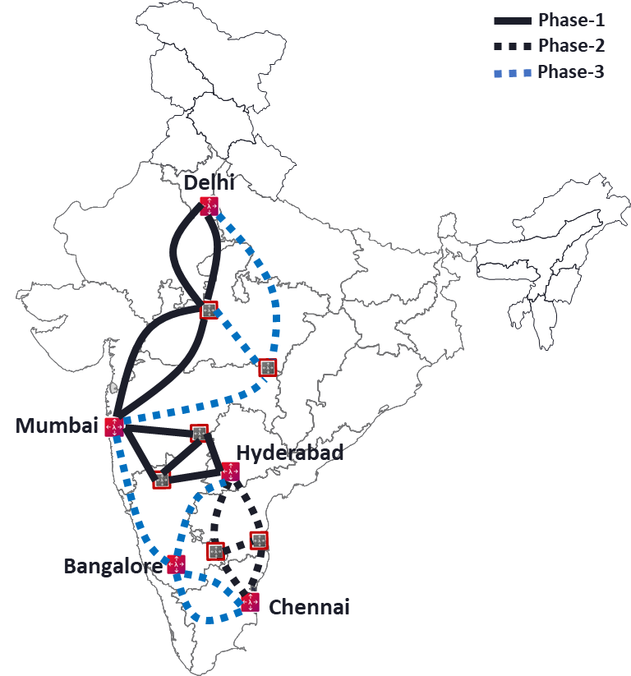
Express Long-haul backbone
Build “Express” long haul network between 5 major cities
Based on architecture optimised for high bandwidth connectivity
RLS line system with integrate C&L Band
Network capable of delivering 400GE client
on Day-1 and 800GE client on Day-2
Estimated EOL capacity
of 34Tbps
Layer 0 control plane for automated restoration

Slide 11
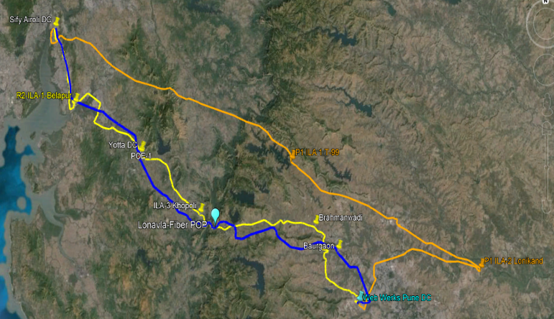
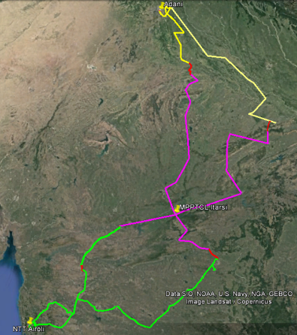
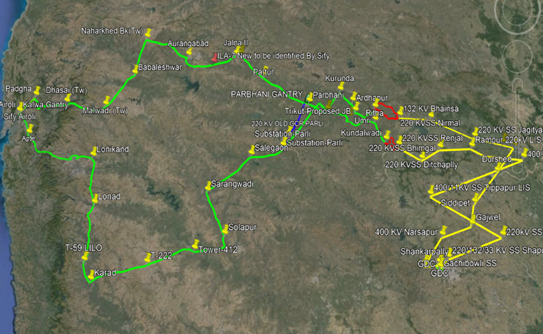
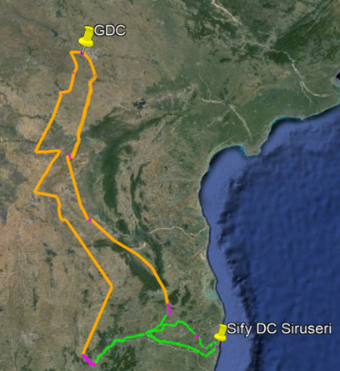
LONG HAUL NETWORK - ROADMAP
Mumbai to Pune
Mumbai to Delhi
Mumbai to Hyderabad
Hyderabad to Chennai
RFS Apr’22
54% UG + 46% OPGW
3 path L0 CD network
C band 43 channels with 500G per channel
1.4 Tbps live so far
Client protection & line protection.
Enterprise and CSP workloads
RFS – Sept 2024
13% UG + 87% OPGW
2 path L0 CDC Regen network.
C+L band 85 channels, 300G per channel
Line protection
Enterprise and CSP workloads
In Project Phase
8% UG + 92% OPGW
2 path L0 CP CDC ladder network.
C+L band 85 channels,300G per channel
Line protection
Enterprise workloads
Feasibility study
24% UG + 76% OPGW
TN – OPGW network yet to be opened up for commercial use
2 path L0 CP CDC ladder network
C+L band 85 channels with 300G per channel

Slide 12
INTERCONNECTED EDGE
Sify’s focus has been to create a highly interconnected edge across all its sites by creating an ecosystem of:
Content providers
ISP’s
Carriers
Exchanges
Sify edge sites are some of the most interconnected/content rich sites in the geographies they operate in:
Sify Noida – largest peering site in Noth India
Sify Rabale – largest network site in Navi Mumbai
Sify Chennai Tidel – carries the largest content provider
Sify runs and operates the AMS-IX exchange under a franchisee model in India and supports NIXI across multiple sites
All Sify’s edge sites have a transparent cross connect policy that provides all residents an online portal to enable cross connects

Slide 13
NETWORK as a Service Roadmap for Digital enablement
Current Status
Digitization of internal processes completed
Asset and inventory digitized
Customer Centric
Digital Experience
Build stickiness by co-creating network services with customers
Network as a Service
Self provisioned ‘network as a service’ – cloud like experience
Integrate on demand add on services – security
Consistent and reliable operations
Non-linear costs of operations as business scales
Expose digital view of the network to the customer
Service provisioning and assurance visibility to customers

Slide 14
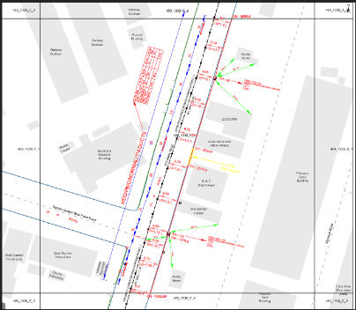
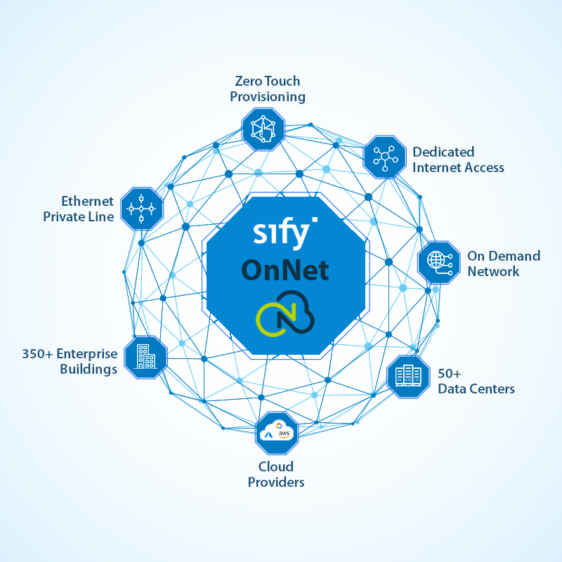
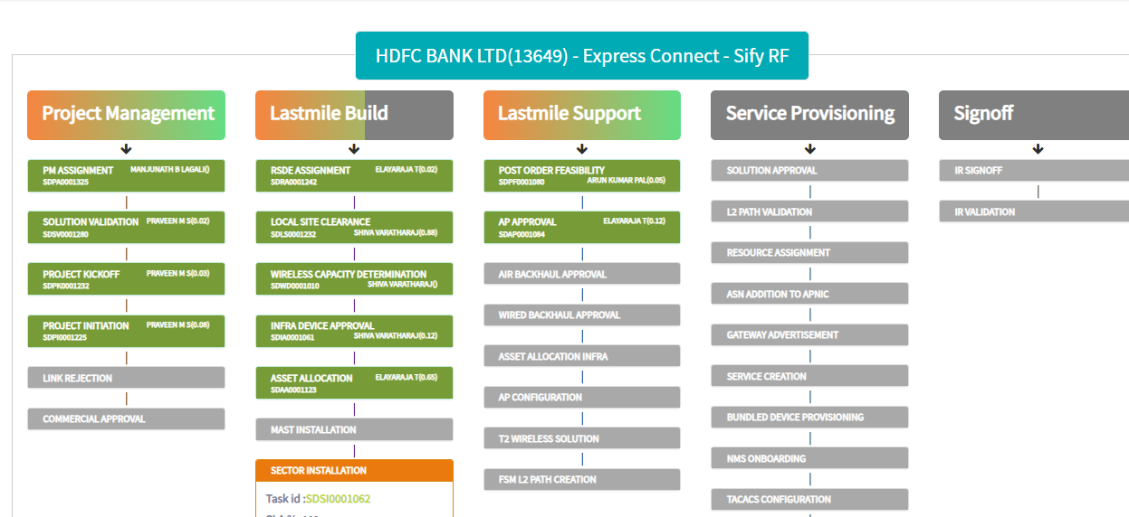
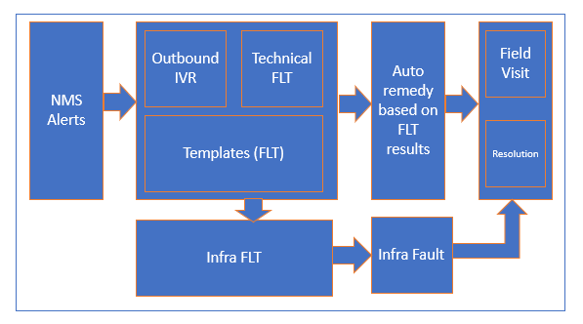
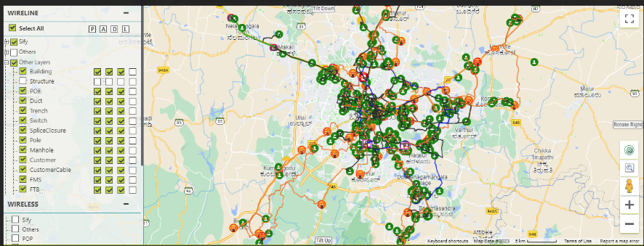
Outcome so far
FEASIBILITY
DIGITAL NETWORK
FULFILLMENT
ASSURANCE
Mid mile build
  Connectivity
    Wireless access
    Fiber access
    Estimate path
    MACD
  Digital Asset based digital twin.
  Digitization workflows for Fiber vendors with API across the ecosystem
  Faster turnaround for the customer
  Inhouse self service Digital services platform
  Connected buildings and Data Centers across India
  Simple point, click, connect
  Agile on demand services
  Cloud connects, Internet and Ethernet services
  Complete lifecycle management
  Service delivery automation across all services
  Automated provisioning and testing
  Order to asset management integration
  Digitized workflow for build
  Truck roll tracking & Vendor Billing
  Paperless Signoff
Alerts to tickets to remediation
Customer self-care
Auto remediation pipeline
L1 to L2 automation
E-Bonding for partners and vendors
Change automations
App based truck roll assignment and tracking
65 % of instant upgrades
53% for new connects within 10 mins
48% of building connects instant closure
300 buildings RFS
Service Order to delivery in 10mins
Connect order to delivery in 48hrs.
Customer visibility of end-end delivery
Mean time to deliver adherence of 95%
OLA compliance to 96%
100% system generated events
35% auto remediation closures
95% of SLA adherence

Slide 15
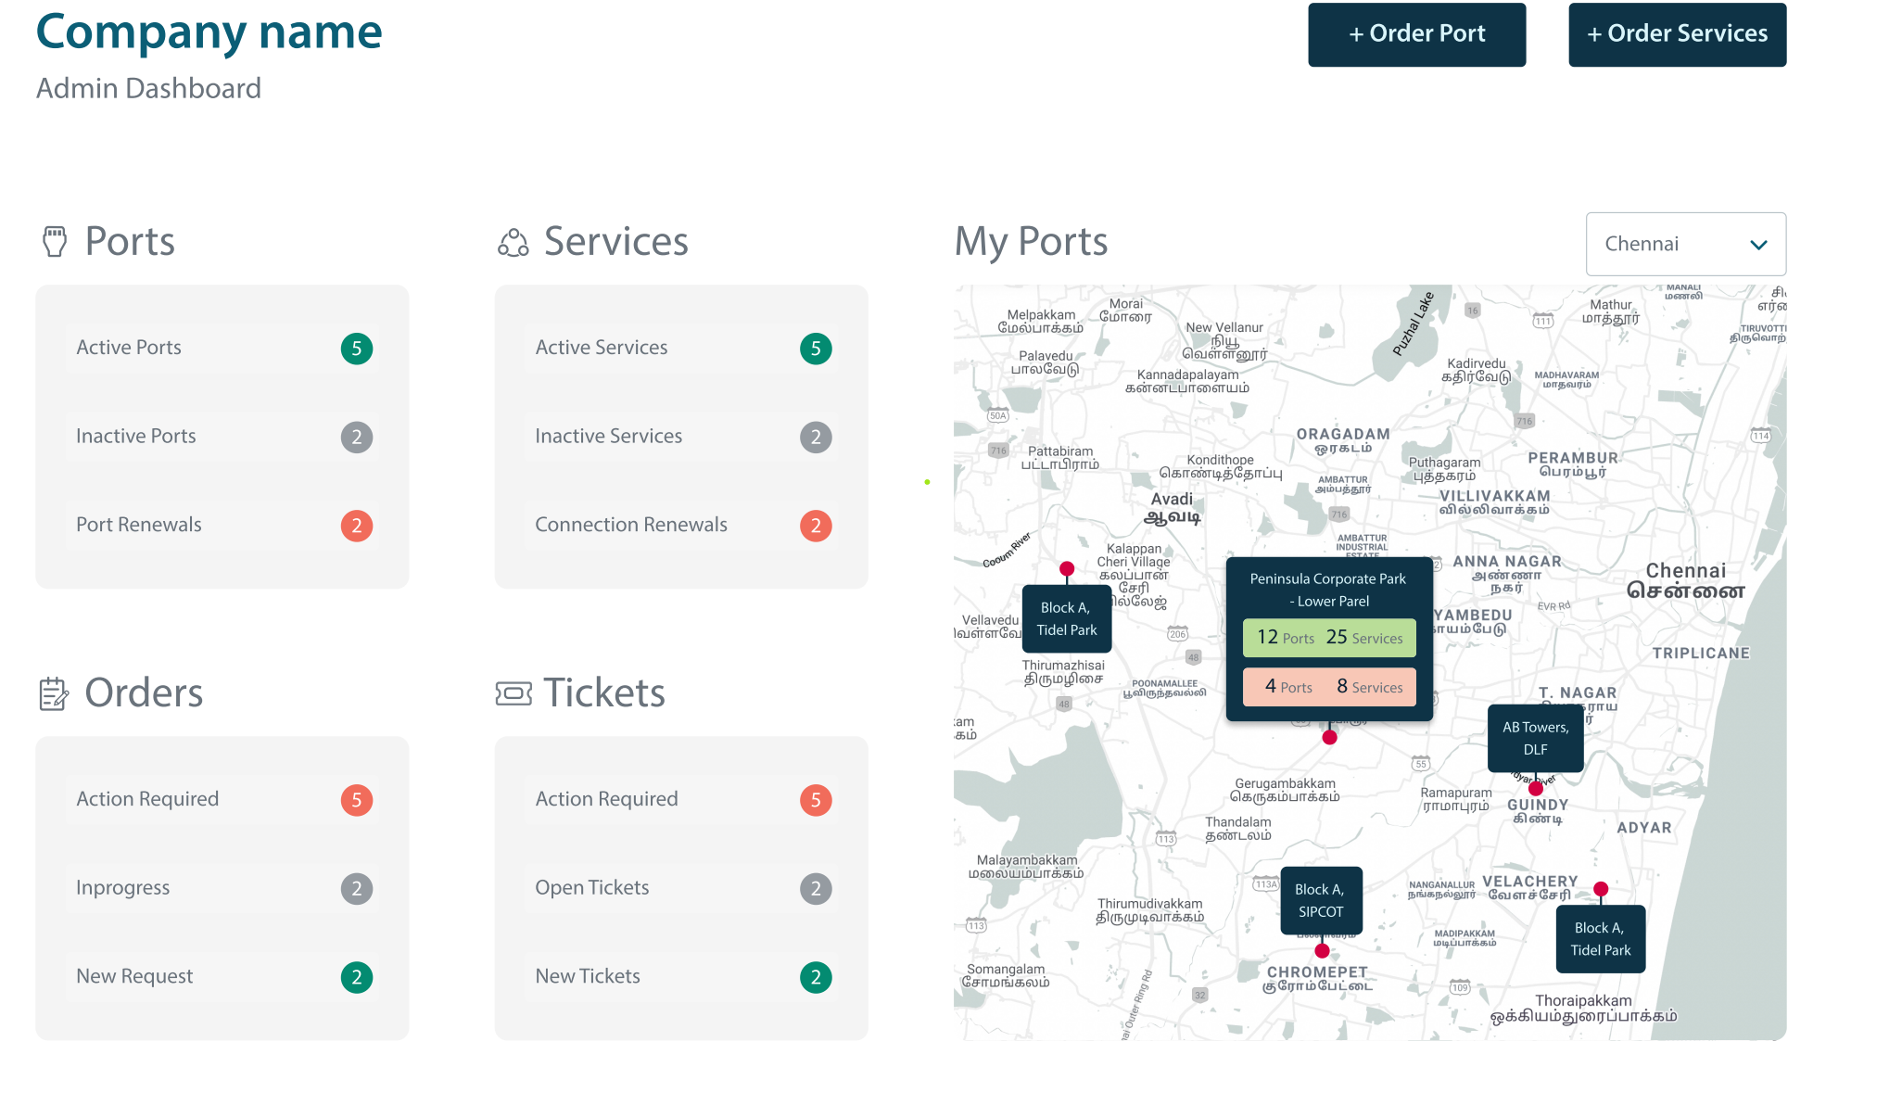
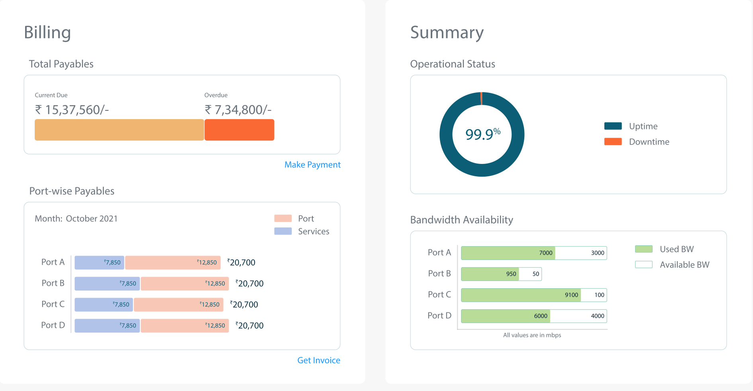
Sify Flashnet – NETWORK AS A SERVICE
Enable customers to gain control of networks
Online ordering, make a change in minutes
Near real time service delivery
Connect to clouds, enterprises and Data Centres digitally matching the cloud experience
Scale networks to meet business needs
Scale bandwidth in real time inline with digital business needs
Pay per use billing with flexible contracts
Manage the complete service lifecycle through a single portal

Slide 16



Critical NATIONAL networks managed by sify
SCALE
COMPLEXITY
RELIABILITY
Most widely distributed postal system
India’s Inter Banking Transactions
#1 Derivative Stock Exchange
The largest network in terms of scale, spanning ~28000 sites with ~56,000 links and ~28,000 routers & switches
Data Center Management for DC and DR
Sify is the Network Integrator and Service Provider for the last 9+ years
The network spanning RBI, IFTAS, CCIL and member bank Data Centers and branches, is the backbone of the Indian banking system, which enables all inter-bank transactions in India
Secure Network connectivity from Member Banks to the Applications
Multi-service provider management and scale
Aggregating member traffic to enable creation of a digital platform for its members.
Multi-cast management across 3800 members and 31 POP’s
Managing a multi service provider environment
Trusted Partner for Secure & Reliable Network Services
NDA/Sify Confidential
Notes:
DOP, IFTAS, NSE

Slide 17









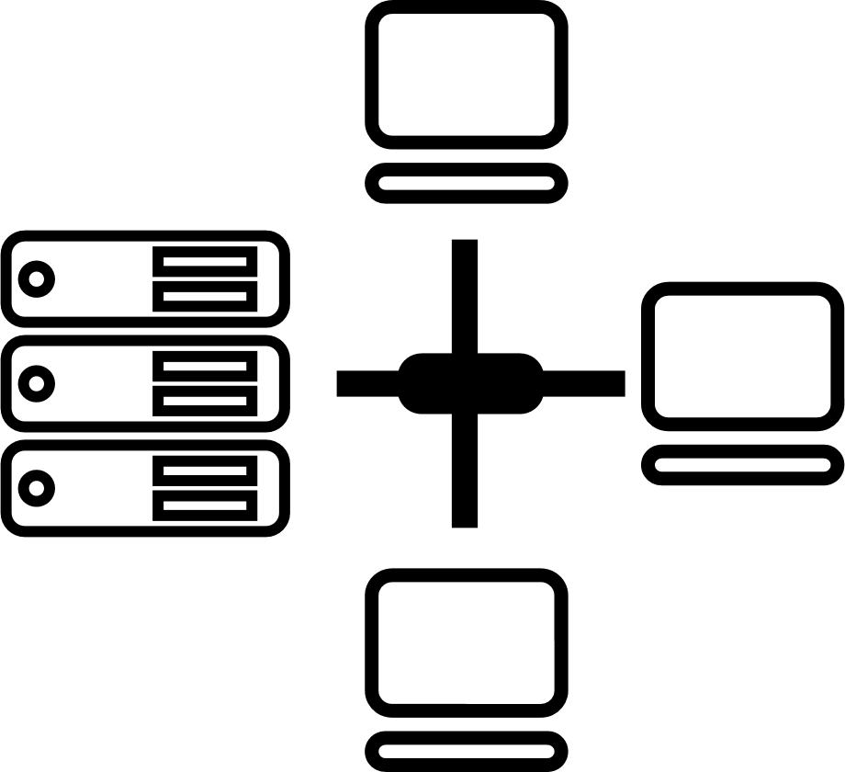






CIO Choice 2025 for
AI Ready Data Centers
Best Future-Proof Data Center Project
Award for Sustainability
Innovation in Data Center
India’s 1st Nvidia
DGX Ready Liquid &
Air Cooled DCs
Best in
Services Industry
DC Services India & ​Managed Cloud Services APAC ​
Managed Network Services - MQ
Tried Tested Trusted
Your digital infrastructure partner for over 25 years
Network
Infra Services
Network Digital
Managed Services
Data Center
Colo Services
CloudInfinit^{+AI}
GPU Cloud
Cloud & IT
Managed Services
Digital Apps
Managed Services
Industry Apps
Managed Services
Security
Managed Services
Thank You

Slide 18
Services Automation so far
Partner portal
API
Sify Aakash
Sify network orchestrator
Feasibility: wireless and fiber access with streamlined workflows and APIs for faster service delivery
Digital Network- Sify OnNet- self-service digital platform for agile, on demand services with complete lifecycle management
Fulfillment: automated provisioning, testing, and reporting with integrated order-to-asset mgt, digitized build workflows, and vendor billing tracking
Assurance: End-to-end automation from alerts to remediation, customer self-care, L1 to L2 automation, e-bonding for partners and vendors
Legacy Connectivity
Digital Connectivity
Digital services
Feasibility
Service orchestrator
Service decomp
Project mgmt.
Workorder Mgmt.
Onnet orchestrator
Service design and model
Service decomp
Lifecycle mgmt.
Enterprise orchestrator
SDWAN
NFV
Managed services
Auto remediation
Change
Policy
Escalation
Workflow
Order Mgmt.
Billing
BSS
Customer care
API
Inventory
Monitoring & remediation
Sify Wireless access
ZTP
Templates
CLI
Sify packet network
SDN controllers
Resource Mgmt.
NETCONF/CLI
Sify Optical network
T-SDN controllers
TL1/ Webhooks
Sify Enterprise infra
SDWAN
Wi-Fi
SASE
3rd party infra-SP & Cloud
APIs & ebonding
Reporting
OSS
FEASIBILITY
DIGITAL NETWORK
FULFILLMENT
ASSURANCE
65 % of instant upgrades
53% for new connects within 10 mins
48% of building connects instant closure
300 buildings RFS
Service Order to delivery in 10mins
Connect order to delivery in 48hrs.
Customer visibility of end-to-end delivery
Mean time to deliver adherence of 95%
OLA compliance to 96%
100% system generated events
35% auto remediation closures
95% of SLA adherence

Slide 19
Sify onnet
Self service ordering Portal & API
Enable customers to gain control of networks
Online ordering, make a change in minutes.
Near real time service delivery.
Connect to clouds, Enterprises and Datacentres digitally matching the cloud experience.
Scale networks to meet business needs
Scale bandwidth in real time inline with digital business needs.
Pay per use billing with flexible contracts.
Manage the complete service Lifecyle through a single portal.
Sify Onnet
On demand platform
Ethernet
Cloud connectivity
Internet Access
Datacenter Interconnect
CSPs
DCs
On-net & Near-net Bldgs.
4 Clouds
66 + DCs
300+ Bldgs.

