Slide 1
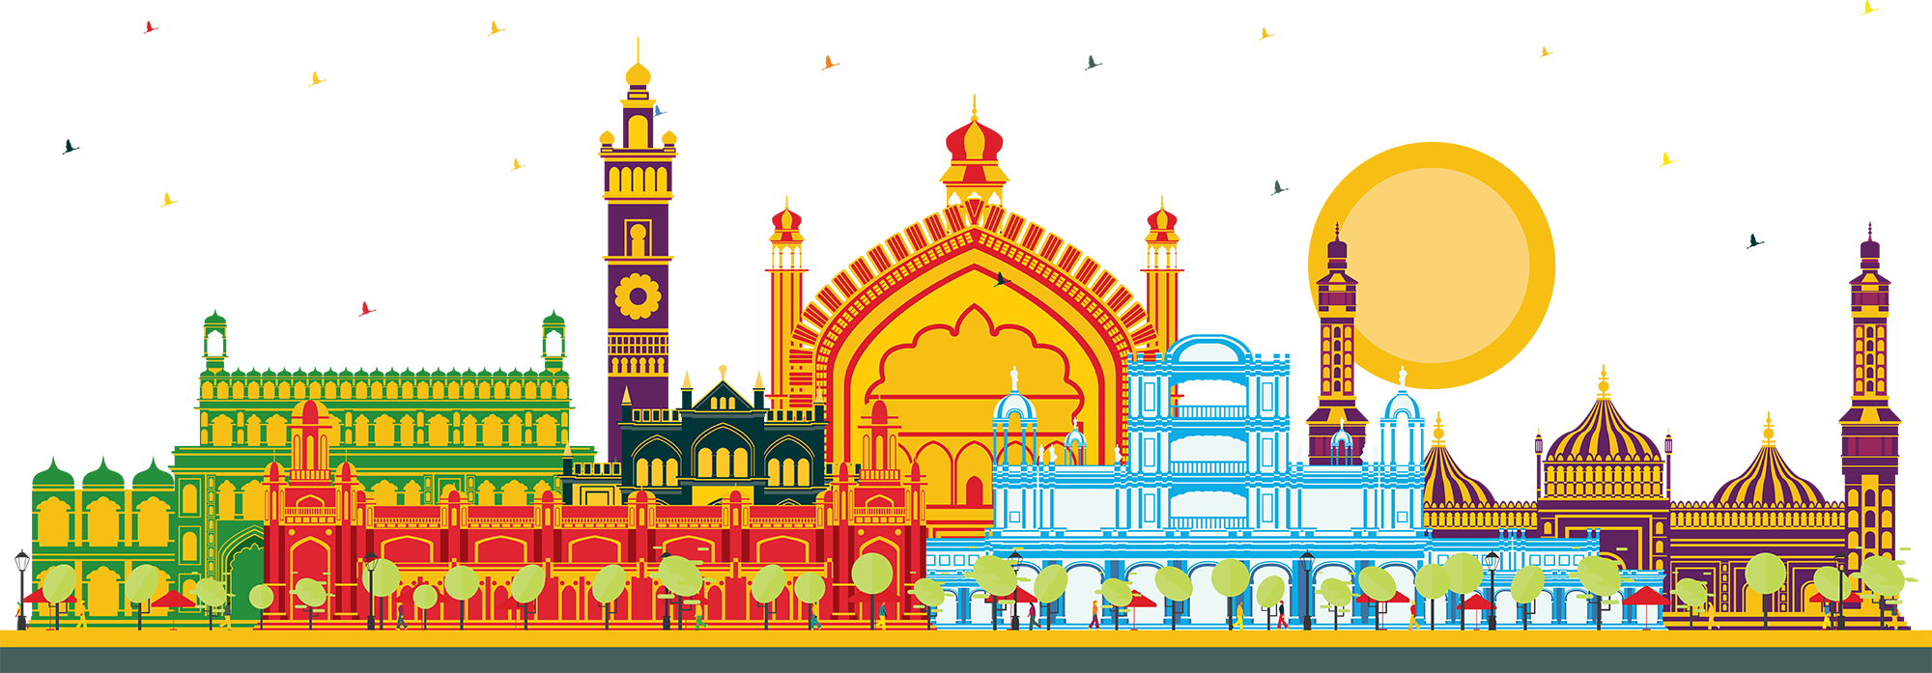
EMPOWERING
INDIA’S AI AMBITION
Raju Vegesna
Chairman, Sify Technologies Ltd.
Your digital bridge for transformation, built on world class digital infrastructure, platforms and services

Slide 2
UP has emerged as a technology hub
Lucknow is a bright spot for IT sector growth with a focus on AI
Why Uttar Pradesh?
Why Lucknow?
$301B
Economy size
$765M
Govt. IT CapEx
6th
in IT exports (2nd for electronics)
800
Tech & BPM Start-ups (200 in Tech)
75K
Tech talent
2nd
In Ease of Doing business across Tier-2/3 cities (India)
10x
Planned growth in IT sector by 2030
Top Five Tech Clusters*
Lucknow (AI, ML hub), Noida (IT, ITeS hub), Kanpur (Drone, Robotics), Varanasi + Prayagraj (R&D)
$54M IT Spend
(IT Outsourcing $10M, Managed Services $4M)
$14M
Cloud Spending
AI-Hub
In UP
*Highest govt investment
Biggest AI hub in UP
40 Acres land acquired for building AI City in 2024
Major investment into compute infrastructure – GPU, Hyperscalers, Data platforms
Second highest GSDP contributor in UP (after GB Nagar)
MeiTY has set up CoE for med-electronics and health-informatics to stimulate tech start-up growth (50 start-ups by 2030)
Hub for niche IT players (HCL and Siemens)
Lucknow
CoEs for AI and MedTech
AI COE at IIIT supports 15+ AI/ML startups
Source: TechCircle Analysis

Slide 3







The Digital future
SCALABILITY
PRODUCTIVITY
SECURITY
ICT ecosystem
AI/ML
Predictive analytics
Hybrid IT
Hybrid Work
Enterprises are converging to secure, scalable end-to-end data center, network and digital
Notes:
Need for a Scalable and Hardened Technological Infrastructure is required for a future ready digital bank:
Operational Efficiency:
• Decrease average transaction process time by 25% through automation
• Implement process automation for 5 key operational workflows
• Decrease operational costs by 15% with no loss of service quality
Enhanced Customer Experience
• Increase mobile app ratings to 4.7 stars with 80% +ve reviews
• Achieve a 30% reduction in customer support tickets
• Increase digital banking transaction volumes by 25% YoY
Security & Compliance
•Implement consistent data encryption standards across on-premises, private cloud and public cloud environments.
• Achieve compliance certifications for all regulated workloads
• Achieve maximum coverage of multifactor authentication and stringent access controls
AI/ML and predictive analytics is used by Banks for fraud detection and prevention, personalized banking services, process automation, and predictive analytics.
Blockchain: Banks use blockchain for various applications, including cross-border payments, trade finance, identity verification, and compliance with regulatory standards.
Hybrid IT: deploying hybrid environments as per business priorities
Network Backbone: rearchitect the network architecture for digital transformation
Key results like these typically require multiple technology initiatives depending on the bank's digital transformation state. The specific results highlighted above require a highly available and performant core banking system, API gateway, embedded AI/ML insight and foresight engine, and versatile data Lakehouse to power a consumer-grade, modern user experience.

Slide 4
Innovating TO STAY Relevant
1995-2005
Internet Revolution
2006-2011
Data Explosion
2012-2020
Cloud Innovation
2021 onwards
Digital Acceleration
Age
of
AI
Sify 1.0
Sify 2.0
Sify 3.0
Sify 4.0
RETAIL INTERNET SERVICE PROVIDER
ENTERPRISE SERVICES COMPANY
DIGITAL ICT SERVICES PROVIDER
DIGITAL TRANSFORMATION PARTNER (digital@core)
First private
ISP in India
Launch of MPLS &
Data Center services in India
Launch of Enterprise Cloud platform & Hybrid Cloud services
Launch of end-to-end
Digital services
From revolutionizing consumer internet in the 90s to becoming a Digital Transformation Partner for Enterprises

Slide 5
OUR Investment PHILOSOPHY
Digital
Services
  Skilled workforce to support modern technologies
  Services across the digital spectrum
  Embedded AI
  Secure by design
3000+ SMEs across platform automation, modern apps, AI/ML, DC, Cloud, Networks, Security
Infinit AI/ML, Infinit FSO, SaaS & Industry solutions
  Modern cloud platform – x86 & GPU support
  Ample data stores for data explosion
  Cybersecurity Operations Centers
  Cloud Management Platform for efficient operations
CloudInfinit^{+AI} , GPU as a Service
Hybrid Cloud Infrastructure
Infinit CMP, Cloud Anywhere Edge Cloud
Infinit MNS platform, NOC
Global SOC, MSS, Infinit Security
Cloud,
AI & Security
  AI ready data centers
  Core and Edge data centers for edge use cases
  Certified and compliant
  Focus on sustainability
14 DCs, 227+ MW IT power
407+ MW by 2025
Scalable to 970+ MW
231+ MW RE Power
10 Edge DCs. AIOps, AI Ready, Liquid cooling
Data
Centers
Network
Infra
  Reliable national network backbone
  On-demand capacities
  Deep Distribution Capillarity
  Open Cable Landing Stations for subsea cables
1700+ Cities, 3700+ PoPs
120K Km Fiber coverage 24+ Metros
3 CLS, 8 International POPs
Sify OnNet- automated Ent WAN
Notes:
1400+ Digital Networks
350+ Cloud
450+ Modern Apps & AI/ML,
100+ Cybersecurity,
100+ Platform automation,
500+ Technology Integration

Slide 6
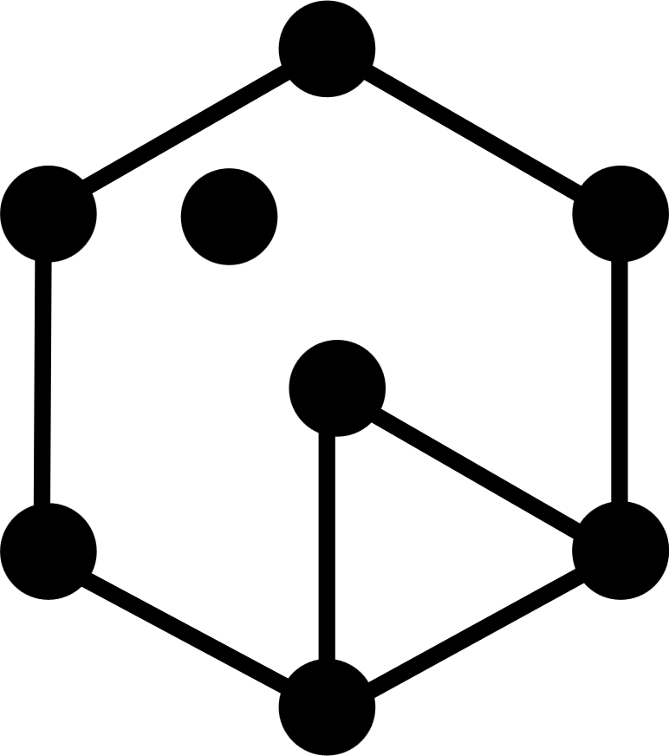
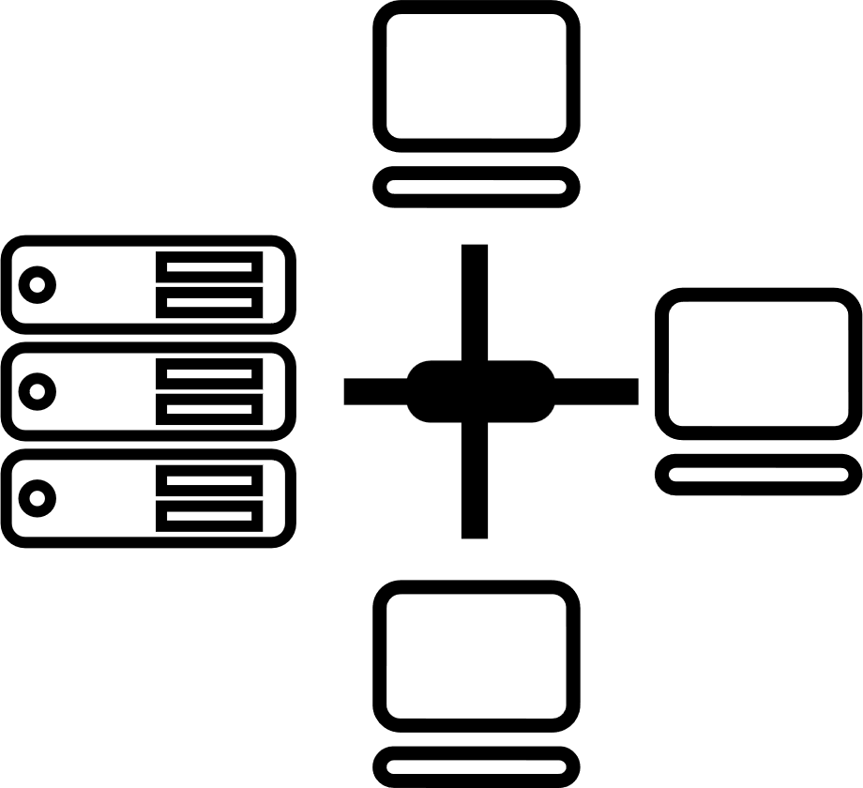

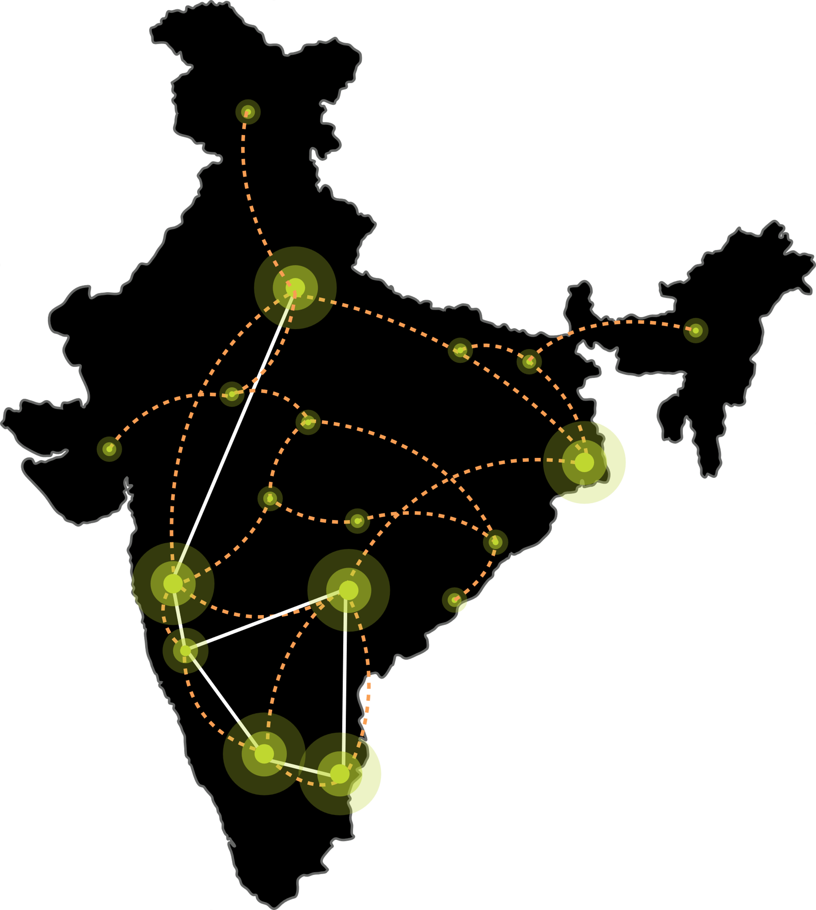






OuR digital INFRASTRUCTURE & PLATFORMS
India’s Top 10 banks, Top 4 Manufacturing, 3 Major Hyperscalers, Global Social Media, OTT, Security Players, and 10,000+ Enterprises trust Sify
Metro Networks
Fiber access
Connected Buildings
Interconnected DCs
Express Long-Haul Backbone, High Bandwidth and Low Latency across Key Locations
Network
Infra Services
Network Digital
Managed Services
NOIDA 02
NOIDA 01
SAARC Gateway, Kolkata
Data Center
Colo Services
CloudInfinit^{+AI}
GPU Cloud
MUMBAI 03 RABALE
KOLKATA 01
MUMBAI 02 AIROLI
MUMBAI 01 VASHI
CLS, Versova, Mumbai
HYDERABAD 02
HYDERABAD 01
Cloud & IT
Managed Services
Security
Managed Services
CHENNAI 02
BENGALURU O2
CHENNAI 01
BENGALURU 01
CLS, Siruseri, Chennai
Digital Apps
Managed Services
Industry Apps
Managed Services

Slide 7
AI DEMAND FORECAST - INDIA
Massively increasing AI market ($ Bn)
Leading to Higher growth in India Hyperscale AI Demand (MW)
Global
India
CAGR: 31%
CAGR: 26%
5 yr CAGR – 70%
Along with high use of power for AI computation (KW/rack)
Sify – One of the few players in India with AI-ready DCs
India’s first NVIDIA certified DGX-ready Data center Service Provider for liquid cooling to support AI servers
Host AI and power dense workloads, up to 130 KW power/rack
A ChatGPT query needs ~10x as much power to process as a Google search. And thus, operators need to bring some infrastructural changes to manage the high-power demand
Source: Kotak Research

Slide 8

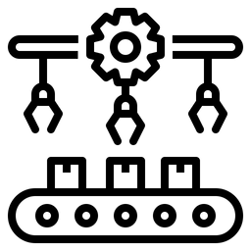

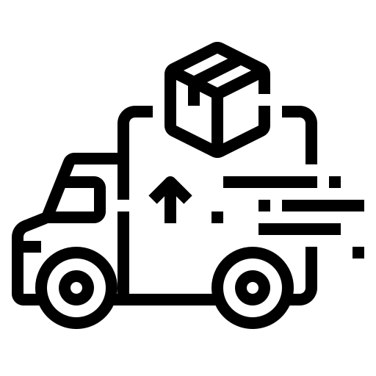




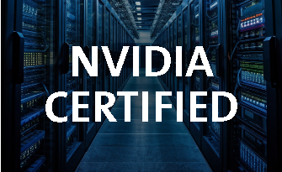
Sify's AI ​
Ecosystem ​
Architecture​
BFSI
Manufacturing
Retail
Logistics
Healthcare
Education
Media
IT/ITeS
DNB
Govt./PSU
Flexible
Scalability
Increase
Productivity
Predictive
Analytics
Mitigate
Risks
Sify Al Platform
Al Enterprise Suite
Gen Al Studios, AlOps-Digital Twins
Innovation
Data Science Tools, Frameworks,
Dashboard, Governance
Tools: Pre-trained Models, Jupyter -Tensorflow, Python, Inference server...
Sify
Al Learning
Sify CloudInfinit^{+AI}
Hybrid IT
Sify CMP
Sify GPU as a Service
Orchestration | Provisioning | GPU Workload Containers
Companion
Labs,
Training
Modules
Sify GPU
NVIDIA
Sify
Compute
Sify
Networking
Sify
Storage
DGX POD
X86 GPU
Sify AI Data Centers
Scalable, Secure, Green
DGX-ready Certified DC
Cloud Adjacent DC
Infrastructure
Sify AI Network Infra​
600 Gbps Bandwidth
Ent & CSP Workloads
Hyper Reach, Hyperconnect, Edge Connect, Private 5G,
On-demand Bandwidth

Slide 9

Our DATA CENTERS: INDIA FOOTPRINT (SIX Markets)
NOIDA 02 CAMPUS
Tower B
43+ MW
Tower 1
11.5 MW
Tower 2
9.6 MW
Tower 3
BTS
NOIDA 01
Noida
10.8MW
Tower A
43+ MW
Tower C
43+ MW
1st Tier III
in 2000
Tower 4
8.1 MW
Tower 5
43+ MW
Tower 6
40+ MW
Q2 2025
MUMBAI 01
Vashi
0.9 MW
Tower 7
40+ MW
Q3 2025
Tower 8
40+ MW
Tower 9
40+ MW
Tower 10
40+ MW
KOLKATA 01
2.2 MW
Tower 11
40+ MW
Q3 2025
Tower 12
40+ MW
Q4 2025
MUMBAI 02
Airoli
5.4 MW
HYDERABAD 02 CAMPUS
(FAB CITY)
MUMBAI 03 CAMPUS (RABALE)
HYDERABAD 01
Financial Dist.
14.4 MW
Block 1
26 MW
Additional Blocks
26-52 MW each
(including BTS)
BANGALORE 02 CAMPUS (AEROSPACE PARK)
BANGALORE 01
Electronic City
7.6 MW
Tower 1
20+ MW
Q2 2025
Tower 2
20+ MW
CHENNAI 02 CAMPUS (SIRUSERI)
CHENNAI 01
Tidel Park
3.6 MW
Tower A
43+ MW
Tower B
43+ MW
Tower C
43+ MW
Operational
In Development
Planning
All Power references are Design IT Power at Full Capacity
All Power references are Design IT Power at maximum Capacity

Slide 10


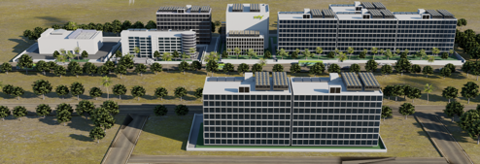
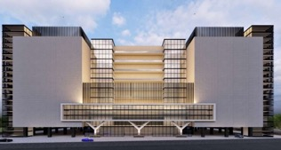
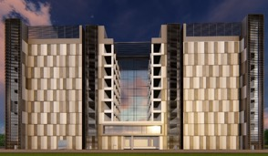
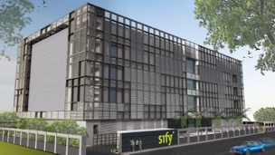
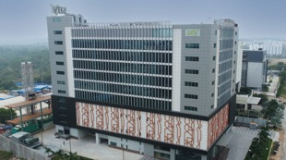
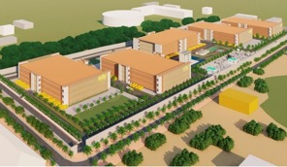
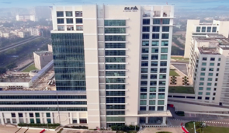
AI-READY, hyperscale, Hyperconnected, Green,
Data Center campuses
India’s 1st Nvidia DGX Ready Air-Cooled DCs
March 2022
India’s 1st Nvidia DGX Ready Liquid Cooled DCs
August 2024
Mumbai 03, Rabale
IT Power: 377+ MW
Noida 02
IT Power: 130+ MW
Chennai 02, Siruseri
IT Power: 130+ MW
5 Towers Operational
4 Towers In Development
3 Towers in Planning
1 Tower Operational
2 Towers in Planning
1 Tower Operational
2 Towers in Planning
Bengaluru 02
IT Power: 40+ MW
Hyderabad 01, Financial Dist.
IT Power: 14.4+ MW
Hyderabad 02, Fab City
IT Power: 250+ MW
Kolkata 01, DLF IT Park New Town
IT Power: 2.2+ MW
In Development
Operational
Planning
Operational
14 DCs - 227+ MW IT power | 407+ MW by 2025 | Campuses scalable to 970+ MW with BTS capabilities

Slide 11
At the Uttar Pradesh Investors Summit held in 2022,
Sify announced one of India's largest investments in the
Data Center space,
INR 2692 crores to be invested in Noida
Notes:
At the Uttar Pradesh Investors Summit held in 2022, Sify announced one of the largest investments in the Data Center space in India, INR 2692 crores to be invested in Noida to begin with.

Slide 12
Sify Noida 02 AI-Ready Data Center Campus will generate highly skilled opportunities in new technology areas like AI/ML & Big Data

Slide 13
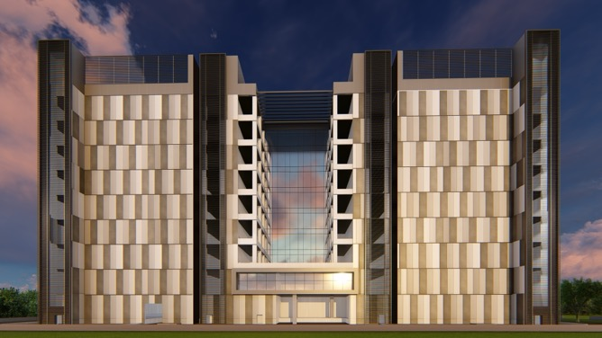
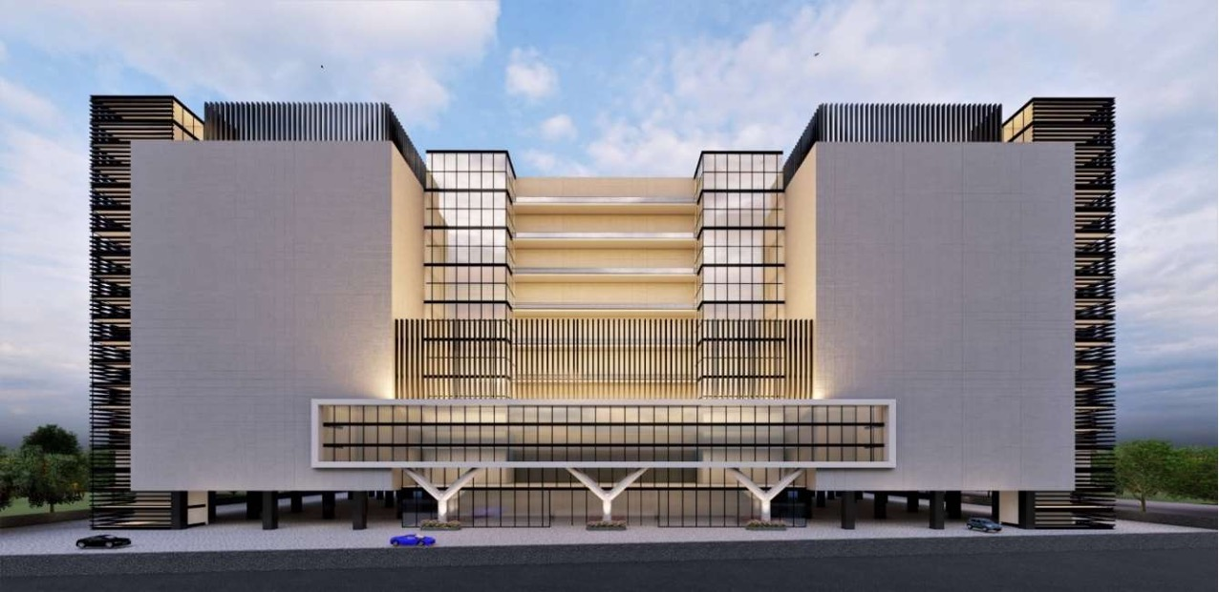
Overview: Noida 02 Data Center Campus
OUR LARGEST AI-READY HYPERSCALE DATA CENTER CAMPUS IN NORTH INDIA
130+ MW IT capacity in 3 Data Center Towers
A
B
C
IGBC Gold Certified.
ESG best practices, 30% RE power
Hyperscale &
AI-Ready Infrastructure
Dedicated
on-site 220 kV
GIS substation (N+1)
Vertical & Horizontal expansion
Scalable, resilient, hyperconnected, secure and green
K8-rated
perimeter wall with 10 Level secure access control
Option of 2
Built To Suit Towers for 86+ MW
4 Hardened Fiber Routes connecting NOIDA 01 DC, enabling low latency access to Hyperscalers,
OTT, Content & Security providers

Slide 14
Sify has expanded the investment portfolio with
Edge Data Centers
Notes:
At the Uttar Pradesh Investors Summit held in 2022, Sify announced one of the largest investments in the Data Center space in India, INR 2692 crores to be invested in Noida to begin with.

Slide 15

Our edge data Center footprint
CHANDIGARH 01
NOIDA 02
NOIDA 01
LUCKNOW 01
JAIPUR 01
PATNA 01
AHMEDABAD 01
GUWAHATI 01
INDORE 01
SAARC Gateway, Kolkata
MUMBAI 03 RABALE
KOLKATA 01
MUMBAI 02 AIROLI
BHUBANESHWAR 01
MUMBAI 01 VASHI
NAGPUR 01
CLS, Versova, Mumbai
HYDERABAD 02
HYDERABAD 01
COCHIN 01
CHENNAI 02
BENGALURU 02
CHENNAI 01
BENGALURU 01
CLS, Siruseri, Chennai
Notes:
Low latency, easy access and faster content delivery at Tier 2 locations, ensuring seamless data processing and superior customer experience.

Slide 16
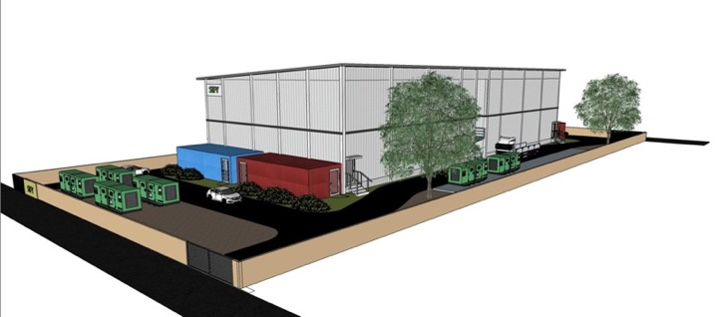
Overview: Lucknow 01 Edge Data Center
ELEVATE YOUR EDGE EXPERIENCE
14+ MW IT capacity in 2 Data Center Towers
IGBC certified
ESG best practices
Hyperscale &
AI-Ready Infrastructure
Dedicated
Dual feeder power supply
Standalone purpose-built prefab shell
10 level perimeter and internal security layers
Fast, Agile, Local, Efficient, and Secure
Customised designs with vertical and horizontal expansion
4 dedicated fiber entry paths with multiple telcos
  Interconnect for various Content Creators, TELCO IP Transit nodes, IXs and ISPs

Slide 17
The Future is Here. Let’s lead It Together…
INTERNET UNLOCKED A GENERATION
AI POWERS THE FUTURE
Two decades ago, the internet revolutionized the world, creating new opportunities, industries, and global connectivity
Now, AI is set to unleash an even bigger wave of transformation, enabling new generations to innovate, serve global needs, and redefine possibilities
EMPOWERING THE AI JOURNEY
Sify is investing in AI-ready infrastructure to support this revolution, nurturing talent and powering the future of India's digital economy

Slide 18








Award for Sustainability
Innovation in Data Center
India’s 1st Nvidia
DGX Ready Liquid &
Air Cooled DCs
DC Services India &
Managed Cloud Services APAC
Managed Network Services Global- MQ
Tried Tested Trusted
Your digital infrastructure partner for over 25 years
Network
Infra Services
Network Digital
Managed Services
Data Center
Colo Services
CloudInfinit^{+AI}
GPU Cloud
Cloud & IT
Managed Services
Digital Apps
Managed Services
Industry Apps
Managed Services
Security
Managed Services
Thank You

