Slide 1



AI-READY DATA CENTERS:
FUTURE PROOFING INDIA’S DIGITAL AMBITIONS
Girish Dhavale
CTO – Data Center Services
Mumbai | 13 December 2024
India’s Data Center Pioneer

Slide 2
Agenda
INDIA
DATA CENTER HUB
SIFY
DATA CENTER ADVANTAGE
01
04
DATA CENTER AI READINESS
ESG
02
03

Slide 3
India: A Data Center Hub
India’s Colo Data Center capacity stood at 977 MW IT Load as of H2 2023
India will be adding 464 MW of new Colo capacity each year until 2028
KEY DRIVERS
Digital Economy Expansion
Increased Data Consumption
Cloud & Emerging Tech: AI, 5G, Edge Solutions
Growth Segments: GDC/GCCs
30+ Cities- Tier 2 and 3
Government policy & Regulatory Frameworks
Source: Research Firms

Slide 4




Key Challenges shaping data center strategies
AVAILABILITY OF POWER
MODERN COOLING TECHNOLOGIES
“By 2028, more than 70% of enterprises will alter their data center strategies, due to limited energy supplies, a major increase from less than 5% in 2023”
“By 2027, AI workloads will consume nearly 50% of data center compute power, making liquid cooling essential to support the increasing demands of AI-driven infrastructure”
SUSTAINABILITY
SCALABILITY
“By 2027, 75% of organizations will have a data center sustainability program, up from less than 5% in 2022, driven by cost optimization and stakeholder pressures”
“By 2026, 75% of organizations will prioritize scalable IT strategies to support growth initiatives like entering new markets and launching products”
Source: Gartner forecasts

Slide 5
Future ready data center architecture
CUSTOMIZABLE & MODULAR INFRA
ENGINEERED FOR AI WORKLOADS
MULTI LAYERED NETWORKS
Multi tower campuses with Vertical and Horizontal expansion to support future business growth
Designed for 200 kW/rack high density racks. 6.3m floor to floor height, 2100 kg/m² load bearing capacity
Multi-tier fiber and copper for low-latency deployments, supporting high-capacity network bandwidth of 600 Gbps
RELIABLE
POWER SUPPLY
SUSTAINABLE
OPERATIONS
On premise 110, 220, 230 kV substation with 48 hours of fuel storage with redundant supply contracts
Liquid & Air-cooling solutions, 60% renewable energy, ESG best practices and automation led continuous monitoring
Ensure business continuity, maximize uptime, resilient connectivity and sustainability
with RAS designed scalable digital infrastructure

Slide 6





Data Center AI-Readiness
Power
Scalable and robust power infrastructure
Tolerant to dynamic load variations
Redundant distribution systems
Support multiple water temperature scenarios
Support different cooling methodologies
Cooling
High-capacity fiber and copper network
Multiple paths, dual meet-me-rooms, and distribution
Network
Purpose-built data center buildings
Structural design to meet local codes and seismic rating
Server Hall
Designed and built to accelerate your AI Adoption

Slide 7








OPERATION CONTROLS
TRADITIONAL
IT ENVIRONMENT
THE PAST
THE FUTURE
DIGITAL
IT ENVIRONMENT
Centralized /
on-premise
Slow to adapt
Large, sparse, and horizontal
Manual operations
Interconnected
Tier level design
Subpar security
Unregulated
Distributed /
Hybrid IT
Simple, Scalable, Agile and Flexible
Automated and SLA based operations
Connecting multi sites
Heightened Security
BCP- Disaster Recovery
Compliance ready
Green and Sustainable
Cloud
On-Premises
Edge
On-Premises
On-Premises
Primary Site
Secondary Site/DR
Hosting
Colocation

Slide 8
DIGITALIZATION OF DATA CENTERS: AI/ML ROAD MAP
COGNITIVE
Improved Service level
Reduce lead time
PREDICTIVE
Value
3
Improved Service level
Reduce lead time
CONNECTED
“New services and business models”
Improved visibility
Enhance productivity
2
“Self optimizing response”
Offer as value added service with core products
Phase
“Predict what will happen”
1
Digital feedback, auto-Ticket generation & resolution
“Understand causes and impacts”
“See what is happening”
ML data models
“Define data and sources”
“Get plugged in”
Time series/ Historical data and data object model
Telemetry dashboards for CXO, Ops & Process
BMS, ERP, Serviceability data
Edge Gateways & Cloud data model
Time

Slide 9



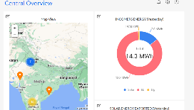


AUTOMATION: data centers
Real time visibility:
into operations, assets, people and process. Better resource utilization across rack space, power, RE, cooling, security and cross connects
Measurability:
in operations basis predefined conditions or SOPs. Resource capacity utilization and trend analysis. KPI based service contract renewals. Usage based Infra resource planning
Predictability:
in failure and downtime. Preventive maintenance of assets, AMC contract realization. Demand forecasting and capacity planning
Enhanced Efficiency:
in capacity utilization, PUE, WUE, DG power fuel, UPS power, DC carbon footprint, service and support efficiency
Site Equipment
Hardware Connectivity
Operation Command Center
POWER
Multiple Energy meters
3rd party Integration - ERPs & tools
Chiller Plant
Busway Sensors
OPC
DG
IOT Cloud with AI/ML Algorithms
API
Multiple PACs/ CRAH/ AHU
UPS
Ops Equipment
Safety & Security Equipment
Smart IO interface
OPC
Internet
Temperature & Humidity Sensor
Wireless/ Wired
Ethernet
IOT Gateway
UPS-1
L2 switch
Dashboard
OPC
Centralized dashboards, tickets and reports accessed via Laptop, Tablet, Mobile etc.
TX
Transformers (LT & HT)
CMMS (Manual Ops Data)
API’s
Solution Components
Increased Savings
on PUE
Improved
equipment uptime
Increased Person hour
savings monthly
Reduction in operating costs
Notes:
Remove numbers, generic

Slide 10


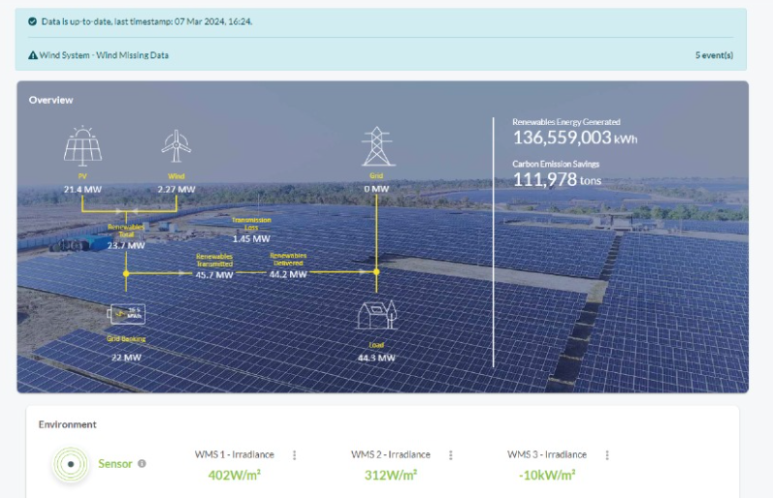


ESG FOcus
Data Center MEP
Sustainable Processes
High efficiency for Equipment even at low utilization levels
Selection of equipment with high energy saving parameters
Right redundancy levels
ASHRAE Guidelines. IGBC
ISO 14001 Environmental Certification
Carbon abetment policy
Low PUE, WUE
Green Power Contracts
Future Roadmap
Contracted 231 MW Green power via Power Purchase Agreements
Additional nation-wide Green power for future projects. ~500MW planned to meet long-term sustainability goals
Up to 79% Green Power in Mumbai, 60% Chennai, 30% Noida
To become RE100 (Carbon Neutral) by 2030. 29% GHG emission reduction by FY2025
Exploring options to secure up to highest RE penetration for Sify DCs, as permitted by regulation
  Targeting high level of Renewable Energy penetration by year 2025
Driving sustainability from BASE BUILD - POD - PROCESS

Slide 11

Our DATA CENTERS: INDIA FOOTPRINT (SIX Markets)
CHANDIGARH 01
14 MW
NOIDA 01
Noida
10.8MW
NOIDA 02 CAMPUS
Tower B
43+ MW
Tower 1
11.5 MW
Tower 2
9.6 MW
Tower 3
BTS
LUCKNOW 01
14 MW
Tower A
43+ MW
Tower C
43+ MW
1st Tier 3
in 2000
Tower 4
8.1 MW
Tower 5
43+ MW
Tower 6
40+ MW
Q2 2025
MUMBAI 01
Vashi
0.9 MW
Tower 7
40+ MW
Q3 2025
Tower 8
40+ MW
Tower 9
40+ MW
Tower 10
40+ MW
KOLKATA 01
2.2 MW
Tower 11
40+ MW
Q3 2025
Tower 12
40+ MW
Q4 2025
MUMBAI 02
Airoli
5.4 MW
HYDERABAD 02 CAMPUS
(FAB CITY)
MUMBAI 03 CAMPUS (RABALE)
HYDERABAD 01
Financial Dist.
14.4 MW
Block 1
26 MW
Additional Blocks
26-52 MW each
(including BTS)
BANGALORE 02 CAMPUS (AEROSPACE PARK)
BANGALORE 01
Electronic City
7.6 MW
Tower 1
20+ MW
Q2 2025
Tower 2
20+ MW
CHENNAI 02 CAMPUS (SIRUSERI)
CHENNAI 01
Tidel Park
3.6 MW
Tower A
43+ MW
Tower B
43+ MW
Tower C
43+ MW
Operational
In Development
Planning
All Power references are Design IT Power at maximum Capacity
All Power references are Design IT Power at Full Capacity

Slide 12


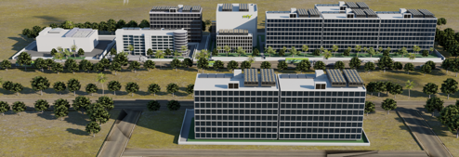
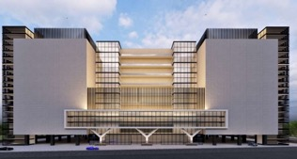
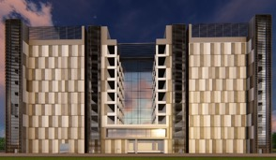
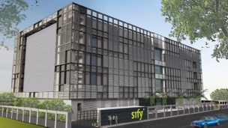
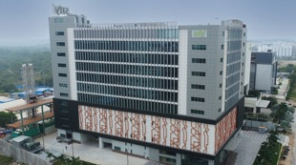
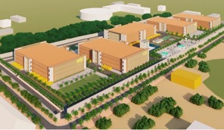
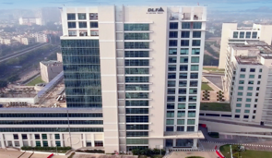
AI-READY, hyperscale, Hyperconnected,
Green, Data Center campuses
India’s 1st Nvidia DGX Ready Air-Cooled DCs
March 2022
India’s 1st Nvidia DGX Ready Liquid Cooled DCs
August 2024
Mumbai 03, Rabale
IT Power: 377+ MW
Noida 02
IT Power: 130+ MW
Chennai 02, Siruseri
IT Power: 130+ MW
5 Towers Operational
4 Towers In Development
3 Towers in Planning
1 Tower Operational
2 Towers in Planning
1 Tower Operational
2 Towers in Planning
Bengaluru 02
IT Power: 40+ MW
Hyderabad 01, Financial Dist.
IT Power: 14.4+ MW
Hyderabad 02, Fab City
IT Power: 250+ MW
Kolkata 01, DLF IT Park New Town
IT Power: 2.2+ MW
In Development
Operational
Planning
Operational
14 DCs - 227+ MW IT power | 407+ MW by 2025 | Campuses scalable to 970+ MW with BTS

Slide 13
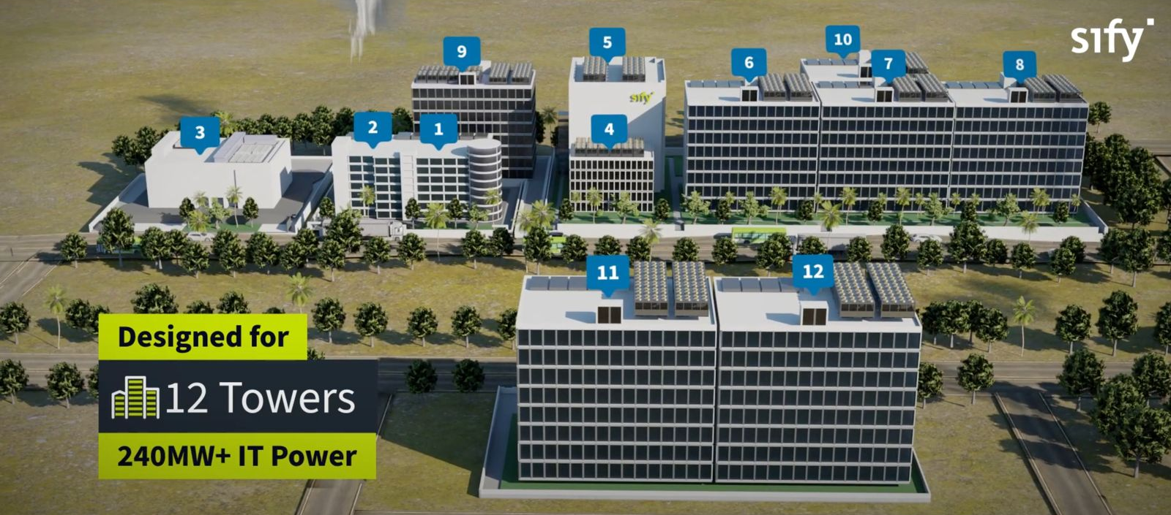
Overview: MUMBAI 03 MEGA CAMPUS, RABALE
OUR LARGEST AI-READY HYPERSCALE DATA CENTER CAMPUS
Hyperscale &
AI-Ready Infrastructure
99 MW RE
ESG best practices, Up to 79% RE power
Tower 5 Live
43+ MW IT capacity
Dedicated
on-site 110, 220 kV
GIS substation (N+1)
Designed for
12 towers
377+ MW IT Power
Option of 7
Built To Suit Towers for 280+ MW
K8-rated
perimeter wall with 10 level secure access control
5 Towers Operational
4 Towers In Development
3 Towers in Planning
Cloud onramp to 3 Hyperscale cloud providers
4 dedicated fiber entry paths with multiple telcos
Mega campus supports a robust ecosystem of multiple Hyperscalers, Network Nodes, IP Exchanges, and ISPs

Slide 14






Award for Sustainability
Innovation in Data Center
India’s 1st Nvidia
DGX Ready Liquid &
Air Cooled DCs
DC Services India &
Managed Cloud Services APAC
Managed Network Services Global- MQ
Tried Tested Trusted
Your digital infrastructure partner for over 25 years
THANK YOU

