Slide 1
AI-READY, HYPERSCALE, HYPERCONNECTED, GREEN
DATA CENTER CAMPUSES
India’s Data Center Pioneer
Dec 2024
EMPOWERING INDIA’S DIGITAL TRANSFORMATION

Slide 2
India: A Data Center Hub
India’s Colo Data Center capacity stood at 977 MW IT Load as of H2 2023
India will be adding 464 MW of new Colo capacity each year until 2028
KEY DRIVERS
Digital Economy Expansion
Increased Data Consumption
Cloud & Emerging Tech: AI, 5G, Edge Solutions
Growth Segments: GDC/GCCs
30+ Cities- Tier 2 and 3
Government policy & Regulatory Frameworks
Source: Research Firms

Slide 3




Key Challenges shaping data center strategies
AVAILABILITY OF POWER
MODERN COOLING TECHNOLOGIES
“By 2028, more than 70% of enterprises will alter their data center strategies, due to limited energy supplies, a major increase from less than 5% in 2023”
“By 2027, AI workloads will consume nearly 50% of data center compute power, making liquid cooling essential to support the increasing demands of AI-driven infrastructure”
SUSTAINABILITY
SCALABILITY
“By 2027, 75% of organizations will have a data center sustainability program, up from less than 5% in 2022, driven by cost optimization and stakeholder pressures”
“By 2026, 75% of organizations will prioritize scalable IT strategies to support growth initiatives like entering new markets and launching products”
Source: Gartner forecasts

Slide 4
Future ready data center architecture
CUSTOMIZABLE & MODULAR INFRA
ENGINEERED FOR AI WORKLOADS
MULTI LAYERED NETWORKS
Multi tower campuses with Vertical and Horizontal expansion to support future business growth
Designed for 200 kW/rack high density racks. 6.3m floor to floor height, 2100 kg/m² load bearing capacity
Multi-tier fiber and copper for low-latency deployments, supporting high-capacity network bandwidth of 600 Gbps
RELIABLE
POWER SUPPLY
SUSTAINABLE
OPERATIONS
On premise 110, 220, 230 kV substation with 48 hours of fuel storage with redundant supply contracts
Liquid & Air-cooling solutions, 60% renewable energy, ESG best practices and automation led continuous monitoring
Ensure business continuity, maximize uptime, resilient connectivity and sustainability
with RAS designed scalable digital infrastructure

Slide 5

Our DATA CENTERS: INDIA FOOTPRINT (SIX Markets)
NOIDA 02 CAMPUS
Tower B
43+ MW
Tower 1
11.5 MW
Tower 2
9.6 MW
Tower 3
BTS
NOIDA 01
Noida
10.8MW
Tower A
43+ MW
Tower C
43+ MW
1st Tier 3
in 2000
Tower 4
8.1 MW
Tower 5
43+ MW
Tower 6
40+ MW
Q2 2025
MUMBAI 01
Vashi
0.9 MW
Tower 7
40+ MW
Q3 2025
Tower 8
40+ MW
Tower 9
40+ MW
Tower 10
40+ MW
KOLKATA 01
2.2 MW
Tower 11
40+ MW
Q3 2025
Tower 12
40+ MW
Q4 2025
MUMBAI 02
Airoli
5.4 MW
HYDERABAD 02 CAMPUS
(FAB CITY)
MUMBAI 03 CAMPUS (RABALE)
HYDERABAD 01
Financial Dist.
14.4 MW
Block 1
26 MW
Additional Blocks
26-52 MW each
(including BTS)
BANGALORE 02 CAMPUS (AEROSPACE PARK)
BANGALORE 01
Electronic City
7.6 MW
Tower 1
20+ MW
Q2 2025
Tower 2
20+ MW
CHENNAI 02 CAMPUS (SIRUSERI)
CHENNAI 01
Tidel Park
3.6 MW
Tower A
43+ MW
Tower B
43+ MW
Tower C
43+ MW
Operational
In Development
Planning
All Power references are Design IT Power at maximum Capacity
All Power references are Design IT Power at Full Capacity

Slide 6


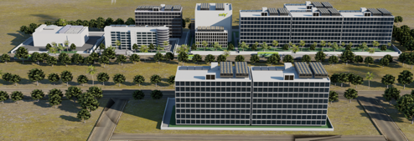
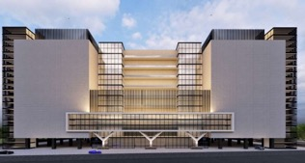
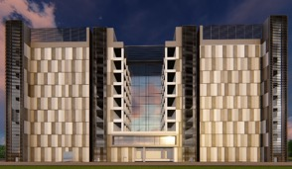
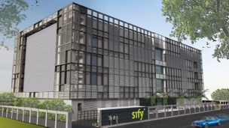
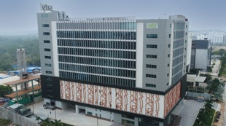
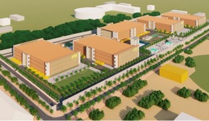
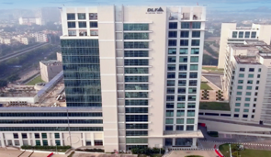
AI-READY, hyperscale, Hyperconnected, Green,
Data Center campuses
India’s 1st Nvidia DGX Ready Air-Cooled DCs
March 2022
India’s 1st Nvidia DGX Ready Liquid Cooled DCs
August 2024
Mumbai 03, Rabale
IT Power: 377+ MW
Noida 02
IT Power: 130+ MW
Chennai 02, Siruseri
IT Power: 130+ MW
5 Towers Operational
4 Towers In Development
3 Towers in Planning
1 Tower Operational
2 Towers in Planning
1 Tower Operational
2 Towers in Planning
Bengaluru 02
IT Power: 40+ MW
Hyderabad 01, Financial Dist.
IT Power: 14.4+ MW
Hyderabad 02, Fab City
IT Power: 250+ MW
Kolkata 01, DLF IT Park New Town
IT Power: 2.2+ MW
In Development
Operational
Planning
Operational
14 DCs - 227+ MW IT power | 407+ MW by 2025 | Campuses scalable to 970+ MW with BTS

Slide 7
Data Center Advantage
Hyperscale, Hyperconnected, Green, AI-ready
RAS based design for future ready infrastructure
Liquid & Air-Cooling ready Data Centers, up to 200 kW power/rack.
14 DCs, 227+ MW IT power, expanding to 407+ MW by 2025
Hyperconnected, Carrier-neutral and Rich Interconnect ecosystem
India’s Data Center Powerhouse for over 2 decades
3 of 4 Hyperscalers, Global OTT & Social media players,
India’s Top 10 banks,
and 600+ enterprises…
Campuses scalable to
970+ MW with BTS capabilities
AI/ML led operational excellence with 100% uptime
Enhanced 10 levels of security with automation
231 MW renewable energy contracted
Notes:
Operational- as is ready: 227.7 rounded to 227 (included tower B Noida, Chen 02)
Expanding: operational + development: 407.7 rounded to 407 MW
Scalable to: expanding to, operational + development+ planning: 970.5, 970 MW

Slide 8

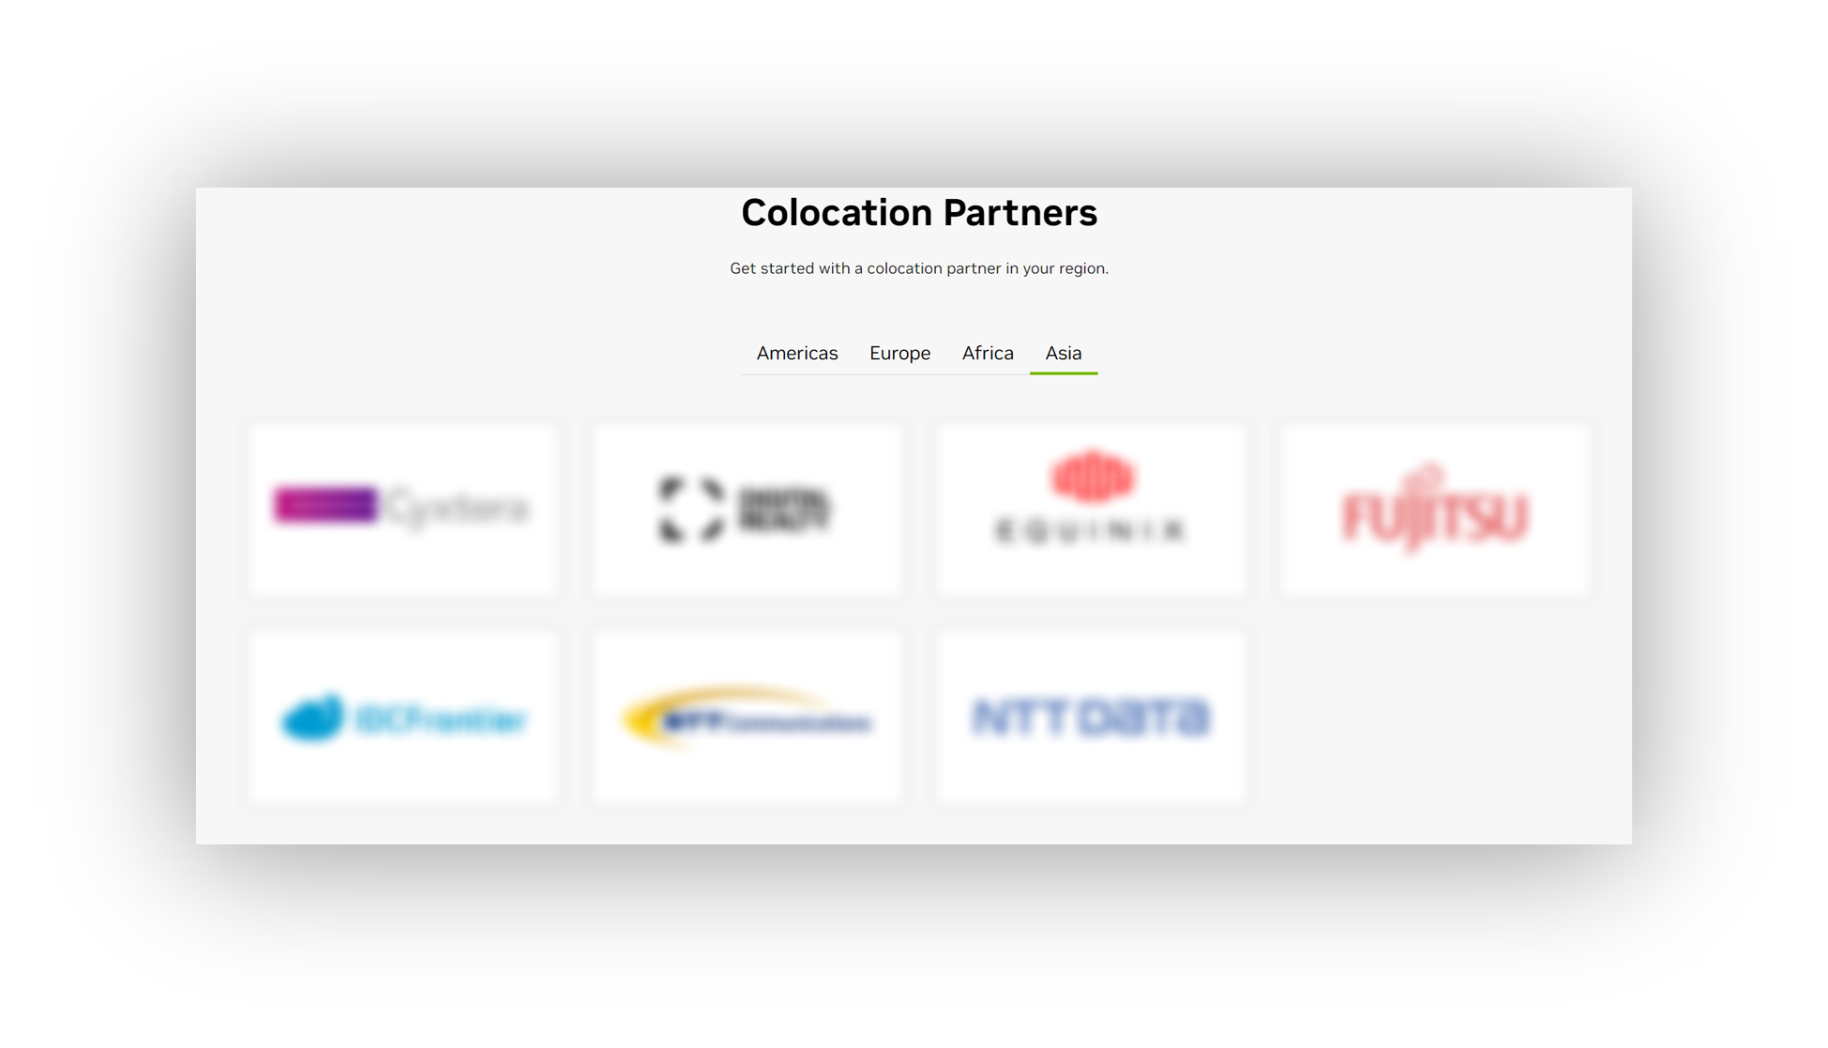

SIFY’S AI-Ready Data centers
India’s first and only NVIDIA certified DGX Ready Data Center Service Provider
Support 130+ kW power per rack with Air & Liquid Cooling
High performance AI Compute with
GPU as a Service
Ref: https://www.nvidia.com/en-us/data-center/colocation-partners
India’s 1st Nvidia DGX Ready Air-Cooled DCs
March 2022
India’s 1st Nvidia DGX Ready Liquid Cooled DCs
August 2024

Slide 9
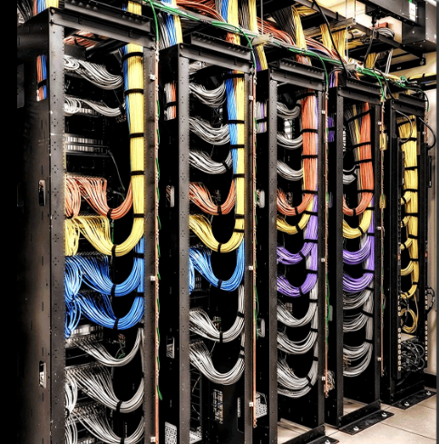



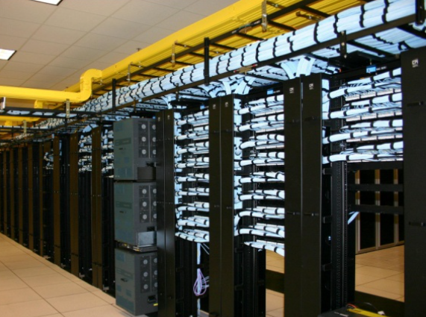



Network Connectivity highlights
Multi-tier Network
Reliable Network Access
Cross-Connectivity
Multi-tier Fiber and Copper for low latency Infini-band like deployment
Cluster based rack placement
High capacity intra rack and inter rack network
Multiple Fiber routes to the building and MMRs at each tower of the DCs.
Enables connect for DR, NDR, FDR deployments
Access via high capacity 600 gbps networks
Lower TCO as expensive network bandwidth not required
Carrier Neutral
Meet-Me-Room
Access to Clouds Internet Exchanges & Cable Landing stations
90% of fiber links are from non Sify Telcos
Extension simplified with in-campus wiring and is a low capex option for all Telcos
MDF(Network Closet) in every floor, connected to MMR via network risers
Separate access to telco MMRs for O&M in the BTS
Proximity to Internet exchanges, Hyperscale, OTT, Social Media
Access to Cable landing station
High capacity, robust connectivity, and cost-effective bandwidth
Notes:
Access via high capacity 200 gbps + networks
Multi-tier Fiber and Copper for low latency deployments with high capacity 200 Gbps+ networks.
Cluster based rack placement
High capacity intra rack and inter rack network

Slide 10
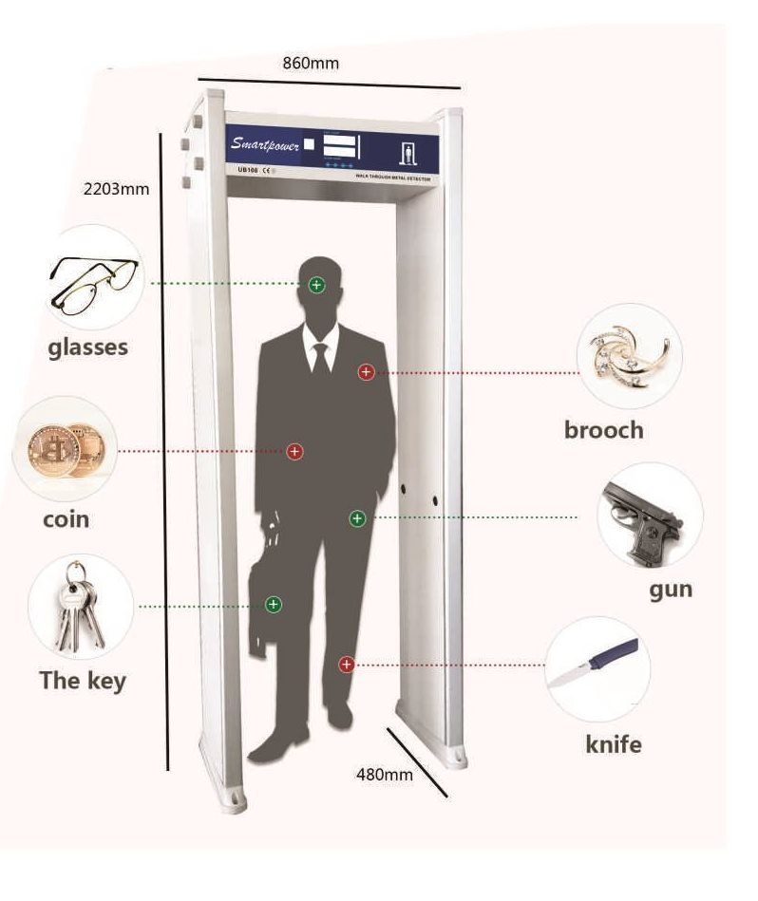
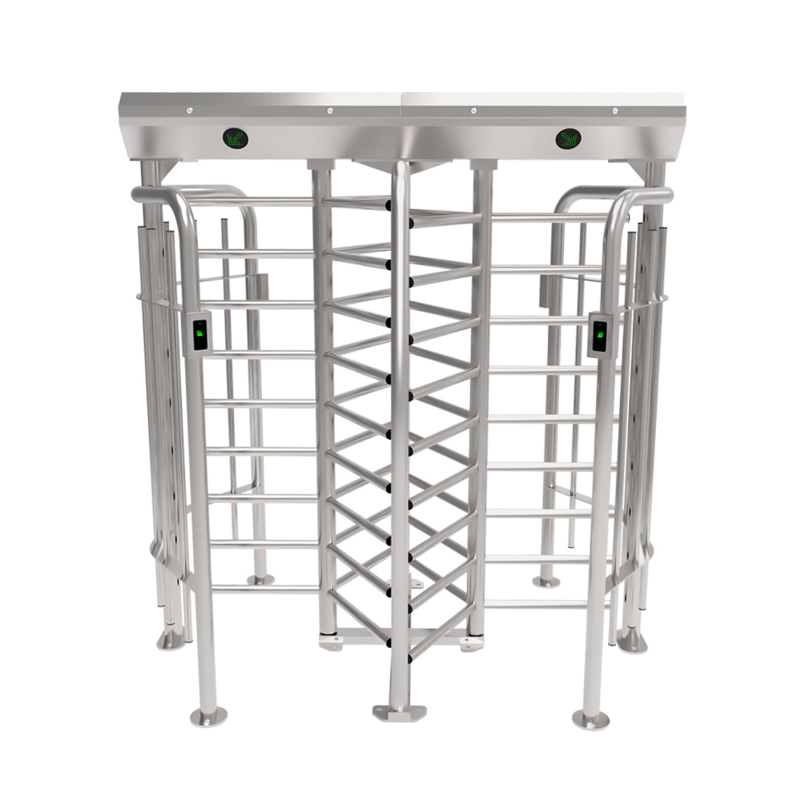


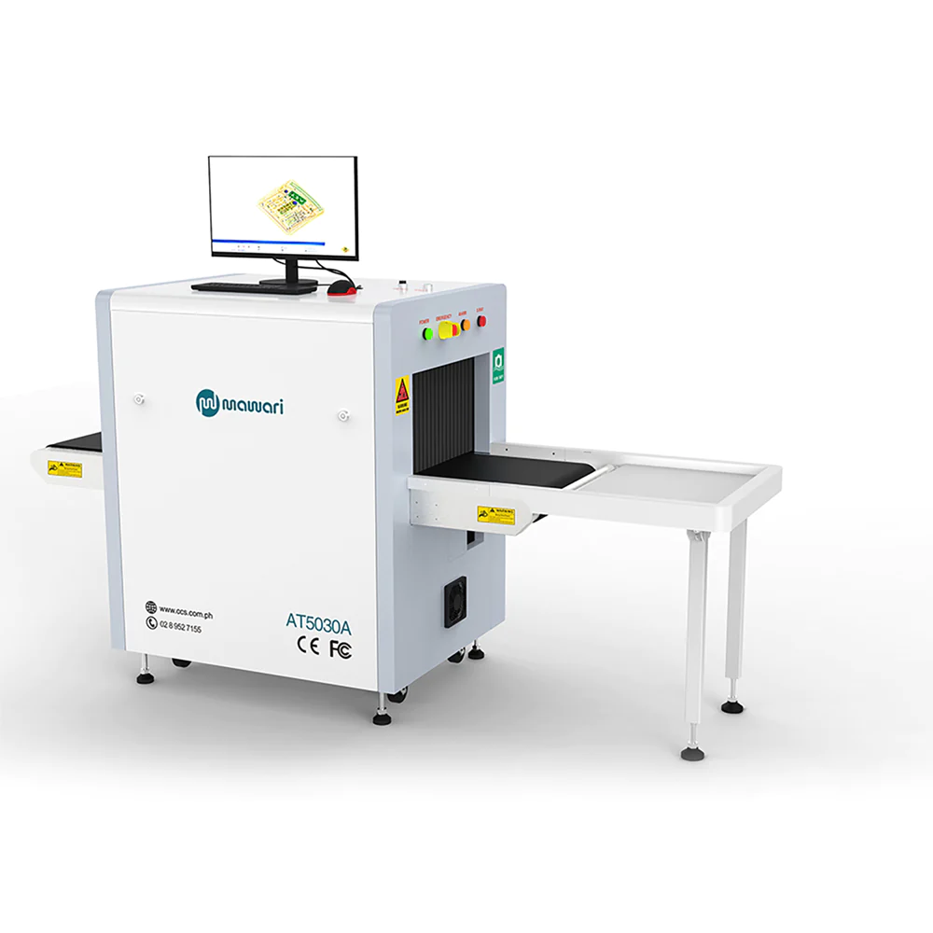






Comprehensive Security
First layer
Premise Boundary - All four sides boundaries are secured with solid wall and fencing. Protected with Vehicle crash Barrier on Main Entrance Gate.
SECOND layer
Perimeter Physical guard monitoring & Door Frame Metal Detector (DFMD) for visitors
THIRD layer
Building entrance Security cabin - X-ray baggage scanning
FOURTH layer
Building entrance Security cabin - Physical Frisking at entrance of building
by Handheld Metal Detector (HMD)
Access controlled half height Turnstile before entering the lift - to avoid forced entry and anti-pass.
FIFITH Layer
Building entrance Security cabin - Full height turnstile for pedestrian movement
SIXTH Layer
Passenger & Material Elevator - Access controlled half height Turnstile before entering the lift - to avoid forced entry and anti-pass
SEVENTH layer
Passenger & Material Elevator - Access controlled allowing entry to only approved floors
EIGHTH layer
Floor level - Physical security, Hand-held metal detector, access control door.
NINETH layer
Server Hall Entrance - Biometric cum Card reader before entering server room
TENTH layer
Cage Entrance - Server hall cage entry door biometric digital access control
10-tiered physical and electronic security powered by automation and 24x7 surveillance

Slide 11
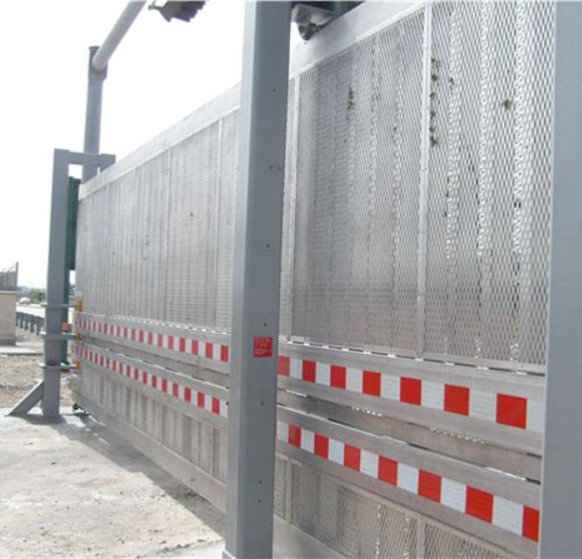
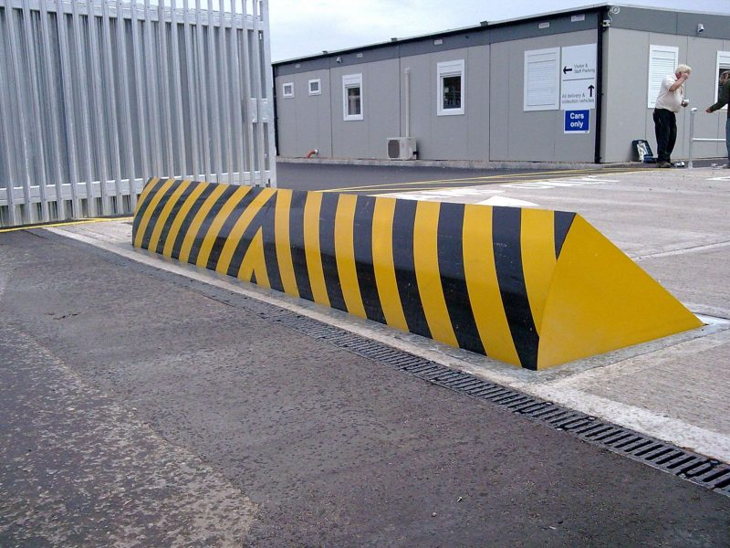
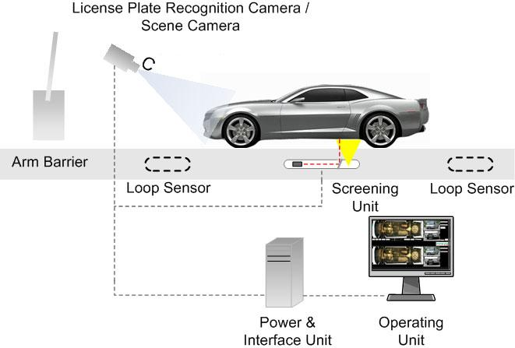
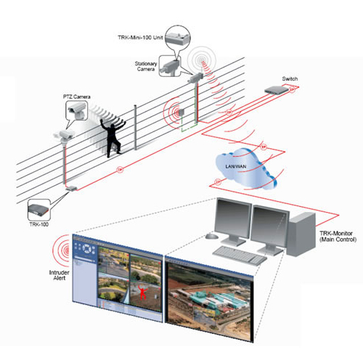
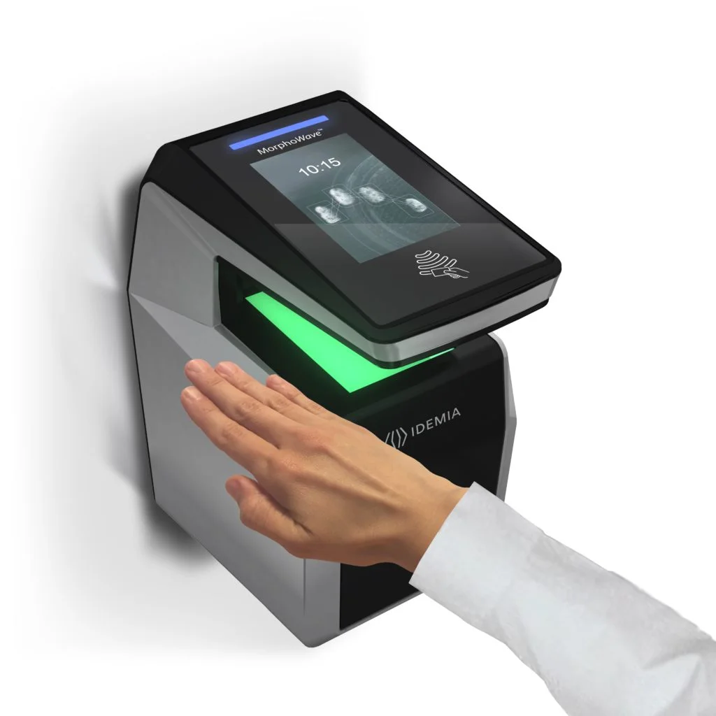

ENHANCED SECURITY
K8 Rated
Boundary Wall
Truck
Rejection
Automatic
Road Blocker
Under Vehicle Surveillance System (UVSS)
Perimeter intrusion detection system (PIDS)
Advanced Security Software
Anti-Terrorism/Force Protection (ATFP) US DOS standard; designed to stop a 15000-pound vehicle at 40MPH
The truck entry path is designed in a way unauthorised trucks are rejected and exited without entering the compound
  K8 rated road blocker - manually operated once the UVSS clears the vehicle. Can also be automated once the UVSS system completes the vehicle scan and found normal
  Provides automatic vehicle inspection, real-time monitoring, threat detection, image archiving, and integration with other security systems to enhance security protocols by thoroughly inspecting and capturing high-resolution images
  Video Analytics
  Facial Recognition
  Integrated access and visitor management
  Realtime access control dashboard
  Contactless Palm Reader
  Electric pulse, gives a non-hazardous shock to people trying to climb to disable them and give alarm with the incident location.
  Integrated with CCTV system – fixed zoom camera immediately takes images, PTZ will turn towards the incident area, with popup alert, audible alarm, email alert, and SMS to security officers

Slide 12


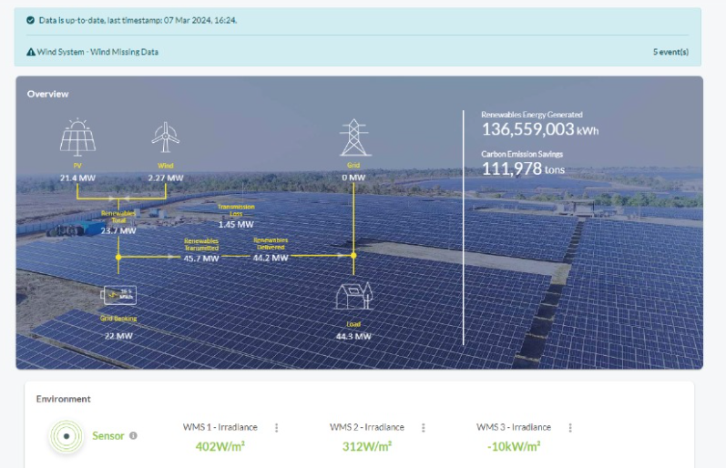


ESG FOcus
Data Center MEP
Sustainable Processes
High efficiency for Equipment even at low utilization levels
Selection of equipment with high energy saving parameters
Right redundancy levels
ASHRAE Guidelines. IGBC
ISO 14001 Environmental Certification
Carbon abetment policy
Low PUE, WUE
Green Power Contracts
Future Roadmap
Contracted 231 MW Green power via Power Purchase Agreements
Additional nation-wide Green power for future projects. ~500MW planned to meet long-term sustainability goals
Up to 79% Green Power in Mumbai, 60% Chennai, 30% Noida
To become RE100 (Carbon Neutral) by 2030. 29% GHG emission reduction by FY2025
Exploring options to secure up to highest RE penetration for Sify DCs, as permitted by regulation
  Targeting high level of Renewable Energy penetration by year 2025
Driving sustainability from BASE BUILD - POD - PROCESS

Slide 13



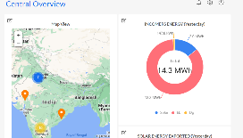


AUTOMATION: data centers
Real time visibility:
into operations, assets, people and process. Better resource utilization across rack space, power, RE, cooling, security and cross connects
Measurability:
in operations basis predefined conditions or SOPs. Resource capacity utilization and trend analysis. KPI based service contract renewals. Usage based Infra resource planning
Predictability:
in failure and downtime. Preventive maintenance of assets, AMC contract realization. Demand forecasting and capacity planning
Enhanced Efficiency:
in capacity utilization, PUE, WUE, DG power fuel, UPS power, DC carbon footprint, service and support efficiency
Site Equipment
Hardware Connectivity
Operation Command Center
POWER
Multiple Energy meters
3rd party Integration - ERPs & tools
Chiller Plant
Busway Sensors
OPC
DG
IOT Cloud with AI/ML Algorithms
API
Multiple PACs/ CRAH/ AHU
UPS
Ops Equipment
Safety & Security Equipment
Smart IO interface
OPC
Internet
Temperature & Humidity Sensor
Wireless/ Wired
Ethernet
IOT Gateway
UPS-1
L2 switch
Dashboard
OPC
Centralized dashboards, tickets and reports accessed via Laptop, Tablet, Mobile etc.
TX
Transformers (LT & HT)
CMMS (Manual Ops Data)
API’s
Solution Components
Increased Savings
on PUE
Improved
equipment uptime
Increased Person hour
savings monthly
Reduction in operating costs
Notes:
Remove numbers, generic

Slide 14

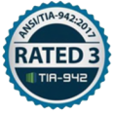














COMPLIANCE AND CERTIFICATIONS
MEITY Cloud Empanelled
India’s 1st Nvidia DGX Ready Air Cooled DC since 2022
Rated 3: Concurrently Maintainable Site Infrastructure
Data Center, Cloud &
Managed Services
IT Service Management
Telecom Data Center & Managed Services
India’s 1st Nvidia DGX Ready Liquid Cooled 130/KW/rack DC since 2024
Hosting Partner
PCI DSS
SOC 1 Type II
SOC 2 Type II
World’s international standard for occupational health and safety
Business Continuity Management System
Environmental Management system
Green Building
SAP Certified In Hosting Services
SAP Certified In Cloud Services
SAP Certified In SAP HANA Operations Services
SAP Certified In Application Management Services

Slide 15
AI readiness

Slide 16





OUR AI READY Data CenterS
Power
Scalable and robust power infrastructure
Tolerant to dynamic load variations
Redundant distribution systems
Support multiple water temperature scenarios
Support different cooling methodologies
Cooling
High-capacity fiber and copper network
Multiple paths, dual meet-me-rooms, and distribution
Network
Purpose-built data center buildings
Structural design to meet local codes and seismic rating
Server Hall
Designed and built to accelerate your AI Adoption

Slide 17
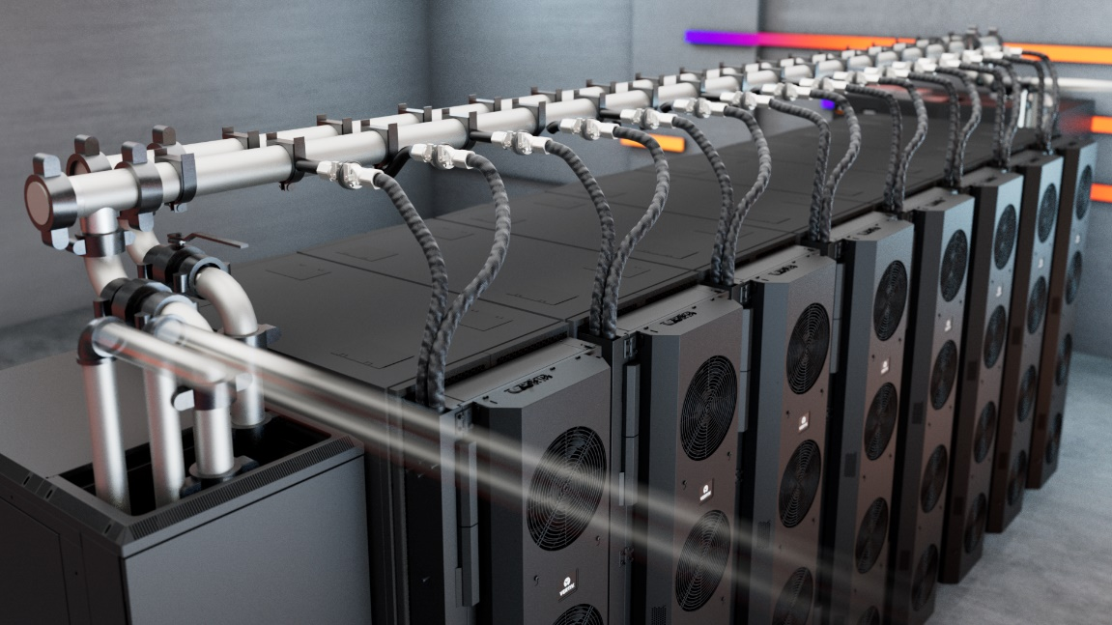
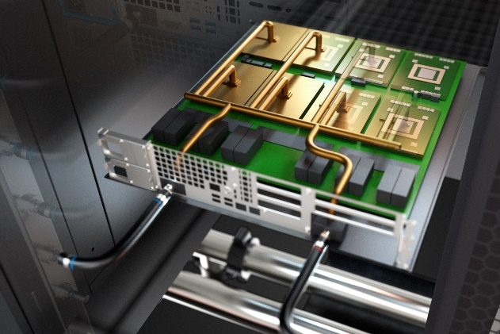
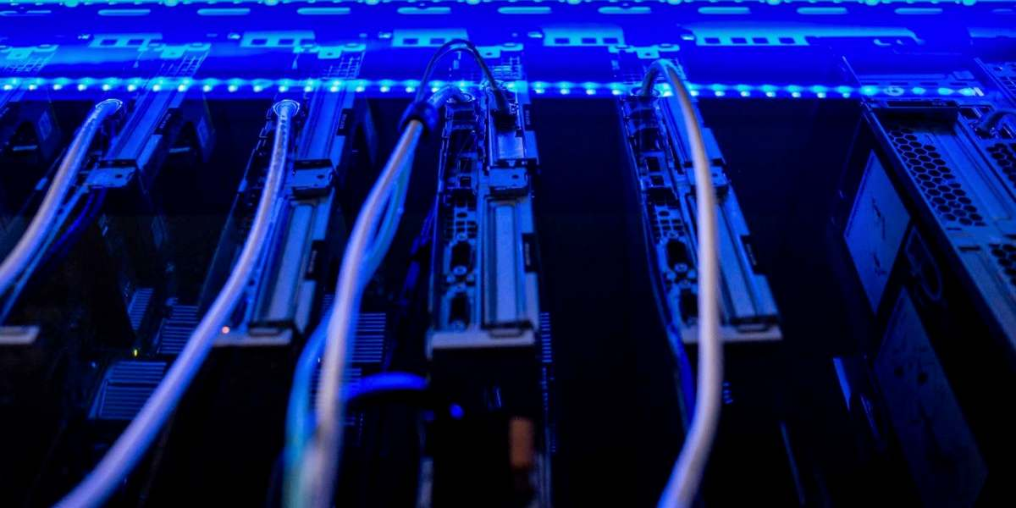
Modern cooling solutions for power dense workloads
REAR DOOR HEAT EXCHANGER
Direct-to-chip
Liquid immersion cooling
Ideal for 20-50 kW Rack load
PUE: 1.4
Ideal for 50 – 150 kW Rack load
PUE: 1.2 - 1.4
Ideal for 50-200 kW Rack load
PUE: 1.2 – 1.35
Advanced liquid cooling solutions to shield your AI hub from heat surges

Slide 18
AI-ready Data Centers summary
SERVICES | CHALLENGES | SOLUTION |  | SIFY READINESS
POWER | Quality, Uninterrupted Power | Grid level feeder on 220kV or above |  | 220kV onsite substation
POWER | Block power to support larger AI rack cluster | Design power clusters including UPS, Busbars that support larger power blocks, usually up to 1000KW per row |  | Each power blocks is in 2160kW
HYBRID COOLING TECHNOLOGIES | Any one type of cooling such as DX or Chilled water doesn’t support varying AI rack environment | Data center to support wider range of water temperature, usually from 18 deg C to 40 deg C |  | Supports multiple cooling technology such DX, Chillers and Dry Coolers
WATER DISTRIBUTION | Precise flow, pressure and temperature, controlled water distribution | Design the water distribution with the help of CFD analysis and design appropriate control systems |  | Supports CDU based and non-CDU based water distribution, delivering precise water parameters
WATER QUALITY | Maintain accurate level of water quality parameters | The primary and secondary water parameters to be maintained for efficient heat transfer and clog free distribution |  | Multistage water management system including chemical treatment to maintain the water parameters
BUILDING INFRASTRUCTURE | Adequate floor loading and height | Design buildings that supports high floor loading, and space for multilayer overhead infrastructure |  | Buildings comply with latest building codes, 6.3 meters room height, 2100kg floor loading
NETWORK | Redundant and scalable backbone and internet connections | Large capacity, inter data center, inter city and internet gateway |  | Network supports its data center with all types and capacities of network. Low latency connects to Hyperscale Clouds, OTTs, IXs
Strategically designed framework to enable and optimize hosting for AI Workloads

Slide 19
Data centers by location

Slide 20
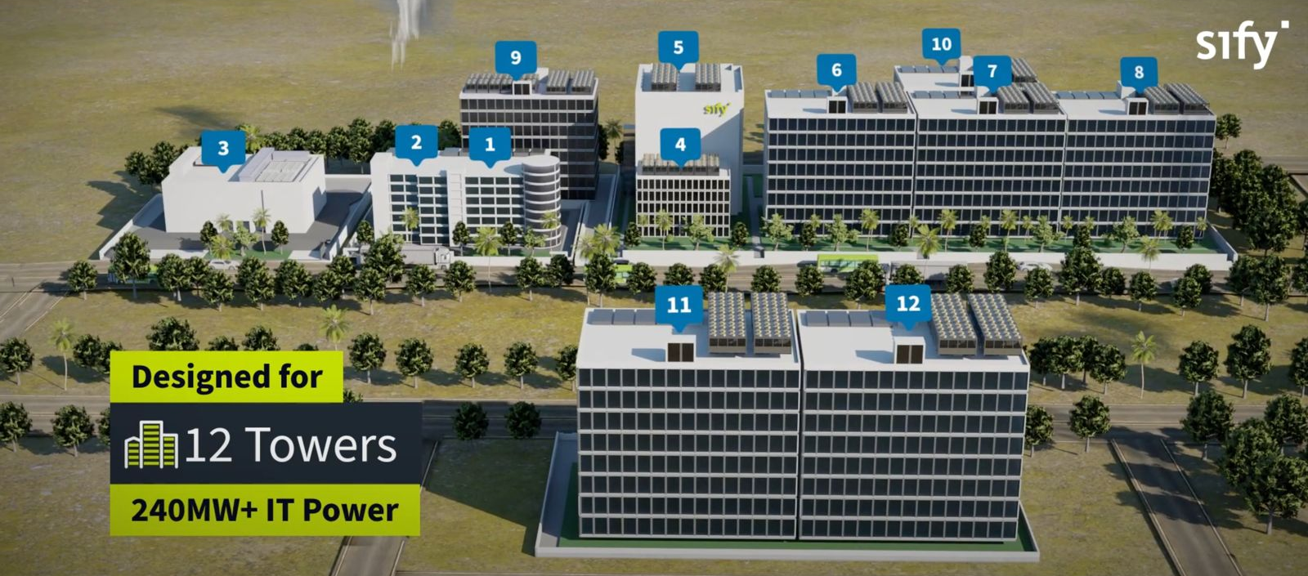
Overview: MUMBAI 03 MEGA CAMPUS, RABALE
OUR LARGEST AI-READY HYPERSCALE DATA CENTER CAMPUS
Hyperscale &
AI-Ready Infrastructure
99 MW RE
ESG best practices, Up to 79% RE power
Tower 5 Live with
43+ MW IT capacity
Dedicated
on-site 110, 220 kV
GIS substation (N+1)
Designed for
12 towers
377+ MW IT Power
Option of 7
Built To Suit Towers for 280+ MW
K8-rated
perimeter wall with 10 level secure access control
5 Towers Operational
4 Towers In Development
3 Towers in Planning
Cloud onramp to 3 Hyperscale cloud providers
4 dedicated fiber entry paths with multiple telcos
Mega campus supports a robust ecosystem of multiple Hyperscalers, Network Nodes, IP Exchanges, and ISPs

Slide 21
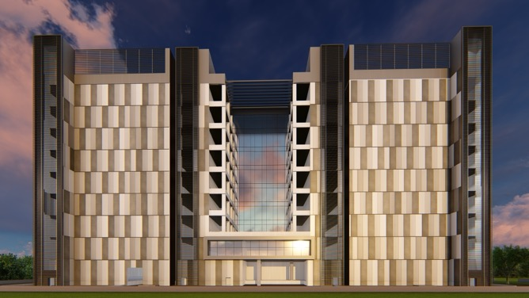
Overview: Chennai 02 Data Center Campus, SIRUSERI
OUR LARGEST AI-READY HYPERSCALE DATA CENTER CAMPUS IN SOUTH INDIA
Hyperscale &
AI-Ready Infrastructure
A
B
C
IGBC Platinum Certified.
ESG best practices, 60% RE power
Vertical & Horizontal expansion
Dedicated
on-site 230 kV
GIS substation (N+1)
130+ MW IT capacity in 3 Data Center Towers
Scalable, resilient, hyperconnected, secure and green
K8-rated
perimeter wall with 10 level secure access control
Option of 2
Built To Suit Towers for 86+ MW
Integrated Transpacific CLS designed for 4 cables with over 2 Petabyte capacity
4 dedicated fiber entry paths with multiple telcos

Slide 22
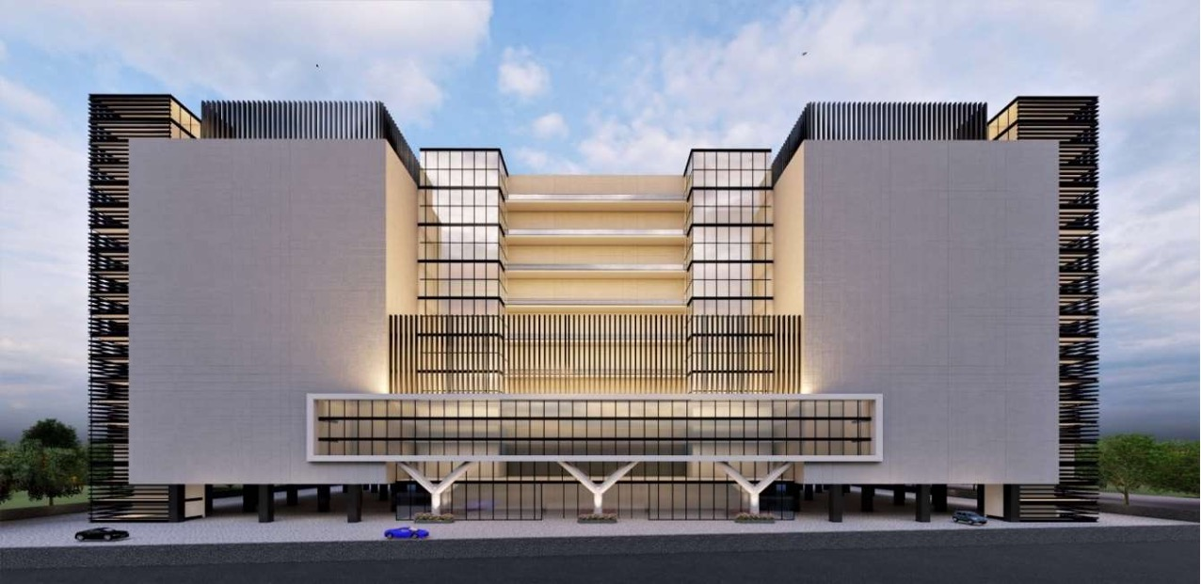
Overview: Noida 02 Data Center Campus
OUR LARGEST AI-READY HYPERSCALE DATA CENTER CAMPUS IN NORTH INDIA
Hyperscale &
AI-Ready Infrastructure
A
B
C
IGBC Gold Certified.
ESG best practices, 30% RE power
Vertical & Horizontal expansion
Dedicated
on-site 220 kV
GIS substation (N+1)
130+ MW IT capacity in 3 Data Center Towers
Scalable, resilient, hyperconnected, secure and green
K8-rated
perimeter wall with 10 Level secure access control
Option of 2
Built To Suit Towers for 86+ MW
4 Hardened Fiber Routes connecting NOIDA 01 DC, enabling low latency access to Hyperscalers,
OTT, Content & Security providers

Slide 23
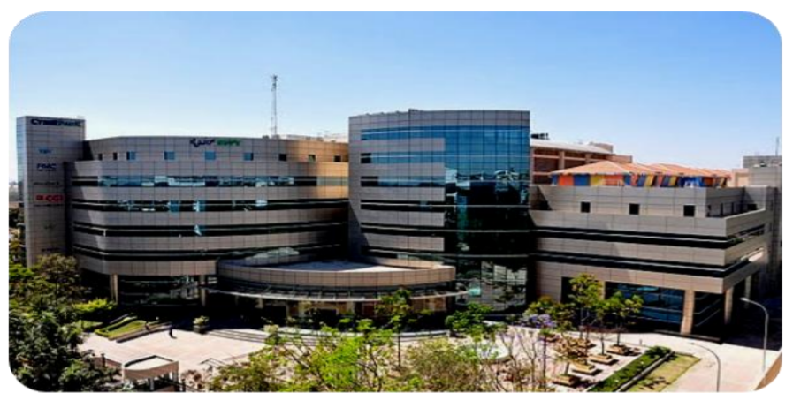
Overview: BANGALORE 01, electronic City
IT power capacity of 7.6 MW
Addressing market segments like IT/ITeS, E-Com, Retail, Media, Healthcare, BFSI
Enterprise-grade Sify CloudInfinit services to enable hybrid cloud adoption
Carrier-neutral facility, dual Meet-Me-Rooms with multiple IX, ISPs
Offers colocation & managed services, DRaaS, and CDN services

Slide 24
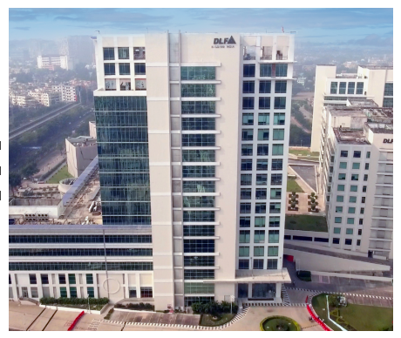
Overview: Kolkata 01, Newtown
IT power capacity of 2.2 MW
Addressing market segments like Manufacturing, BFSI, Govt, PSUs, IT/ITeS
Nodal location for service delivery to neighboring SAARC countries
Carrier-neutral facility, dual Meet-Me-Rooms with multiple IX, ISPs
Offers colocation & managed services, DRaaS, and CDN services

Slide 25
Your trusted data center partner
Sify is a LEADER in the IDC MarketScape Data Center Services India, 2024
Mission Critical Customer Experience
2 Decades of Operational Experience
Future-ready
Data Centers
Trusted
Partner
3 out of 4 Hyperscalers
Global OTT & social media players
India’s top 10 banks
Global InfoSec security providers
600+ customers across all major industries
100% uptime
Best Practices covering Safety, Security, Availability, Excellence
PUE & WUE prediction and optimization
Certifications: Information Security, EHS, PCI-DSS, SOC 1 SOC 2, NVDIA, MeitY, IGBC
Mega campus approach for long term scalability with BTS
Next Gen Data Center design & operations.
AI ready infra with liquid cooling solutions
AI/ML platform enabling faster decision-making
Up to 70% Green Power available
1st commercial Data Center provider in India since year 2000
Data Center, Networks Digital and Security services under one roof
Reliability for services
Flexibility for customer requirements
Ensuring accountability, reliability, flexibility and choices through our innovative designs and services

Slide 26








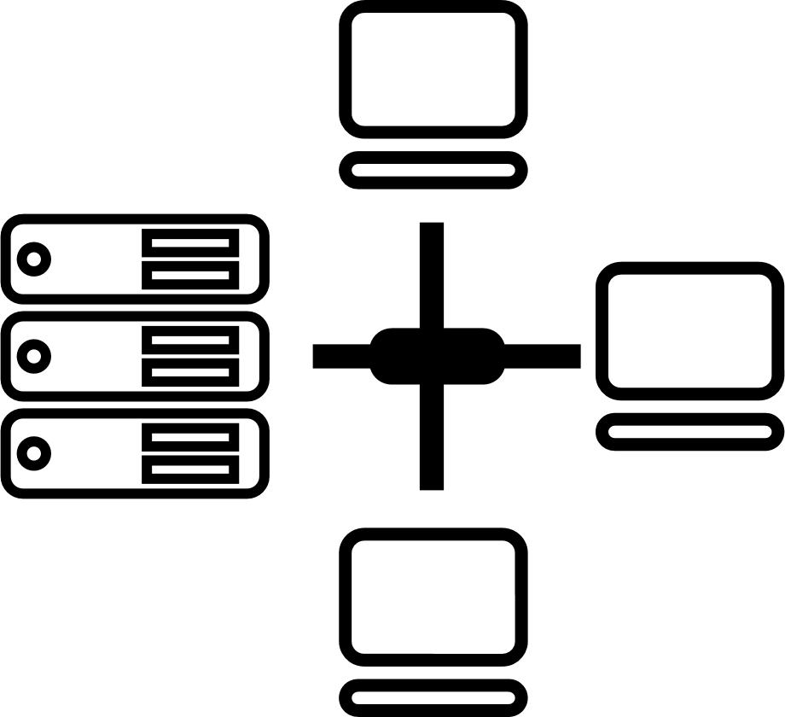






Award for Sustainability
Innovation in Data Center
India’s 1st Nvidia
DGX Ready Liquid &
Air Cooled DCs
DC Services India &
Managed Cloud Services APAC
Managed Network Services Global- MQ
Tried Tested Trusted
Your digital infrastructure partner for over 25 years
Network
Infra Services
Network Digital
Managed Services
Data Center
Colo Services
CloudInfinit^{+AI}
GPU Cloud
Cloud & IT
Managed Services
Digital Apps
Managed Services
Industry Apps
Managed Services
Security
Managed Services
Thank You
Notes:
Assocham- Industry
Times Now- Brand
Nvidia- Partner
MMA- Brand
IDC- Cloud- APAC: Leader in Marketscape, India Data Cneter Service 2024

