Slide 1
MANAGED NETWORK SECURITY
DDoS Mitigation Capability
November 2024

Slide 2

Sify’s Managed Security Services
Device Management
Firewall, FortiManager and FortiAnalyzer management
DDoS attack detection and mitigation
DDoS Protection
Secure SDWAN
SASE
Differences from traditional firewall-based security & features
Network security as a Cloud delivered service
Notes:
Device Management
Device management involves overseeing and controlling network security devices to ensure optimal performance and security. This includes managing firewalls, which act as the first line of defense against threats and utilizing tools like FortiManager and FortiAnalyzer. FortiManager centralizes the administration of multiple Fortinet security devices, streamlining policy management and updates. FortiAnalyzer provides detailed analytics and reporting, enhancing visibility into network activity and aiding in threat detection and response.
DDoS Protection
DDoS (Distributed Denial of Service) protection focuses on identifying and mitigating attacks aimed at overwhelming network resources and causing disruptions. DDoS attack detection involves monitoring network traffic to identify patterns indicative of a DDoS attack. Mitigation strategies then come into play, such as traffic filtering, rate limiting, and rerouting, to neutralize the attack and maintain service availability.
Secure SDWAN
Secure SD-WAN (Software-Defined Wide Area Network) integrates traditional WAN capabilities with enhanced security features. Unlike traditional firewall-based security, which often relies on static and location-specific defenses, Secure SD-WAN provides dynamic, application-aware routing, centralized control, and robust security measures across all network points. This includes encryption, intrusion prevention, and real-time threat detection, ensuring secure and efficient connectivity for distributed networks.
SASE
SASE (Secure Access Service Edge) is a cloud-delivered network security model that combines WAN capabilities with comprehensive security functions. Network security as a cloud-delivered service ensures that security measures such as secure web gateways, firewalls, and zero trust network access are integrated and managed from the cloud. This approach provides scalable, flexible, and consistent security across all endpoints, supporting the modern needs of mobile workforces and cloud-based applications.

Slide 3
Sify DDoS Protection Services

Slide 4
DDoS Protection - Key to Availability Risk Planning
Site Selection
Physical Security
Fire Protection & Detection
Electrical & Power
Environment & Weather
DDoS Attacks?
When measuring the risk to the availability or resiliency of services, where does the risk of DDoS attacks fall on the list?
Availability Scorecard
Notes:
When measuring the risk to the availability or resiliency of services, the risk of DDoS attacks typically falls high on the list.
This is because DDoS attacks directly target the accessibility and performance of online services by overwhelming them with excessive traffic.
Such attacks can cause significant disruptions, rendering services slow or completely unavailable to legitimate users.
Given the potential for severe operational impact, revenue loss, and reputational damage, organizations prioritize mitigating the risk of DDoS attacks alongside other critical threats to ensure continuous service availability and resiliency.

Slide 5
Network impact
The Broad Impact of DDoS Attacks
IPS
Load Balancer
DATA CENTER
Target Applications and Services
Attack Traffic
Good Traffic
Notes:
A DDoS (Distributed Denial of Service) attack aims to overwhelm a network, server, or online service with a flood of internet traffic, causing significant disruption. The impact on the network includes severe slowdowns or complete unavailability of services, making it difficult or impossible for legitimate users to access the targeted resources. This can lead to interrupted business operations, loss of revenue, and a damaged reputation. Additionally, the excessive traffic can strain network infrastructure, potentially causing collateral damage to other services and increasing operational costs for mitigation and recovery.

Slide 6
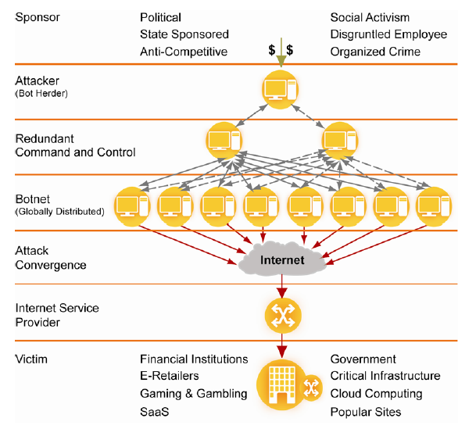
Anatomy of a DDoS attack
DDOS attacks are generated with aim of disruption of service
Key Components: Victim server, BOT Infected machines for launching attack, C&C server & Attacker
Once a user machine is infected with a BOT, it can be taken control using a C&C server
The attacker uses a C & C server to send commands to the infected machines for launching attack traffic to a Victim machine
The infected machines start generating DDOS traffic towards the Victim machine and pull down the service
Notes:
C&C (Command & Control)

Slide 7
Outcomes Of DDoS Attacks
Operations
Help Desk
Recovery
Lost Worker Output
Penalties
Lost Business
Brand & Reputation Damage
IT personnel tied up addressing the attack
High amount of help desk calls will be received
Manual work will need to be done to re-enter transactions
Employee output will be lost
Service level agreement (SLA) credits or other penalties
Ability to attract new customers be affected
Cost to the company brand and reputation

Slide 8
Planning To Protect DDoS Threats
Minimise the impact of a DDoS attack
Know your network – Visibility and baseline
Block DDoS attacks
Know who to call – Network or security
Know what to do – Incident handling procedure
Know what to block – Unwanted ports and services
Know where to block – Stateful or stateless devices
Utilize the security capabilities built into other network and security infrastructure to minimize impact where possible
Subscribe for specialised solutions and services are based around DDoS attack protection
Service providers offering DDoS services can deal with higher magnitude attacks which could saturate an organization’s internet connectivity.
Hybrid solutions – Cloud and premise based
Notes:
Understand traffic patterns to spot anomalies and have contacts for network and security teams.
Establish and practice an incident response plan, identifying and blocking unnecessary ports and services.
Use stateful or stateless devices to block traffic effectively and leverage existing network security features.
Invest in dedicated DDoS protection services and engage providers for handling large-scale attacks.
Implement a combination of cloud and on-premise DDoS protection solutions for comprehensive defense.

Slide 9
How does Our Service Work?
Sify uses a combination of Genie ATM + Radware DefensePro in its cloud
Netflow is collected from Sify Edge Routers and sent to Genie ATM
The volume is measured against the threshold settings for individual signatures
In case the traffic levels are found to be crossing the threshold for a host IP, then Sify would inject a /32 BGP host route to all its peering Edge Routers with next hop as Radware DefensePro [scrubbers]
The traffic for the host is diverted via the scrubbers and cleaned

Slide 10
DDoS Protection Scope
Attack Type | Protection
• TCP SYN Flood
• Spoofed TCP-SYN flood
• SYN/ACK Reflection Flood
• TCP ACK flood
• Smurf attack
• Ping flood
• ping of death
• ICMP Echo request flood
• Teardrop attack
• low-rate denial of service attack
• Mydoom
• UDP Flood
• Nuke | (for volumetric attacks)
• HTTP/HTTPS flood attack | (for volumetric attacks)
• DNS amplification attack
• IP fragmented attack etc.

Slide 11
Attack Monitoring & Management
24x7x365 MNOC
End to end single point of ownership
Pro-active monitoring and management
Alarm isolation and resolution
SLA driven, integrated centralized processes
Demonstrable performance indicators
Instant and easy accessibility through the service portal, emails and phone
Implementation and transition services
Best practices aligned with the ITIL framework

Slide 12
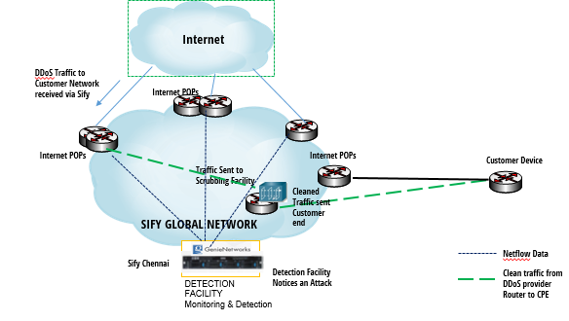
Solution Architecture

Slide 13




Managed Security Services – DELIVERABLES (1/2)
INCIDENT MANAGEMENT
CHANGE MANAGEMENT
Incidents will be created by the customer or by Sify through Sify’s Delivery portal Aakash or through mail notification.
Periodicity: 24X7
Any change to the existing the infrastructure or configuration to the customer assets will be followed as per the SOW and as per the SOC’s Change management process.
Periodicity: 24X7
CONFIGURATION MANAGEMENT
VENDOR MANAGEMENT
Manage the configuration on all network security devices as per the design document and best practices if applicable
Periodicity: 24X7
Sify NOC will interact with respective with corresponding vendor for any kind of replacement of customer asset as per the proposed SOW.
Periodicity: 24X7

Slide 14



Managed Security Services – deliverables (2/2)
DEVICE MANAGEMENT
EMAIL AND WEB BASED SUPPORT
Check whether the Device management port could be reached; if so, take initial backup of the device configuration.
Periodicity: 24X7
Customers would have access to Sify’s security experts through email and web during regular working hours
Periodicity: 24X7
TELEPHONIC SUPPORT
Skilled Network Security resources will be available during regular working hours to provide technical support over phone.
A toll-free number would be provided to the customer for this purpose.
Periodicity: 24X7

Slide 15

Sify’s Managed DDoS Protection
Completely managed service for Sify’s On-Net Internet customers
Protects against network layer attacks (volumetric, protocol type attacks)
Four scrubbing centres – London, Singapore, Chennai and Mumbai
Detection and Mitigation Solution based on Genie + Radware platforms

Slide 16
Overview of Sify’s DDoS protection services
Provides DDoS protection to wide range of Enterprise Customers
Comprehensive security with best-of-the-industry devices
Cloud-based implementation
Backed up by Emergency Response Team
Distributed Scrubbing Centers in India & abroad for mitigation nearest to the origin of attack thus minimizing collateral and latency impacts
Scalability of mitigation

Slide 17
Attacks Mitigated in the Past 2 Years
CUSTOMER | TYPE OF ATTACK | MAGNITUDE
Major Private Bank | Malform TCP with port 0 and UDP Flooding | 3.61 Gbps
Transport Sector PSU | UDP Flooding and DNS Amplification | 18.30 Gbps
Biggest Public Sector Bank | Malform UDP with port 0 and UDP flooding | 12.88 Gbps
Power Sector PSU | UDP Flooding | 25.15 Gbps
Broadband Provider | Memcached Attack | 1.06 Gbps

Slide 18





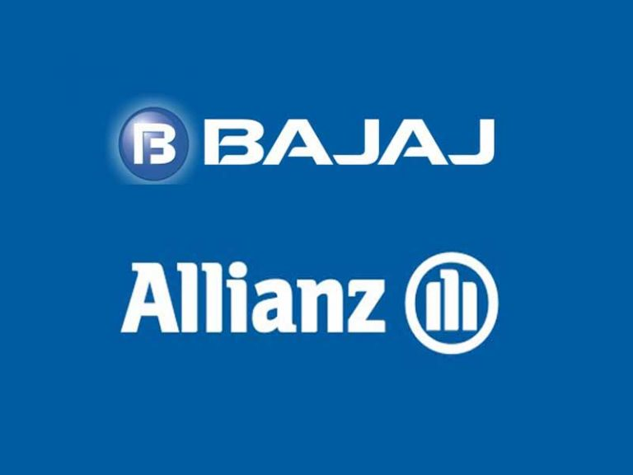























Customers Relying on Sify’s DDoS Mitigation Service

Slide 19
THANK YOU

