Slide 1
Helping you
achieve your
DIGITAL AMBITION
Notes:
Sify is one the leading players across the networks, data center, cloud, digital, and IT services space in India.
From being India’s first ISP in 1998 we have pioneered voice & data services & have matured to be one of India’s largest digital transformation companies.
Being India’s only organically grown ICT company, Sify has grown from being an infrastructure focused firm to offering a robust & converged ICT ecosystem.
With a track record of more than two decades in the business, Sify is best placed to understand the digital transformation demands of the modern-day enterprise.

Slide 2
MANAGED Network SERVICES
Sify Managed Wi-Fi
Feb 2024

Slide 3

INDEX
Sify Overview
Industry Trends
Sify’s Managed WiFi Services
Case Study
References
Sify’s Solution Platform

Slide 4
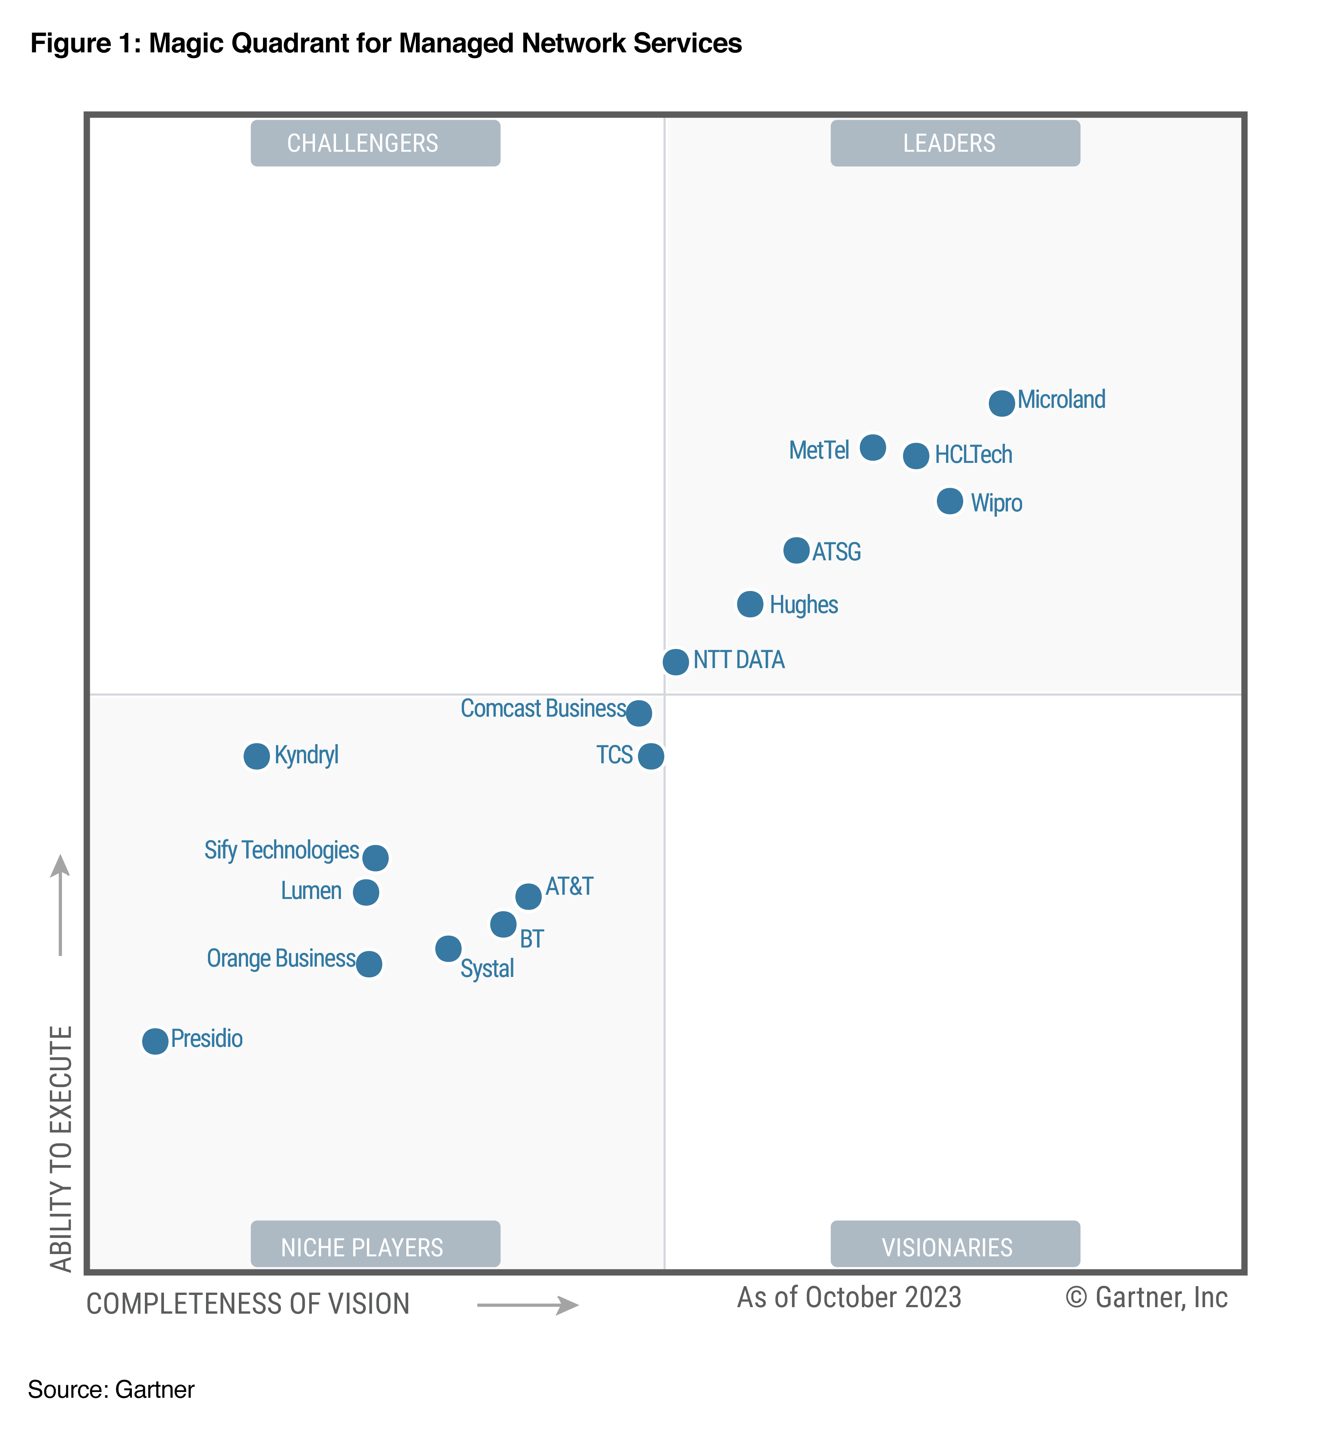
INDUSTRY RECOGNITION
Sify is a Niche Player in Gartner’s MQ for
Managed Network Services Global 2023

Slide 5
Our Observation of Wi-Fi TRENDS
IoT building block
Wi-Fi, the foundation technology for the IoT apps, is reinforcing its position with Wi-Fi 6 and Wi-Fi 6E, which employ OFDMA to improve performance in dense environments.
Wi-Fi 6 in enterprises
Wi-Fi 6 offers improved performance & enables QoS for critical apps.
Network optimization
The growing use of video conferencing, voice-over-IP services, X Reality (XR) applications, and high definition (HD) streaming in enterprise environments has placed new strains on Wi-Fi networks.
Mobile edge computing
Primary driver for edge computing is growth of IoT apps with large data sets and low latency req.
Target wake time (TWT) technology, reduces battery consumption & makes Wi-Fi a suitable choice for sensor-based devices.
It increases the number of devices that can simultaneously connect to a single Wi-Fi AP & adds features to improve battery life of IoT devices
Wi-Fi 6 is designed to better serve densely populated zones, such as stadiums, hotels and convention centers
That inevitably calls for a new level of network optimization that OEMs are working on perfecting
Leading use cases for edge computing include smart grid, oil and gas monitoring, traffic management, remote video processing, and mfg. monitoring and analytics.

Slide 6
Sify’s Managed Wi-Fi Services

Slide 7
Why Managed WiFi is Better?
On Premise DIY WiFi
Sify Managed WiFi
On Premise DIY
Sify Managed
Enterprise must decide the platform, model numbers, capacity, features etc from a wide market
Sify designs the best-fit solution based on the Enterprise’s current architecture and future needs
Platform/models will come to EOL/EOS, forcing the Enterprise to a technology refresh
Technology refresh is Sify’s responsibility
Optimum utilisation of feature set depends on internal skillsets available
Sify teams are well-trained and up to date with the technology
Platform requires to be hosted locally, redundancy to be planned, high availability to be ensured
Platform is available in geo-redundant mode. Connectivity, power, hosting ensure ~100% availability
RMA and spares planning is tedious. Involves additional cost.
Spares supply and replacement is a planned activity

Slide 8
Why Sify’s Managed Wi-Fi?
PROBLEMS ASSOCIATED WITH WI-FI
OUR SOLUTION
Lack of uniform access policy
Lack of uniform access policy
Lack of uniform access policy
Challenges in enforcing standardized network access policies & role-based authentication leading to management & enforcement overhead.
Service based model. End-to-End ownership.
No visibility into wireless network
No visibility into wireless network
No visibility into wireless network
Impact on turn-around-time w.r.t troubleshooting & diagnostics
Bottleneck for network expansion or upgrade.
Cloud-based Centralized Management platform
Inadequate protection against wireless threats
Inadequate protection against wireless threats
Inadequate protection against wireless threats
Challenges in early detection & protection against advanced wireless threats leading to security threats & incidents.
Controlled Internet access to guest users
Complex or tedious onboarding process
Long wait time for guest WiFi onboarding leading to user frustration
Highly scalable & resilient
Pan India deployment & support
Lack of visibility on user groups
Lack of visibility on user groups requesting access & challenge in enforcing customized access policies.

Slide 9
Managed WiFi PROPOSITIONS
Sify Managed Wi-Fi Features
Proposition | Basic | Enterprise | Industrial
Feature | Guest Access | Guest Access | Guest Access
 |  | AD Integration | AD Integration / BYOD
 |  | BYOD | Policy Enforcement / Advance Security
 |  | Policy Enforcement | Custom Web Pages
 |  | Custom Web Pages | Outdoor APs
 |  | Advance Security | Location Based Services

Slide 10
SCOPE OF WORK
Deployment of Wireless Access Points
Hardware at customer site & management platform at Sify DC
Includes PoE Injectors/Switches & passive cabling
Configuration of Wireless SSIDs
SSIDs can be configured as per customer’s requirement
Build Customized Home Page
Captive portal customized for customer
Will be used to login to the wireless network
Provide Multiple Access Methods
OTP, Username-Password, AD Based etc.
Provide Metrics
To customer’s IT team on internet usage by guests/ users
Install Internet Links
Of required capacity
Based on number of users who will be accessing the wireless network
24 x 7 Proactive Network Monitoring and Management

Slide 11
Managed WiFi Deliverables
Monitoring & Reporting
24x7 proactive monitoring with real-time & historic reporting
Configuration Management
Common policies across regions with on request auditing of configuration
Incident Management
Common reporting & ticketing platform. RCA prepared based on incidents raised by customers
Change Management
Inventory Management
Management of all changes to be executed in customer WLAN networks proactively & on request
Managing logical resource of customer network – WLAN networks, IP address, VLAN etc.
Provider Governance
Transition Services
SLA Reporting
Vendor Management
Coordination with Aruba vendors to work on issues related to managed wireless services
Identifying transport providers at each site, engaging for ordering, connecting transport links, coordinating for any issues
Enabling seamless transition of customer’s network from incumbent to Sify Managed WiFi
Managing end-to-end SLA between WiFi components which includes Access Point, Switches, and Security Appliance.

Slide 12
Security Coverage (1/3)
Sify’s Managed WiFi Service ensures protection against the following categories of threats –
# | Type of Threats | Threat Description | Associated Risk
1 | Rogue AP | An unauthorized Wi-Fi appliance connected on the respective authorized Wi-Fi network | An intruder connecting to such rogue AP can collect all network traffic to devise a hacking plan and subsequently launch attack to siphon off sensitive data or carry out DDoS etc.
2 | Mis-configured AP | Improperly configured critical security parameters viz. authentication, encryption, unsecured management etc. on authorized APs | Entire Wi-Fi network could be open and vulnerable to attack
3 | Banned devices | List of Wi-Fi appliances which tried connecting authorized Wi-Fi network with malicious intent in past | Overwhelming of Wi-Fi network with authentication traffic as a precursor to divert attention before actual attack
4 | Client mis-association | Wi-Fi enabled user devices connecting to unsecured open available Wi-Fi network which may be unsecured | Open Wi-Fi network made available with malicious intention of intercepting unencrypted data between end user and Wi-Fi appliances for illegitimate usage.
5 | ICS/ Bridging client | Authorised user’s device connected to internal corporate network (or any other network) also gets connected to Wi-Fi network, in effect extending one network to another by forming a bridge between them | Intruder may masquerade identity and pose threat to organisational network by sniffing the network traffic using legitimate participating user
6 | Ad hoc connection | Authorised Wi-Fi appliances extending Wi-Fi connection intentionally or unintentionally by allowing unauthorized Ad hoc connections through its Wi-Fi devices, thereby establishing a peer-to-peer network | Hacker can easily bypass all secured mechanism by forming an ad hoc connection via an authorized Wi-Fi user and may create backdoor on authorized user to be used in future planned attacks

Slide 13
Security Coverage (2/3)
# | Type of Threats | Threat Description | Associated Risk
7 | AP MAC spoofing | Hacker can spoof the MAC Id of active Wi-Fi appliance to divert all traffic to spoofed AP | Identity theft of valid user and privileged administrator of Wi-Fi network to further carry our malicious activities
8 | Honeypot AP | Honeypot AP is the AP which has same Wi-Fi network name but with high gain antenna do that valid users shall be forced to connect/reconnect to such honeypot APs | Identity theft of valid user and privileged administrator of Wi-Fi network to further carry our malicious activities
9 | DoS attack | Denial of Service attack (commonly known as DoS) is an attack where network is flooded with illegitimate connection requests to overload authorized Wi-Fi appliances | Legitimate users are denied access to Wi-Fi network
10 | WEP guard | Wired equivalent privacy (WEP) is encryption algorithm to encrypt traffic between Wi-Fi user and AP. This encryption algorithm is weak and is already known to be cracked | Hacker can crack the WEP encryption using appropriate tools, and thereby execute further malicious Wi-Fi networks
11 | Authentication, Authorization and Accounting | AAA is mechanism to identify end user and his activities | Hacker can access Wifi network easily without any traces
12 | Access to whitelisted applications | List privilege and need to know basis information should be made available to reduce risk | Threat landscape of data increases if open internet is permitted

Slide 14
Security Coverage (3/3)
# | Type of Threats | Threat Description | Associated Risk
13 | Anomaly traffic | Inspection of malicious traffic | Malicious traffic can impact ongoing productivity and other associated threats
14 | Access activation and deactivation methodology | Uninterrupted access can support malicious activities | Breach of access control. Intended malicious traffic can impact ongoing productivity and other associated threats
15 | Incident monitoring methodology and action | Identification of ongoing incident is very critical to avoid any malicious activity | Absence of monitoring and alert mechanism can lead security breaches across Wi-Fi setup
16 | Wi-Fi access should be limited to smartphone, and it should not be extended to laptops | This might lead to branch users accessing internet using Wi-Fi on banks assets | Bank LAN will be exposed over the internet
17 | Wi-Fi access should be allowed only to mobiles with sim cards | Non-authorised users may try to access Wi-Fi with malicious intent | Possible access to Wi-Fi with malicious intent
18 | LAN ports on access points should be in BLOCK mode | Non-authorised users may try to access Wi-Fi with malicious intent | Possible access to Wi-Fi with malicious intent

Slide 15
Sify’s Managed WiFi Platforms
Supports On-Prem, Hybrid & Cloud models
Works on fully on Cloud model
Sify MWiFi
Compatible in multi-vendor environments
Optimized for the Cisco ecosystem
Aruba Enterprise
Cisco Meraki
Supports Centralized & Distributed Controllers
Controller is on Meraki Cloud
Aruba Instant On
Low-cost option targeted towards the SMB market
Designed for easy & fast installation
Completely cloud managed

Slide 16
The Aruba Platform

Slide 17
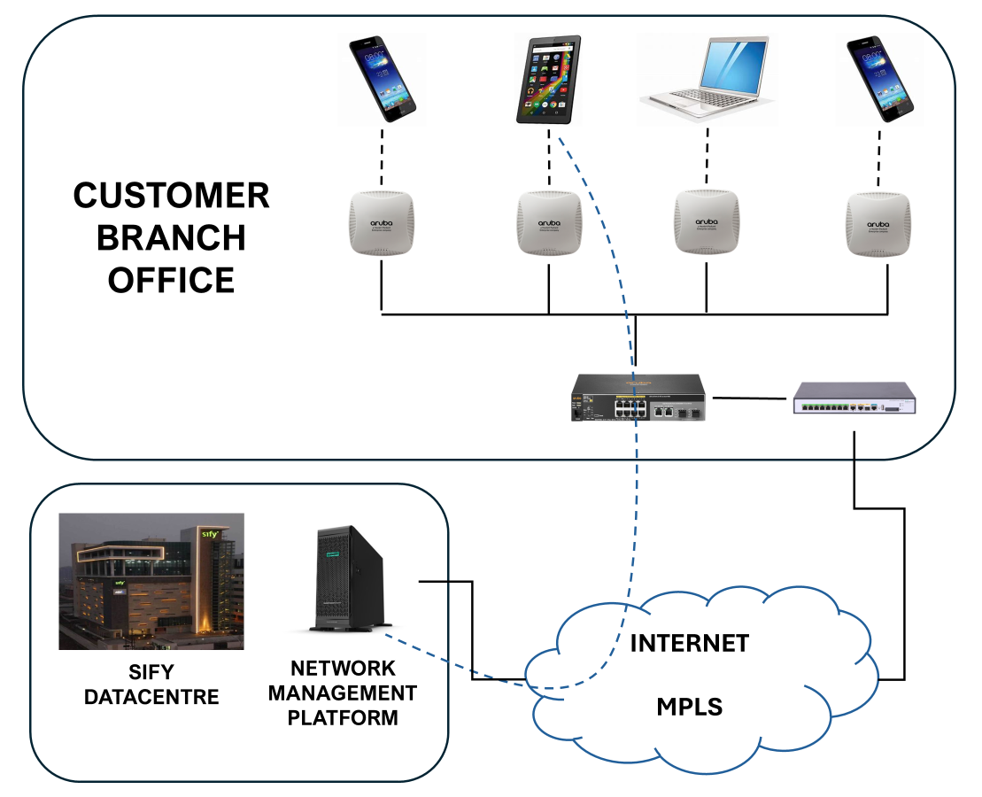
Aruba wi-Fi Architecture
Key Components
User Devices
Access Points
PoE Switches/ Injectors
Router/ Firewall
Connectivity Link
Network Management Platform

Slide 18
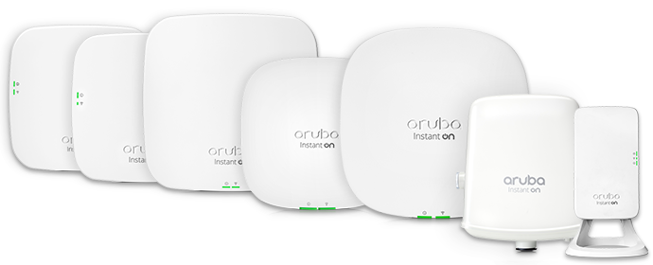
Aruba Access Points
Aruba wireless access points deliver superb Wi-Fi performance to meet the density and performance needs of customer environment – they can be deployed as controller-managed (ArubaOS) or controller less (Instant OS) APs depending on the design, scope and scale of the wireless network.
Aruba Access Point Classifications
Indoor Access Points
Rugged Access Points
Outdoor Access Points
Hospitality Access Points
Remote Access Points
Notes:
Indoor Access Points
Indoor access points are normally preferred for enterprise offices, schools, retails, auditoriums etc.
This is normally the preferred access point from the cost perspective.
Rugged Access Point
Rugged Aruba wireless APs deliver gigabit Wi-Fi performance to mobile devices in harsh, weather-protected environments such as warehouses, industrial freezers or enclosures in extreme environments such as stadiums.
Outdoor Access Point
Innovative and aesthetically-designed outdoor wireless access points deliver gigabit Wi-Fi performance to 802.11ac mobile devices under any weather conditions. Recommended for outdoor deployments such as Parking lots, Tourist attractions, Public hotspot etc.
Hospitality Access Point
The multifunctional and affordable access point (AP) combines high-performance wireless mobility with wired Gigabit Ethernet access in a surprisingly compact device. Compact and cost-effective dual-radio AP easily mounts to a standard data wall-box and uses the existing structured cabling system to provide secure wired and wireless network access in dormitories, classrooms, hotels, medical clinics and multitenant environments. Can easily be converted to a desk mounted AP to provide the same benefits for branch offices and teleworkers.
Remote Access Point
Extend the same corporate user experience to small branch and remote sites with a solution that’s easy to deploy and manage. Aruba remote access points come preconfigured, so employees simply plug in to any existing Internet connection and they’re ready to go. Remote APs extend the corporate network to users working from home, or at temporary work sites. This means users can access the same SSID, Intranet, and other services.

Slide 19
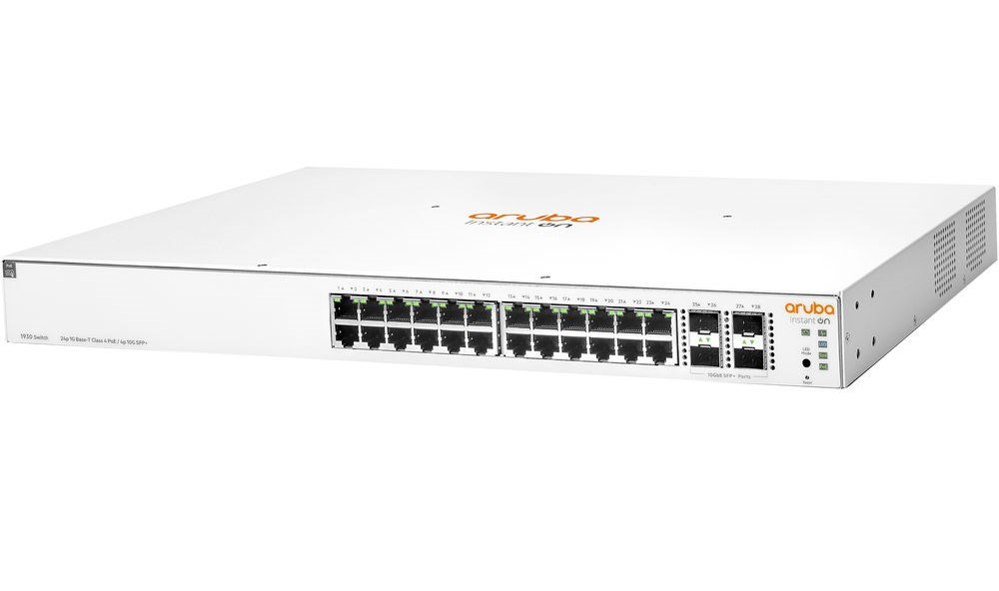
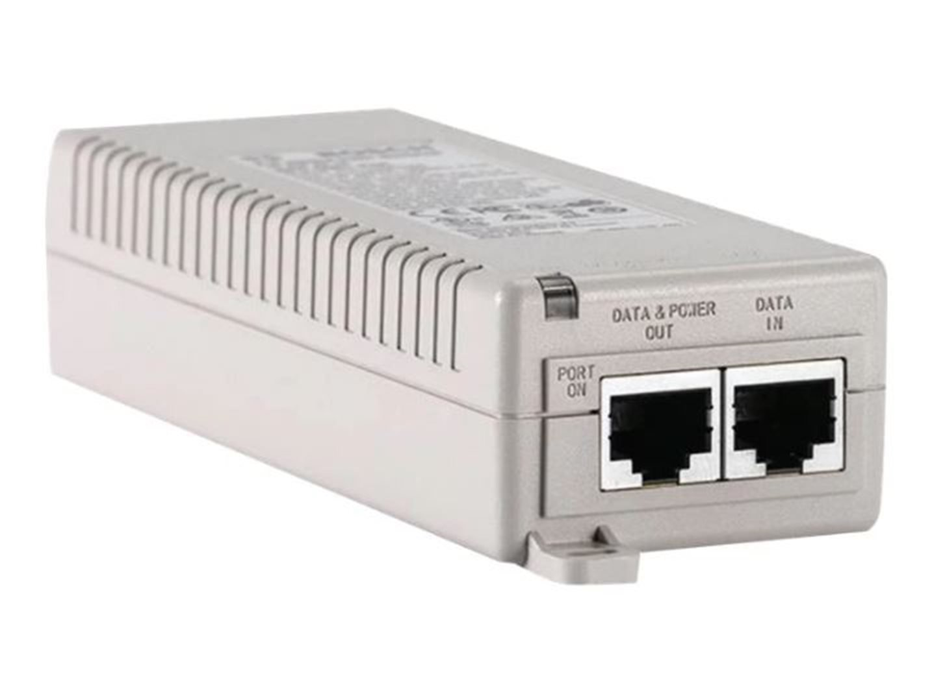
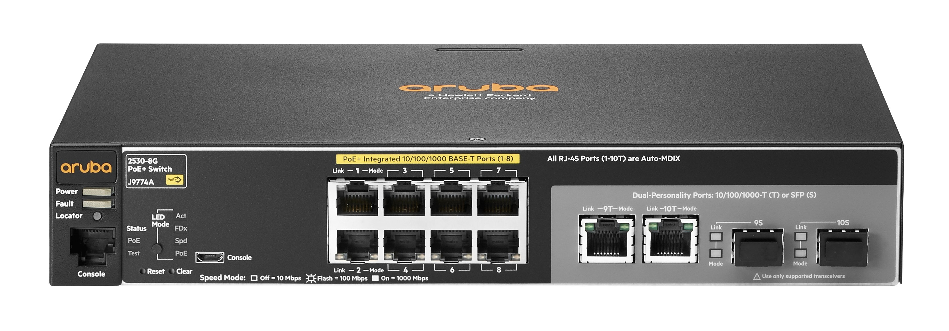
Aruba PoE Switches
Sify Scope of MWLAN Switches is primarily PoE switches used for powering on Access points where the access point count are more than 2 in a single location.
Aruba switches bring performance and reliability to the mobile-first campus. These industry-leading switches are scalable, secure, and feature HPE Smart Rate multi-gigabit ports for high-speed connectivity.
These switches ensure that connectivity, security and smart network management complement each other so that all these devices can securely connect.
Aruba’s switches integrate seamlessly with the wireless network as well as with Aruba’s industry-leading security and network management solutions
Notes:
Sify is also delivering Managed services for monitoring and management of Aruba Switches deployed by third party in Customer Premises, through Sify NMS and Management platform CPPM.

Slide 20

Licensing: ClearPass (CPPM) (1/2)
Aruba’s AAA server (CPPM) provides role and device-based network access control for employees, contractors and guests across any multivendor wired, wireless and VPN infrastructure.
With a built-in context-based policy engine, RADIUS, TACACS+, Non-RADIUS enforcement options, device profiling, posture assessment, on boarding, and guest access options, ClearPass is unrivaled as a foundation for network security in organizations of any size.
FEATURES
Role-Based Access Enforcement
Scalable Virtual Appliances
Intuitive Policy Configuration
Authentication/ Authorization Flexibility
Self-Service Device Onboarding
Customizable Guest Access
Aruba 360 Security Exchange Program
SSO for Improved User Experience
Advanced Reporting and Alerts
Device Fingerprinting
Virtualization Platform Support
Notes:
Role-based network access enforcement for multi-vendor wireless, wired and VPN networks
Virtual appliances that can be deployed in a cluster to increase scalability and redundancy
Intuitive policy configuration templates and visibility troubleshooting tools
Supports multiple authentication/ authorization sources (AD, LDAP, SQL dB)
Self-service device on boarding with built-in certificate authority (CA) for BYOD
Guest access with extensive customization, branding and sponsor-based approvals
Supports NAC and EMM/MDM integration for mobile device assessments
Comprehensive integration with the Aruba 360 Security Exchange Program
SSO supports Ping, Okta and other IM tools to improve user experience on SAML 2.0-based applications
Advanced reporting and granular alerts. Bandwidth limiting, Time of day access features
Active and passive device fingerprinting
Support for virtualization platforms such as VMware, Microsoft, CentOS & Amazon

Slide 21
Licensing: ClearPass (CPPM) (2/2)
There are two types of Licenses namely Appliance and Application licenses. This is a mandatory license for all ClearPass deployments as the licenses enables the ClearPass application on the VM.
Appliance License: For enabling ClearPass on the VM. This will be a perpetual License (Permanent).
Application Licenses: ClearPass application licenses are available in three types, Access, Onboard and OnGuard. They are available as perpetual and subscription-based licenses
Access Licenses
Enables 802.1X, MAC Authentication, TACACS+, Guest, OnConnect, 360 Security Exchange, and Endpoint Profiling
Consumption based on a concurrent session per-endpoint model
360 Security Exchange, Endpoint Profiling, and TACACS+ (from 6.7.1) enabled with at least 100 licenses installed
Onboard Licenses
Enables automated provisioning and creation of unique device identity certificates
Consumption based on an active certificate per-user model
Available as perpetual or subscription licenses for 100 to 10K concurrent endpoints
OnGuard Licenses
Leverages agents for advanced endpoint posture assessments over various connections
Consumption based on a per-endpoint model for persistent and dissolvable agents
Available as perpetual or subscription licenses for 100 to 10K concurrent endpoints
Application License Types
Notes:
1 ACCESS LICENSES
The Access license is used to enable 802.1X, MAC Authentication, TACACS+, Guest, OnConnect, 360 Security Exchange (previously ClearPass Exchange) and Endpoint Profiling. Access license consumption is based upon a concurrent session per-endpoint model. The 360 Security Exchange, Endpoint Profiling and TACACS+ (starting with 6.7.1) are enabled when at least 100 Access licenses are installed but do not consume any Access licenses. A session is considered active when an endpoint is authenticated/authorized and actively connected to the network. When a new endpoint establishes a session, an Access license is removed from the pool. When the endpoint discontinues the session, an Access license is returned to the pool. Session checks are performed every 15 minutes. If the session end cannot be identified (e.g. no accounting), the license will be removed from the pool for a period of 24 hours from the time the endpoint authenticated/authorized and connected to the network.
2 ONBOARD LICENSES
The Onboard license is used to enable automated provisioning and the creation of unique device identity certificates for any Windows, macOS, iOS, Android, ChromeOS, and Linux devices via a user driven, self-guided portal. Onboard license consumption is based upon an active certificate per-user model. For example, if a given user has four devices with an active certificate each, only one onboard license is required. If over time, three out of the four devices are retired, and their associated certificates revoked, the fourth device certificate being active will still keep the onboard license associated to the user. Onboard licenses are available as perpetual or subscription-based licenses from 100 to 10K concurrent endpoints. Multiple Onboard licenses can be installed on a standalone appliance or cluster for increased licensed capacity, for example 100+100+100 = 300. Subscription licenses (which include support) are tracked both on licensed capacity and term. If two subscription licenses are installed 6 months apart, the total term will be one and a half years however in the last 6 months, the licensed capacity will drop to the remaining valid subscription.
3 ONGUARD LICENSES
ClearPass OnGuard leverages persistent and dissolvable agents to perform advanced endpoint posture assessments over wireless, wired and VPN connections. OnGuard’s health-check capabilities ensure compliance and network safeguards before devices connect. OnGuard license consumption is based upon a per-endpoint model. For example, if the OnGuard persistent agent is to be installed (persistent agent) or used (dissolvable agent) on five endpoints within a 24-hour period, five OnGuard licenses are required. OnGuard licenses are available as perpetual or subscription-based licenses from 100 to 10K concurrent endpoints. Multiple OnGuard licenses can be installed on a standalone appliance or cluster for increased licensed capacity, for example 100+100+100 = 300. Subscription licenses (which include support) are tracked both on licensed capacity and term. If two subscription licenses are installed 6 months apart, the total term will be one and a half years however in the last 6 months, the licensed capacity will drop to the remaining valid subscription.

Slide 22
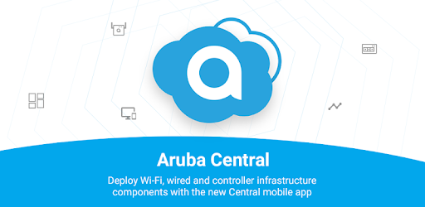
Licensing: Aruba Central
Aruba Central is a cloud-based network management solution offered by Aruba Networks,
It’s a centralized user-friendly dashboard for managing Aruba networking devices, including APs, switches, and branch controllers.
Being a cloud-native solution, it offers the flexibility of managing distributed networks from anywhere, providing
It supports advanced features such as role-based access control, real-time analytics, and firmware updates
This contributes to a seamless and scalable network management experience for organizations of varying sizes

Slide 23
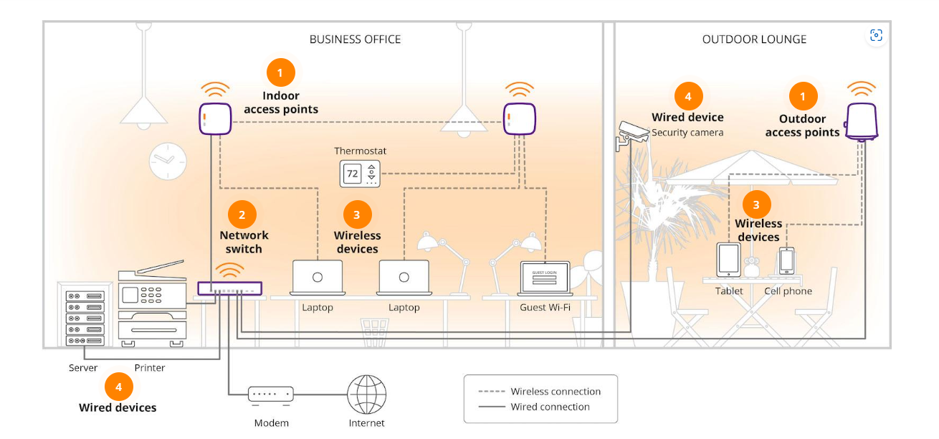
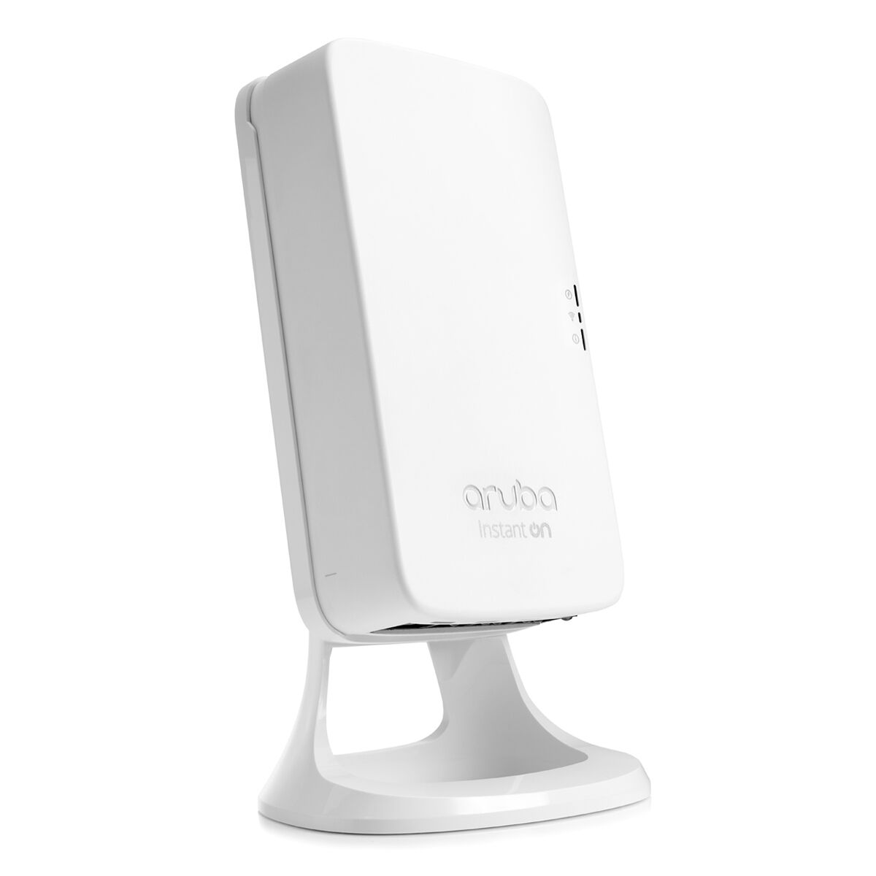
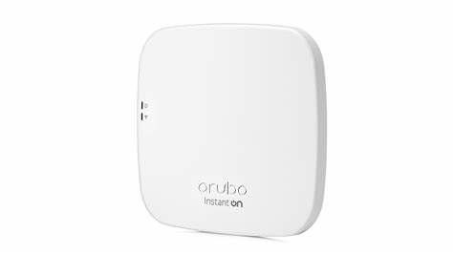
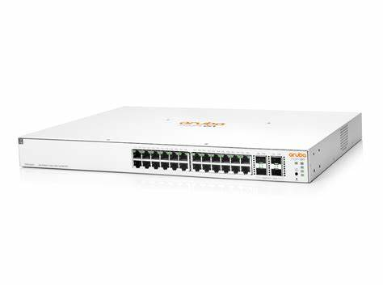
Aruba Instant On
Aruba Instant On is a line of networking products and solutions targeted towards small and medium-sized businesses (SMBs). It offers a range of features and benefits tailored to meet the networking needs of SMBs
Instant On devices are designed for easy installation and configuration, making it simple for SMBs to set up their network infrastructure without requiring advanced technical expertise
This product offers a cost-effective networking solution tailored to the needs and budgets of small and medium-sized businesses while having the reliability of Aruba

Slide 24
The Meraki Platform

Slide 25
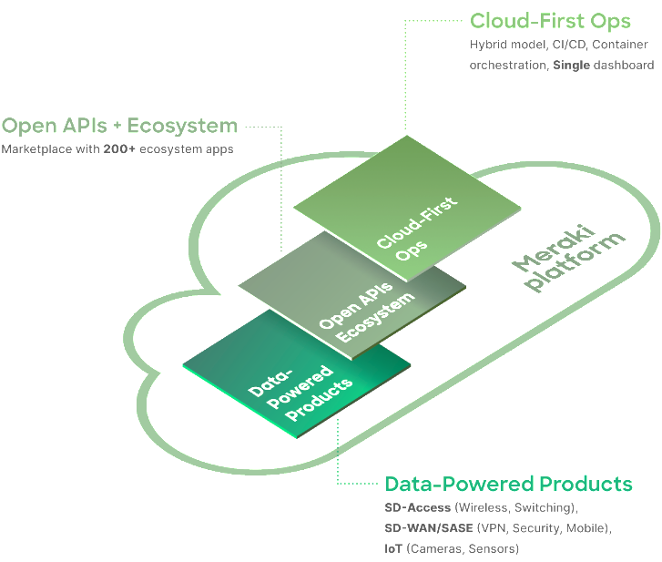
Control everything, deploy everywhere
Deploy Faster: Meet The Network's Ever-changing Needs In Minutes
Manage Everywhere: Run Operations Easily From One Dashboard On Any Device
Scale Reliably: Grow The Business With A Solid Ecosystem Of Apps And Technology Partners

Slide 26
Meraki Ecosystem
MR – Wireless
Variety of models that cater to indoor/ outdoor, hospitality, high performance, & value priced WiFi6E access points
MX – Security
A complete Unified Threat Management solution sized from small branch to Datacenter levels
MS – Switching
Stackable switches for networking & connectivity with 10 Gbps, 40 Gbps & 100 Gbps interface options
MV – Smart Cameras
Simplifying security with out-of-the-box provisioning & flexible management for real-time visibility
MG – Cellular Gateway
Unlock wireless WAN connectivity via cellular links for backup & redundancy
MT – Sensors
Indoor sensor models for protecting critical assets with out-of-the-box & real-time environmental visibility
Sify Managed

Slide 27
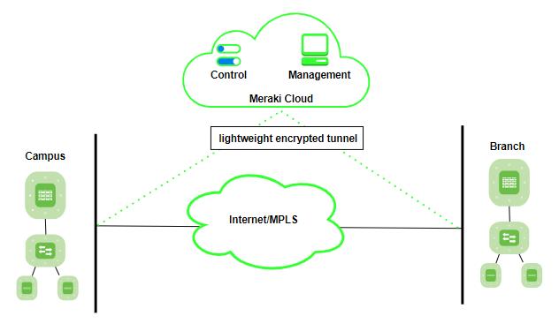
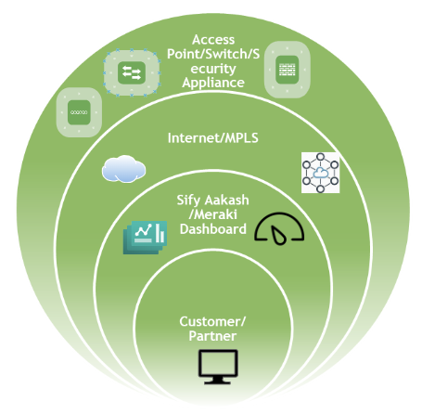
Meraki Architecture
Managed Wireless Services Architecture for the Meraki Platform

Slide 28
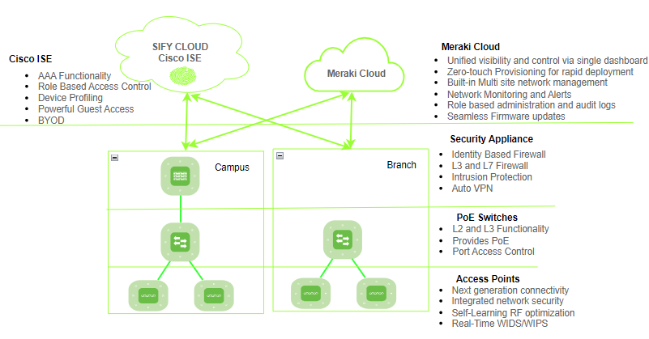
Meraki Solution Components

Slide 29

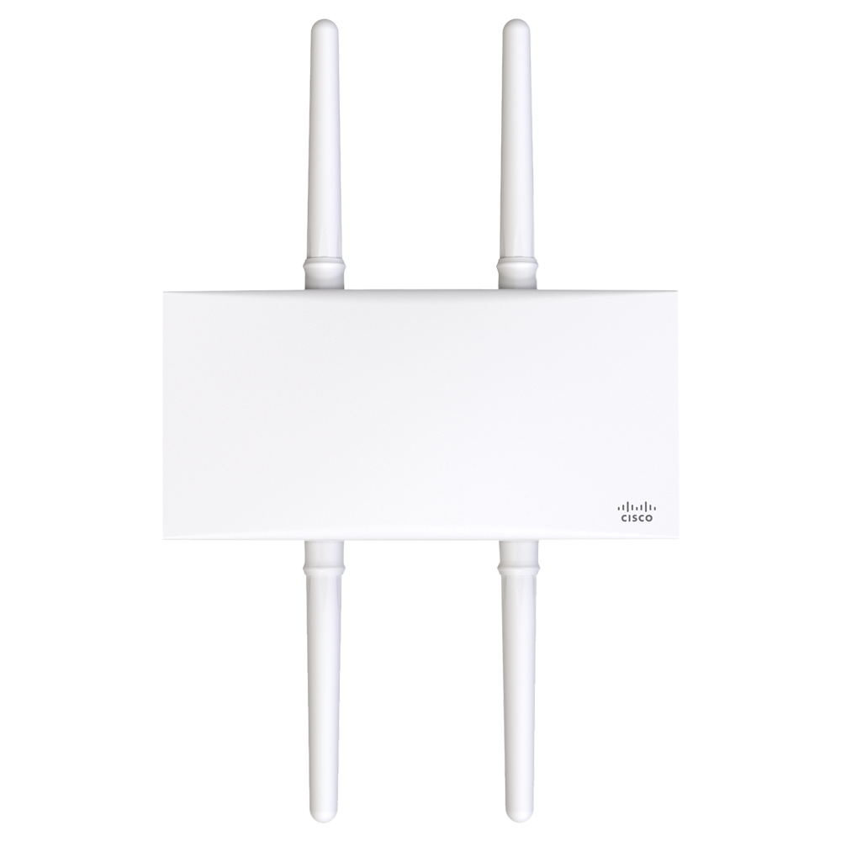
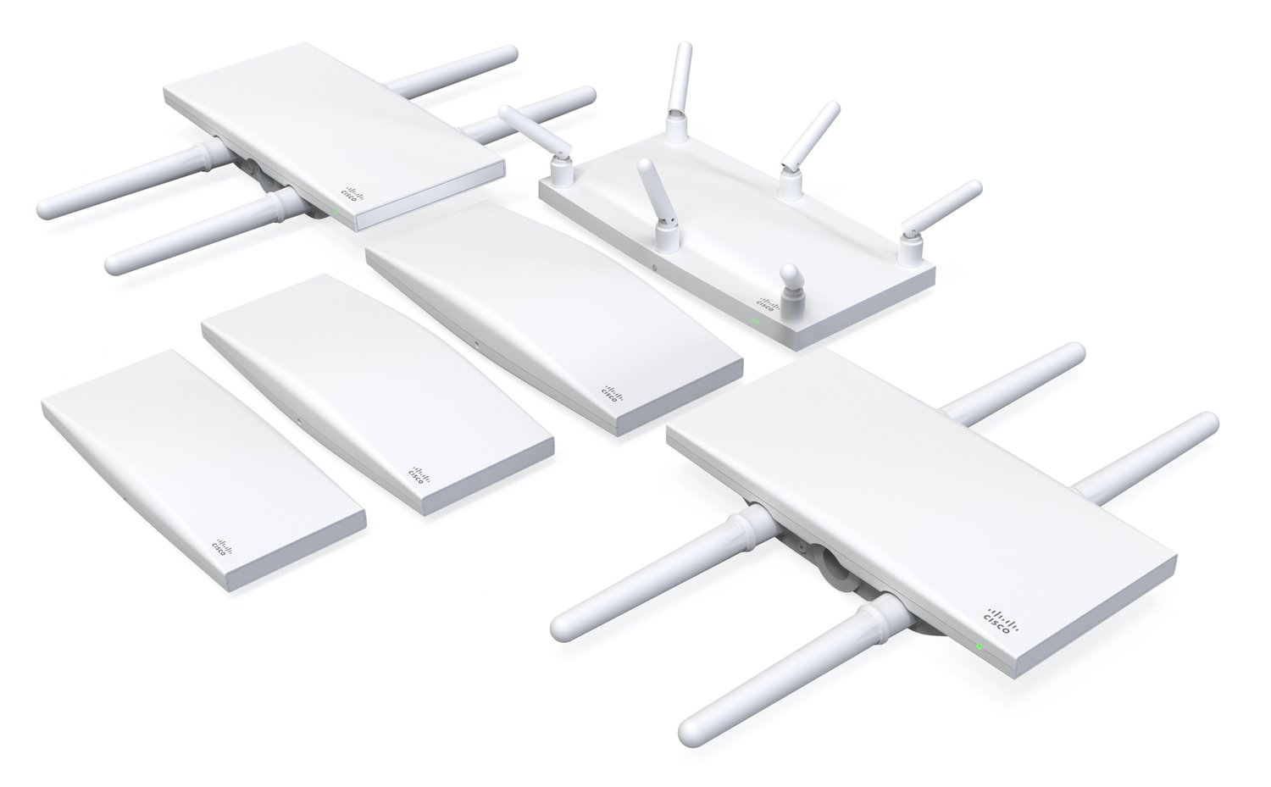
Meraki Access Points (MR)
Cloud Management
All Meraki devices can be centrally managed through the Meraki Dashboard, thus MRs can be configured, monitored, and troubleshot from any location with internet access
Zero-touch Deployment
All Meraki devices can be deployed with minimal manual configuration. Once connected to the network, they automatically pull configurations from the cloud, streamlining the deployment process
Intelligent Radio Assignment
Support intelligent radio assignment, which optimizes the allocation of 2.4 GHz and 5 GHz frequencies based on real-time usage and interference conditions
Mesh Networking
Support mesh networking, allowing MRs to wirelessly extend the network coverage without the need for additional cabling
Auto RF Management
The Auto RF feature continuously monitors the radio environment and adjusts settings dynamically to optimize performance
Integrated Security Features
MRs include built-in security features such as WPA3 encryption, stateful firewall, integrated Layer 7 application visibility, and content filtering
Scalability
Meraki solutions are designed to scale easily, whether deploying a small network for a single location or managing large, distributed networks with thousands of access points.
Location Analytics
MRs can provide location analytics, allowing ability to gather insights on visitor behavior, track foot traffic, and analyze user engagement within a physical space
Firmware Updates
Firmware updates are automatically managed through the cloud, ensuring that devices are always running the latest and most secure software.
Application Visibility & Control
MRs offer Layer 7 visibility, allowing administrators to see which applications are being used on the network for policy enforcement and network optimization.

Slide 30
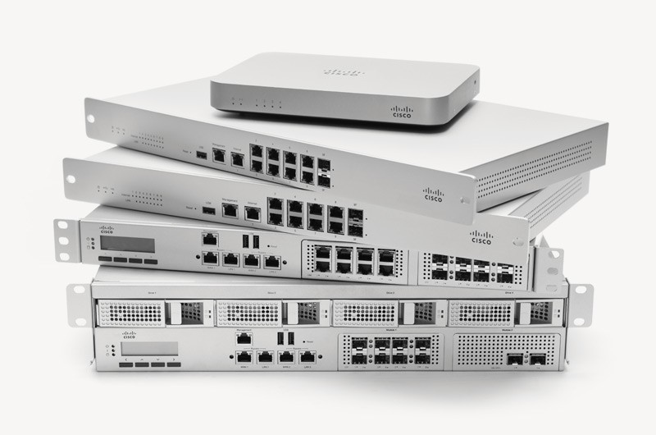
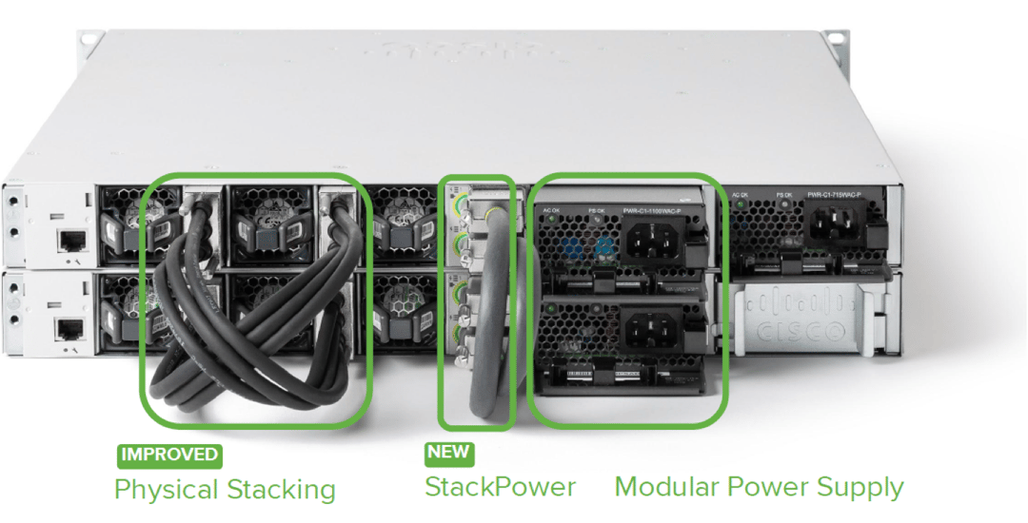
Meraki Switching (MS)
Network Visibility and Monitoring
The Meraki Dashboard provides comprehensive visibility into the network, including real-time monitoring, traffic analysis, and historical data. This allows administrators to quickly identify and address network issues.
Power over Ethernet (PoE) Support
Many Meraki switches support Power over Ethernet (PoE) and PoE+ to power devices such as IP phones, cameras, and access points directly through the Ethernet cable, eliminating the need for separate power sources.
Stacking and Virtual Stacking
Meraki switches support physical stacking, allowing multiple switches to be interconnected and managed as a single logical unit. Virtual stacking is also supported, enabling the management of multiple switches as a single entity, even if they are not physically stacked.
Smart Link Aggregation
Meraki switches support link aggregation, allowing multiple physical links to be combined into a single logical link. This enhances redundancy and increases available bandwidth between switches and connected devices.

Slide 31
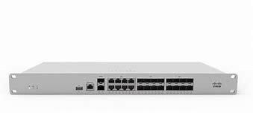
Meraki Firewalls (MX)
Cisco Meraki MX (Meraki Security Appliance) are a series of cloud-managed security appliances designed to provide a comprehensive security solution for networks. These are part of the Cisco Meraki cloud-managed networking portfolio and offer a range of features to secure and manage network traffic
Unified Threat Management (UTM)
Integrates various security features into a single appliance, offering UTM capabilities. This includes firewall, VPN, intrusion prevention, content filtering, and antivirus functionalities
Cloud Management
Fully cloud managed. Administrators can configure and monitor the MX devices using the Cisco Meraki dashboard, a centralized and intuitive web-based interface
Auto VPN and SD-WAN
Support Auto VPN, making it easier to establish secure site-to-site VPN connections.SD-WAN is also supported, optimizing the performance of network traffic across multiple locations
Application Visibility and Control
Provide visibility into network traffic, allowing administrators to monitor and control the usage of applications. This helps in optimizing bandwidth and ensuring appropriate application access policies
Threat Intelligence Integration
Leverage threat intelligence to enhance security. MX can identify and block threats based on real-time data and updates from Cisco's Threat Intelligence feeds
Content Filtering
The MX series includes content filtering capabilities, allowing administrators to enforce web usage policies and block access to inappropriate or non-business-related content
Layer 7 Firewall
Meraki MX firewalls operate at the application layer (Layer 7) of the OSI model, allowing for granular control and visibility into applications and user activities on the network
Integration with Other Meraki Devices
MX firewalls seamlessly integrate with other Meraki devices, such as Meraki access points and switches, creating a unified and centrally managed network infrastructure

Slide 32
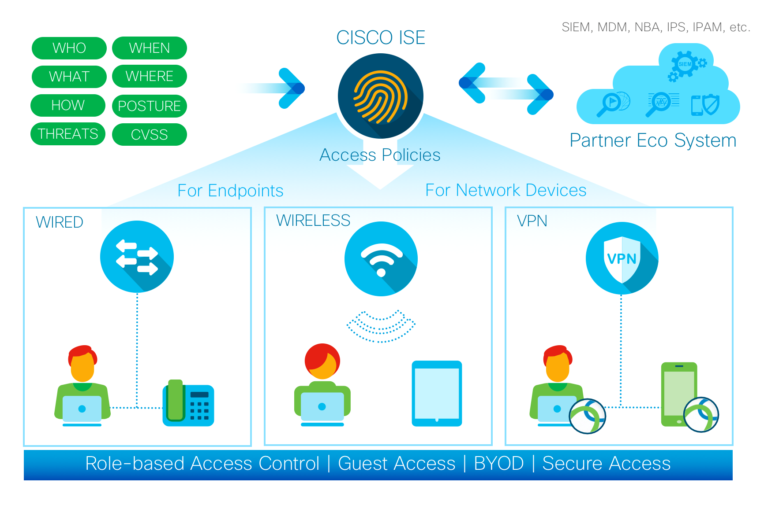
Licensing: Cisco ISE
Cisco Identity Services Engine (ISE) is a comprehensive security policy management platform that enables organizations to enforce security policies across the network infrastructure. When it comes to authentication, Cisco ISE offers different license types and features to support various authentication methods and requirements.
Base Licenses: Includes fundamental functionalities such as device administration, posture assessment, profiling, and guest services. It lays the foundation for all other features, including authentication
Authentication Licenses: Determines the number of concurrent authentications the ISE deployment can handle. Depending on the scale and needs, authentication license level is chosen
Advanced Cisco ISE Features
Multi-factor Authentication (MFA)
Device Registration
Adaptive Network Control (ANC)
BYOD Licenses
Guest Services Licenses
Notes:
Cisco ISE provides advanced features related to authentication, such as:
Multi-factor Authentication (MFA): ISE supports various MFA methods, including one-time passwords (OTP), certificates, and more. Advanced licenses may be required to enable and manage these features.
Device Registration: Some deployments may require device registration as part of the authentication process. Cisco ISE can assign policies based on the type and health of the device, and additional licenses may be needed for this functionality.
Adaptive Network Control (ANC): ANC allows ISE to dynamically adjust access policies based on the security posture of the endpoint device.
BYOD (Bring Your Own Device) Licenses: Cisco ISE can play a crucial role in BYOD scenarios, ensuring that personal devices meet security compliance before granting access to the network. Licenses associated with BYOD features may be required for this functionality.
Guest Services Licenses: Cisco ISE can provide guest access with different levels of authentication and authorization. Guest services licenses may be necessary to manage the guest access policies, including authentication for guest users.

Slide 33
Licensing: Enterprise & Advanced Security
Enterprise License:
The Enterprise License is a comprehensive license that covers a range of features across Meraki product lines
Advanced Security License:
This license is specific to Meraki security appliances and includes additional security features
Features
Features
Comprehensive Cloud Management
24/7 Customer Support
Firmware Updates
NBD Hardware Replacement
Scalability
Smart Licensing
Feature Enablers
Location Analytics
Bluetooth/ WiFi Analytics
Enhanced Threat Protection
Intrusion Detection and Prevention (IDS/IPS)
Advanced Malware Protection (AMP)
Content Filtering
Web Search Filtering
URL Categorization
Threat Intelligence Feeds
Security Dashboard and Reporting
Policy Enforcement
Notes:
Meraki Enterprise License:
Comprehensive Cloud Management:
The Enterprise License is the foundational license required for all Meraki devices. It enables cloud-based management through the Meraki Dashboard, allowing administrators to configure, monitor, and troubleshoot Meraki devices from anywhere with internet access.
Firmware Updates:
The Enterprise License includes access to firmware updates. This ensures that Meraki devices are running the latest and most secure software, with new features and enhancements.
24/7 Customer Support:
With the Enterprise License, customers have access to 24/7 customer support provided by Meraki. This support covers technical assistance, troubleshooting, and guidance in managing Meraki deployments.
Next-Business-Day Hardware Replacement:
In the event of hardware failure, the Enterprise License includes next-business-day hardware replacement. This helps minimize downtime by providing a replacement device promptly.
Feature Enablers:
While the core cloud management features are available with the base license, the Enterprise License may include additional feature enablers that enhance the capabilities of specific Meraki devices. For example, in the case of security appliances, the Enterprise License might include advanced security features.
Scalability:
The Enterprise License is designed to scale with the organization's needs, whether it's a small deployment or a large, distributed network with numerous Meraki devices.
Smart Licensing:
Meraki uses Smart Licensing to simplify the license management process. Smart Licensing allows administrators to manage and allocate licenses efficiently, ensuring that devices have the necessary licenses for their features.
Insight License:
The Insight License is designed for Meraki access points and provides enhanced analytics and location-based services, including location analytics and Bluetooth/Wi-Fi analytics.
Meraki Advanced Security License:
Enhanced Threat Protection:
The Advanced Security License includes enhanced threat protection features to bolster the security posture of the Meraki security appliances. This may include advanced threat detection and mitigation capabilities.
Advanced Malware Protection (AMP):
AMP is a key component of the Advanced Security License. It provides protection against advanced malware, including zero-day threats. It uses advanced techniques to analyze and detect malicious files in real-time.
Intrusion Detection and Prevention (IDS/IPS):
The license includes intrusion detection and prevention features that monitor network traffic for suspicious or malicious activity. It can help identify and block potential threats, enhancing overall network security.
Content Filtering:
Advanced Security License may include content filtering capabilities, allowing administrators to control and filter web content based on categories. This helps enforce acceptable use policies and enhances web security.
Web Search Filtering:
The license may provide web search filtering capabilities, allowing administrators to control access to search engine results and filter out potentially harmful content.
URL Categorization:
Advanced Security License may offer URL categorization features, enabling administrators to categorize and control access to websites based on predefined categories.
Threat Intelligence Feeds:
Integration with threat intelligence feeds provides real-time information on emerging threats and helps Meraki security appliances adapt to new and evolving security challenges.
Security Dashboard and Reporting:
The license may include additional reporting and dashboard features specific to security. This helps administrators gain insights into security events, threats, and the overall security posture of the network.
Policy Enforcement:
Advanced Security License allows for more granular policy enforcement based on the detected threats and the security policies defined by the organization.
Smart Licensing:
Like other Meraki licenses, the Advanced Security License may be managed through Smart Licensing, providing a simplified approach to license management

Slide 34
Sify’s Solution Platform

Slide 35
Managed WiFi Platform capability
Role-based Network Access Enforcement for Multi-vendor Wireless, Wired & VPN Networks
Posture Checks for Endpoint Compliance
User Profiling & Device Profiling
Health-check Capabilities to Ensure Compliance & Network Safeguards Before Devices Connect
Multiple Authentication/ Authorization Sources (AD, LDAP, SQL Db)
Self-service Device Onboarding with Built-in Certificate Authority (CA) for BYOD
NAC And MDM Integration for Mobile Device Assessments
Comprehensive Integration with OEM Security Exchange Programs
End User Device Monitoring with NOC Services
User Access Tracking for Monitoring & Troubleshooting
Intuitive Policy Configuration Templates & Visibility Troubleshooting Tools

Slide 36
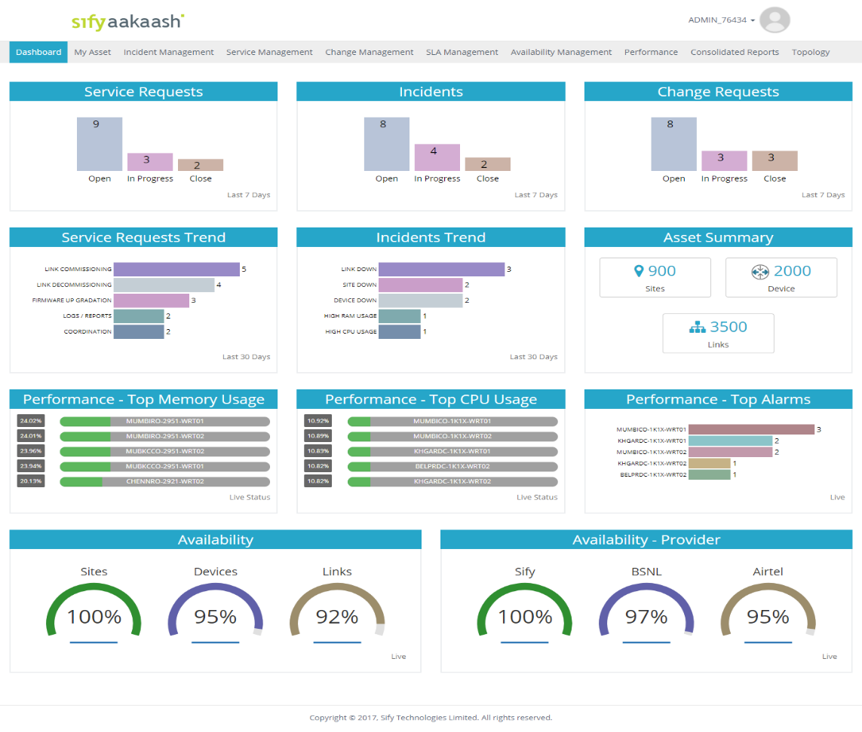
Sify AAKAASH – CUSTOMER PORTAL
  Customer Service Portal Highlights:
  Sify Aakaash Portal is customer facing portal that offers integrated view of the Service requests, Network performance Reports, Inventory and trouble tickets that have been registered for the issues reported and identified pro-actively.
  All the incidents and changes are recorded through the system for customer visibility as well as for analysis
  Enhanced real-time and scheduled reporting based on defined configuration

Slide 37
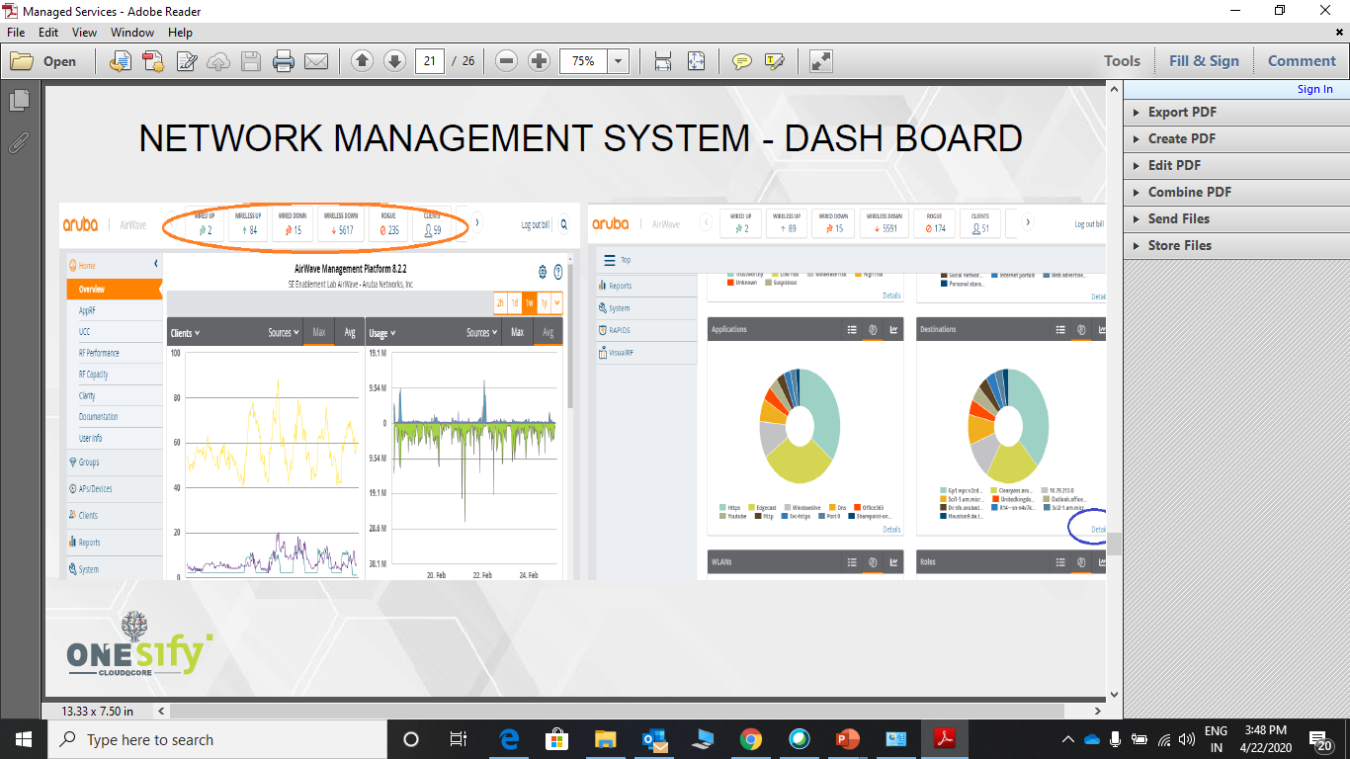
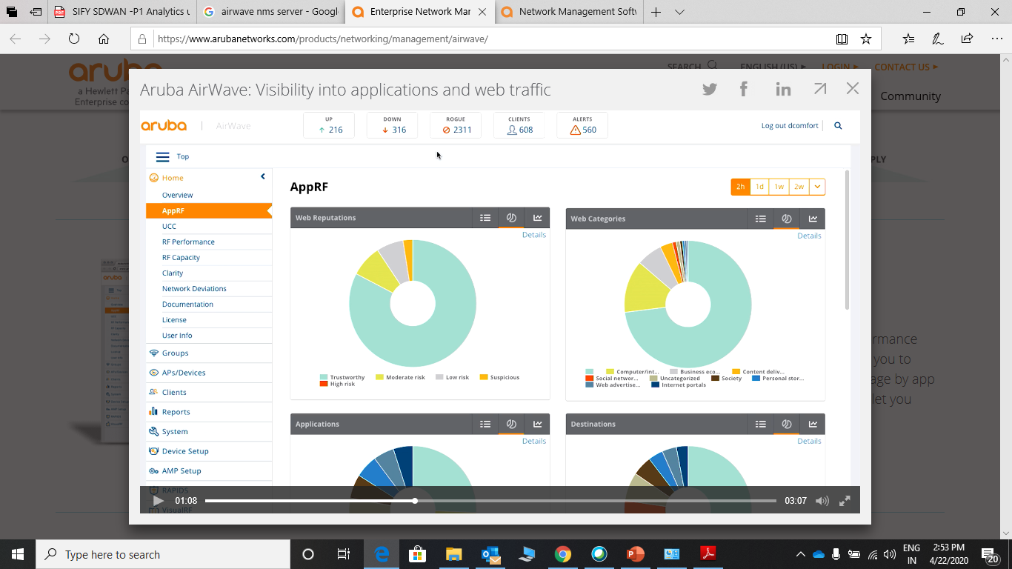
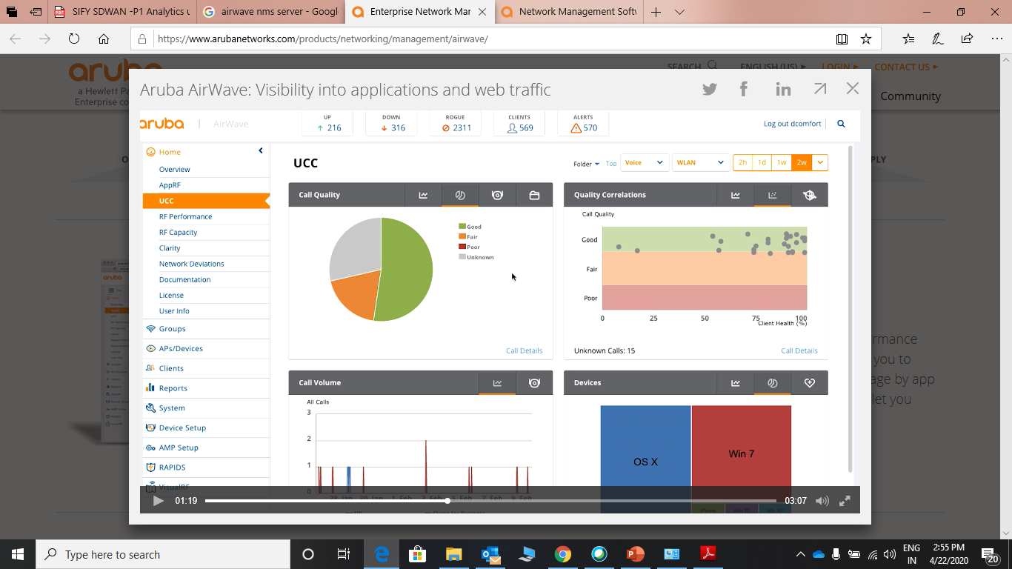
Dashboards
Details Clients, RF Performance, Capacity and Reports
Details of Top applications , Application visibility by destination and Web traffic

Slide 38
Case Study

Slide 39





Enabling digital transformation for the world’s second-LARGEST geographically diversified steel producer
Objectives
To establish a NOC integrating IT, OT assets to enable insights into the Network across DC, Cloud and End users.
Build and Operate a Private Network across all Campuses
Integrated Value and Outcome
  Specialized skillsets and processes across NOC setup & managed services which outclassed the traditional IT outsourcing model deployed by the incumbent.
  MWiFi platform integration with customer’s Access & Identity Management System (AIMS), ensured an integrated Platform for all IT, OT assets, as well as Wearable Safety devices across its workforce.
ENABLING DIGITAL TRANSFORMATION
Project Model
  Managed Services led model – per device/ per node
Sify’s Uniqueness
  Integrated value of skills – NSP, Network Integrator, NOC & Managed Services, Network Transformation Services, Security Services alongside Network Infrastructure services
Value for customer
  The NOC has enabled network orchestration and analytics for the customer across his IT & OT assets and people, which in turn has resulted in better efficiency & control.
  Sify’s Private Network has enabled large scale sensorization of plant operations leading to better efficiencies and significant cost savings.

Slide 40
CUSTOMER PAIN AREAS
Design
Configuration
Visibility
Reporting
Scalability
Management
Authentication
Guest Access
User experience
SLA
Role based policy enforcement for different profiles of users not available.
No online visibility into the ongoing activity of the Wi-Fi Users
Complete end-to-end WLAN management from a central console not possible
Multiple authentication modes at the same time were not available
No Controlled Internet access to guest users with OTP based authentication
Poor end user experience resulted in Wi-Fi not being the preferred network
There was no accountability & SLA on the Wi-Fi provider
Poorly designed & conceived AP positioning resulted in blackspots in many areas
Granular reporting on Wi-Fi usage was not available.
Rapid addition of WLAN nodes not possible

Slide 41
MANAGED WIFI – KEY OBJECTIVES
IT OBJECTIVE
BUSINESS OBJECTIVE
Uptime → High uptime, preferably 99.99%.
Coverage → 100% coverage across all locations with the help of floor plan survey and heat maps to determine the exact count of APs required.
Security → Integration with AD & Security systems & policies for seamless & secured access for all employees, guests.
Scalability → Highly scalable system that can be rolled out PAN India
User Access → Seamless access for employees & guests across locations, as per their profile and access policies, with freedom to use their own devices.
Monitoring & Management → Real time monitoring, management & reporting (on users, applications, bandwidth, security) from a single dashboard for countrywide visibility,
SLA → End-to-end responsibility on a single vendor with SLA.
Access on the move → Seamless access on the move for users
Secured Access → Ease of access to Internet and Corporate application, as per current IT Policy
BYOD → Flexibility of letting users use multiple types of devices: corporate Laptop, Mobile, handheld terminals etc
Guest Access → Temporary Guest user access over a secured connection & smooth authorization process
Managed Services → Managed Services Model ensuring
  protection from technological obsolescence,
  prevent extra spend due to design flaws,
  save on manpower & skillset enhancements,
  hire the best in industry.
Reporting → Single dashboard visibility on complete network, locations, users, applications, service providers etc.

Slide 42
MANAGED WIFI – KEY OBJECTIVES
Benefits to users
Benefits to IT Team
Seamless integration with Customer’s AD server has helped to ensure that wherever the user goes, he is able to access the applications over the WiFi network based on his profile and access policy without needing to do any configurational changes in his device.
Users are also able to get uninterrupted WiFi access over the entire office premises (spread across multiple buildings) even while on the move.
AD access with single sign-on and self registration facilities have ensured that users no longer have to wait for getting access to the WiFi network
Users are able to access the WiFi network using their preferred devices such as Laptop’s or handhelds and are no longer tied to their desktops.
User access controlled through multiple auth mechanism (AD / MAC auth for employees & 2-factor auth for guests) has ensured that unauthorized users are unable to access Wi-Fi network.
Implementation of Wireless Intrusion Prevention system (WIPS) has ensured that any external attack / intrusion happening on the WiFi network is captured & prevented in real time
Integration of the heat maps with NMS dashboard gives real time visibility of signal coverage across the WiFi network, enabling better handling of user complaints, capacity planning, health monitoring & management etc.
Integration with Customer’s security systems ensures secured access over the WiFi network.
Detailed visibility & analytics helps the IT team to rationalize network capacities across locations in terms of bandwidth, network elements, switch ports etc.

Slide 43
MANAGED WIFI – KEY OBJECTIVES
Benefits to Leadership Team
Benefits to Business
An unprecedented real time and in-depth visibility of the network, users, applications etc. on a single dashboard enables the leadership team have a complete view of:
  Entire network and its performance,
  Applications and their usage across the company,
  Users, their access habits & productivity towards the organization
Detailed visibility coupled with granular reporting and analytics enables the leadership team take important and critical decisions fast in terms of investments, roll-outs etc.
In depth visibility & detailed analytics helps the leadership team take quick decisions on the IT team’s reports of network rationalization across offices and locations thereby saving cost and enhancing efficiencies.
Deeper engagement with the service provider leads to greater trust between the two organizations. This helps to ensure that the service provider always goes the extra mile to serve his client.
A well-planned network reaching every nook & corner of the premises and designed with role-based access policies enables the users to access their critical applications securely even while on the move thereby helping them to take decisions faster.
A high uptime, highly stable and secure network enables users to utilize their time better and more productively.
A properly designed guest access policy also enables the management to extend the WiFi access to selective guests as they deem fit.
Integration of the WiFi network with the BMS / HMS application enables the management to keep track of all users and their activities across the premises, detect any unauthorized entry etc. and immediately raise alerts with IT team for speedy resolution.

Slide 44





IoT Project
Managed Wi-Fi to enable connectivity for the IoT devices implemented at multiple customer locations
Managed Wi-Fi to enable connectivity for the IoT devices implemented at multiple customer locations
The Customer’s floor locations require Access Points equipped to function at extreme environments
The data from the sensors need to transferred to the IoT developer & NMS for monitoring and reporting

Slide 45





TATA MAIN HOSPITAL, JAMSHEDPUR
Providing complete High Availability Wi-Fi Network coverage of hospital building infrastructure - 99.99% SLA
Managing Access and Authentication of different user sets - VIPs, Doctors and Employees and Guests
Providing predictable and secure network infra to enable personalized healthcare experiences from edge to cloud
Sify is helping improve patient and staff experiences while improving operational outcomes.
We enabled rapid and seamless client onboarding and proactive monitoring and support of the Wi-Fi Network
Notes:
Network Access System - ClearPass Policy Manager (CPPM)
Network Management System – Aruba Airwave

Slide 46




Benefits/ outcomes for our client
1
Unified Operations
Centralized management and orchestration across campus, branch and remote work
2
Seamless Connectivity
Application assurance and live upgrades for Clustering environment for high performance and business continuity
Market Development
3
Secure Access
Automated and unified Dynamic Segmentation for IoT and users supports Zero Trust and SASE frameworks
4
Flexibility
Rapid scale, on-demand connectivity, consumption-based commercial models

Slide 47

Benefits/ outcomes for our client
Seamless Connectivity
Flexibility
Application assurance and live upgrades for Clustering environment for high performance and business continuity
Rapid scale, on-demand connectivity, consumption-based commercial models
Unified Operations
Secure Access
Visibility
Centralized management and orchestration across campus, branch and remote work
Automated and unified Dynamic Segmentation for IoT and users supports Zero Trust and SASE frameworks
Instant APs has automated RF mgmt. to ensure strongest WLAN connections to all devices with granular visibility to apps for prioritization of business-critical data

Slide 48



VOLUMETRIC DATA in the project
1535
23
1471
166
162
User Count
Controllers
Access Points
Air Monitors
PoE Switches
Notes:
Network Access System - ClearPass Policy Manager (CPPM)
Network Management System – Aruba Airwave

Slide 49

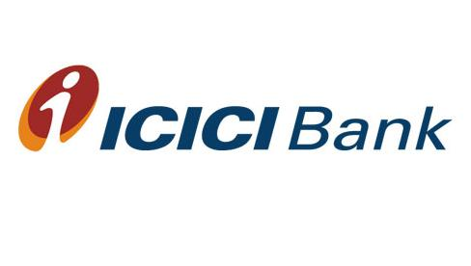





Our Managed WiFi CLIENTS

Slide 50
Thank you

Slide 51

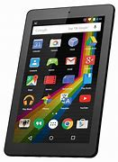

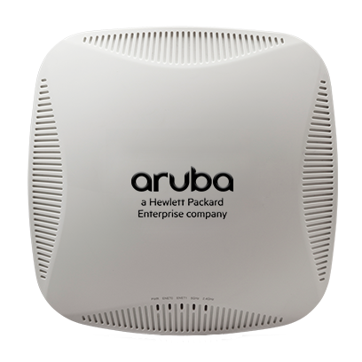
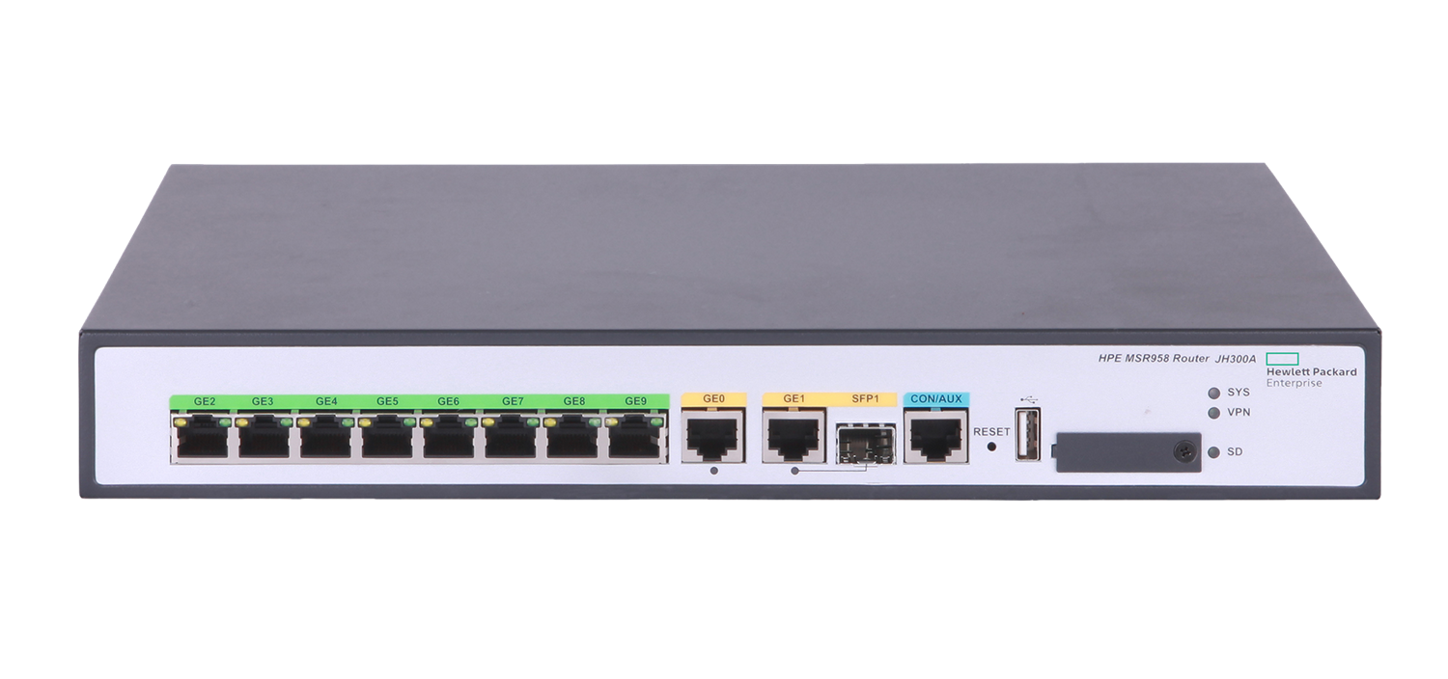
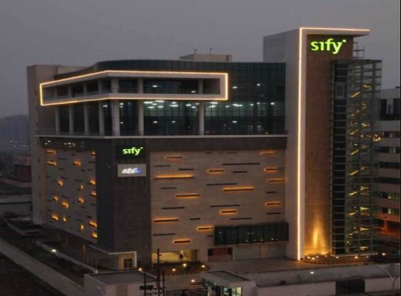
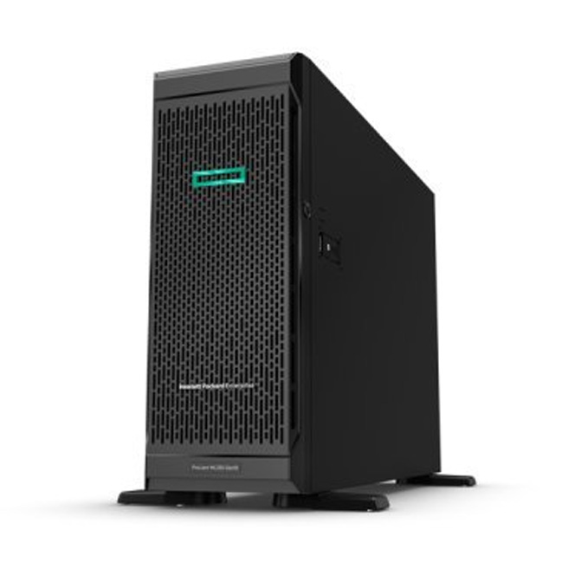
CUSTOMER BRANCH OFFICE
INTERNET
MPLS
SIFY DATACENTRE
NETWORK MANAGEMENT PLATFORM

