Slide 1
KERELA, TAMIL NADU, WEST BENGAL SDCs
Integrated Case Study

Slide 2
Accelerating TRANSFORMATION Journey for the State Government
Govn.
Project Objective
Design and build integrated digital infrastructure on Private Cloud with Managed Services
Integrated Value and Outcome
Sify’s digitally-enabled products and services:
Design, build, and manage integrated State Data Centers (SDCs) in Kerala to boost eGovernance activities of the state with private cloud build to ensure a scalable and resilient integrated infrastructure.
Private cloud and automation-enabled solution along with infrastructure for dynamic and on-demand allocation of SDC resources to different departments
Seamless transition from existing DCO and OEM services for SDCs
Committed SLA with Support Renewal for existing IT and non-IT infrastructure
Managed services with onsite team ensured reliable and efficient operations
ITIL based processes ensured seamless change, incident, and process management with continual environment optimization
Full lifecycle responsibility through assessment, implementation, and tech refresh within a record timeline
Compliance ready infrastructure to meet regulatory guidelines
Project Model
Private Cloud IT Build model
Sify’s Uniqueness Sify’s experience, assets, and partner ecosystem for executing large scale SDC projects for Government. The Integrated solution covering different elements –
Scalable, highly available, and virtual infrastructure for private cloud
DC setup using best-of-breed technology
Managed Services provider
Cost optimization
Private Cloud Build
Value for Client
Single point of ownership for integrated infra build and management
Enhanced visibility and reduced downtime through highly available infrastructure
Increased operational efficiency resulted in enhanced CSAT scores

Slide 3
Accelerating TRANSFORMATION Journey for the State Government
Govn.
Project Objective
Design and build DR setup with business continuity plan to ensure resiliency
Integrated Value and Outcome
Sify’s digitally-enabled products and services:
Design and build Disaster Recovery(DR) center to implement Business Continuity Plan for critical business applications hosted on the SDC.
Data center build as per Tier III guidelines
Site assessment, DR build, and complete IT and non-IT infra setup
External virtualization for heterogenous storage
Integrated networking solution ensuring low latency and seamless connectivity
EMS suite of monitoring, performance, and fault management, SLA, and helpdesk management
Disaster Recovery Management (DRM) tools and GSLB for automated DR and drills
Unified security controls SIEM, Firewall, and physical security related components
Project Model
On-premise DR Build model
Sify’s Uniqueness Sify’s experience, assets, and partner ecosystem for executing large scale SDC projects for Government . The Integrated solution covering different elements –
DR built using best-of-breed technology
Application and Database Migration
Cost optimization
DR Build
Value for Client
Single point of ownership for design, build, and management
Highly available and scalable IT infrastructure ensuring higher visibility and availability
Increased operational efficiency resulted in enhanced CSAT scores

Slide 4
Accelerating TRANSFORMATION Journey for a Leading Statutory Body
Project Objective
Design and Implement a state-of-the-art, cost-effective, automated and secure DR for business applications
Integrated Value and Outcome
Sify’s digitally-enabled products and services:
Design and build state-of-the-art Disaster Recovery(DR) Center using best-of-breed technology elements at Hyderabad to ensure business resiliency during unprecedented events.
Seamless assessment and migration of applications and data at DR with minimal disruption as per customer’s requirements
Application centric Software Defined Network to ensure low latency
DR security design & implementation using new infra (SIEM, Proxy, IPS, Email security, WAF, APT, and end-point protection) ensuring advanced threat identification and remediation
License cost optimization of OS and DB through architectural efficiencies
Full lifecycle responsibility through assessment, implementation, and migration within a record timeline
Dashboards for real-time input to track RTO and RPO
Meeting core business requirements with compliance ready infrastructure to meet regulatory guidelines
Project Model
On-premise DR Build model
DR Build
Sify’s Uniqueness Sify’s experience, assets, and partner ecosystem for executing large scale migration projects for Government . The Integrated solution covering different elements –
Physical or virtual infra, Software-defined Network, Security, and Managed services
DR workflow automation, SOP, and best practices
Application and data migration from DC to DR
Heterogeneous application aware data replication
Value for Client
Single pane of management for DC and DR
Higher application availability, visibility, and data availability
Compliance-ready infrastructure with enhanced operational efficiency

Slide 5
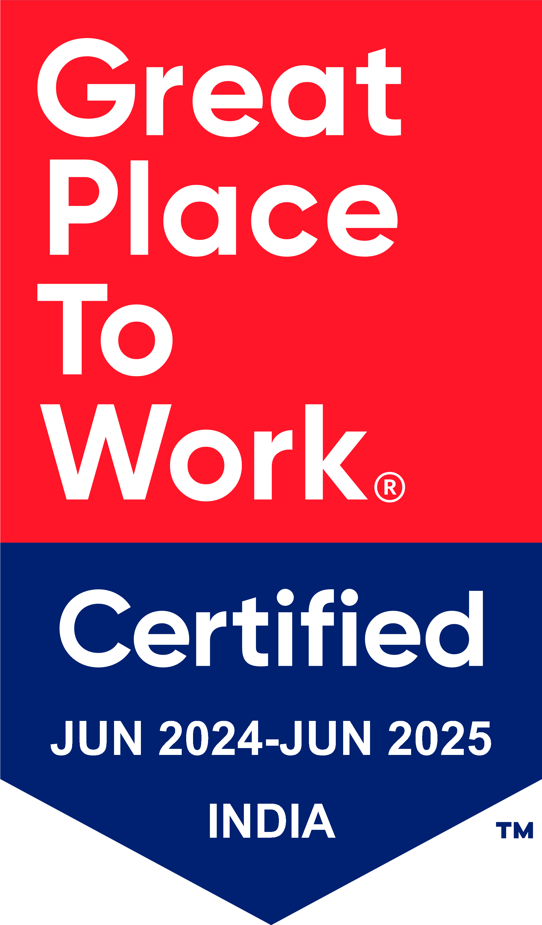
Thank You

