Slide 1
SP ARMADA
Cloud Services Case Study

Slide 2
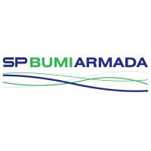
SP ARMADA: DIGITAL TRANSFORMATION FOR Oil & Gas
Oil & GAS
Integrated Value and Outcome Sify’s digitally-enabled products and services:
Build a dedicated DC cloud hosting solution for their SAP landscape on Sify Cloud with comprehensive integrated migration, connectivity, security, and managed services
Set up DC cloud hosting solution at Sify’s Navi Mumbai, Airoli
Assessment, design, and migration of SAP systems using Native Replication Method
All cloud ready applications migrated to Sify CloudInfinit
Cloud Legacy apps and infra in cloud adjacent DC with near zero latency
Integrated DC-network solution to ensure low-latency connectivity
Hybrid security framework for both hosted & cloud footprint
Management of the enterprise cloud resources with hybrid cloud management platform
Full lifecycle responsibility through assessment, minimal downtime migration & implementation within a record timeline
Value for Client
Agile digital-ready compliant infrastructure ensured higher uptime of service levels which resulted in 25% reduction in yearly cost, End-to-end ownership by one partner with SLA, no conflict of interest with application partners.
Project Objective
Implement integrated future ready digital infrastructure on Sify CloudInfinit for their SAP landscape
Project Model
Fully services model(vis-à-vis existing capex + services model)
Private CLOUD LED
Sify’s Uniqueness Sify’s nationwide presence, experience, and partner ecosystem for executing similar IT projects for same industry vertical. The integrated value proposition was built on:
Experienced SAP partner & cloud (Infra + Managed) service provider
Hybrid cloud management platform
DC, DRaaS and Cloud Interconnect (Sify’s own service), Network, Security, and Managed services

Slide 3
A leading oil & gas company looking to bring in more business agility and cost reduction
SP Armada’s transformation goal: To sustain the growth and continue market differentiation with a reliable and compliant digital infrastructure
Objective
Why Sify was chosen?
Sify’s value additions
Implement integrated future ready digital infrastructure on Sify CloudInfinit for their SAP landscape
Migrate SAP landscape to Sify Enterprise cloud to attain an isolated environment
Single provider of infrastructure managed services
Reduce Total cost of ownership (TCO)
Having performed large scale migrations of SAP ecosystem of similar customers to DC-Cloud configurations
Experienced SAP partner & cloud (Infra + Managed) service provider
DC, DRaaS and Cloud Interconnect (Sify’s own service), Network, Security, and Managed services
Facilitated frictionless migration of the workloads and applications to avoid vendor lock-in and realization of cost optimizations
Managing 400+ enterprise customer on Sify CloudInfinit, Azure & AWS platforms
Designed the cloud architecture on Sify CloudInfinit through cloud assessment services to deliver a well-architected framework for risk free cloud migration
Migrated 22+ Instances using the proven CloudInfinit workload migration process
Providing service assurance with Sify multi cloud platform (CMP)

Slide 4
Built secure Sify cloud infrastructure
Before transformation
After transformation
Customer success factors/ benefits
Infra sprawl – Hosted SAP instances to isolated environment
High cost due to over-provisioning
Lack of visibility on capacity utilization and performance
Inability to manage unplanned spikes
Lack of robust security for business-critical applications
Transformation of IT from a maintenance service to a strategic business contributor
Low latency for hosted core applications
Single Sify CI cloud solution for all the workloads
Pro-active monitoring of utilization and performance through CloudInfinit CMP
Pay-as-you go model with Auto-scalability, faster implementation
Implemented advance security framework to safeguard applications
Drive and differentiate SP Armada in its market powered by Sify CloudInfinit transformation framework
Agile digital-ready compliant infrastructure ensured higher uptime of service levels which resulted in 25% reduction in yearly cost
Migration of SAP (core application SAP is running on the same) from Lenovo to Sify’s CloudInfinit
End-to-end ownership by one partner with SLA

Slide 5
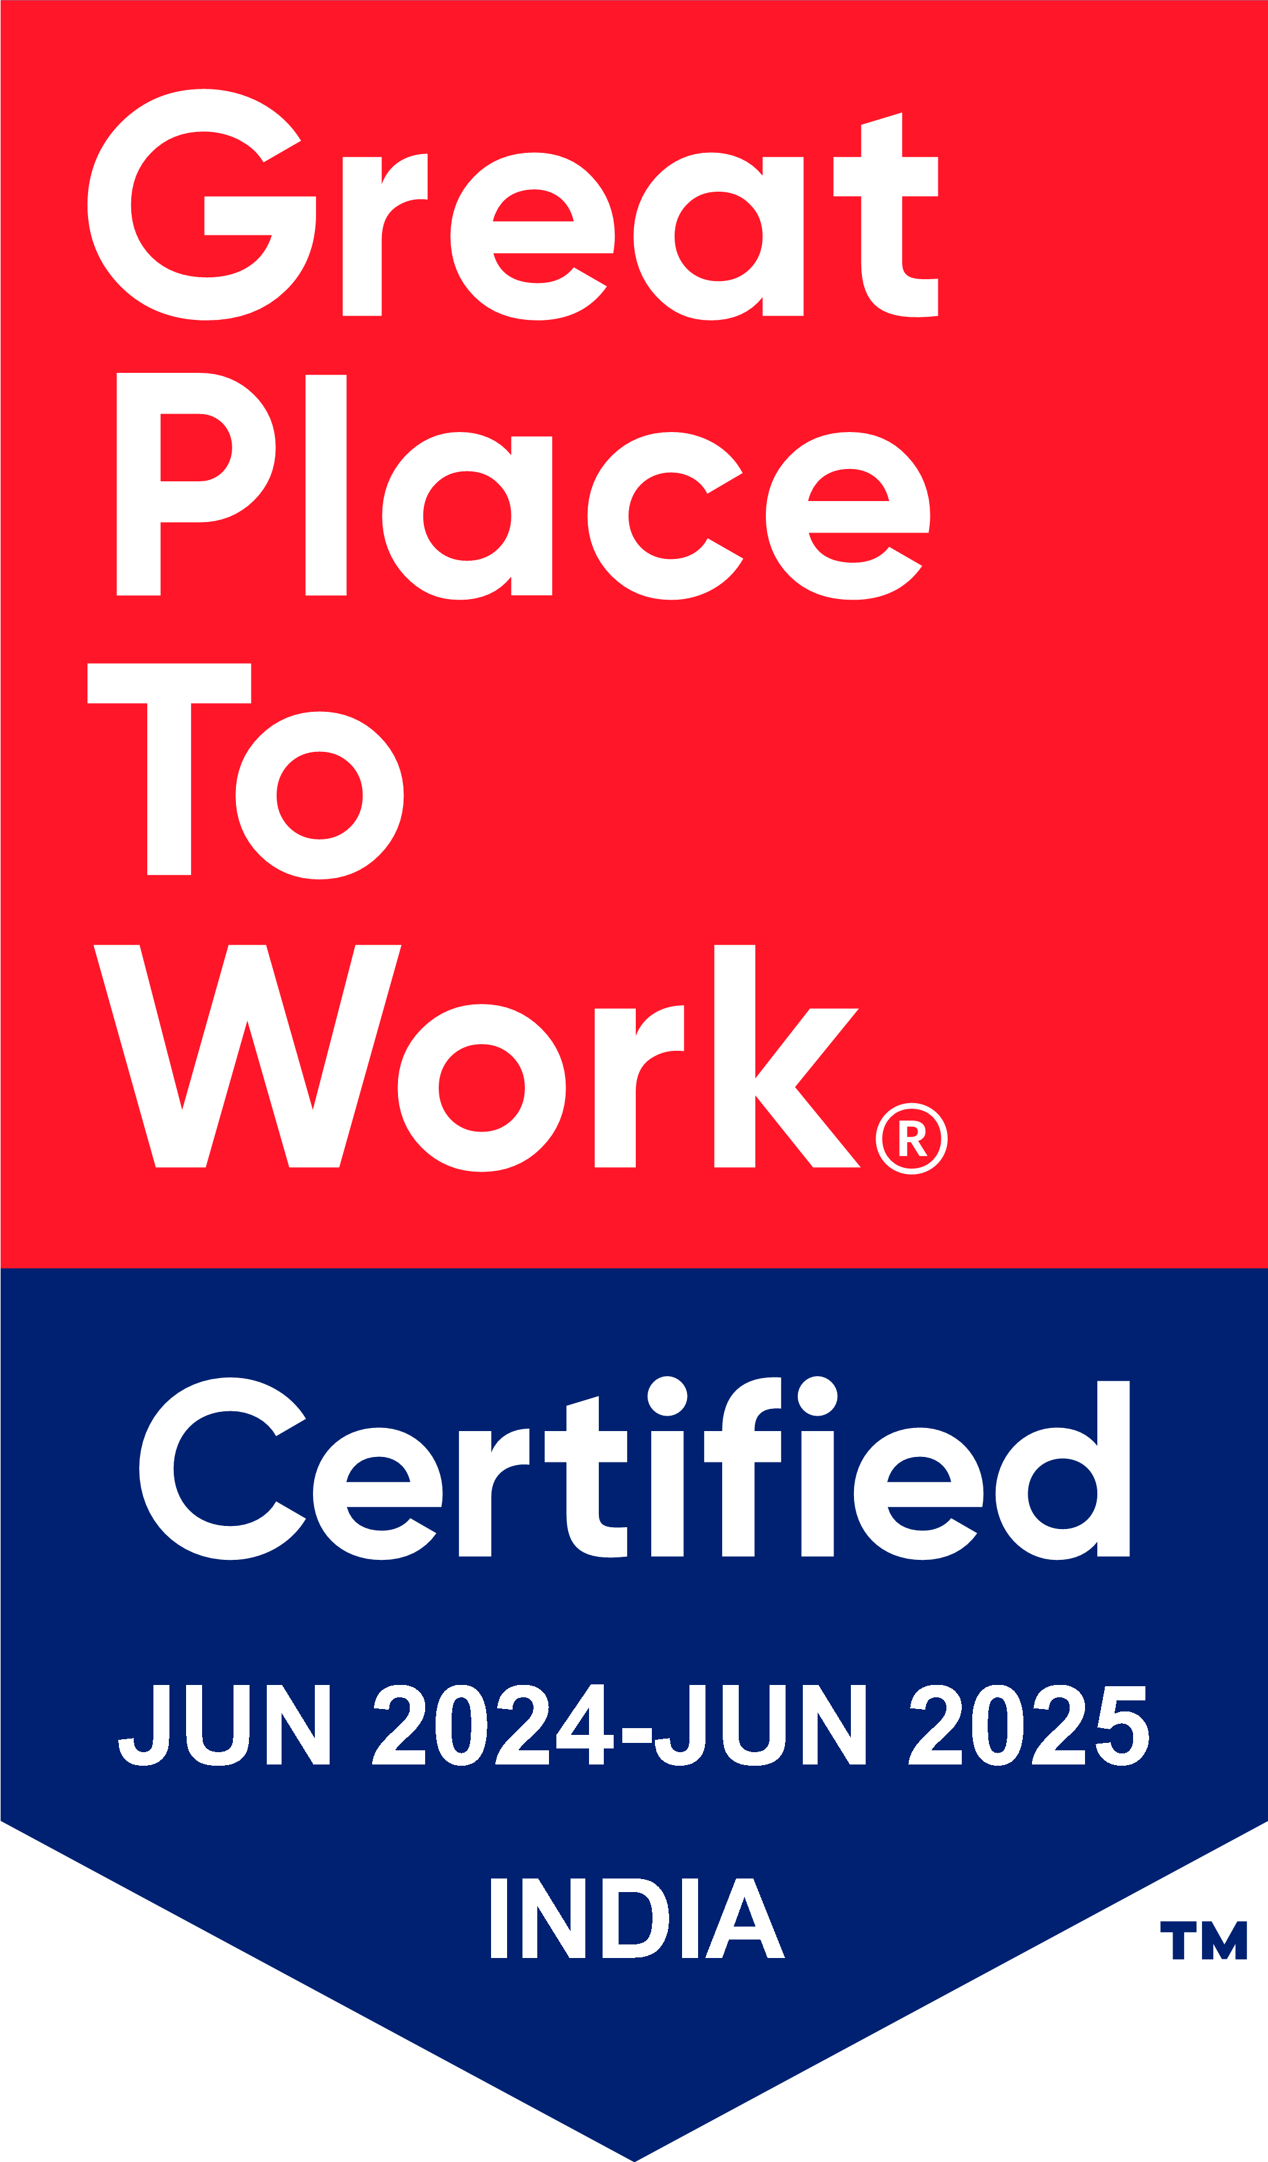
Thank You

