Slide 1
RITTAL - EPLAN
SAP Case Study

Slide 2
Rittal – Eplan Temp. Workmen & Canteen Management
Client
Overview
Rittal is a German Company Headquartered in Herborn. The Company Manufactures Electrical enclosures for use in industrial settings. Founded in 1961, Rittal is a subsidiary of the Friedhelm LoH Group. The name Rittal is derived from the places where the company was founded – Rittershausen in Dietzhölztal.
Scope of Work
Solution Highlights
Rollout the Rittal HCM process into Eplan
Implementation of temporary workers with Rittal full time
Replicating the Rittal HCM scenarios to Eplan (newly acquired company)
Updating & migrating of master data into the newly rolled out HCM system
Capturing the punch in and out timings of the temporary workers in SAP HCM payroll system
Canteen management - linked to the salary component for the amount of food items the employees consume
Benefits
Challenges
Rittal and Eplan employees coming under single HR umbrella
Automation of canteen and the canteen meal passes and direct links to SAP HCM salary master
Migration of legacy excise based pricing procedure to GST based procedure
Master Data validation, correction, upload, training end users on SAP as Eplan was using Tally before this transformation
Identifying the appropriate approving authority in Eplan
Integration of finger swipe machine installed in canteen with SAP system

Slide 3
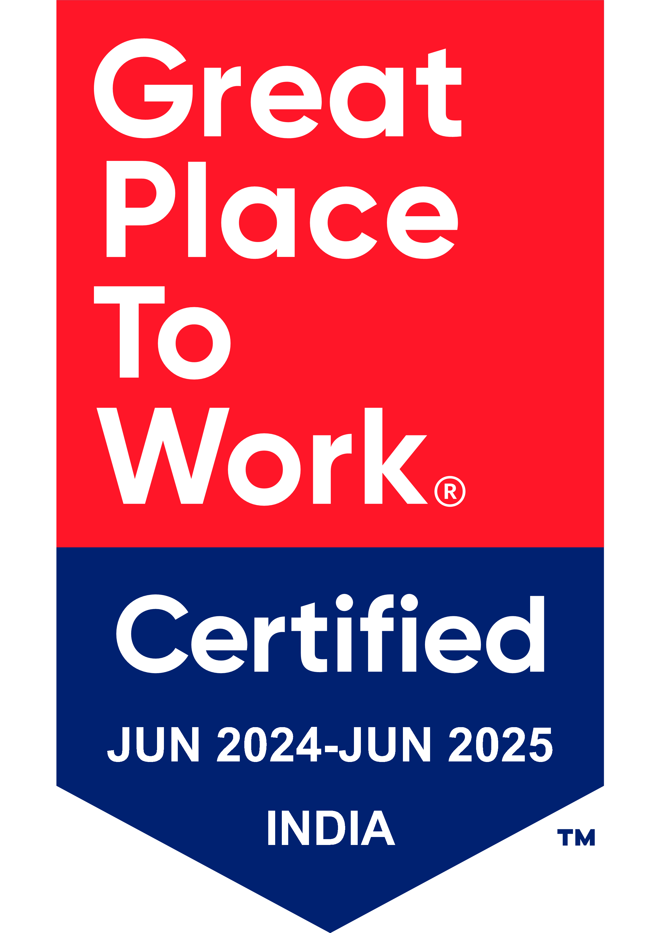
Thank You

