Slide 1
RITTAL
SAP Case Study

Slide 2
Rittal – GST and AMS
Client
Overview
Rittal is a German Company Headquartered in Herborn. The Company Manufactures Electrical enclosures for use in industrial settings. Founded in 1961, Rittal is a subsidiary of the Friedhelm LoH Group. The name Rittal is derived from the places where the company was founded – Rittershausen in Dietzhölztal.
Scope of Work
Solution Highlights
GST implementation
AMS support to the daily business operations
Modules in scope - SD, MM, FI, CO, HCM and ABAP
GST implementation
GST pricing procedure scrapping excise pricing
Providing AMS support for their SD, MM, FI, CO, HCM and ABAP
Approx. 40 tickets monthly
Approx. 5 CRs
80 number of users
Benefits
Challenges
Implementing GST as per Government of India regulation
Improvement in SAP system performance by regular AMS support
Last minute changes by Government in GST and subsequent changes from SAP delayed the GST implementation
Training the users into GST related changes
Coordination with client’s BASIS team - located in Germany with 5 ½ hours of time difference

Slide 3
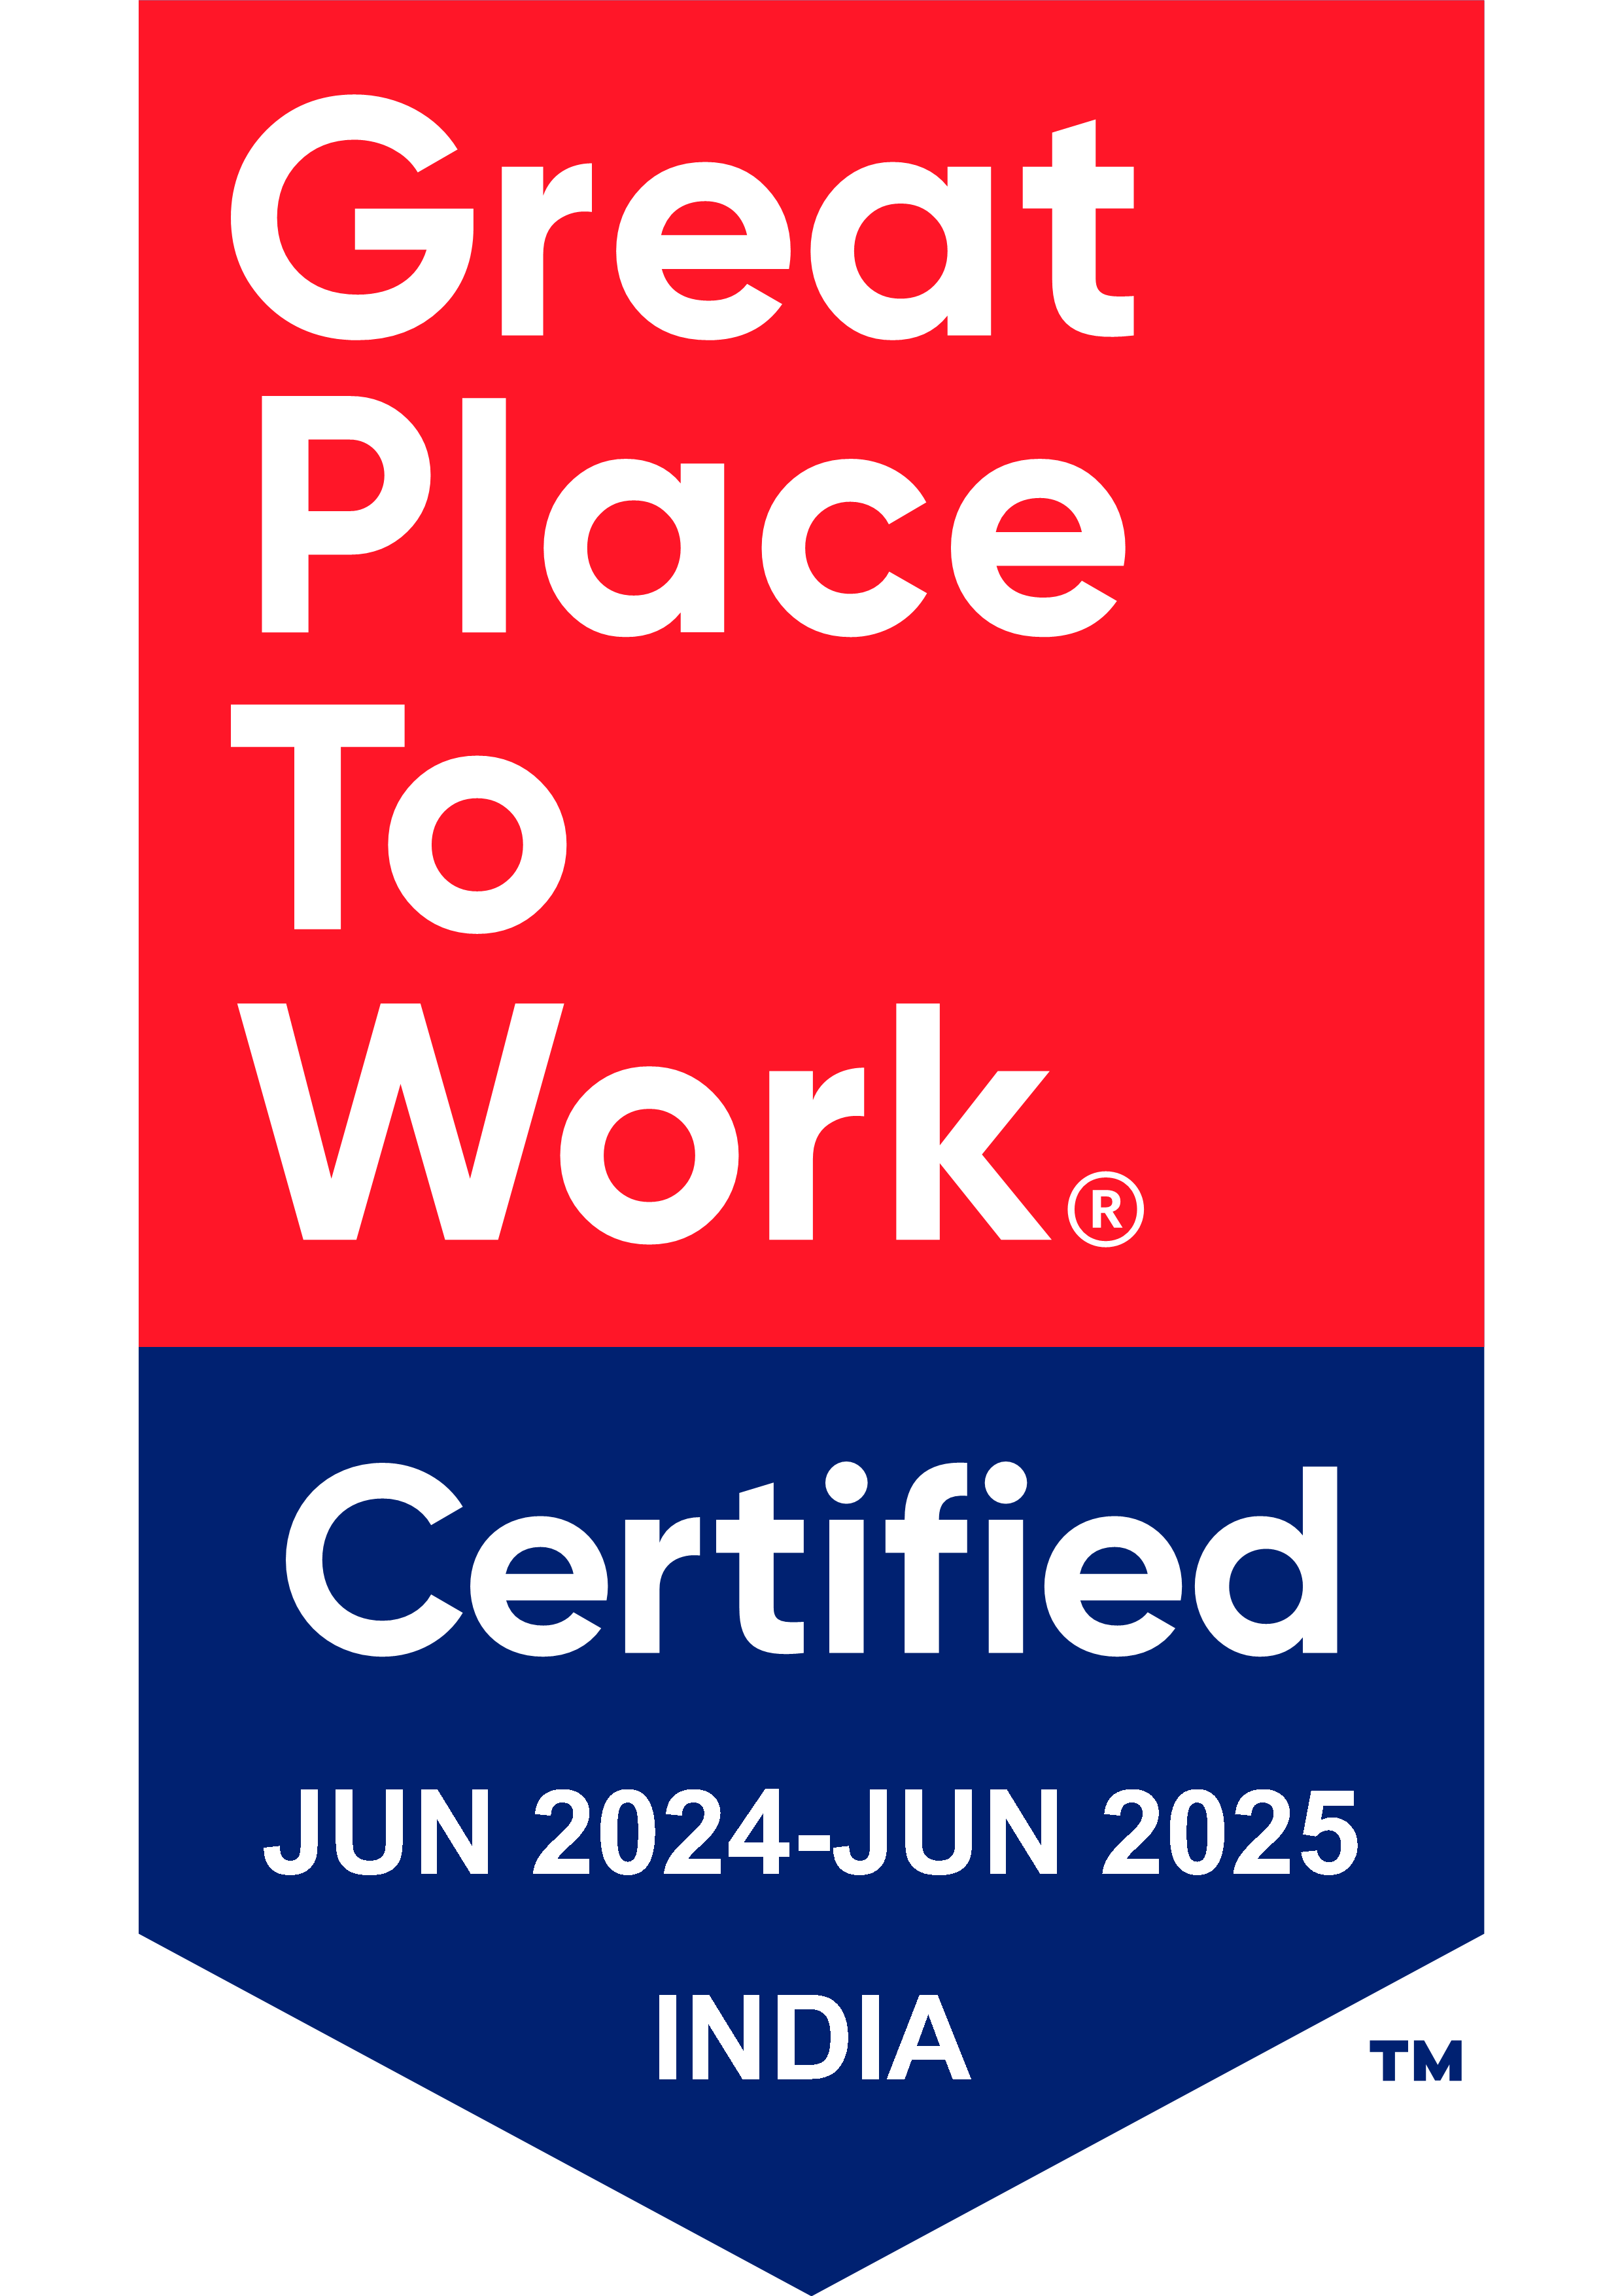
Thank You

