Slide 1
RCI INDUSTRIES
SAP Case Study

Slide 2
RCI Industries – S/4 HANA Implementation & AMS
Client
Overview
RCI Industries and Technologies Limited is a private company which offers Indian handicrafts, specially made by Copper & Brass metals. It also has copper strips and copper wire as its product. Sify is implementing the ERP software, SAP S/4 HANA 1610 FSP2 at RCI Industries and technologies limited.
Scope of Work
Solution Highlights
Implementation of SAP S/4 HANA 1610 FSP2 on cloud solution
Landscape design SAP S/4 HANA 1610 (DEV/QA/PRD)
Documenting business process
Mapping business requirements in SAP
Fiori apps, output and reports
S4HANA – AMS & books closure for 4 Quarters
Implementing the SAP DEV,QAS and PRD server on Sify Cloud
Documented AS IS - TO BE process for business
Configuration of SAP S/4 HANA FI,CO, MM, SD, PP, PM, PS, HR, Basis, ABAP modules
Developing custom programs for process enhancements
Developing Fiori application for analytical and transactional requirements
100 No of Users
200 Man-days AMS support
20 No of CR’s completed in AMS period
Benefits
Challenges
Enhanced user experience
Improvement in SAP system and DB performance
Scalability (being on Cloud)
Content copy and Best practice activation
Complex business process mapping
Master data and transaction data upload for open items
User training

Slide 3
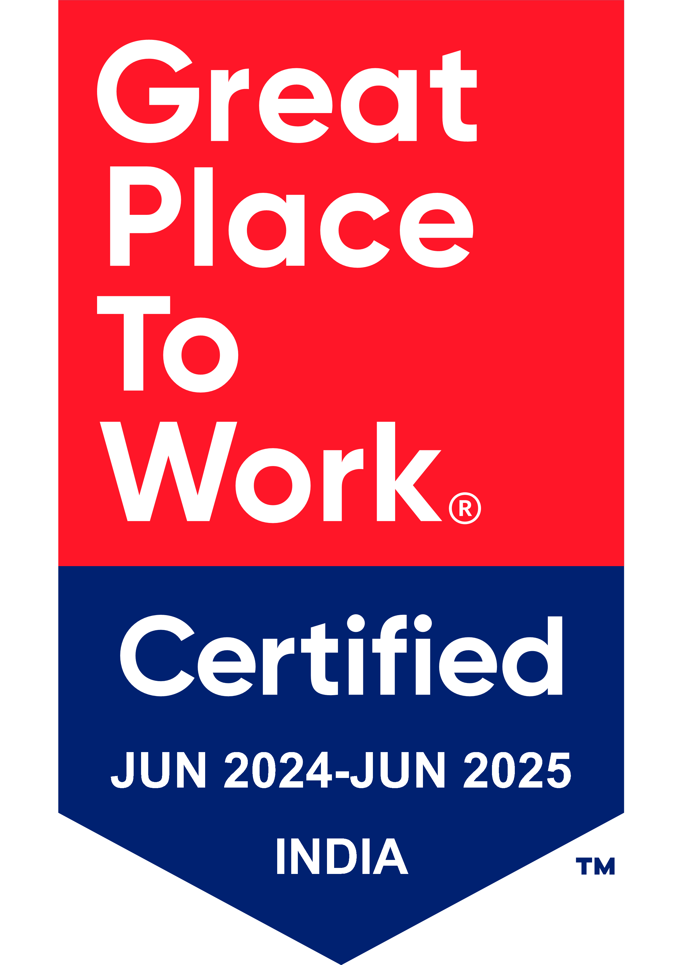
Thank You

