Slide 1
MORE RETAIL
Integrated Case Study

Slide 2
More Retail
RETAIL - DEMERGER
Project Objective
Demerge the IT environment from the parent group company IT and set-up a new hybrid IT to run the retail application to support 620 supermarkets, 22 hypermarkets, 11 warehouse and 10 branches.
Integrated Value and Outcome Cloud@coreTM products and services:
Migration of existing IT infrastructure components with minimum services disruption
Hybrid IT - Leveraged AWS to run 80% of the retail application and 20% of the legacy application on Sify Colocation Services
Leveraged Sify Managed Connectivity Services to Interconnect DC, DR data replication and branch application access.
Managing data center, Disaster Recovery, Network Services and Security using Sify Managed Services Platform
Strong project management to complete the project on a time and within the budgeted cost.
Value for Client
A single IT Managed Services partner to carve out the application from the parent company and host it on a hybrid IT & manage IT services across Cloud, Colocation, Disaster Recovery, Network and Security.
Project Model
Opex | Consumption Model
HYBRID CLOUD LED
Sify’s Uniqueness Integrated value proposition: Sify successfully leveraged hybrid IT offering – AWS, Colocation, DR, Managed Network and Security to demerge the IT environment from the parent group company.

Slide 3
Sify accelerates the Cloud Journey of a Retail Giant with its Hybrid Cloud Solution- 2 pager
Transformation goal: Effectively upgrade to cloud-ready Infrastructure after separation from group companies to enhance customer experience and operational efficiency
Objective
Why Sify was chosen?
Sify’s value additions
Seamless migration of applications to Hybrid cloud
Ensure business continuity
Consultative approach in devising the Hybrid IT solution
Our experience with large migrations in a similar set up
Sify’s comprehensive services centered around the cloud - Cloud adjacent Data Centers, Scalable Network, Hybrid Cloud and Digital services.
Single Service Provider for Hybrid cloud, Network, Security, Migration & Managed Services
Migrated all cloud ready infra & business application on AWS Cloud consisting 200 VMs
Migrated non-cloud ready applications to Sify Hosted DC
Provide Cisco Network & Fortinet Security Infrastructure at Sify DC
DR @ Bengaluru on Virtualized Environment
Performed physical Lift & Shift of one of Critical Biz Application Infrastructure (Non- x.86)
Hybrid multi cloud management for Infrastructure Administration and stable, reliable and efficient operations.

Slide 4
Ensured high availability and performance along with effortless management
Before transformation
After transformation
Customer success factors/ benefits
DC in Bangalore, DR in Mumbai
Workloads running on x.86 (Windows, Linux) & Non-x.86 (AIX) Platform,
DR Service only for one Critical Business Application
Managed Services by IBM
IT Landscape - Data Center (AWS & Sify Hosted DC Rabale), DR in Bangalore
Hybrid Solution
Dedicated DC Network
Commvault Data Backup Solution at DC
Unified Security Controls like DDOS, SIEM, Firewall, Proxy & Security related components
Sify Private Cloud Solution at DR
Automated DR using DRM tool
99.5% Uptime Monthly for IT Infra in HA Mode
Higher performance
Reduced footprint
Increased customer delight
Dashboard, State of the art tools, process and procedures

Slide 5
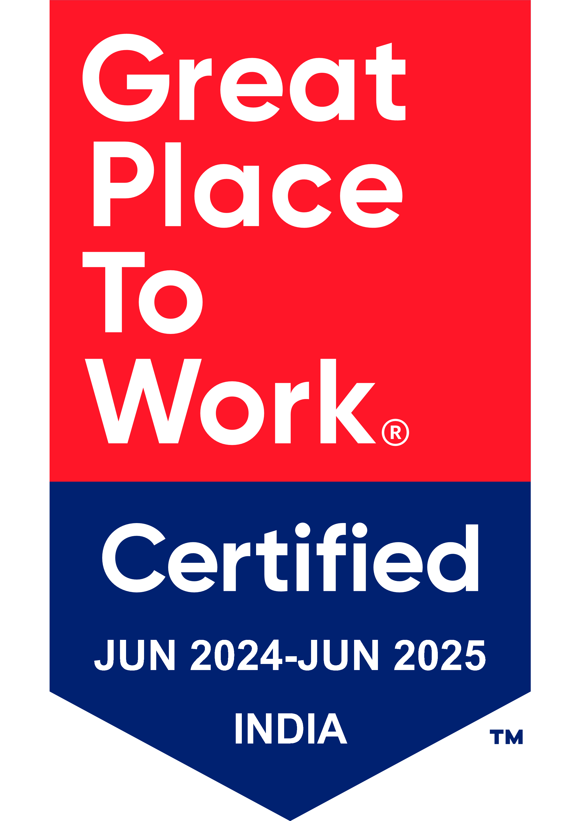
Thank You

