Slide 1
DIESL
SAP Case Study

Slide 2
DIESL – DB Upgrade & Migration
Client
Overview
DIESL, among leading logistics companies in India, provides solutions for integrated logistics, supply chain management, & third-party logistics. It was on SAP ECC6.0 EHP 4 , they wanted to migrate to HP-UX to RHEL & Upgrade oracle 10g to 11g in Sify Cloud.
Scope of Work
Solution Highlights
Migrate SAP landscape from On-premises DIESL DC to Sify co-location and then to Sify Cloud.
OS Migration from HP-UX to RHEL.
DB Upgrade from Oracle 10g to Oracle 11g.
Built the SAP DEV,QAS and PRD server from existing server in DIESL DC to SIFY Cloud and Testing has been carried successfully.
The End User connectivity for the New Cloud Servers.
Data transfer of SAP ECC DEV,QAS,PRD,SOL,BI_DEV,BI_PRD to sify co-location and then to Sify cloud.
Benefits
Improvement in SAP system performance
Since SAP version is ECC 6.0 EHP 4 and DB Upgraded to Oracle 11g from Oracle 10g, so that they can use latest features.
Scalable (being on Cloud)
Challenges
Data copy from DIESL DC to Sify DC.
Minimum downtime for migration process.
Large Database ( 2.4 TB ) which leads to get many network issues while migration.

Slide 3
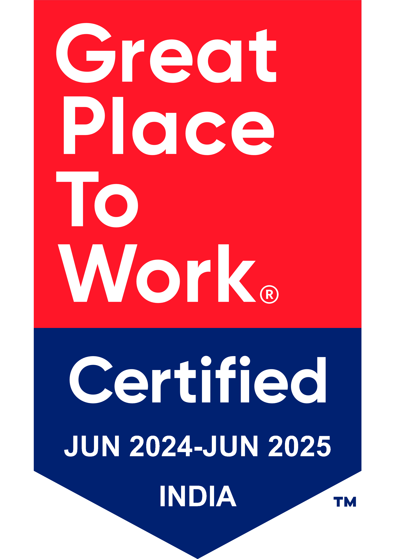
Thank You

