Slide 1
UNIVERSAL SOMPO
Digital Services Case Study

Slide 2
general INSURANCE
Universal sompo: intelligent and automated managed services
Project Objective
Make service management efficient, IT operations agile and integrated service/helpdesk for IT users
Integrated Value and Outcome
One Sify ITSM Platform bringing tool-based service management, automation and productivity
Enabling integrated and intelligent IT Operations through One Sify ITSM platform
Integrated service desk and helpdesk
SLA driven IT operations, hence better TAT and agile ops
Value for Client
Priority support 24/7 with resolution within 4 hours
Misconfiguration of core revenue application server identified and corrected, preventing failure and business loss.
Actionable insights for future IT transformation goals (state of the art DevOps, RPA, SDWAN)
Value for Sify
Competitive edge, full stack products and services play, creating stickiness in services, great reference for managed services covering data center, NOC, SOC and integrated service desk
Project Model
Tool based service management bringing automation and productivity
Competition
IBM, Wipro
Managed services led
Sify’s Uniqueness One Sify Platform (ITSM, ITOM etc.) bringing integrated and automated service management.
Unified integrated managed services covering end user, data center, NOC, SOC and integrated service desk
Contract Duration
3 years

Slide 3
intelligent and automated managed services
Key IT Transformation goal for Universal Sompo was to make service management efficient, IT operations agile and integrated service/helpdesk for IT users
Objective
Why Sify was chosen?
Sify’s value additions
Uplift IT Support Experience
Increase productivity through automation
Cost optimization
Tool based service management bringing automation and productivity
Integrated intelligent service desk
SLA Driven managed services
One Sify Platform (ITSM, ITOM etc.) bringing integrated and automated service management
Defined SLA Driven managed services
Unified integrated managed services covering end user, data center, NOC, SOC and integrated service desk
3

Slide 4
bringing intelligent it support experience and operational efficiency through service management
Before transformation
After transformation
Customer success
No integrated service desk/helpdesk
No tool-based automation, hence no productivity
IT worked in silos. Hence no end user experience
No SLA driven IT Operations
Integrated service desk and helpdesk
One Sify ITSM Platform bringing tool-based service management, automation and productivity
Enabling integrated and intelligent IT Operations through One Sify ITSM platform
SLA driven IT operations, hence better TAT and agile ops
Priority support 24/7 with resolution within 4 hours
Misconfiguration of core revenue application server identified and corrected, preventing failure and business loss.
Actionable insights for future IT transformation goals (state of the art DevOps, RPA, SDWAN)
Notes:
Customer success Point 2: IBM AIX Server hosting Oracle Enterprise 11G DB had a misconfiguration during deployment around 1300 days back. It was discovered by Sify and corrected by a joint activity between the current DBA and SIFY MITS Teams.

Slide 5
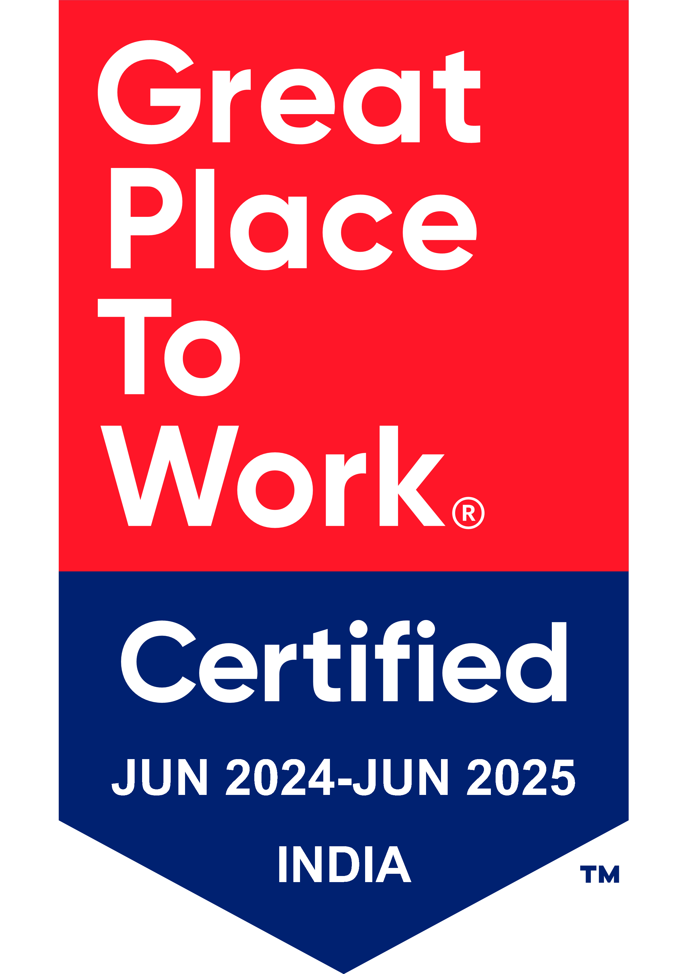
Thank You

