Slide 1
MAX BUPA HEALTH INSURANCE
Integration Case Study

Slide 2
HEALTH INSURANCE
Project Objective
Consolidate four data center application workloads and build Managed Private Cloud and DR Services at Sify DC
Integrated Value and Outcome Cloud@coreTM products and services:
Design, build and deploy Hosted Private Cloud Infrastructure.
Study and migrate close to 20 applications to hosted private cloud with near-zero downtime window.
Set up DR at a different seismic zone using DRaaS to provide granular data recovery time objectives.
Implement security framework to comply with the insurance Industry Regulatory Requirements.
Managed Services using Sify Managed Services Platform covering DC, DR, Branch Network and Security
Value for Client
Resilient IT Infrastructure to roll out new solutions at a rapid rate without delays in procurement of new hardware, software and other IT Infrastructure resources with 10% reduction on TCO YoY.
Project Model
Fully services model (vis-à-vis existing capex + services model)
PRIVATE CLOUD LED
Sify’s Uniqueness Integrated value proposition: Cloud Assessment Services, designed a private cloud architecture using Sify CloudInfinit CMP best practices, automated DR on Sify DRaaS model, Telecom Services for DC-DR connectivity, and end-to-end Managed IT Services

Slide 3
How max bupa achieved better compliance, improved efficiency and business agility- 2 pager
MAX Bupa transformation goal: To revolutionize the customer service by launching their cashless approvals within 30 mins initiative, they want to equip themselves with an IT infrastructure that’s massively scalable
Objective
Why Sify was chosen?
Sify’s value additions
Leverage analytics and big data to enhance their customer insight
Agility to support marketing & digital campaign management channels
Transform the current Infrastructure into a well architected framework
Consolidate the applications landscape into a single data center
Obtain 24x7 service assurance
Scalable and modular Infrastructure Architecture to be able to adapt to business and regulatory demands of Max Bupa
Dynamically auto scale and provide elastic upgrade/downgrade based on Max Bupa’s business requirement
Automated DR in OPEX model
Sify’s flexible Auto Scaling provided choice of Utility based Payment options like Pay-as-per-use
Extensive business relationship with the Max Group servicing Max Healthcare and Max Life
Designed a private cloud architecture on CloudInfinit CMP best practices
Migrated 100+ Instances and 60 TB data using the proven CloudInfinit workload migration process
Providing service assurance with CloudInfinit CMP
3

Slide 4
Built a private cloud and dr using cloudinfinit cmp best practices
Before transformation
After transformation
Customer success factors/ benefits
Setup was not in compliance with IRDA IT Guidelines
Lack of standardization, efficiency & agility
IT landscape spread over 4 locations leading to higher TCO
Aging infrastructure in need of a technology refresh
Improved Performance & Operational Efficiency
New Age DC + DR set-up – converted entire infra landscape into DC and DR as a Service
Reduced planning & deployment time
Granular recovery intervals & data protection
Bandwidth on demand to replicate DC data
State of the art tools, processes and procedures
Sify’s CloudInfinit enabled Max Bupa to roll out new solutions at a rapid rate without delays in procurement of new hardware, software and other IT Infrastructure resources
10% reduction in TCO on a yoy basis
Seamless transition to Managed Services
Zero Downtime Migration

Slide 5
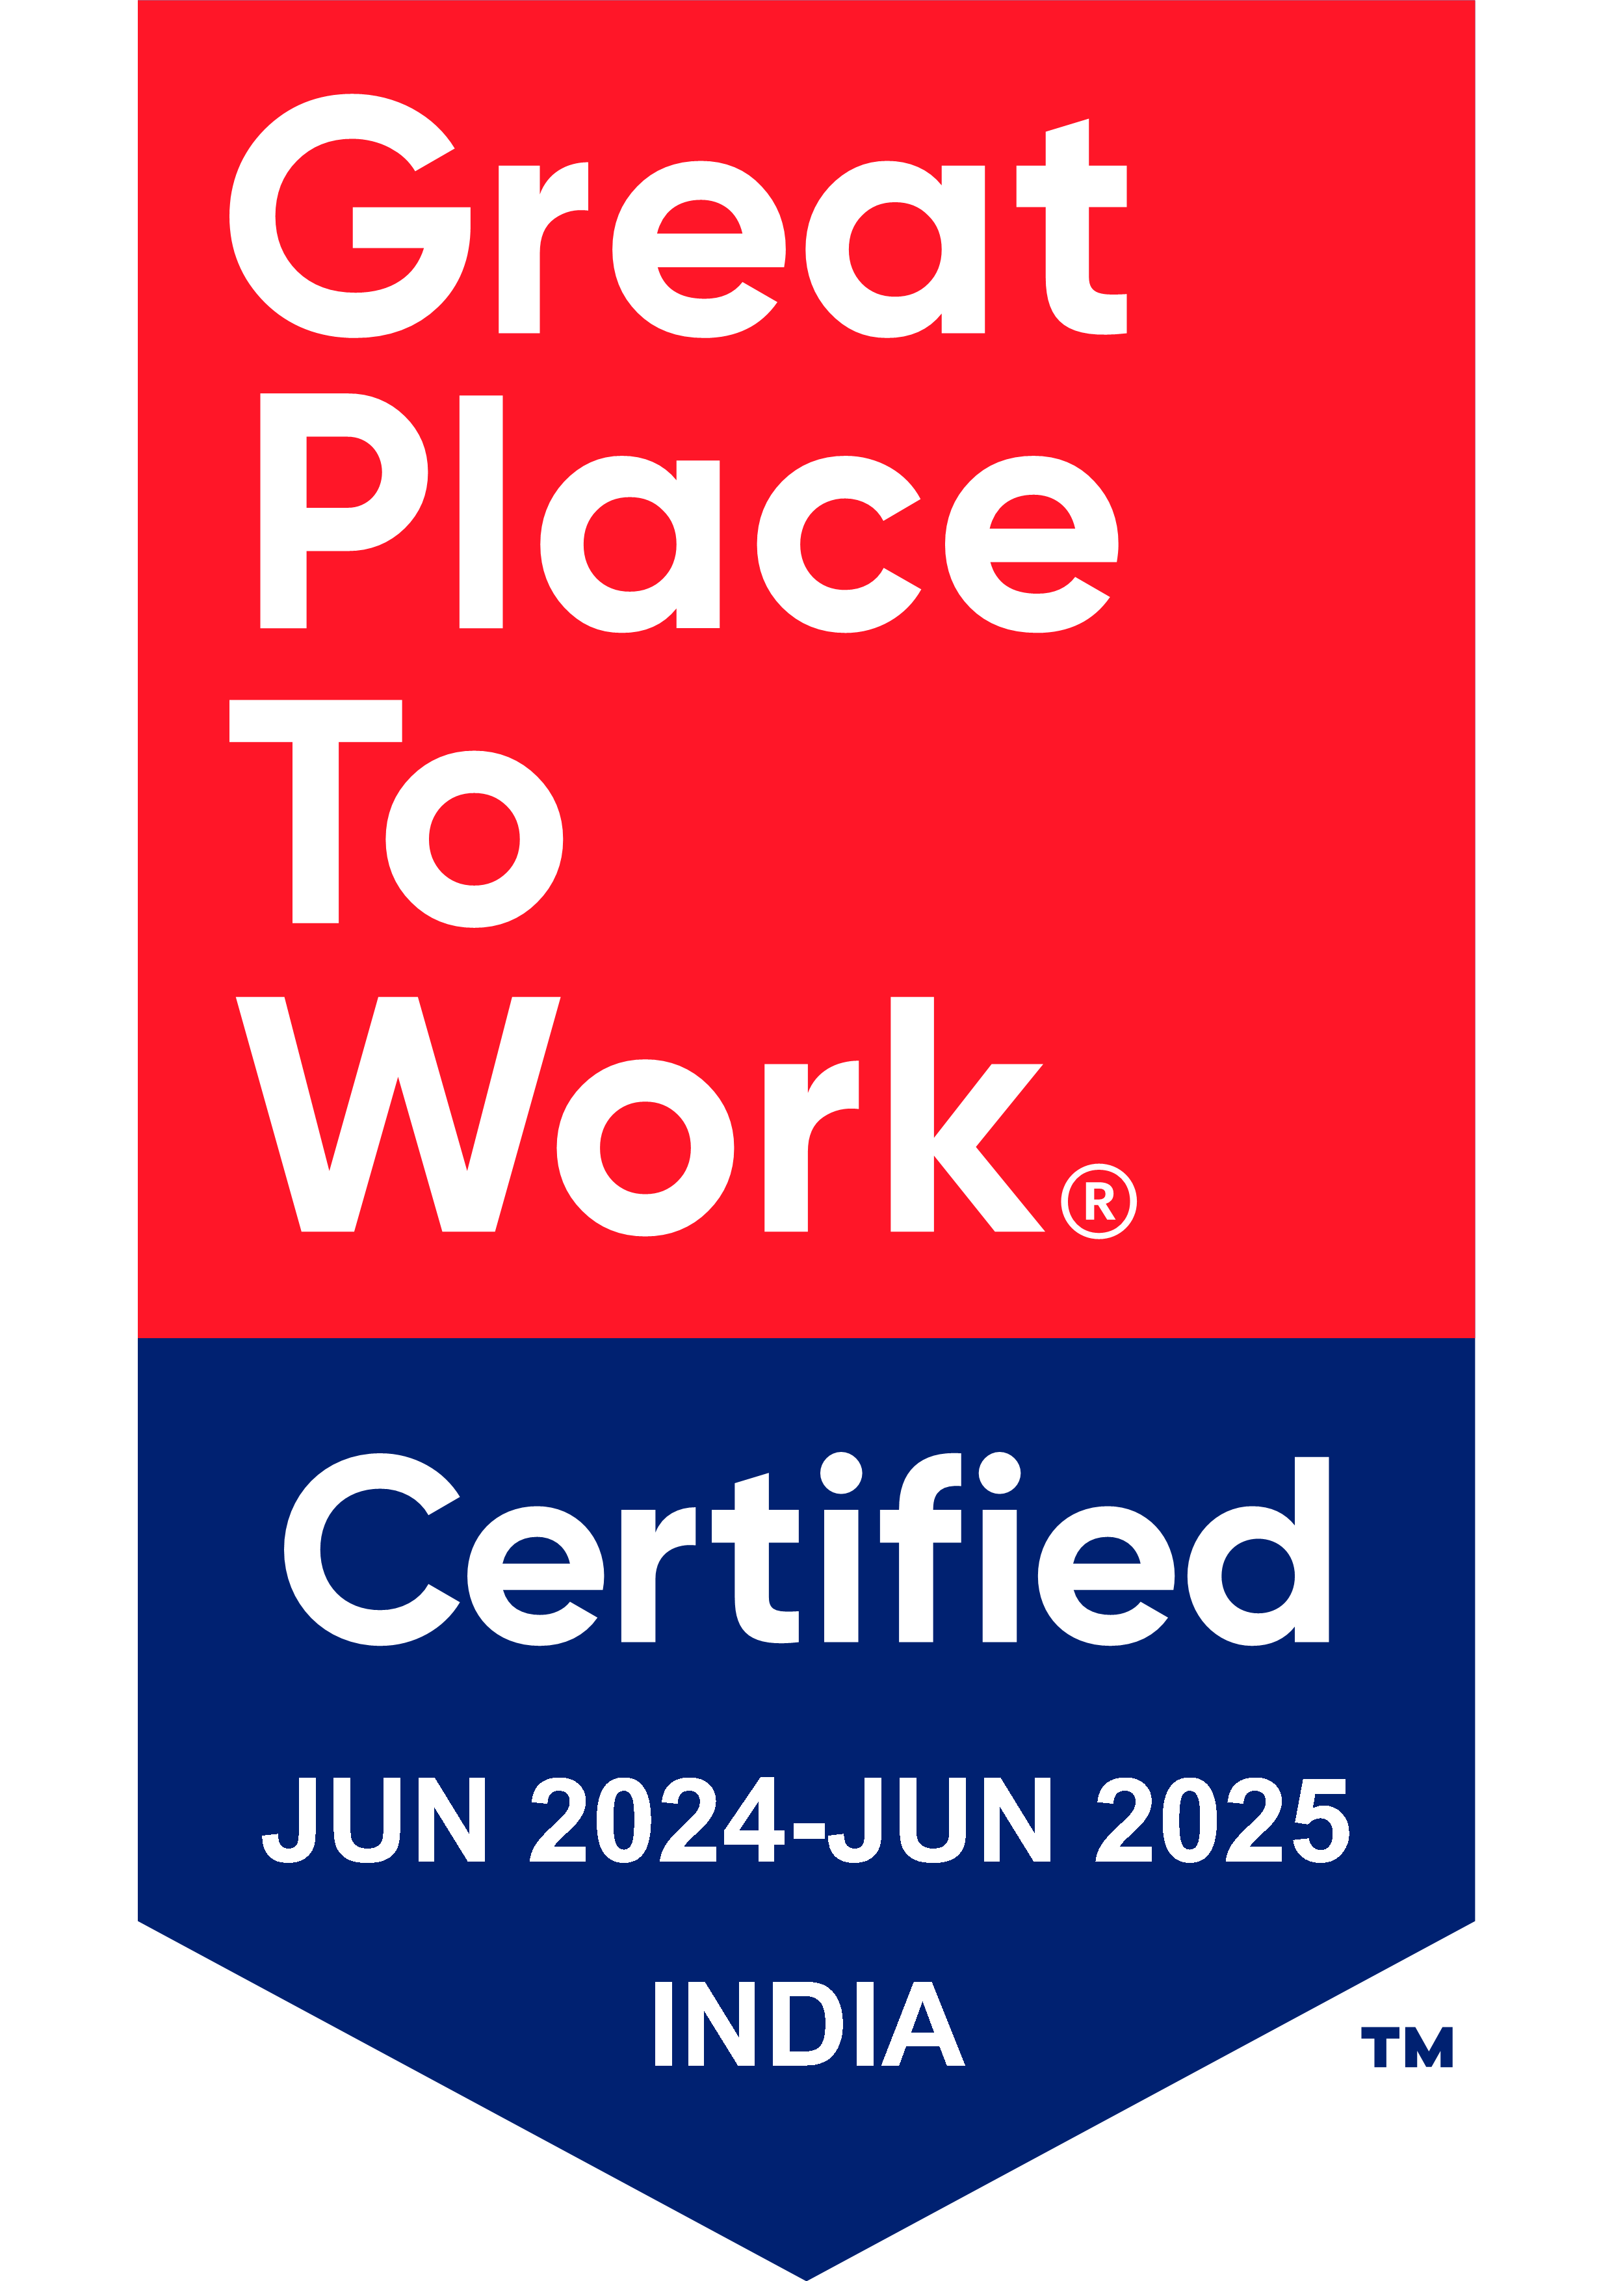
Thank You

