Slide 1
MAGMA
Cloud Case Study

Slide 2
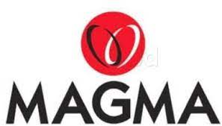
A leading insurance company looking to bring in more business agility and cost reduction
Magma’s transformation goal: To sustain the growth and to continue market differentiation, they wanted to launch digital services and equip themselves with an IT infrastructure that’s massively scalable and ready for cloud enhanced service development
Objective
Why Sify was chosen?
Sify’s value additions
Implement integrated future ready digital infrastructure on hyper-scale Multi Cloud Platform ( AWS + AZURE)
Reduce TCO and Optimized Cloud usage
Cloud Optimized Solutions on Azure and AWS
Create on demand agile IT infrastructure for easy adoption of micro services to deploy Data Warehouse, IOT, AI, Containers
Having performed large scale migrations of BFSI customers to multi-Cloud configurations
Customized NGIT Framework to meet Cloud requirements of Magma -AWS/AZURE Cloud to be managed out of a single management, governance and security framework
Facilitated frictionless migration of the workloads and applications to avoid vendor lock-in and realization of cost optimizations
Managing 400+ enterprise customers on Sify CloudInfinit, Azure, OCI & AWS platforms
The only provider in INDIA who Provides NETWORK and ALL HYBRID Services on AZURE
Designed the cloud architecture and Migration Approach on AZURE and AWS through cloud assessment services to deliver a well-architected framework for risk free cloud migration and coexistence
Migrated 125+ Instances using the proven propriety Cloud workload migration process from On Prem to various Public Clouds
Providing service assurance with CloudInfinit Multi Cloud CMP
2

Slide 3
Built secure hyper scale cloud infrastructure with Near and FAR DR
Before transformation
After transformation
Customer success factors/ benefits
Infra sprawl – virtualized infra, on-prem, hosted private cloud at multiple locations
Managing Multiple Clouds was a challenge
Migration of Workloads to the right Cloud as per technology fit
Capacity augmentation with long lead times due to lengthy procurement cycle
Inability to manage unplanned spikes
High cost due to over-provisioning
Lack of visibility on capacity utilization and performance
Absence of DR
Single Sify-AWS public cloud solution for all the workloads
Low latency hybrid cloud between Sify hosted Core Insurance application and AWS public cloud
Transformation of IT from a maintenance service to a strategic business contributor
Pay-as-you go model with Auto-scalability, faster implementation
Pro-active monitoring of utilization and performance through Cloud Monitoring Framework
Enhanced resiliency by setting up Cross Cloud DR
Drive and differentiate Magma in its market powered by Sify’s Cloud transformation framework
Creating platform for upcoming projects around Data Warehouse, DAM
Migration of Right workload to Right Cloud where best Cost Savings were foreseen
Managing the entire migration of public cloud & private IT infrastructure end to end

Slide 4
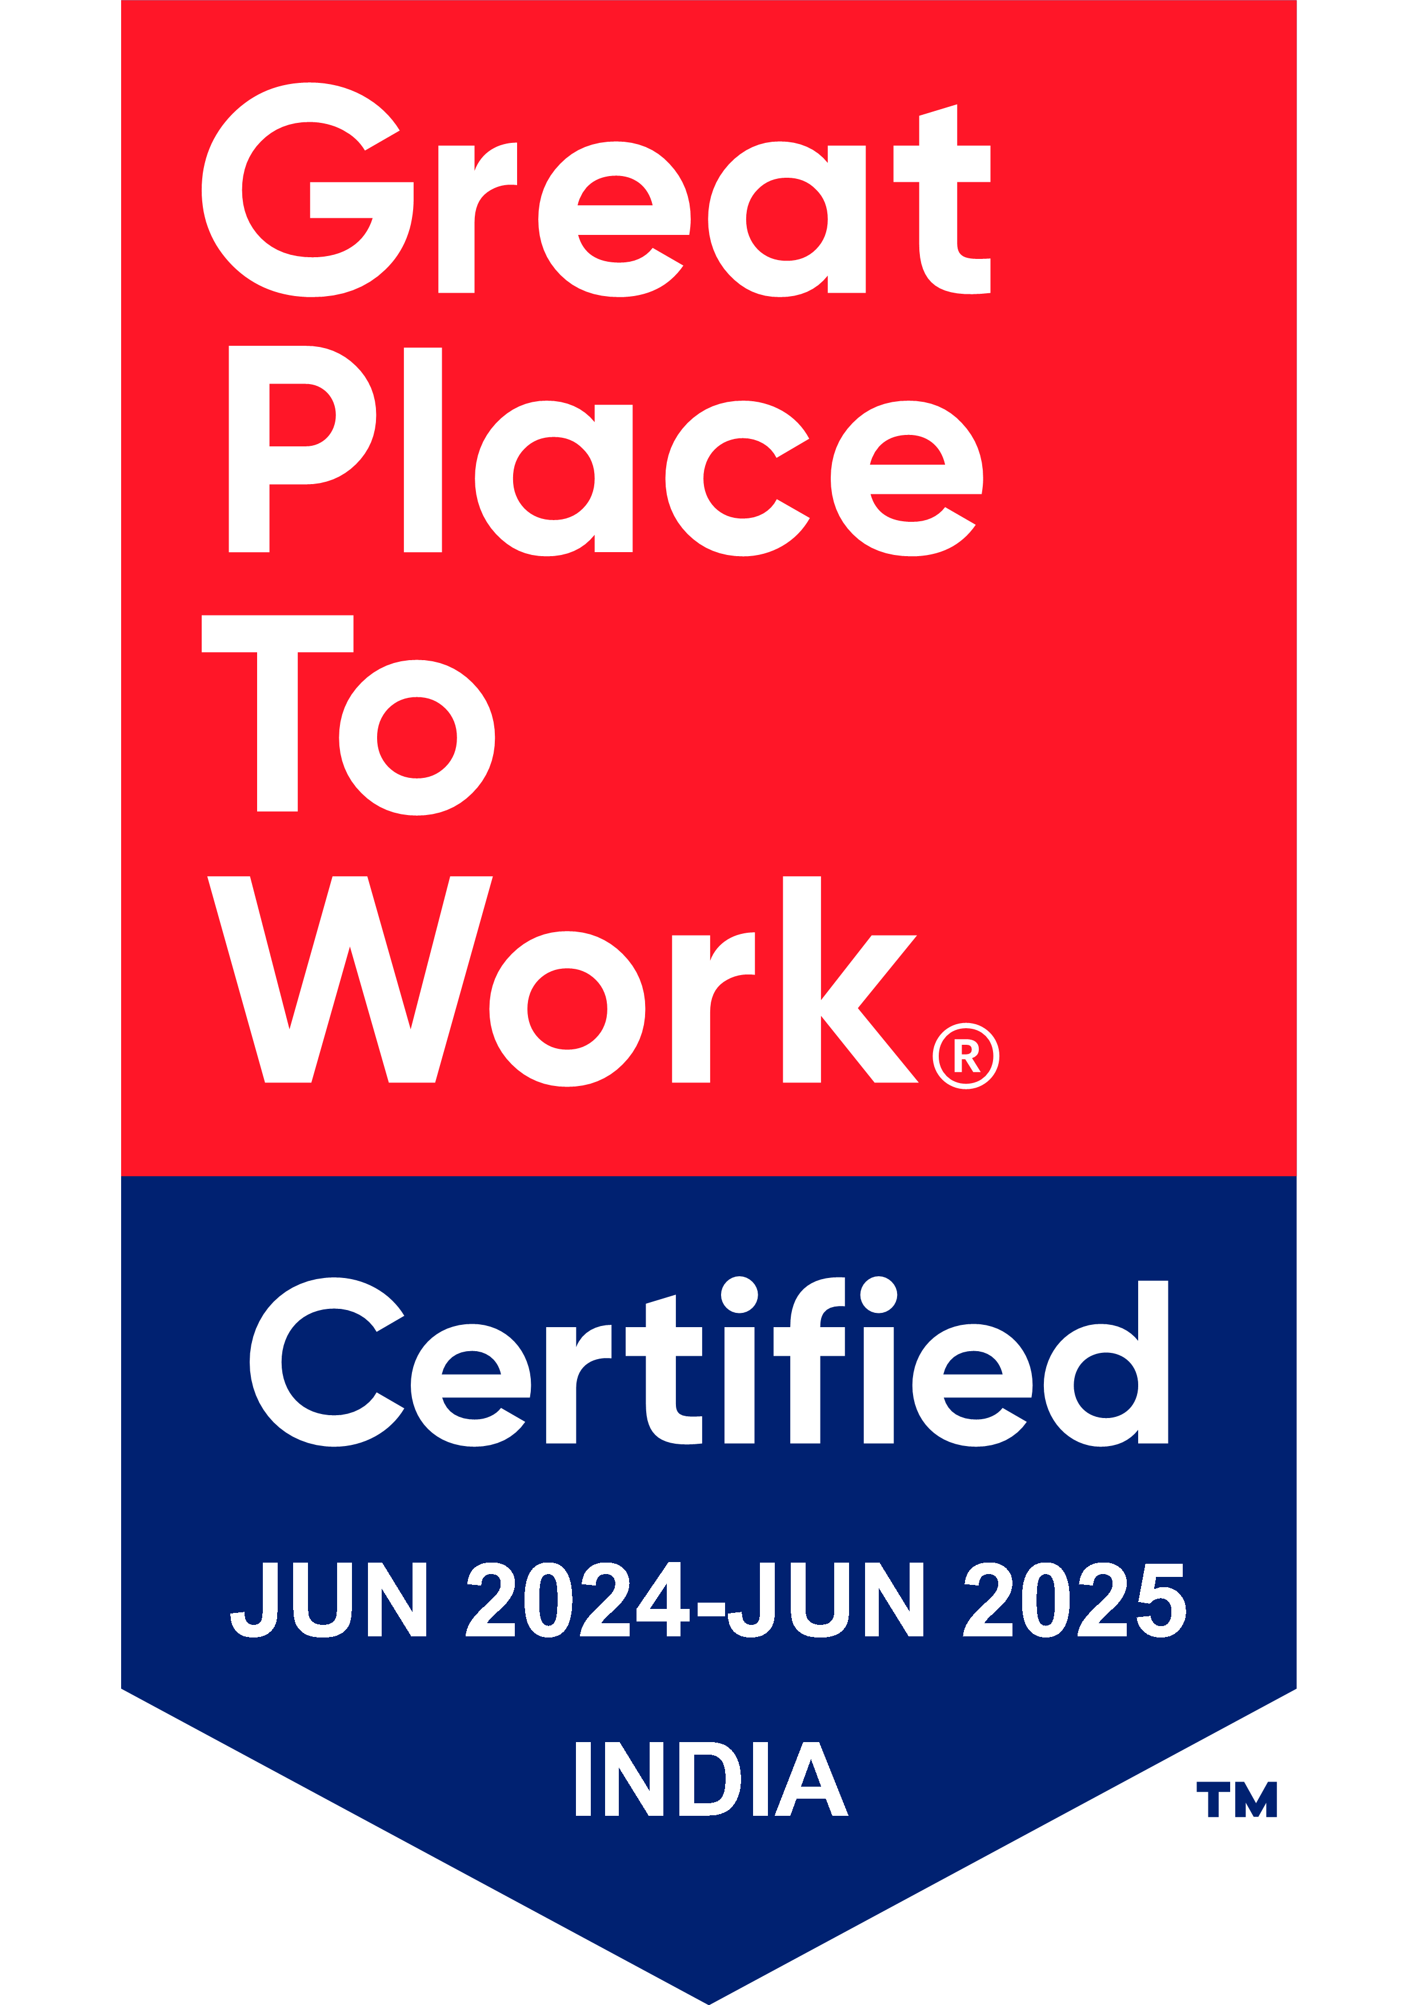
Thank You

