Slide 1
CLIX
Cloud Case Study

Slide 2
Leading NBFC company looking to use DIGITAL platform to expand business and Improve customer experience
To address business expansion demands for India Geo, transform customer experience, reduce cost of IT operations, and keep IT secure & business ready.
Objective
Why Sify was chosen?
Sify’s value additions
To migrate existing workload from Wipro & DXC to AWS Cloud.
To implement integrated future ready digital infrastructure on hyper-scale cloud.
To create on demand agile IT infrastructure for easy adoption of micro services to deploy Data Lakes, Containers and Automation around all services consumed in AWS Cloud.
Reduce TCO
Had prior experience of performing large scale migrations of enterprise customers to multi cloud configurations.
Customized NGIT framework to meet requirements of Clix. Cloud to be managed out of a single management, governance and security framework.
Sify’s proven capabilities in digital transformation, incumbency as a SD-WAN and technology integration partner.
Ability to align with customers’ dynamic business needs without vendor lock-in.
Partnered with AWS for hyper-scale cloud platform with right size AWS scope.
Designed the AWS Landing Zone Architecture on AWS based on inputs from Clix to deliver a well-architected framework for risk free cloud migration.
Migrated 80+ instances using proven Sify’s workload migration process with zero disruption in business.
Additional security services with Akamai WAF & NGFW.
2

Slide 3
Leveraged AWS PLATFORM along with managed services
Before transformation
After transformation
Customer success factors/ benefits
Virtualized infra, hosted private cloud at multiple locations (Wipro & DXC) with Managed services (inhouse ,DXC, Wipro).
Capacity augmentation with long lead times due to lengthy procurement cycle.
Inability to manage unplanned spikes, data lake setup and micro services deployed in private cloud.
High cost due to over-provisioning, lack of visibility on capacity utilization and performance.
Multiple sources of data inputs.
Single auto elastic, multi AZ AWS Public cloud solution for all the workloads with enhanced resiliency by near DR.
Pay-as-you go model with auto-scalability, faster implementation.
Pro-active monitoring of utilization and performance through CloudInfinit CMP.
Consolidated multiple sources of data under AWS cloud, including Data Lakes.
Consolidation of services on secure cloud infra for better BI, customer experience.
Enabled IT systems for business expansion on the fly.
Realization of cost optimizations with per hour cost visibility.
More focus on business than IT.
Transformation of IT from a maintenance service to a strategic business contributor.

Slide 4
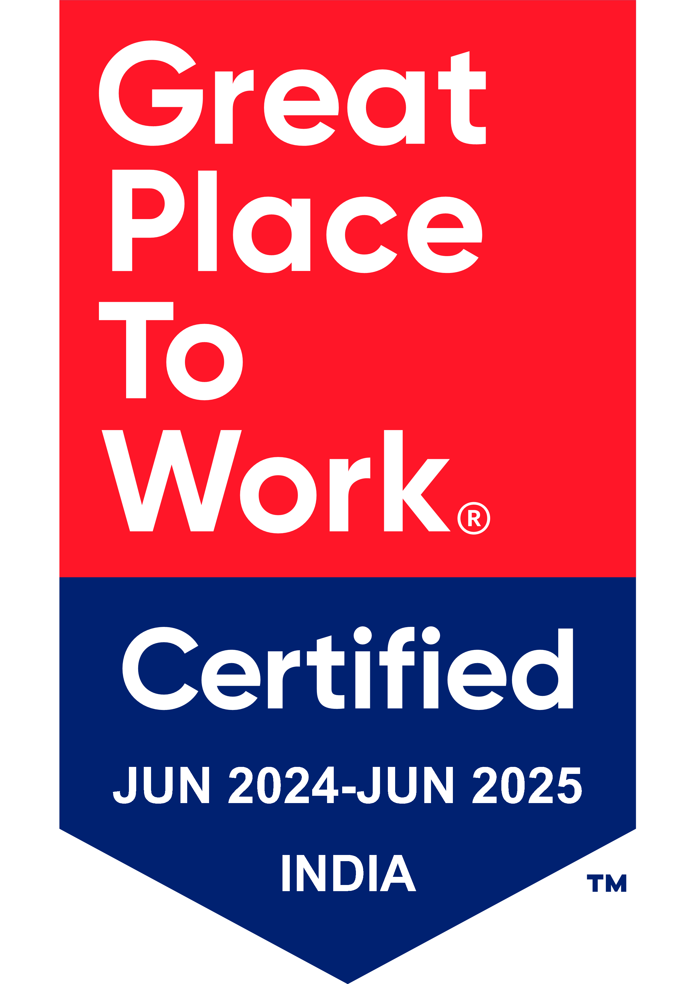
Thank You

