Slide 1
IRCON INTERNATIONAL
SAP Case Study

Slide 2
IRCON INTERNATIONAL Limited – SAP Migration
Client
Overview
Ircon International Limited (IRCON), incorporated by the Central Government under the Companies Act, 1956 on 28th April, is the leading turnkey construction company in the public sector known for its quality, commitment and consistency in terms of Performance. It was on SAP ECC6.0 EHP5 in AIX Platform and they wanted to migrate to RHEL with ECC 6.0 EHP 5 on Sify Cloud.
Scope of Work
Solution Highlights
Migrate SAP landscape from On-premises IRCON to Sify Cloud.
SAP Migration from ECC 6.0 EHP5 on AIX to ECC 6.0 EHP5 with RHEL.
SAP landscape to be moved from AIX/Oracle to RHEL/Oracle.
SAP ECC 6.0 EHP 5 (DEV/QA/PRD/).
Solution Manager 7.2 & SAP Router.
Built the SAP DEV,QAS and PRD server from existing server in IRCON DC to SIFY Cloud and Testing has been carried successfully.
The End User connectivity for the New Cloud Servers has been provisioned.
Benefits
Improvement in SAP system performance
Since SAP migrated to ECC 6.0 EHP 5 on RHEL, they are using the operations smoothly.
Scalable (being on Cloud)
Database Oracle Upgraded to 12.1.0.1
By implementing solution manager 7.2 customer can have all the latest functionality.
Challenges
Data copy from IRCON DC to Sify DC.
Minimum downtime for migration process.
DB Upgraded from oracle 9c to oracle 12c.

Slide 3
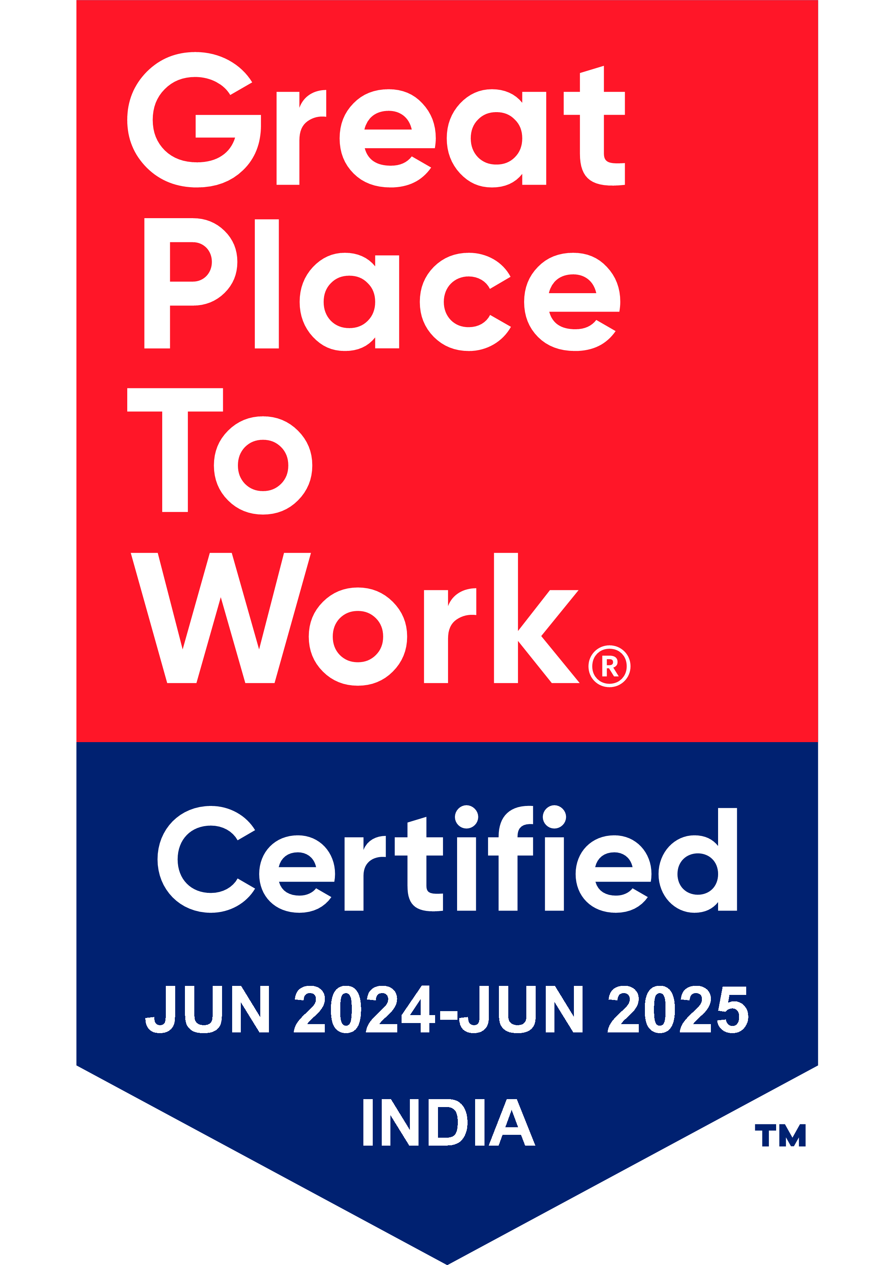
Thank You

