Slide 1
SUN PHARMA
Data Center Case Study

Slide 2
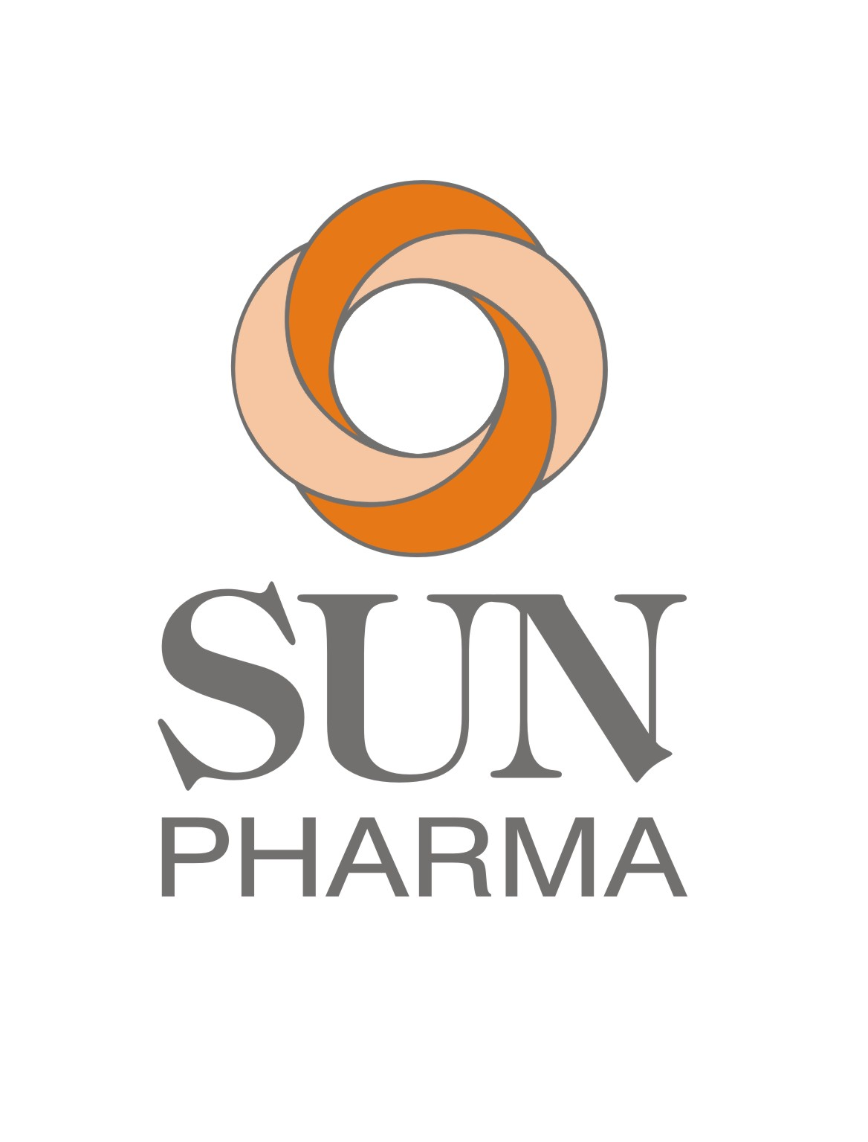
Sify helps Sun Pharma gain resiliency and Availability- 2 PAGER
Transformation Goal: To keep IT secure & business ready, reduce the cost of IT operations and enhance customer experience.
Objective
Why Sify was chosen?
Sify’s value additions
Move to a more resilient and secure infrastructure while ensuring minimal disruption
Modernize and consolidate IT infrastructure for business agility
Co-locating on premise captive DC to a secure DC location
Reduce TCO and ensure 100% uptime
Sify’s extensive experience with large/complex migrations for similar IT setups
Sify has unique cloud adjacent data centers with deterministic connectivity to Hyperscalers which is in line with their future plan for hybrid cloud
Sify solution is compliant with the stringent regulations and global compliances
Sify took a consultative approach to build the right business case for the customer to address their pain points and for cost optimization.
Completed UAT and Production Setup migration with minimum disruption within 20 days only - one of the fastest complex workload migrations
Physical lift and shift + migration to 2 sites in a span of 3 days.
Provision for a “Parallel Setup” before migration to ensure near-zero downtime
Additionally, owned IT service assessment, management and governance
2

Slide 3
Seamless transformation in record time with Sify datacenters
Before transformation
After transformation
Customer success
IT infrastructure was lacking scalability, agility and availability
Existing DC at Gurugram was not financially viable to run from on-premise
Applications demanded high performance storage whereas their IT infra was about to reach end of support cycle
Most of the IT budget was being used for keeping the lights-on
Existing challenges with cable congestions w.r.t. cooling efficiency and traceability
Cost savings due to capex vs opex pricing model and efficient management with simplified cabling
Sify’s solution enabled the dynamic management required to meet the application needs
Moving to Sify improved availability, security and overall reliability of the IT landscape
The new infrastructure provided better application performance vis-a-vis existing IT setup.
Cloud-ready IT Infrastructure ensuring resiliency and security for future business endeavors
Huge savings and high ROI over next 5 years with the new DC setup.
Achieving business agility with the new consolidated IT Infrastructure
Re-routing funds from savings towards strategic plans such as Pharma R&D etc.
No disruption due to natural calamities such as earthquakes etc.

Slide 4
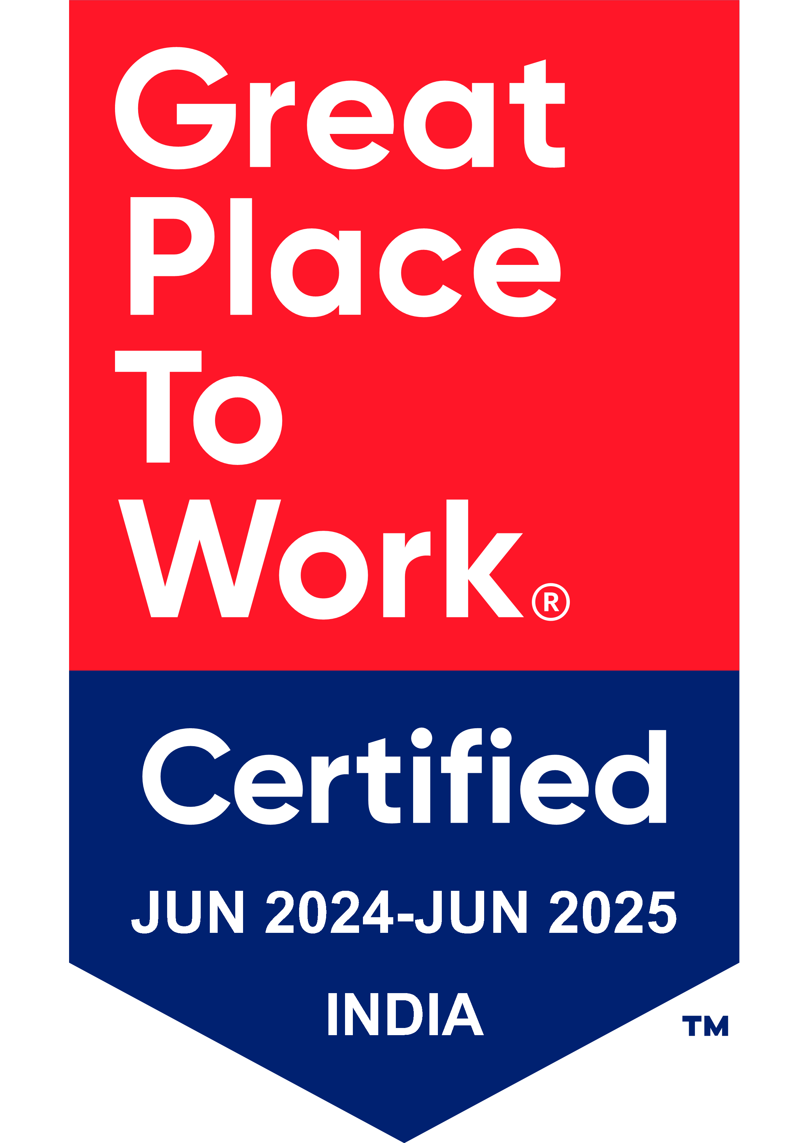
Thank You

