Slide 1
ADYEN
Data Center Case Study

Slide 2
AdYEn
Payment gateway
Project Objective
To provide Data Center Services to host client's IT infrastructure and to cater to their growing business needs
Integrated Value and Outcome Data Center products and services:
Data Center Colocation services to provide 99.99% uptime with secure and reliable environment
All banking compliances for the data center were met.
Stringent security at Sify Data Center
Full life cycle responsibility through assessment, audits and following best policies and compliances
Implementation of project within a record timeline
The project has resulted in a smooth, seamless, and secure payment gateway to the client's users
Value for Client
Using Sify's Data Center services, the client was able to realize significant improvements in their go-to-market process.
Digital-ready infrastructure to cater to future needs with Sify managing their end-to-end services.
Project Model
Infrastructure as a Service (IaaS) Model
Data centric services
Sify’s Uniqueness Integrated value proposition: Data Center, secure environment, dense fiber connectivity in the region, carrier neutrality and connectivity to 50+ edge data centers, multiple internet exchanges hosted within the data center

Slide 3
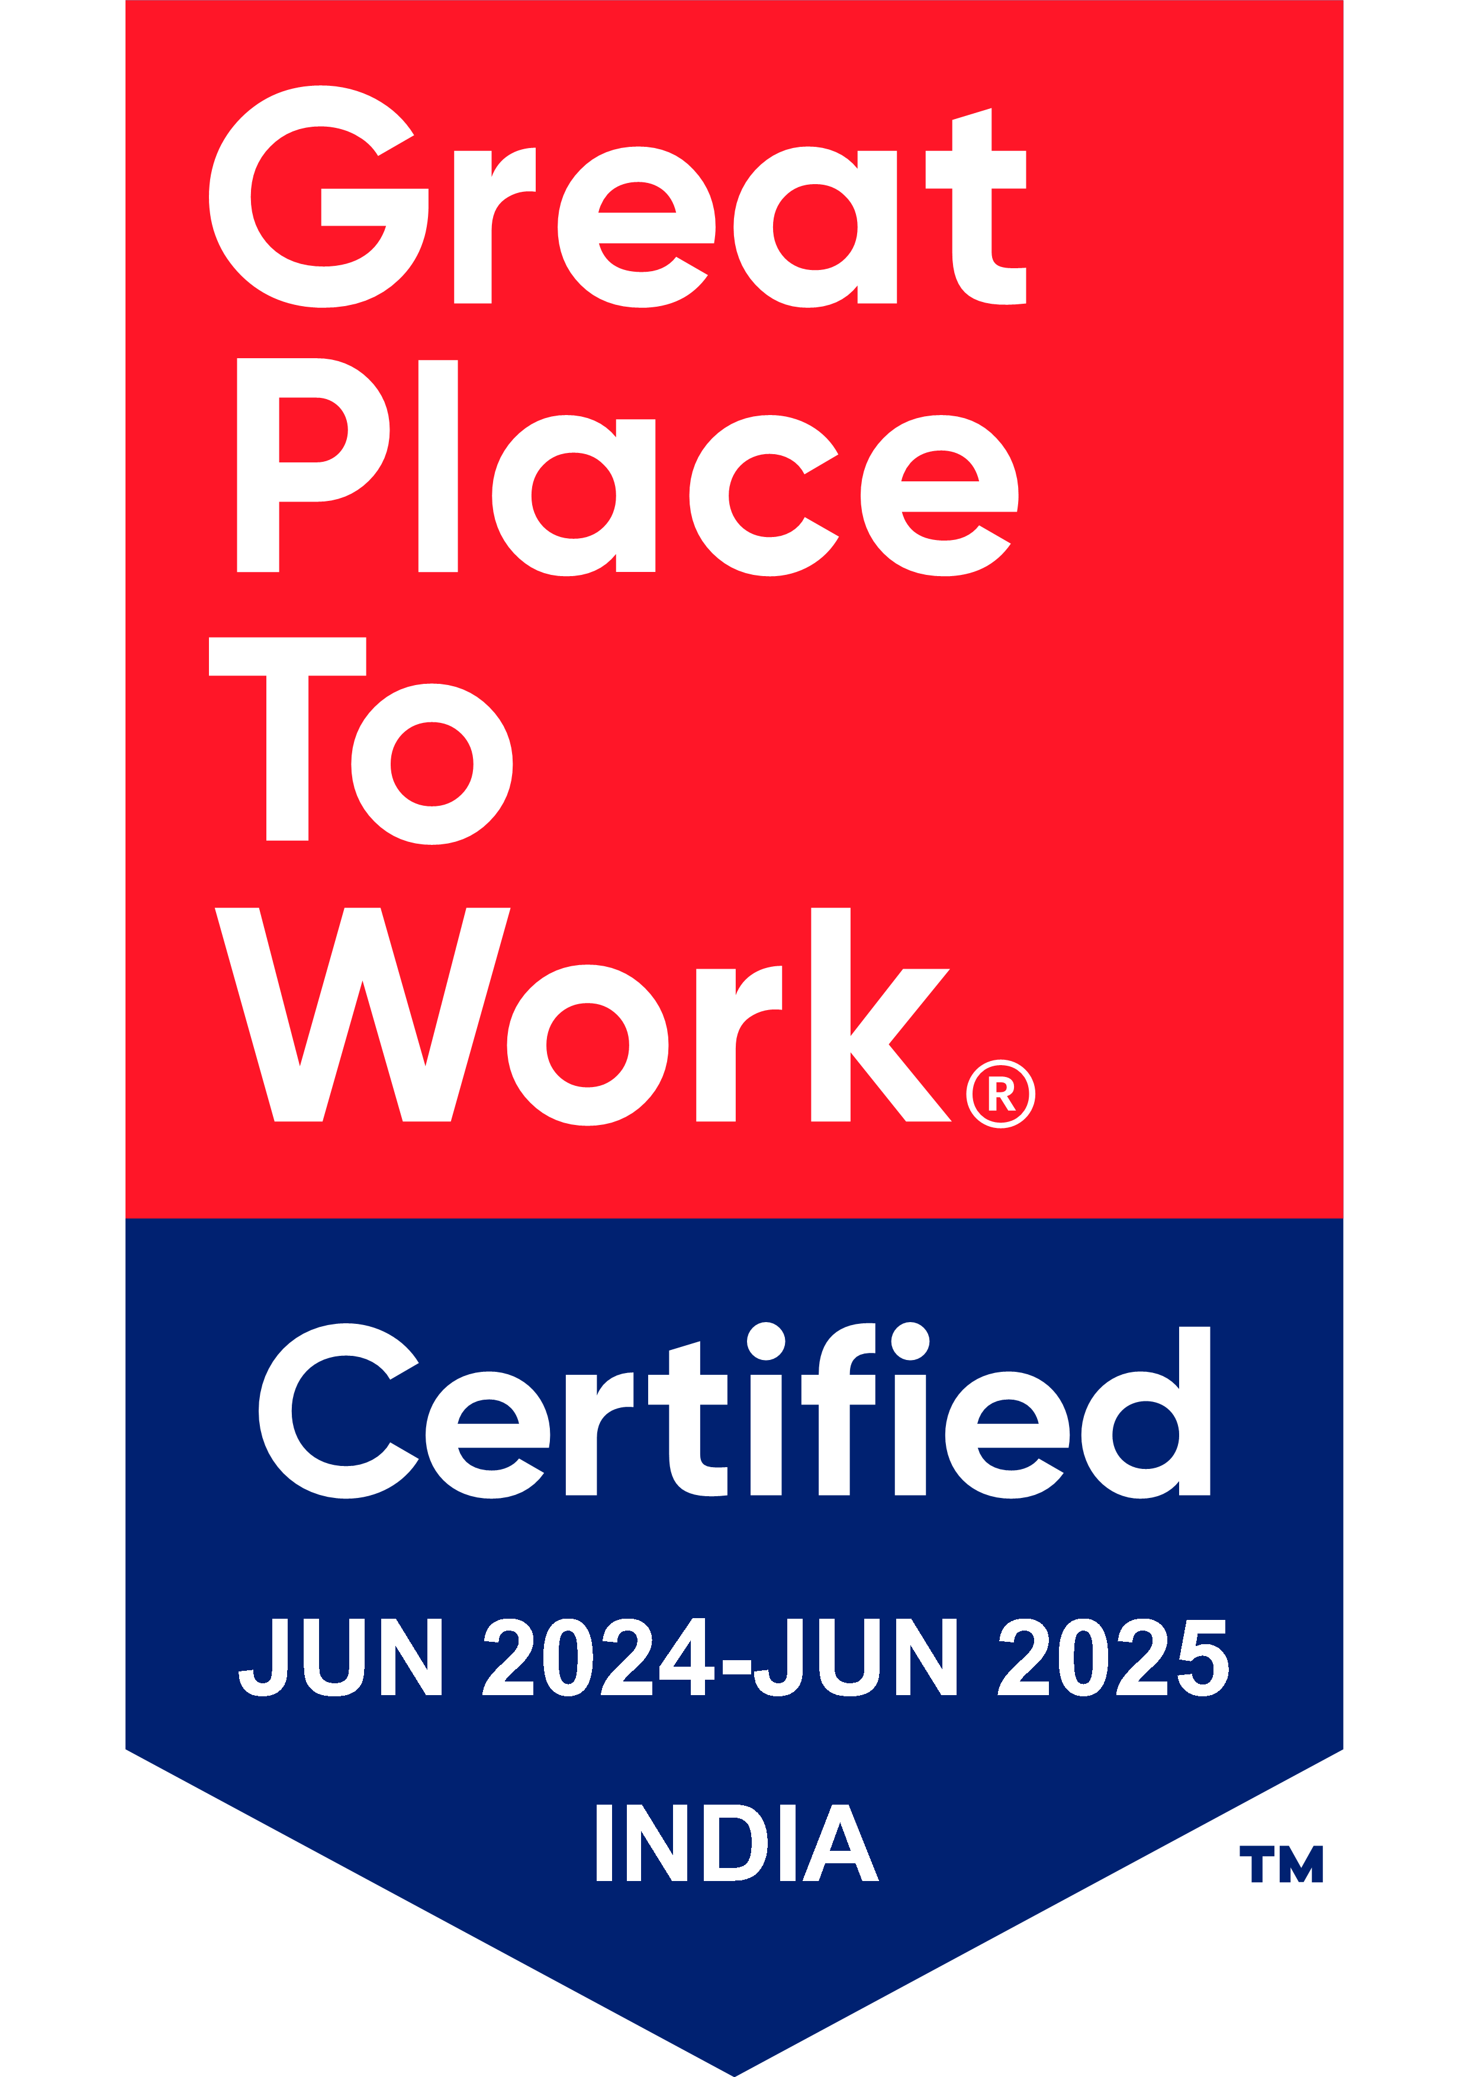
Thank You

