Slide 1
ADHUNIK METALIK
SAP Case Study

Slide 2
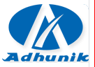
Adhunik Metalik Limited– SAP MSSQL DR ON AWS CLOUD
Client
Overview
Adhunik Metaliks Limited is an alloy, special and construction steel manufacturing company. The Company is engaged in the manufacture and sale of steel, both alloy and non-alloy. The Company's segments are Iron and steel, and Mining and Power
Scope of Work
Solution Highlights
Disaster Recovery setup for SAP MSSQL on AWS cloud
Infrastructure provisioning for SAP
Managed Services(OS, Virtualization & MSSQL DB)
Managed Backup Services.
Network &Security Services.
We managed the entire project for setup DR, working with multiple vendors (Win for OS, SAP components, & MSSQL replication)
We helped Adhunik integrate the proposed new setup with their running production for Stand by Production system as DR
Implementation location – AWS (Mumbai)
MSSQL Log shipping methodology
SQL DB size 380 GB
RTO: <=4 hours and RPO: <=30minutes
Benefits
Challenges
Business continuity in the event of primary disaster
Stand by for Production system
Maintain application availability during planned and unplanned downtime.
Avoid data loss
Minor issues in Data Centre Readiness
There were some minor network issues- MPLS line
Port opening for the New Cloud Servers.

Slide 3
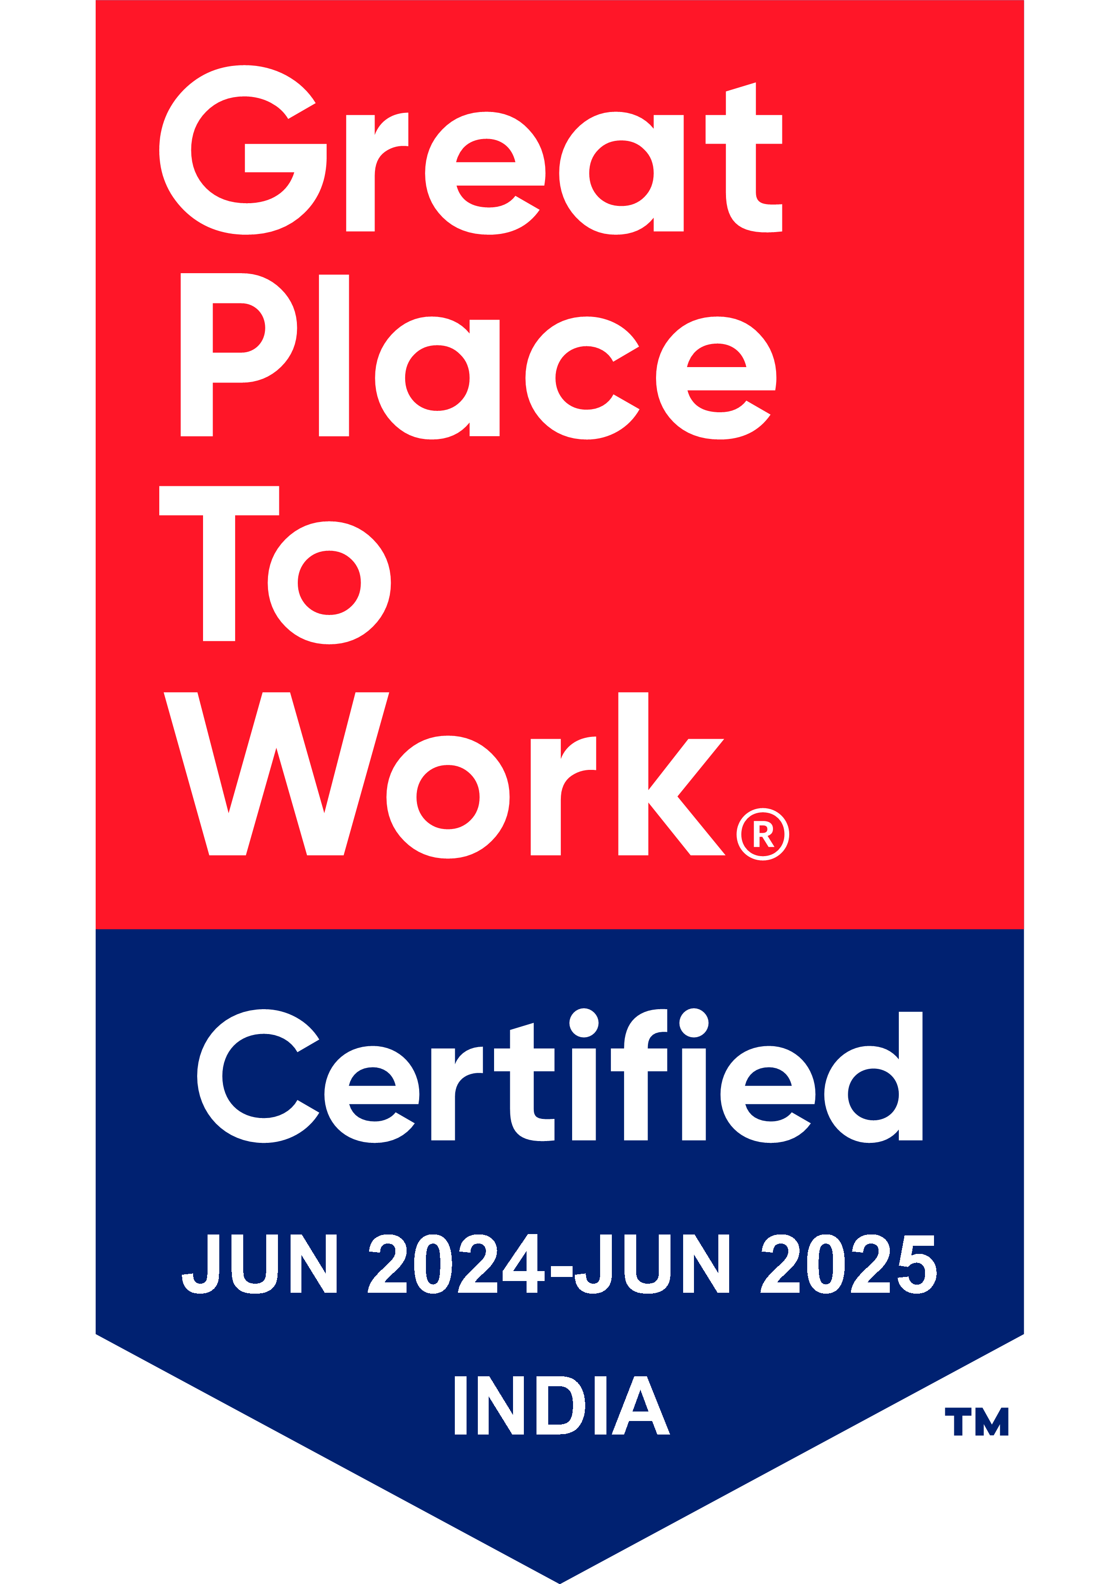
Thank You

