Slide 1

Sify & CISCO JOINT customer event
- Integrated offerings led by Meraki in Kolkata | 5th July

Slide 2
EVENT SUMMARY
Theme:
Unlocking Insights – Redefining Network Efficiency, Streamlining Operations, Maximizing Value
Key Discussion Areas:
Discovering Sify & Cisco’s integrated solutions, leading with Meraki offering
Date:
5th July
Venue:
JW Marriott, Kolkata
Attendees:
30-40 (CIOs, CTOs & IT Leaders)
Target Segment: Commercial & SMB
Final List - Kolkata.xlsx (180+ accounts)

Slide 3
AGENDA - tbd
Time (IST) | Session | Speakers
6:00pm - 6:30pm | Registrations
6:30pm – 6:40pm | Welcome address by Sify Team | Nihar Chakraborty CRO East Sify Technologies
6:40pm – 7:00pm | Keynote Presentation (Lead offering – Meraki) TBD | Abhijit Datta Lead Solution Engineering, Cisco
7:00pm – 7:20pm | Topic TBD (Covering capabilities deck for Sify) | Pranesh Babu Global Head – Network Digital Services Sify Technologies | Rakesh Doshi Senior Vice President & Head – Network Services Sify Technologies
7:20pm – 8:00pm | Meraki Topic | Shobhit Agarwal Meraki Specialist Cisco | Suresh Gummaraju Product Head, Network Solutions Sify Technologies
8:00pm – 8:30pm | Demo & Discussion
8:30 pm onward | Networking Dinner

Slide 4
SIFY & CISCO REPRESENTATIVES AT THE EVENT
S No | Sify / Cisco Executive | Designation | Confirmed
1 | Pranesh Babu Khyatasandra | Global Practice Head Network Digital Services, Sify | Yes
2 | Suresh Gummaraju | General Manager Product Management, Sify | Yes
3 | Rakesh Dosi | Business Head Network Services, Sify | Yes
4 | Nihar Chakraborty | CRO – East, Sify | Yes
5 | Abhijit Datta | Leader Solution Engineering, Cisco | Yes
6 | Shobhit Agarwal | Meraki Specialist, Cisco | Yes
7 | Aakanksha Rishi | Alliance Marketing Manager, Sify | Yes

Slide 5
REGISTRATIONS
S.No. | Name | Email ID | Phone Number | Company | Designation
1 | KAUSTABH SINHA | kaustabh.sinha@abdosindia.com | 9748753581 | ABDOS INDIA | Sr.Manager IT
2 | Debarshi Dasgupta | debarshi.dasgupta@abp.in | 9830044108 | ABP | Manager IT
3 | Debasis Sur | debasis.sur@abp.in | 7980910139 | ABP | Manager - IT Network
4 | Sudip Acharjee | sudip.acharjee@abp.in | 9874027346 | ABP | DGM IT NETWORK AND COMMUNICATIONS
5 | PARTHA SINHA | partha.sinha@ambujaneotia.com | 9007017904 | AmbujaNeotia Gr. | DGM - IT
6 | Sameer P Khakhar | sameer.khakhar@bandhanbank.com | '+919820283875 | Bandhan Bank | Deputy CISO
7 | Prasun Thakur | parsun.thakur@birlacorp.com | 9330918873 | Birla Corporation Ltd | DGM
8 | Gopin Ghosh | gopin.ghosh@birlacorp.com | 9038658550 | Birla Corporation Ltd | Senior Executive
9 | Vivek Suthar | vivek.suthar@birlacorp.com | '+919109104987 | Birla Corporation Ltd | AVP
10 | Srinivasa Molguri | srinivasa.molguri@birlacorp.com | 9907855202 | Birla Corporation Ltd | Manager
11 | Ashok Kumar | kumar.ashok@birlacorp.com | 7498238650 | Birla Corporation Ltd | AVP
12 | Dinesh Naskar | dinesh.naskar@centuryply.com | 9831353755 | Century PlyBoards (i) Ltd | HEAD IT -INFRA
13 | Tamal Nag | tamal.nag@ddevgroup.in | 9073905013 | Ddev Plastiks Industries Ltd | GM - IT
14 | Chandan Upadhyay | chandan@frankrosspharmacy.com | 9647433470 | Emami Frankross Limited | IT Manager
15 | Subrata Shil | subrata.shil@frankrosspharmacy.com | 9073940250 | Emami Frankross Limited | Asst. Manager IT
16 | SURAJIT BANERJEE | surajit.banerjee@emamipaper.com | 7603022086 | Emami Paper Mills | IT Head
17 | Jayanto Karjee | jayanto.karjee@eveready.co.in | 9873646189 | Eveready Industries | Manager - Infra
18 | SUDIPTA BAG | sudipta.bag@eveready.co.in | 9903158009 | Eveready Industries | Area Manager IT
19 | Biswajit Bag | biswajit.bag@exide.co.in | 9830186902 | Exide Industries Ltd | Head IT Infra & Security
20 | Biswajit Das | biswajit.das1@gainwellindia.com | 9062241010 | Gainwell Commosales | Network & Firewall Engineer
21 | Sanjib Chandra | sanjib.chandra@gainwellindia.com | 8334068068 | Gainwell Commosales | IT-Executive
22 | Sabitabrata Ghosh | sabitabrata.ghosh@gainwellindia.com | 7044094788 | Gainwell Commosales | Manager - IT
23 | GOLLAPUDI SUBRAMANIYAM | gsubramaniyam@gscl.co.in | 8585058602 | Goldstone Cements Limited | HEAD IT
24 | Arnab Kundu | arnab.kundu@greenply.com | 8800277189 | Greenply Industries Limited | Sr. Executive - IT
25 | Abhishek Kumar | abhishek.kumar@greenply.com | 9771488162 | Greenply Industries Limited | Senior Executive
26 | Malay K Pal | malay@imerit.net | 9831725872 | iMerit Technology Services | Director -IIS
27 | Bhupesh Sinha | bhupesh.s@in.indorama.net | 9903966720 | Indorama Venture | Lead - IT Infra & Aps
28 | Arindam Dutta | arindam.du@in.indorama.net | 8017666818 | Indorama Venture | IT Head
29 | SAJJAD MONDAL | SAJJAD.MONDAL@LINCLIMITED.COM | 9331945686 | LINC LIMITED | Senior Executive
30 | SOUVIK MUKHERJEE | souvik.mukherjee@linclimited.com | 8777097982 | LINC LIMITED | IT MANAGER
31 | Mrinmoy Mukherjee | mrinmoy@pattonindia.com | 8585026112 | Patton International Limited | CIO
32 | Kunal Chakraborty | kunal@rashmigroup.com | 9007471314 | Rashmi Group | Manager IT & SAP
33 | Kaushik Chakravarty | kaushik.chakravarty@rashmigroup.com | 9433201281 | Rashmi Group | DGM IT
34 | Debasish Saha | debasish.saha@shyamgroup.com | 9051722522 | Shyam Metalics and Energy | Senior Manager - IT
35 | Masum Banerjee | masumbanerjee@shyamgroup.com | 9903317260 | Shyam Metalics and Energy | Sr. Manager IT
36 | Abhradip Gon | gon.abhradip@sifycorp.com | 9830589777 | Sify Technologies Ltd. | Partner Business Manager
37 | Partha Das | partha.it@tarsons.in | 8538885723 | Tarsons Products ltd | IT Executive
38 | AVIJIT RAKSHIT | avijit.it@tarsons.com | 9840499152 | Tarsons Products ltd | IT HEAD
39 | Sanjay Kumar Singh | sanjay.singh@techno.co.in | 9831803925 | Techno Electric & Engineering Company | Dy. General Manager (IT)
40 | Sanmay Adhikary | sanmay.adhikary@veedol.com | 9874987276 | Tide Water Oil Co (India)Ltd | Lead ERP
41 | Uttam Gorai | Uttam.Ghorai@wbsetcl.in | 8777016050 | WBSETCL | SE (IT&C)

Slide 6
EVENT BRANDING

Slide 7

INVITE

Slide 8


BACKDROP
*Main backdrop would be an LED screen, side panels would be static

Slide 9


STANDEES

Slide 10

REGISTRATION DESK

Slide 11


OTHERS
Side Panels
Name Tag
Footer

Slide 12
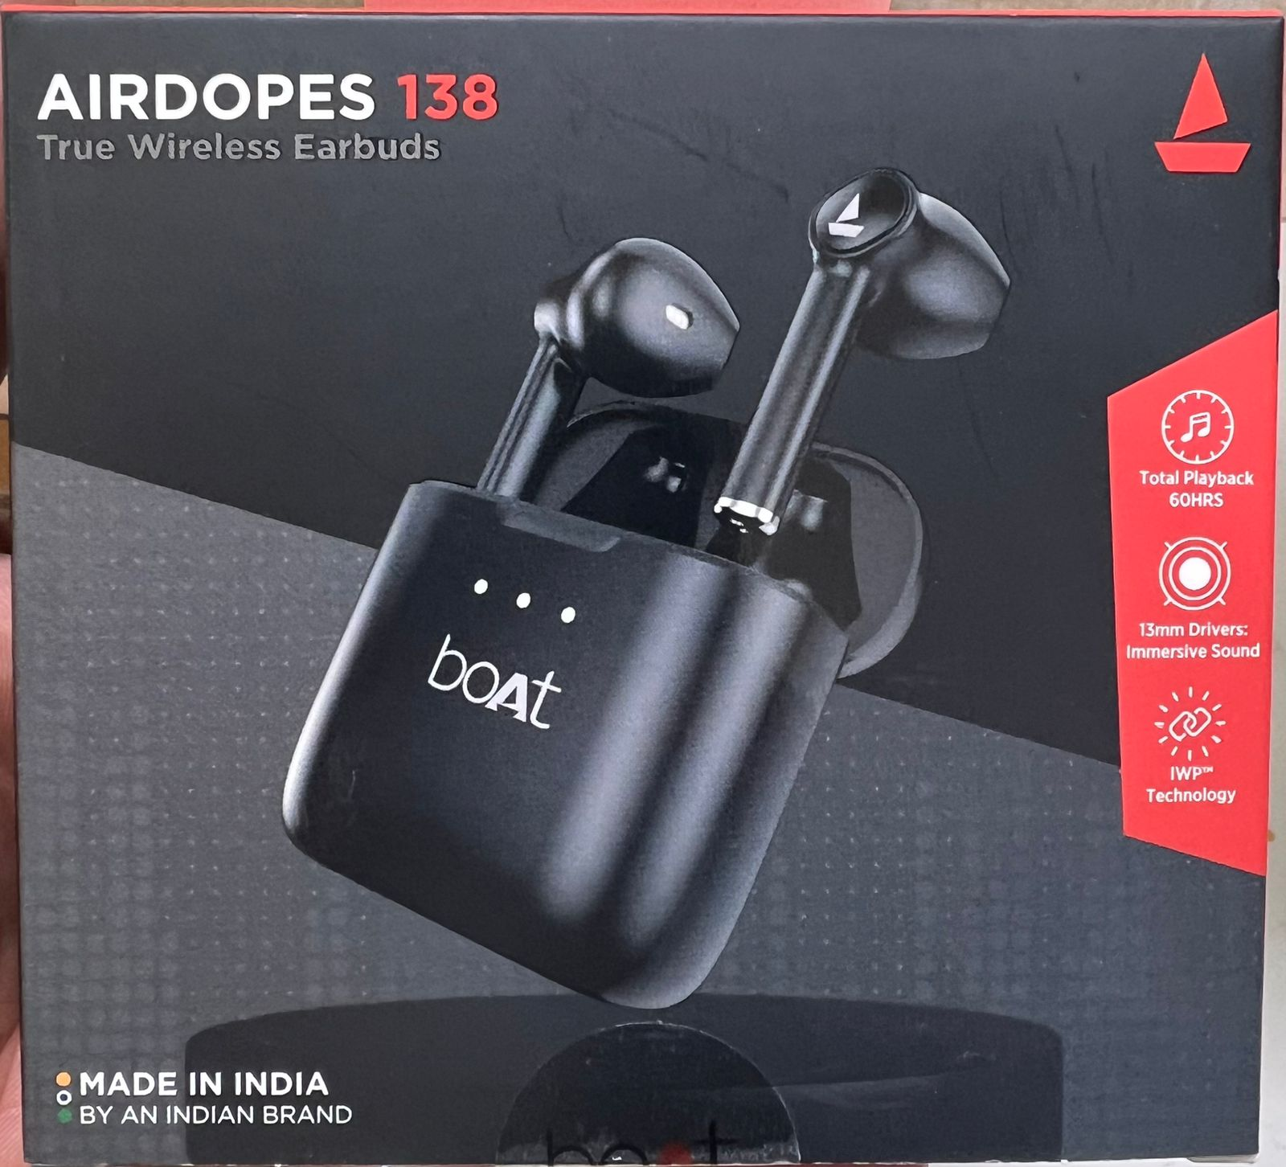
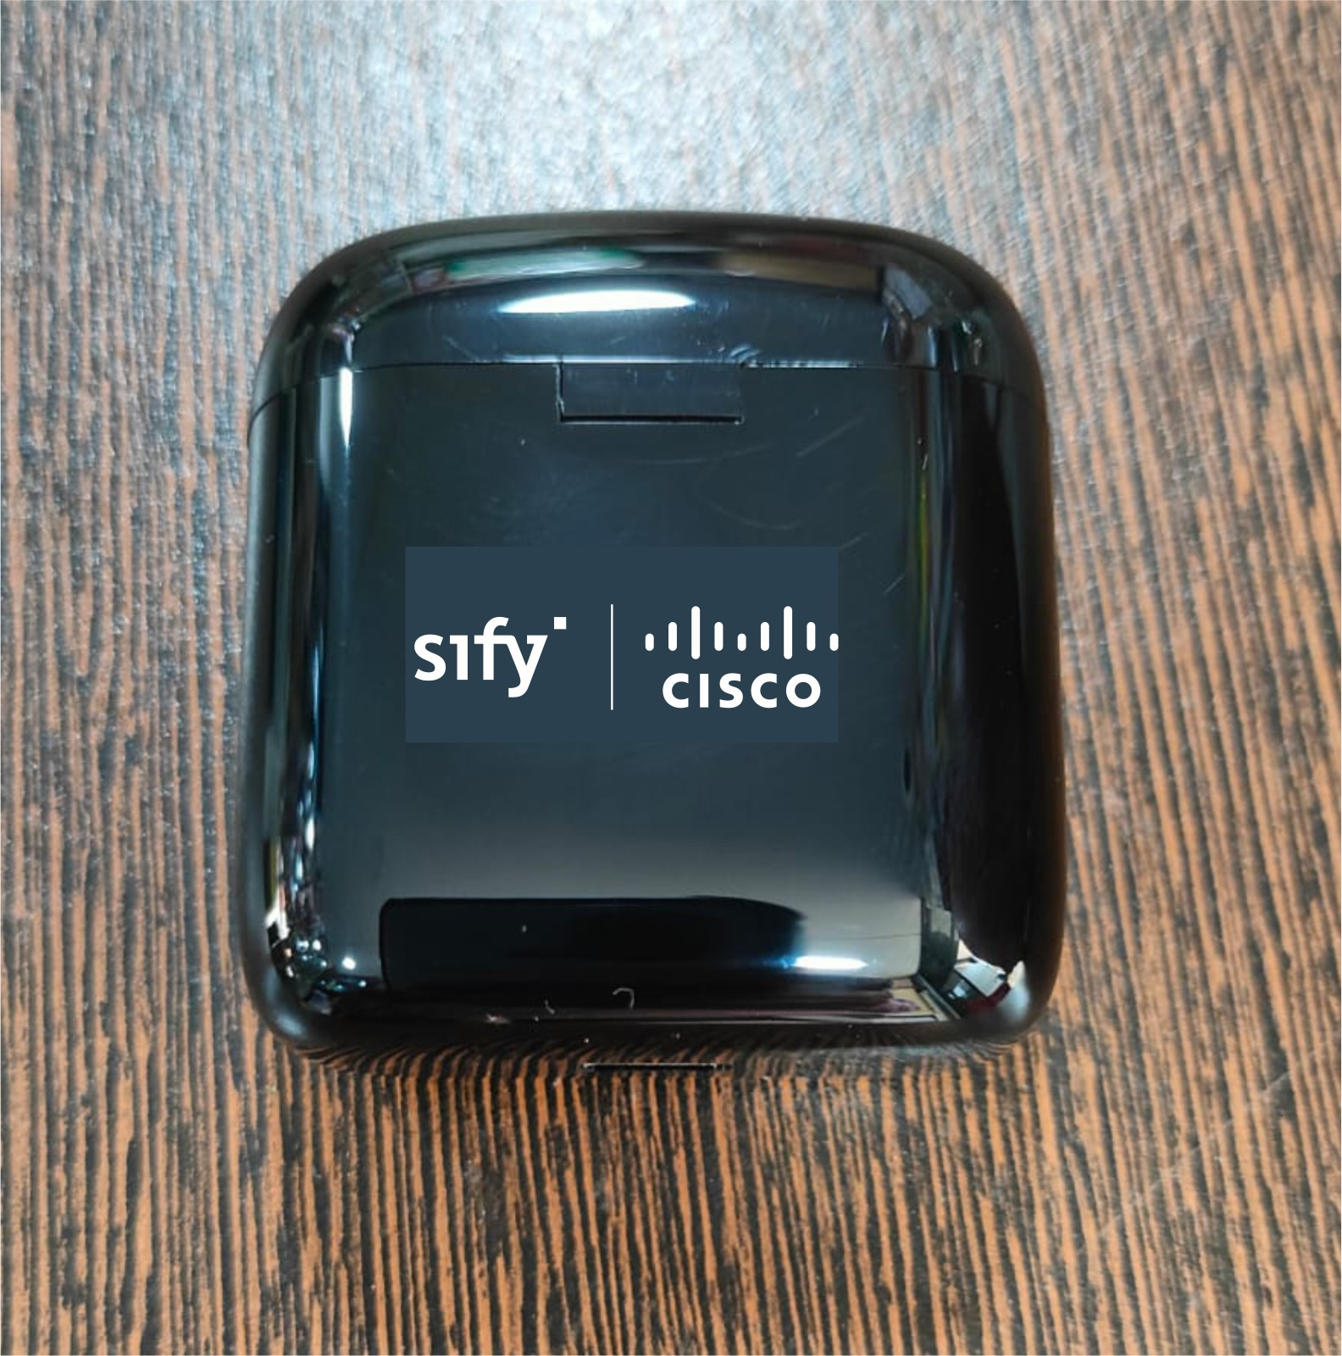
GIVE AWAY
boAt wireless earphones
MRP - 1000

