Slide 1


SOCIAL BRAND GUIDELINES
Best Practices for Representing Sify Technologies Online
SIFY SM GUIDELINES 24-25

Slide 2
The Social Brand Guidelines aim to enable our employees to maintain a consistent and professional brand presence on social media.
These guidelines apply to all employees, contractors, and partners representing Sify on social media.
OBJECTIVE

Slide 3
Protect the Company's Reputation:
-Ensure consistent and professional communication that aligns with Sify’s brand values.
Maintain Confidentiality:
-Safeguard sensitive information to protect the company and its stakeholders.

Slide 4
Responsibility:
-Be accountable for the content you post and its impact on the audience and the company.
Legal Compliance:
-Adhere to applicable laws and regulations to avoid legal issues and penalties. All social media content must comply with industry regulations. Include appropriate disclaimers for content that involves any sort of financial or legal advice to avoid potential liabilities.

Slide 5
Reporting:
-Report any accounts acting as Sify; or any suspicious activity or potential security threats received from any of Sify's social media accounts​.
Brand voice and tone:
-Our communication should always reflect Sify’s professionalism and authority in the ICT sector. Adapt the tone to fit the platform—formal on LinkedIn, engaging and slightly conversational on X and approachable on Facebook.

Slide 6
Responses on social and google ratings:
-Respond to comments and messages within 24 hours to maintain engagement and show our commitment to customer service. Keep all interactions professional, helpful, and courteous to reflect positively on our brand.

Slide 7
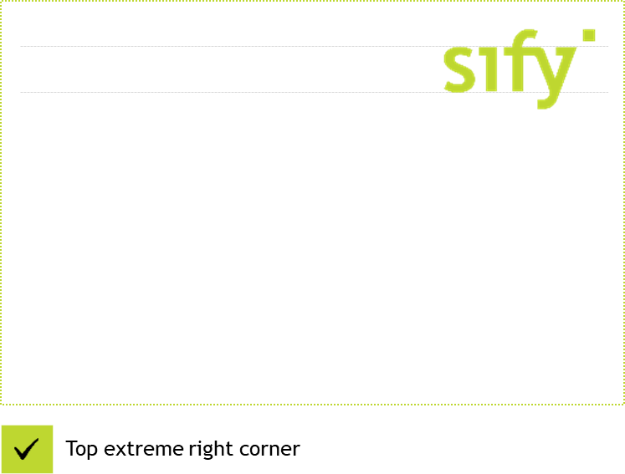

Logo Placement on Creatives
Sify logo should always be placed on the top right corner of the creative (social posts, EDM headers, social banners and social cards), unless the creative is for alliance / channel marketing*.
Top extreme right corner
*For co-branding guidelines, kindly refer to co-marketing guidelines from slide 14 to 18.

Slide 8




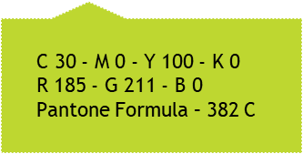
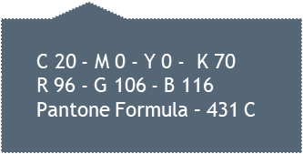

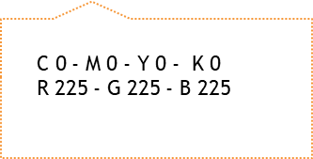
Logo Colors

Slide 9
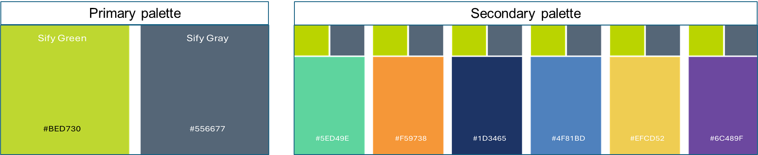
Color Palette
Green and Gray are our primary colors signifying growth and knowledge, respectively.
As a Next Gen brand, we are adding eye-popping colors, that resonate with the new generation, and add freshness to the brand. These secondary colors form a complementary color palette along with Sify’s primary colors

Slide 10


Creative: Typography

Slide 11
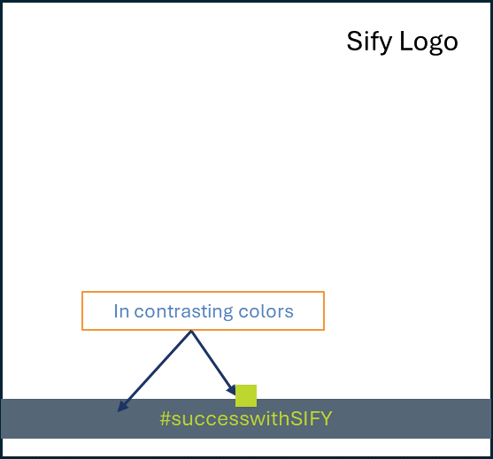
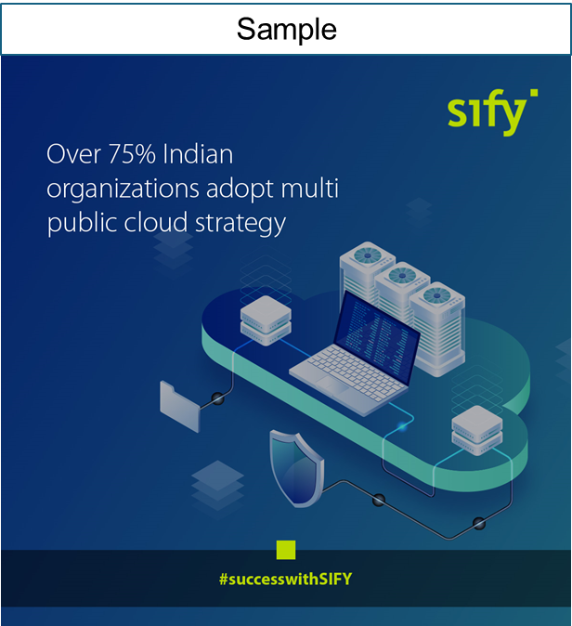
Creative Template

Slide 12
Creative Template: Hashtags
  #successwithSIFY: Customer speaks/case studies
  #SIFYblogs: Blogs
  #SIFYwins: Recognition
  #SIFYat__________ : Event participation
  #starsofSIFY & #peopleofSIFY: Employee features
  #SIFYfeatured: Media Coverage
  #lifeatSify: Office Celebrations
  #stayaheadwithSIFY: Service-related posts

Slide 13
Creative: Imagery Guidelines
  Image Quality: Use high-resolution images (at least 1200x1200/ 1200x627 pixels) to ensure clarity and sharpness. Consider using a slight blur effect on background images to bring the foreground text or graphics into sharper focus. Ensure the background does not detract from the main message.
  Human Imagery: Images of real humans- Modern workforce, IT professional(s) working with relevant technology, attending virtual meetings. Create a sense of movement in images to show people at work, energetic, determined and enterprising.
  Real Employees: Whenever possible, use images of real Sify employees instead of models. Capture candid moments of employees at work or interacting with clients to convey a genuine and relatable brand image.

Slide 14
Creative: Imagery Guidelines
  Screenshots and Mockups: Show screenshots and mock-ups of interfaces and digital platforms developed by Sify.
  Background: Abstract technical textures like data streams, connected network, network diagrams, data center infrastructure, etc. Use images of cities to communicate our event locations.
  Dynamic Visuals: Use dynamic visuals that represent innovation, digital transformation, and user interaction. Use imagery to represent futuristic concepts.
  Cultural Sensitivity: Be mindful of cultural representations. Ensure images are appropriate and respectful to all audiences.

Slide 15
Co-Marketing: Guidelines
Co-marketing Guidelines ensure that all partner marketing activities comply with relevant laws & regulations, including copyright, trademark, and advertising standards.
Guidelines help maintain the quality of marketing materials, ensuring that the shared content reflects positively on both brands and resonates with the target audience.

Slide 16
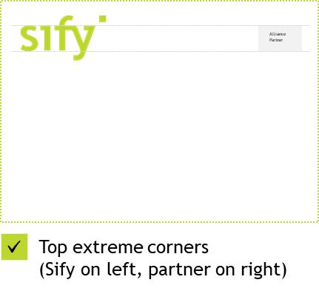
Co-Marketing: Alliance Partners
Alliance Partner logo should always be placed on the top right corner of the creative, aligned in height with the Sify logo placed on the top left corner.
Top extreme corners
(Sify on left, partner on right)
*In case there is a contradiction between Sify and Partner brand guidelines, kindly reach out to Sify Marketing at marketing@sifycorp.com

Slide 17
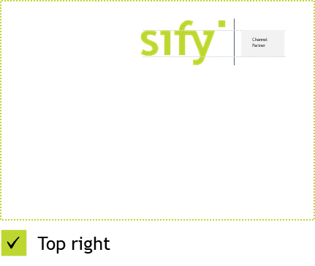
Co-Marketing: Channel Partners
  The Sify and Channel Partner logos should always be mentioned as a lock-up and not individually.
  This lock-up should always be placed on the top right corner of the creative.
  Always use a separator ‘|’ between the 2 logos.
Top right
*In case there is a contradiction between Sify and Partner brand guidelines, kindly reach out to Sify Marketing at marketing@sifycorp.com

Slide 18
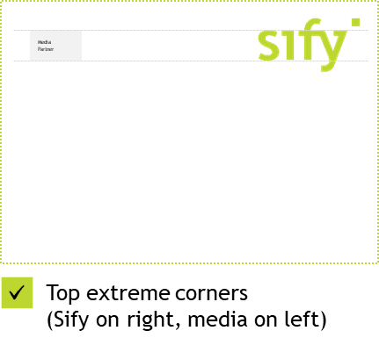
Co-Marketing: Media Partners
Media Partner logo should always be placed on the top left corner of the creative, aligned in height with the Sify logo placed on the top right corner.
Top extreme corners
(Sify on right, media on left)
*In case there is a contradiction between Sify and Partner brand guidelines, kindly reach out to Sify Marketing at marketing@sifycorp.com

Slide 19
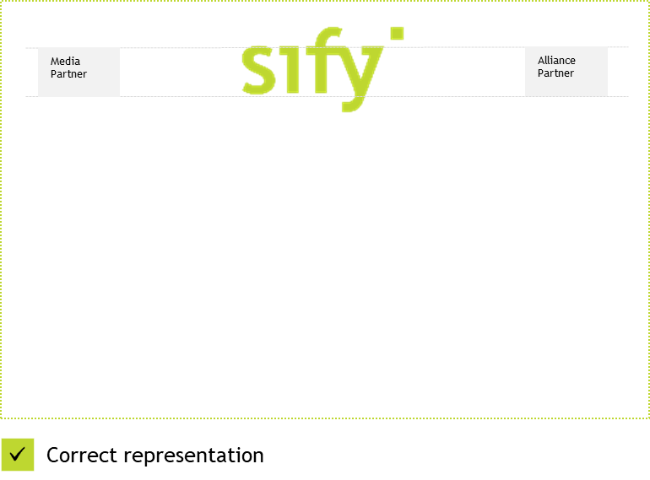
Co-Marketing: Alliance and Media Partners
In case both Alliance and Media/Channel partners are present in a creative, place the Media partner logo on the top left, Sify logo at the top center, and Alliance partner logo on the top right.
Correct representation
*In case there is a contradiction between Sify and Partner brand guidelines, kindly reach out to Sify Marketing at marketing@sifycorp.com

Slide 20
Thank You
In case of any query, please contact:
Ritesh Sharma
ritesh.sharma@sifycorp.com
9873281811
Jahnabi Banerjee
jahnabi.banerjee@sifycorp.com
7278655059
Ali Imran Khan
aliimran.khan@sifycorp.com
8770633600

