Slide 1
AI-READY DATA CENTERS:
POWERING FUTURE READY BUSINESSES
June 2024
EMPOWERING INDIA’S DIGITAL TRANSFORMATION

Slide 2
agenda
BUSINESS PRIORITIES & TECHNOLOGY DEMANDS
WHERE ARE WE MOVING?
BUILDING BLOCKS OF AN AI-READY DATA CENTER
SIFY DATA CENTERS EMPOWERING ENTERPRISES

Slide 3
BUSINESS & Technology PRIORITIES
Business Expansion
Diverse Product Portfolio
Operational Efficiency
Security & Compliance
Expand operations to diverse geographical locations. Enter new markets to support business growth and new customer access.
Innovative products/services for evolving customers needs with personalized experience and recommendations.
Streamline operations, optimize processes and resource usage to maximize productivity and reduce costs.
Ensuring robust security to protect user data, IPs, critical systems and adhering to regulations.
Integrated IT, Digital Marketplace
Digital-first Platforms
AI/ML &
Analytics
Cybersecurity & GRC
Jumpstart biz operations in new locations with scalable and agile IT stack and digital marketplaces for global reach.
Intuitive user experience across platforms- mobile apps, internet portals, IVRs, open APIs, microservices, and cloud for faster time to market.
Automate routine tasks, improve decision making, enable predictive maintenance and enhance service delivery.
Next gen firewalls, intrusion detection systems, encryption technologies, and multi-factor authentication with
automated compliance tools.

Slide 4








Where are we moving?
TRADITIONAL
IT ENVIRONMENT
THE PAST
THE FUTURE
DIGITAL
IT ENVIRONMENT
Centralized /
on-premise
Slow to adapt
Large, sparse, and horizontal
Manual operations
Interconnected
Tier level design
Subpar security
Unregulated
Distributed /
Hybrid IT
Simple, Scalable, Agile and Flexible
Automated and SLA based operations
Connecting multi sites
Heightened Security
BCP- Disaster Recovery
Compliance ready
Green and Sustainable
Cloud
On-Premises
Edge
On-Premises
On-Premises
Primary Site
Secondary Site/DR
Hosting
Colocation

Slide 5








Future of Digital enterprise
Streamline internal processes through automation
Improve adoption of
digital channels
Strengthen data security and compliance posture
Operational Efficiency
Customer Experience
Security & Compliance
AI/ML
Hybrid IT
Predictive Analytics
Network Backbone
Enterprises are converging to secure, end-to-end data center, cloud and networks
Notes:
Need for a Scalable and Hardened Technological Infrastructure is required for a future ready digital bank:
Operational Efficiency:
• Decrease average transaction process time by 25% through automation
• Implement process automation for 5 key operational workflows
• Decrease operational costs by 15% with no loss of service quality
Enhanced Customer Experience
• Increase mobile app ratings to 4.7 stars with 80% +ve reviews
• Achieve a 30% reduction in customer support tickets
• Increase digital banking transaction volumes by 25% YoY
Security & Compliance
•Implement consistent data encryption standards across on-premises, private cloud and public cloud environments.
• Achieve compliance certifications for all regulated workloads
• Achieve maximum coverage of multifactor authentication and stringent access controls
AI/ML and predictive analytics is used by Banks for fraud detection and prevention, personalized banking services, process automation, and predictive analytics.
Blockchain: Banks use blockchain for various applications, including cross-border payments, trade finance, identity verification, and compliance with regulatory standards.
Hybrid IT: deploying hybrid environments as per business priorities
Network Backbone: rearchitect the network architecture for digital transformation
Key results like these typically require multiple technology initiatives depending on the bank's digital transformation state. The specific results highlighted above require a highly available and performant core banking system, API gateway, embedded AI/ML insight and foresight engine, and versatile data Lakehouse to power a consumer-grade, modern user experience.

Slide 6
Ai-ready data centers

Slide 7
DIGITALIZATION OF DATA CENTERS: EVOLUTION
COGNITIVE
Improved Service level
Reduce lead time
PREDICTIVE
Value
3
Improved Service level
Reduce lead time
CONNECTED
“New services and business models”
Improved visibility
Enhance productivity
2
“Self optimizing response”
Offer as value added service with core products
Phase
“Predict what will happen”
1
Digital feedback, auto-Ticket generation & resolution
“Understand causes and impacts”
“See what is happening”
ML data models
“Define data and sources”
“Get plugged in”
Time series/ Historical data and data object model
Telemetry dashboards for CXO, Ops & Process
BMS, ERP, Serviceability data
Edge Gateways & Cloud data model
Time

Slide 8







Building blocks of an AI-Ready Data center
Scalability
Security
ESG
Future-ready Cooling Technologies
Global
Compliances
Low Latency Connect to Hyperscale Clouds, OTTs and Various IXs
AI/ML
Based Operations
Notes:
Foundations of a data centers

Slide 9



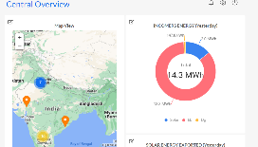


AUTOMATION: TECHNICAL ARCHITECTURE
Site Equipment
Hardware Connectivity
Operation Command Center
POWER
Multiple Energy meters
3rd party Integration - ERPs & tools
Chiller Plant
Busway Sensors
OPC
DG
IOT Cloud with AI/ML Algorithms
API
Multiple PACs/ CRAH/ AHU
UPS
OPC
Ops Equipment
Safety & Security Equipment
Smart IO interface
Internet
Temperature & Humidity Sensor
Wireless/ Wired
IOT Gateway
UPS-1
L2 switch
Ethernet
Dashboard
OPC
Centralized dashboards, tickets and reports accessed via Laptop, Tablet, Mobile etc.
Transformers (LT & HT)
TX
API’s
CMMS (Manual Ops Data)
Solution Components

Slide 10
Transforming Data Center Management with AI/ML
REALTIME VISIBILITY
MEASURABILITY
Operations: Land, Building, POD, People and Process
DC Infrastructure Assets: Active and passive information
Resource Utilization
  Space – Rack space
  Power – Grid power, DG, UPS, RE, Power Exchange
  Cooling
  Cross-connects
Operations: Condition or SOP based monitoring
Resource capacity utilization & trend analysis: Time based (Daily, Weekly, Monthly etc.) and Facility wide comparative analysis
KPI based service contract renewals
Usage based Infrastructure resource planning
PREDICTABILITY
EFFICIENCY
Failure & Downtime: MTBF, MTTR, RCA and Service TAT
Maintenance, Service & Support requirements
  Preventive Maintenance of assets
  AMC Contract realization
Demand forecasting and capacity planning
Capacity Utilization
  Rack Space burn down or consumption efficiency
  Power Utilization Efficiency (PUE) [ Grid/ RE ]
  DG Power fuel efficiency
  UPS Power efficiency( Load requirement vs Backup time)
  Water Utilization Efficiency
  DC Carbon Footprint
Service & Support efficiency
8-10% savings
on PUE
20% improvement in
equipment uptime
Up to 300-person hour
savings monthly
10% reduction in operating costs

Slide 11






Comprehensive Security framework
Confidentiality, Integrity, Accessibility based Security Policy
Centralized Security Command Center
10 Layer of Physical Security
Surveillance and Risk Assessment
Electronic Security & Controls
Process Review & Improvement

Slide 12


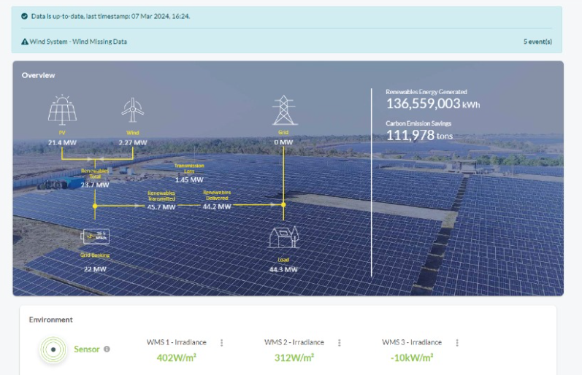


ESG FOcus
Data Center MEP
Sustainable Processes
High efficiency for Equipment even at low utilization levels
Selection of equipment with high energy saving parameters
Right redundancy levels
ASHRAE Guidelines
ISO 14001 Environmental Certification
Carbon abetment policy
Low PUE, WUE
Green Power Contracts
Future Roadmap
Contracted 231 MW Green power via Power Purchase Agreements
Additional nation-wide Green power for future projects. ~500MW planned to meet long-term sustainability goals
Up to 70% Green Power available in Mumbai
To become RE100 (Carbon Neutral) by 2030. 29% GHG emission reduction by FY2025
Exploring options to secure up to highest RE penetration for Sify DCs, as permitted by regulation
  Targeting high level of Renewable Energy penetration by year 2025

Slide 13
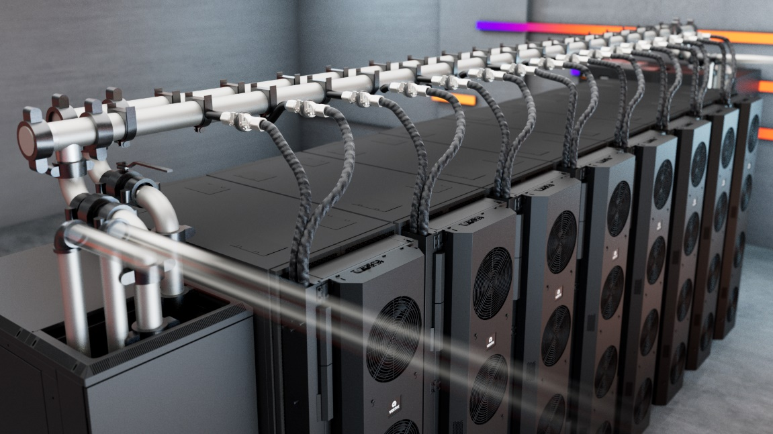
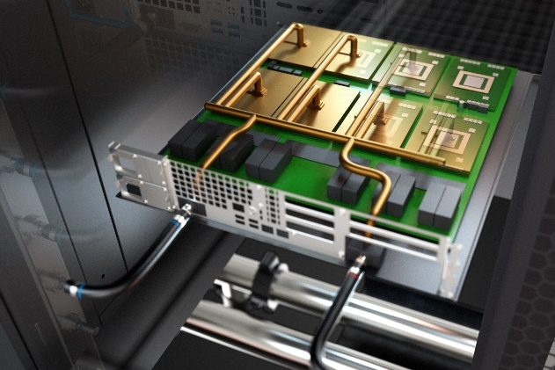

liquid cooling for ai & power Dense workloads
REAR DOOR HEAT EXCHANGER
Direct-to-chip
Liquid immersion cooling
Ideal for 20-50 KW Rack load
PUE: 1.4
Ideal for 50 – 150 KW Rack load
PUE: 1.2 - 1.4
Ideal for 50-200 KW Rack load
PUE: 1.2 – 1.35

Slide 14










Network and Connectivity Highlights
Location
Pan India
Network Presence
Reliable
Network Access
Cross-Connectivity
DC Interconnect
All our Data Centers are strategically located in dense Metro regions of the country on well-connected super-fast networks.
36000+ Kms of fiber access across 24+ Metro cities, 3700+ POPs
1600+ cities ensuring enhanced security and last mile connectivity
Access all tenants via cross connects/bulk fiber
Lower TCO as expensive network bandwidth not required
Multiple Fiber routes to the building and MMRs at each tower of the DCs.
Enables connect for DR, NDR, FDR deployments
Pan India dense fiber connectivity with interconnect services across 66+ Data Center facilities
Uniform Latency
Carrier Neutral
Meet-Me-Room
Easy Access to Internet Exchanges & Clouds
Leverage Common Infrastructure
Ensure all market participants access equal latency across the towers via standardized prewired cabling. ~150 Mtrs distance with less than 1ms latency
90% of fiber links are from non Sify Telcos
Extension simplified with in-campus wiring and is a low capex option for all Telcos
MDF(Network Closet) in every floor, connected to MMR via network risers
Separate access to telco MMRs for O&M in the BTS
Remote hands for network related troubleshooting
Leverage common network timing (PTP) setup
Access to Internet exchanges, Hyperscale, OTT, Social Media
Lower cost and improved user experience by accessing Internet exchanges for content distribution

Slide 15
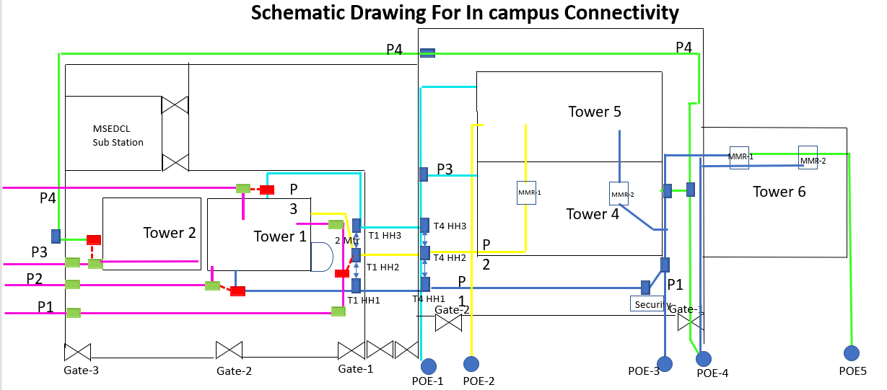
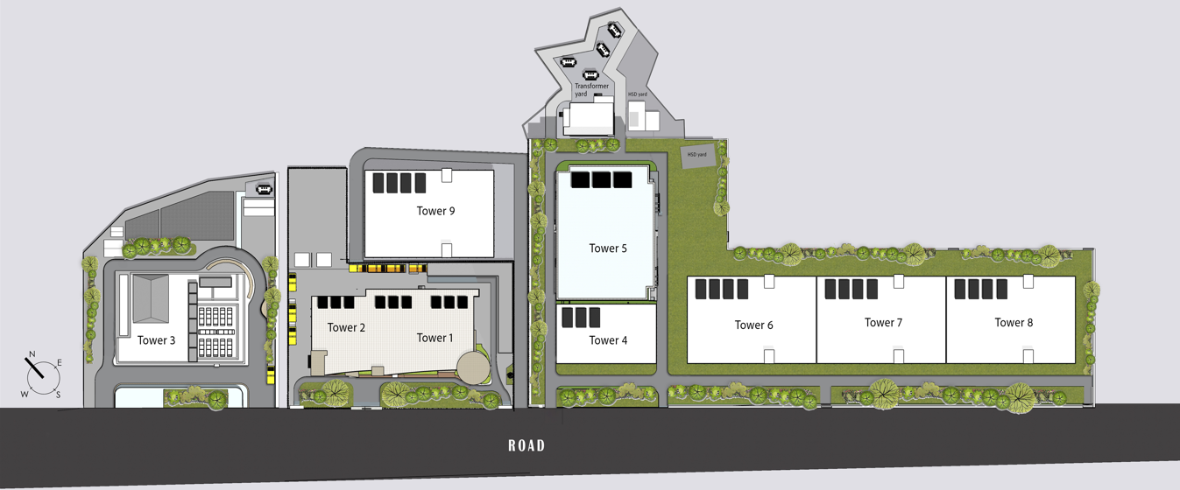
Network Fiber Paths
Interconnected DC towers in the campus via fiber Cross Connect offer uniform network access for applications hosted in any of the towers. And four POE for each tower for external telecom fiber
High-capacity bulk fiber from diverse routes between the towers.
All buildings in Sify Rabale campus have strong fiber interconnect with multiple routes.
Direct Cross connects to other Telcos hosted in the campus for customer to connect to cloud nodes: AWS, Oracle Fast Connect & Google Connect.
Secure high-capacity pre-laid bulk fiber for robust and scalable connectivity, each route has multiple ducts and sub ducts for fiber access from any tower to any tower.

Slide 16
Sify data centers

Slide 17

SIFY DATA CENTERS: INDIA FOOTPRINT (Six Markets)
NOIDA 02 CAMPUS
Tower B
26 MW
Q2 2024
Tower 1
11.5 MW
Tower 2
9.6 MW
Tower 3
BTS
NOIDA 01
Noida
10.8MW
Tower A
26 MW
Tower C
26 MW
1st Tier 3
in 2000
Tower 4
8.1 MW
Tower 5
38.8 MW
Tower 6
26 MW
Q2 2025
MUMBAI 01
Vashi
0.9 MW
KOLKATA 01
2.2 MW
Tower 7
20-30 MW
Q3 2025
Tower 8
20-30 MW
Tower 9
20-40 MW
Tower 10
20-40 MW
Tower 11
19.2 MW
Q3 2025
Tower 12
19.2 MW
Q4 2025
HYDERABAD 02 CAMPUS
(FAB CITY)
MUMBAI 02
Airoli
5.4 MW
HYDERABAD 01
Financial Dist.
14.4 MW
MUMBAI 03 CAMPUS (RABALE)
Block 1
26 MW
Additional Blocks
26-52 MW each
(including BTS)
BANGALORE 02 CAMPUS (AEROSPACE PARK)
BANGALORE 01
Electronic City
7.6 MW
CHENNAI 02 CAMPUS (SIRUSERI)
Tower 1
11 MW
Q2 2025
Tower 2
11 MW
CHENNAI 01
Tidel Park
3.6 MW
Tower A
26 MW
Tower B
26 MW
Q2 2024
Tower C
26 MW
Operational
In Development
Planning
All Power references are Design IT Power at Full Capacity
All Power references are Design IT Power at Full Capacity
Notes:
Add star above Vashi

Slide 18
Sify Data Center Advantage
Hyperscale, Hyperconnected, Green, AI-ready
RAS based design for future ready infrastructure
AI-Ready with Hybrid Liquid Cooling, up to 200 KW power/rack
14 DCs, 190+ MW IT power, expanding to 300+ MW by 2025
Hyperconnected, Carrier-neutral and Rich Interconnect ecosystem
India’s Data Center Powerhouse for over 23 years
India’s Top 5 banks, 3 of 4 Hyperscalers, Global OTT & Social media players,
and 600+ enterprises…
Campuses scalable to
600+ MW with BTS capabilities
AI/ML led operational excellence with 100% uptime
Enhanced 10 levels of security with automation
231 MW renewable energy contracted

Slide 19

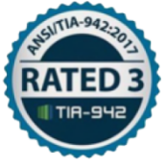


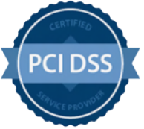











DATA CENTER: COMPLIANCE AND CERTIFICATIONS
z
MEITY Cloud Empanelled
India’s 1st Nvidia DGX Ready DC
Rated 3: Concurrently Maintainable Site Infrastructure
Data Center, Cloud &
Managed Services
IT Service Management
PCI DSS
Telecom Data Center & Managed Services
Hosting Partner
SOC 1 Type II
SOC 2 Type II
World’s international standard for occupational health and safety
Business Continuity Management System
Environmental Management system
Green Building
SAP Certified In Hosting Services
SAP Certified In Cloud Services
SAP Certified In SAP HANA Operations Services
SAP Certified In Application Management Services

Slide 20
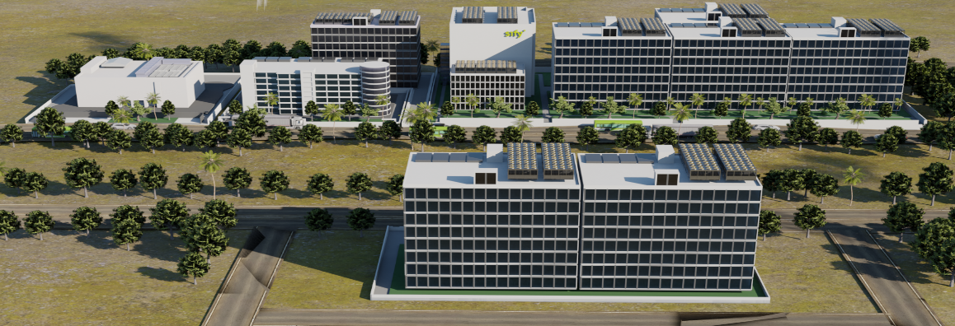
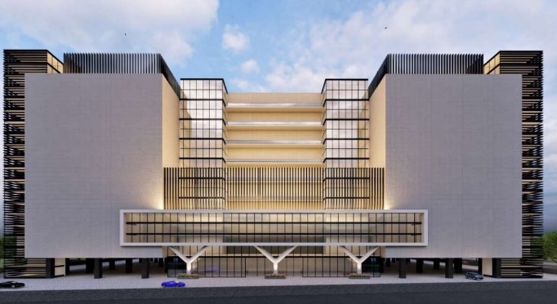
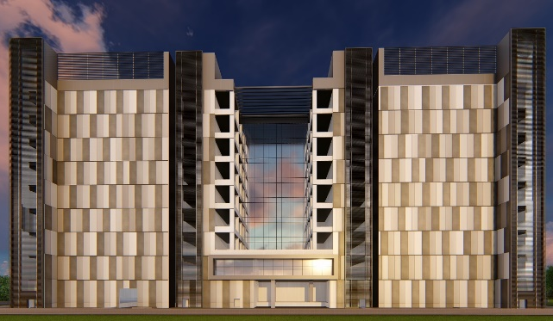
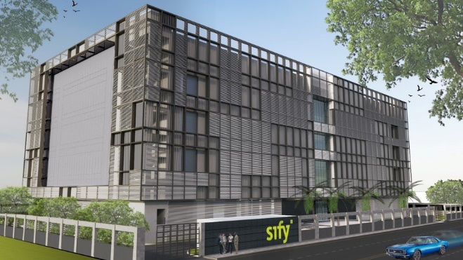
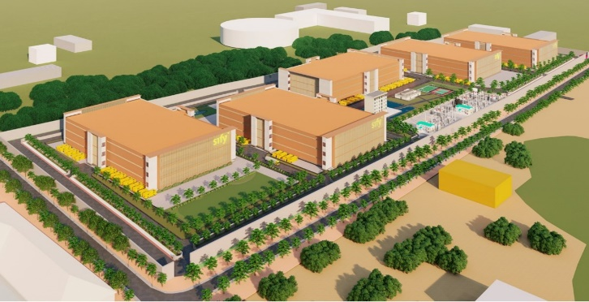
OUR HYPERSCALE DATA CENTER CAMPUSES
Tower B Operational Q2 FY 24
Noida 02
Power: 78 MW IT | Racks: 13,000
Mumbai 03, Rabale | Power: 240 MW IT | Racks: 32,000
5 Towers Operational
4 Towers In Development
3 Towers in Planning
In Development
Tower B Operational Q2 FY 24
Tower 1 Operational Q3 2025
Chennai 02, Siruseri
Power: 78 MW IT | Racks: 13,000
Bengaluru 02
Power: 22 MW IT| Racks: 4,500
Hyderabad 02, Fab City
Power: up to 250 MW IT | Racks: 25,000
In Development
In Development
Planning

Slide 21
Sify’s strong presence across industries
10,000+ India’s leading enterprises trust Sify’s DC, Cloud, Network, Security and Digital services.
600+ Top enterprises across industries power on Sify’s Data Centers.
Multiple global hyperscale CSPs continue to expand their presence in India with Sify’s AI ready Data Centers
India’s top 10 Banks are using Sify’s integrated Data Center and Network services
India’s leading conglomerate chose Sify Data Center to host critical apps across its multiple companies - Power, Ports, Gas, Civil Infra, Logistics
Accelerating strategic expansion of a global cloud security company by collocating in Sify’s Data Centers at Mumbai, Noida and Chennai
Colocation in Sify’s multiple DCs, CDN services and edge DC connectivity enable global OTT & Social Media Network to improve performance and reach
2 of the leading Global FMCG companies, India’s retail chain and top 2 logistics companies in India rely on Sify’s Data Centers
SAP Migration to Hyperscaler, Digital Networks integrating IT, OT & People for the world’s second-largest geographically diversified steel producer
Sify has designed, deployed and is managing the infrastructure that runs India’s entire inter banking transactions
Hybrid IT with DC Colo and Managed Services across DC, DR, Network, Security, and End-User Services for a Manufacturing conglomerate

Slide 22



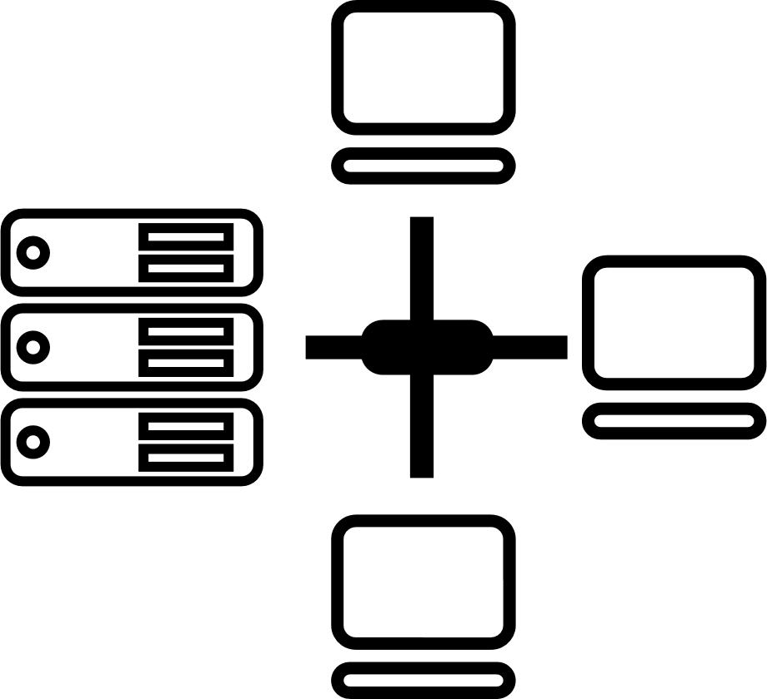






Tried Tested Trusted
Your digital infrastructure partner for over 23 years
Network
Infra Services
Network Digital
Managed Services
Data Center
Colo Services
CloudInfinit
Ent Cloud Infra
Cloud & IT
Managed Services
Digital Apps
Managed Services
Industry Apps
Managed Services
Security
Managed Services
Thank You

