Slide 1

Outsource complexities and maximize opportunities with Sify's Digital IT Managed Services
JUNE 2024
Anitosh Halder

Slide 2








SIFY Enabling digital experiences
Trends, Proposition & Growth Levers
HYBRID CLOUD ADOPTION
INFORMATION SECURITY
HYBRID NETWORK
APP MODERNIZATION
Build service, cloud service, hyperscale partnerships
Cloud Access Security, Cloud Security Posture management, Cloud Native Application security
SDWAN, SASE, ZTNA
DevSecOps, Cloud native app, InfinitDigital SaaS services
App modernization skills across multiple verticals to offer higher value and enhanced customer experience
SDWAN, SASE, ZTNA technologies to empower hybrid networks built on decades of network management experience
Value Stream Management and DevSecOps to ensure faster time to market, release quality, security, and compliance
FSO and comprehensive security services to secure the agile and borderless enterprise 24x7
FULL STACK OBSERVABILITY
EDGE TRANSFORMATION
CUSTOMER EXPERIENCE
AI/ML FORESIGHTS
InfinitFSO platform for availability and performance
Intelligent Edge
Immersive customer experience with AR/VR custom content creation
For real time prescriptive foresights for workflow optimization
AI/ML Foresights for real time data driven workflow optimization at the edge and send outcomes to cloud for reinforcement learning
Higher availability, performance and security for existing and new customers with digital infrastructure and hybrid IT
Immersive AR/VR experiences to help organizations convert impulsive customers in the free / trial mode into paying customers
AI/ML Foresights platform with Auto MLOps to transform domain experts or citizen data scientists into formally trained data scientists

Slide 3

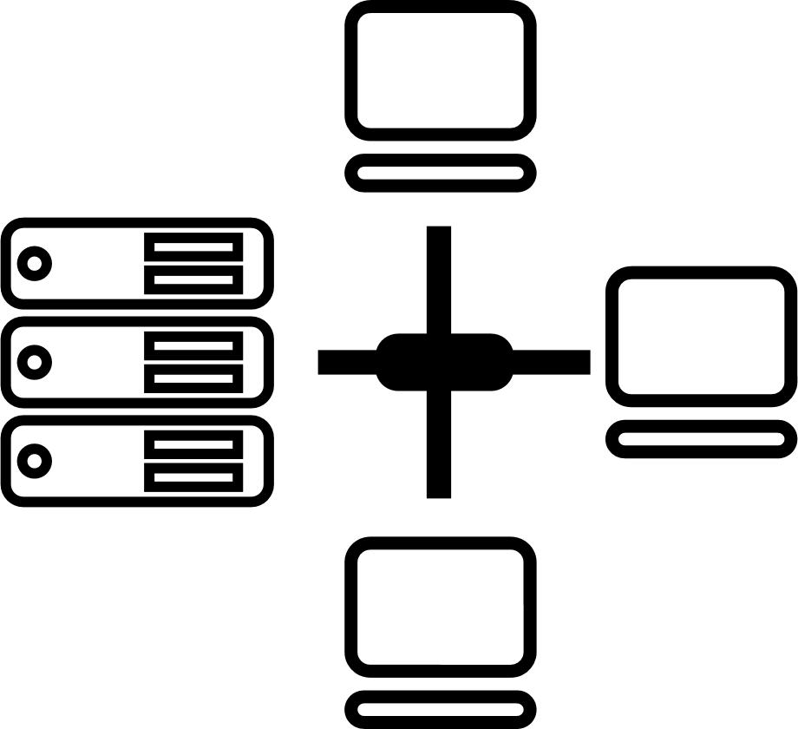

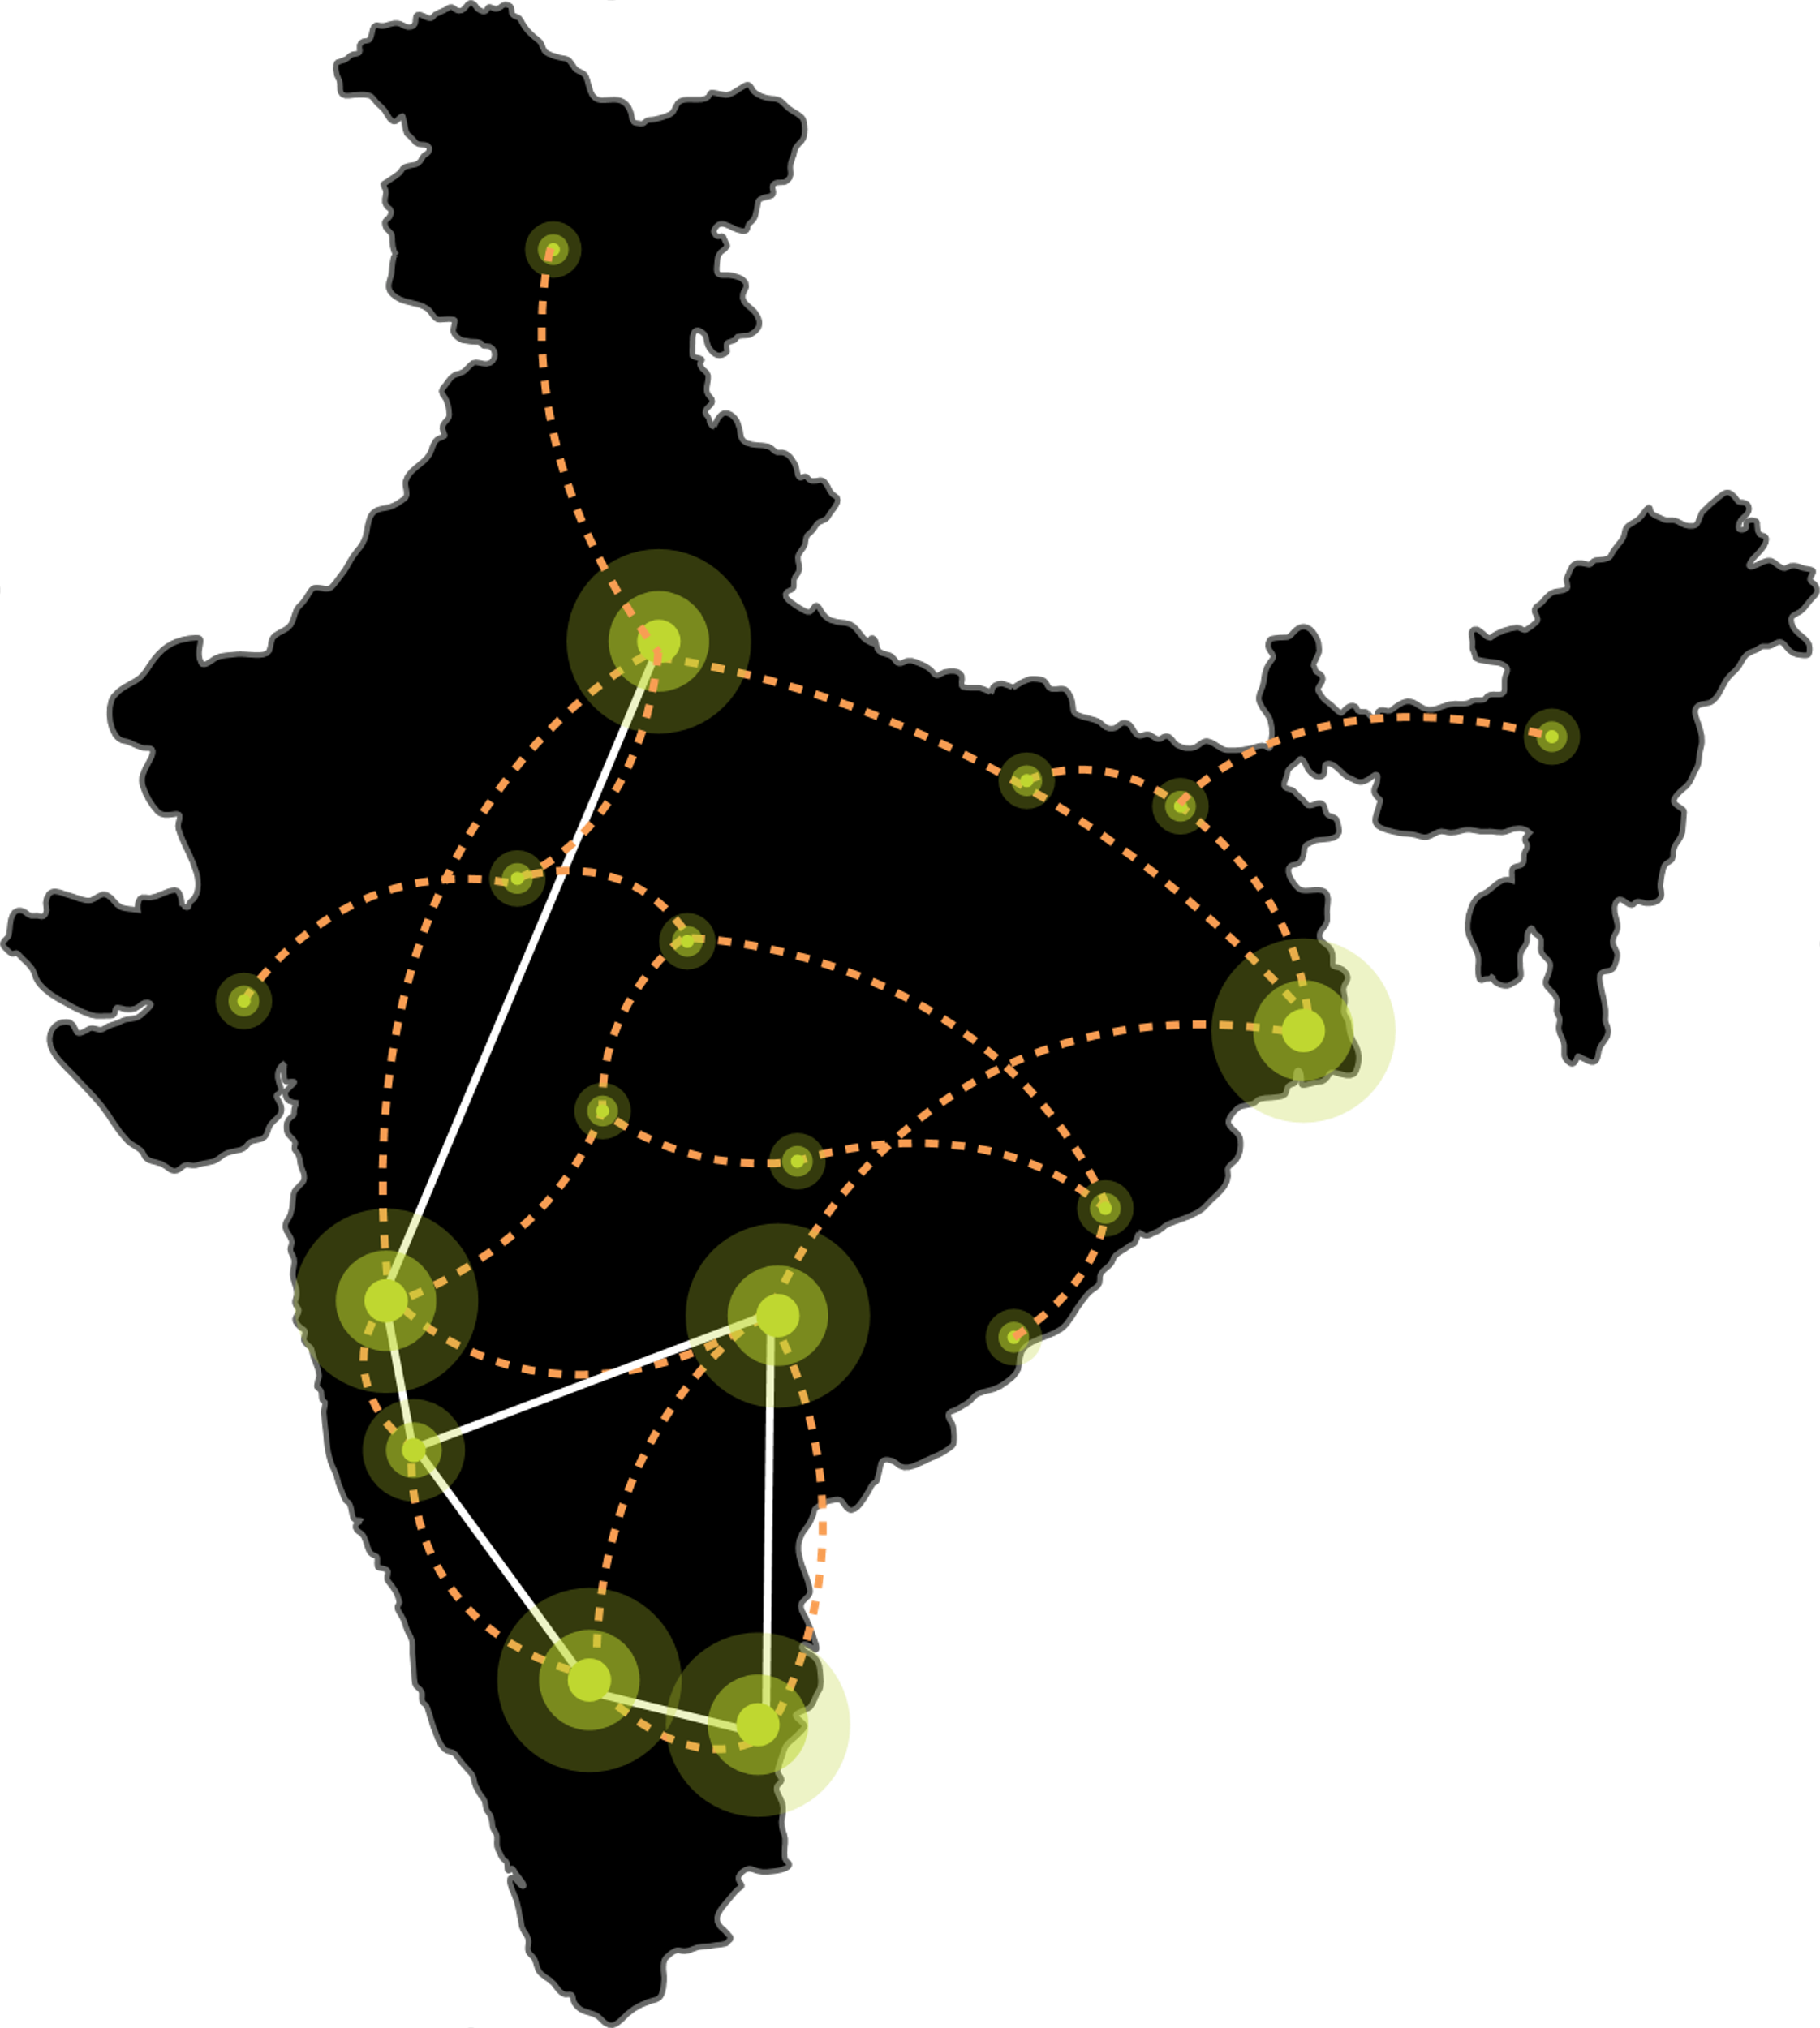






Investments in DIGITAL INFRASTRUCTURE & PLATFORMS – SIFY
India’s Top 5 banks, Top 4 Manufacturing, 3 Major Hyperscalers, Global Social Media, OTT, Security Players,
and 10,000+ Enterprises trust Sify…
Metro Networks
Fiber access
Connected Buildings
Interconnected DCs
Express Long-Haul Backbone, High Bandwidth and Low Latency across Key Locations
Network
Infra Services
Network Digital
Managed Services
NOIDA 02, DC
NOIDA 01
CloudInfinit
Ent Cloud Infra
Data Center
Colo Services
MUMBAI 03 RABALE, DC
SAARC Gateway, Kolkata
KOLKATA 01
MUMBAI 02 AIROLI
MUMBAI 01 VASHI
CLS, Versova, Mumbai
HYDERABAD 02, DC
HYDERABAD 01
Cloud & IT
Managed Services
Security
Managed Services
CHENNAI 02, DC
BENGALURU O2, DC
CHENNAI 01
BENGALURU 01
CLS, Siruseri, Chennai
Digital Apps
Managed Services
Industry Apps
Managed Services

Slide 4
Integrated IT Managed Services - Sify

Slide 5
SIFY MANAGED SERVICES: SNAPSHOT
20+ years of experience in providing managed services
Global Innovation & Delivery center at Chennai & Hyderabad
300+ satisfied managed services customers
Managed Services covering the entire Infra landscape – DC / DR / Cloud / Network / Security / EUS
Inhouse Certified & Skilled Resources
Key Highlights
Assessment & tool led transition approach
Proactive monitoring & management for efficient BAU
Flexible & Optimized delivery model as per customer requirements
Performance tuning & support
Incident, Problem, Change management
Managed Services Coverage
Data Center – Server, Storage, Backup, Virtualization, O/S, DR Management, DC LAN, Security
Cloud - AWS, Azure, OCI, GCP, Private / Hybrid Cloud
Network – NOC, LAN, Wi-Fi, WAN, VPN, IP/VoIP, VC, SDWAN
Security – SOC, SIEM, Threat Management, Information Security, Audits & Certifications, GRC
Infra Apps – Database, Middleware’s, Mail Messaging, Directory Services, etc.
Engineering led IT transformation roadmap
Service management based on ITIL framework
Compliance to Industry standards – ISO 9001, 20000, 27000
Inhouse L&D platform helping continuous upskilling

Slide 6




WHAT WE HEAR
Focus on what matters
to the business
Hard to staff
IT positions
Concerned about getting hacked
Avoiding unexpected costs are difficult with IT
I just want technology to work for our employees
I want to focus on what matters (our business)
– not IT
When technology isn’t working, it affects our bottom line
Technology sector unemployment is at <1.3% (20-year low)
Average technology sector base salary: $70,697 (True Cost 1.25x - 1.4x)
Invest in training - then they leave for higher pay!
I am not confident we
are secure
We don’t know how to protect our business from hackers
Mitigating risk to our organization is difficult
in IT
I want IT costs to be predictable
I need a trusted partner
to help us plan for IT expenditures
When technology isn’t working, it affects our bottom line

Slide 7











HOW CUSTOMER EXPECTS
SUPPORT
TOOLS
Unlimited
Support Desk
Unlimited On-site Support
Proactive
On-site Visits
Threat Detection
and Response
Secure Managed
Network
Remote Management
and Monitoring
Client Business
Review Process
Security Operations
Center
Network
Operations Center
Security Training
and Phishing
Email and Web
Security
Security Tools

Slide 8



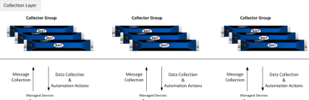
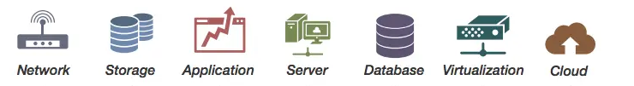

DIGITAL IT MANAGED SERVICES FRAMEWORK
Customers
Sify Delivery Team
Single partner for Managed Services across Digital IT
Operational Excellence driven by Automation
Proactive Assurance, Predictive Analytics & AIOps
Customer-centric Service Delivery model
Service Management Portal
Service Fulfilment
Provisioning, Orchestration & Service Assurance – Sify Multi-CMP
Request
Event
Incident
Problem
Change
Asset Mgmt.
CMDB
Service Mapping
AI/ML Tools
Sify Monitoring Tool
Data Store
Discovery & Mapping
Monitoring
Business Services Dashboard
Automation
Event Management
AIOps
Data
Visualization
Backup
Polled
Logs
Agents
API
Patch Management
Syslogs
VA / PT
AV
SIEM
API
Agents
DR
Any Cloud
Operations Support Systems

Slide 9





Automation-led managed services
Provisioning
Workflow
Event
Runbook
Catalog based orchestration - Creation, Self Service, Multi Cloud Management, etc.
Sequential workflow defined services and checks with or without any intervention – Service Request, Notifications, Authorization, Assignment etc.
Triggered based on one or sequence of events – Alerts from tools or APIs, Threshold violations, etc.
SOP based sequential tasks - Service Health checks & defined actions.

Slide 10
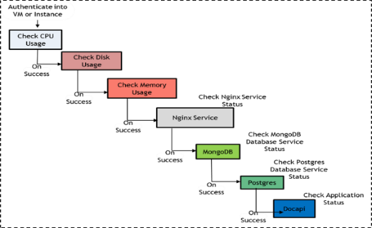
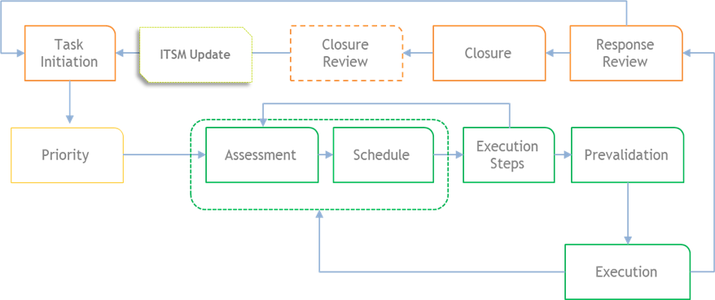
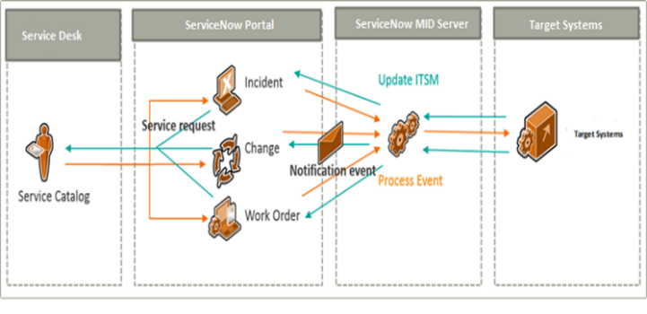
Managed services Automation
Workflow automation
Run Book automation
Service desk integration
Few references for use cases automated
Active Directory User Management
Exchange Mailbox Management
Linux File deployment from SVN
DNS Records
VMware ESX Hardening
Log rotation on systems and network devices
Message parsing on Active Directory & Microsoft Exchange Servers
Daily Health checks on Network devices, Storage Systems & Databases
Configuration backup of SAN / LAN Switches & Firewalls
Automated Ticket Routing
Workflow & Runbook based automation for predefined request categories
Pre-fetch & auto update tickets with high CPU/Memory consuming processes
CMDB Updates
Integrated OEM Ticketing & Escalation

Slide 11








Smart & Efficient Service Management Portfolio - Sify
Tool & Automation led Service Management
Integrated Intelligent Service Desk
Customized Service Delivery Model
Self Service Portal & Omnichannel services
AIOps powered Full Stack Observability
Compliance & Incident Management
Auto Remediate ticket management system
Catalogue based Service Assurance

Slide 12
INTEGRATED SERVICE DESK

Slide 13











DAY IN A LIFE IN IT OPERATIONS - INTEGRATED SERVICE DESK
Primary Service Desk
BCP Service Desk
Central Service Desk
Central Service Desk
Remote Support
Remote Support
DC Ops Team
SD Lead
SD Lead
Service Management
Service Management
IPC Managers
MIS
OEM
MIS
Command Center
Infra and App Support
Quality & Audit
IPC Team
Compliance and GRC
Technical Architect
Delivery Manager
NOC
App Support Team
Infra and Network Support Team
Onsite Support Engineers
App Lead
Infra Lead
Asset and Vendor Mgt
Domain Leads
Domain Leads
Tools Team
EUS Team Lead
On call Resources
L1 Admin
L2 Admin
L3 Admin and SME
Tools SME
L1 Admin
L2 Admin

Slide 14









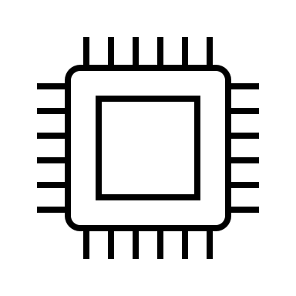






Making lives efficient with OMNICHANNEL communications - SELF SERVICE SUPPORT
Business Users
IT Users
Multiple channels for Ticket logging
Integrated Channels Chatbot, WhatsApp
IVR based call logging to reach directly
AI Chatbots & Assistants acting as First Point of Contact
Assist users with self service
Update CMDB for better CI mapping
Improve KEDB
Enable automation for less human contact
Auto Assign tickets as per the SLA
AIOPS based event correlation
Automation based on the SOP and AIOPS based feeds
Reports
Phone
Email
Web
Chat
AI/ML , Bots
Agent Less
IVR
Acknowledge
Knowledge Based
Log
Incident/ SR
Attempt
Resolution
Close Incident
KEDB
CMDB
AIOPS
ITSM Tool
Ticket log
Auto Ticket Routing
L1 & L2 Agent Support
Auto Escalation
SLA Based Auto Ticket Assignment
Unified Dashboard
Auto Routing of Tickets
Manage SLA
Predictions
Auto Assign
EUS Support FCR/ RD
Infra Support L1
Supervisor
Manager
L2 , L3 Support
App, Infra , WAN
App Support L1
WAN Support L1
Reports and SLA
Physical Agent
Command Center

Slide 15
CLIENT BUSINESS REVIEW PROCESS
Weekly Status Meeting
Quarterly Steering Meeting
Monthly Project Status Meeting
Yearly Management Meeting
Status update of regular and key assignments
Approach and solution discussion on key assignments
Way forward/approval/ technical feasibility discussion
Monthly status report discussion on –
Tickets
SLA
System availability
Change request report discussion –
UAT support
Prioritization
Delivery time-line
Consumed efforts
Quarterly steering committee meeting on –
System performance
KPI discussion
Value addition
Operational efficiency
Operational quality
New innovations
New process automation
Yearly management discussion on –
IT alignment with business value drivers
Technology upgrades
Strategic initiatives
Meeting Cycle and frequency can be modified as per requirement and mutual agreement

Slide 16
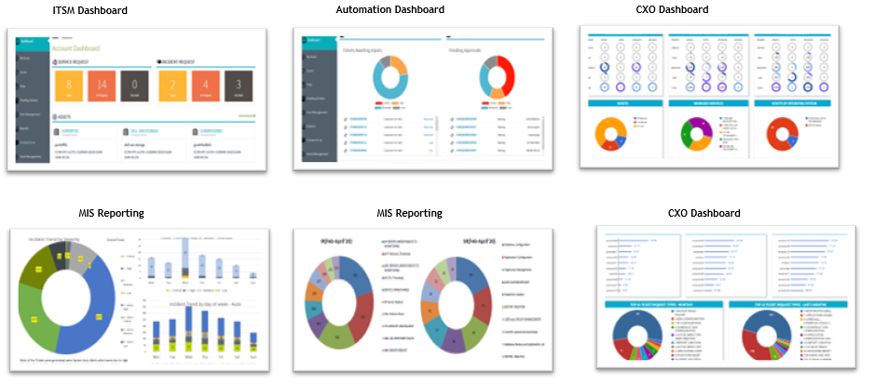
VISIBILITY TO PERFORMANCE
Notes:
Dheeraj

Slide 17
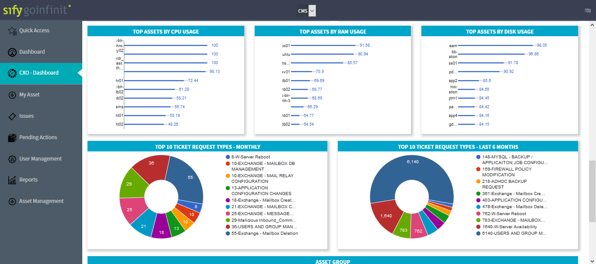
MANAGEMENT VIEW FOR CXO
Notes:
Dheeraj

Slide 18
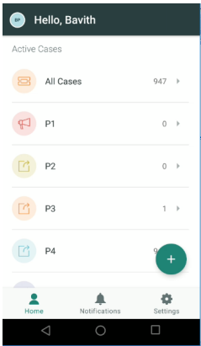
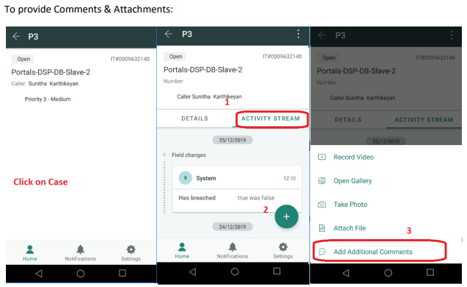
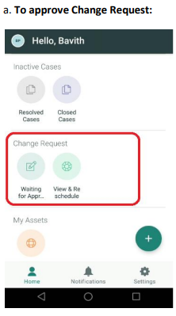
CHECK THE LIFE OF IT OPS WHILE ON THE MOVE
Notes:
Dheeraj

Slide 19
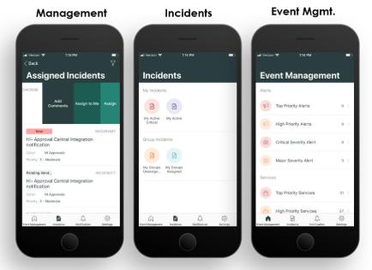
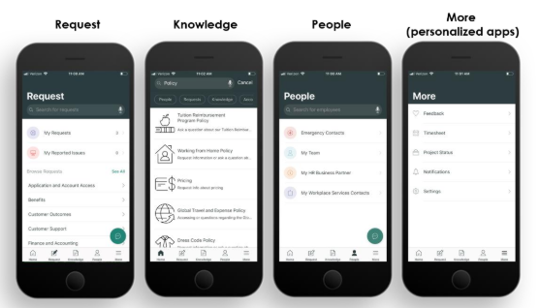
SERVICE MANAGEMENT ON THE GO
Notes:
Dheeraj

Slide 20
SOC

Slide 21







SECURITY AT WORK
Security Training and Phishing
Security Operations Center (SOC)
Remote Management and Monitoring
Monitoring & Alerting
Secure Managed Network
Network Sensors
Anti-Malware Protection
Anti-Virus / Anti-Malware
Email & Web Security
Detection and Response Platform
Threat Detection and Response
Firewall

Slide 22






SECURITY MANAGED SERVICES FRAMEWORK
Comprehensive Managed Security Services from Edge to Cloud Deployments
Single solution provider covering DC, Network, Cloud, App, Hosts and Data
Offering Shared/On site/Hybrid Services to manage diverse solution portfolio with customized support models
Integrated seamlessly with other managed services in the ITSM platform to provide a unified view with faster ticket resolution
SLA driven Security Services by virtue of SASE & Security providers hosted in Sify DCs
AI/ML driven continuous Security Assurance Monitoring, & Automated Incident Management
Real-time monitoring through multiple feeds, to safeguard all the systems and sensitive information
Correlate security inputs to business context and current threat insights for Auto remediation
Governance, Risk & Compliance Assurance
Identify security vulnerabilities across your digital IT infrastructure and remediate with Sify’s advanced managed services
Enable organizations to meet regulatory and compliance requirements: SEBI, RBI, IRDA, ISO27001…
Customers
Sify SOC
Service Management Portal
Service Fulfilment
Service Assurance
Provisioning & Orchestration (SOAR)
Request
Event
Incident
Problem
Change
Asset Mgmt.
CMDB
Service Mapping
Monitoring / Management (MSS)
Detection (MDR)
Governance Risk & Compliance (GRC)
Tools
Performance & Availability
IAM
SIEM
UEBA
EDR
NBAD
Vulnerability Assessment
Penetration Testing
OS & Application Patch Management
Security Product Consoles
Threat Intelligence
Security Audits
Firewall, IDS/IPS, ATP, RA VPN, WAF, SWG, SASE. DDoS, DNS Security
NGAV
DLP, Email Security
CASB, PAM, MFA
User | Device
Branch | WAN
DC
Any Cloud
Security Controls
Notes:
We adhere to a structured framework that consists of three distinct layers: assurance, tools, and security controls.
Within the SOC, there are three separate teams: MSS (Makers), MDR (Checkers), and GRC (responsible for IT security audits, VA & PT services). These teams collectively extend their oversight and supervision of security controls, regardless of their geographical locations, as illustrated in the lower right corner of the screen.
The assurance layer encompasses the closely integrated IT Service Management (ITSM) platform, which aligns with ITIL standards, and the Security Orchestration, Automation, and Response (SOAR) platform.
Structured framework covering Assurance, Tools, and Security controls
SOC powered MSS (Makers), MDR (Checkers), and GRC (IT security audits, VAPT services)
Geo agnostic with complete visibility of all security controls and centrally managed
Security Orchestration, Automation, and Response (SOAR) platform
Assurance layer includes an ITSM platform as per ITIL standards

Slide 23
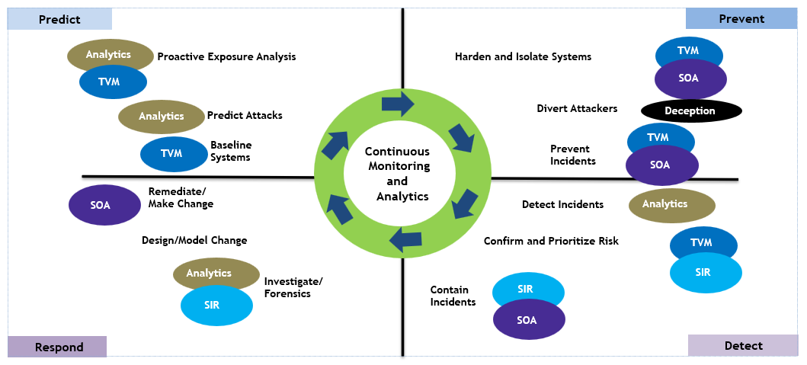
SOC MONITORING PHILOSOPHY

Slide 24
NOC

Slide 25

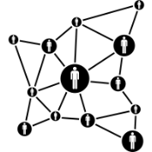
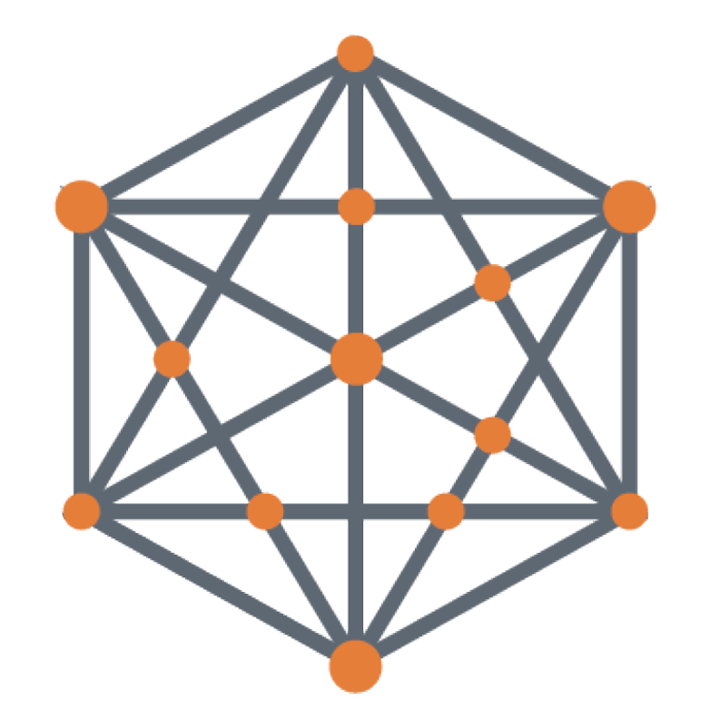
NETWORK MANAGEMENT AND OPERATIONS SCOPE
Network Operations Outsourcing
Network Consolidation & Operations Outsourcing
Network Transformation
& Operations
Operations Transition from existing managed services provider to Sify
Advanced NOC Services
SLA Management
Vendor Management
AMC Management
Network Study & Assessment
Service Provider Consolidation
Performance Management and Optimization
CPE Management
Network Redesign/ Reengineering
Software Defined Network Deployment

Slide 26
SIFY MANAGED NOC
Strengths
Uniquely positioned as an NMSP, NSP & NI
Managing Carrier Class Networks for 20+ years
Collaborative relationships with leading Telcos
Running some of India’s largest, complex, mission-critical networks
2,333
POPs
4,000
Infra Links
9,000
IP/MPLS Nodes
1,20,022
Wireless Links
600+
MNS Customers
76,000+
Managed WAN Links
47,000+
Managed CPE
4,000+ Tickets/day
400+
Skilled people
Next-Gen NOC Features
Robotic Process Automation by Leveraging AIOps
AI/ML led Intelligent Network Monitoring
Full Stack Observability (FSO) Enablement

Slide 27
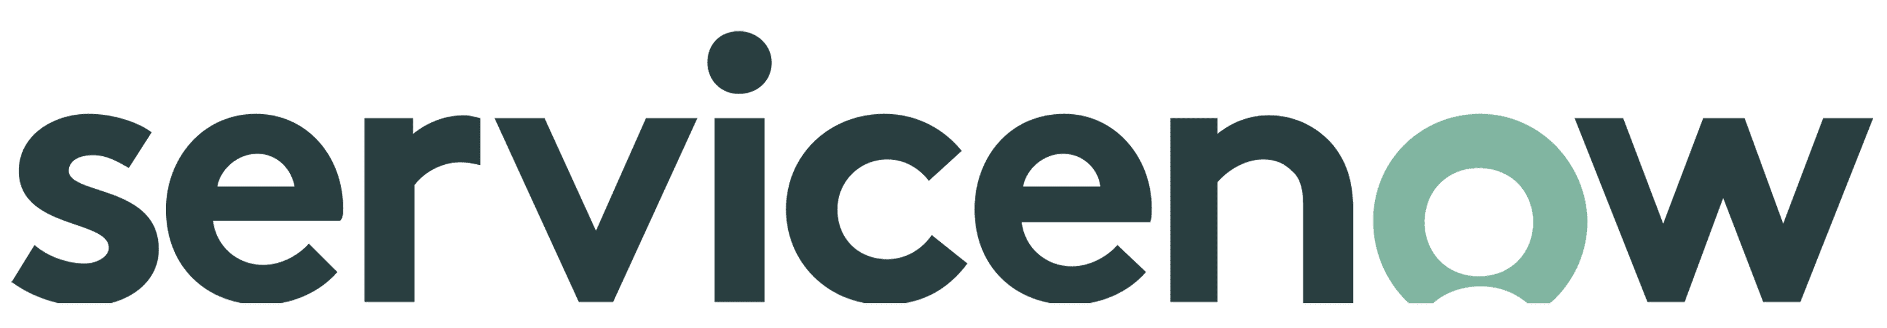


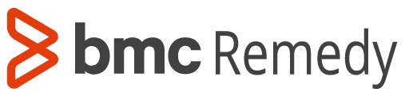
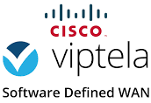
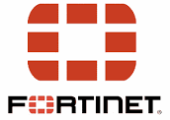








PLATFORM INTEGRATION FOR BETTER OUTCOMES
Service Desk
Sify Portals
ITSM
Integrated DX Layer
E-BONDING
federated
partners
Incident
FSM
Asset Mgmt.
Dashboards
Insights
Self Service
Problem
Service Req
Preventive
CMDB
Change
Workflows
3rd party Dash boards
Automation Interface
Sify’s Intelligent Event Aggregation, Correlation, Prediction and Integration layer
Network
Configuration
Network
Remediation
Network
Analytics
Third party Telemetry Platform
(TE or similar)
Data Aggregator
Events, Alarms, Data, Config
Sify’s Adaptation layer
Metric Data, SNMP, Logs, NetFlow
Metric Data, SNMP, Logs, NetFlow
Physical
Infrastructure
Virtual Infrastructure
Telco-cloud
Infrastructure

Slide 28
TOOLS

Slide 29

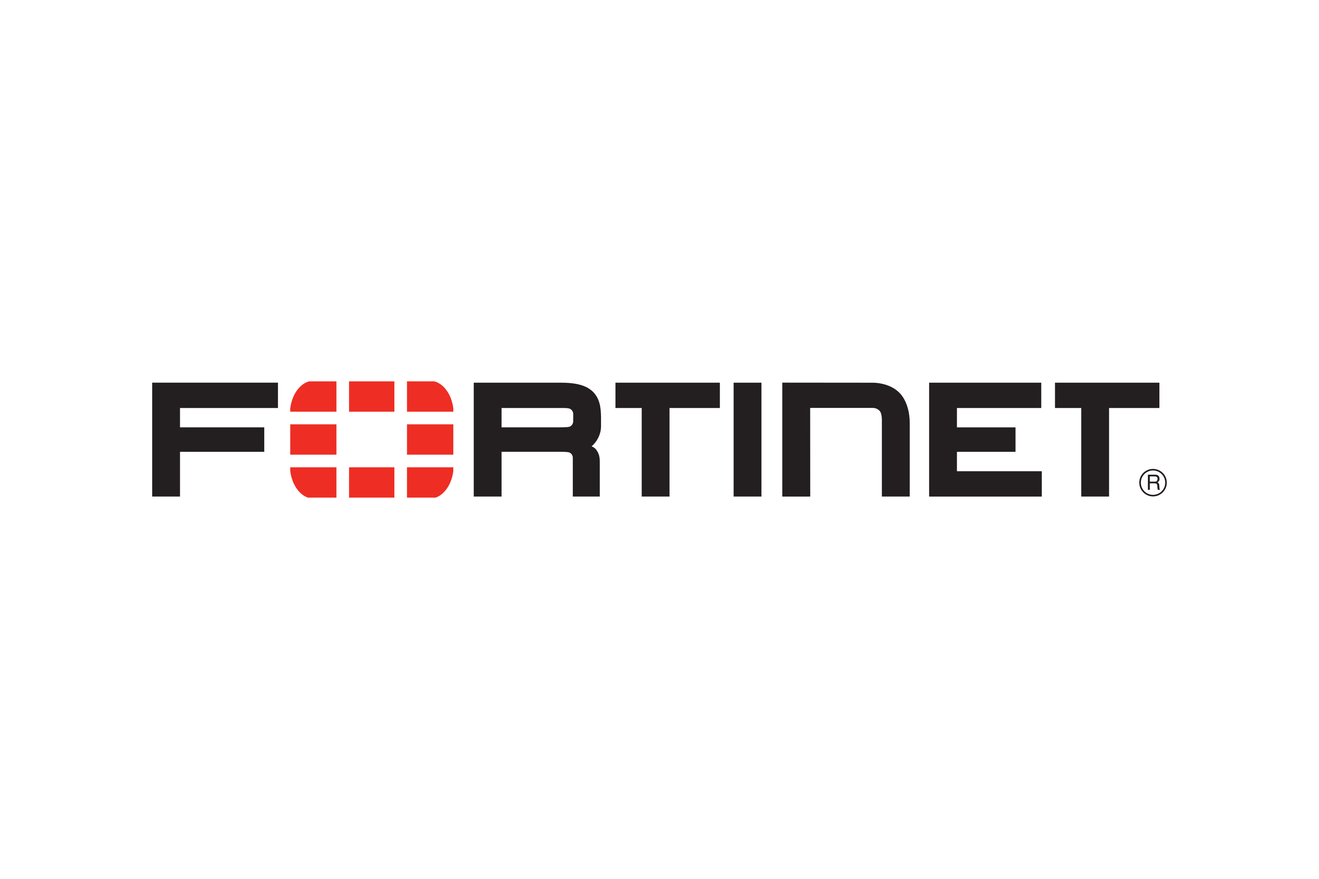



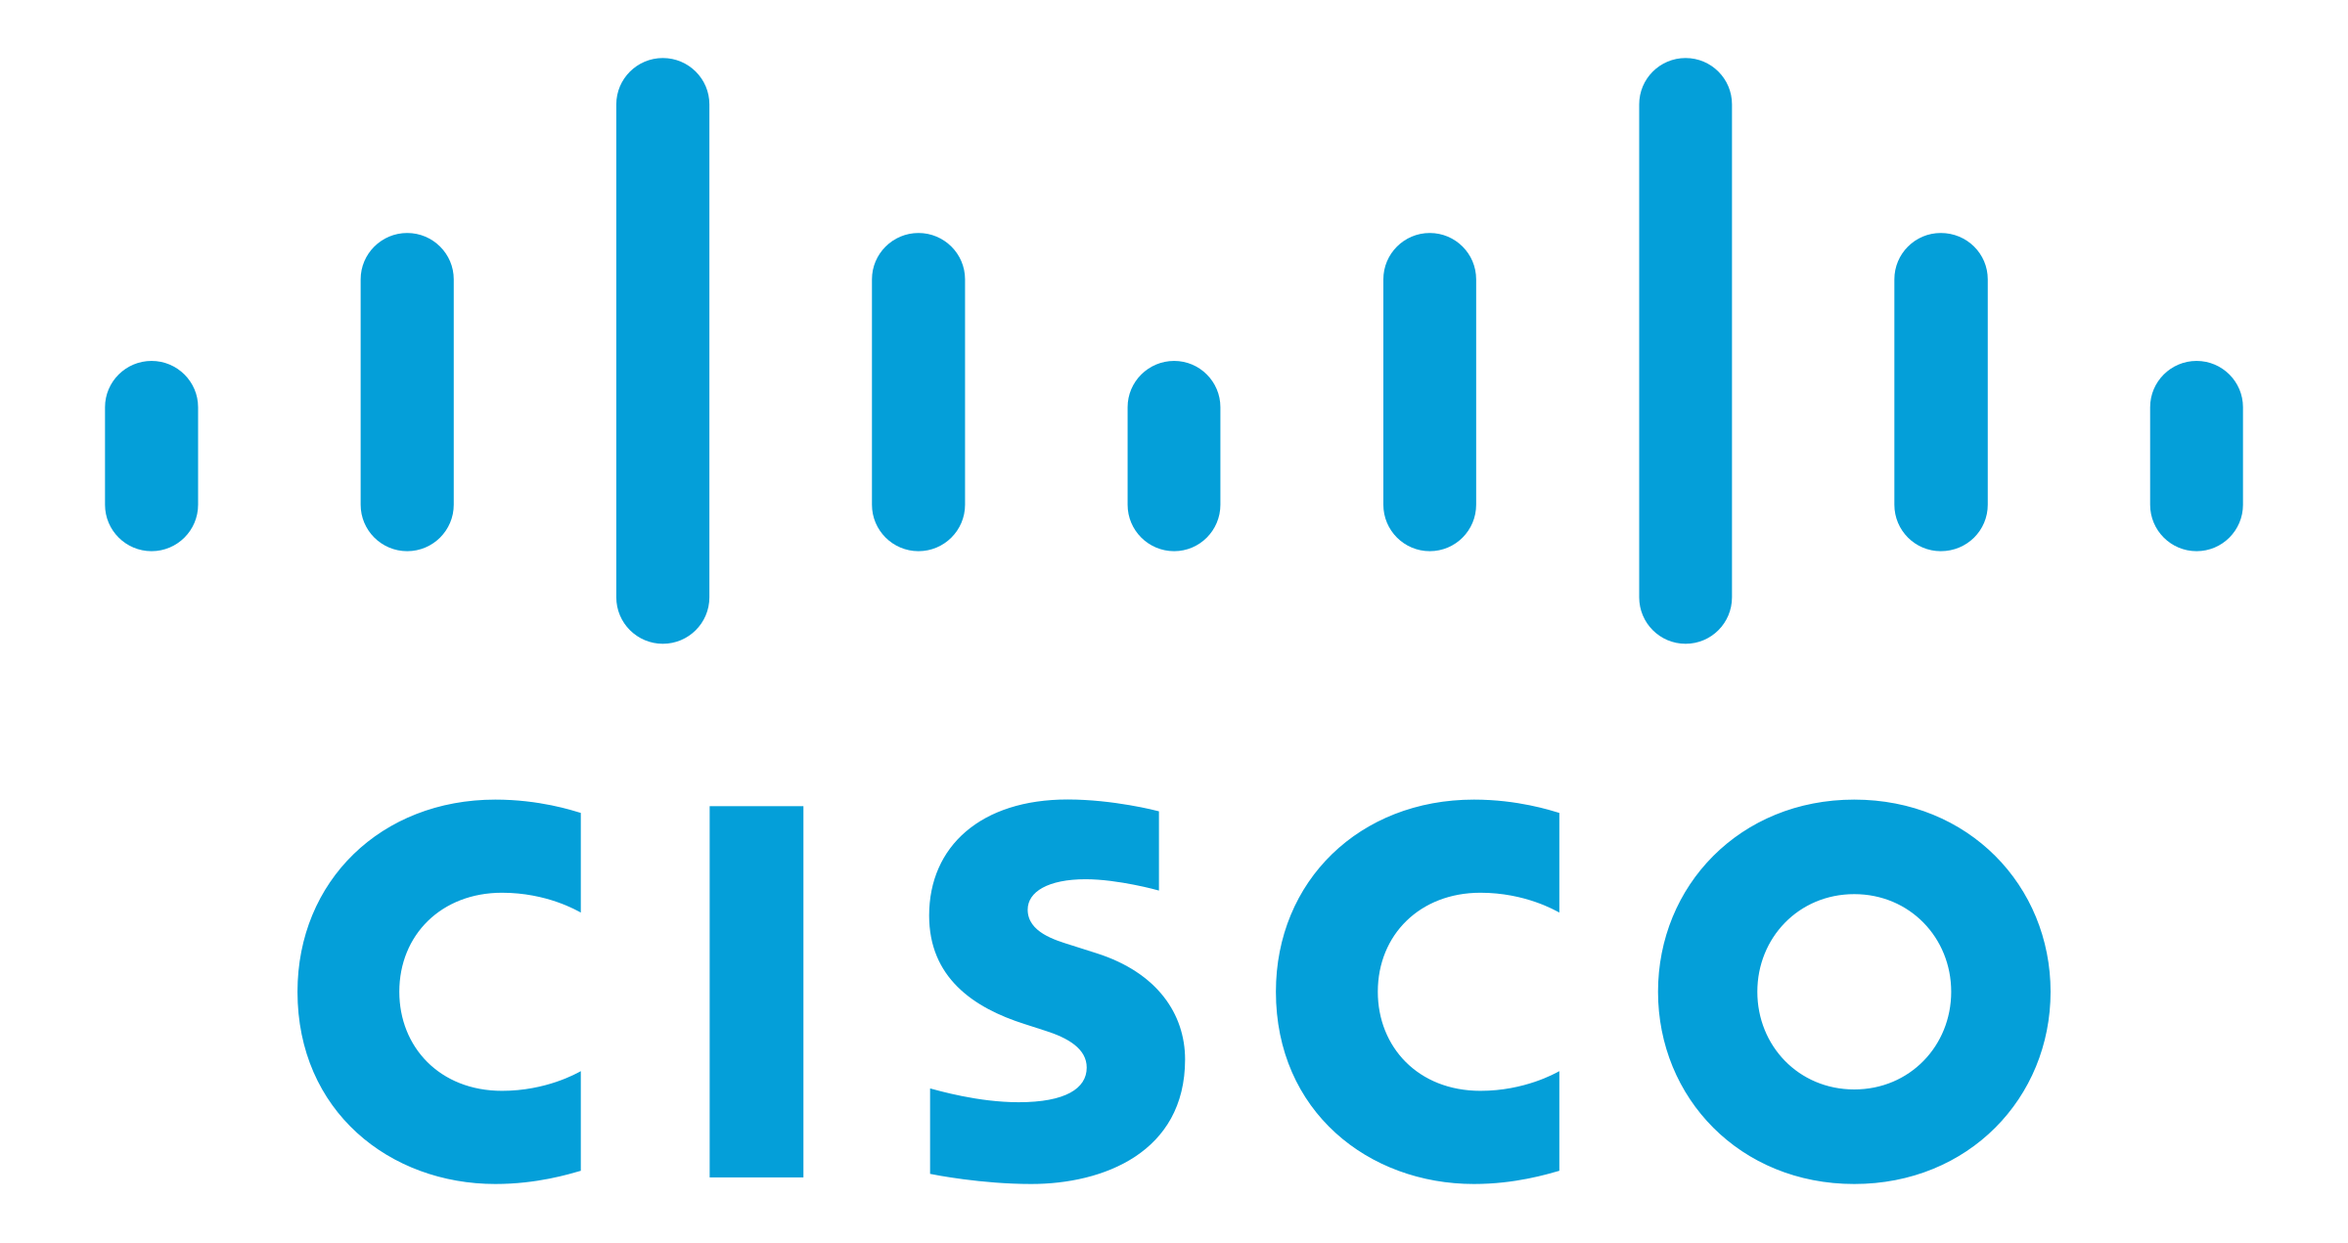


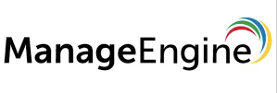

TOOLS ACROSS IT LANDSCAPE
EMS
Server Management
SIEM
Security
APM
Application Monitoring
NMS
Incident, Problem Management
SLA and Contract Management
Project Management
Chatbot / Live Chat
FSO
Integrated View
IT Management
Patch Management
AI/ML
Analytics
End User Experience
Anomaly Detection
Transaction Monitoring
Infra Monitoring
Root Cause Analysis
Topological View
Correlation
Analytics / Dashboards
ITSM / ITAM
Network Monitoring
Performance Management
Traffic Analysis
Log Management
IP Address Management
Web Portal / MobileApp
NCCM
Configuration management
Configuration Compliance
Configuration Audit
IOS Upgrades
Policy Management
Change Management
Asset Lifecycle Management
Notes:
NMS – Everest, Beacon
NCCM - Everest

Slide 30
MONITORING LANDSCAPE
APPLICATION MONITORING
SERVER MONITORING
CLOUD MONITORING
Microsoft Exchange
Apache Tomcat
Microsoft IIS
SharePoint
MS Active Directory
Microsoft Windows Server
Linux/Unix
  Solaris, AIX, HP-UX, Linux, Sinix, Tru64 UNIX, Red Hat
Cisco Unified Computing System (UCS)
IBM Power Systems
Novell Open Enterprise Server
Private
  Flexpod, Vblock
Public
  AWS, Rackspace, MS Azure, Google App Engine, Google Apps, SFDC CRM
Citrix CloudPlatform
OpenStack
Apache CloudStack
vCloud, Pure Storage
Docker, Nutanix
VIRTUALIZATION MONITORING
NETWORK MONITORING
DATABASE MONITORING
VMware
Citrix XenServer
Microsoft Hyper-V
Router and Switch
Network Response Time
Cisco Qo5
Cisco IP SLA
Flow Analysis
Cisco NX/MDS
Microsoft SQL Server
MySQL
DATACENTER MONITORING
STORAGE MONITORING
VOIP / VDI MONITORING
Data Center Power, Cooling & Energy
EMC
Hitachi
Nimble
IBM System Storage
Dell
NetApp
HP
Cisco VoIP
Citrix XenDesktop / XenApp
RESPONSE TIME MONITORING
Website
Application
Email
DNS, DHCP
Database
Active Directory

Slide 31
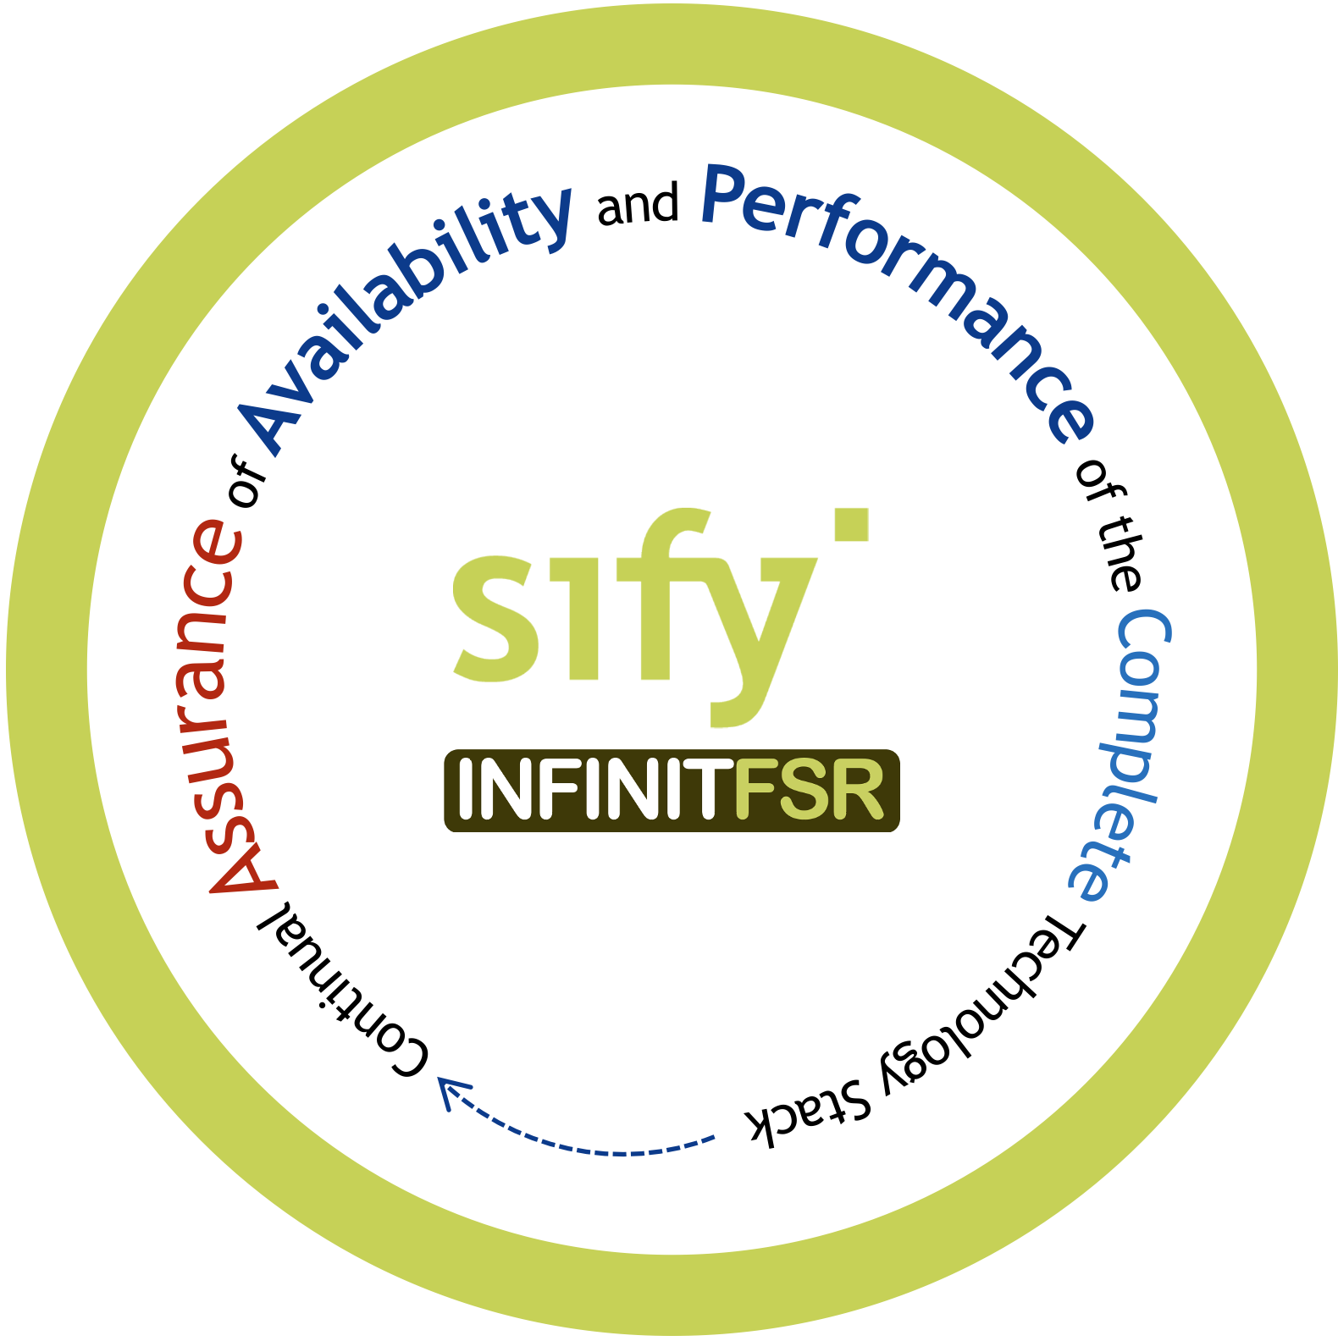
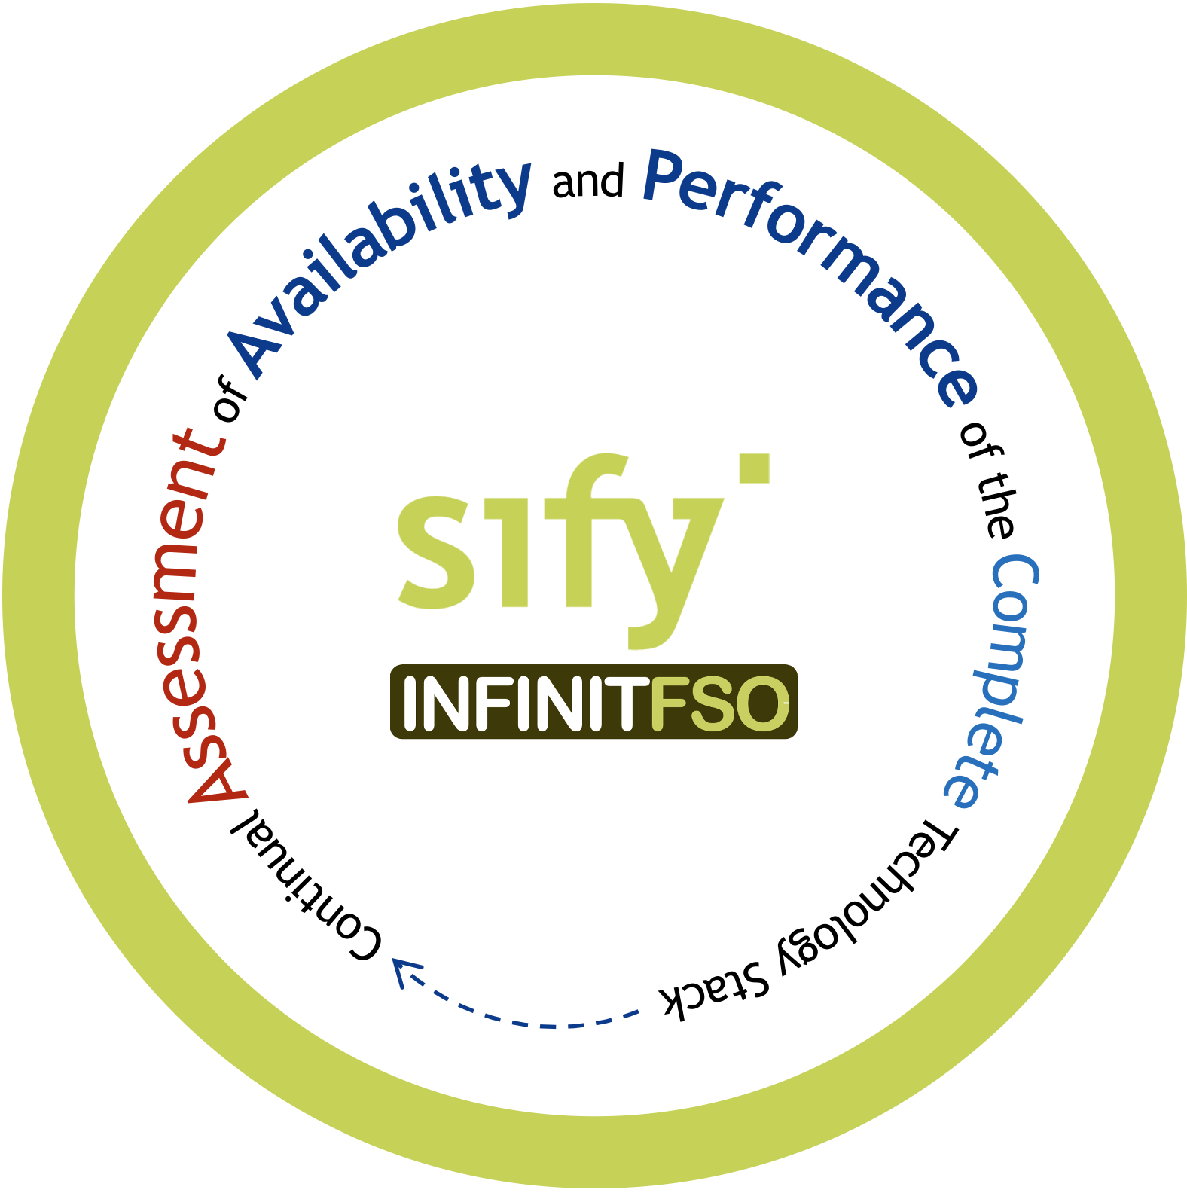
AIOps powered Full Stack Observability
Service Management and Visualization Dashboard
4
Prediction, Prevention, and Remediation of
Business Service Availability and Performance Issues
Network Performance
Multi Cloud FinOps
App Security Services
App Performance
App Resource Optimization
...
BATCH
Real Time Predictive Insights
Multi Domain Telemetry
3
AI OPS
Asset Dependency Map Generation
X-MELT
STREAM
2
1
Telemetry - Metrics, Event Logs, Traces From All Sources
NET OPS
IT OPS
SEC OPS
APP OPS
Notes:
Slide 336

Slide 32
SWOT ANALYSIS OF SIFY

Slide 33
SWOT ANALYSIS OF SIFY
Strengths
Strong presence in Enterprise and Govt. Market
Integrated Services portfolio
Very strong in Infrastructure transformation
Deep pocket investments around NEW
Large geographical spread of projects
Weakness
Application Managed Services credentials
Application Managed Services capability beyond SAP & Oracle
Cloud Native Managed Services skillsets
Managed Security services including compliance governance by industry is the need of the hour
Opportunities
Traditional IT service companies defocusing the pure play Managed Services in India & more focused on Application led Digital Services
Sify’s strong presence across vertical in Colocation & Telecom links which can be capitalized to cross-sell Managed Services business
Threats
Global Companies i.e., Accenture, Kyndryl has already aligned their services/offerings on Cloud Native Technologies so its high time for Sify to capture the clients who are at crossroad of legacy and cloud environment
Industry regulation governance & compliance understanding

Slide 34

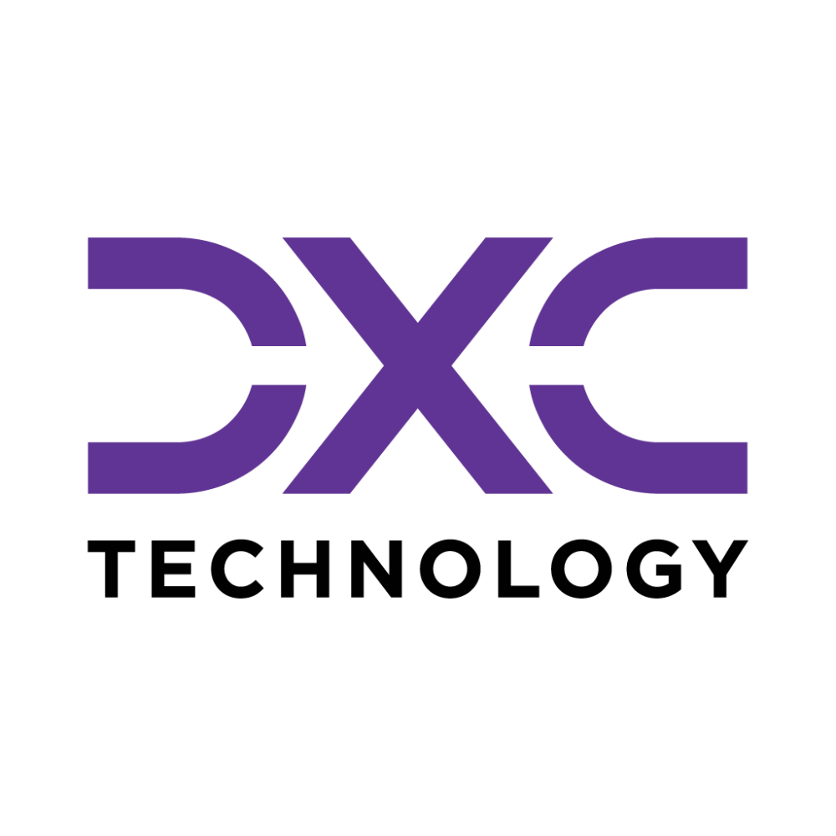
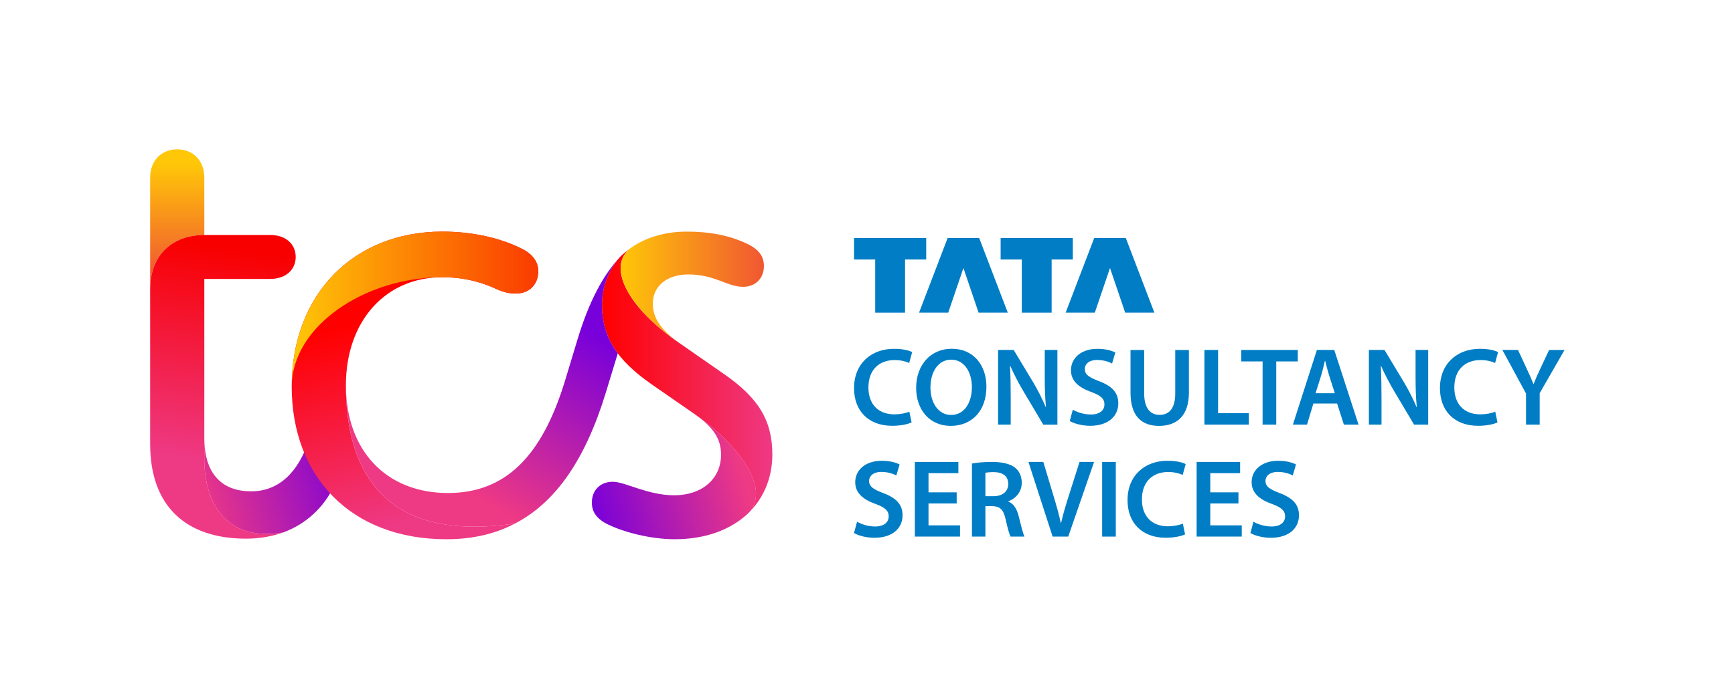


COMPETITION INSIGHTS
Weakness
Defocusing the InfraMS/T&M Business and focus on Digital Transformation and Modernization (Cloud, App, Security, Business Consulting, etc). Opportunity: To position CMP, CI & Hybrid IT Managed Services along with DC Colo, SOC & NOC services.
Disinvested from DC Hosting business in 2021. Opportunity: Colo & DC IT Managed Services.
APMEA region revenue is flat/degrowing from last 4-5 years.
Not Visible in cloud/transformation opportunities in India Market. Opportunity: To attack the legacy accounts & position IT Transformation areas as Managed Service Partner.
Customers have been dissatisfied with Wipro's managed services delivery. This has led to some customers switching to other providers. Opportunity: List down segment wise accounts where Wipro has renewal this FY with a core attack team with Integrated Managed services offerings.
Weakness
All offerings are aligned to Global Customers, so DXC lacks positioning their value to India Market. Opportunity: We are seeing at Britania which is their legacy account for last 10 years, similar accounts to be identified & create an Integrated Managed Services pitch from Sify & go all out.
Prices are not competitive as per India Market, DXC needs to work on 28% GP which is difficult to sustain in India market against the competitors.
Since India is a small Market for DXC about 300 M USD, so no management focus to grow India business.
DXC offerings are not custom made for India Market and lot of internal push required to sell to create a winning proposition for India customers.
Unbaked vertical offerings – having presence only in few. Opportunity: Positioning Industry use cases on Sify CI will help us to get in the accounts & create mind share replacing DXC with transformation led ICT portfolio.
Weakness
Focused on large deals, hence upselling in existing account is low. Opportunity: Our towered portfolio offerings will be key.
Lack end to end integrated services skillset.
GTM structure is confusing between NTT data & NTT Netmagic offerings.
Opportunity: Integrated service positioning with key ICT offerings from Colo & WAN.
They don’t have much focus on stand alone SOC opportunities.
Vertical focus services missing due to non-integrated approach.
Opportunity: Integrated service offerings with key transformation project positioning.
Weakness
Focused on large deals & services offering around their platforms.
Opportunity: Our key OEM alliance & services around the same with agnostic solutions.
Low penetration at Mid tier market.
Opportunity: Sify’s large customer base at Mid tier is key for upsell.
Their focus is on operations only & hence transformation journey with clients are less.
Opportunity: Sify’s pointed services around customer transformation need.
Not focussing on IMS only projects.
Opportunity: Integrated service offerings with key transformation project positioning.
Weakness
Don’t have an integrated service offerings.
Opportunity: Integrated service offerings.
Don’t have good SI project references.
Opportunity: Sify’s key references on integrated projects.
Beyond BFSI & TEST accounts, very tactical approach in GTM.
Opportunity: Vertical specific GTM approach with Integrated transformation pitch.
Don’t have truly large Managed services references in Enterprise & PSU.
Opportunity: Integrated service offerings with key transformation project positioning with referenceable case studies by vertical.

Slide 35
MARKET INSIGHTS – INDUSTRY WISE

Slide 36

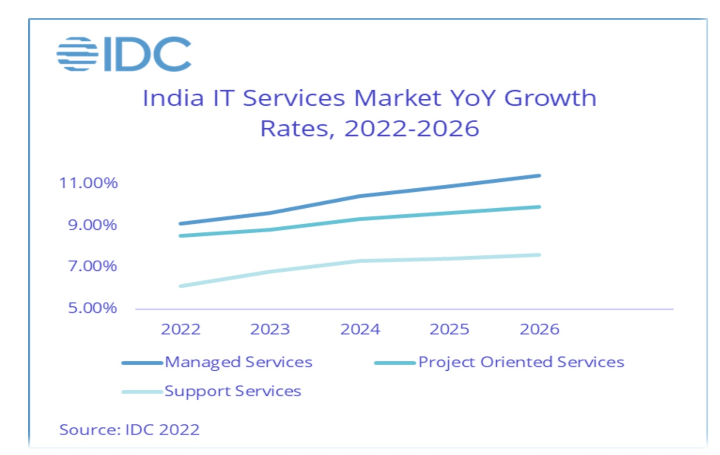

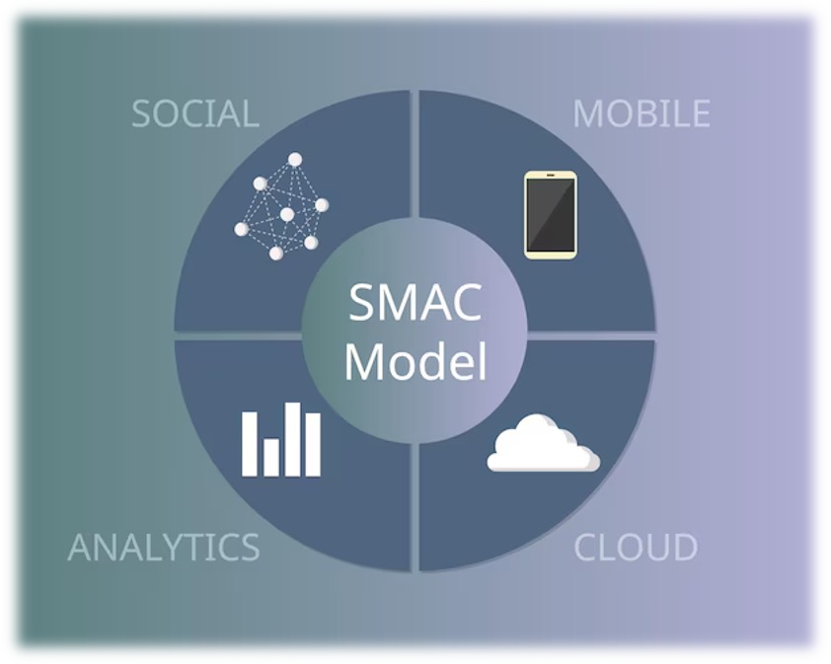



INDIA IT OUTSORCING MARKET GROWTH
The IT outsourcing market in India is expected to reach US $7.81 billion in 2023
India IT Outsourcing Market growing at CAGR 12.42% from 2022 to 2027
The India domestic IT outsourcing services market size is projected to reach US $13.27 billion by 2026
Key factors of influence
Digital transformation investments continue to rise among Indian enterprises
Enterprises investing in next CLOUD wave which is Cloud Modernization, data analytics, AI/ML, Cloud Native App Development
IT Becoming the core pillar of Business Expansion Strategy for small and medium-sized
businesses
Security and compliance becoming boardroom discussions
The increasing demand for talent and modern age skills
Source: IDC & MarketsandMarkets

Slide 37
MANAGED SERVICES TRENDS FOR MANUFACTURING
Transforming the core and innovate faster with ERP modernization
Innovation at the Edge
Business Continuity & High Availability
Work from Anywhere
Use Cases
Edge line Data Center
DR on Colo/Cloud
ZTNA
SD-WAN
Backup on cloud
SD-WAN
SAP on Cloud/Colo
Managed Wi-Fi & Sensors
SD-WAN
GWS/M365
Trends
SAP Basis Support & Carveout services
AI/ML Powered Automation
Managed Security Services (SIEM, MDR, GRC)
End Point Security
Managed IoT gateway
CASB
Collab as a service
Full Stack Observability
DMS- Forum
Managed IT Services (Links, NOC, SOC, Cloud, ITOps)
Sify Services
ERP modernization, enabling faster digital adoption
Support for IoT devices, scalability, support for decentralized application
High availability IT systems, Risk and Compliance, Redundancy & failover, data replication
Enhanced connectivity & security for remote sites & users with better user experience
Benefits

Slide 38
MANAGED SERVICES TRENDS FOR SMALL & MEDIUM BANKS AND NBFCS
Thinning the Core
Digital offerings extending service portfolios
Regulation needs
Geographical expansion
Use Cases
Hybrid IT offerings with ISV & Strategic partners
Data in Motion & Rest Security services
ZTNA
NDR / FDR as a Service or Hosted
App & Infra Security
SD-WAN
CBS infra Hosting
SASE
Brand monitoring
GWS/M365
Trends
Peripheral Biz app cloud
AI/ML Powered Automation
Enterprise Cloud for peripheral DB & object storage
Cloud Security services
End Point Security
SASE
Collab as a service
Full Stack Observability
Managed IT Services (Links, NOC, SOC, Cloud, ITOps)
Sify Services
Agile & faster GTM
Digital banking
Business continuity & compliance
Multi-tier banking
Benefits

Slide 39
MANAGED SERVICES TRENDS FOR MEDIA
Low-cost enterprise cloud for peripheral workloads with hyperscaler adjacency and NSE BSE pops
Predictive RCA with operational efficiency improving customer experience
Resilient content with intelligent security and network services
Monetization of digital asset enabling new revenue stream
Use Cases
DAM- Tenovos
CASB
Full Stack Observability
Managed security & Network services
Trends
AI/ML Powered Automation
Hybrid Cloud
Image Management
Sify CI Landing- Cloud adjacency
Multi Cloud Management- CMP
NSE/BSE Links as a service
Sify Services
Low Latency,
Cost optimization
MTTR Improvement, Multi platform management & Cost control
Security Risk Mitigation, Network wide data protection
Simpler asset lifecycle management
Benefits

Slide 40
6-ON-6 Business Strategy

Slide 41














6-on-6 BUSINESS STRATEGY
LT 6 Focus
Enable special management focus on clients with large business transformation plan.
Existing Client Expansion
Identify large WAN & DC Colo existing clients where their MS renewal is coming up.
06 01
Grow New Offerings
Offer new services around
Microservices,
Full Stack Observability, and hybrid IT solutions.
Cloud Managed Services
Identify Colo customers of Sify who are exploring cloud adoption and try to position CMP & enable their cloud journey on Hybrid IT architecture.
05
02
Ecosystem Led Engagement
Collaborate with cloud providers, IT Infra & security OEMs for Infra Modernisation and security upliftment client base.
04
03
Competition Business Acquisition
Identify competition clients with low CSAT due to either ongoing operations or any transformation/innovations.
Focus on competition clients with diversifying business growth plan in next 3 years.

Slide 42


Tried Tested Trusted
Your digital infrastructure partner for over 23 years
Network
Infra Services
Network Digital
Managed Services
Data Center
Colo Services
CloudInfinit
Ent Cloud Infra
Cloud & IT
Managed Services
Digital Apps
Managed Services
Industry Apps
Managed Services
Security
Managed Services
Thank You

