Slide 1
AI-READY DATA CENTERS:
POWERING FUTURE INNOVATIONS
FOR MEDIA AND IT/ITeS
June 2024
EMPOWERING INDIA’S DIGITAL TRANSFORMATION

Slide 2
agenda
MEDIA & IT/ITeS BUSINESS PRIORITIES & TECHNOLOGY DEMANDS
WHERE ARE WE MOVING?
BUILDING BLOCKS OF AN AI-READY DATA CENTER
SIFY DATA CENTERS POWERING THE MEDIA & IT/ITeS INDUSTRY

Slide 3
Media & Entertainment BUSINESS PRIORITIES
Faster Time To Market
Personalized Experience
Consumer Experience
Digital
Security
Creating high-quality original content & ensuring faster pre & post-production and distribution across multiple platforms.
Personalized content recommendations based on viewer preferences and behaviors.
Intuitive user interfaces to enhance the viewer experience, customer support, and active user engagement.
Ensuring robust security to protect user data and critical payment information from cyberthreats.
Intellectual Property Protection
Revenue Generation
Diversity & Inclusion
Regulatory Compliance
Ensuring content authentication, sourcing, and protecting valuable content from piracy/copyright infringement.
Utilizing advertising strategies, subscription-based models to monetize platforms across the globe.
Promoting diversity and inclusion both on-screen and behind the scenes.
Staying compliant with local and international regulations, including content standard and IP laws.

Slide 4
M&E Business Priorities LEADING to technology demands
Content
development
Low latency, high Bandwidth
Content Distribution
Continuous Innovation
Interoperable, cross-organization data management and access management between teams, tools and platforms across the content lifecycle.
Robust network environment ensures faster digital media transport of large rendered files, audio, video, and images.
Leveraging CDNs to distribute content globally across multiple platforms, ensuring high-quality streaming.
Faster deployment of apps or upgrades, modern digital asset management.
Security Framework
Data Analytics Platform
Regulatory Compliance
Consumer Experience
Using advanced threat detection and response, multi-factor authentication, and regular security audits to safeguard critical user data.
AI-enabled data-driven insights on content performance, viewer retention, and forecast audience demand.
Using DRM systems to safeguard intellectual property and prevent unauthorized access and distribution of digital content.
AI-led personalized engines to deliver content recommendations. Analyze customer feedback and ensuring superior UX.

Slide 5
IT/ITeS BUSINESS PRIORITIES
Business Expansion
Collaboration b/w Innovation Centers
Real-time Service Provisioning
Governance, Risks, and Compliance
Expand operations to diverse geographical locations. Enter new markets to support business growth and new customer access.
Fostering collaboration is crucial for driving innovation, efficiency, quality, and competitiveness.
Enable rapid deployment and scalability of services through flexible service models.
Adherence to local & international regulations, risk management strategies to build trust and reliability.
Continuous Innovation
Partnerships & Alliances
Upskilling & Talent Retention
Sustainable Practices
Innovate on the go, product enhancement, faster feature release, automation in operations and service delivery.
Expand service capabilities, co-develop solutions and accelerate go-to-market.
Culture of continuous learning, cross functional projects, skill assessments tools and certifications.
Sustainable practices, and socially responsible business practices in IT operations to reduce carbon footprint.

Slide 6
IT/ITES Business Priorities translating to technology demands
Expansion & Global Reach
R&D
Centers
Edge Computing & Serverless Architecture
AI-driven Compliance Solutions
Integrated IT solutions to jumpstart biz operations in new locations, digital marketplaces for global reach.
Set up AI labs, collaboration tools, high performance computing, seamless connectivity, DevSecOps.
Enable real-time provisioning by reducing latency and providing on-demand scalability.
AI-driven compliance tools for managing regulatory requirements and mitigating risks.
AI/ML led Data Analytics
Partnerships & Alliances
LMS, AR/VR/MR for Upskilling
Sustainable Infrastructure
Predictive analytics, forecast client demands, and real-time decision making to drive innovation and improve service delivery.
API management platforms enables seamless integration and collaboration with partners & alliances.
Digital learning modules, XR solutions for immersive learning and digital assessments
Energy-efficient digital infrastructure, renewable energy sources, and best practices.

Slide 7








Where are we moving?
TRADITIONAL
IT ENVIRONMENT
THE PAST
THE FUTURE
DIGITAL
IT ENVIRONMENT
Centralized /
on-premise
Slow to adapt
Large, sparse, and horizontal
Manual operations
Interconnected
Tier level design
Subpar security
Unregulated
Distributed /
Hybrid IT
Simple, Scalable, Agile and Flexible
Automated and SLA based operations
Connecting multi sites
Heightened Security
BCP- Disaster Recovery
Compliance ready
Green and Sustainable
Cloud
On-Premises
Edge
On-Premises
On-Premises
Primary Site
Secondary Site/DR
Hosting
Colocation

Slide 8
Ai-ready data centers

Slide 9
DIGITALIZATION OF DATA CENTERS: EVOLUTION
COGNITIVE
Improved Service level
Reduce lead time
PREDICTIVE
Value
3
Improved Service level
Reduce lead time
CONNECTED
“New services and business models”
Improved visibility
Enhance productivity
2
“Self optimizing response”
Offer as value added service with core products
Phase
“Predict what will happen”
1
Digital feedback, auto-Ticket generation & resolution
“Understand causes and impacts”
“See what is happening”
ML data models
“Define data and sources”
“Get plugged in”
Time series/ Historical data and data object model
Telemetry dashboards for CXO, Ops & Process
BMS, ERP, Serviceability data
Edge Gateways & Cloud data model
Time

Slide 10







Building blocks of an AI-Ready Data center
Scalability
Security
ESG
Future-ready Cooling Technologies
Global
Compliances
Low Latency Connect to Hyperscale Clouds, OTTs and Various IXs
AI/ML
Based Operations
Notes:
Foundations of a data centers

Slide 11



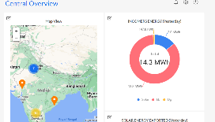


AUTOMATION: TECHNICAL ARCHITECTURE
Site Equipment
Hardware Connectivity
Operation Command Center
POWER
Multiple Energy meters
3rd party Integration - ERPs & tools
Chiller Plant
Busway Sensors
OPC
DG
IOT Cloud with AI/ML Algorithms
API
Multiple PACs/ CRAH/ AHU
UPS
OPC
Ops Equipment
Safety & Security Equipment
Smart IO interface
Internet
Temperature & Humidity Sensor
Wireless/ Wired
IOT Gateway
UPS-1
L2 switch
Ethernet
Dashboard
OPC
Centralized dashboards, tickets and reports accessed via Laptop, Tablet, Mobile etc.
Transformers (LT & HT)
TX
API’s
CMMS (Manual Ops Data)
Solution Components

Slide 12
Transforming Data Center Management with AI/ML
REALTIME VISIBILITY
MEASURABILITY
Operations: Land, Building, POD, People and Process
DC Infrastructure Assets: Active and passive information
Resource Utilization
  Space – Rack space
  Power – Grid power, DG, UPS, RE, Power Exchange
  Cooling
  Cross-connects
Operations: Condition or SOP based monitoring
Resource capacity utilization & trend analysis: Time based (Daily, Weekly, Monthly etc.) and Facility wide comparative analysis
KPI based service contract renewals
Usage based Infrastructure resource planning
PREDICTABILITY
EFFICIENCY
Failure & Downtime: MTBF, MTTR, RCA and Service TAT
Maintenance, Service & Support requirements
  Preventive Maintenance of assets
  AMC Contract realization
Demand forecasting and capacity planning
Capacity Utilization
  Rack Space burn down or consumption efficiency
  Power Utilization Efficiency (PUE) [ Grid/ RE ]
  DG Power fuel efficiency
  UPS Power efficiency( Load requirement vs Backup time)
  Water Utilization Efficiency
  DC Carbon Footprint
Service & Support efficiency
8-10% savings
on PUE
20% improvement in
equipment uptime
Up to 300-person hour
savings monthly
10% reduction in operating costs

Slide 13






Comprehensive Security framework
Confidentiality, Integrity, Accessibility based Security Policy
Centralized Security Command Center
10 Layer of Physical Security
Surveillance and Risk Assessment
Electronic Security & Controls
Process Review & Improvement

Slide 14


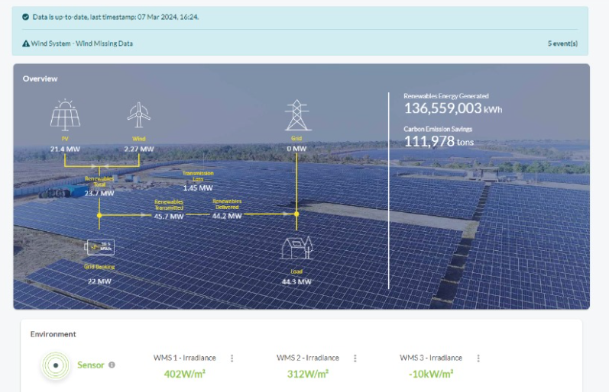


ESG FOcus
Data Center MEP
Sustainable Processes
High efficiency for Equipment even at low utilization levels
Selection of equipment with high energy saving parameters
Right redundancy levels
ASHRAE Guidelines
ISO 14001 Environmental Certification
Carbon abetment policy
Low PUE, WUE
Green Power Contracts
Future Roadmap
Contracted 231 MW Green power via Power Purchase Agreements
Additional nation-wide Green power for future projects. ~500MW planned to meet long-term sustainability goals
Up to 70% Green Power available in Mumbai
To become RE100 (Carbon Neutral) by 2030. 29% GHG emission reduction by FY2025
Exploring options to secure up to highest RE penetration for Sify DCs, as permitted by regulation
  Targeting high level of Renewable Energy penetration by year 2025

Slide 15
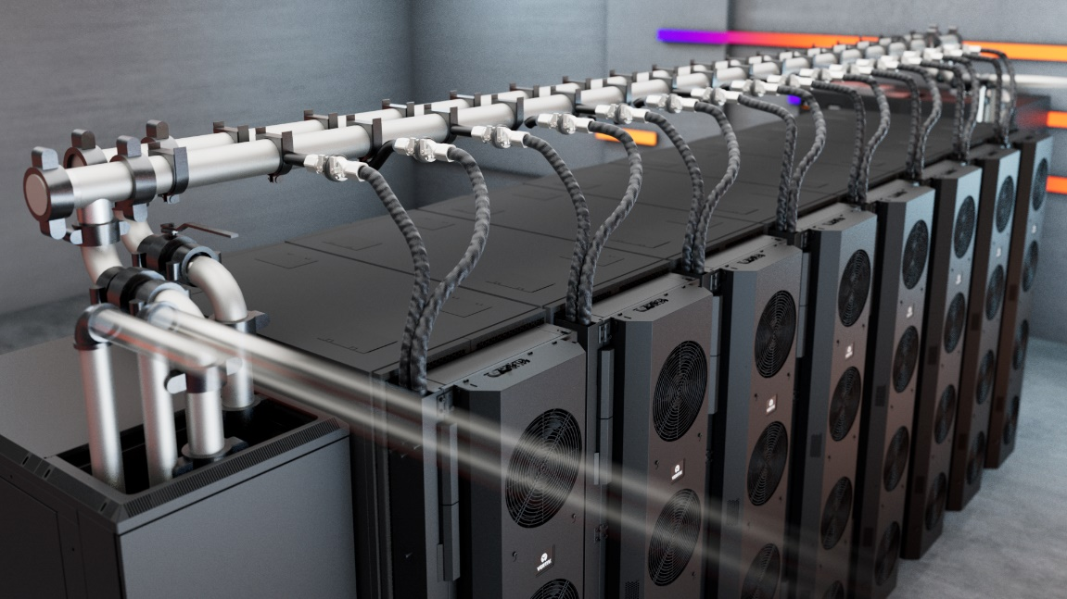
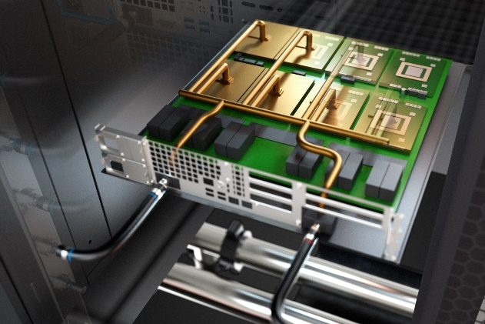

liquid cooling for ai & power Dense workloads
REAR DOOR HEAT EXCHANGER
Direct-to-chip
Liquid immersion cooling
Ideal for 20-50 KW Rack load
PUE: 1.4
Ideal for 50 – 150 KW Rack load
PUE: 1.2 - 1.4
Ideal for 50-200 KW Rack load
PUE: 1.2 – 1.35

Slide 16










Network and Connectivity Highlights
Location
Pan India
Network Presence
Reliable
Network Access
Cross-Connectivity
DC Interconnect
All our Data Centers are strategically located in dense Metro regions of the country on well-connected super-fast networks.
36000+ Kms of fiber access across 24+ Metro cities, 3700+ POPs
1600+ cities ensuring enhanced security and last mile connectivity
Access all tenants via cross connects/bulk fiber
Lower TCO as expensive network bandwidth not required
Multiple Fiber routes to the building and MMRs at each tower of the DCs.
Enables connect for DR, NDR, FDR deployments
Pan India dense fiber connectivity with interconnect services across 66+ Data Center facilities
Uniform Latency
Carrier Neutral
Meet-Me-Room
Easy Access to Internet Exchanges & Clouds
Leverage Common Infrastructure
Ensure all market participants access equal latency across the towers via standardized prewired cabling. ~150 Mtrs distance with less than 1ms latency
90% of fiber links are from non Sify Telcos
Extension simplified with in-campus wiring and is a low capex option for all Telcos
MDF(Network Closet) in every floor, connected to MMR via network risers
Separate access to telco MMRs for O&M in the BTS
Remote hands for network related troubleshooting
Leverage common network timing (PTP) setup
Access to Internet exchanges, Hyperscale, OTT, Social Media
Lower cost and improved user experience by accessing Internet exchanges for content distribution

Slide 17
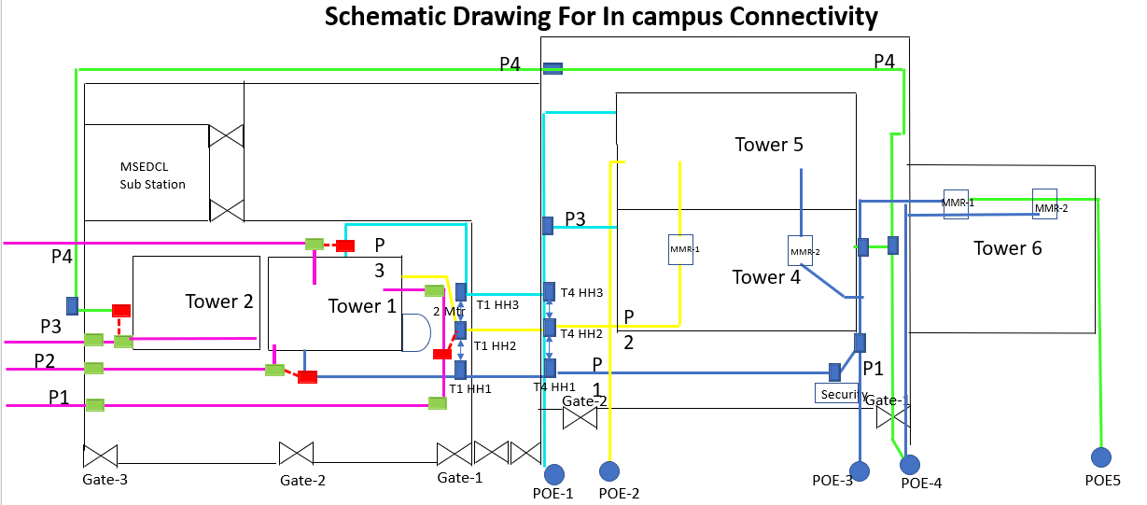
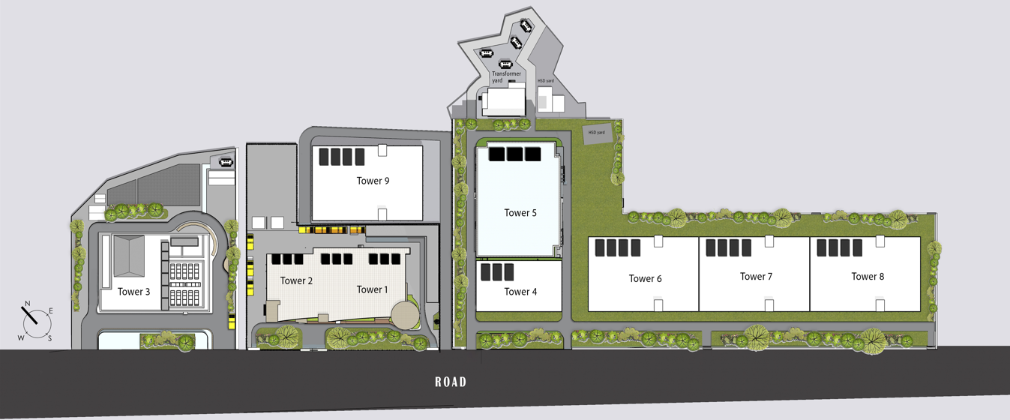
Network Fiber Paths
Interconnected DC towers in the campus via fibre Cross Connect offering uniform network access for application hosted in any of the towers. And four POE for each towers for external telecom fibres
High-capacity bulk fibre from diverse routes between the towers.
All buildings in Sify Rabale campus have strong fiber interconnect with multiple routes.
Direct Cross connects to other Telcos hosted in the campus for customer to connect to cloud nodes: AWS, Oracle Fast Connect & Google Connect.
Secure high-capacity pre-laid bulk fiber for robust and scalable connectivity, each route has multiple ducts and sub ducts for fiber access from any tower to any tower.

Slide 18
Sify data centers

Slide 19

SIFY DATA CENTERS: INDIA FOOTPRINT (Six Markets)
NOIDA 02 CAMPUS
Tower B
26 MW
Q2 2024
Tower 1
11.5 MW
Tower 2
9.6 MW
Tower 3
BTS
NOIDA 01
Noida
10.8MW
Tower A
26 MW
Tower C
26 MW
1st Tier 3
in 2000
Tower 4
8.1 MW
Tower 5
38.8 MW
Tower 6
26 MW
Q2 2025
MUMBAI 01
Vashi
0.9 MW
KOLKATA 01
2.2 MW
Tower 7
20-30 MW
Q3 2025
Tower 8
20-30 MW
Tower 9
20-40 MW
Tower 10
20-40 MW
Tower 11
19.2 MW
Q3 2025
Tower 12
19.2 MW
Q4 2025
HYDERABAD 02 CAMPUS
(FAB CITY)
MUMBAI 02
Airoli
5.4 MW
HYDERABAD 01
Financial Dist.
14.4 MW
MUMBAI 03 CAMPUS (RABALE)
Block 1
26 MW
Additional Blocks
26-52 MW each
(including BTS)
BANGALORE 02 CAMPUS (AEROSPACE PARK)
BANGALORE 01
Electronic City
7.6 MW
Tower 1
11 MW
Q2 2025
Tower 2
11 MW
CHENNAI 02 CAMPUS (SIRUSERI)
CHENNAI 01
Tidel Park
3.6 MW
Tower A
26 MW
Tower B
26 MW
Q2 2024
Tower C
26 MW
Operational
In Development
Planning
All Power references are Design IT Power at Full Capacity
All Power references are Design IT Power at Full Capacity
Notes:
Add star above Vashi

Slide 20
Sify Data Center Advantage
Hyperscale, Hyperconnected, Green, AI-ready
RAS based design for future ready infrastructure
AI Ready with Hybrid Liquid Cooling, up to 200 KW power/rack
14 DCs, 190+ MW IT power, expanding to 300+ MW by 2025
Hyperconnected, Carrier-neutral and Rich Interconnect ecosystem
India’s Data Center Powerhouse for over 23 years
India’s Top 5 banks, 3 of 4 Hyperscalers, Global OTT & Social media players,
and 600+ enterprises…
Campuses scalable to
600+ MW with BTS capabilities
AI/ML led operational excellence with 100% uptime
Enhanced 10 levels of security with automation
231 MW renewable energy contracted

Slide 21

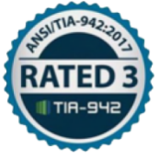


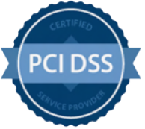








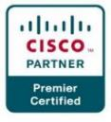


DATA CENTER: COMPLIANCE AND CERTIFICATIONS
z
MEITY Cloud Empanelled
India’s 1st Nvidia DGX Ready DC
Rated 3: Concurrently Maintainable Site Infrastructure
Data Center, Cloud &
Managed Services
IT Service Management
PCI DSS
Telecom Data Center & Managed Services
Hosting Partner
SOC 1 Type II
SOC 2 Type II
World’s international standard for occupational health and safety
Business Continuity Management System
Environmental Management system
Green Building
SAP Certified In Hosting Services
SAP Certified In Cloud Services
SAP Certified In SAP HANA Operations Services
SAP Certified In Application Management Services

Slide 22
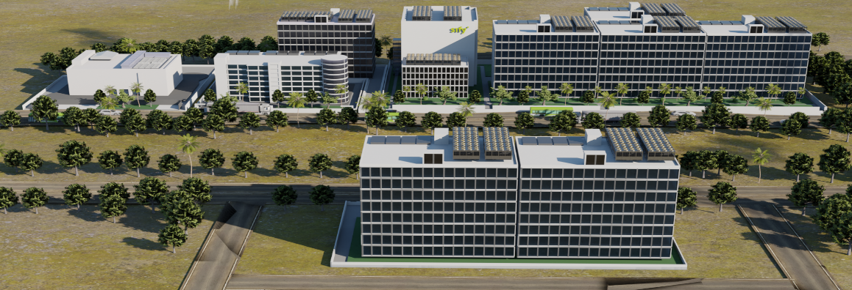
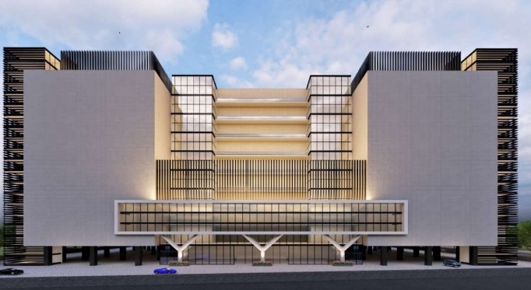
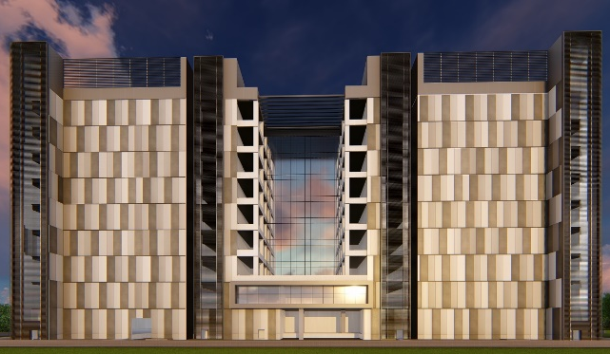
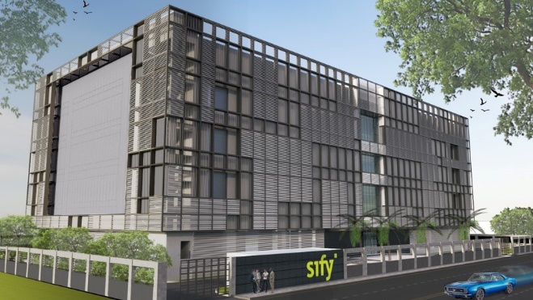
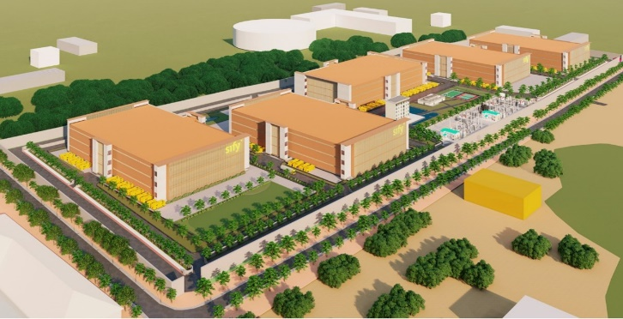
OUR HYPERSCALE DATA CENTER CAMPUSES
Tower B Operational Q2 FY 24
Noida 02
Power: 78 MW IT | Racks: 13,000
Mumbai 03, Rabale | Power: 240 MW IT | Racks: 32,000
5 Towers Operational
4 Towers In Development
3 Towers in Planning
In Development
Tower B Operational Q2 FY 24
Tower 1 Operational Q3 2025
Chennai 02, Siruseri
Power: 78 MW IT | Racks: 13,000
Bengaluru 02
Power: 22 MW IT| Racks: 4,500
Hyderabad 02, Fab City
Power: up to 250 MW IT | Racks: 25,000
In Development
In Development
Planning

Slide 23
Sify’s strong presence in It/ites & media industry
200+ India’s leading IT/ITeS and Media companies trust Sify’s DC, Cloud, Network and Digital services. 60+ Top Media & IT/ITeS enterprises trust Sify’s Data Centers.
Multiple global hyperscale CSPs continue to expand their presence in India with Sify’s AI ready Data Centers
Carrier-neutral data center and cloud connectivity solutions helped US-based cloud contact center company build footprint in India
Global System Integrator offering diverse IT services trusts Sify’s Data Centers and Network services in India
Accelerating strategic expansion of a global cloud security company by collocating in Sify’s Data Centers at Mumbai, Noida and Chennai
Colocation in Sify’s multiple DCs, CDN services and edge DC connectivity enable global OTT & Social Media Network to improve performance and reach
India’s leading Print & Digital Media Publishing house powers on Sify’s Data Centers & Network services
India’s top broadcasting media house takes advantage of Sify’s cloud managed and network services
Leading Media group chose Sify’s digital asset management platform on a hyperscale cloud
AR/VR based immersive experience created for training employees of a global DC company
Notes:
Media- 158 channels - 50
IT&ITeS- 1500 channels - 50
Direct- 200

Slide 24



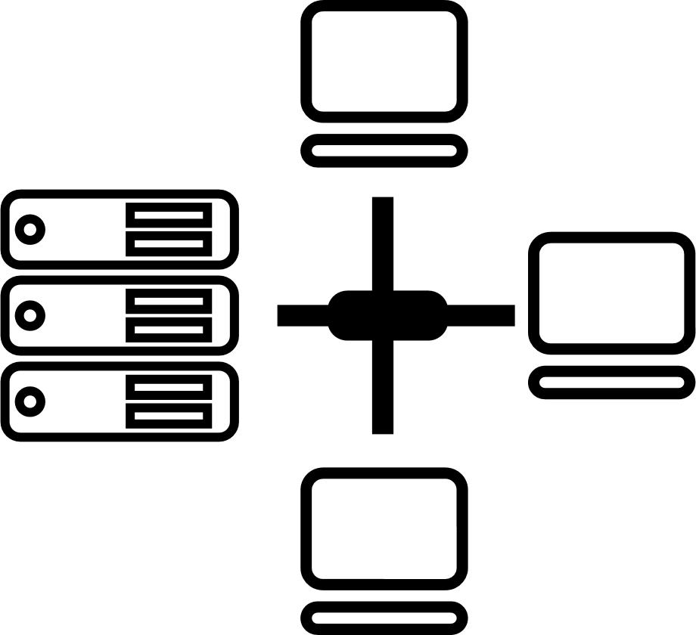






Tried Tested Trusted
Your digital infrastructure partner for over 23 years
Network
Infra Services
Network Digital
Managed Services
Data Center
Colo Services
CloudInfinit
Ent Cloud Infra
Cloud & IT
Managed Services
Digital Apps
Managed Services
Industry Apps
Managed Services
Security
Managed Services
Thank You

