Slide 1
AI-READY DATA CENTERS:
POWERING THE FUTURE-READY BFSI
June 2024
EMPOWERING INDIA’S DIGITAL TRANSFORMATION

Slide 2
agenda
BFSI BUSINESS PRIORITIES & TECHNOLOGY DEMANDS
WHERE ARE WE MOVING?
BUILDING BLOCKS OF AN AI-READY DATA CENTER
SIFY DATA CENTERS POWERING THE BFSI INDUSTRY

Slide 3
BFSI BUSINESS PRIORITIES
Diverse Product Portfolio
Customer Centric Services
Compliance-Ready
Digital
Security
Innovative products/services for evolving customers needs- Saving accounts, loans, insurance, and digital payment solutions
Unique experience, exceptional customer service, addressing issues, & continuously improving services
Adherence to compliance with RBI, IRDA, SEBI.
Compliance frameworks, risk mgmt., and governance transparency
Fraud detection & prevention, cyber security protocols, and data privacy to safeguard customer information & core systems
Multi-channel Accessibility
Financial Inclusion
Neo Banking
Personalized Solutions
Seamless experience across multiple channels- branch, ATMs, online banking, mobile apps, and phone banking
Serving the unserved & underserved segments of society- rural and low-income communities
Digital first banking experience, operates completely online ensuring simplified processes and enhanced banking experience
Tailored products/services for individual customer needs. Addressing specific queries, preferences, and achieving financial goals

Slide 4
Business Priorities translating to technology demands
Digital-first platforms
User
Experience
Cybersecurity
Regulatory Compliance
Intuitive user experience across platforms- mobile Apps, internet portals, IVRs built on Open APIs, microservices, and cloud for faster time to market
CRM systems with AI, data analytics, chatbots, and NLP technologies personalizes customer interactions & facilitates omnichannel communication
Next gen firewalls, intrusion detection systems, encryption technologies, and multi-factor authentication to protect against cyber threats
Automated compliance tools, blockchain for audit trails, AI-driven tools ensures adherence to regulatory requirements-KYC, AML, GDPR
Risk
Management
Legacy system modernization
Talent
acquisition
Financial Inclusion
Systems powered by data analytics, machine learning, and predictive modeling help assess and mitigate risks more accurately
Modernizing legacy systems with app re-platforming, containerization, API enablement facilitates seamless integration while ensuring data integrity and system reliability
AI-powered recruitment platforms, virtual interviews, assessment tools, and digital learning platforms, enhances right talent sourcing/acquisition
Mobile banking, digital payments, and branchless solutions with biometric & Aadhar authentication empowers underserved populations

Slide 5








Where are we moving?
TRADITIONAL
IT ENVIRONMENT
THE PAST
THE FUTURE
DIGITAL
IT ENVIRONMENT
Centralized /
on-premise
Slow to adapt
Large, sparse, and horizontal
Manual operations
Interconnected
Tier level design
Subpar security
Unregulated
Distributed /
Hybrid IT
Simple, Scalable, Agile and Flexible
Automated and SLA based operations
Connecting multi sites
Heightened Security
BCP- Disaster Recovery
Compliance ready
Green and Sustainable
Cloud
On-Premises
Edge
On-Premises
On-Premises
Primary Site
Secondary Site/DR
Hosting
Colocation

Slide 6
Ai-ready data centers

Slide 7
DIGITALIZATION OF DATA CENTERS: EVOLUTION
COGNITIVE
Improved Service level
Reduce lead time
PREDICTIVE
Value
3
Improved Service level
Reduce lead time
CONNECTED
“New services and business models”
Improved visibility
Enhance productivity
2
“Self optimizing response”
Offer as value added service with core products
Phase
“Predict what will happen”
1
Digital feedback, auto-Ticket generation & resolution
“Understand causes and impacts”
“See what is happening”
ML data models
“Define data and sources”
“Get plugged in”
Time series/ Historical data and data object model
Telemetry dashboards for CXO, Ops & Process
BMS, ERP, Serviceability data
Edge Gateways & Cloud data model
Time

Slide 8







Building blocks of an AI-Ready Data center
Scalability
Security
ESG
Future-ready Cooling Technologies
Global
Compliances
Low Latency Connect to Hyperscale Clouds, OTTs and Various IXs
AI/ML
Based Operations
Notes:
Foundations of a data centers

Slide 9



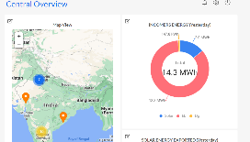


AUTOMATION: TECHNICAL ARCHITECTURE
Site Equipment
Hardware Connectivity
Operation Command Center
POWER
Multiple Energy meters
3rd party Integration - ERPs & tools
Chiller Plant
Busway Sensors
OPC
DG
IOT Cloud with AI/ML Algorithms
API
Multiple PACs/ CRAH/ AHU
UPS
OPC
Ops Equipment
Safety & Security Equipment
Smart IO interface
Internet
Temperature & Humidity Sensor
Wireless/ Wired
IOT Gateway
UPS-1
L2 switch
Ethernet
dashboard
OPC
Centralized dashboards, tickets and reports accessed via Laptop, Tablet, Mobile etc.
Transformers (LT & HT)
TX
API’s
CMMS (Manual Ops Data)
Solution Components

Slide 10
Transforming Data Center Management with AI/ML
REALTIME VISIBILITY
MEASURABILITY
Operations: Land, Building, POD, People and Process
DC Infrastructure Assets: Active and passive information
Resource Utilization
  Space – Rack space
  Power – Grid power, DG, UPS, RE, Power Exchange
  Cooling
  Cross-connects
Operations: Condition or SOP based monitoring
Resource capacity utilization & trend analysis: Time based (Daily, Weekly, Monthly etc.) and Facility wide comparative analysis
KPI based service contract renewals
Usage based Infrastructure resource planning
PREDICTABILITY
EFFICIENCY
Failure & Downtime: MTBF, MTTR, RCA and Service TAT
Maintenance, Service & Support requirements
  Preventive Maintenance of assets
  AMC Contract realization
Demand forecasting and capacity planning
Capacity Utilization
  Rack Space burn down or consumption efficiency
  Power Utilization Efficiency (PUE) [ Grid/ RE ]
  DG Power fuel efficiency
  UPS Power efficiency( Load requirement vs Backup time)
  Water Utilization Efficiency
  DC Carbon Footprint
Service & Support efficiency
8-10% savings
on PUE
20% improvement in
equipment uptime
Up to 300-person hour
savings monthly
10% reduction in operating costs

Slide 11






Comprehensive Security framework
Confidentiality, Integrity, Accessibility based Security Policy
Centralized Security Command Center
10 Layer of physical security
Surveillance and risk assessment
Electronic security & controls
Process review & improvement

Slide 12


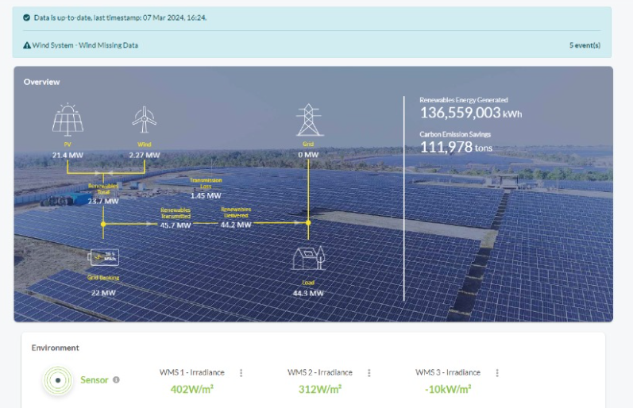


ESG FOcus
Data Center MEP
Sustainable Processes
High efficiency for Equipment even at low utilization levels
Selection of equipment with high energy saving parameters
Right redundancy levels
ASHRAE Guidelines
ISO 14001 Environmental Certification
Carbon abetment policy
Low PUE, WUE
Green Power Contracts
Future Roadmap
Contracted 231 MW Green power via Power Purchase Agreements
Additional nation-wide Green power for future projects. ~500MW planned to meet long-term sustainability goals
Up to 70% Green Power available in Mumbai
To become RE100 (Carbon Neutral) by 2030. 29% GHG emission reduction by FY2025
Exploring options to secure up to highest RE penetration for Sify DCs, as permitted by regulation
  Targeting high level of Renewable Energy penetration by year 2025

Slide 13
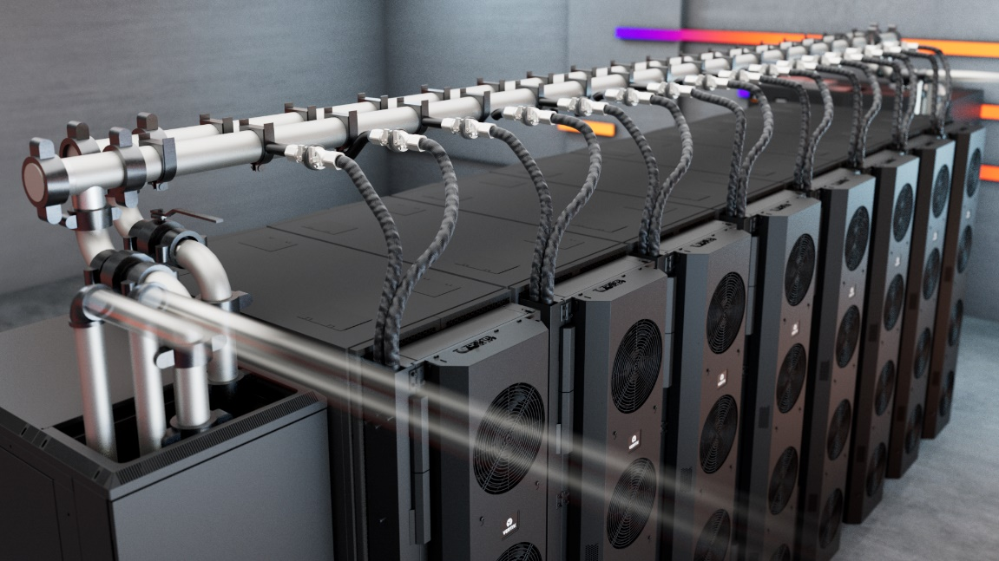
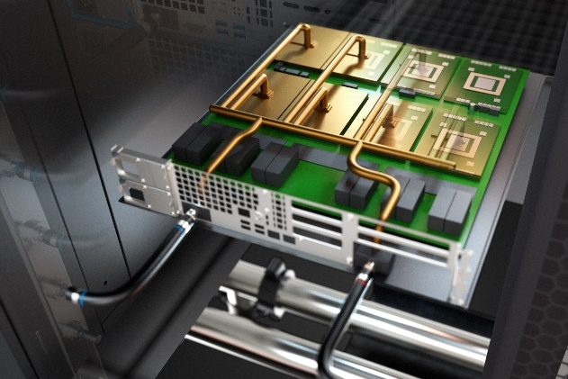
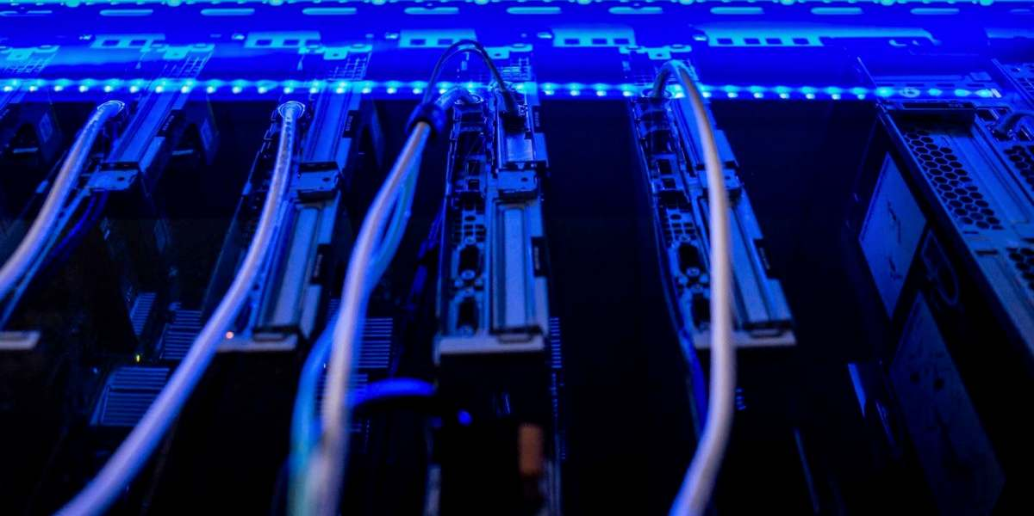
liquid cooling for ai & power Dense workloads
REAR DOOR HEAT EXCHANGER
Direct-to-chip
Liquid immersion cooling
Ideal for 20-50 KW Rack load
PUE: 1.4
Ideal for 50 – 150 KW Rack load
PUE: 1.2 - 1.4
Ideal for 50-200 KW Rack load
PUE: 1.2 – 1.35

Slide 14










Network and Connectivity Highlights
Location
Pan India
Network Presence
Reliable
Network Access
Cross-Connectivity
DC Interconnect
All our Data Centers are strategically located in dense Metro regions of the country on well-connected super-fast networks.
36000+ Kms of fiber access across 24+ Metro cities, 3700+ POPs
1600+ cities ensuring enhanced security and last mile connectivity
Access all tenants via cross connects/bulk fiber
Lower TCO as expensive network bandwidth not required
Multiple Fiber routes to the building and MMRs at each tower of the DCs.
Enables connect for DR, NDR, FDR deployments
Pan India dense fiber connectivity with interconnect services across 66+ Data Center facilities
Uniform Latency
Carrier Neutral
Meet-Me-Room
Easy Access to Internet Exchanges & Clouds
Leverage Common Infrastructure
Ensure all market participants access equal latency across the towers via standardized prewired cabling. ~150 Mtrs distance with less than 1ms latency
90% of fiber links are from non Sify Telcos
Extension simplified with in-campus wiring and is a low capex option for all Telcos
MDF(Network Closet) in every floor, connected to MMR via network risers
Separate access to telco MMRs for O&M in the BTS
Remote hands for network related troubleshooting
Leverage common network timing (PTP) setup
Access to Internet exchanges, Hyperscale, OTT, Social Media
Lower cost and improved user experience by accessing Internet exchanges for content distribution

Slide 15
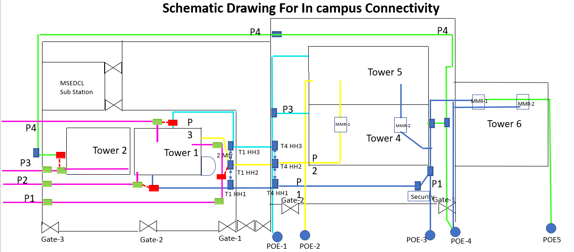
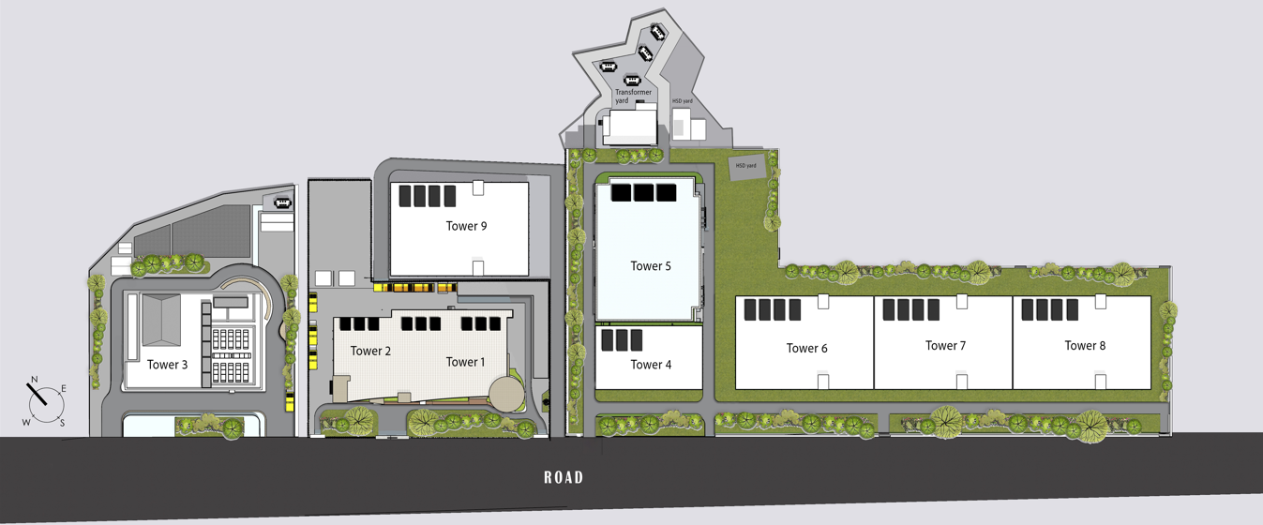
Network Fiber Paths
Interconnected DC towers in the campus via fibre Cross Connect offering uniform network access for application hosted in any of the towers. And four POE for each towers for external telecom fibres
High-capacity bulk fibre from diverse routes between the towers.
All buildings in Sify Rabale campus have strong fiber interconnect with multiple routes.
Direct Cross connects to other Telcos hosted in the campus for customer to connect to cloud nodes: AWS, Oracle Fast Connect & Google Connect.
Secure high-capacity pre-laid bulk fiber for robust and scalable connectivity, each route has multiple ducts and sub ducts for fiber access from any tower to any tower.

Slide 16
Sify data centers

Slide 17

SIFY DATA CENTERS: INDIA FOOTPRINT (Six Markets)
NOIDA 02 CAMPUS
Tower B
26 MW
Q2 2024
Tower 1
11.5 MW
Tower 2
9.6 MW
Tower 3
BTS
NOIDA 01
Noida
10.8MW
Tower A
26 MW
Tower C
26 MW
1st Tier 3
in 2000
Tower 4
8.1 MW
Tower 5
38.8 MW
Tower 6
26 MW
Q2 2025
MUMBAI 01
Vashi
0.9 MW
KOLKATA 01
2.2 MW
Tower 7
20-30 MW
Q3 2025
Tower 8
20-30 MW
Tower 9
20-40 MW
Tower 10
20-40 MW
Tower 11
19.2 MW
Q3 2025
Tower 12
19.2 MW
Q4 2025
HYDERABAD 02 CAMPUS
(FAB CITY)
MUMBAI 02
Airoli
5.4 MW
HYDERABAD 01
Financial Dist.
14.4 MW
MUMBAI 03 CAMPUS (RABALE)
Block 1
26 MW
Additional Blocks
26-52 MW each
(including BTS)
BANGALORE 02 CAMPUS (AEROSPACE PARK)
BANGALORE 01
Electronic City
7.6 MW
Tower 1
11 MW
Q2 2025
Tower 2
11 MW
CHENNAI 02 CAMPUS (SIRUSERI)
CHENNAI 01
Tidel Park
3.6 MW
Tower A
26 MW
Tower B
26 MW
Q2 2024
Tower C
26 MW
Operational
In Development
Planning
All Power references are Design IT Power at Full Capacity
All Power references are Design IT Power at Full Capacity
Notes:
Add star above Vashi

Slide 18
Sify Data Center Advantage
Hyperscale, Hyperconnected, Green, AI-ready
RAS based design for future ready infrastructure
AI Ready with Hybrid Liquid Cooling, up to 200 KW power/rack
14 DCs, 190+ MW IT power, expanding to 300+ MW by 2025
Hyperconnected, Carrier-neutral and Rich Interconnect ecosystem
India’s Data Center Powerhouse for over 23 years
India’s Top 5 banks, 3 of 4 Hyperscalers, Global OTT & Social media players,
and 600+ enterprises…
Campuses scalable to
600+ MW with BTS capabilities
AI/ML led operational excellence with 100% uptime
Enhanced 10 levels of security with automation
231 MW renewable energy contracted

Slide 19




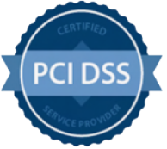











DATA CENTER: COMPLIANCE AND CERTIFICATIONS
z
MEITY Cloud Empanelled
India’s 1st Nvidia DGX Ready DC
Rated 3: Concurrently Maintainable Site Infrastructure
Data Center, Cloud &
Managed Services
IT Service Management
PCI DSS
Telecom Data Center & Managed Services
Hosting Partner
SOC 1 Type II
SOC 2 Type II
World’s international standard for occupational health and safety
Business Continuity Management System
Environmental Management system
Green Building
SAP Certified In Hosting Services
SAP Certified In Cloud Services
SAP Certified In SAP HANA Operations Services
SAP Certified In Application Management Services

Slide 20
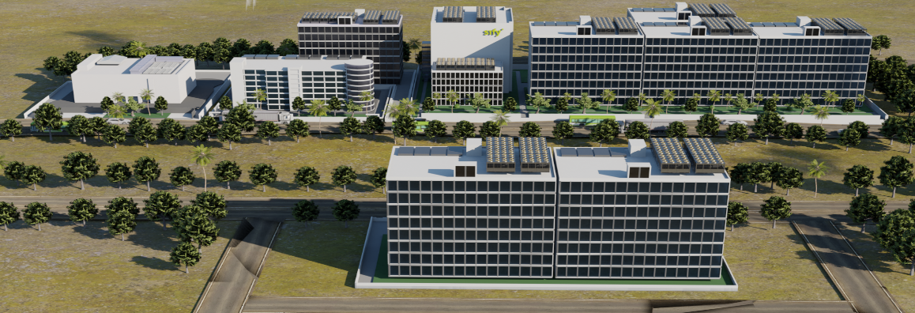
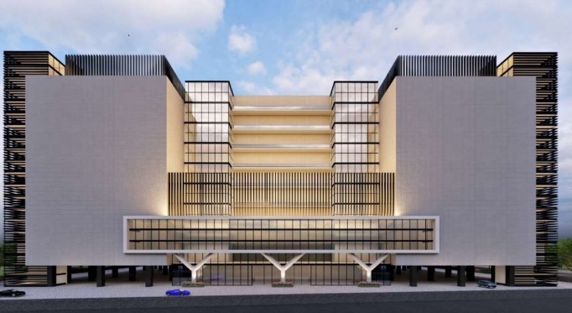
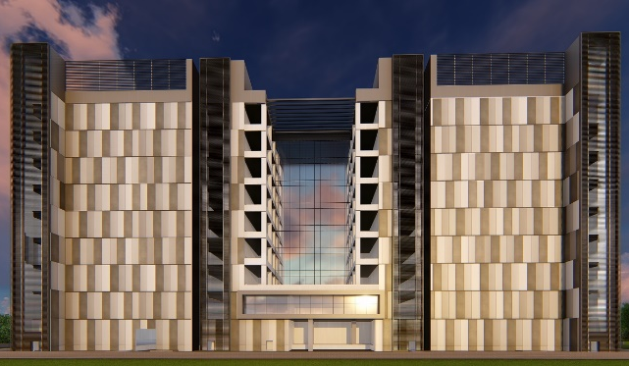
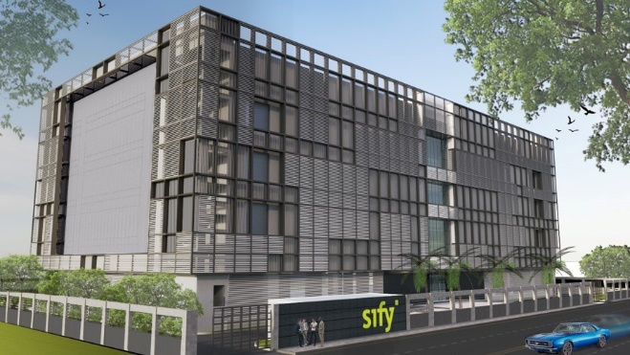
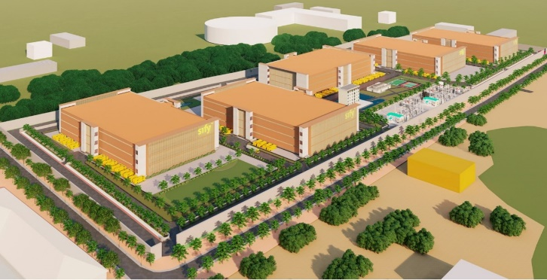
OUR HYPERSCALE DATA CENTER CAMPUSES
Tower B Operational Q2 FY 24
Noida 02
Power: 78 MW IT | Racks: 13,000
Mumbai 03, Rabale | Power: 240 MW IT | Racks: 32,000
5 Towers Operational
4 Towers In Development
3 Towers in Planning
In Development
Tower B Operational Q2 FY 24
Tower 1 Operational Q3 2025
Chennai 02, Siruseri
Power: 78 MW IT | Racks: 13,000
Bengaluru 02
Power: 22 MW IT| Racks: 4,500
Hyderabad 02, Fab City
Power: up to 250 MW IT | Racks: 25,000
In Development
In Development
Planning

Slide 21
Sify’s strong presence in
India’s Financial Services Industry
 | 15,000+ Public sector Bank offices | 27000+ Postal Banks | 5,000+ Co-operative Bank offices | 13,000+ Private sector & Small Banks | 4,500+ Public sector insurance co. offices | 4000+ Payment & Stock Exchanges
As a preferred partner to BFSI industry leaders, Sify enables over 60% of financial transactions in India through its integrated Digital ICT services,
built on data centers, cloud, network, and digital services. Sify is proud to support the government's digital initiatives, digital payments, and financial inclusion with its comprehensive hosting, network, and managed services.
42% of Sify’s revenue is generated from financial services vertical.
India’s top 5 Banks trust Sify Data Centers.
300+ Data Center services projects executed in BFSI.
Top 10 Banks in India are using integrated Data Center and Network services from Sify.
80+ leading BFSI customers are hosted in Sify DCs.
Data Center migration & transition projects executed: 100+ BFSI Private. 80+ BFSI PSU.
World’s most widely distributed postal system runs on network managed by Sify.
35+ leading Banks, 15+ Insurance companies, 2nd largest housing finance company, largest general insurance company, large NBFCs, new age Fintechs have signed multi-year Data Center services contract with Sify.
Sify has designed, deployed and is managing the infrastructure that runs India’s entire inter banking transactions.
Sify Connects…
15,000+
27000+
5,000+
13,000+
4,500+
4000+
Public sector Bank offices
Postal
Banks
Co-operative Bank offices
Private sector & Small Banks
Public sector insurance co. offices
Payment & Stock Exchanges

Slide 22



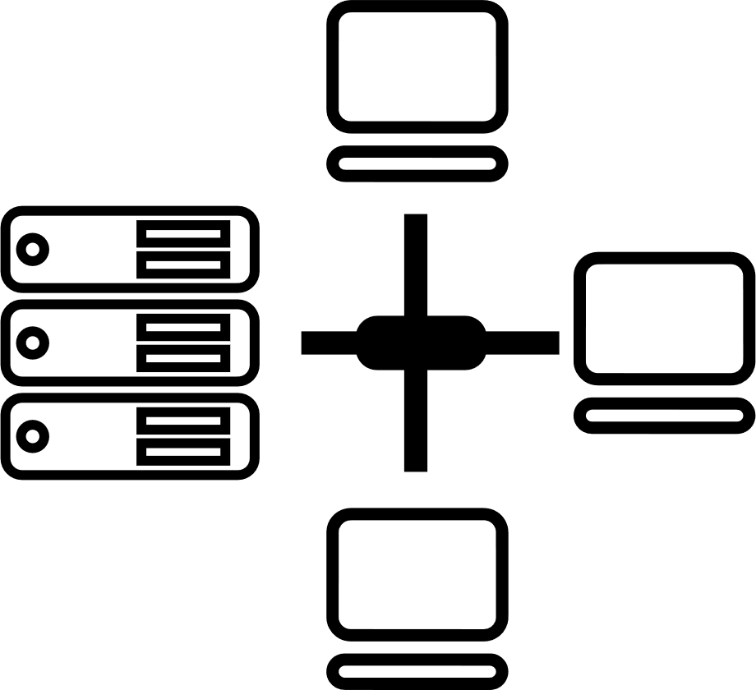






Tried Tested Trusted
Your digital infrastructure partner for over 23 years
Network
Infra Services
Network Digital
Managed Services
Data Center
Colo Services
CloudInfinit
Ent Cloud Infra
Cloud & IT
Managed Services
Digital Apps
Managed Services
Industry Apps
Managed Services
Security
Managed Services
Thank You

