Slide 1
AI-POWERED MANAGED NETWORK SERVICES:
Driving Innovation in Manufacturing
June 2024
Sify is your digital bridge for transformation, built on our world class IT infrastructure,
digitalized services & core digital platforms.

Slide 2
agenda
MANUFACTURING BUSINESS PRIORITIES & TECHNOLOGY DEMANDS
WHERE ARE WE MOVING?
MANUFACTURING 4.0 → 5.0 & NETWORK LANDSCAPE
SIFY DIGITAL MANAGED NETWORK SERVICES
SIFY EMPOWERING THE INDUSTRY

Slide 3
manufacturing BUSINESS PRIORITIES
Digital Threads
Quality Control
Smart Shop Floor
Business Continuity Planning
Integration of production workflows, data-driven strategies, and customer experience to optimize production processes
Quality production driven by insights to minimize loss, stringent assurance standards, automated inspections, and full traceability across the supply chain.
Smart, connected technology to improve decisions, enhance safety and productivity, and prepare for unplanned scenarios.
Ensuring continuity with risk assessments, remote monitoring, and recovery plans
Intellectual Property Protection
Supply Chain Resilience
Sustainability and Green Manufacturing
Enhance Change Management
Preventing unauthorized usage and open gateways for research & development
Building robust supply chains with diversified suppliers and real-time visibility
Adopting eco-friendly practices and reducing environmental footprint
Foster a culture of innovation and adaptability by upskilling workforce through comprehensive training programs
Notes:
Underlying message- technology and innovation become driving factors to accomplish these business priorities

Slide 4
Business Priorities translating to technology demands
Smart Manufacturing
Operational Efficiency
Cybersecurity
Real Time Monitoring
Intrusion detection and prevention systems
Network segmentation and security for OT
Multi-factor authentication and encrypted communications
Leveraging IoT, AI, and automation to enhance manufacturing processes
Real-time data analytics for continuous improvement
Lean manufacturing techniques supported by digital tools
Utilizing real-time data to manage stock levels, reduce overstock, and avoid stockouts
Predictive Maintenance Systems
Plant Modernization
Supply Chain Optimization
Regulatory Compliance
Leveraging IoT, AI, and automation to enhance manufacturing processes
Integration of legacy systems with API driven
Adoption of edge computing for enhanced performance
IOT enabled logistics for end-to-end visibility
Advanced analytics for supply chain efficiency
Automated Compliance tracking and reporting tools
IOT enabled monitoring for compliance with safety standards

Slide 5







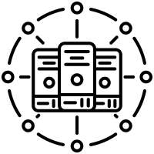
Where are we moving?
TRADITIONAL
IT ENVIRONMENT
THE PAST
THE FUTURE
DIGITAL
IT ENVIRONMENT
Centralized /
on-premise
Slow to adapt
Large, sparse, and horizontal
Manual operations
Interconnected
Tier level design
Subpar security
Unregulated
Distributed /
Hybrid IT
Simple, Scalable, Agile and Flexible
Intelligent and Automated
Connecting multi sites
Heightened Security
BCP- Disaster Recovery
Compliance ready
Green and Sustainable
Cloud
On-Premises
Edge
On-Premises
On-Premises
Primary Site
Secondary Site/DR
Hosting
Colocation

Slide 6
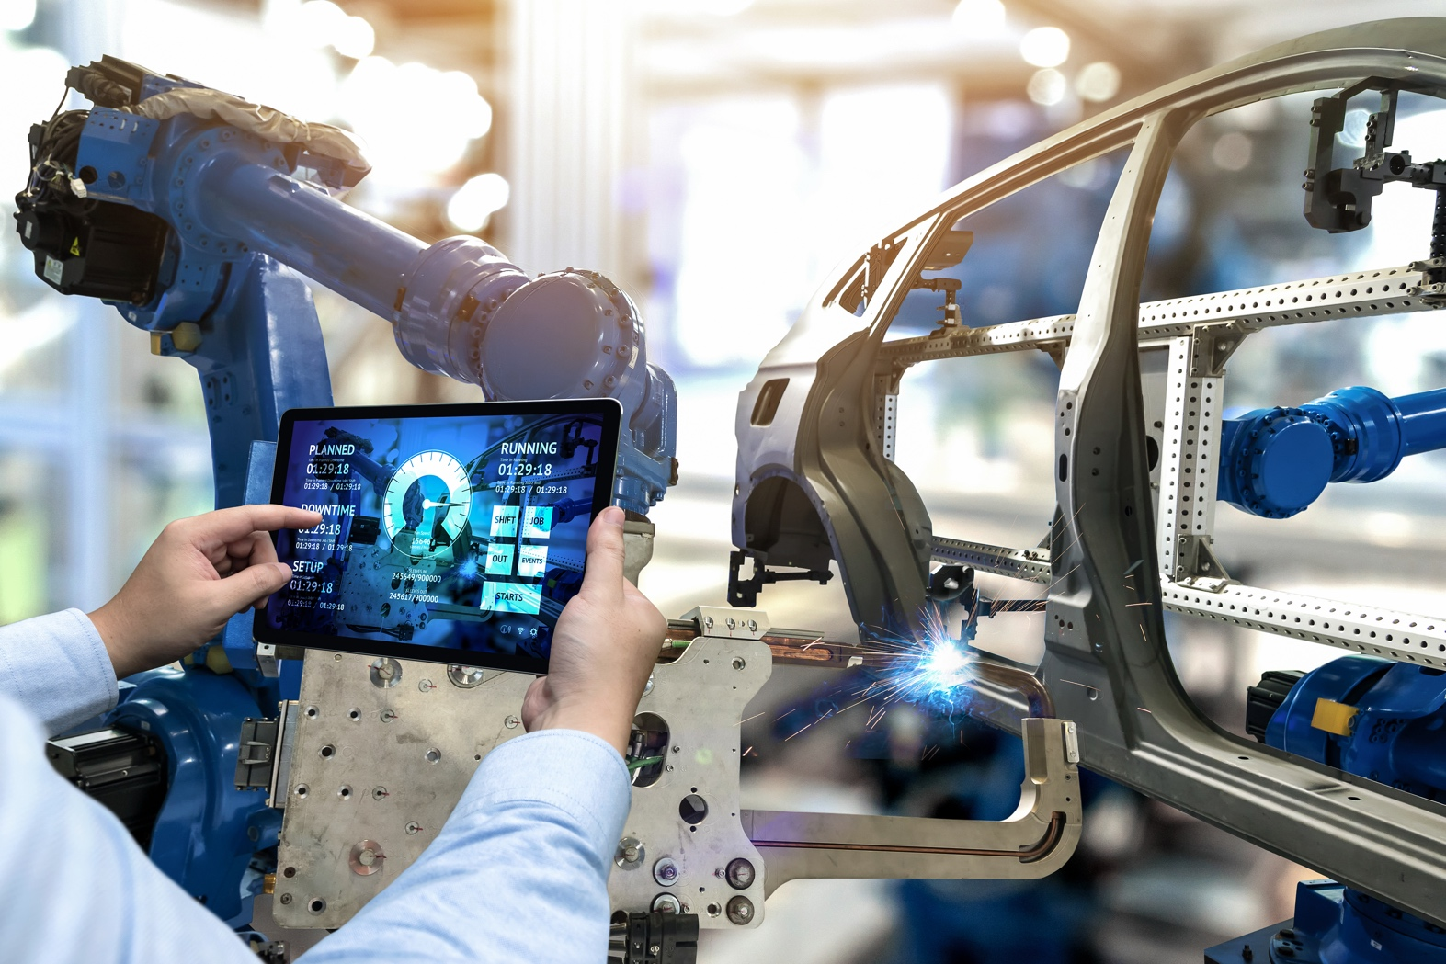





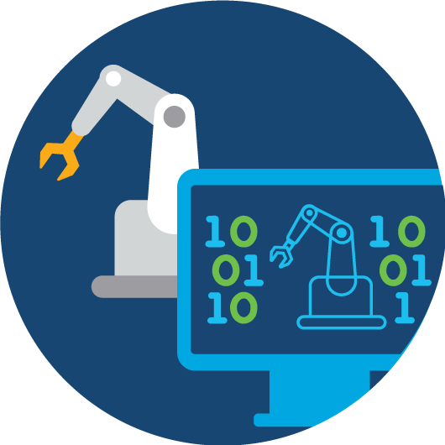
Manufacturing 4.0 → 5.0
Human- machine collaboration
Personalization
Sustainability
UPTIME
PRODUCT QUALITY
SAFETY
Machine Learning
Artificial Intelligence
Predictive Maintenance
Digital
Twin
Manufacturers are converging to secure, end-to-end data center, cloud and networks
to balance efficiency with human-centric values, sustainability, and adaptability.
Notes:
4.0- 5.0
Focus: Manufacturing 4.0 focuses on automation, data, and interconnected systems, while Manufacturing 5.0 emphasizes human-machine collaboration, personalization, and sustainability.
Technology Use: Both stages utilize advanced technologies like AI and robotics, but Manufacturing 5.0 specifically integrates these technologies to enhance human capabilities and address broader societal goals.
Goals: Manufacturing 4.0 aims to maximize efficiency and productivity, whereas Manufacturing 5.0 aims to balance efficiency with human-centric values, sustainability, and adaptability.
trends, such as Predictive Maintenance, Artificial Intelligence, Machine Learning and Digital Twin are driving benefits and value for Manufacturers. They are the basis of Industry 4.0 Digital Manufacturing trend, enabling:
Maximized uptime and quality
Improved safety, security, and reliability
Predictive maintenance, machine learning, and digital twin applications
Connecting factory to partners and suppliers

Slide 7
Manufacturing use cases and networks
Transforming the core and innovate faster
Innovation
at the Edge
Business Continuity & High Availability
Work from Anywhere
More
Network Bandwidth
Low
latency Data
Network
Consistency
Secure
Networks
ERP modernization and apps:
Video, AGVs, thermal imagery, sensors with remote personnel
Real-time control of unmanned vehicles and support for critical applications
Deploy & manage more devices across more locations with the same resources
Securely connect users across plant, head office, and regional offices
ERP modernization, enabling faster digital adoption
Support for IoT devices, scalability, support for decentralized application
High availability IT systems, Risk and Compliance, Redundancy & failover, data replication
Enhanced connectivity & security for remote sites & users with better user experience
AI and Automation in manufacturing, requires a future ready Network architecture

Slide 8
SIFY DIGITAL MANAGED NETWORK SERVICES

Slide 9




Sify’s NETWORK INFRASTRUCTURE & managed SERVICES
Hybrid
Access Strategy
Cloud and
Digital Ready
Designed for Mission Critical Networks
Automation
100K+ wireless enterprise connects across 1600+ Cities, 3700+ PoPs
Pan India Fiber coverage across 24+ Metro Cities
8 International PoPs,
3 CLS, global partnerships with Telecom Carriers and Internet Exchanges
66+ Interconnected DCs, 99.999% guaranteed availability
Connectivity to all major Hyperscalers
High Bandwidth and Low Latency
Fully meshed backbone for resiliency
Powered by AI/ML based operations with dual NOCs
Edge Network strategy to augment tier 2 cities digital infrastructure
Sify OnNet: India’s first automated enterprise WAN
On Demand network infrastructure services
Empowering organizations with Network consolidation and transformation

Slide 10
NETWORK DIGITAL MANAGED SERVICES
Outcome-based Network Managed Services enabling scalability & reliability to empower digitization
Cloud Managed Branch & Campus operations with integrated Security
Secure WAN employing Managed SD-WAN & SASE
Software Defined & Secure DC Network Architecture
Capability built over 2+ decades supporting large, diverse customers
Modern Tools enabling AIOps & Observability for enhanced customer experience
Service Delivery Platform
Actionable Insights & Analytics
Delivery Process Automation & AIOps

Slide 11
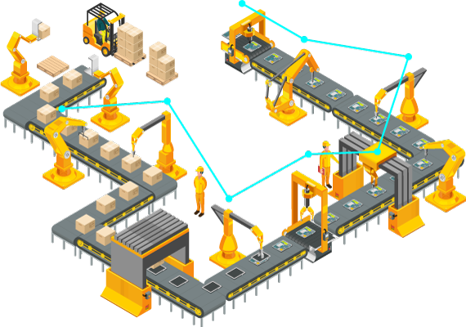
Smart manufacturing solutions
Connected Factory Solutions
IOT Network Access Solutions
Wifi6 / Pvt 5G Wireless Access
Software Defined Visibility & Control
EDGE Computing Infrastructure
Secure Network
IOT Network Security
IT/OT Security
Smart Applications
Asset Tracking & control
Safe Working Environment
Process Automation / Quality Control
Physical Security – Surveillance & Access
Work from anywhere - workload everywhere
Expand the network
Move data securely to applications & analytics
Extract and route IoT edge data
Notes:
The multi-domain, end-to-end, secure IoT architecture, enables customers to easily extend the network they and know trust, across their production environment. It offers the same powerful capabilities of the enterprise network, but is specially designed to satisfy specific demands of the manufacturing environment, such as resiliency, long life cycle, and easy to deploy and use. Cisco supports all the protocols used by assets on the plant floor, and offers hardened technology for extreme conditions that’s purpose-built to thrive in any industrial control system environment, no matter how harsh or challenging.
Customers can also realize unprecedented scale, with the automation capabilities of Cisco intent-based networking, which captures and translates IT and OT intent, so it can be applied across the network. This eliminates the manual work required to deploy and scale a network, and reduces the management burden.

Slide 12
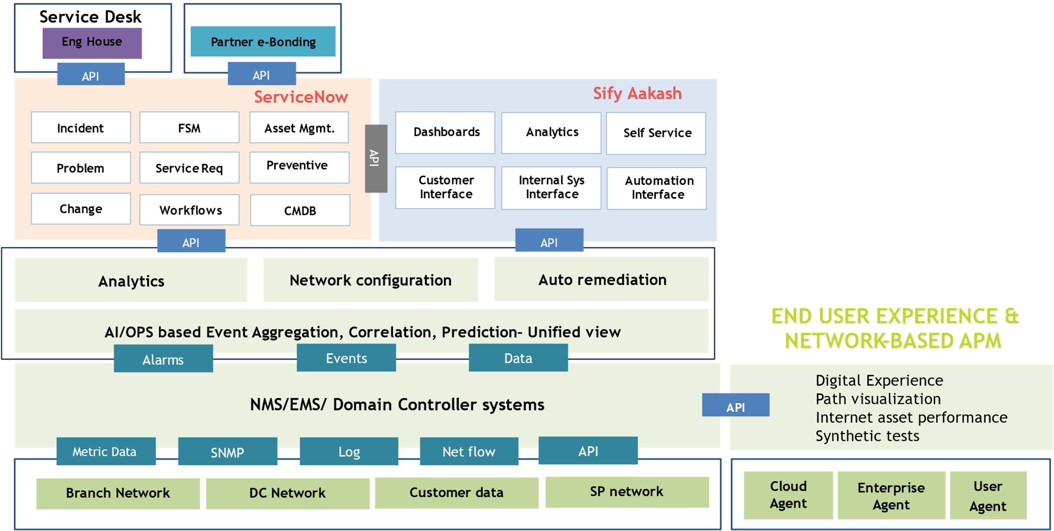
NETWORK DIGITAL SERVICE DELIVERY PLATFORM
Automation & AI Driven
Incident Co-relation, Diagnostics Bots, Service Provisioning, Predictive Insights & AIOps
Network Observability
End to End visibility: Topology, Service Relationship & End user experience
Customer Experience
Aakash provides intuitive Analytics, Inventory & Self Service
Tools Integration
Multi Vendor NMS, EMS & Controllers. E-Bonding with key Telco’s & OEM’s ITSM tools
ITSM

Slide 13










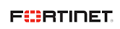
MANAGED SD-WAN SERVICES
Centralized management
SD-WAN USE CASES
Improve Resiliency through Overlay SD-WAN across MPLS & Internet Links
Optimize Cost through Load balancing across links and Application Prioritization
Improve Operational Efficiency & Visibility through Centralized Management
Secure Branch Internet Breakout & Multi-cloud Access
Smart capacity planning through Application-level visibility
Changes can be made quickly across multiple sites
Allows template usage for same routing policies
Automation
Automatic switching based on congestion & criteria
Automated deployments across network from single console
Web-based consoles
Easily orchestrate configurations
Enables connectivity for app requirements on-demand
SD-WAN
Detailed Reporting
Full Visibility Performance dashboards
Enables network configuration based on app intelligence & UX
Performance-based policy routing
Technology Partnerships
Distributing bandwidth based on links across ISPs
Ensuring reliable outbound link for apps & svc’s
Fast setups for secure communication
Apps managed with policies
Drives down costs
Improving security, availability & business continuity

Slide 14




SASE SERVICES
Cloud Platforms
SASE FUNCTIONALITIES
Secure Web gateway
Firewall as a service
Zero trust network access
Cloud access security broker
Remote Browser isolation
Data loss prevention
Network sandbox
DNS Protection
Web app & API Protection
CDN, External DNS
Legacy VPN
Edge compute protection
Branch
Datacenter
Corporate/HO
Smartphone
Factory
Laptop
Security Service Edge (SSE) provides cloud-based, integrated security for secure access to websites, SaaS apps and private apps
Combines SD-WAN access and traffic monitoring functions in a unified solution for all types of accesses
Decreases Latency and enhance App and Network Performance by removing backhauled traffic flows
SASE helps Detect and Mitigate Threats, Connect and Secure Remote Workers, Identify and Protect Sensitive Data
Technology Partnerships

Slide 15
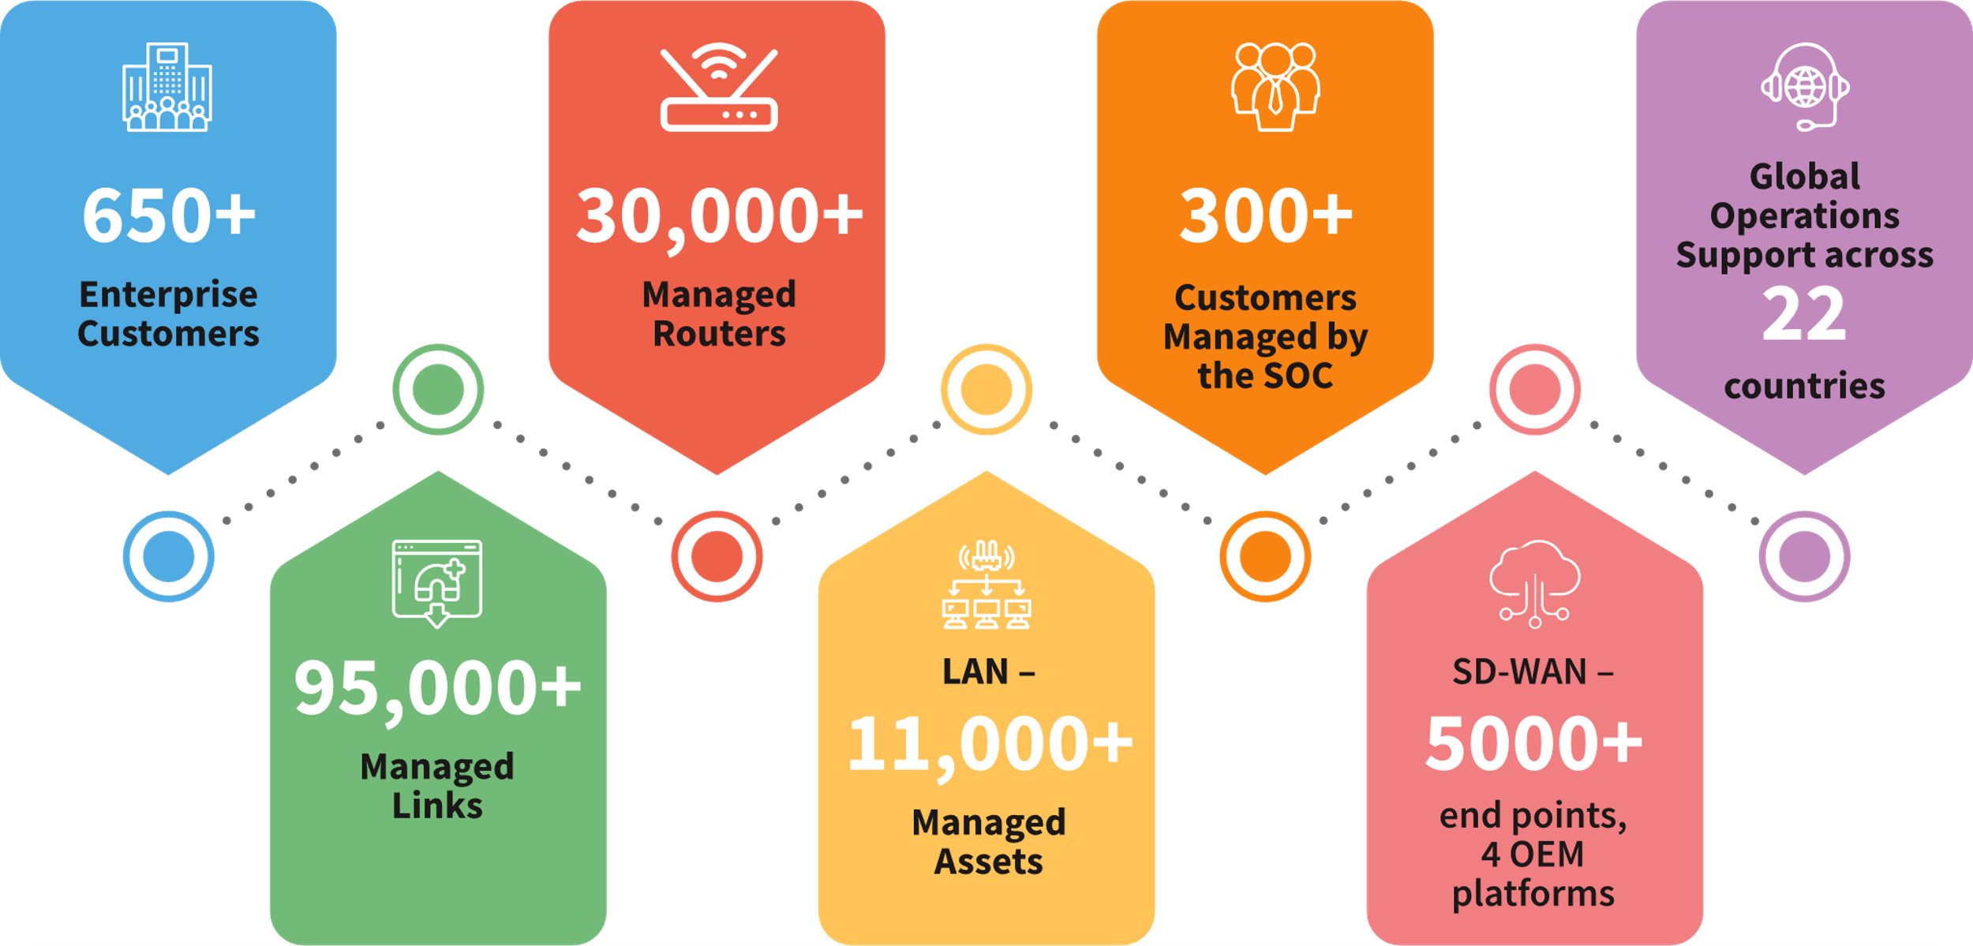
MANAGED NETWORK Digital SERVICES Capabilities
Large Project Experience
Extensive Skillsets
Advanced Network Tools & Integration
Constant Innovation
Technology Partnerships
1 Lakh+
Sify in
Gartner’s Magic Quadrant for
Managed Network Services 2023

Slide 16
Sify’s strong presence in India’s manufacturing sector
500+ India’s leading Manufacturing companies trust Sify’s DC, Cloud, Network and Digital services. 270+ Top Manufacturing enterprises trust Sify’s Managed Digital Network Services.
Digital Network for integrating IT, OT & People for the world’s second-largest geographically diversified steel producer
India’s Top 3 out of 5 Automobile companies in the two-wheeler segments trust Sify’s Network infra and managed services
Sify offers Internet, P2P, MPLS Connectivity, Network Management and Managed Wi-Fi to one of India’s biggest FMCG Companies
Sify Offer’s Secure SD-WAN
to one of India’s leading Luxury Retail Chains
Sify manages the NOC of a Global commercial vehicle manufacturing, renowned for innovation and reliability
Sify’s Manages the SD-WAN
setup of a Pioneer In Automotive Excellence
One of India’s leading Tyre manufacturer’s NOC is managed by Sify
Sify manages NOC for one of India’s largest manufacturer and distributer of packaged foods
Three leading Logistics companies trust Sify Managed Network Services
Notes:
Network deployment-
Renault
Hero MotoCorp
Apollo Tyres
JSW Steel
Tata steel

Slide 17


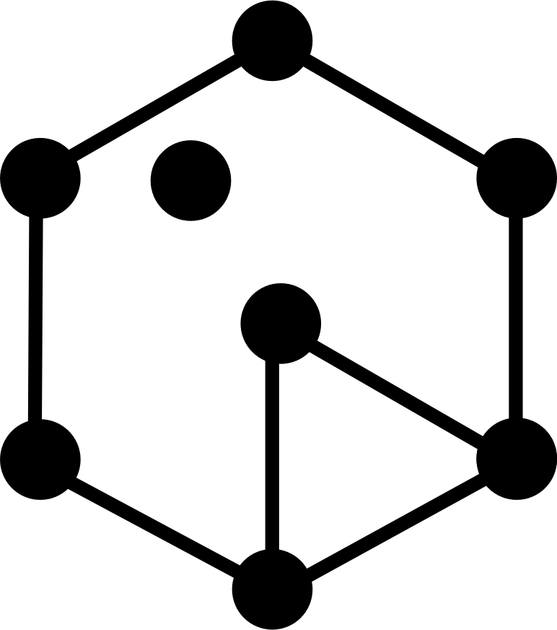
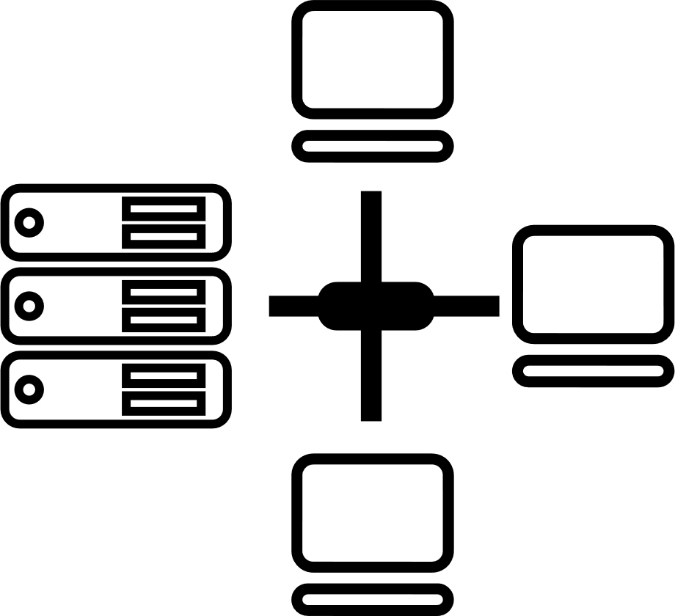
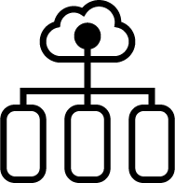





Tried Tested Trusted
Your digital infrastructure partner for over 23 years
Network
Infra Services
Network Digital
Managed Services
Data Center
Colo Services
CloudInfinit
Ent Cloud Infra
Cloud & IT
Managed Services
Digital Apps
Managed Services
Industry Apps
Managed Services
Security
Managed Services
Thank You

