Slide 1



CAPABILITY PRESENTATION TO
ESSAR OIL & GAS
Jun’18

Slide 2
AGENDA
01
INTRODUCING SIFY
02
DATA CENTER AND CLOUD TRANSFORMATION CAPABILITIES
03
NETWORK SERVICES TRANSFORMATION CAPABILITIES
04
SECURITY SERVICE ENGAGEMENT MODELS
05
TOOLS & AUTOMATION CAPABILITIES
06
WHY SIFY FOR ESSAR OIL

Slide 3


INTRODUCING SIFY

Slide 4
SIFY’S JOURNEY SO FAR…
Established HQ in Chennai
Listed on NASDAQ
Launch of MPLS service in India
Raju Vegesna takes over as Sify’s Chairman
Launch of SAP Private Cloud services and practice
Launch of business outcome based models
1995
1999
2001
2006
2013
2017
1998
2000
2004
2012
2016
First private ISP in India
First Tier3 Datacenter in India
Launch of RIM services, NOC, SOC services
Launch of Cloudinfinit services
VPEC hybrid cloud and CI containers offerings launched
Sify has surfed the wave of technology disruption from its inception

Slide 5
SIFY FINANCIALS
SIFY’S EVOLUTION
REVENUE & GROWTH
Cloud Transformation
Partner
Converged ICT Services
Provider
CAGR 19%
Managed DC and N/W Services Provider
Network/
Data Center
Service Provider
INR Crores
TELECOM SERVICES : IT SERVICES WALLET SHARE
PRODUCT REVENUE VS SERVICE REVENUE
In %
INR Crores

Slide 6
SIFY’S INVESTMENT IN DIGITAL AGE TECHNOLOGY
TREND
INVESTMENT
Increased adoption of cloud services
Increase in number of cloud DCs from 4 to 6
Two new cloud DCs are under implementation; 100% growth in capacity by 2020
Cloud and Software Defined Network Orchestration IP developed by Sify
Outcome focussed managed services
Service catalogue based Managed Services
Outcome focussed KPI driven SLA
Increasing demand for Utility models
All services delivered as pay-per-use in the following models
      Component Aligned
  Usage Aligned
  Business Outcome Aligned
Increasing play for service providers
Competence built up of Service Provider-led transformation in areas such as Network Integration, Hybrid Cloud & DC outsourcing
Converged services for IT & Telecom
Investment in all areas of ICT: Datacentre/Cloud, Network, IoT, Applications in service provider model built around productized services and delivered on utility models

Slide 7
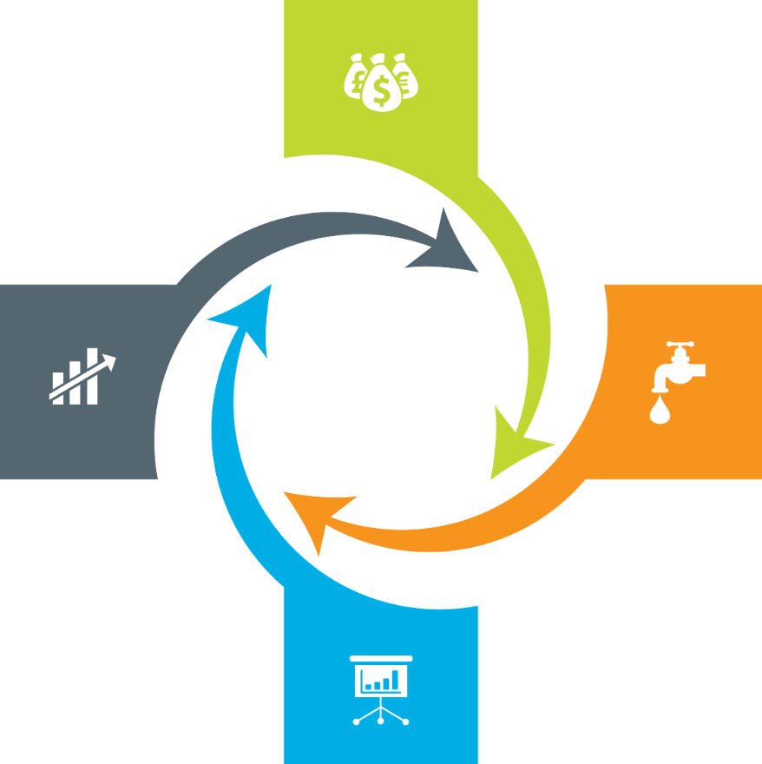
Our Engagement Models
Assets + Services Systems are owned by the client and annuity based payout for services
Outcome based Client engagement is based on defined business outcome generated by IT solutions and services
Usage based No upfront investment by client and payout is based on consumption
ENGAGEMENT MODELS
Component based Reduced upfront investment as client subscribes to infrastructure owned by Sify as a part of their overall infrastructure requirement

Slide 8
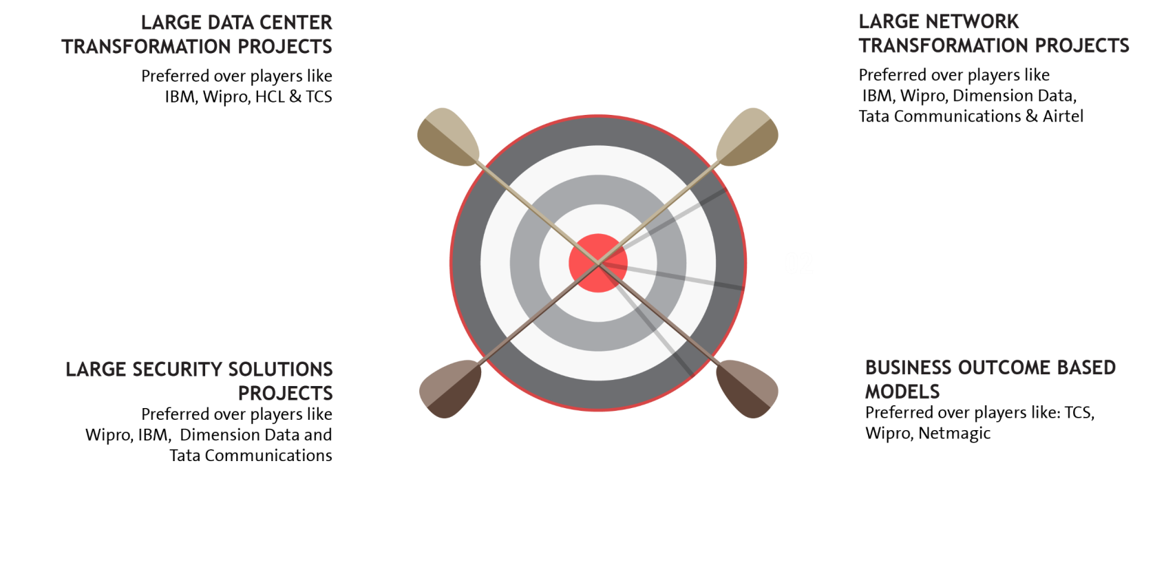

















EXECUTION CAPABILITIES

Slide 9


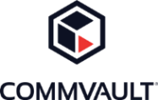









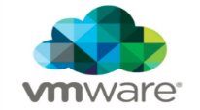














Strategic Partnerships
Technology Partners
Cloud and Acceleration Partners
Application Partners
Security Partners

Slide 10
Our People Capabilities and Strengths
550+
DATA CENTER AND MANAGED SERVICES
1800+
NETWORK
SERVICES
70+
SECURITY
SERVICES
225+
APPLICATION
SERVICES

Slide 11
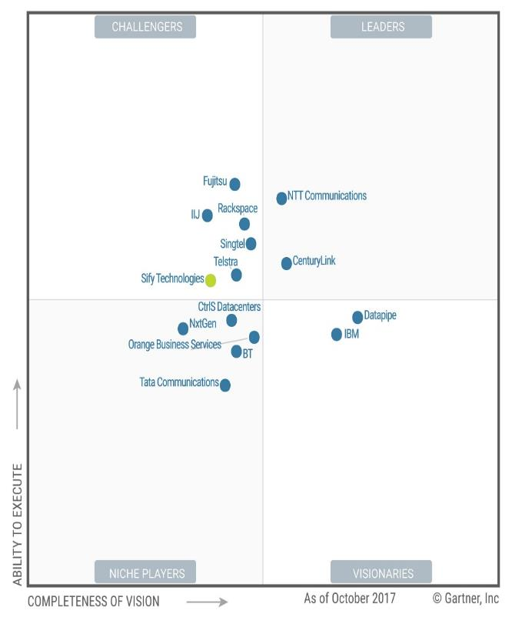
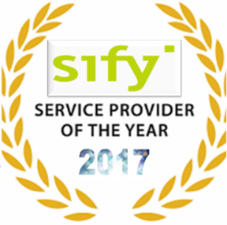
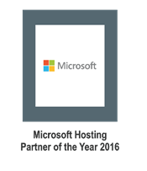
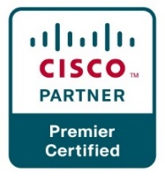
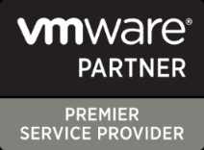

Recognitions
Partner of the year 2017
Network Transformation Services
2018
Data Center Transformation Services
2018
Sify moves up to the challenger position in the Gartner MQ for Managed Hybrid Cloud Hosting – Asia Pacific (2017)

Slide 12




cloud@core
TM
ALIGNED TO OUR CUSTOMERS’ CLOUD TRANSFORMATION PURSUIT
CLOUD ENABLING
CLOUD INSPIRED
CLOUD PURE
CLOUD ENHANCED
Cloud DC
Hyper reach/Hyper scale transport
Oracle FastConnect | ExpressRoute | DirectConnect | Partner Interconnect
Software Defined Network services
Cloud build
Private | Hyperconverged | Enterprise
Security services for cloud
Migration and Implementation services
Sify CloudInfinit
  Enterprise Multi-Tenant
  Dedicated
  Hosted SAP/S4 HANA
  Azure Stack as a Service
Edge Connect Services
SD-WAN
Collaboration services on Cloud
AWS
Azure
OCI
GCP
Multi Cloud Management platform & services
Modern Applications
Kubernetes-as-a-Service
AI/ML
Forum DIGITAL
HCM Digital (iTest)
Learning Management
Internet-of-Things (IOT)
Industry Solution-as-a-Service

Slide 13
DATA CENTER AND CLOUD
TRANSFORMATION CAPABILITIES

Slide 14
Data Center and Cloud Services Driven Infrastructure Transformation Partner
Data center experience
Cloud experience
Over 250 man-years of experience in Data Centre build & operations
Own Cloud Orchestration & Management IP which is hosting 300+ customers
Designed and built 12 Tier III DC’s in India with 2 lakhs + sq. ft.
Implemented Hybrid Managed Cloud for 100+ organizations
Hosting major Enterprises, Govt, PSU, Global Cloud and Content Providers
MeitY certified CSP, STQC audit completed
Extensive experience in delivering end-to-end Data Centre services from design, implementation, operations
DC IT and technology integration experience
Service provider experience
Experience of providing IAAS/PAAS/DRAAS (300+ customers) on our Sify Cloudinfinit platform
In house team of 400+ skilled and certified resources to deliver projects
Our Cloud services offer industry-leading SLAs with guaranteed 99.95% uptime

Slide 15
Our Data Center Transformation Framework
TENETS
OFFERING
TENETS
OFFERING
Application as Service
Business Aligned
Pay per use model
SAP
Microsoft
Oracle
Sify Apps
Right Fit IT Strategy
Optimized IT and OPS
Future Ready
Discovery & Assessment
ROI Analysis
Transformation Roadmap
Apps
Transformation
IT
Modernization
Assessment
OFFERING
TENETS
OFFERING
Infra
    P – V
    V – V
  Platform
    Win8 – Win10
  Apps
    Lotus - Exchange
Agility
Autonomous
Predictive
Analytics
Change the Business
Digital IT
IOT
TENETS
}
‘’0’’ Defect Migration
Seamless
End to end ownership
Cloud
Innovation
Sify’s
DCT Framework
Migration
Security
Transformation
Infrastructure
as a Service
TENETS
OFFERING
TENETS
OFFERING
Seamless
Impregnable
Audit & Compliance
driven
Network
End Point
IT
Agility
Future Ready
Consumption
    Private Cloud
    Enterprise Cloud
      AWS/Azure/ CI
    Hybrid IT
  Backup
  DR
  Acceleration
  DC Security
OPS
Transformation
TENETS
OFFERING
Cloud Nerve Center
Shade and Dedicated Pool
End to end Management
Automation
Lean Operations
Cloud Ready

Slide 16
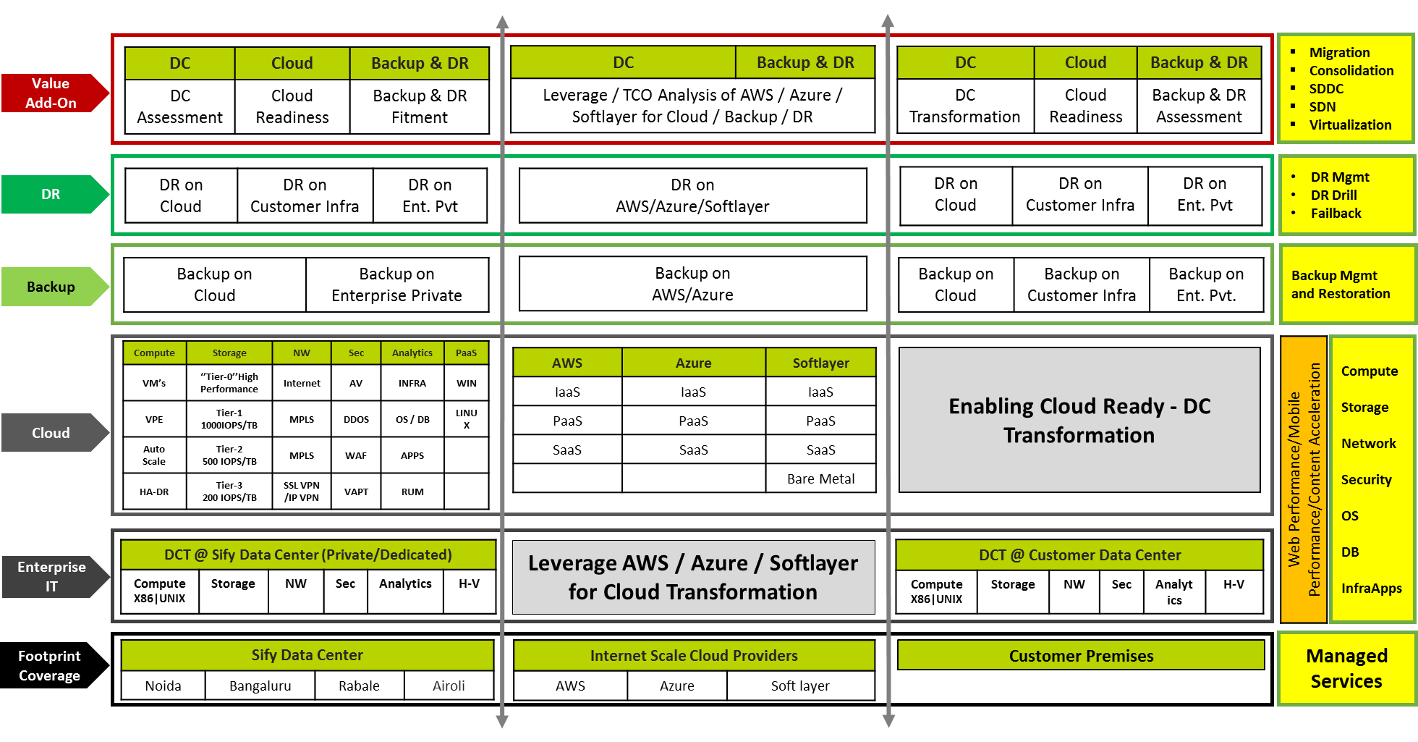
Data Center Transformation Aligned Services

Slide 17




DR SERVICES: MODELS
ON-PREMISE
SIFY CLOUD
SIFY COLOCATION
PUBLIC CLOUD
(AWS/ AZURE)
DRaaS
  DR Services through Sify’s Pre-validated architecture and tools to fulfil required SLAs
DR Build
  DR delivery model build as per Customer environment and Business Demand
DR Consultation
  Complete Assessment of environment to decide backup / DR Strategy
Managed Services
  DR Support Services for Customer’s Existing/new Setup
DRaaS
  Pay-As-You-Go Disaster Recovery as a Service
  Protect the security and continuity of critical IT service delivery
DRaaS
  Pay-As-You-Go Disaster Recovery as a Service
  Protect the security and continuity of critical IT service delivery.
DR Build
  DR delivery model build as per Customer environment and Business Demand
Managed Services
  Regular Backup & DR Support services | Profile/policy administration
DRaaS
  Pay-As-You-Go Disaster Recovery as a Service
  Protect the security and continuity of critical IT service delivery.
  Protect, replicate, recover & convert seamlessly
DR Build
  DR delivery model build as per Customer environment and Business Demand

Slide 18
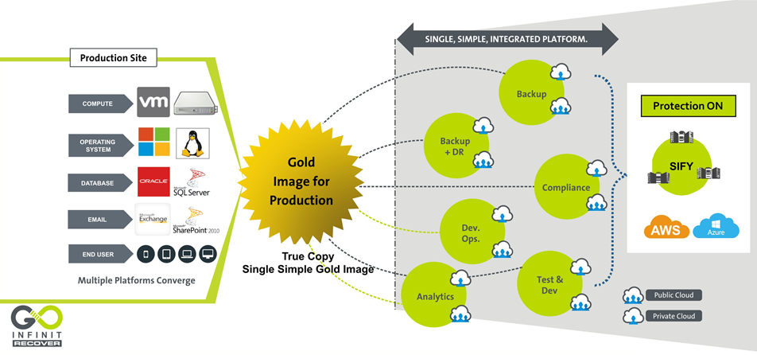
DR Services – Goinfinit Recover

Slide 19
DC AND APPLICATION SERVICES PROOF POINTS
Reference Customers | DC/DR Hosting | Colocation | Application Services | Managed Services | Solution Landscape
Mahanagar Gas | û | ü | û | û | Co-location
IOCL | ü | û | ü | û | DC Hosting, DC- IT Services, Microsoft Services (Exchange)
SP Armada | û | û | ü | û | Routed SAP Licenses
Oil India | ü | û | ü | ü | Microsoft Services (Exchange)
Haldia Petrochemicals | û | û | ü | û | SAP AMS/ BASIS Services

Slide 20
NETWORK SERVICES
TRANSFORMATION CAPABILITIES

Slide 21
NETWORK SERVICES TRANSFORMATION PARTNER
Integrated NOC & SOC, 24x7x365 Operations
Managed Network and Security Service
Network Integrator
Network design, platform selection, solution interoperability, seamless migration
Visibility Tools -1200+ Man Years in Tools & Process
Outcome based services which are technology centric and OEM agnostic
Supported by Advance Toolsets - CA Spectrum, Service Now, CA e-Health
Managing multi-vendor environments, single ownership, SLA driven
Design, Analysis, Planning, Deployment, Integration & Transitioning
DoP, IDRBT, NSE, Sanmar, Oil India
Large Project Design and Rollout Experience
Investments in Digital and Cloud Network (SMAC)
Zero Latency connectivity into Cloud Service Providers Like AWS & Microsoft Azure
Capabilities of Delivering Managed Wifi & SD WAN from Sify Cloud
Cloud and Software Defined Network Orchestration IP developed by Sify

Slide 22
NETWORK SERVICES – KEY STRENGTH
Design Experience
  Inhouse engineering design team of Service Provider class network (Sify + Customer Networks)
  Experience of high availability and scale centric network design
Deployment integration and transition
  Over 2 decades of Large Network Deployment, Integration and Transitioning experience
  Some marquee Large projects like DoP, IDRBT, Muthoot, New India Assurance
Operation and maintenance
  Project Management, Operations with a Field Team of 1300+ Trained Engineers on the field manning 400 POP Location
  Deploy Personnel for Field & NOC Operations, Fault, Change & Vendor Management
Service provider management
  360 degree engagement with all carriers (buy, deploy, manage and sell)
  99.9995% uptime on backbone achieved on the network
NOC, SOC and Systems experience
  Integrated NoC and SOC operations for the last 12+ years
  Over 600 customers in dedicated/shared or hybrid mode of management
  Visibility tools - 1200+ Man Years Experience in Tools & Process
Mature alliance and relationship with global leaders
  Sify Service Provider IP Network is built on Cisco Technologies (For last 2 decades)
  Many firsts Cisco technology implementation – CSR/WAAS/GETVPN/Optical 100G
  Over 200+ POP routers of the same family inhouse managed by Sify
  Sify Public & Private Cloud Setup on HP, Sify Storage on IBM Flash , Sify SAP ECC/HANA Platform on Cisco

Slide 23
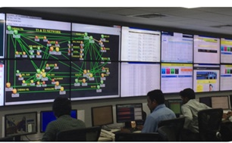
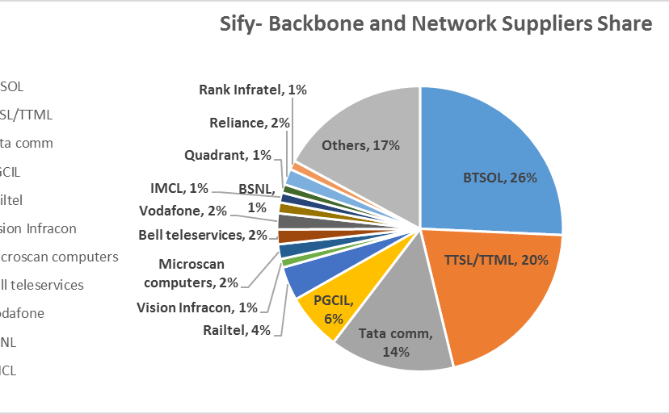
OUR NETWORK MANAGED SERVICES & OPERATIONS CAPABILITIES
Integrated NoC and SoC
24x7x365 Operations
Adherence to ITIL Framework supported by advanced toolsets
Deployment of industry standard tools
CA Spectrum, CA eHealth, ServiceNow
Detailed CRM Workflows in Oracle
Customer Portal for near-real time view and reporting dashboards
Expertise in aligning to customer-owned monitoring & ticketing tools
Expertise in API integration for infra-tools
Scale of Operations
Over 600 managed Enterprise customers
1.35 Lacs+ Enterprise connections implemented
76,000+ managed customer links
44,650+ managed CPE
Experience of managing Carrier Network Infrastructure
Service Provider Management
Engagement with over 10 NLD providers for backbone communication
Collaboration with BSNL/MTNL, Bharti, Tata Communications, Vodafone, Reliance, PowerGrid, RailTel
360 degree carrier engagement
Experience of managing multiple physical access media

Slide 24
OUR NETWORK EXPERTISE & SKILL SET
 | Total Resources | Technical skill sets | Other Training
Network engineering and solution | 47 | CCNA + CCNP + CCIE
SDN CoE | 32 | Dec Ops, Scripting, Tools, Network Management, ITIL
Central NoC | 150 | CCNA + CCNP
Service operations | 40 | CCNA + ITIL
Service operations – Field PMO and project managers | 1317 32 | PMP Prince and CCNA | Internal Training
SDM Service desk Infrastructure operations | 177 115 80 | ITIL CCNA | Internal Training Internal Training Internal Training
Deep Engineering Expertise
Deep Cisco expertise-CCNA, CCIE
Integrated SDN CoE
Advanced L2/L3 Engg
L1 teams trained in FLT on diverse media
Experience in deployment of Hybrid Management models
Project Management
PMI framework-based Project governance
Dedicated Project team for planning & Control
Integrated tools to track, monitor and report on the project
Dedicated Project Execution team and logistic teams
Extensive Field Teams
1300+ trained engineers on field, covering over 400 manned locations
Project teams that deliver customer centric projects
Business Relationship Management
Extensive Quarterly Business & Service Reviews
Proactive solution & service enhancement recommendations
Proactive Network cost optimization

Slide 25
SIFY’S MANAGED SERVICES – Digital Distribution Architecture
NETWORK MANAGEMENT
SERVICE MANAGEMENT
MEMBERS MANAGEMENT
Network Uptime
Link Uptime
End-to-End Latency
Response & Resolution Times
Change Management
Capacity & Utilization
Call Attendance Rate
Filed Support
Service Request Completion
SLAs
24*7*365 monitoring of Network Infrastructure.
Incident, Problem and Change Management.
Software version and updates
Spares and service support
Inventory management
Network configuration and change.
Capacity and Availability management
Tools for Network monitoring and performance management.
Tools for tickets, support and reports
Change, Incident and Problem records.
Uptime/SLA and capacity reports.
Provide monitoring feeds and reports to exchange.
Periodic and on-demand reports on network health and ticket resolutions.
Setup a round the clock helpdesk
Commissioning/Migration/Decommissioning
Configuration guidelines for Members
Field management for hands and feet support
Liaison with service providers
Service provider Governance.
SCOPE

Slide 26
WAN Transformation with Sify Managed SDWAN
Deliver Customer Value, Not Just Cost Efficiency
Unify Managed services
Key enabler for Digital transformation
Agile & Flexible
Application centric
Performance aware
Software based
Carrier agnostic Overlay architecture.
Multi-transport support.
Centralized control & Monitoring.
Unique topologies per segment.
Encryption, segmentation and service chains
Cloud off-ramping
Application aware routing.
Application based policies.
Application visibility & recognition.
Real-time enforcement of App SLA.
Centralized policy control.
Continuous quality assessment.& path liveliness
Consolidates multi provider WAN as a single fabric.
Faster convergence of application traffic.
Bandwidth augmentation with Active/Active utilization.
TCP optimization
Software platforms enabling physical or virtual CPE.
Zero touch provisioning.
Centralized configuration.
Agility for operations with analytics.
Interoperable with legacy.

Slide 27
Sify Managed SDWAN: Value Propositions
1
2
3
Difficult to simplified operations
Connectivity-centric to App centric
Cloud Enablement
Discover , understand needs and manage performance
Facilitate & manage performance
Automation, programmability, consolidation and agility
4
5
6
Inflexible to Flexible
Visibility & Analytics
Security
Hybrid WAN, Topologies, Physical/Virtual, convergence
Behaviours, Trends and feedback loops
Cloud perimeter branch and user security.
Managed services to drive efficiencies, lead engagements through insights and
value beyond cost economics.

Slide 28
NETWORK REFERENCES & TRANSFORMATION CAPABILITIES
Customer | Network Design | Network Build/Integration | Network Managed Services | Bandwidth Service Provider | Network Security | Network consolidation transformation | SDN
BPCL | ü | ü | ü | ü | û | ü | ü
HPCL | ü | ü | ü | ü | û | û | û
IOCL | û | û | û | ü | û | û | û
MGL | ü | ü | ü | ü | û | û | û
RIL | û | û | û | ü | û | û | û

Slide 29
SECURITY SERVICE
ENGAGEMENT MODELS

Slide 30
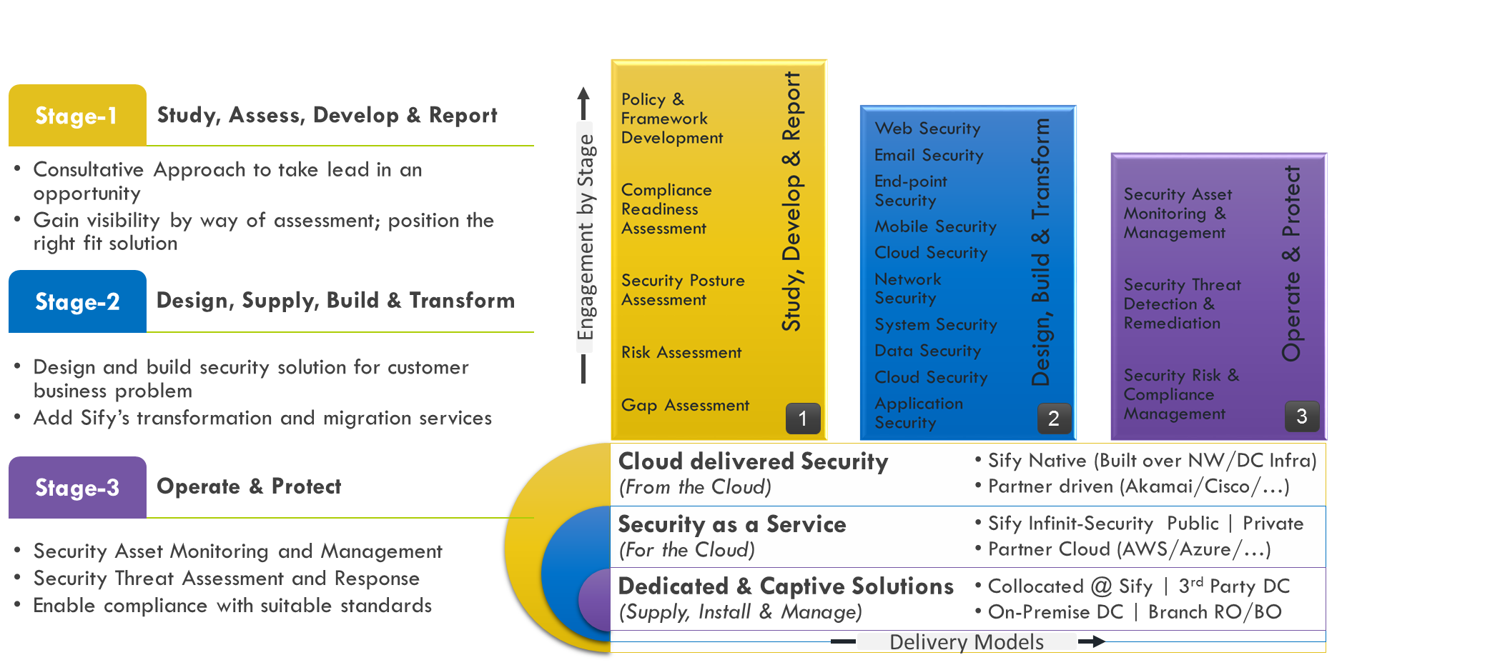
Our Security Services Engagement Models

Slide 31
Sify DDoS Capabilities

Slide 32
SECURITY SERVICES EXECUTION PROOF POINTS
Reference Customers | Information Security Consulting | Security Transformation | Professional Services | Security Operations | Incident Response | Solution Landscape
NTPC | ü | ü | ü | ü | ü | SIEM,PIM and IPS
IOCL | ü | ü | û | ü | ü | NGFW, IPS, Web Gateway, DDoS, SLB, LLB
ONGC | ü | û | û | ü | û | IPS
BPCL | ü | û | û | ü | ü | Vulnerability Management

Slide 33
TOOLS & AUTOMATION CAPABILITIES

Slide 34
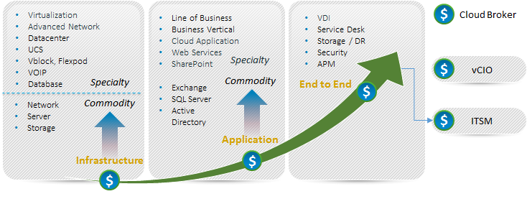
Our Tools and Automation Capabilities
Application Monitoring
SERVER MONITORING
CLOUD MONITORING
SAP
Microsoft Exchange
IBM WebSphere
Apache Tomcat
Microsoft IIS
JBoss
SharePoint
Sybase EAServer
Lotus Notes
MS Lync
MS Active Directory
Oracle WebLogic
Microsoft Windows Server
Linux/Unix
  Solaris, AIX, HP-UX, Linux, Sinix, Tru64 UNIX, Red Hat
Cisco Unified Computing System (UCS)
IBM Power Systems
Novell Open Enterprise Server
Private
  Flexpod, Vblock
Public
  Amazon, Rackspace, MS Azure, Google App Engine, Google Apps, SFDC CRM
Citrix CloudPlatform
vCloud
Cloud Monitor (Websites)
Virtualization Monitoring
NETWORK MONITORING
Database Monitoring
VMware
Citrix XenServer
Microsoft Hyper-V
Oracle Solaris Zones
IBM PowerVM
Red Hat Enterprise Virtualization
Router and Switch
Network Response Time
Cisco Qo5
Cisco IP SLA
Flow Analysis
Oracle DB
Microsoft SQL Server
Informix
IBM DB2
MySQL
Sybase
Service desk as service
Big Data & CUSTOM APPS
Storage Monitoring
VoIP / VDI monitoring
Provide Service Desk in Multitenant Model
Hadoop, Cassandra, Mongo DB
Customizable packages for open source applications or in house applications
EMC
IBM System Storage
NetApp
Cisco VoIP
Citrix XenDesktop / XenApp
Hitachi
34

Slide 35




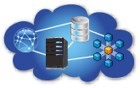

Our Tools and Automation Capabilities
UNIFIED MONITORING OF PUBLIC AND PRIVATE IT ENVIRONMENTS
Application Monitoring
Server Monitoring
Cloud Monitoring
Virtualization Monitoring
Database Monitoring
Storage Monitoring.
Data Center Monitoring
Main Frame Monitoring
Response Time Monitoring
Big Data Monitoring
Basic Network Monitoring
Features
What can we monitor
Multitenancy
Dashboard & Reports
Distributed Architecture
Unified Trending
Visual Alarms & Reporting
Email Alerting
3rd Party Integration (Service Now for ITSM )
Agent and Agent less Monitoring
UMP (Portal ) available via Mobile
Dashboards and Reporting
Service Levels
End User Response Time
Performance and Availability
Events and Faults
Power
Efficiency
Network
LAN & WAN
Server
Physical & Virtual
Database
IT & Business
Application
Commercial & Custom
Cloud
Public & Private
35

Slide 36
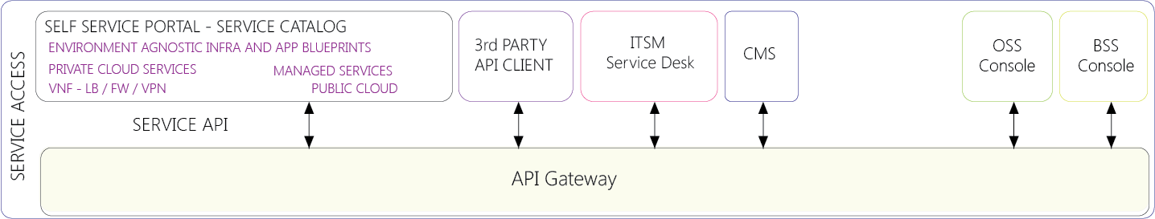
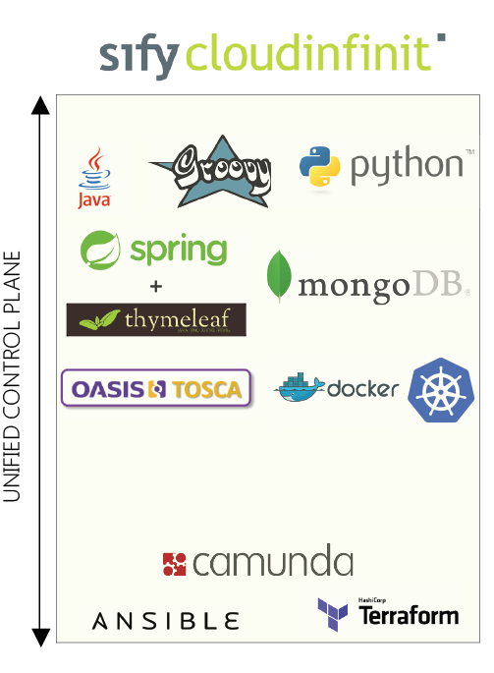

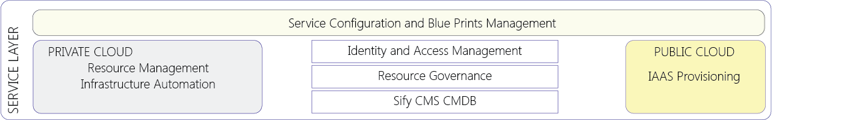
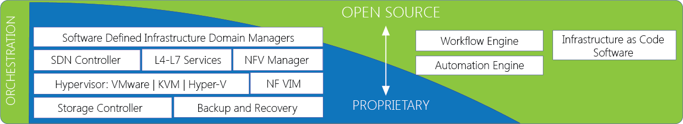
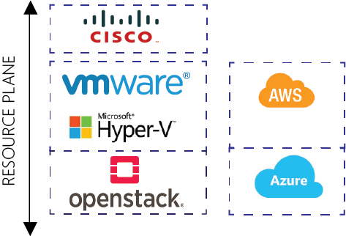
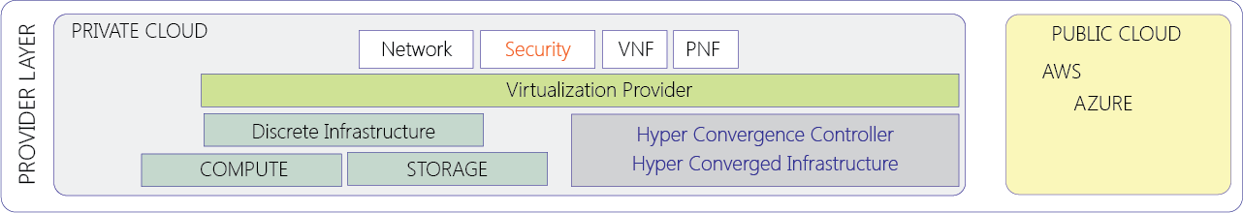
Our Tools and Automation Capabilities
36

Slide 37
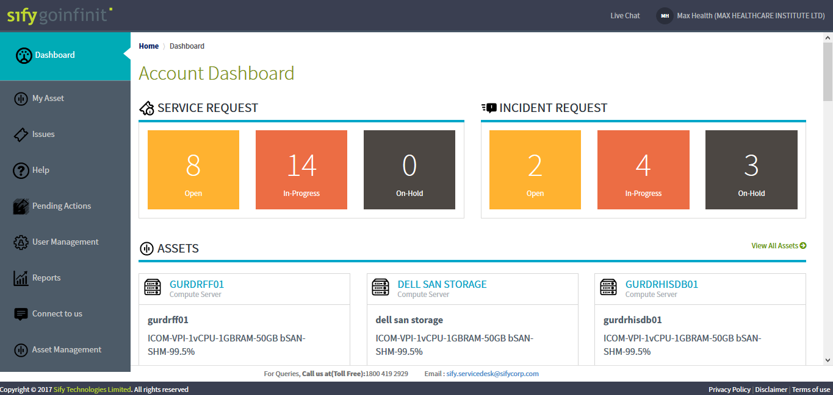
Our Tools and Automation Capabilities

Slide 38
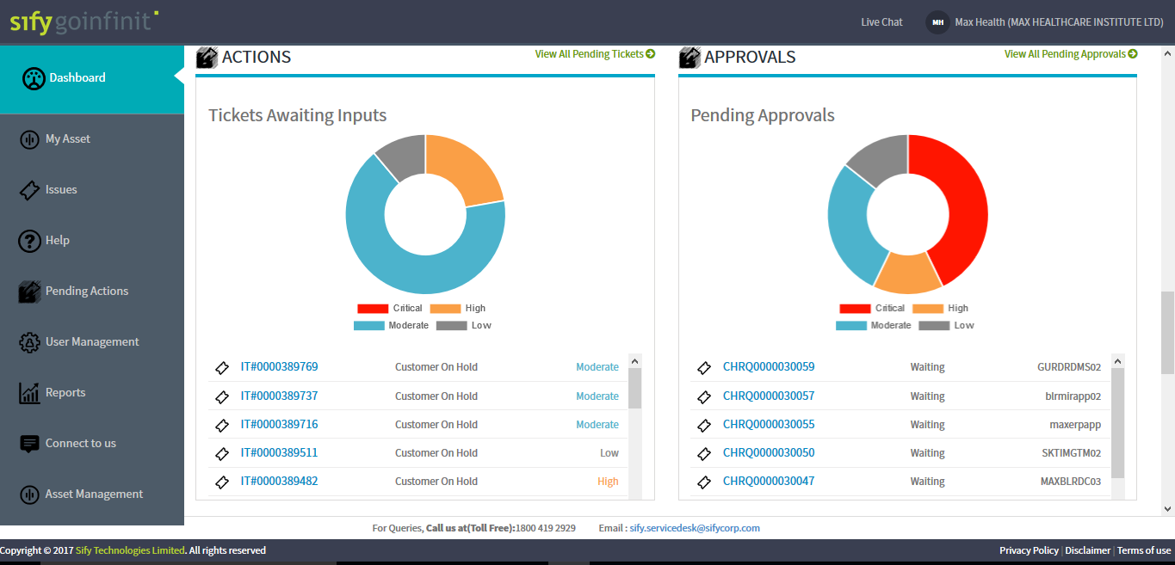
Our Tools and Automation Capabilities

Slide 39
WHY SIFY FOR ESSAR OIL

Slide 40







SIFY – OIL & GAS CUSTOMERS

Slide 41




Why Sify for Essar oil? (TO BE UPDATED)
Sify customer in O&G
  Data to be added
DC partner for 5-10 years
  Data to be added
Network partner
Data to be added
Security partner
  Data to be added

Slide 42
APPENDIX

Slide 43
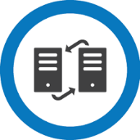







Case study: INFINET (Functional needs)
High Availability
  Network architecture and configuration to support uptime of 99.9975% for each physical/ logical link.
Security
Isolation & Encryption
Load Sharing
Load Sharing Traffic across multiple links in DC’s, Member Bank’s and RBI RO’s
Redundancy
To provide Link level, path level, router level and network level redundancy
Traffic Failover
To ensure Auto failover between two or more telecom service providers at IDRBT / RBI / CCIL and member locations.
Traffic Segregation
Traffic segregation between Member Bank and RBI ROs
Traffic Replication
3 Dedicated point-to- point links between DCs for Traffic Replication with auto failover
Business Continuity
The INFINET network to be designed and configured to support all BCP scenarios without any major changes in the network
Network Monitoring & Management
Setup a NOC to operate, monitor and maintain INFINET network using own latest Network Monitoring Infrastructure

Slide 44
Case study: INFINET (Value proposition)
Design
Partnerships
Network Integration
Managed Services
Design based on specific requirements of INFINET network, customers and applications.
Mitigate current pain points.
Meet the scale, performance and reliability needs
Manage carrier relationships by being a customer and a provider.
Leverage being a major partner and customer of Cisco.
Skills and project expertise.
Integrated NSP and NI delivery processes.
Deliver the incumbent advantage.
Centralized NOC with integrated systems for core and Edge.
ITIL compliant processes and systems.
In-house developed systems
End to End Execution
Tunnel-less VPN for scale, performance and multicast.
Performance & event based resiliency
Segregation of networks for security & performance
6 providers for Availability with redundant & divergent links.
Cisco routers and GET VPN technology.
Zero downtime migration.
Enable facility readiness, offload major customer processes.
One representative for INFINET customers.
New KPIs integration to understand network better.
Application performance visibility.
Software reliability, compliance audits

Slide 45


CASE STUDY: Enhanced & Consolidated Data Center, WAN and IT Experience for India Post
Customer Demand
    Network Integration & Project Management
    Plan, Supply, Design and Implement the network
    Data center Network
    Disaster Recovery center Network
    28,000 locations – WAN & LAN
    Migrate 1400 locations to MPLS
    Security design & Implementation
  Technical implementation
    Setup a captive NOC and deliver Managed services.
    Own the DOP Network and ensure Uptimes are met
    Coordinate with Other SI to implement the DOP vision
    Own all KPIs for Network & Security
    Key benefits
    MPLS VPN and Internet services across all the 28,000 sites on Sify network
    Built a second Redundant Network over a second service provider.
    Bandwidth services with scale
    Largest MPLS network ever built
15 months Project Roll-out time 5 years Of successful management of the telecom infrastructure 100% MPLS implementation against 5% of all the locations 10x Average report execution time improvement
Sify’s approach on DoP Project
Data Center Network and Security Setup
WAN Migration
Enhanced IT Experience
Strong collaboration between business and IT
Decentralize IT Management
Bottom up modelling
Approach
Standardization and availability of IT Services across 30,000 p

