Slide 1

SIFY’S DIGITAL TRANSFORMATION CAPABILITIES
June 2021

Slide 2
AGENDA
Data Center & Cloud Transformation Services
Digital Services
Smart Network Services
Security Centric Services

Slide 3
OUR Understanding of RPG Group Business and Digital transformation JOURNEY
30000+
Employees
4Bn$+
Turnover
Infrastructure Tyres
Energy Health & IT
15 Companies
Digital Transformation
  Data Driven Organization
  DC Consolidation
  Network Transformation
  Cybersecurity
  Supply Chain Disruption
TECHNOLOGY VISION
Cloud
  Moving Apps to Cloud
  Scalability – Scale with Business growth
  Flexibility – to operate & manage, seamless connectivity
  Consolidation – Retiring non-critical applications, Enhanced visibility, Data security
Business Vision
Embracing digital transformation to drive business agility, profitability, seamless collaboration
and operational efficiency

Slide 4
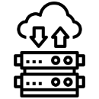


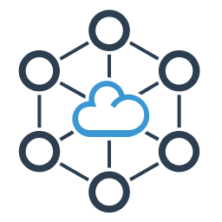
Current setup - KEC
DC DR hosted
with ST Telemedia
SAP S4 HANA, HANA DB, 0365, Teams, McAfee, Palo Alto
Partnered with Accenture for Application Managed Services
Using TCL (primary) & Airtel MPLS service to connect with multiple locations

Slide 5
Current setup – Raychem RPG
DC DR hosted
with Azure & IBM
Oracle EBS, Oracle Sales Cloud, Oracle DB, 0365, Teams, Symantec, Palo Alto, Fortinet
Partnered with Birlasoft for Application Managed Services
Using TCL(primary) and Airtel MPLS service to connect with multiple locations

Slide 6
Current setup – RPG Lifesciences
DC DR hosted
with ST Telemedia (for SAP)
SAP ERP, Instruments/Pharma Applications, 0365, Teams, LTS Security, McAfee
Partnered with NTT for SAP Managed Services
Using TCL (primary & secondary) and Tikona (additional bandwidth) as MPLS & ILL service

Slide 7




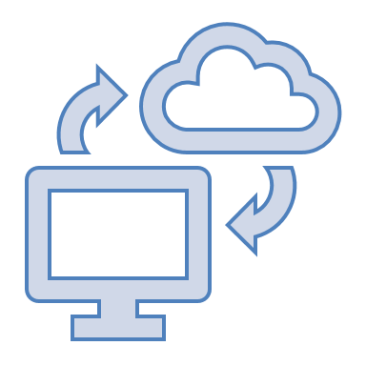




Strategic Objective
DC Migration & Infrastructure Optimization
Consolidation & Optimization
Solution to move Business Applications to state of the art Data Centre Hosting with business continuity solution for critical applications.
Modernization with focus to reduce TCO and business downtime.
Reduce TCO
Business Continuity for critical Application
Hybrid and Multi Cloud Options
Network and Security
Industrial IOT
Managed Security
Application Management Services

Slide 8
Sify engagement
SAP, Exchange, Covigilance, Track & Trace, Product Serialisation, clinical development apps & other pharma apps
Web based Apps, Open Text documentation, sales & distribution, mobility, procurement, etc.
DC hosted On Premise
& Partial DR at TCL
Using TCL Links & Citrix SDWAN to connect with multiple locations

Slide 9






We believe
everything that can be migrated to cloud
must be migrated
For the rest, we have
cloud adjacent
datacenters to configure
the most efficient
hybrid multi cloud
Enabling your
hosted applications work
seamlessly
with cloud applications as if they are in the same datacenter
  With a
  10G+ speed
  connection to the
  hyperscale cloud
  at less than
  100 microseconds latency
Sify owns the entire assessment, migration, security and managed services from any current state to any desired cloud configuration

Slide 10




cloud@core
TM
ALIGNED TO OUR CUSTOMERS’ CLOUD TRANSFORMATION PURSUIT
CLOUD ENABLING
CLOUD INSPIRED
CLOUD PURE
CLOUD ENHANCED
Cloud Data Centres
For Enterprises and Hyperscale CSPs
Private Cloud at DC
Hyperconverged | Enterprise
Hyper reach/Hyperscale NW
Hyper Reach/Hyperscale transport
Data Center Interconnect
SD-WAN
Migration Services
Migration and Implementation services
IaaS at Cloud DCs
CloudInfinit
  Enterprise Multi-Tenant
  Dedicated
  Hosted SAP/S4 HANA
  Azure Stack as a Service
Edge infra aligned to Cloud
Edge Connect Services
Hyperscale Platforms adjacent to Cloud DCs
AWS
Azure
OCI
GCP
Multi-cloud Management platform & services
Digital Services
App Modernization
Kubernetes-as-a-Service
Digital Apps (SaaS)
Forum DIGITAL
HCM Digital (iTest)
Learning Management
Internet-of-Things (IOT)
Industry Solution-as-a-Service

Slide 11
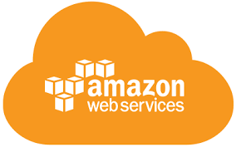
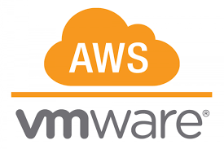
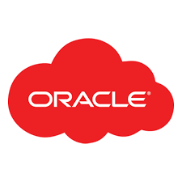




cloud adjacency: SIFY COMPLEMENTING HYPERSCALERS
Business Benefits of Sify’s Cloud Investment
Best of breed performance with Hybrid Cloud configuration
Efficient integrations with extended ecosystems
Compliance with data sovereignty
Business continuity with resilience
Simplicity with self service
Operational efficiency with reduced IT administration
Cost reduction with On-demand bursting to public clouds.
Hyperscale Clouds AT VERY LOW LATENCY
r
y
b
RABALE DATA CENTER (Cloud Adjacent)
H
i
d
C
l
o
DC INTERCONNECT
u
d
Express Route
y
b
H
ri
d
C
l
o
u
Direct Connect
Sify Cloud Connect
d
Hybrid Multi Cloud
Partner Interconnect
Colo + Managed Services
F
a
r
D
Direct Connect
AIROLI DC ^{(Near Cloud / DR)} - Enterprise Multi Tenant Cloud ^{AT MINIMAL LATENCY}
R
Colo + Managed Services
Sify CLOUDINFINIT CMP | AIOps Platform for Managed Services
FAR DR READY
HOSTED PRIVATE CLOUD + APPS AS A SERVICE
CLOUD INFINIT
SAP GRID
ORACLE EXADATA
AZURE STACK
NEAR DR
Hyderabad Data Center

Slide 12
Data Center & Cloud Transformation Services

Slide 13
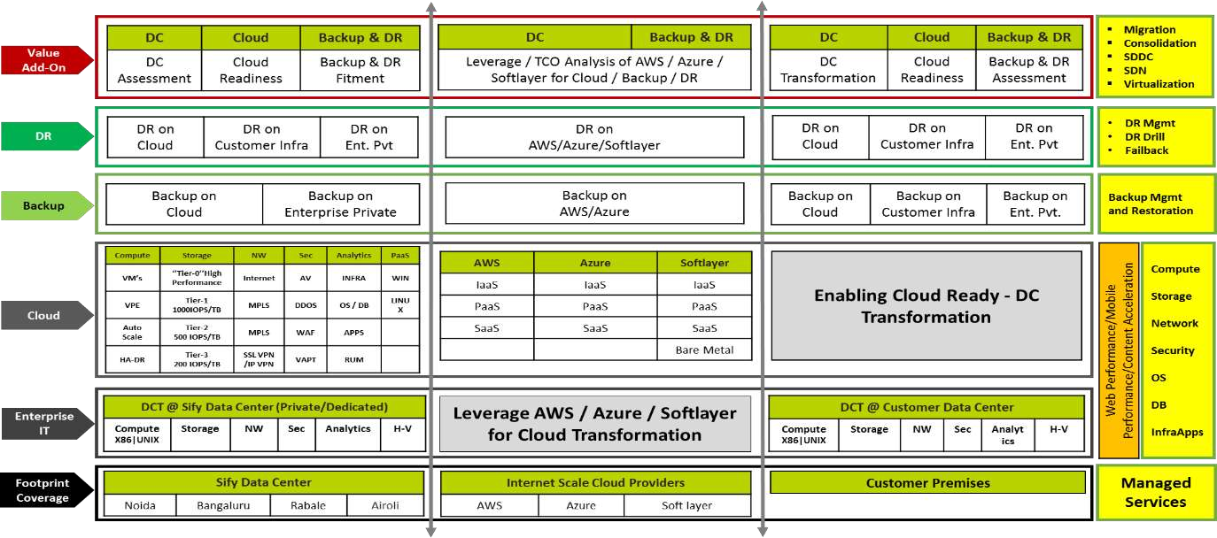
DATA CENTER TRANSFORMATION ALIGNED SERVICES

Slide 14

MANAGED Services PORTFOLIO
Data Center-Centric Services
End User centric services
20 years of experience in DC and Cloud management
15 years of experience in securing enterprise IT
Experience in running enterprise Apps and SaaS
Digital Experience Management using Global Platforms
CLOUD & DATACENTER CENTRIC SERVICES
Cloud assessment & migration
DC (Colocation / White Labelling)
CloudInfinit multicloud CMP
CloudInfinit enterprise Cloud
Hosted SAP Cloud/ Azure Stack/ Oracle Exadata as a service
Multicloud managed services
Oracle, AWS, Azure Cloud services
MANAGED SECURITY SERVICES
Implement consistent set of controls to prevent security threats
Continuously monitor to detect security breaches
Tactical threat containment and automated response
APPLICATION & PLATFORM SERVICES
Design and implementation of SaaS (ForumNXT, SFFNxt, iTest, LMS)
Implementation of enterprise apps (S4HANA, O365, Dynamics CRM)
Application migration: on-prem to Cloud
App modernisation
Big data and Analytics
END USER SERVICES
Digital Experience Management Platform
Operational Data Analysis & Insights
AIOps enabled Service Desk (including application L0 support)
Desktop as a Service
Workplace as a Service
DC ASSESSMENT, SERVER FARM OPTIMISATION, CLOUD STRATEGY,LICENSE OPTIMISATION (HARDWARE & SOFTWARE), APPLICATION AUDIT
Notes:
Sify offers a plethora of managed services around infrastructure management, spread across Data Center centric services and end user centric services. Intrinsically, the former involves managed services around cloud and DC centric services, security services and application & platform services.
In terms of Cloud and DC centric services, these involve DC and Cloud assessment and migration services, colocation services, multi cloud managed services around Sify’s enterprise cloud and partner public clouds.
In terms of managed security services, it involves proactive threat management and detecting security breaches.
In terms of managed application and platform services, it involves SaaS/enterprise apps implementation and cloud migration, app modernization and data analytics.
In terms of end user services, it involves Digital Experience Management, deriving data intelligence and delivering desktop and workplace as a service.
Other services include comprehensive DC assessment, Server Farm optimization , Enterprise cloud strategy management, hardware and software license optimization and application audit services.

Slide 15
Digital Services

Slide 16
Sify Cloud enhanced services
Value-Chain
Transformation
Intelligent
Applications
DevOps
Conversational AI
DIGITAL SERVICES
RPA & Cognitive
Automation
AI (Facial Recognition /
Text Extraction)
Analytics
Machine Learning

Slide 17
Common challenges addressed by Sify Value Chain
IT audits are expensive and not comprehensive
DevOps and Cloud initiatives are expensive
Security controls are manual and reactive
Manual, inaccurate and delayed MIS reports
Hard to identify bottlenecks, gaps and pitfalls in software delivery
Lack of standardization in DevOps and DevSecOps tools
Delays in Cloud and DevOps transformations
Delays and cost overrun with software initiatives
Measuring team productivity
is difficult
Compliance reporting is manual
and expensive

Slide 18
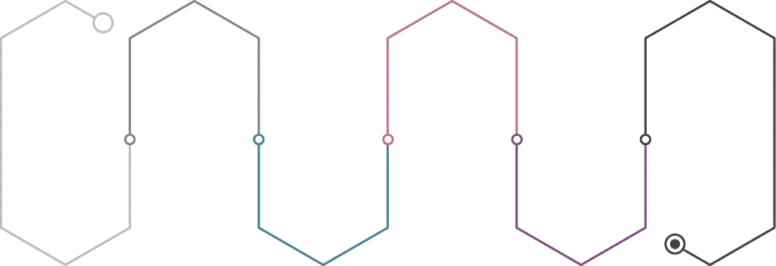
Sify Value Chain Platform - A truly All Ops Coverage
DevOps
ComplianceOps
AIOps
Tool Chain Setup
Continuous Integration
Continuous Deployment
Compliance Automation
Cost/Workload Optimization
Incident Prediction / Remediation
DevOps Prediction
Environment Provisioning
Application Provisioning
Security Assessment
Security Testing
Track Atomic Progress
Measure KPIs
CloudOps
SecOps
GovernanceOps

Slide 19
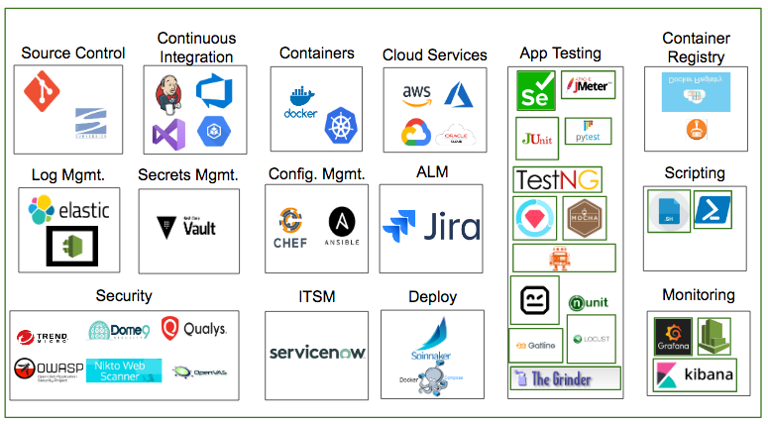
Prebuilt tools Out of the Box, accelerate your implementation
Sify Value Chain also gives a flexibility to plug & play and add any more tools that are not available “Out-of-the-box”
50+
Tools Integrated (Plug & Play)
600+
APIs Integrated
200+
Cloud Services Enabled
500+
Security Policies
100+
Design Best Practices
20+
AI/ML Models

Slide 20
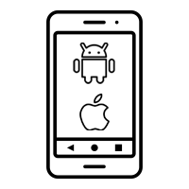



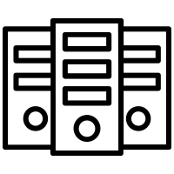

Modern Applications - Sify’s Center of Excellence
Hybrid Mobile Apps
Native iOS Mobile Apps
Native Android Mobile Apps
Interactive 3D, VR, AR & MR Apps
Server Side Applications
AI, ML & Deep Learning
Computer Vision Natural Language Processing & Chat Bots
Html5 | jQuery | Cordova | Onsen UI | AngularJS | Ionic | NativeScript | React Native
Objective-C | Swift
Java
Unity 3D | 3ds Max | Three.js
Node JS | PHP | Angular
TensorFlow | OpenCV | Tesseract | AWS Recognition | AWS Lex

Slide 21
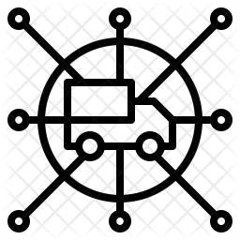


ForumNxt Portfolio
Distributor Konnect
Value Added Services
Mobility
Corporate Portal
Dealer Portal
Corporate Salesman
Dealer Salesman
Merchandising Application
Perfect Store-Image Recognition
AI/ML Chatbots
Gamification and Loyalty Programs
eRetail – Retailer Enablement Program
Intelligent Merchandising – Marketing Productivity
Notes:
(3 Minutes) - Features
This brings us to the offering's portfolio of ForumDIGITAL, which is categorized into 4 components.
The first bucket, Dealer Konnect, consists of the web portals, to be used by the corporate and the distributor users. Corporate users on their portal can perform various activities, around planning, execution, tracking, governance and control of the activities and tasks performed by the distributor portal.
Distributor portal on the other hand, is more about the transactions, where it can be used to create purchase orders, sales invoices, credit & debit notes etc. Distributor portal also gets to monitor and plan the movements of its salesman, which brings us to the next bucket, Mobility.
This bucket consists of 3 mobile application, aimed at corporate salesman, distributor salesman and merchandiser. With the reins controlled by the corporate and the distributor portal. Corporate salesman and merchandising application are tagged to the corporate portal, where a corporate salesman must perform various activities on behalf of the company, like collections from the distributors, creating purchase order for the distributor and so on. Where as, merchandising application helps the merchandiser to perform his tasks in the market, like ensuring planogram compliance, share of shelf, display equipment's condition check and so on.
Distributor salesman mobile application on the other hand is tagged to the distributor portal, which enables the salesman to service the market on behalf of the distributor. Collections, taking sales order from the retailers, stock entry are some of the tasks that this application helps him to do.
We then have Analytics, which consists of data visualization reports in form of interactive BI dashboards to provide a holistic view of the company’s performance.
And then the Value-added services, which speaks about the advanced digital offerings in the portfolio, that complements the core product and provide extra value in multitudes. We have Image recognition, to define a perfect store and process the defined metrics every time an image is clicked to have a standard measurement of various parameters required in a retail store to complement our merchandising application
AI/ML Chatbots: AI enabled chatbots, where a user can ask questions from the chatbot to get a data backed answer. These chatbots can help the salesman in the market, or the distributors in performing their tasks on the distributor portal. These chatbots can have several use cases and can be very versatile in helping the users.
Gamification and Loyalty Programs: Gamification brings the sales team on one platform and gamify their jobs, which leads to a more productive working environment, where the motivation of the field force is fueled by positive reinforcement. A company can employ various use cases in employing gamification for their field force; dashboards, challenges for the quarter or month, points earned etc. to name a few. Loyalty Programs, is a process designed for logical allocation and redemption of the loyalty points to various stakeholders in the supply chain. These programs have just one objective, that is to encourage the usage of this application, so that the corporate can have an accurate picture of the performance.
eRetail, is our retailer application to bring the retailer into the technology ecosystem, this application allows the retailer to place the orders directly to the distributors, which makes it easier for the companies to manage the remotely located retailers, whom the distributors are not able to service frequently. Apart from ordering, there are many other features in this application, like feedback, view of active schemes, notifications etc.
And, Intelligent Merchandising, is to to optimize the communication to the consumers by the brands, this offering covers Digital asset management and intelligent campaign management to efficiently manage the ad campaigns and the content thus ensuring marketing productivity.

Slide 22
Smart Network Services

Slide 23



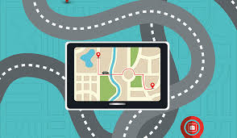
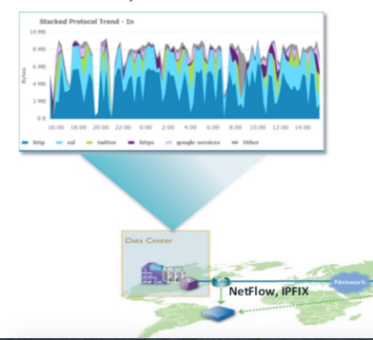
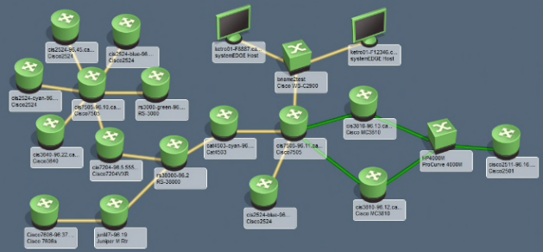
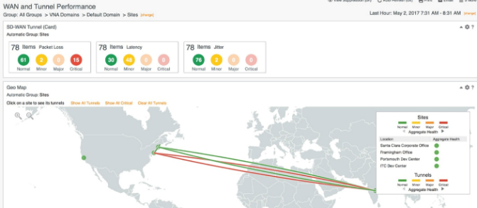
Key outcomes expected
Improve End User experience through improved network reliability
Capable, mature and experienced partner
Reliable Partner for Outsourcing complex task & in return get SLA commitment
Cost & solution optimization through effective utilization of network, Data center & cloud assets
Deep Insights into the network and Future transformation
24x7x365 NOC Operation
Contextual dashboards for easy snapshots across the network

Slide 24
SIFY’S APPROACH TO network TRANSFORMATION
Active – Active Dual Circuits
Dual clouds single ownership
Unified access design
Simple & scalable network model
Ease of governance & admin
Optimized network
Application aware routing
Provider agnostic design
Embedded security
Better analytics
ROBUST LASTMILE DESIGN
INTELLIGENT EDGE NETWORKING (SD-WAN)
PROCTIVE NETWORK MONITORING & MANAGEMENT
OUTCOME OF STEADY STATE NETWORK DESIGN
24x7x365 Proactive Network management, Monitoring & reporting
Trained resources for complex networks
99.99% uptime assured for NOC
Constant network optimization
High Availability
Optimum resource utilization
Application aware setup
Robust support mechanisms
Single ownership
Digitally transformed network

Slide 25
SD-WAN HENCE IS enabling WAN Transformation
Customers can now utilize any Service provider, any transport type (MPLS/ILL/BB/4G-LTE) suiting Applications in their network
Allowing Application Prioritisation against only QoS
Cloud based Centralized Management platform provides real time visibility and unified management
SD-WAN overcomes
the shortcomings
of legacy WAN architectures
Rapid and scalable deployment of network services with Zero Touch Provisioning , hence providing Agility
SDWAN supports integration with legacy network architectures
All WAN links can be aggregated to give unified WAN pipe and links can be used in active-active

Slide 26




Sify Managed SDWAN
ONE
MANAGEMENT
24/7 Managed services focused around outcomes
Watch
Incident
Problem
Project
Field
Analytics
ONE
POLICY
Sify Cloud
Unified secured policy across the network & locations
NG Firewall
Content filtering
Intrusion prevention
PKI
ONE
NETWORK
SLA backed network services connecting users to DC/Cloud
Intelligent Routing
Network Reliability
Network Optimization
Encryption
Sify MPLS/Internet/BYON
Sify MPLS/Internet
Sify CloudConnect
Sify MPLS/ BYON
CE
CE
CE
CE
CE
Branch
Corporate/HO
Factory
Cloud
Data Center
Notes:
Sify’s Managed SDWAN deployment changes the way WAN network used to work.
Sify has got unique experience in managing multiple Telecom Service providers and OEMs across the industry and can offer single ownership & unified SLA.
Cloud based Centralized Management platform provides real time visibility and unified management
Sify has inhouse integrated NOC & SOC operational 24x7 which is manned by highly skilled resources. The Tools & ITIL framework ensures seamless services for customers.
Sify can provide SDWAN solution irrespective of Service providers and media types and provide End-to-End Managed Services Model- Edge CPEs, Subscription, Installation & Support.
Customers can now utilize any Service provider, any transport type (MPLS/ILL/BB/4G-LTE) suiting Applications in their network.
SDWAN supports integration with legacy network architectures. Customers get clear visibility of site wise utilization of various Apps. App based SLA can be implemented.
This End to End managed services & advanced Analytics allow customers to focus their Application performances rather than worrying on underlying media.

Slide 27
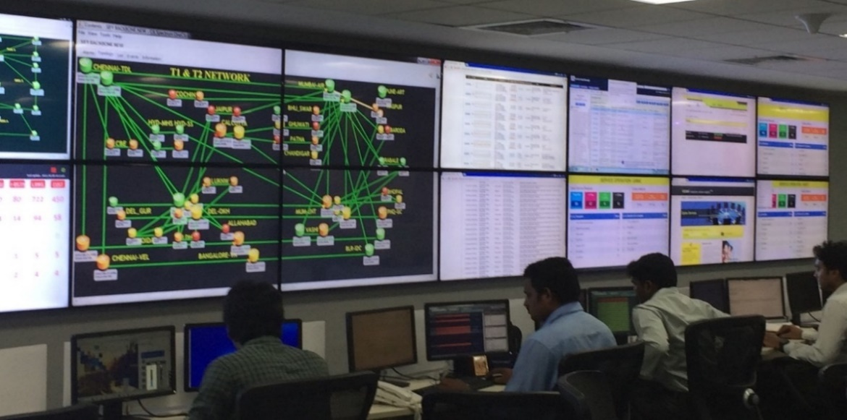
OUR SERVICE FOCUSED OPERATIONS CENTRE
2333 POPs
4000 Infra Links
9000 IP/MPLS Nodes
120022 Wireless AP
800+ Managed Network customers
96000+ Managed WAN links
60650+ Managed CE
7000+ Tickets/day
100+ circuits /day
400+ Skilled people
Service desk
Managed LAN
Fault Management
Managed WAN
Performance Management
Shared NOC
SLA Management
Captive NOC
Capacity Management
Managed Infrastructure
Network Security
Managed Security
Regulatory Management
NW INTEGRATION
Change Management
PROJECT DELIVERY
VOICE
TELECOM
ENTERPRISE
SECURITY
FACILITY
POPs

Slide 28
proposed network management Deliverables
Link Management
  24x7 Monitoring
  Error Logs and port errors
  Link Configuration
  Root Cause Analysis
  Service Provider Management
Router Management
  24x7 Monitoring
  High Availability Configuration
  Routing
  QOS
  Backup Management
  IOS Upgrades
Proactive Monitoring
  Faster identification of incidents
  Detect problems before they have bigger impact
Incident Management
  SLA driven incident response
  Reduced time to repair for customer / Network outages
  Incident prioritization for special attention
Configuration Management
  Faster response time for device crashes
  Configuration readily available for restoration
Problem Management
  Reduce number of issues in the network
  Permanent fix to repeating incidents
Change Management
  Planned approach to changes
  Scheduled to reduce customer impact
  Advanced notification to customer for better planning
Asset Management
  Control on inventory of IP Phones & routers
  Performance of asset usage & life cycle
Access Management
  Control on access
  Differentiated user profiles
  Accountability
  Allowing right users via 2FA upon remote VPN usage

Slide 29
Security Centric Services

Slide 30
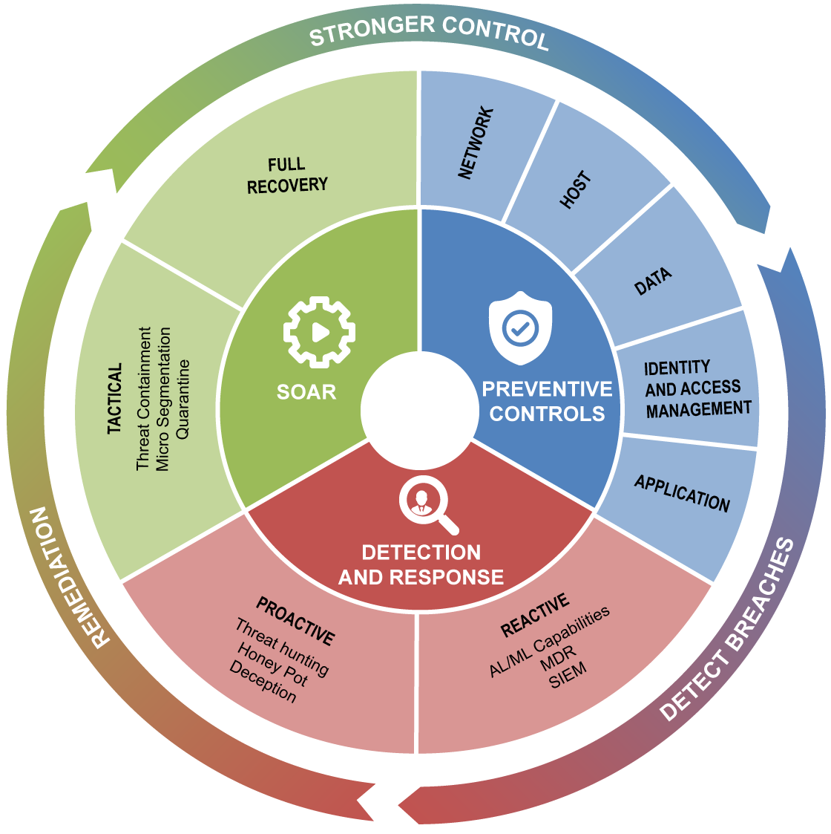
The changing face of security
Implement robust preventive controls for
security across the spectrum
1
Implement proactive and reactive techniques
to detect vulnerabilities
2
Isolate and contain threats; recover security of IT assets
3
Incorporate up to date threat intelligence to reinforce preventive controls
4

Slide 31
SIFY Holistic security strategy
Prevent
Predict
Detect
Divert
Decide
Defeat
Implement zero trust models
Apps & network micro segmentation
Micros security services
Security controls testing
AI enabled behavioral prevention
Forward deployed threat intelligence
High accuracy prediction
Attack infra prediction & attribution
Aggregate and dedupe threat intel
Integrate with existing controls
Breach prediction and avoidance
High fidelity alerts with actionable insights
Behavioral anomaly detection
Situational awareness
Continuous monitoring and GRC assessment
Dynamic rolling baseline and lateral movement detection
Detect unknown threats and zero days
Divert threats and minimize impact
Integrate deception with FW/IPS DNS
Integrate deception with NAC to isolate lateral movement
Collect TTP’s and IOC’s from adversaries
Force adversaries to waste time and resources
Periodic cyber range training
Visual threat /incident prioritization
Build or invest in MDR
Develop SOAR practice
Build data lakes for analyzing IOC/IOA and TTPs
Prioritize threat mitigation with AI
Use identified IOC’s and TTPS to immunize systems
Leverage SOAR technologies to automate remediation
Leverage EDR platforms to search and defeat using IOCs
Feed IOCS to protection layer to improve resilience
Integration with existing security controls
Breach prediction and avoidance

Slide 32



















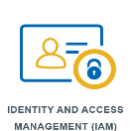








Sify engineered security services (Cloud/DC)
Security Services Stack
for Sify DC & Cloud
Security Services Stack
for any cloud
Sify GoInfinit
Cloud
VPI | VPE | Private
Public &
On-premise Cloud
AWS | Azure | VMware
Cloud native
Security services
VPDC FW
Services
Web App
Firewall
Network
IPS
VPN GW
Cloud DDOS
Protection
PIM
Log Mgmt.
SIEM
Cloud CDN
WAF
Micro-segmentation
NBA
Security Asset
Management
Key Mgmt
Services
Deception
MFA
CASB

Slide 33
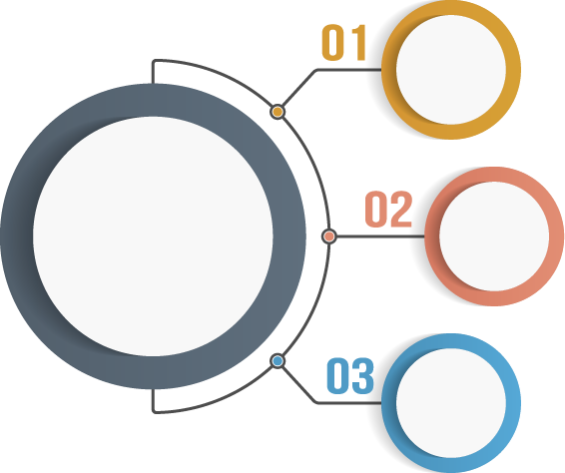




Security Operations Centre - Delivery Model
Captive SOC
Remote SOC
Hybrid SOC
Notes:
SOC is a combination of MSS as well as MDR and these are the various delivery models that Sify provides.
Captive SOC
Customer requirements are gathered
Solutions are tailored with the help of the OEM’s to meet the customer requirements
Installation and configuration is completed along with necessary documentation
Dedicated resources are hired and place post the required knowledge transition
Hybrid SOC
Customer requirements are gathered
Solutions are tailored with the help of the OEM’s to meet the customer requirements
Part of the solution is installed and configured along with necessary documentation
Part of the solution is delivered as a service from Sify Security as a Service Cloud
Dedicated resources are hired and placed at customer premises for business hours support
Non-business hours support is extended using the remoted shared support team
Remote SOC
Customer requirements are gathered
Solutions are tailored with the help of the OEM’s to meet the customer requirements
Part of the solution is installed and configured along with necessary documentation
Part of the solution is delivered as a service from Sify Security as a Service Cloud
24x7 support is extended using the remoted shared support team

Slide 34
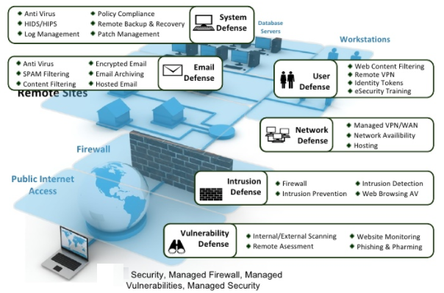
Managed security services
Notes:
Sify MSS team manages all the technologies and products that are part of customer security landscape
MSS team delivers the support as per the agreed SLA with the customer for the agreed scope of work

Slide 35

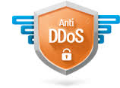






Cloud Infrastructure Security - Multilayer Defense
Access Layer
Network Layer
Platform Layer
IPS
DDOS
VA/ PT
UTM
Anti-virus/ Anti-Bot
Protection
WAF
SSL-VPN
PIM
Content Filter & Proxy
Security Monitoring & Operations(SEC-OPS)

Slide 36



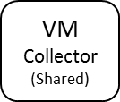
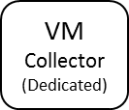








SIEM - SECURITY EVENT MONITORING & INCIDENT RESPONSE
Service Features
Service Design
Security Event collection and monitoring
Export events from agentless and agent-based environments
Supports event collection and parsing for 200+ data sources
SLA-driven Event Monitoring and Incident response based on criticality
Self-service, online reports and executive, compliance dashboards
Extension to support Managed Tenants of CloudInfinit, Private, Public and Collocation services
Security
Operations
Center
Incident
Monitoring
& Response
Centralized Security Manager
(Multi-tenant, SOC Managed)
Event
Correlation
& Analytics
Cloud Infinit, Private, Public Cloud & AWS tenant Management networks hosting connector VMs for event collection
Event
Collection
& Parsing
Network & Security appliances
Data
Sources
App/Db/OS instances
Data sources supported across IT infra ecosystem
Notes:
Sify MSS team manages all the technologies and products that are part of customer security landscape
MSS team delivers the support as per the agreed SLA with the customer for the agreed scope of work

Slide 37









SIEM Architecture
Single Pane of Glass Security Dashboard
Sify Security
Operations Center
CSP
Unified Security Portal
Threat & Vulnerability Alerts
Central
Database
Security
Analysts
End Point Security Alerts
Access & Application Security Alerts
Incident Data
Reporting
Engine
Sec Event Monitoring
Data Protection Alerts
- - - - - - - - - Secure Connectivity - - - - - - - - -
On-Prem DC
Correlated Events
System and Application alerts
SIEM
Service Management
Incident
Tickets
Extending Service Center Console
Log monitoring & Event Analysis Alerts
Other Security Devices
Notification
Incident Alerts/ Remediation Information
Status Reporting
Notes:
Sify MSS team manages all the technologies and products that are part of customer security landscape
MSS team delivers the support as per the agreed SLA with the customer for the agreed scope of work

Slide 38




New Age Cloud security platform - Unified view
Secure Access Service Edge (SASE)
Secure Web Gateway (SWG)
Cloud Security Posture Management (CSPM)
Zero Trust Network
Access (ZTNA)
Cloud Access Security Broker (CASB)
Cloud Applications
Managed
Unmanaged
Websites
Public Cloud Environments
Private apps
Private apps
Private Cloud
(data center)
API-enabled
Protection
Risk Insights
Reverse Proxy
Cloud-Native Proxy
IaaS Storage-Scan
&
Cloud Security Assessment
Zero Trust Network Access
Security Cloud
CASB-API
NG Secure Web Gateway
CSPM
Private Access
NewEdge
Single console
for security administrators
Users from unmanaged devices
Users from managed devices
Notes:
Sify MSS team manages all the technologies and products that are part of customer security landscape
MSS team delivers the support as per the agreed SLA with the customer for the agreed scope of work

Slide 39
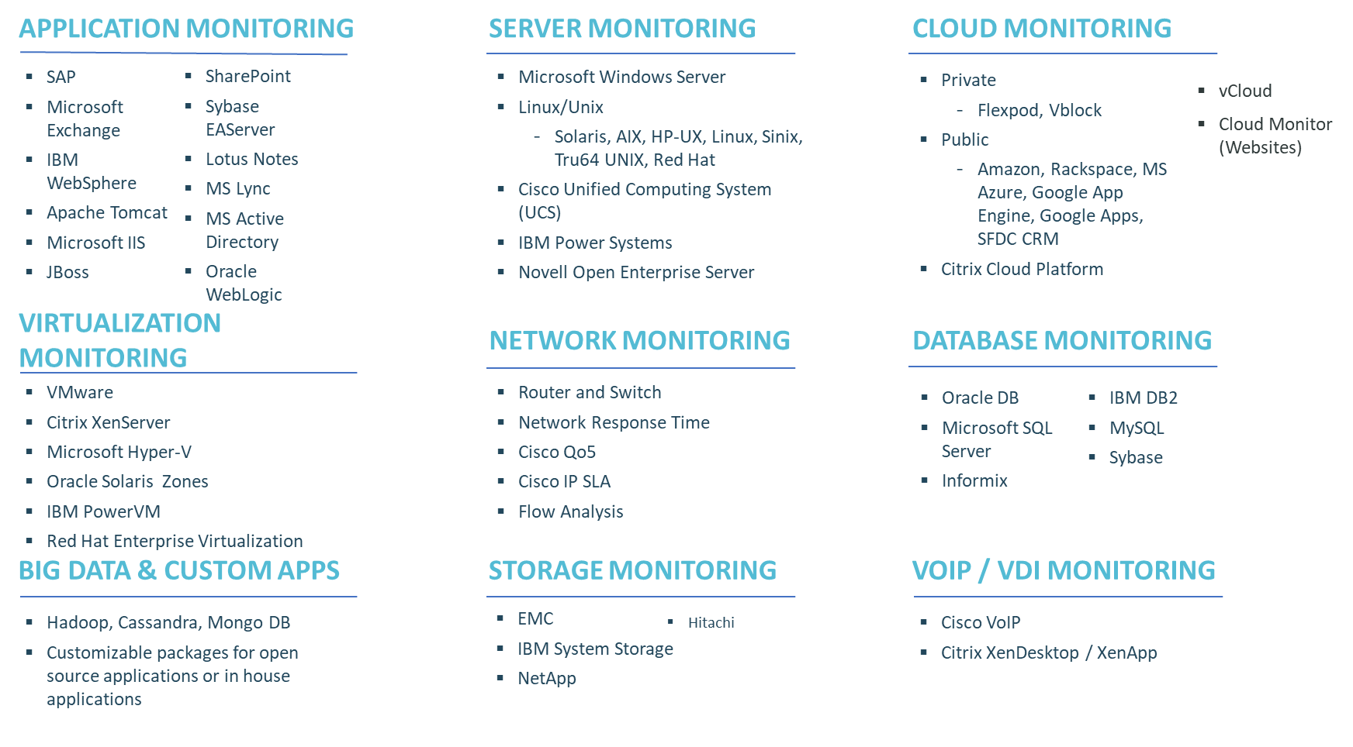
MONITORING TOOLS - CA UNIFIED INFRASTRUCTURE MANAGEMENT

Slide 40
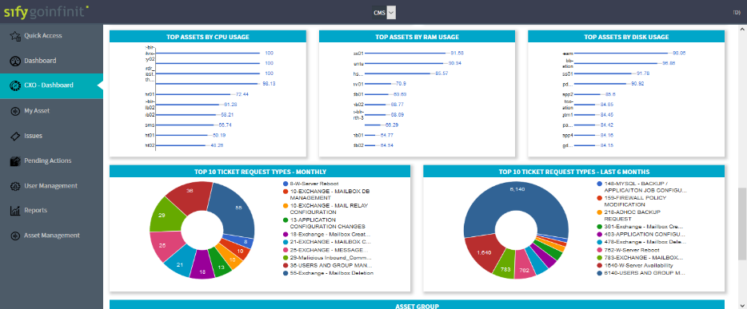
ServiceNow Customer CXO Dashboard

Slide 41
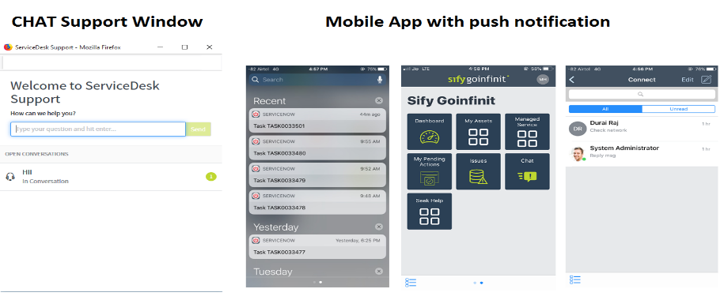
Customer support – Mobile App / Chat in ServiceNow

Slide 42
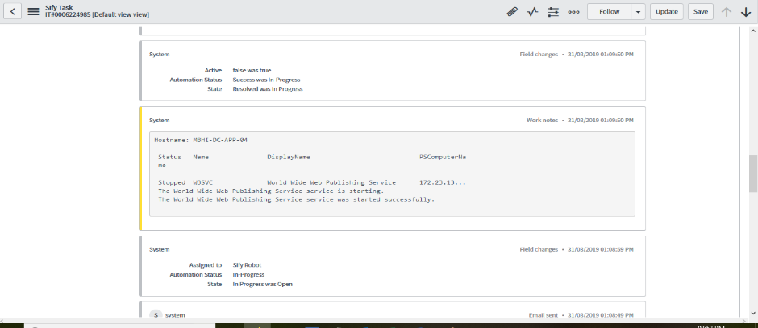
Automation - Service Restoration using Bot
Service disruption alert automated using Bot
Customer Delight:
Service is restored in 1 min, as compared to >20 min earlier
Operation advantage:
Achievement of SLA
No human intervention

Slide 43
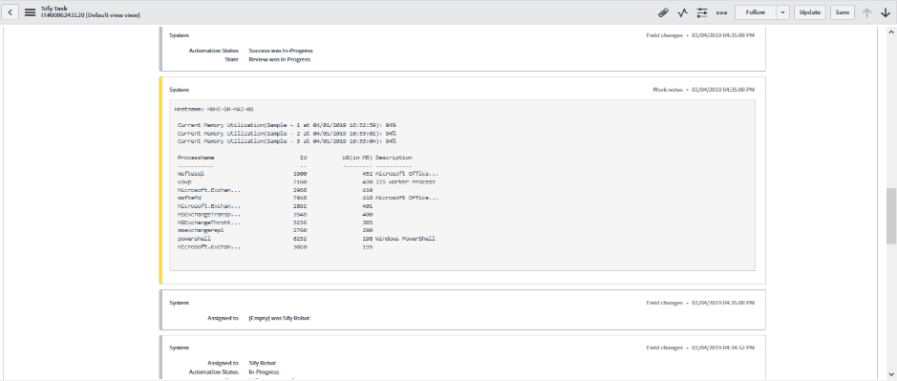
Partial Automation – Thresholds violation
Bot collects required information from the endpoint device and basic triage is performed.
Customer Delight:
Faster response and resolution
Operation advantage:
Achievement of SLA
Eliminating effort of L1 to login to endpoint

