Slide 1

Proposal for DC-NDR in Sify’s SAP Cloud Mahindra & Mahindra
January ‘21

Slide 2
AGENDA
Executive summary
Understanding of current SAP infrastructure
Design and Architecting right choice of Sify Enterprise Cloud platform
NDR & BCP Requirements
Enterprise Security Architecture
Migration approach and plan
END-TO-END TECHNICAL MANAGEMENT – BASIS SUPPORT, MANAGED SERVICES
WHY SIFY ?
2

Slide 3
Executive summary
Mahindra & Mahindra Ltd. (M&M) currently has a large SAP productive landscape to support their key business functions in their Automotive, Farm Equipment and few other group companies. The core application is SAP S/4 HANA 1709 of 12TB database with other surround systems like SAP SRM, SCM, BW, BO, EP, Fiori, etc. The entire SAP Infrastructure is hosted on premise at their MITC office along with a NDR set up 1 km away at Kandivali with near real-time replication.
As a part of their strategic direction to move to cloud, M&M intends to migrate and deploy their entire SAP infrastructure in DC and NDR out of a cloud platform.
Sify being a Certified provider of SAP cloud platform is keen to partner with M&M to design and architect the desired cloud infrastructure for hosting M&M’s SAP DC and NDR. Sify with its rich experience in SAP migrations will migrate all M&M’s SAP systems to Sify’s cloud platform and provide end-to-end Managed Services, Security Services and Basis Support.
Sify’s solution described in detail in this document consists of DC and DR located out of Sify’s Data Centers at Airoli and Rabale respectively connected by a high throughput low latency network which will be ideal for the DC – NDR near real time synchronization.

Slide 4


Project Objectives
DC – NDR on SAP Cloud platform
Operations & Managed Services
Managed Network
Security Services
Basis Support
Seamless migration with minimum down time
Design & Implementation Of Scalable, Highly Available & Interoperable ICT Infra
End-to-end secure hosting of SAP Landscape
Near zero data loss solution with 2-way replication across DC-NDR for all SAP Production systems
Comprehensive & proactive O&M

Slide 5




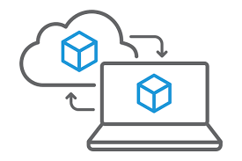


Project Scope
Objectives
Cloud Infrastructure Setup
DC, Near DR in Service model
Establishment of DC and NDR
2 Way replication and Meeting RTO & RPO
Backup of the data
Network & Security
Enhance Network experience through Metro Network
SLA Base operation & managed Services
1
Implement
O&M
Installation
Configuration
Cluster
Manage
Operate
Basis Administration
7
2
NDR
6
3
Migration
Sync replication
High availability
Replication
Switchover
5
4
Telecom
MPLS
Internet
P2P
Security
Detect
Protect
Respond

Slide 6
High level solution approach
Understanding of current SAP landscape
Design and Architecting right choice of Sify Enterprise Cloud platform
NDR & BCP requirement (meeting RTO RPO objectives with high throughput low latency Sify MetroConnect)
Enterprise Security architecture
Migration approach with minimized downtime
SLA based Managed Services
  Guaranteed uptime of 99.9 % for DC – NDR landscape
  RPO RTO for DC –NDR setup is synchronized near real-time
  Basis Support and Administration for entire SAP landscape in DC- NDR

Slide 7
Critical success factors & sify’s relevance
Critical Success Factor | Sify Experience & Relevance
RIGHT CHOICE OF HYBRID CLOUD PLATFORM | SAP Certified Provider of Cloud & Infrastructure Operations for more than 6 years Providing SAP Cloud Infrastructure to 40+ customers SAP Certified Provider of SAP HANA Operations
SAP MIGRATION EXPERIENCE | Rich experience of SAP Migrations across various cloud platforms SAP Certified Provider of Application Operations for SAP S/4 HANA
NDR & BCP EXPERIENCE | Offering Disaster Recovery-As-A-Service for SAP Cloud Infrastructure to many customers Processes comply to Industry standards prevalent for RPO and RTO
SINGLE POINT OF OWNERSHIP ACROSS ALL SUSTENANCE & MANAGED SERVICES | Matured SAP Practice with deep expertise in Migrations and SAP Application Management Supporting many customers for SAP Basis Administration across multiple platforms Adhere to industry standards like ISO 27001, ISO 9001 and ISO 20000 based service delivery
TCO OPTIMIZATION | Sify owns most of the Assets to drive best value and lower cost
SERVICE PROVIDER’S COMPETENCIES AND EXPERIENCE TO MANAGE DATA CONVERGENCE | Sify experiences in managing DC, Network, Hybrid Cloud & Multi Cloud solutions including Data Governance across people, processes and technologies to manage and protect company’s data assets on Cloud.

Slide 8
Scope of work
DC & NDR CLOUD PROVSIONING
SAP MIGRATION
CLOUD & BASIS MANAGED SERVICES
Assessment of the current infrastructure
Requirement Finalisation for DC & NDR Cloud & Design validation
Implementation & configuration of scalable Sify Cloud
Configure virtual machines (VMs)
Data provisioning using storage architecture
Configure Network connectivity
Configure Security
Configure Backup
Provision Telecom Connectivity
Migration Planning
Logical Grouping of Applications for Migration
Configuration of Replication for SAP environments
Migration of all SAP Systems
Setup NDR for the Production SAP landscape
Setup Far DR for Production Environments
Management Platform to orchestrate, manage, automate provisioning, de-provisioning of cloud infrastructure consisting of VM’s, Storage, Backup, Network, Security
O/S Managed Services
VM OS patch management
Basis Support & Administration
Drills for NDR

Slide 9
Understanding of current
SAP infrastructure

Slide 10
Productive SAP applications
The SAP landscape consisting of following systems running on HP Superdome server, Lenovo and Huawei:
S4 HANA 1709
SAP SRM - Supplier Relationship Management
SAP SRM - Portal
SAP Enterprise Portal
SAP Web-dispatcher – EP
SAP Process Orchestration
SAP PI Web-dispatcher
SAP Business Object Enterprise
SAP SCM Portal
EWM Swaraj
SAP BODS
SAP IBP – HCIDS
SAP SCM Portal
SAP GRC Access Control
SAP SOLUTION MANAGER
SAP BW - Business Warehouse
SAP Fiori
SAP Web-dispatcher - FIORI
SAP ADS
SAP DBM - Dealer Business Management
SAP ERP SLO
SAP NLS
SAP DMS
SAP Digital Signature
SAP Supply chain APO
+ HSM Appliance

Slide 11
Present SAP Landscape
DC – MITC
NDR – Kandivali Plant ( 1 KM Range )
S.No | Description | Quantity
1 | Number of Virtual Instances | 102
2 | Operating System | SUSE – 90 Window-12
3 | 38 Database Instances | HANA -12 Non HANA-17
S.No | Description | Quantity
1 | Number of Virtual Instances | 75
2 | Operating System | SUSE – 70 Window-5
4 | 23 Database Instances | HANA-10 Non HANA - 4
Average Data growth per day 20GB
Peak Working hours are 8 am to 8 pm
Backup is done as a D-D-T mechanism with 7day retention
2 restore drills per year
Far DR in Chennai

Slide 12
Design and Architecting right choice of Sify Enterprise Cloud platform

Slide 13
solution design considerations
Scalability
Availability
Sify Enterprise Cloud provides scalability to provide continuous growth to meet the requirements and demand coming in for applications.
Computational power within one operating environment has been virtualized and supports vertical scaling also horizontal scalability (leveraging multiple systems to work together on a common problem in parallel) is supported.
Clustering has been the mainstay for ensuring availability at all times.
Affinity rules and high availability rules are created in resource pool
Separate cluster will be configured for database workloads and SAP Apps & NON-SAP Workloads.
Interoperability
Manageability
Interoperability is achieved using multi-OEM environment.
Multiple OEM Operating systems and Storage interact seamlessly with each other and support the open architecture solutions.
Centralized management by Sify CI Management Portal.
Centralized Resource Monitoring.

Slide 14
key design considerations & highlights
Key Design Considerations
Highlights of Proposed Solution
TIER-III/TIA942 Certified Facilities
High-Availability
Scalability
Interoperability
Security
Managed Network
NDR Solution
Simplified Management
Continuous Replication to meet RTO and RPO
Reduced Infrastructure footprint
24x7 Operations to meet SLA
DC and NDR Certified Facilities
High-availability in design
Scalable Architecture
Interoperable solution based on open architecture
Secure by design
NDR Simplified Management
No disruption in existing Data center to provide minimum downtime
Virtualization is proposed to reduce footprint
Comprehensive 24x7 Operations

Slide 15
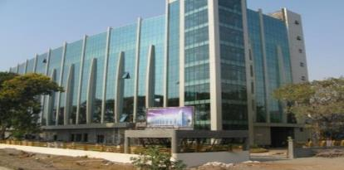
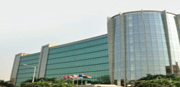
Proposed DATA CENTERs
DC - Airoli, Navi Mumbai
NDR- DC Rabale, Navi Mumbai
Site address:
Sify Technologies Limited,
Reliable Plaza, K10 Thane Belapur Road, Navi Mumbai -400710.
Site address:
Sify Technologies Limited,
Plot No. R-847, 1/, T.T.C. Industrial Area, MIDC Industrial Area, Sector 2, Rabale, Navi Mumbai
DC facilities are Tier 3+ compliant
DC – NDR within 5 to 10 KM distance

Slide 16
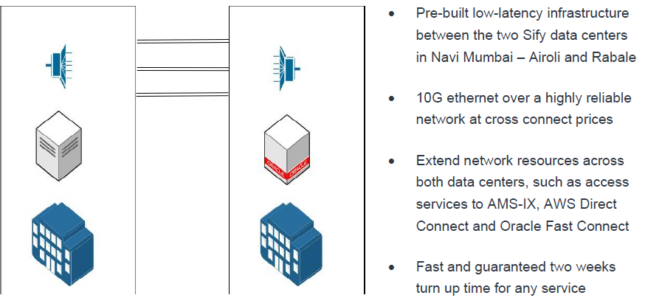
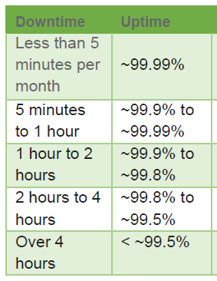
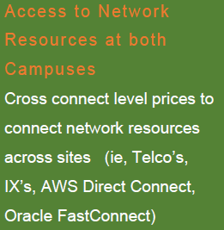
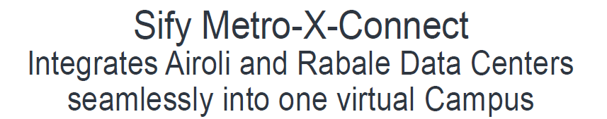
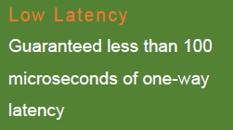
Add diagram for Airoli – Rabale Metro cluster – AMIT kataria

Slide 17

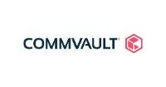



COMPUTE/STORAGE/BACKUP/NDRM - Solution Summary
Requirement
Proposed Solution
Installation & Configuration of Compute Solution
Installation & Configuration of Storage Solution
NDR Management Solution
Installation & Configuration of Backup Solution
Data replication between DC, NDR
Proposed Scalable infra
Proposed enterprise grade storage fabric for Backup in DC & NDR
Proposed Native tool for replication to NDR
Proposed enterprise Backup Solution
Virtual Environment in DC & NDR with VMware
Key Technologies
Solution Highlights
Integrated Compute/Servers/Network
Scalable at Each Layer
High Availability Configured at HA and application level
Near Disaster Recovery solution
Standardized Backup Solution with Primary DC

Slide 18
NON-HANA and application servers SIZING for DC
Sizing | DC
 | Existing |  |  | Proposed
 | SAPS | Server | Total SAPS | SAPS | Server | Total SAPS
APP SERVER | 86,100 | 18 | 15,49,800 | 92,560 | 18 | 16,66,080
 | 1,15,000 | 1 | 1,15,000 | 1,22,410 | 1 | 1,22,410
NON HAHA DB | 87,570 | 5 | 4,37,850 | 92,560 | 5 | 4,62,800
Storage |  | SSD (TB) | 120 | SSD (TB) | 120
 |  | SAS (TB) | 140 | SAS (TB) | 140

Slide 19




Infra configurations in DC : HANA and non-hana
32C (5218) / 128GB / 2 * 300GB HDD / 4 * 10G / 92560 SAPS (Production)
32C (5218) / 384GB / 2 * 300GB HDD / 4 * 10G / 92560 SAPS
2P / 40C (6248) / 384GB / 2 * 300GB / 4 * 10G / NO OS / 122410 SAPS
NON HAHA DB
Virtualized Application servers
NON HANA application Server
Physical (5 nodes)
VM VM VM VM
VM
(18 nodes)
. . . . . . . .
16G FC Fabric in HA
10/ 25 G Ethernet Fabric in HA
(8276L - 28 Core) / 224 Core / 12TB HANA TDi Server with OS (1 no.)
HAHA Production 01 Upgradable up to 24 TB
8260L - 24 Core) / 192 Core / 12TB HANA TDi Server with OS (1 no.)
HAHA NON-Production Upgradable up to 24 TB
8260L / 96 Core / 4.6TB HANA TDi Server (2 no.)
HANA SRM 01 HANA BW 01 Upgradable up to 6 TB
Storage 01
120 SSD for HANA Nodes
140 TB SAS (Effective) for Appls

Slide 20
airoli DC - Fact Sheet
Building Features Floors in building: 7 Floors, Reinforced concrete structure building Total Area : 1,20,000 Sq ft Raised Floor area : 45,000 Sq ft Server Hall Location: 4th to 6th Floors Slab to Slab height: 3800mm Raised Floor Height: 700mm Power System Incoming supply: 110KV dedicated substation Total Designed Power Capacity: 10.5MVA Service Provider: MSEB UPS Configuration: N + N Battery Backup : 10 mins on full load Distribution: Dual Feed up to Racks Generator Configuration: N + 1 Fuel Storage : 24 hours on full load | Architectural & Building Structure Seismic Zone: Zone III Seismic Protection: Building strengthened as per IS 1893: 1984 criteria for earthquake resistant design of structure Structural Floor Loading : 1500 Kg/Sq mt for 5th & 6th Floor & 750 Kg/Sqmt for 4th Floor Freight Elevators: 2 Ton & 1 Ton Passenger Lifts : 2 numbers Perimeter Wall & Doors : 2 Hours Fire rated Cooling System Cooling System : DX Based machines CRAH Redundancy : N+1 Temperature : 22 +/- 2 deg C Humidity : 50 +/- 5 % RH Dust Control : Less than 5 Micron Integrated Building Management System Access Control : Multi layer access control system Video Surveillance : 24*7 for all critical areas with retention for 90 days Fire Detection : Addressable smoke detectors VESDA: Aspirating Smoke Detectors Fire Suppression : FM 200 used for Server Halls and Battery Rooms. Addressable Water leakage Detection Ultra sonic Rodent repellent system

Slide 21
DC Network & Security Solution

Slide 22


DC Network - Solution Summary
Requirement
Proposed Solution
Supply, Installation & Configuration & Management:
Redundant WAN Switches
Redundant Core / Server Farm Switches
Redundant Management Switches
WAN Switches - 24x 1 Gig & 4x10 Gig Uplink
Core / Server Farm Switches - 48x 1/10/25Gig SFP+ & 6x40/100Gig QSFP Uplink
Management Switches – 24x 1Gig & 4x1Gig Uplink
Key Technology Partner
Solution Highlights
Core to Servers Connectivity on 10Gig Fiber scalable to 25Gig
40 G Port Channel upgradable to 100Gig
Best of Breed proven technology
Single Central Management
Massive scalability
High Availability

Slide 23


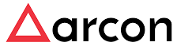
Security - Solution Summary
Requirement
Proposed Solution
External firewall with UTM Features
SSL VPN
DDoS
PIM as a service
Anti-virus
Internet traffic filtering with SSL VPN
Protect and track activities of Admin users
Protect Servers from malicious attacks
Key Technologies
Solution Highlights
Best of Breed proven technology
Scalable solution
High Available solution and no single point if failure
Defense in depth approach
Improved protection / Detection mechanism

Slide 24







Proposed DC network architecture
SIFY
INTERNET
M&M Existing
DC
M&M Existing
NDR
250 Mbps
Sify DC (Mumbai)
500 Mbps
PRIVATE CLOUD
SIFY
P2P
500 Mbps
SIFY
P2P
WAN ROUTERS
SIFY
P2P
PERIMETER
FIREWALL
WAN SWITCH
SIFY
INTERNET
500 Mbps
SIFY Proposed NDR
NDR
M&M Existing FAR DR
NDR
PIM
1 Gbps LAN Extension
250 Mbps
CORE SWITCH
500 Mbps
Management
Switch
SAP HANA SERVERS

Slide 25



Proposed dc switching architecture
SIFY
INTERNET
SIFY
INTERNET
SIFY
P2P
SIFY
P2P
M&M NEW DC @ SIFY
M&M NEW NDR @ SIFY
1G Copper Access inks
1G Copper Access inks
WAN SWITCH
WAN SWITCH
WAN SWITCH
WAN SWITCH
10G Fiber Up Links
10G Fiber Up Links
CORE/ SERVER SWITCH
CORE/ SERVER SWITCH
CORE/ SERVER SWITCH
CORE/ SERVER SWITCH
1G Copper
LAN EXTENSION
40/ 100G Port
Channel
40/ 100G Port
Channel
10G Fiber Access Links
10G Fiber Access Links

Slide 26







M & M Cloud Infrastructure Security- Multilayer Defense
Network Security Group
Access Layer
Network Layer
Platform Layer
IPS
Server Security
DDOS
UTM
SSL-VPN
PIM
Anti-virus/ Anti-Bot
Protection

Slide 27
NDR & BCP Requirements

Slide 28
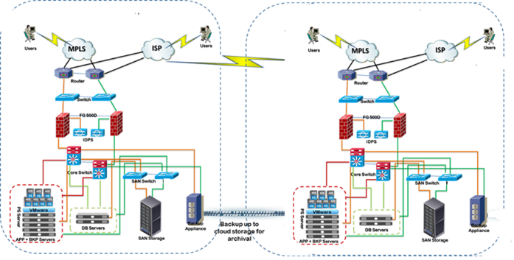
SIFY RECOMMENDED DEPLOYMENT OPTION WITH FEATURES & MERITS
SIFY CLOUD INFINITE DEPLOYMENT
FEATURES & MERITS
Highly available service
scaling up and scaling down of resources
High available network
High available security
On demand Storage
Best of Software deployed to provide cloud functionality
Faster Provisioning Time
Lower TCO for customer vis a vis Private Cloud

Slide 29
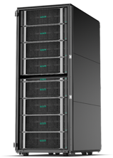
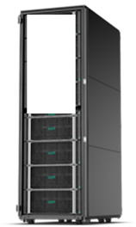

DC – NDR replication for clustered environment
SD Flex 8P / 12TB compute block (Production)
SD Flex 8P/12TB compute block (Near DR)
HPE Service guard Extension for SAP HANA System Replication
Smart Quorum for Full-proof Failure Fencing mechanism
Safesync System Replication to protect data integrity
Self-tuning HANA operation timeout monitoring
Decision logic for instance restarts vs takeover
Automation of failure detections,
secondary takeovers and role reversals
HANA-aware easy deployment
and administration
HPE Serviceguard
For SAP HANA
Sync Replication
HPE Serviceguard
Cluster
For ECC CI
Server 01
Server 02
Storage 01
Sify DC#1 & Sify NDR#1
Storage 02

Slide 30
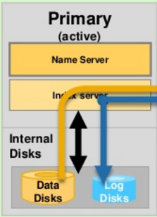
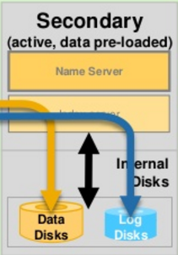
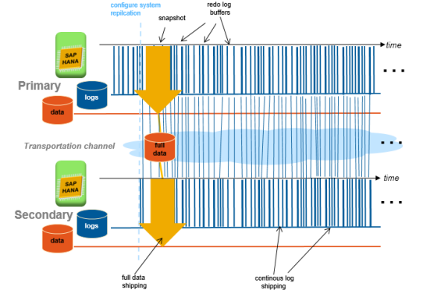
Sify’s disaster recovery APPROACH for Non Clustered Systems
DC
synchronous Replication with Log Replay
DR
Initial Full Data Shipping
Operation mode log replay: Initial full data and redo log shipped to secondary

Slide 31
DR Setup and Drill Approach for Non-Clustered Systems
DR Setup - Steps
Install the HANA DB (HANA)
Install the SAP Applications
Set up system replication on primary and Near DR systems.
Start the primary system.
Restore the DB Backup in the secondary System
Enable system replication on the primary system.
Register the secondary system with the primary system.
Start the secondary system and enable the replication
Rsysnc method of replication from Application server at DC to DR
RPO : 0
RTO : 20 Minutes.
DR Drill - Steps
During DR Drill , Stop Primary Application server and Primary DB.
Takeover to Secondary DB.
Testing by M&M team
Unregister Primary DB from Replication Setup.
Once Primary db is up to sync secondary db with Primary re-enable replication from secondary to Primary.
Stop the Secondary Application and Secondary DB.
Takeover to Primary DB from Secondary DB.
Deregister the Primary DB and start the application
Testing by Safari team on Primary DB
Enable System replication from Primary to Secondary
RPO: Recovery Point Objective (RPO) refers to the point in time in the past to which you will recover.
RTO: Recovery Time Objective (RTO) refers to the point in time in the future at

Slide 32
NON-HANA and application servers SIZING for NDR
 | DC
 | Existing |  |  | Proposed
 | SAPS | Server | Total SAPS | SAPS | Server | Total SAPS
APP SERVER | 86100 | 14 | 1205400 | 92560 | 14 | 1295840
 | 115000 | 1 | 115000 | 122410 | 1 | 122410
NON HAHA DB | 87570 | 3 | 262710 | 92560 | 3 | 277680
Storage |  | SSD (TB) | 75 | SSD (TB) | 75
 |  | SAS (TB) | 120 | SAS (TB) | 120
Sizing

Slide 33
NON-HANA and application servers SIZING for DC
Sizing | DC
 | Existing |  |  | Proposed
 | SAPS | Server | Total SAPS | SAPS | Server | Total SAPS
APP SERVER | 86100 | 14 | 1205400 | 92560 | 14 | 1295840
 | 115000 | 1 | 115000 | 122410 | 1 | 122410
NON HAHA DB | 87570 | 3 | 262710 | 92560 | 3 | 277680
Storage |  | SSD (TB) | 75 | SSD (TB) | 75
 |  | SAS (TB) | 120 | SAS (TB) | 120

Slide 34
Infra configurations in NDR : HANA and non-hana
32C (5218) / 128GB / 2 * 300GB HDD / 4 * 10G / 92560 SAPS (Production)
32C (5218) / 384GB / 2 * 300GB HDD / 4 * 10G / 92560 SAPS
2P / 40C (6248) / 384GB / 2 * 300GB / 4 * 10G / NO OS / 122410 SAPS
NON HAHA DB
Virtualized Application servers
NON HANA application Server
Physical (3 nodes)
VM VM VM VM
VM
(14 nodes)
. . . . . . . .
16G FC Fabric in HA
10/ 25 G Ethernet Fabric in HA
(8276L - 28 Core) / 224 Core / 12TB HANA TDi Server with OS (1 no.)
HAHA Production 01 Upgradable up to 24 TB
8260L / 96 Core / 4.6TB HANA TDi Server (2 no.)
HANA SRM 01 HANA BW 01 Upgradable up to 6 TB
Storage 01
75 SSD for HANA Nodes
120 TB SAS (Effective) for Appls

Slide 35
RABALE DC - Fact Sheet
Building Features Floors in building: 9 Floors, Reinforced concrete structure building Total Area : 202738 Sq ft Raised Floor area : 65000 Sq ft Server Hall Location: 1st to 6th Floors Slab to Slab height: 4350mm Raised Floor Height: 700mm Power System Incoming supply: 110KV dedicated substation Total Designed Power Capacity: 20MVA Service Provider: MSEB UPS Configuration: N + N Battery Backup : 10 mins on full load Distribution: Dual Feed up to Racks Generator Configuration: N + 1 Fuel Storage : 24 hours on full load | Architectural & Building Structure Seismic Zone: Zone III Seismic Protection: Building designed as per IS 456 WITH AN IMPORTANCE FACTOR OF 1.5 Structural Floor Loading : 1500 Kg/Sq mt Freight Elevators: 2 Ton & 1 Ton Passenger Lifts : 3 numbers Perimeter Wall & Doors : 2 Hours Fire rated Cooling System Chillers : Hybrid - Combination of Air cooled and Water Cooled Chillers and CRAC Units. CRAH Redundancy : N+2 Temperature : 22 +/- 2 deg C Humidity : 50 +/- 5 % RH Dust Control : Less than 5 Micron Integrated Building Management System Access Control : Multi layer access control system Video Surveillance : 24*7 for all critical areas with retention for 90 days Fire Detection : Addressable smoke detectors VESDA: Aspirating Smoke Detectors Fire Suppression : Novec© 1230 used for Server Halls and Battery Rooms. Addressable Water leakage Detection Ultra sonic Rodent repellent system

Slide 36
WAN Solution

Slide 37


WAN Network - Solution Summary
Requirement
Proposed Solution
Wide Area Network
Service Provider MPLS VPN (existing MPLS providers at DC)
Dual Internet Links at DC and Near DR
P2P Links for DC, DR, NDR Replication NW
LAN Extension between DC & Near DR
New data center as additional Hub site to existing MPLS WAN
ILL Links at New DC and New Near DR
P2P Links for data replication
Bandwidth Provisioning:
  500Mbps P2P links
  1Gbps for LAN Extension
  250Mbps internet links
Monitoring, Management & Reports
SLA based Services
Key Technologies
Solution Highlights
Highly redundant delivering 99.5% site availability
Low latency network
Scalability to support up to 10Gbps
Proximity to public cloud service providers
CPE Hardware
Network Provider

Slide 38


P2P Network
Point to Point Ethernet Circuits between
  500Mbps between Sify Airoli (DC) & MRV Chennai (DR)
  500Mbps between MITC Kandivali & Sify Airoli (DC)
  500Mbps between MITC Kandivali & Near DR
  500Mbps between MRV Chennai & Near DR
  1Gbps between Sify Airoli (DC) & Near DR
DATA CENTER
DR SITE
500Mbps
500Mbps
SIFY AIROLI
500Mbps
MRV CHENNAI
1Gbps
500Mbps
NDR SITE
OLD DC
SIFY RABALE
MITC KANDIVALI

Slide 39




Telecom Architecture – P2P Links
Adva
SW
1Gbps
Airoli DC LAN
MITC LAN
Metro Access
Network
Metro Access
Network
2x500Mbps
ME
DSW
CPE
VPE
DSW
ME
2x500Mbps
VPE
CPE
Sify MPLS
Network
DSW
ME
CPE
ME
Metro Access
Network
Metro Access
Network
MRV LAN
2x500Mbps
2x500Mbps
VPE
DSW
CPE
VPE
1Gbps
New NDR LAN
Adva
SW
CPE
Customer Premise Edge
MITC – Airoli DC, EVPL, 500Mbps
VPE
VPN Provider Edge
MITC – New Near DR, EVPL, 500Mbps
ME
Metro Ethernet Switch
MRV – Airoli DC, EVPL, 500Mbps
DSW
Distribution Switch
Adva
Adva NID
MRV – New Near DR, EVPL, 500Mbps
SW
Core Switch
Airoli DC – New Near DR, EPL, 1Gbps

Slide 40
Telecom Architecture – Internet Links
Metro Access
Network
Airoli DC LAN
DSW
ME
1x250Mbps
IPE
CPE
Sify Internet
Network
ME
CPE
Metro Access
Network
New NDR LAN
DSW
1x250Mbps
IPE
CPE
Customer Premise Edge
IPE
Internet Provider Edge
New Near DR, Internet, 250Mbps
ME
Metro Ethernet Switch
Airoli DC, Internet, 250Mbps
DSW
Distribution Switch

Slide 41
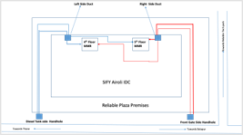
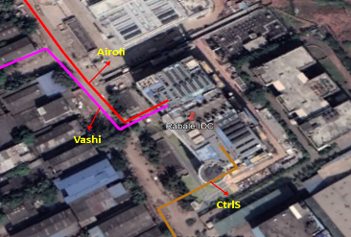
Engineered FOR high availability
Fiber routing diversity
Electronics redundancy
Inbuilding diversity
Airoli IDC
Rabale IDC

Slide 42
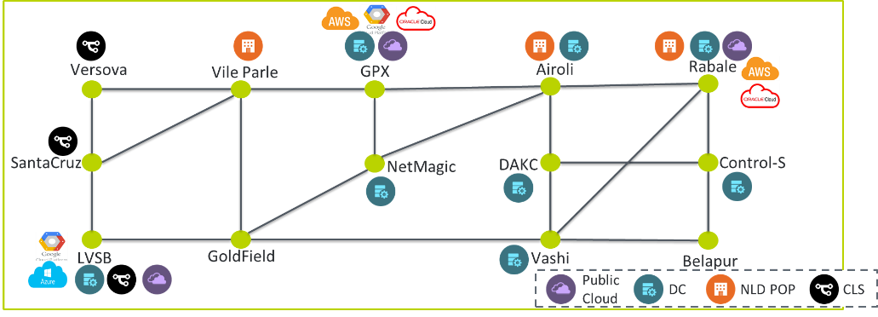
Optical Network as a Platform
Scalability
Reliability
Multi-service
Futuristic
80 Lambdas
Scalable from 10G to 200G per Lambda.
Lambda reuse through CDC ROADM
3 Path protection for all Major Data centers
Optical ASON for all path protection and restoration.
Protocol Transparency provides media independence – FC/Ethernet/SDH
Equal capability nodes.
SDN managed providing Agility and On-demand services.
Seamless integration with other cities.

Slide 43
Datacentre Interconnect : Opt DCI Product Features
Premium Protected
Non-Premium service on Optical DCI
Linear service on Optical DCI
  Ethernet – 2G, 4G, 6G, 8G, 10G, nx10G & 100G
  Fiber Channel – 1G, 2G, 4G, 8G & 10G.
  SDH – STM1, STM4,STM16, STM64/10G WAN PHY.
  Sub 50msec Protection
  Guaranteed restoration.
  Availability - 99.99%
  Ethernet – 2G, 4G, 6G, 8G, 10G, nx10G & 100G
  Fiber Channel – 1G, 2G, 4G, 8G & 10G.
  SDH – STM1, STM4,STM16, STM64/10G WAN PHY.
  Availability - 99.5%
  Ethernet – 2G, 4G, 6G, 8G, 10G, nx10G & 100G
  Fiber Channel – 1G, 2G, 4G, 8G & 10G.
  SDH – STM1, STM4,STM16, STM64/10G WAN PHY.
  Guaranteed restoration.
  Availability - 99.9%
Network Performance
Latency | Rabale | DAKC | CtrlS | Netmagic | GPX | LVSB
Airoli | <1ms | <1ms | <1ms | <1ms | <1ms | <2ms
Rabale |  | <1ms | <1ms | <1ms | <1ms | <2ms
DAKC |  |  | <1ms | <1ms | <1ms | <2ms
CtrlS |  |  |  | <1ms | <1ms | <2ms
NetMagic |  |  |  |  | <1ms | <1ms
GPX |  |  |  |  |  | <1ms
  Latency < 2msec
  Bit errors <10E-12
  Packet loss = 0

Slide 44
Migration approach and plan

Slide 45
MIGRATION APPROACH
Key Considerations
  Smooth transition to Cloud landscape
  Minimum Business disruption
Approach
  Sify will migrate Current systems to Cloud using Replication Method.
  Systems will be migrated landscape wise (e.g. All development in one phase, followed by Quality and then Production)
  During the Migration Sify will require 1 Downtime in each Phase which will be switchover period of around 4 hours.
  Before any Switchover UT, SIT and UAT will be perform jointly by Sify & M&M teams.
  NDR will be build within 72 hours once Production environments will be moved to Sify Cloud
  FAR DR will be configure at Bangalore location post DC and NDR is operational from Mumbai.

Slide 46
MIGRATION APPROACH
Setup Development/Test/Production Application architecture in Sify DC Cloud (same DB as Current DB)
DC Switchover to Sify’s DC and Change access of Test users to Sify cloud for 1st level testing
System wise cutover to New DC with logical grouping
Installation of Application at NDR and start replication from Sify DC Cloud to Sify NDR Cloud
Start Replication of landscape from Current DC to Sify Cloud
Testing of New Environment with Test Users and Note down the changes required during cutover
DC Switchover to Sify Cloud with Change of User Access

Slide 47
High level Activities
M&M
SIFY
M&M
Backup of Current System before starting Replication
Changes in Current Production system for Replication
Provide Backup Plan to M&M to initiate Backups
Provide Parameters for Replications to M&M team
Installation of SAP systems at Sify DC
Enable Replication parameters at DR(Sify) site
Switchover from current DC to Sify DC
Installation of SAP in NDR location (SifyDC)
Enabling Replication between Sify DC and DR
User Acceptance Testing will be performed by M&M Business Users.

Slide 48
High level project plan
Sr.No. | Activity | W1 | W2 | W3 | W4 | W5 | W6 | W7 | W8 | W9 | W10 | W11 | W12 | W13 | W14 | W15 | W16 | W17 | W18 | W19 | W20 | W21 | W22 | W23 | W24 | W25 | W26 | W27 | W28 | W29 | W30 | W31 | W32 | W33 | W34 | W35 | W36 | W37
1 | Hardware Delivery
2 | Project Planning
3 | Installation/Allotment/Configuration of Hardware
4 | Installation of Base OS and OS prerequisites
5 | Installation of Application and DB at Sify's Environment
6 | Configuration of Data Replication for HANA & Sybase systems
7 | Start SAP at Sify DC for testing
8 | Testing by Sify and M&M Team
9 | Reinitiate Replication between Curent DC and Sify's DC
10 | Switch over from Current DC to New DC
11 | UT, SIT and UAT
12 | Change in the network to redirect users to Sify's DC
13 | System Release to Users
14 | Configuration of Near DR
15 | Testing for NDR
16 | Configuration of Far DR
17 | DR Drill
 | Sify Infra Team
 | Sify SAP Team
 | Sify and M&M Team
Note:
Systems will be migrated landscape wise (e.g., all Development instances in one phase, followed by Quality and then Production)
During the Migration Sify will required 1 downtime in each Phase for the landscape being migrated. The switchover period is expected to be around 4 hours.

Slide 49
Prerequisites
  Remote connectivity of M&M Ltd SAP systems ( VPN access or Public IP server to access the server )
  Windows Jump Server to connect the existing Customer On premise SAP Servers.
  Client to provide SAP, OS, DB User Credentials to connect the SAP Server(As per the Perquisite Sheet)
  S-user ID and Password for SAP service marketplace
  Need Production Server Downtime for SAP Migration
  DB team support required to enable replication parameters at DC site.
  Dedicated MPLS Link between M&M DC to Sify Cloud DC to Enable DB Replication Setup.

Slide 50
ASSUMPTIONS
  Downtime window confirmation should be provided by M&M Ltd during production cutover.
  M&M Ltd will coordinate with third party for creating additional RFC Connectivity to other non SAP source systems (if any).
  System Backup will be scheduled only after migration of SAP Landscape.
  Any new changes during the migration will be considered as Change Request.
  Third Party integration Responsibility will be taken care from customer end.
  All required Licenses are in place.

Slide 51
OUT OF SCOPE
  Any new development of Custom ABAP objects or Functional processes in SAP.
  Configuration/Upgrade of Peripheral devices, such as Printers, Faxes, Roll-out of SAPGUI on to workstations.
  Testing (post-migration) of any nature (regression or functional) is out of scope. (M&M Ltd will perform Unit Testing of SAP data post-migration)
  Creation/modification of Test Cases, Test Scripts.
  System backups during SAP Migration phase.
  Except SAP, any Third-party integration will be taken care from customer end.

Slide 52
Risk Mitigation Plan
Risk | Impact | Risk Mitigation
Breakage of Link between two Data centers | High | During Data Replication period, continuous monitoring of Log shipping has to be planned. In case of Link Failure for longer duration additional Link has to be planned
DownTime Over Run | High | Trial Run is been plan for rehearsal.
Testing Time Exceeded | Medium | Project Plan has to clearly mention time line for UT, SIT and UAT
Change in Source System | High | Full Offline Backup is required before any critical change in source system.
HANA Version Change/Update during Implementation/Migration | Medium | HANA Patching and Upgrade has to be planned at the end of the migration/Implementation

Slide 53
END-TO-END TECHNICAL MANAGEMENT – BASIS SUPPORT, MANAGED SERVICES

Slide 54





Basis Support in Project Phase
Sify proposes comprehensive Basis Administration and HANA / Sybase/ MaxDB DB Management in project phase for systems are in Scope:
After Go-Live the following activities will be performed:
  Setting up NDR for the SAP landscape
  Reconfiguration of Solution Manager if required
Scope
BASIS support and administration of all deployed SAP systems in DC and NDR
Perform DR drills twice a year
Mandatory patch updates
Client refresh limited to 4 times per system per year. M&M needs to share system refresh schedule in advance.
Sify will provide 24x7 coverage for Basis support. Delivery is planned entirely from remote.
Out of Scope
SAP Technical and Functional upgrades and migrations
Database version upgrades

Slide 55

Proactive management
Syslink Xandria
Not reliant on SAP tools only
Native & Custom Checks
Work with any SAP technology
Escalation Based Notifications
SLA Reporting
Landscape sync. Analysis
Predictive resource planning
Dashboards
Auto Reactions
Open API
Technical Performance Monitoring
Cloud
Automation
Reporting & Dashboards
Business Process Monitoring
Audit, Security & Compliance
Predictive Resource Consumption

Slide 56

















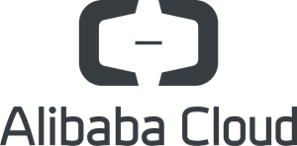
SAP SYSTEM monitoring
Xandria Master Server
HTTPS
Agent
Agent
Gateway
Agent
HTTPS Proxy
Operating System
SAP Server
Outbound
Notifications
Email
SMS
Dashboards
Public Cloud
Amazon Web Services
Microsoft Azure
Google Cloud Platform
Alibaba Cloud
iOS App
Open APIs
Ticketing
Automation
Additional Monitoring
SaaS
Service Now
Scripts & Programs

Slide 57
BASIS AMS SUPPORT LEVEL
Severity Level | Response Time | Resolution Time | Severity Level Definitions | Service Level
1 (High) | 2 hours | 4 hours | If a function / module is not available or is very seriously impaired and the impact on business is severe; many end users are unable to perform their normal work. | 95%
2 (Medium) | 4 hours | 15 Business hours | There is no direct immediate impact on business. Work can continue with minor disruptions or loss of efficiency. Alternative ways of performing normal work are available | 95%
3 (Low) | 1 day | 24 Business hours | Non-critical error or a cosmetic change , a minor problem for which a permanent workaround is in place. This could however result in loss of productivity to the user. This is a non-critical requirement which disrupts neither the functional nor operational flow. | 90%
* SLAs are not applicable for Enhancements/Change Requests

Slide 58
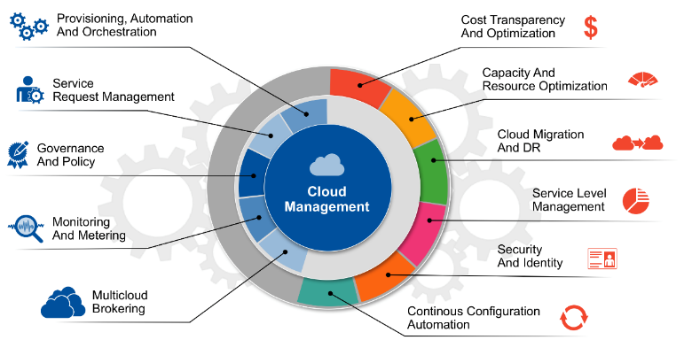
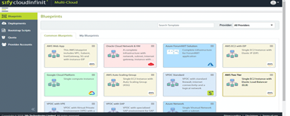
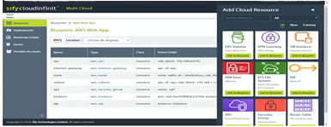
Sify’s cloud management platform (setup & integrate)
Services Features
Composed of cloud resources like VPC, Subnet, Instance & EIP as a single solution
Customize prebuilt / build from scratch
Choose cloud resources with simple clicks
Refer existing resources to build a solution topology
Specify parameters for a specific project
Reverse Engineer from an existing Deployment (sat Dev)
Adapt for higher levels (stating, production, volume testing)
Provisioned, decommissioned, managed as single unit

Slide 59
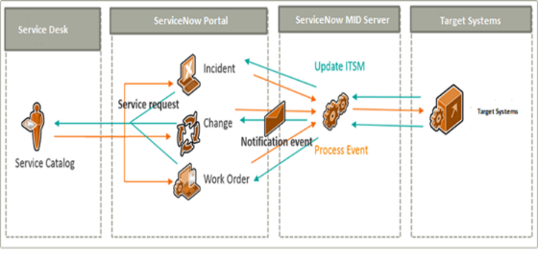
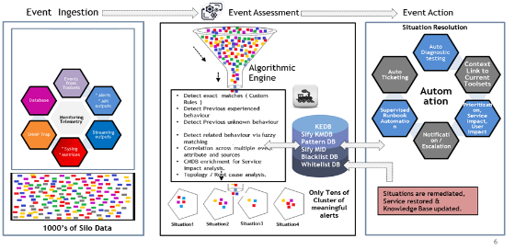
Automation excellence
Service Desk integration
Event Automation
Few reference for use case automated
Automated Ticket Routing
Workflow & Runbook based automation for predefined request categories
Pre-fetch & auto update tickets with high CPU/Memory consuming processes
CMDB Updates
Automated action from predefined flow on events
Response action for CPU threshold violations
Automated restart of services on specific events
Scheduled trigger of action on events
Notes:
David

Slide 60
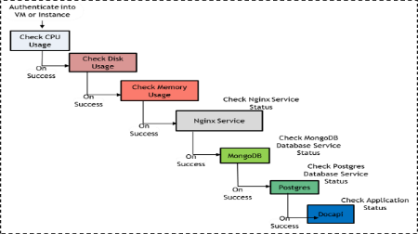
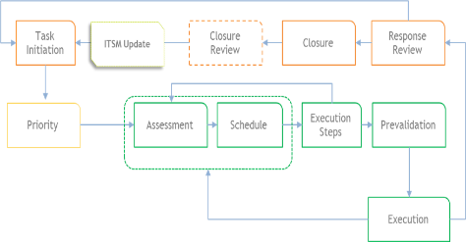
Automation excellence
Workflow automation
Run Book automation
Few reference for use case automated
Active Directory User Management
Exchange Mailbox Management
Linux File deployment from SVN
DNS Records
Server Hardening
Log rotation on systems and network devices
Message parsing on Active Directory & Microsoft Exchange Servers
Daily Health checks on Compute devices, Storage Systems & Databases
Configuration backup of SAN / LAN Switches & Firewalls
Notes:
David

Slide 61
Service reporting through ServiceNow
Unified view of IT
Pinpoint issues in IT
Unified view of all services
Proven and Matured Player for Delivering on Managed Services Platform
Expand to other Infrastructure Devices and Applications
Enables from moving from Reactive support to Proactive
Industry Standard Proven Tool for Large customer base and Deployments
Excellence in Monitoring and Management – Scalable, Robust, and Ease of Mgmt.
Improved Visibility - Reducing MTTR (Mean Time To Resolve)
Better Integration across various industry recognized tools
Plug and Play with custom probes to monitor certain features
Enables Pay-As-You-Go Model
SLA Dashboard
Dashboard of Service Availability

Slide 62
WHY SIFY ?

Slide 63
EXPERIENCE ADVANTAGE
500+
300+
80+
Datacenter services projects executed
Datacenter Migration projects
Platform Migration Projects
25+
230+
70+
30+
IT Ops Transformation projects
Enterprise Cloud clients
Private cloud & DR clients
CDN & Cloud Security customers

Slide 64
PEOPLE ADVANTAGE
700+
DATA CENTER, CLOUD AND MANAGED SERVICES
1800+
NETWORK CENTRIC
SERVICES
125+
SECURITY
SERVICES
225+
APPLICATION
SERVICES

Slide 65









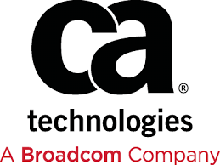










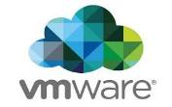










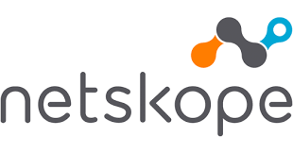


Partnership advantage
IAAS / PAAS
Technology Partners
Application Partners
Security Partners

Slide 66

Sify-AWS Strategic Partnership
AWS Partner Network member enrolled and recognised as
Advanced Tier Consulting Partner
Channel Reseller
Direct Connect Partner
One of the key AWS Direct Connect Provider in PAN India, Sify has a unique advantage of having the Direct-Connect as well as its own Metro-Cross Connect that provides connectivity at 10G+ speed
AWS + Sify Advantage
End to end AWS Integrated service coverage - Access-Architect-Migrate-Manage-and Secure
Best in breed Hybrid-Cloud Configuration through our AWS Cloud Adjacent Data-Center connected at a 10G+ Speed at less than 100 Microseconds
Sify provides unified, integrated, single pane of glass of management across their private IT and AWS IT
Only Partner in India who can offer Cloud adjacent datacenter to AWS cloud by virtue of AWS cloud being hosted in Sify’s Rabale.
In-house Certified skilled resources on AWS Integrated Offerings covering the entire gamut of Platform/Infra, Direct-Connect, Cloud Front, SAP and Digital Services
One stop shop for Assess, Architect, Migrate, Manage & Secure plus other AWS Professional Services (Back-up, Disaster Recovery, Digital Services)
By virtue of being enrolled in Advanced Tier Consulting Track, Sify is a key partner of AWS providing the Advanced Managed services for AWS cloud integrated offerings

Slide 67



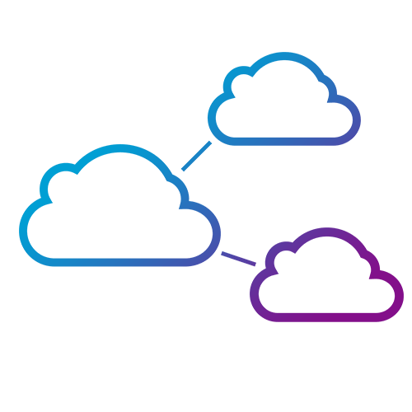


Our Infrastructure & SERVICES ADVANTAGE
SIFY ASSETS
RELEVANCE TO DIGITAL ENTERPRISE
  10 Pan-India DCs with 70 MW capacity
  Roadmap to add 200 MW in next 4 years
Hosting for hyperscale operators
Centerpiece of the hybrid cloud
  Largest MPLS network (by connections)
  3100+ PoPs across 1600 towns in India
Internet growth from non-metros
Platform to move content to “edge”
  “Cloud Connect” data superhighway
  48 on-net data centers
Cost-effective terabit network scale
Interconnect Public and Private clouds
  Enterprise and Hybrid Multi Cloud
  Enterprise Cloud grid fabric
Public / Private / Hybrid Clouds
Cost effective and pay-as-you-go model
  Remote Operations Centers
  NOC, SOC, managed services
Global and domestic IT outsourcing
Supports outcome-based services model
  Applications and solutions
  iTest, ForumNXT, eLearning, SAP, Oracle, App Modernization
IT-enablement for distributed businesses
Supports Digital Transformation initiatives

Slide 68







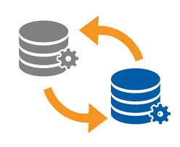
Rich migration experience of 6+ Years
On Premise --> On Premise
On Premise --> Sify InfinitSAP
On Premise / Hosted --> AWS
Upgrades / Conversion to HANA with Migrations
Carve-outs
Other Provider --> Sify InfinitSAP
Carve-outs
Other Provider --> Sify InfinitSAP
Successfully migrated 50+ SAP systems across all above scenarios
25+ migrations executed with re-platforming (heterogenous migration)
More than 10 migrations with simultaneous technical upgrades and updates
Experienced in complex Carve-outs

Slide 69
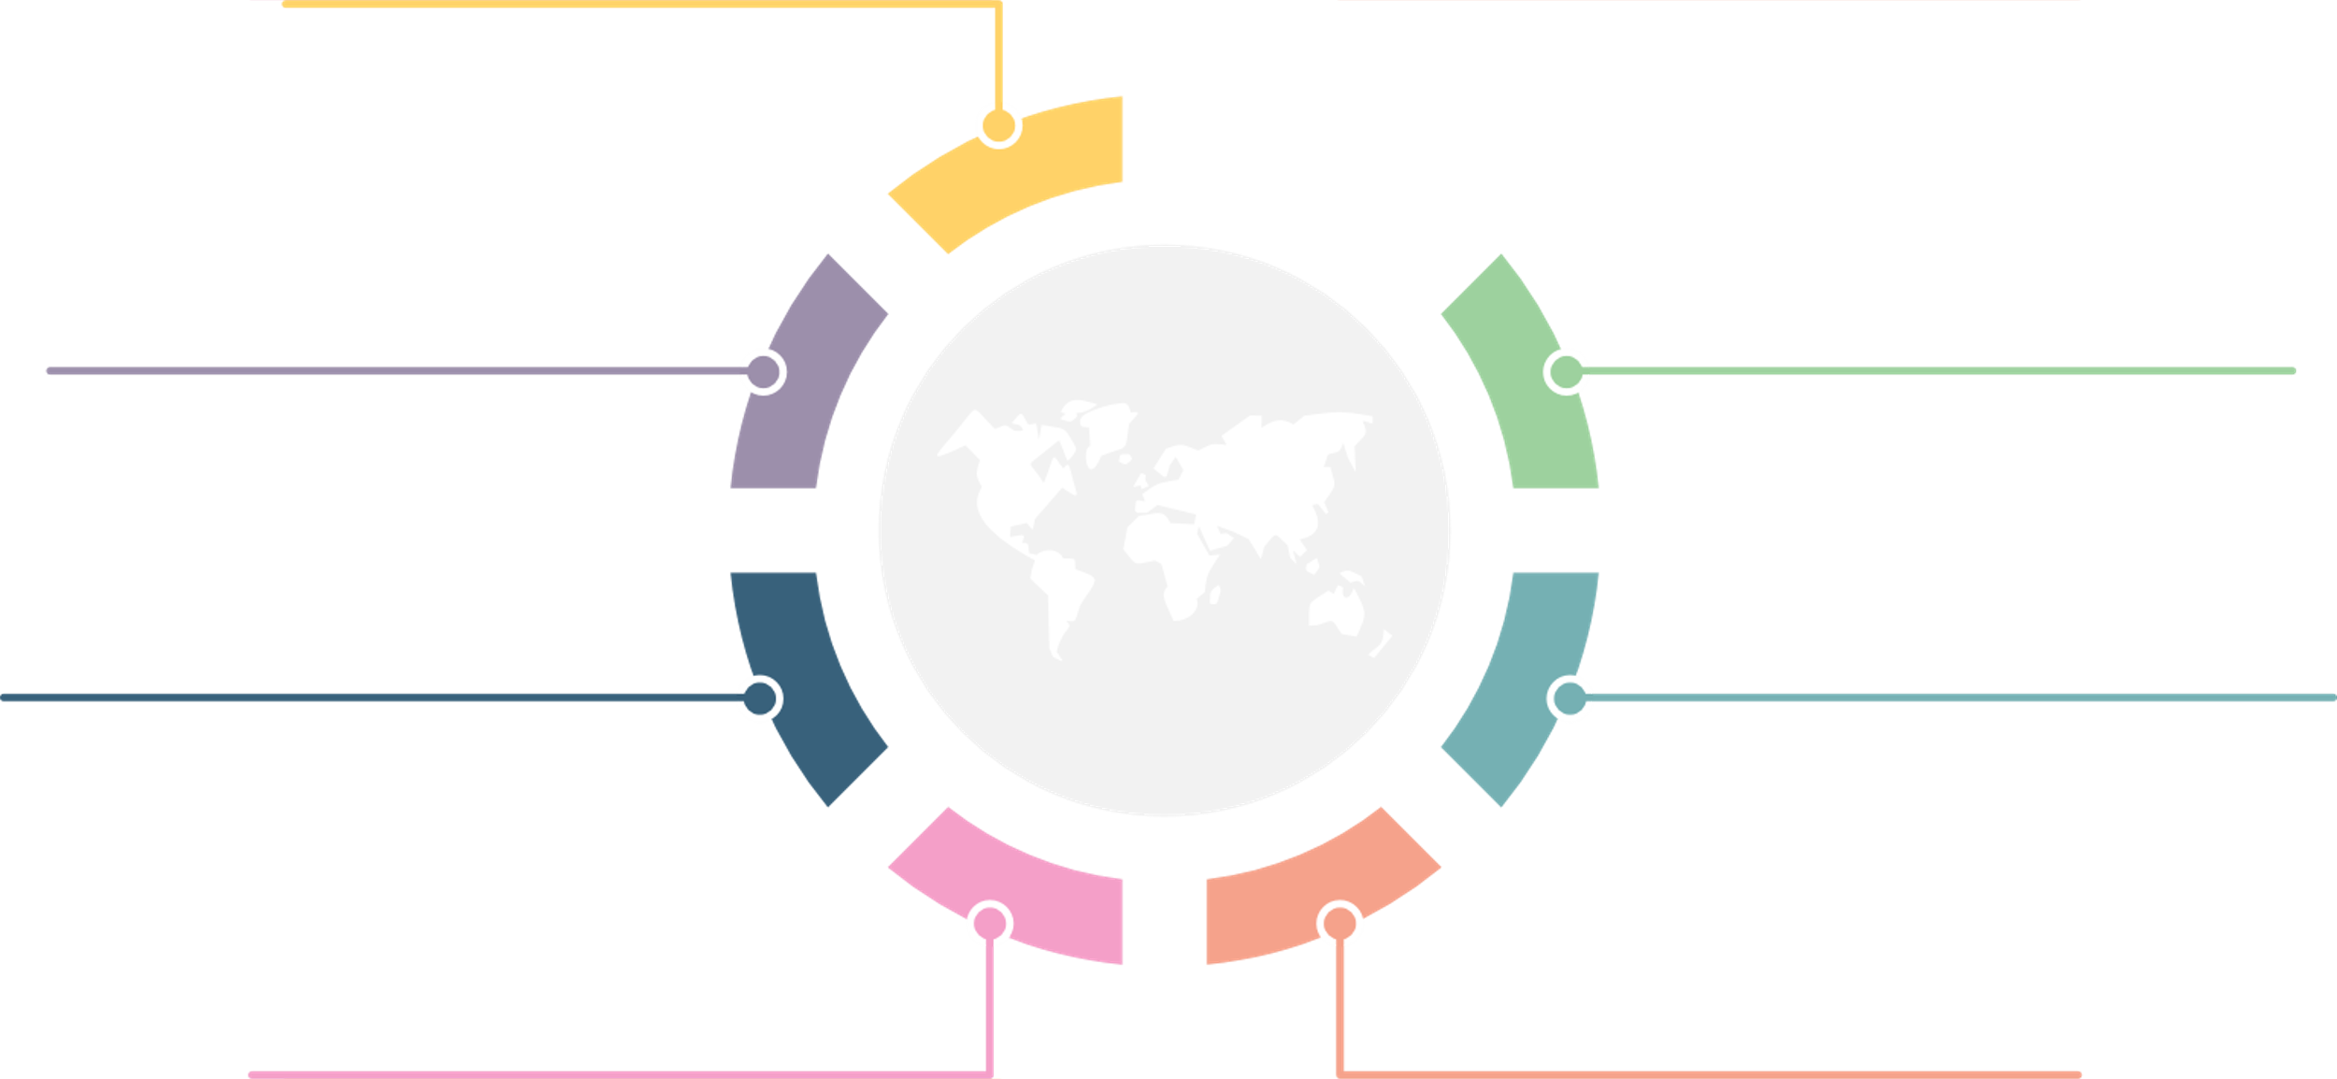
WHY SIFY FOR SAP MIGRATION, INFRASTRUCTURE AND MANAGEMENT?
Matured Delivery for Cloud Migrations
Invested in State of the art Tools and Automation
Single Vendor for end-to-end Application Uptime SLA
One stop shop for taking
SAP to Cloud
Trusted Cloud Advisor-choice of Cloud Infrastructure
Expertise in S/4 HANA Implementation and Conversion
Integrated play across Telecom, Cloud and SAP Services
Experienced in specialized Migrations like carve-out
Notes:
And how we offer everything under one roof?
Because we have the tools and automation, we have the people skilled and certified, we have the processes qualified in various audits.
To summarise: huge installed base across all sizes and verticals
Our key Sales motions in 2020
Migration of SAP DC / DR to Sify CI
Conversion of ECC to S/4 HANA and upgrades
SAP Basis and Application Managed Services
S/4 HANA implementation
End to end delivery capability
Example of single point of ownership example Fieldfresh, Tata Sponge

Slide 70


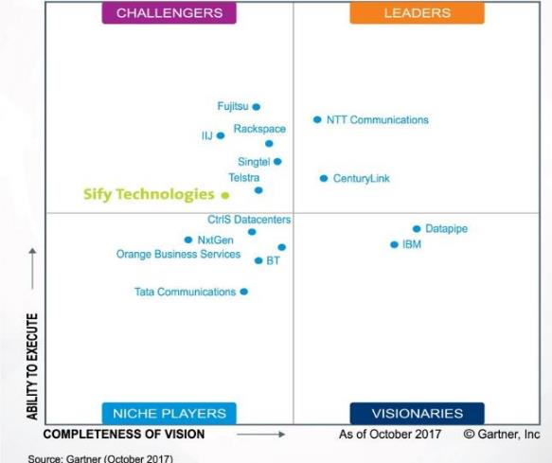




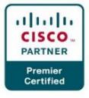


INDUSTRY RECOGNITIONS
Recognition in Market Guide for Public Cloud Managed and Professional Services Providers APAC 2020
Recognition in Critical Capabilities for Managed Hybrid Cloud Hosting APAC 2018
Recognition in Market Guide for Top Data Center Service Providers 2018
Recognition in Market Guide for Vulnerability Assessment
and Penetration Testing Consulting Services in India 2019
Recognition as a notable vendor in MQ for Data Center Outsourcing and Hybrid Infrastructure Managed Services, Asia/Pacific 2019
Major Player in
MarketScape for Cloud
Managed Services APeJ 2019
The Economic Times
Iconic Brands 2020
Hybrid Multi Cloud
Data Center Transformation Services
2018
Network Transformation Services
2018
Sify in Challenger Quadrant in Gartner MQ for Managed Hybrid Cloud Hosting APAC 2017
Hosting Partner
Leadership Recognition
Cloud Transformation (2018)
Network Transformation (2019)

Slide 71
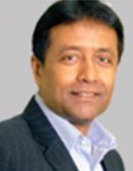
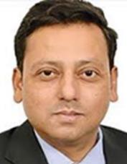
SIFY TEAM
Kamal Nath
Chief Executive Officer, SIFY Technologies
Kamal is a business transformation evangelist serving as the CEO since 2012. Under his leadership, Sify has grown multi fold in revenue and profitability by establishing Sify as a preferred end-to-end technology service provider to the enterprises, public sector and government segment. Prior to Sify, his fastpaced cross functional stint spanning 17 years at HCL Technologies, he led various transformational engagements with large enterprises, incubated new business services. Kamal is featured amongst the top CEO’s across his fraternity and is known for pioneering unique business models that have been widely accepted and appreciated by the industry.
Role in Project : Executive Sponsor
Tirthankar Mitra
Regional CEO West , SIFY Technologies
Tirthankar is a ICT Business Leader with over 28 years of diverse experience in providing transformation solutions across enterprises. His previous roles have been across a wide range of organizations - Mellanox, Cisco, AWS, Red Hat & Novell that allowed him to drive successful digital transformation projects, delivering customer satisfaction across cloud scale infrastructure, Next Gen Data Center, Open Source and Artificial Intelligence & Big Data Analytics.
Role in Project : Sales Sponsor

Slide 72
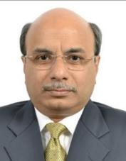
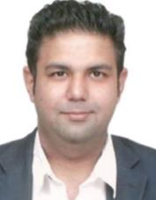
SIFY TEAM
Subhasish Dhar
Head of Delivery – Application Services
Subhasish has 30 years of strong solution-focused consulting experience across multiple domains in Digital, IBM, SAP and Sify. Being with SAP India Consulting for more than 5 years followed by 13 years in SAP Global Delivery, Subhasish has delivered large and complex business solutions for customers across the globe in multiple industries.
Role in Project : Delivery Governance
Kunal Joshi
Lead Solution Architect SAP
Kunal has 20+ years of experience in SAP Solutioning with SAP Basis Background and Certifications on HANA, Oracle and SAP and has been with Sify for last 3+ years as the Lead of Sify’s SAP Solutioning team, he handles Solution Design, and Presales for all major SAP opportunities pan India.
Role in Project : Solution Design for SAP Infrastructure and Application Migration

Slide 73
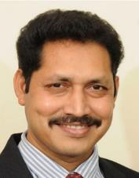
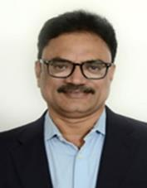
SIFY TEAM
Jitender D
Head of Cloud Engineering & Solutions
Jitender has total 19 years of experience and has been with Sify for last 4+ years. As the Head of Engineering and Solutions for Sify’s Cloud Management Platform, Server and Storage Infrastructure transformation, he handles the Core Engineering function that enables Sify to deliver end to end cloud and managed services solutions.
Role in Project : Cloud Infrastructure Engineering Design
Srinivas Anappindi
Delivery Head- DC IT Practice
Kunal has 20+ years of experience in SAP Solutioning with SAP Basis Background and Certifications on HANA, Oracle and SAP and has been with Sify for last 3+ years as the Lead of Sify’s SAP Solutioning team, he handles Solution Design, and Presales for all major SAP opportunities pan India.
Role in Project :

Slide 74
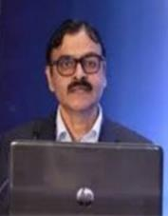

SIFY TEAM
Prashant Pimpalekar
Head – SAP Practice & Delivery
Prashant has total 30 years of experience and has been with Sify for last 6.5 years. As the Head SAP Practice & Delivery, he is responsible for seamless delivery of SAP projects, developing competencies & sales/presales enablement. His technical articles are published in Dataquest, Communications Today & ERPITWorld.com.
Role in Project : Delivery of managed services (SAP Basis support)
Venkata Ramana R
Technical Lead of SAP BASIS/HANA
Venkata has total 15 years of experience in SAP BASIS with multiple SAP Certifications and has been with Sify for last 4+ years as the Lead of Sify’s SAP BASIS/HANA team, he handles the all SAP BASIS AMS accounts ,SAP Implementation , SAP workload migration and DR setup projects.
Role in Project : Lead SAP BASIS/HANA consultant

Slide 75
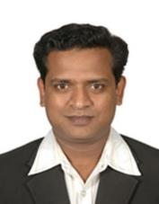
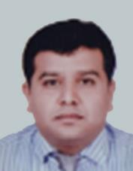
SIFY TEAM
Riyaz Hussain
Head of Network & Security Engineering and Solutions
Riyaz has total 20+ years of experience and has been with Sify for last 3 years. As the Head of Network & Security Engineering and Solutions for Sify’s Cloud Platform, he directs the engineering function that enables Sify to deliver end to end cloud networking & security services solutions.
Role in Project : Cloud Network & Security Design
Samir Shirke
Strategic Account manager
Samir has around 18+ years of experience in Sales & Marketing and has been with Sify for last 10 years. As a part of Account Management, he has been associated with Large Manufacturing conglomerate like M&M Group , AB group and L&T group, specializes in working on Large Projects for Cloud Migration and Digital transformations for Enterprises.
Role in Project : Single Point of Contact for M&M Group

Slide 77
Backup slides

Slide 78
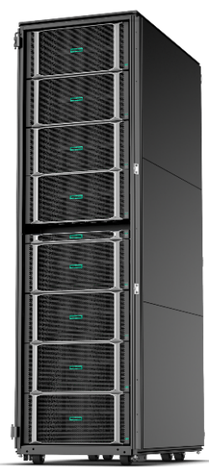
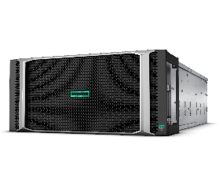
Scalable SAP S/4 HANA instances
Scale-up and scale-out
Superdome Flex compute nodes pool from 4 to 32 socket
Scale-up to 24 TB SAP HANA
Up to 288 TB scale-out for SAP HANA Business Warehouse

