Slide 1


SIFY CAPABILITY PRESENTATION – MEDIA & ENTERTAINMENT

Slide 2

AGENDA
01
Key industry drivers in Media & Entertainment
02
Cloud adoption and Sify relevance in M&E
03
Introducing Sify & Cloud @ Core
04
Sify engagement models/key strengths
05
Sify customer references

Slide 3

Key industry drivers in Media & Entertainment

Slide 4




Digital innovation transforming the media industry
In the late 1990s Napster and file sharing suddenly appeared
In the early 2000s media companies realized the file sharing had fundamentally changed how people wanted to access music and content
Wave 1
Wave 2
Media&
Entertainment
Industry
In the second half of the decade, mobile, social and the cloud grew in importance and consumers began to expect access to their books, films and music anytime, anywhere
Wave 3
Wave 4
The next transformational innovation is likely to be the Internet of Things and living services giving media and entertainment enterprises opportunities to move into new ecosystems

Slide 5
Trends in media and entertainment industry
Trend | Trend Enabling Technologies | Benefits | ICT Play
Chatbots | Cloud, Ultra-fast connectivity, Artificial Intelligence | Automatically dish up the latest headlines to users based on their interests and search history | Cloud infra & Apps, Security, SaaS Application
Virtual Reality | Cloud, Ultra-fast connectivity, Internet of Things | VR promises to transport the viewer into the middle of an experience to form a better connection to the story | Connectivity, Cloud infra & Apps, UCaaS
Automated Journalism | Internet of Things, Artificial Intelligence, Cloud | ‘Robot journalism’ lends a helping hand to journalists and publishers by interpreting and analyzing data to produce content | Connectivity, Cloud infra & Apps, UCaaS
Data Journalism/ Visualization | Data Analytics, Cloud, Machine Learning | Text with visuals is the perfect marriage to satisfy an increasingly mobile audience | Connectivity, Cloud infra & Apps, UCaaS
Real time content management | Data Analytics, Cloud, Machine Learning, Ultra-fast connectivity | Data collection and analytics enable companies to get consumer insights across many channels and devices | Cloud infra & Apps, Security, SaaS Application

Slide 6
Cloud adoption & sify relevance in M&E

Slide 7
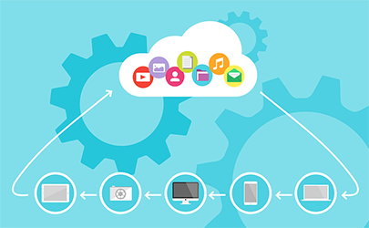
Cloud for MEDIA industry
Challenges
Solution
Managed Cloud Infrastructure
Biggest Challenges in Media and Entertainment Sector -
Reduce rollout cycles to super short duration
Reduce time to market of new content plans and experiences
Cloud computing's pay-as-you-use subscription model
End to end compatibility of ultra-rich content
Video distribution’s move from B2C to B2B
Live content coverage
Maturation of video on-demand services
Storing and analyzing massive data to understand key tenets of content personalization
Super-fast speed to market, to compete with the agile OTT competitors offering similar content

Slide 8




cloud@core
TM
ALIGNED TO OUR CUSTOMERS’ CLOUD TRANSFORMATION PURSUIT
CLOUD ENABLING
CLOUD INSPIRED
CLOUD PURE
CLOUD ENHANCED
Cloud DC
Hyper reach/Hyper scale transport
Oracle FastConnect | ExpressRoute | DirectConnect | Partner Interconnect
Software Defined Network services
Cloud build
Private | Hyperconverged | Enterprise
Security services for cloud
Migration and Implementation services
Sify CloudInfinit
  Enterprise Multi-Tenant
  Dedicated
  Hosted SAP/S4 HANA
  Azure Stack as a Service
Edge Connect Services
SD-WAN
Collaboration services on Cloud
AWS
Azure
OCI
GCP
Multi Cloud Management platform & services
Modern Applications
Kubernetes-as-a-Service
AI/ML
Forum DIGITAL
HCM Digital (iTest)
Learning Management
Internet-of-Things (IOT)
Industry Solution-as-a-Service

Slide 9
RELEVANCE OF SIFY FOR YOUR DIGITAL JOURNEY
Sify Application Services
UCaaS
Sify Network on cloud
Sify Cloud Services
Hosted VC, On-prem VC
Sify Network on cloud
Connectivity, Applications, UCaaS, Collaboration
Connectivity, Cloud infra & Apps, UCaaS
E-learning, AR/VR, Video collaboration
AI, AR/VR, Mobile
Sify Managed Wifi
Sify Cloud Infra for Applications
Sify Security on Cloud
Sify Network on Cloud
Cloud infra & Apps, Security, SaaS Application
SIFY PLAY
Connectivity, Cloud infra Apps
Cloud computing, Big Data/ Analytics
Mobile Application, Analytics, AI/ML
Automated
Journalism
ICT Enabler
Virtual Reality
Emerging Tech
Real time content
Management
Chatbots
Trend

Slide 10






Use Cases-Cloud Services
Application Context
IT infrastructure for real time management of digital content
Cloud Storage for live coverage and digital content
Hosting Analytics & BI Engine
Benefits
Consumers are more demanding than ever, and to be able to deliver choices to them, broadcasters need the scalability of computing power that only cloud computing can provide.
Low cost and high scalability reduces operational expenditure and brings in more flexibility
Enhanced user experience at low costs

Slide 11





Use Cases- Super Fast Ultra Rich Digital Content
Application Context
Digitization of streaming of live content
Customer target and segmentation using AI/ ML applications
Usage of AR/VR for delivery of digital content
Benefits
Improved customer experience
Understand key tenets of content personalization for specific target audiences, enhance user experiences
Continuously expand the existing stable of content

Slide 12



Use Cases- World’s Leading Media and Entertainment Companies
Key Cases
Netflix, for instance, was 100% on cloud in early 2012, and is leading all the way in digital content provider space in Entertainment world
20th Century Fox is another example: the media giant partnered with HP to make its supply chain cloud enabled, and migrated traditional IT infrastructure and computing to cloud platforms
Driven by machine learning, IRIS.TV offers a B2B service to support companies in tracking and improving client interaction with their digital content

Slide 13
INTRODUCING SIFY AND CLOUD@CORE

Slide 14
SIFY TODAY
TECHNOLOGY INTEGRATION SERVICES
Data Center IT
Network Integration
Information Security Services
Collaboration Services
End User Computing Services
TELECOM SERVICES
India Data Business
Global Data Business
Cloud Connect & Managed DWDM
Enterprise VoIP
Managed Network Services
APPLICATIONS SERVICES
iTest – Online Testing Platform
eLearning
Forum – Distribution Management System
Portal Solutions
DC, CLOUD & MANAGED SERVICES
Colocation/White labelling
Data center Transformation
Public Cloud (LaaS/PaaS)
Enterprise private and hybrid cloud
Cloud based DR
DC Managed Services
Managed Security Services
PLATFORM SERVICES
SAP / S4 Hana, Success Factors and hosted cloud infrastructure
Microsoft – Azure, Office & Productivity, Dynamics CRM
Oracle – SaaS, PaaS (HR, Database, Middleware, Cloud Machine)
A balanced portfolio to help clients navigate digital transformation

Slide 15
cloud@core
TM
ALIGNED TO OUR CUSTOMERS’ CLOUD TRANSFORMATION PURSUIT
CLOUD ENABLING
CLOUD INSPIRED
CLOUD PURE
CLOUD ENHANCED
Cloud DC
Hyper reach/Hyper scale transport
Oracle FastConnect | ExpressRoute | DirectConnect | Partner Interconnect
Software Defined Network services
Cloud build
Private | Hyperconverged | Enterprise
Security services for cloud
Migration and Implementation services
Sify CloudInfinit
  Enterprise Multi-Tenant
  Dedicated
  Hosted SAP/S4 HANA
  Azure Stack as a Service
Edge Connect Services
SD-WAN
Collaboration services on Cloud
AWS
Azure
OCI
GCP
Multi Cloud Management platform & services
Modern Applications
Kubernetes-as-a-Service
AI/ML
Forum DIGITAL
HCM Digital (iTest)
Learning Management
Internet-of-Things (IOT)
Industry Solution-as-a-Service

Slide 16







CLOUD@CORE: AGILITY, FLEXIBILITY & CHOICES
Investment and IP Commitments
Commitment beyond Infra: Platform & SaaS
CLOUD@CORE
Commitment beyond Cloud: Network for Cloud
Commitment to make Cloud secure
Capability and Commitment to build Cloud
Commitment of providing choices

Slide 17
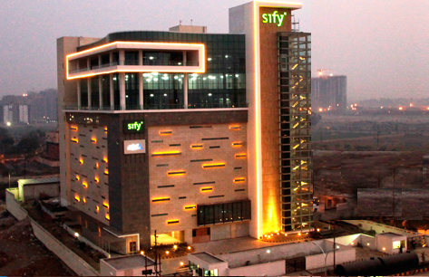
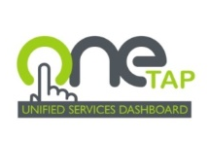
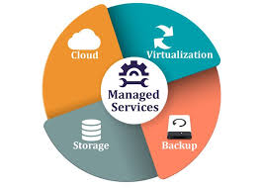
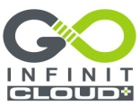
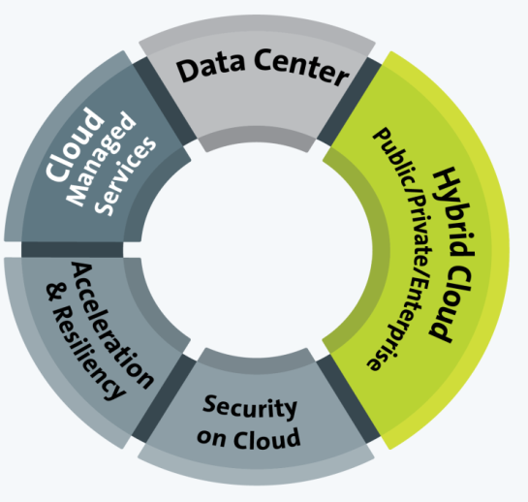


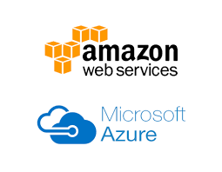
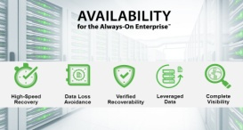
DATA CENTER SERVICES - CLOUD @ CORE
Rack | Space | Power
Managed Hosting Services
Cloud Ready
Managed Services
Enterprise Cloud
Cloud Nerve Center
OneTap | Dashboard
Security & Unified Reporting
Enterprise Grade
Secure & Custom Choices
Network Connected
Private Cloud
Converged | Hyper Converged
Fully Dedicated
Cloud in a BOX
Hybrid Ready
Application Acceleration & Security
Content | Media Delivery.
Cloud Security
Enterprise Application Access
CLOUD SERVICES
@ CORE
CLOUD SERVICES
@CORE
Public Cloud Services
Hyper Scale
Pay Per Use
Over 120+ Platforms
Resiliency Services
DR as a Service
Backup as a Service
Cyber Resiliency Service
Cloud Security Services
Zero Trust Security
SIEM Across Public, Private, Hybrid.
Cyber Resiliency

Slide 18
security transformation - Cloud @ core
Cloud delivered Security
From the Cloud
Security Services on utility model
Security for OT
Cloud Access Security
Securing Operations Technology
O365 | Salesforce | Google Apps
Data Security on Cloud
SDN & NFV based Services
Protecting Sensitive Data in the cloud
ADC | WAF | NGFW | NIPS
Vendor-agnostic approach
Cloud at Core
of Security
Transformation
Security Analytics
Security for Mobility
Enrich Intelligence with Visibility and Analytics
Anti-Phising | Anti-rogue
Securing the End Points
Security as a Service
User | Device | Thing
For the Cloud
Security Services build for Cloud IT

Slide 19
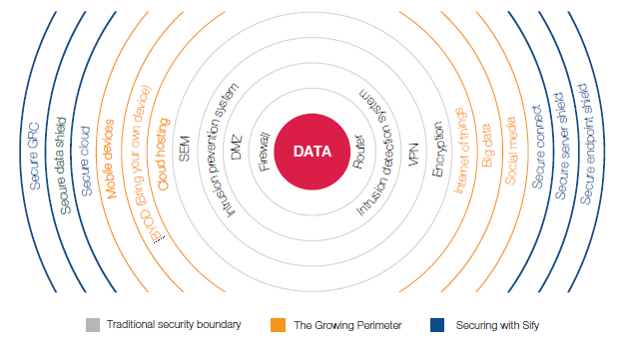
SECURITY SERVICES – CLOUD@CORE
Business drivers for securing IT environment
Advanced data breaches using sophisticated techniques
Increased exposure to hacktivism due to integration of new technologies
Increasing guidance and frameworks from industry organizations
Privacy and data protection regulations

Slide 20





Application services - cloud@core
Digital Platforms and Solutions on Cloud
Talent Management Service
Cloud driven Sify Mobile Application Solutions
Learning Analytics : Sify Learning Record Store for Learning Analytics solutions
ForumNxt and SffNxt
Sify LiveWire LMS : (3.0 and 4.0 under development. New UX and mobile app)
Business Process as a Service
Sify Customer Learning Portal Solutions
True SaaS Model
Partnerships :
Buzzyears Campus Management System
2. Sum Total Talent Management Suite
3. Partner HCM Integration on Cloud (Ramco)
Application & Registrations on Cloud
ForumNxt on Cloud
iTest on Cloud
AWS | Sify Cloud
Audit Apps on Cloud
SffNxt on Cloud
AWS | Sify Cloud
Exam day Support on Cloud
Support on Mobility and Cloud
CLOUD AT CORE
Results & Counselling on Cloud

Slide 21
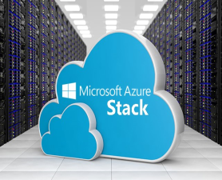

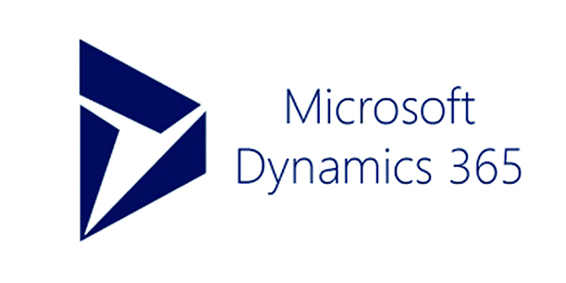
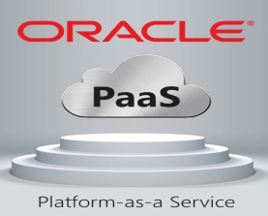
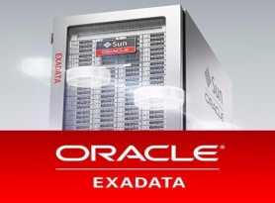









APPLICATION & PLATFORM SERVICES – Cloud@core
Sify Application and Platform Services
Applications
Big Data / Analytics
Platform
PaaS
IoT/ Blockchain
Network/Security
Storage/Compute
SAP Private and Public Cloud for S/4 HANA
Sify Application and Platform Services
SAP Cloud Platform
Automation / ML
PaaS
SAP Private and Public Cloud
SAP Cloud Platform
IaaS
SaaS
PaaS
PaaS
SaaS
IaaS
AIS-2 Cloud @ Core
AIS-2 Cloud @ Core

Slide 22



NETWORK SERVICES - CLOUD@CORE
Unified SLA
Integrated network and service management delivering high performance
Deliver transformational WANs to deliver transformational IT projects
Remote User
Branch Office
Internet
Integrated and scalable multi-service network
Enhanced business productivity
Sify WAN Transformation
Corporate Office
Mobility
MPLS
Public Cloud
Data Center
Optimal expense management
Integrated and uniform security management in the enterprise WAN
UC & C
Operational efficiency

Slide 23
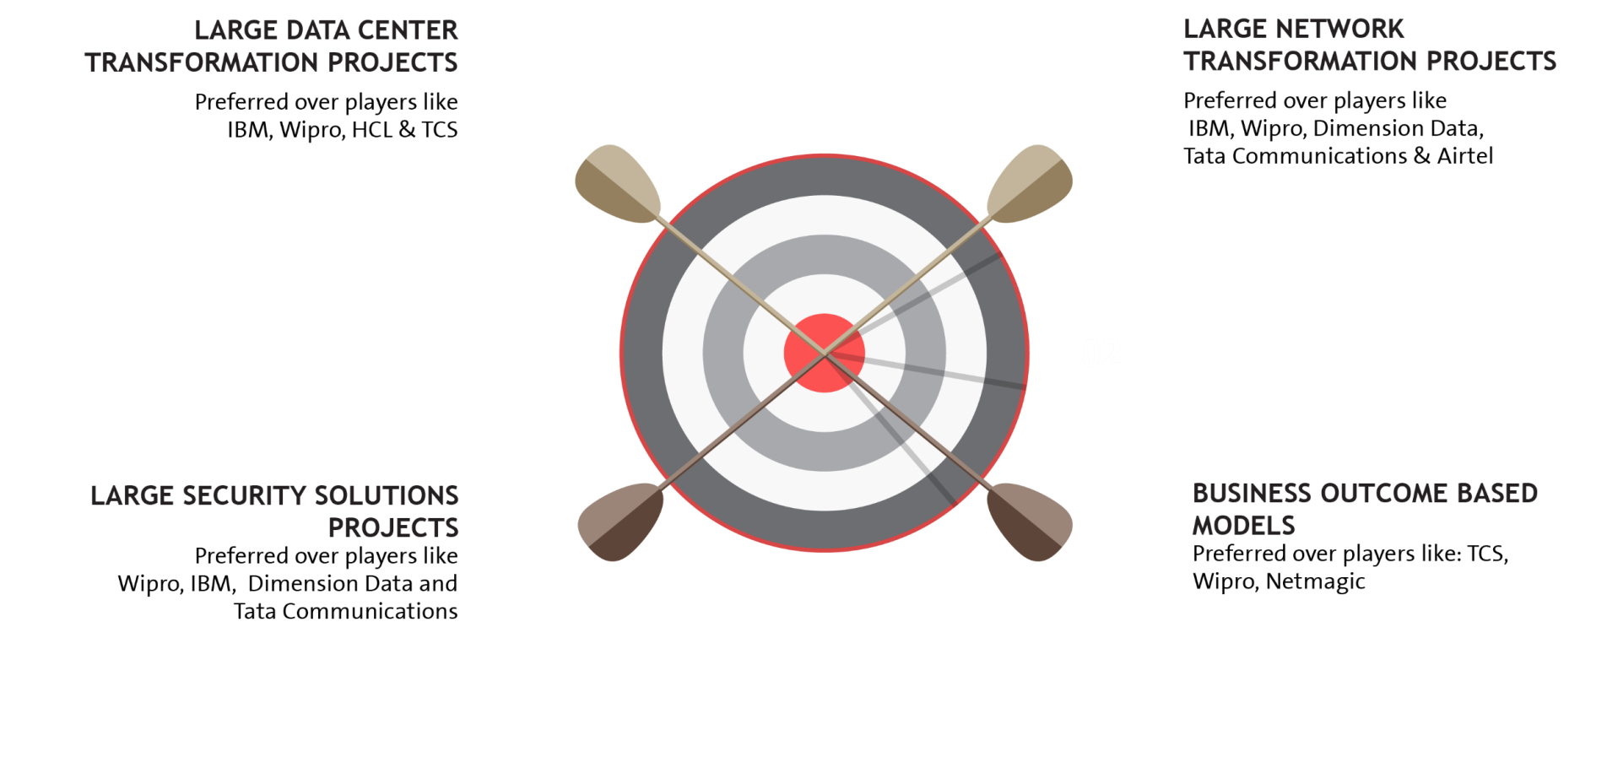


















EXECUTION CAPABILITIES

Slide 24
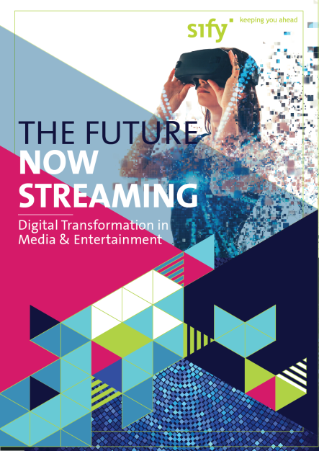
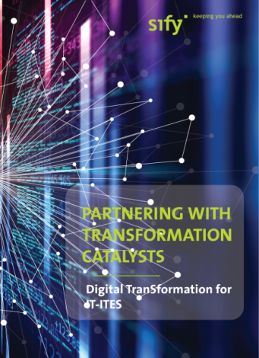






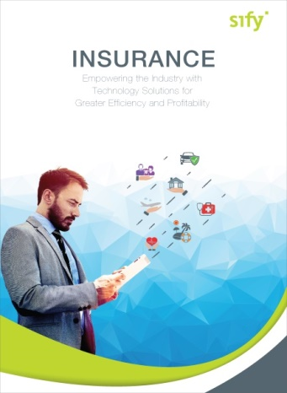

CLOUD@CORE: ALIGNING TO OUR VERTICAL STRATEGY

Slide 25
Cloud and sify relevance for MEDIA

Slide 26
SIFY ENGAGEMENT MODELS AND KEY STRENGTHS

Slide 27
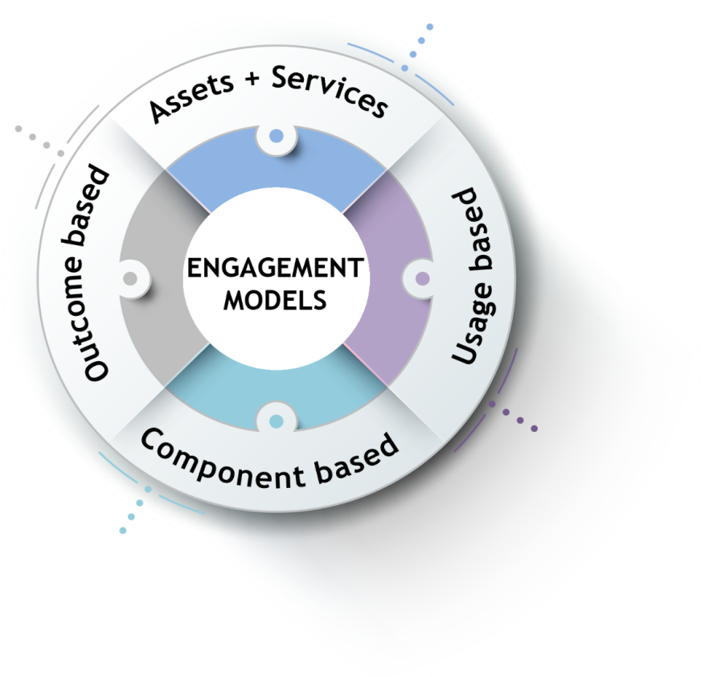
ENGAGEMENT MODELS
Systems are owned by the client and annuity based payout for services
Client engagement is based on defined business outcome generated by IT solutions and services
Less
Hardware
People
Licenses
No upfront investment by client and payout is based on consumption
Reduced upfront investment as client subscribes to infrastructure owned by Sify as a part of their overall infrastructure requirement

Slide 28
Our People Capabilities and Strengths
550+
DATA CENTER AND MANAGED SERVICES
1800+
NETWORK
SERVICES
70+
SECURITY
SERVICES
225+
APPLICATION
SERVICES

Slide 29











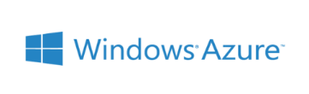















Strategic Partnerships
Technology Partners
Cloud and Acceleration Partners
Application Partners
Security Partners

Slide 30
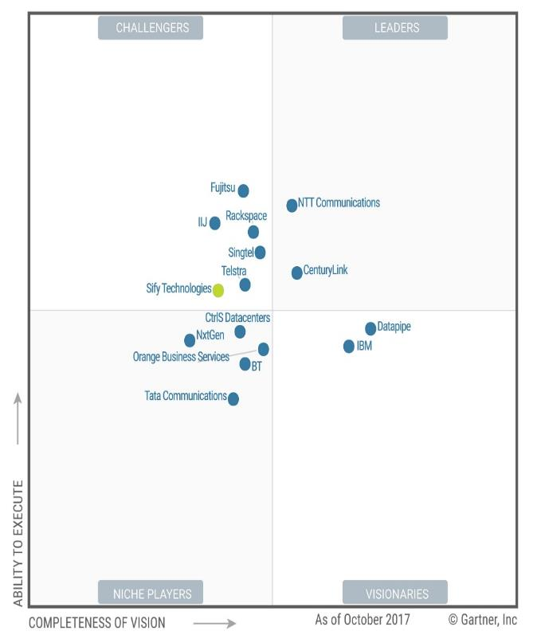

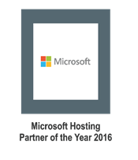
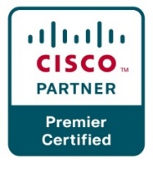


Recognitions
SIFY ENGAGEMENT MODELS AND KEY STRENGTHS
Partner of the year 2017
Network Transformation Services
2018
Data Center Transformation Services
2018
Sify moves up to the challenger position in the Gartner MQ for Managed Hybrid Cloud Hosting – Asia Pacific (2017)

Slide 31
SIFY CUSTOMER REFERENCES

Slide 32








CUSTOMER LOGOS

