Slide 1
Migration of SAP DC, NDR & DR
HDFC LIFE
April ‘21

Slide 2
Executive Summary
Current State
HDFC Life’s current SAP Landscape (SoH, BW, Solution Manager, EP, Fiori etc. systems) is colocated with Sify DC, Mumbai.
Since, the existing infra is reaching end-of-life, it is considering an SAP partner for hosting their SAP environment on Cloud.
Proposed State:
Offer comprehensive SAP Infra Managed Services and optional Basis support.
Migrate HDFC Life’s entire SAP landscape in DC, NDR and far DR to their target environment seamlessly with minimum downtime.
One stop solution to HDFC Life encompassing SAP infra migration, connectivity and managed services.
HDFC Life is India's leading life insurance companies, offering a range of individual and group insurance solutions that meet various life stage needs of customers.
The company currently has 37 retail, 8 group products in its portfolio and has one of the widest reach with 500+ branches in India, touching customers in over 900 cities and towns.

Slide 3
Project SCOPE
DC, NDR on AWS
Set up the DC infrastructure in AWS AZ1 for entire SAP landscape consisting of SoH, BW on HANA, EP, Fiori, Web Dispatcher, Content Server, Open Text, NLSIQ, Solution Manager & SAP Router and
Near DR for SoH in AZ2 of AWS
DR on Sify’s SAP Cloud
Set up the DR on cloud in a different seismic zone
on Sify’s SAP certified grid, Bangalore, for
SoH, BW on HANA and EP
Migration
Seamless migration of current SAP systems to AWS cloud AZ1 and setup of Near DR for SoH in AWS cloud AZ2
Managed Services & Basis Support
Managing the entire DC-NDR-DR infrastructure and replication link, perform DR drills and optionally provide Basis Support for the entire SAP landscape

Slide 4
SIFY EXPERIENCE: RELEVANCE TO HDFC LIFE
ZERO DEFECT SAP MIGRATION CAPABILITY | Experienced team of SAP Certified Consultants with rich migration experience across platforms Successfully migrated 50+ SAP systems many with re-platforming / upgrades / conversions Multiple instances of SAP on AWS deployed by Sify including multi-cloud solutions Complex on-prem to cloud migration including carve-outs using specialized tools
SAP HOSTING & SAP APPLICATION MANAGEMENT EXPERIENCE | SAP Hosting experience for 50+ customers SAP Certified for more than 6 years Comprehensive Application Management Services
CLOUD MANAGED SERVICES EXPERIENCE | 15+ years Experience in Managed Services Multi Cloud Management platform & services Supporting 300+ customers on Sify Cloud, AWS & Azure Established governance framework - executed several large DC/Cloud transformation projects
DR & BCP EXPERIENCE | Processes comply to Industry standards prevalent for RPO and RTO Service provider experience of offering Backup-As-A-Service, Disaster Recovery-As-A-Service on Sify Cloudinfinit, AWS, Azure Cloud
CLOUD & SECURITY SERVICES EXPERIENCE | 12+ years of comprehensive experience offering core security services to clients In-house 24x 7 Security operations center Multi skilled– Multivendor engineering services team, covering 50+ OEM solutions & Platforms
PARTNERSHIPS & INVESTMENTS | Advanced Tier Consulting Partner and Direct Connect Partner for AWS Deep experience of SAP deployment on AWS Offering certified SAP Private Cloud platform for 6+ years
OFFERING SINGLE POINT OF OWNERSHIP ACROSS CLOUD PLATFORMS, MIGRATION, MANAGED SERVICES & BASIS ADMINISTRATION

Slide 5
Sify-AWS Strategic Partnership
AWS Partner Network member enrolled and recognised as
Advanced Tier Consulting Partner
Channel Reseller
Direct Connect Partner
One of the key AWS Direct Connect Provider in PAN India, Sify has a unique advantage of having the Direct-Connect as well as its own Metro-Cross Connect that provides connectivity at 10G+ speed
AWS + Sify Advantage
End to end AWS Integrated service coverage - Access-Architect-Migrate-Manage-and Secure
Best in breed Hybrid-Cloud Configuration through our AWS Cloud Adjacent Data-Center connected at a 10G+ Speed at less than 100 Microseconds
Sify provides unified, integrated, single pane of glass of management across their private IT and AWS IT
Only Partner in India who can offer Cloud adjacent datacenter to AWS cloud by virtue of AWS cloud being hosted in Sify’s Rabale.
In-house Certified skilled resources on AWS Integrated Offerings covering the entire gamut of Platform/Infra, Direct-Connect, Cloud Front, SAP and Digital Services
One stop shop for Assess, Architect, Migrate, Manage & Secure plus other AWS Professional Services (Back-up, Disaster Recovery, Digital Services)
By virtue of being enrolled in Advanced Tier Consulting Track, Sify is a key partner of AWS providing the Advanced Managed services for AWS cloud integrated offerings

Slide 6
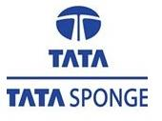
PARTIAL LIST of Sify’s SAP PROJECTS on AWS
Company | SAP Systems | Sify’s Services
 |  | DC Hosting & Managed Services | DR Setup | SAP Migration | Technical Upgrades | Basis Administration
Tata Steel Long Products | SoH, APO, DMS, EP | AWS |  | Carve-out |  | L1 to L3 (for 1 year Post Go-Live)
Tata Steel Mining | S/4 HANA | AWS | Sify SAP grid |  |  | Project Phase & Post Go-Live L1 to L3
JUSCO | ECC – IS Utilities | AWS | AWS
ISWP | ECC | AWS |  | ECC | EHP 0 -> EHP 8 | L1 to L3
Lux Industries | S/4 HANA | Sify SAP grid | AWS |  |  | L1 to L3

Slide 7
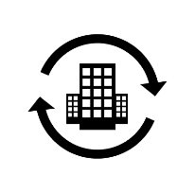
SIFY’s DC & Cloud Transformation Leadership in Insurance
Transformation of DC & DR along with Infrastructure refresh
Migration to Sify Data Center, DRaaS and Managed Services.
Max Bupa Health Insurance
General Insurance Corp.
Transform and private build cloud – Hyper converged infra for DC & DR. Migrate workloads to Private Cloud & Managed Services.
Insurance Information Bureau
Transform and build private cloud on Sify CI & Managed Services.
Transformation of DC & DR, Migration of DC to AWS and DR on hosted model,
Colocation and Managed Services for 5 years
DHFL Pramerica Life Insurance
DC & Cloud
Transformation
Oriental Insurance Corp.
Consolidation and Refresh of infra for hosting the core insurance application & Managed Services.
Strategic Green Field Data Centre / Disaster Recovery Build, Hosting + Managed Services for 5 years.
DHFL General Insurance
Max Life Insurance
Hybrid Infrastructure – Private Cloud and Public Cloud – Sify CloudInfinit and AWS

Slide 8
Proposed DC, NDR, DR solution

Slide 9
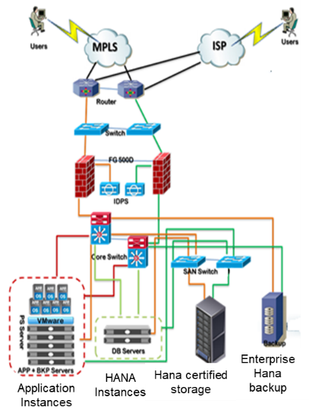
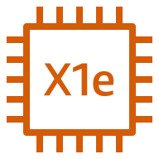
High Level Architecture Diagram
AWS Cloud (Mumbai) – DC & NDR
Disaster Recovery SAP certified Site – Sify CI Enterprise cloud @ (Bangalore)
VPC
Private subnet
Private subnet
Synchronous Replication
BW DB
SOH DB
SOH DB
Private subnet
Private subnet
Virtual Private Gateway
AWS Direct Connect
Application Instance
Application Instance
Public subnet
Public subnet
NAT Gateway
NAT Gateway
Availability Zone 1
Availability Zone 2
Snapshot
Object Storage
Archival Storage

Slide 10
Logical diagram– (option-1)
Production
Production, Dev & QA
Active
ECC
BW
ECC Prod
Cold Standby
ECC
Dev
MCOS
System Replication
Sync
Primary
Warm Standby
ECC
QA
3TB
3TB
3TB
1TB
BW
Dev
System Replication (Async)
BW
QA
Primary/ DC
DR

Slide 11
Logical diagram – (option-2)
Production, Dev & QA
ECC
Dev
MCOS
BW
Dev
Production
ECC
QA
BW
QA
2TB
Active
ECC
BW
ECC Prod
Cold Standby
3TB
System Replication
Sync
Primary
Warm Standby
DR
3TB
3TB
1TB
System Replication
(Async)
Primary/ DC

Slide 12
Solution summary – DC & ndr
Components | Option 1 - AWS (DC) | Option 2 - AWS (DC)
HANA Servers | 1) HANA Instances - 3TB (1 + 1 HA) 2) HANA Instance - 1 TB (1 nos) | 1) HANA Instances - 3TB (1 + 1 HA) 2) HANA Instance - 1 TB (1 nos) 3) SOH DB (QA) - 2 TB
Non HANA Servers (Prod + Dev + QA) | 1) 20 VM Instances with 166 vCPU & 1076 GB RAM 2) Dev & QA - considerd as 200 hrs per month 3) Production - considered as 3 year RI | 1) 34 VM Instances with 242 vCPU & 1532 GB RAM 2) Dev & QA - considerd as 200 hrs per month 3) Production - considered as 3 year RI
Storage | 1) HANA Storage - 29272 GB (SSD, 3000 IOPS / TB) 2) NON HANA Storage - 15042 GB (SSD, 1000 IOPS / TB) | 1) HANA Storage - 62040 GB (SSD, 3000 IOPS / TB) 2) NON HANA Storage - 23010 GB (SSD, 1000 IOPS / TB)
Licenses | Windows, Linux, Virtualization included in VM instances | Windows, Linux, Virtualization included in VM instances
Network & Security | 1) Data Out 2TB per month 2) Cloudwatch 3) NAT Gateway 4) AWS DirectConnect | 1) Data Out 2TB per month 2) Cloudwatch 3) NAT Gateway 4) AWS DirectConnect
Backup | HANA native backup 1) Snapshot Storage - 14 TB 2) Object Storage - 20 TB 3) Archival Storage - 20TB | HANA native backup 1) Snapshot Storage - 14 TB 2) Object Storage - 20 TB 3) Archival Storage - 20TB
Managed Services | 1) 23 VM & O/S Mgmt | 1) 38 VM & O/S Mgmt

Slide 13
Solution summary – DR
Components | Option 1 - Sify CI DR for AWS | Option 2 - Sify CI DR for AWS
HANA Servers | 1) VPE (Dedicated Server) - 3 TB (1 Nos) | 1) VPE (Dedicated Server) - 3 TB (1 Nos)
Non HANA Servers (Prod + Dev + QA) | 1) VPI - 12 Instances with 82 vCPU & 504 GB RAM (one month) 2) VPI - 15 Instances with 80 vCPU & 480 GB RAM (Year) | 1) VPI - 12 Instances with 84 vCPU & 504 GB RAM (one month) 2) VPI - 1 Instances with 6 vCPU & 36 GB RAM (Year)
Storage | 1) HANA Certified Storage - 24876 GB (3000 IOPS / TB) 2) Standard Storage - 12686 GB (1000 IOPS / TB) | 1) HANA Certified Storage (3000 IOPS / TB) - 12588 GB 2) Standard Storage (1000 IOPS / TB) - 6170 GB
Licenses | 1) HANA Servers - Suse Linux 1 Nos 2) HANA Servers - Suse Linux 13 Nos (Monthly) 3) NON Servers - Suse Linux 12 Nos 4) Windows licence - 6 Nos. 5) VMWare lic Virtual instances | 1) HANA Servers - Suse Linux 1 Nos 2) NON Servers - Suse Linux 13 Nos 3) VMWare lic Virtual instances
Network & Security | 1) Virtual Firewall (2G throughput) 2) VPN - 50 Users 3) AV 4) Public IP | 1) Virtual Firewall (2G throughput) 2) VPN - 50 Users 3) AV 4) Public IP
Backup | HANA native backup 1) Snapshot Storage - 3 TB 2) Object Storage - 5 TB | Not considered in DR
Managed Services | 1) Suse O/S Mgmt - 12 nos 2) Suse O/S Mgmt - 13 nos (Month) 3) Windows O/S Mgmt - 2 Nos 4) DRaaS Monitoring & Mgmt 5) DR Drills - 2 Nos | 1) Suse O/S Mgmt - 1 nos 2) Suse O/S Mgmt - 13 nos 3) DRaaS Monitoring & Mgmt 4) DR Drills - 2 Nos
Telecom | 1) IB - 20 Mbps 2) Replication Link - 50 Mbps 2) AWS Directconnect | 1) IB - 20 Mbps 2) Replication Link - 50 Mbps 2) AWS Directconnect

Slide 14
DC, NDR and far DR boq option 1 & 2
Option 1 AWS DC BoQ - https://sify-my.sharepoint.com/:x:/r/personal/tyagi_ashish_sifycorp_com/Documents/hdfc%20life/option%201%20aws.xlsx?d=w8a96a74f11b24e6ebb307db6c766376e&csf=1&web=1
Option 2 AWS DC BoQ - https://sify-my.sharepoint.com/:x:/r/personal/tyagi_ashish_sifycorp_com/Documents/hdfc%20life/option%202%20aws.xlsx?d=wf04adc91eed34271a070bb31dc77f211&csf=1&web=1
Option 1 Sify DR BoQ - https://sify-my.sharepoint.com/:x:/r/personal/tyagi_ashish_sifycorp_com/Documents/hdfc%20life/option%201%20sify%20dr.xlsx?d=web6c93a53c594d529928eb697a6fb255&csf=1&web=1
Option 2 Sify DR BoQ - https://sify-my.sharepoint.com/:x:/r/personal/tyagi_ashish_sifycorp_com/Documents/hdfc%20life/option%202%20sify%20dr.xlsx?d=w63b0ae3ab7254a0db49141c25bb948c7&csf=1&web=1

Slide 15
Migration Approach

Slide 16
MIGRATION APPROACH
Key Considerations:
Smooth transition to Cloud landscape
Minimum Business disruption
Approach:
Sify will Migrate Current systems to Cloud using Replication Method.
Systems will be migrated landscape wise (e.g. All development in one phase, followed by Quality and then Production).
During the Migration Sify will required 1 Downtime in each Phase which will be switchover period of around 4 hours.
Before any Switchover UT, SIT and UAT will be perform jointly by Sify & HDFC Life teams.
NDR will be build within 72 hours once Production environments is moved to AWS.
FAR DR will be configure at Bangalore location post DC and NDR is operational from Mumbai.

Slide 17
MIGRATION APPROACH
Setup Development/Test/Production Application architecture in AWS (same DB as Current DB)
DC Switchover to AWS and Change access of Test users to AWS for 1st level testing
Installation of Application at NDR(AWS) & DR and Start Replication from AWS to Sify DR Cloud
System wise cutover to AWS with logical grouping
Start Replication of landscape from Current DC to AWS
Testing of New Environment with Test Users and Note down the changes required during cutover
DC Switchover to AWS with Change of User Access

Slide 18
HIGH LEVEL ACTIVITIES
HDFC Life
Sify
HDFC Life
Backup of Current System before starting Replication
Changes in Current Production system for Replication
User Acceptance Testing will be performed by HDFC Life Business Users.
Provide Backup Plan to HDFC Life to initiate Backups
Provide Parameters for Replications to HDFC Life team
Installation of SAP systems at AWS
Enable Replication parameters at DR site
Switchover from current DC to AWS
Installation of SAP in NDR location (AWS)
Installation of SAP in DR location (Sify DC)
Enabling Replication between AWS and DR

Slide 19
Prerequisite, Assumption and Out of scope
Prerequisite
Remote connectivity of HDFC Life Ltd SAP systems (VPN access or Public IP server to access the server)
Windows Jump Server to connect the existing Customer’s on premise SAP Servers
Client to provide SAP, OS, DB User Credentials to connect the SAP Server (as per the Perquisite Sheet)
S-user ID and Password for SAP service marketplace
Need Production Server Downtime
DB team support required to enable replication parameters at DC site
Dedicated MPLS Link between HDFC Life DC to AWS to Enable DB Replication Setup
Out of Scope
Any New Development of Custom ABAP objects or Functional processes in SAP
Configuration/Upgrade of Peripheral devices, such as Printers, Faxes, Roll-out of SAPGUI on to workstations
Testing (post-migration) of any nature (regression or functional) is out of scope. HDFC Life Ltd will perform Unit Testing of SAP data post-migration
Creation/modification of Test Cases, Test Scripts
System backups during SAP Migration phase
Other than SAP systems, any third-party integration will be customer responsibility
Assumptions
Downtime window confirmation will be provided by HDFC Life Ltd during Production cutover
HDFC Life Ltd will coordinate with third party for creating additional RFC Connectivity to other non SAP source systems (if any)
System Backup will be scheduled only after migration of SAP Landscape
Any new changes during the migration will be considered as Change Request
All required Licenses are in place

Slide 20
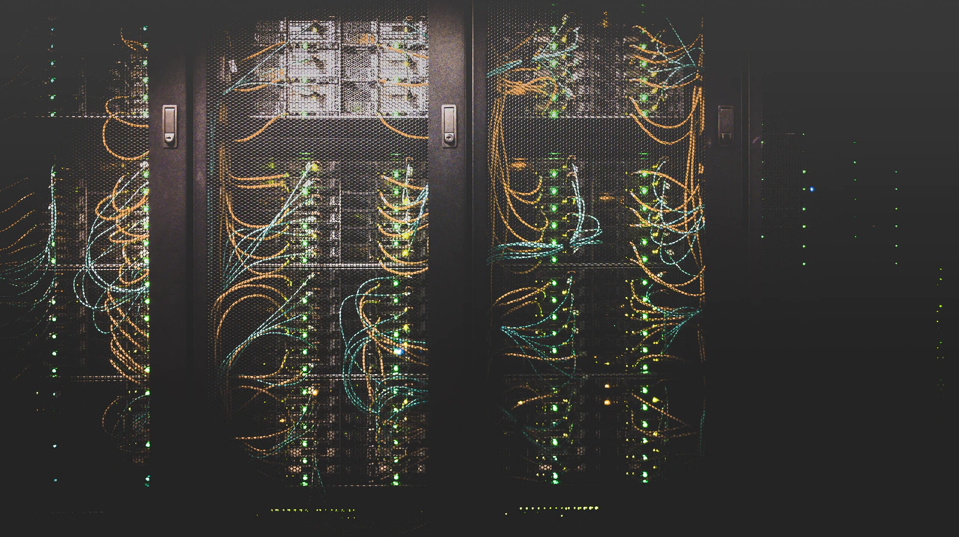
DATA INTEGRITY
Data Integrity using Monitoring Tools
Data Integrity using Verification Method
Data Integrity check via SQL Query
Data Integrity check with Manual Reports
Security for data transfer from primary to secondary site

Slide 21
Data integrity using monitoring tools
Checking the alerts for Data Integrity
With SPS09 system replication specific alerts were introduced (they are no longer hidden behind “Internal Events”):
System Replication Connection Closed
System Replication Configuration Parameter Mismatch
As of SPS12 a new system replication specific alert was introduced for systems running in operation mode “logreplay”:
System Replication Log replay Backlog
The alert is thrown when log replay is delayed on the secondary site causing a longer takeover time. The alert has a different priority based on the size of the redo log that was not yet replayed:–
LOW for 10 GB
MEDIUM for 50 GB
HIGH for 500 GB

Slide 22
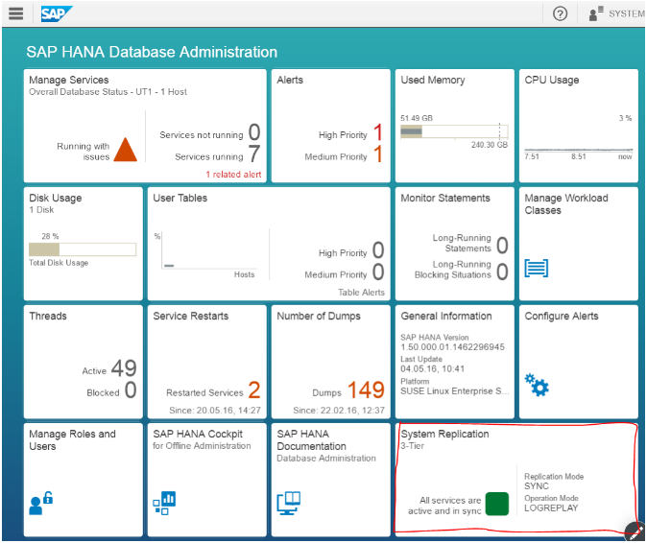
Data integrity using verification method
Using SAP HANA Cockpit
Since SPS11 the SAPHANA cockpit offers a system replication monitoring application.
You can access it from a browser by using this address: <hostname>:80<instance Number>/sap/hana/admin/cockpit
The System Replication tile displays the following states at a glance:
Not configured(meaning system replication is not configured)
All services are active and in sync (green square)
All services are active but not yet in sync (yellow triangle)
Errors in Replication (red circle)

Slide 23
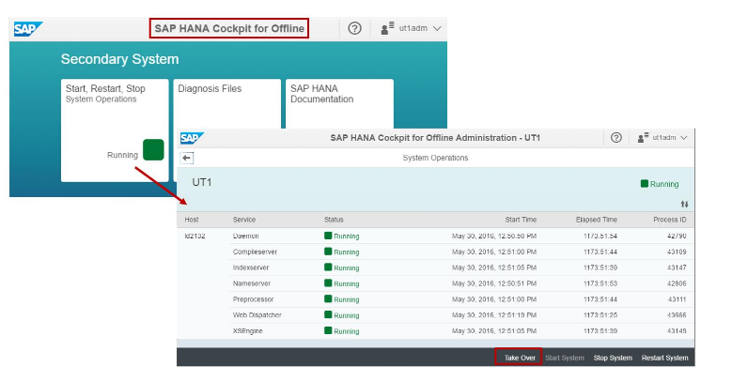
Data integrity using verification method
Using SAP HANA Cockpit

Slide 24
Data integrity check via sql query
Directly get system replication specific information from the system view M_SERVICE_REPLICATION
On the primary execute: select* from"SYS"."M_SERVICE_REPLICATION“
DATA INTEGRITY CHECK WITH MANUAL REPORTS
During the cutover, Sify to run reports on Source environment and the same reports to run on Target environment using same Parameters.
These reports are mainly from Finance (FI) Module.
Based on the reports output, Data Integrity between Source and Target environment to be certified by Sify
Sify to provide the above reports for any external audits for the migration

Slide 25
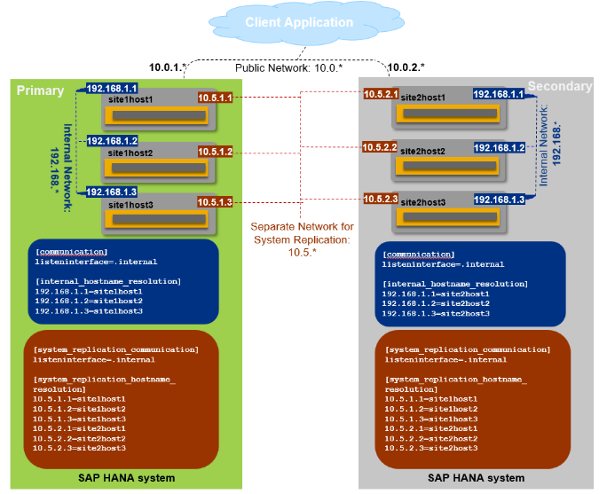
Secure data transfer from primary to secondary site
By default, the primary and secondary systems establish communication using the internal host names.
Connection will be SSL based VPN connectivity.
There is no chance of Data leakage during the Replication.
Multi-node SAP HANA System Replication over separate network with separate internal network

Slide 26
RISK mitigation plan
Risk | Impact | Risk Mitigation
Breakage of Link between two Data centers | High | During Data Replication period, continues monitoring of Log shipping has to be planned. In case of Link Failure for longer duration additional Link has to be plan
Downtime Over-run | High | Trial Run is been plan for rehearsal.
Testing Time Exceeded | Medium | Project Plan has to clearly mention timeline for UT, SIT and UAT
Change in Source System | High | Full Offline Backup is required before any critical change in source system.
HANA Version Change/Update during Implementation/Migration | Medium | HANA Patching and Upgrade has to be planned at the end of the migration/Implementation

Slide 27
Commercials

Slide 28
AWS – Option 1
DC - AWS
Cost Components | OTC | ARC | 5 Year ARC
Compute | - | 17,205,236 | 86,026,178
Storage | - | 3,088,561 | 15,442,805
PAAS | - | - | -
Network & Security | - | 12,658,934 | 63,294,672
Backup | - | 1,198,733 | 5,993,664
Telecom | - | - | -
AWS Cloud Managed Services | - | 938,400 | 4,692,000
One time AWS Cloud Infra Set-up | 651,250 | - | -
Sub Total DC | 651,250 | 35,089,864 | 175,449,320
5 Year AWS DC + Sify SAP Grid DR TCO = 22,02,16,314/-
Note: The TCO of 5 yrs is shown for comparison, but it is assumed that AWS contract will be for 6 years (3 + 3 yr)
DR - Sify CI
Cost Components | OTC | ARC | 5 Year ARC
Compute | 23,750 | 2,786,222 | 13,931,110
Storage | - | 2,226,507 | 11,132,535
PAAS | 5,000 | 483,400 | 2,417,000
Network & Security | 255,000 | 186,079 | 930,397
Backup | - | 497,531 | 2,487,653
Telecom - (IB, Replication BW & AWS Direct connect) | 45,000 | 1,065,000 | 5,325,000
DR Cloud Managed Services | 255,000 | 1,444,660 | 7,223,300
One time DR Cloud Set-up | 85,000 | - | -
Sub Total DR | 668,750 | 8,689,399 | 43,446,995
Billing will be on monthly basis as per actual consumption of the resources.

Slide 29
AWS – Option 2
DC - AWS
Cost Components | OTC | ARC | 5 Year ARC
Compute | - | 23,204,399 | 116,021,995
Storage | - | 4,460,501 | 22,302,504
PAAS | - | - | -
Network & Security | - | 12,658,934 | 63,294,672
Backup | - | 1,198,733 | 5,993,664
Telecom | - | - | -
AWS Cloud Managed Services | - | 1,550,400 | 7,752,000
One time AWS Cloud Infra Set-up | 651,250 | - | -
Sub Total DC | 651,250 | 43,072,967 | 215,364,836
5 Year AWS DC + Sify SAP Grid DR TCO = 23,96,61,604/-
Note: The TCO of 5 yrs is shown for comparison, but it is assumed that AWS contract will be for 6 years (3 + 3 yr)
DR - Sify CI
Cost Components | OTC | ARC | 5 Year ARC
Compute | 23,750 | 1,379,975 | 6,899,876
Storage | - | 1,120,317 | 5,601,585
PAAS | 5,000 | 207,400 | 1,037,000
Network & Security | 136,000 | 169,776 | 848,882
Backup | - | - | -
Telecom - (IB, Replication BW & AWS Direct connect) | 45,000 | 1,065,000 | 5,325,000
DR Cloud Managed Services | 255,000 | 676,685 | 3,383,425
One time DR Cloud Set-up | 85,000 | - | -
Sub Total DR | 549,750 | 4,619,154 | 23,095,768
Billing will be on monthly basis as per actual consumption of the resources.

Slide 30
SAP Services Summary
SAP Services for all Options | OTC | ARC
One Time SAP Installation & Migration | 4,562,500 | -
Basis Support - 24 x7 | - | 2,200,000
Sub Total SAP Services | 4,562,500 | 2,200,000
Additional SAP Services other Options
Basis Support 8x6 | - | 1,400,000

