Slide 1


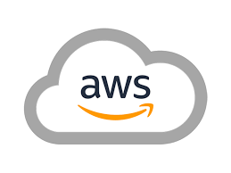

AWS Hybrid cloud Capability
We help customers to achieve their digital ambition through our
“cloud@core” products and services

Slide 2


Session objective
To share
To Showcase Roadmap
Sify’s relevance, thought leadership, customer engagements through skills, investments and partnerships across the entire spectrum of Hyperscale Cloud solution.
HDFC ERGO priorities and expectations from MSP for AWS Advance platform deployment

Slide 3






We believe
everything that can be migrated to cloud
must be migrated
For the rest, we have
cloud adjacent
datacenters to configure
the most efficient
hybrid multi cloud
Enabling your
hosted applications work
seamlessly
with cloud applications as if they are in the same datacenter
  With a
  10G+ speed
  connection to the
  hyperscale cloud
  at less than
  100 microseconds latency and
  < Rs.1 Lakh/annum
Sify owns the entire assessment, migration, security and managed services from any current state to any desired cloud configuration

Slide 4




cloud@core
TM
ALIGNED TO OUR CUSTOMERS’ CLOUD TRANSFORMATION PURSUIT
CLOUD ENABLING
CLOUD INSPIRED
CLOUD PURE
CLOUD ENHANCED
Cloud DC
Hyper reach/Hyper scale transport
Oracle FastConnect | ExpressRoute | DirectConnect | Partner Interconnect
Software Defined Network services
Cloud build
Private | Hyperconverged | Enterprise
Security services for cloud
Migration and Implementation services
Sify CloudInfinit
  Enterprise Multi-Tenant
  Dedicated
  Hosted SAP/S4 HANA
  Azure Stack as a Service
Edge Connect Services
SD-WAN
Collaboration services on Cloud
AWS
Azure
OCI
GCP
Multi Cloud Management platform & services
Modern Applications
Kubernetes-as-a-Service
AI/ML
Forum DIGITAL
HCM Digital (iTest)
Learning Management
Internet-of-Things (IOT)
Industry Solution-as-a-Service

Slide 5
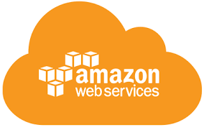
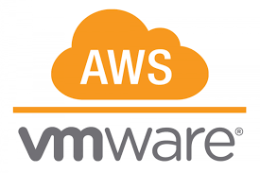
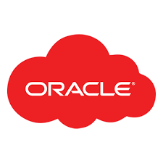
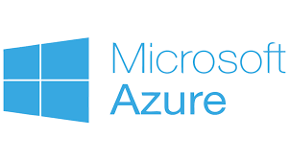



cloud adjacency: SIFY COMPLEMENTING HYPERSCALERS
Business Benefits of Sify’s Cloud Investment
Best of breed performance with Hybrid Cloud configuration
Efficient integrations with extended ecosystems
Compliance with data sovereignty
Business continuity with resilience
Simplicity with self service
Operational efficiency with reduced IT administration
Cost reduction with on-demand bursting to public Clouds.
Hyperscale Clouds AT VERY LOW LATENCY
RABALE DATA CENTER (Cloud Adjacent)
Hybrid Cloud
DC INTERCONNECT
Express Route
Hybrid Cloud
Direct Connect
Sify Cloud Connect
Hybrid Multi Cloud
Partner Interconnect
Colo + Managed Services
Far DR
Direct Connect
AIROLI DC ^{(Near Cloud / DR)} - Enterprise Multi Tenant Cloud ^{AT MINIMAL LATENCY}
Colo + Managed Services
Sify CLOUDINFINIT CMP | AIOps Platform for Managed Services
FAR DR READY
HOSTED PRIVATE CLOUD + APPS AS A SERVICE
CLOUD INFINIT
SAP GRID
ORACLE EXADATA
AZURE STACK
NEAR DR
Hyderabad Data Center

Slide 6








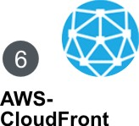


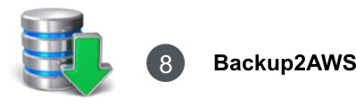
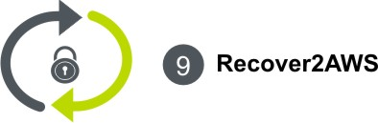
Sify AWS – our INTEGRATED Services
Notes:
Our GoInfinit AWS service portfolio caters to the requirement if you are already using AWS and also if you are new to AWS.
Consider a scenario if you are new to AWS and have a setup in a captive DC or in other colo providers DC or on other public / private cloud setup. We will help you in discovering and analysing the existing infra and design a solution on AWS. Offering is named as AWS-READY.
Now based on solution we designed, if customer is willing to move his workload to AWS then he can do so by subscribing for AWS-MIGRATE service.
Before migrating workload to AWS or to start new setup on AWS, you have to subscribe for infrastructure and services on AWS, for e.g. EC2, EBS, RDS, S3, etc. If you already have an AWS account for single billing we can consolidate your AWS account under Sify and on month end we will charge you along with other professional services. If you do not have then we will create new account for you and will subscribe AWS services for you. Services on AWS is covered under AWS-IT offering.
Comparing to traditional IT when you have your infrastructure ready, you outsource to managed service provider to manage and ensure uptime. Here as a part of 4th offering i.e. AWS-MANAGE we will manage and monitor your IT setup on AWS on 24 X 7 basis. As a part of MANAGE service looking at your utilisation trends we will help you optimise your infra spend on AWS.
When you decide to host on public cloud, security is a key concern. Roofed under AWS-SECURE we offer security services from 24 X 7 world class Security Operation Centre.
CloudFront is our sixth offering under GoInfinit AWS that offers acceleration and better user experience. We are also a partner of Akamai but CloudFront is an obvious choice for content serving if infrastructure is hosted on AWS.
We are also a Direct Connect partner of AWS, that helps us in offering and unique proposition of Integrated AWS and Private Cloud. On demand and pay as per usage option of AWS has allowed customers to store their Backup and setup their DR site on AWS. But what if primary site is of AWS?
We have solutions, our Backup2AWS offering helps you in backing up your AWS site data either in Sify IDC or your own DC. Similarly our Recover2AWS offering helps you in setting up your DR site either in Sify IDC or in your own DC.

Slide 7
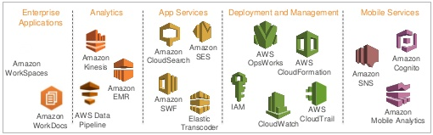

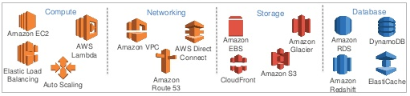
Sify AWS | AWS InFRA & Platform services
Sify offers complete IT stack on AWS Platform to customer as single window solution, whereby customer gets IT resources on AWS along with management, security, connectivity and optimization under single construct and SLA.
Platform services
Core / Foundation services
7
Notes:
Sity provides end to end coverage of AWS IT portfolio Sifyving choice to customers to have single window partner for not just management and support of AWS IT, but also providing the AWS IT components as part of integrated solution.
The offering is completely transparent whereby customer gets visibility of what is subscribed with AWS and various usage reports.
We are authorized channel reseller as well as Public Sector partner for AWS. As part of its AWS-IT portfolio, Sify brings together the design of right fit architecture leveraSifyng AWS IaaS components as well as suggesting right commercial model to leverage basis customer business and usage patterns. This provides effecting, cost optimized solution approach on AWS Cloud.

Slide 8






Sify AWS | Unique Selling Propositions (USP)
Single Window Solution partner
End to end AWS service coverage
Network, AWS IT, Security, Backup, DR & private IT
Assess, Architect, Migrate, Manage, Secure & Innovate
# | Features | Advantages | Benefits
1 | Single Window Solution Provider (Network, Security, AWS IT and Management) | Single Window Solution for all your AWS IaaS needs, right from Connectivity (DirectConnect) to setting up IT on AWS, securing your AWS setup as well as 24x7 monitoring and management | Easy adoption of AWS Cloud and cost savings
2 | End to end AWS service coverage - Access-Architect-Migrate-Manage, Secure & Innovate | Single point ownership to cover all aspects of AWS enablement with defined outcome | Simplified Execution and single point of ownership
3 | Integrated AWS network and security proposition | Sify with its DX Connect and Network, SOC capabilities, offers unique advantage of end to end service coverage | One Partner, Single engagement for all AWS needs
4 | Unified Dashboard across AWS IT and Private IT | Single dashboard for AWS IT as well as Private IT to Sifyve you unified view across your IT state | On-Tap visibility and Control for your complete IT
5 | AWS enabled Digital transformation | Infrastructure aligned to your business needs | New business models, faster time to market
Notes:
Single Window Solution provider for Network, Security, AWS IT and Management is Sify’s USP against competitors. For customer Sify is a single point of contact for AWS service coverage – Access – Architect – Migrate – Manage and Secure.
Sify has DirectConnect, Network and 24 X 7 SOC capabilities with this we are offering single engagement for integrated network, IT management and security to customer. So at any point of time sify is the single neck to catch hold of for Sify. We have industry leading service management platform and monitoring tools that offer single view to customer’s entire lasd scape Private or Public.

Slide 9
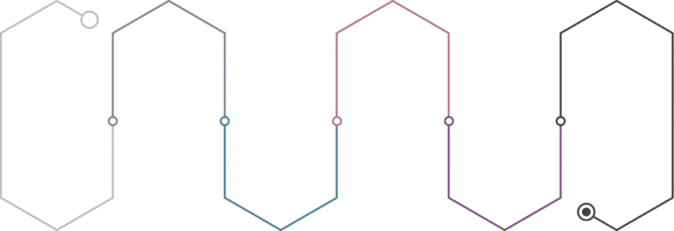
Sify Value Chain Platform- A truly All Ops Coverage
DevOps
ComplianceOps
AIOps
Tool Chain Setup
Continuous Integration
Continuous Deployment
Compliance Automation
Cost/Workload Optimization
Incident Prediction / Remediation
DevOps Prediction
Environment Provisioning
Application Provisioning
Security Assessment
Security Testing
Track Atomic Progress
Measure KPIs
CloudOps
SecOps
GovernanceOps

Slide 10

AI/ML Recommendations (AI Ops)
Sify Value Chain – AI Ops engine uses AI/ML to continuously predict and resolve tool chain as well as application performance and availability
  AI/ML Recommendation
  Workload Optimization
  AI Ops Engine
  Cost Optimization
  Detect abnormal behavior, predict issues, and identify root causes
  Alert business and technology owners proactively
  Avoid security, compliance, and performance issues
  Deployment Error Suggestions
  Application Performance Improvement
  DevOps Best Practices
  Security Issues
  Application Incidents Prediction
  Cloud Maturity

Slide 11
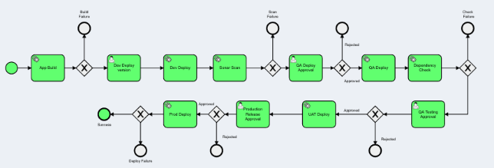
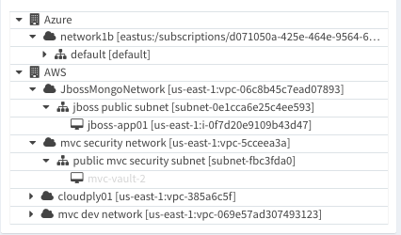
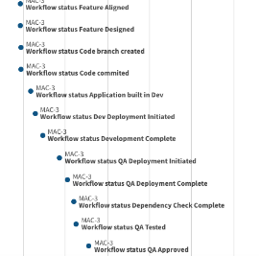
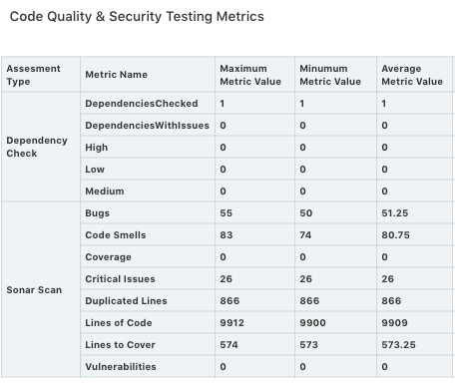
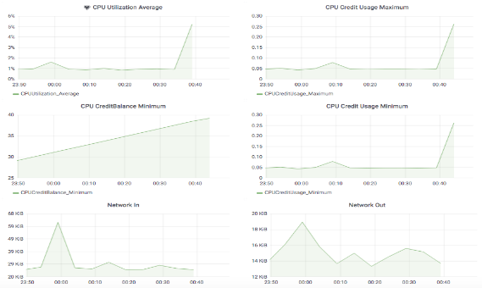
Sify Value Chain facilitates these key out of the box features
Sophisticated CI-CD pipelines
Scriptless Cloud Automation
Step by Step View of Feature Delivery and KPIs
Efficiency
Quality
Automated vs Manual Tasks
Code Coverage
Defect Rate
Setup Security & Compliance Policies
Continuous Application Assessments
Monitor & Optimize App Performance
Management Plane Scan
OS Scan
Vulnerability Scan
Dependency Check
Web Server Testing
Static Analysis
Dynamic Analysis
SOX
SDLC
ISO
PCI
GLBA
GDPR
11

Slide 12
SIFY’s EXPERIENCE & RELEVANCE
Critical Success Factor | Partner’s Desired Capabilities | Sify Experience & Relevance
ZERO DEFECT & MINIMUM DOWN TIME DURING MIGRATION | Experience of Complex Data Center Migration Best fit Migration strategy and approach Experienced team of DC Professionals with migration capabilities across multiple Hypervisor Experience of similar Migrations | Executed Multiple large-scale Hybrid DC Migration V2V, P2V Conversion using VMware Converter. Replication using SRM 100+ Cloud Certified Professional 70+ Private cloud customers
RIGHT CHOICE OF CLOUD INFRASTRUCTURE PLATFORM | Colocation, Private Cloud Experience ISO Certified DC Service Provider | Deliver Multiple Hybrid Migration on Sify CloudInfinit with Colocation ISO 9001, ISO27001, ISO20000
SINGLE POINT OF OWNERSHIP ACROSS ALL MIGRATION SERVICES | Capable of Providing end-to-end SLA | Experience of managing mission critical DC Transformation projects from design to execution and sustenance 24x7 Network Operation Center
TCO OPTIMIZATION | Low cloud economic | Sify own’s most of Assets to drive best value and lower cost

Slide 13
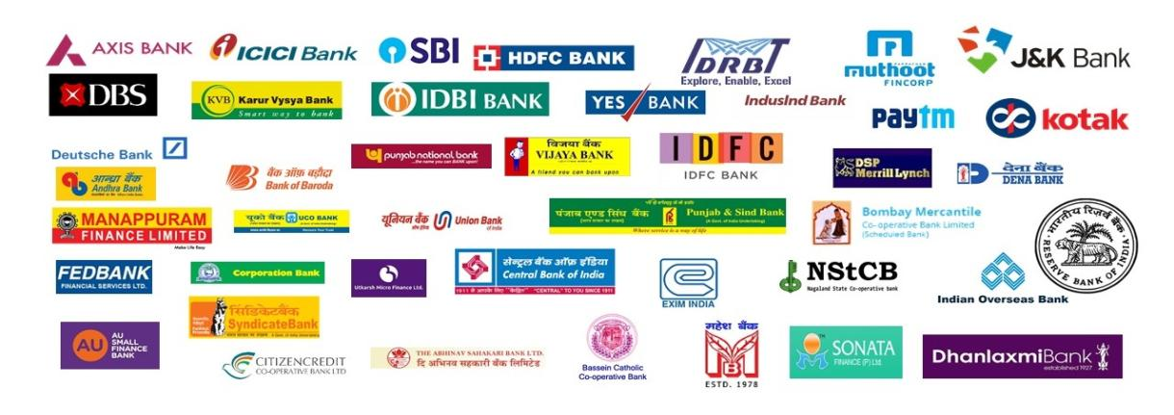
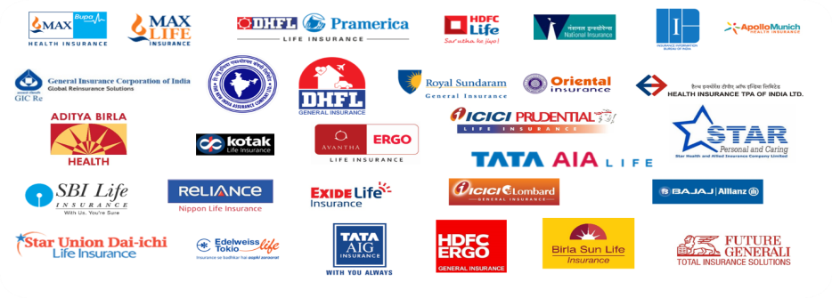
SIFY – BFSI CUSTOMERS

Slide 14
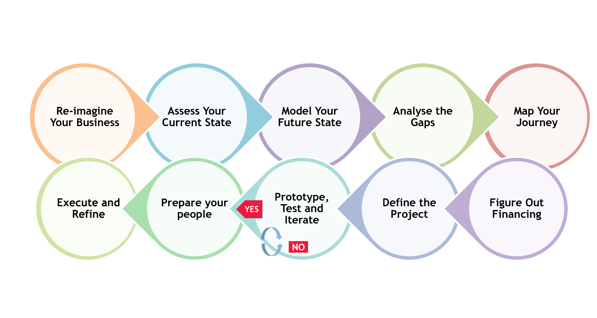
STEP BY STEP APPROACH FOR COST OPTIMIZATION
Following is an indicative 10 step guide. This however varies across industries and may need to be addressed while doing the digital strategy and roadmap

Slide 15
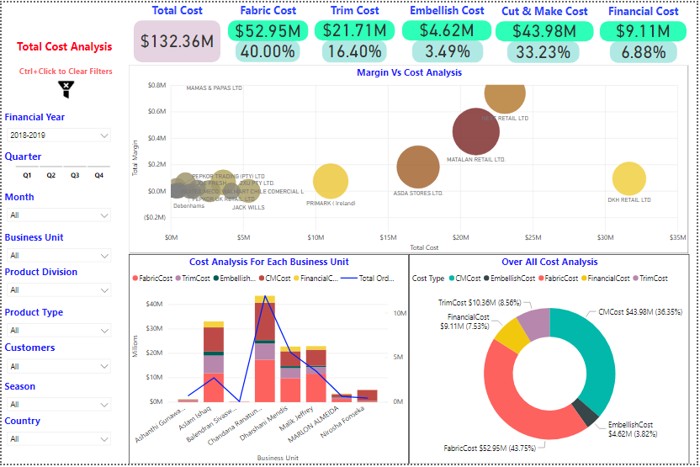
CLOUD COST ASSESSMENT : ILLUSTRATIVE DASHBOARDS
IT Costs
Infra Costs
N/W Costs
License Costs
Vendor Costs

Slide 16
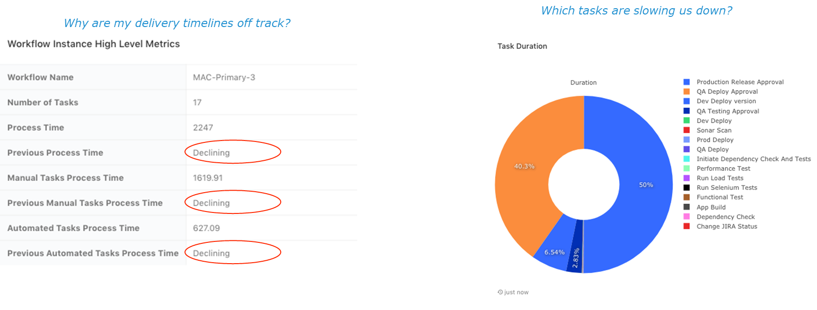
Improve and maintain Speed to Market - Dashboards provide KPIs to improve speed of software delivery

Slide 17
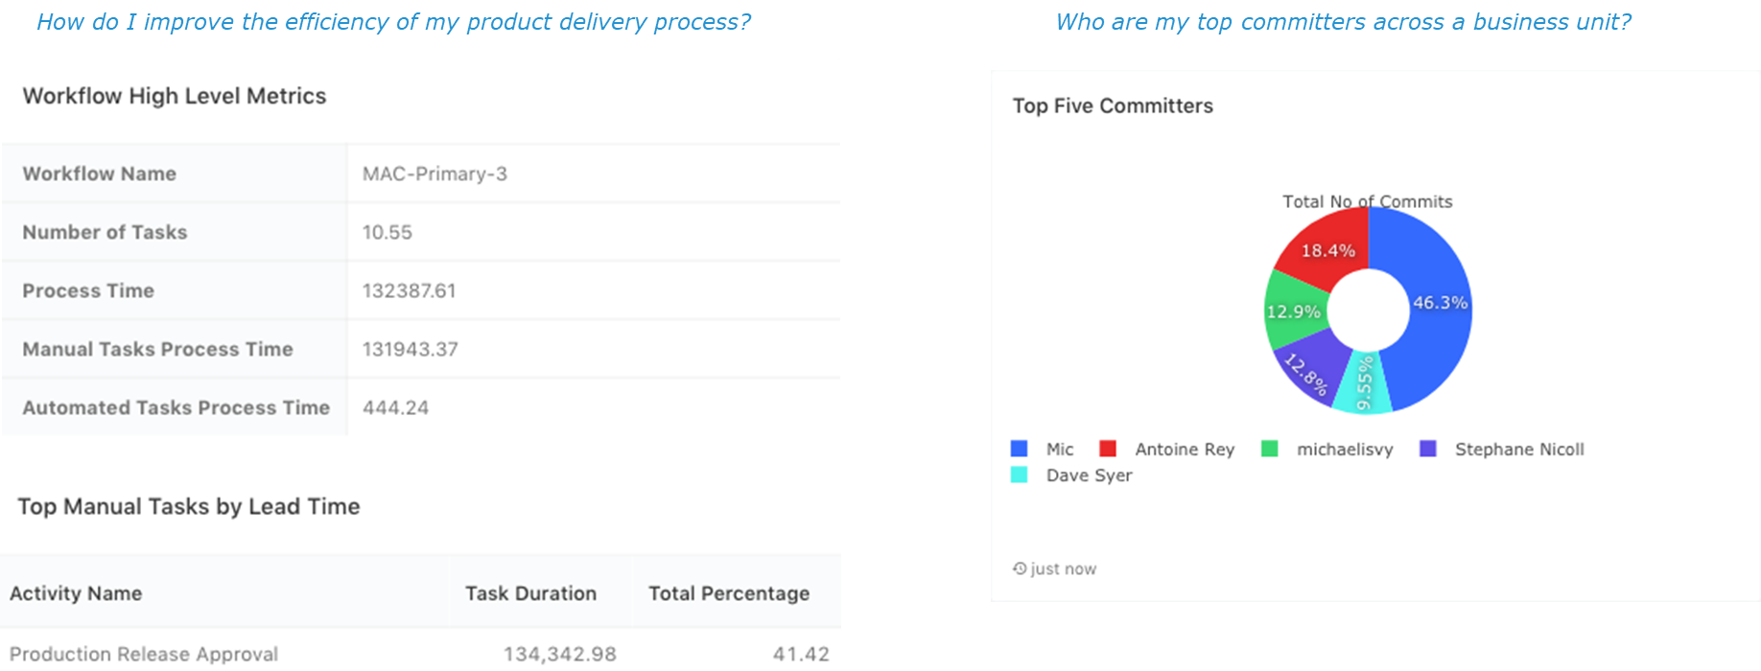
Enhanced Efficiency - Near Real Time Dashboards provide insights to improve efficiency

Slide 18
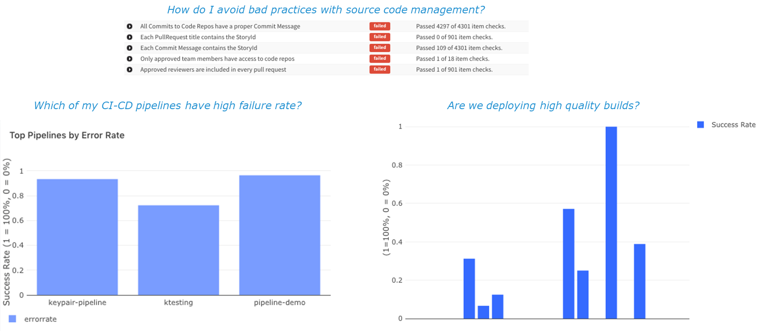
Reduced Change Failure Rate while maintaining High Quality - Dashboards help identify bottlenecks and gaps

Slide 19
Q & A

