Slide 1
DIGITAL TRANSFORMATION
August 2019

Slide 2
AGENDA
SIFY’S JOURNEY AND MARKET POSITION
CURRENT STATUS & SIFY’S RELEVENCE
EXECUTION FRAMEWORK
DIGITAL INNOVATION
CASE STUDIES

Slide 3
SIFY’S JOURNEY AND MARKET POSITION

Slide 4
SIFY’S JOURNEY SO FAR…
CONSUMER FACING ISP
SHIFT TO AN ENTERPRISE SERVICES COMPANY
FULL-FLEDGED TRANSFORMATION INTO AN ENTERPRISE SERVICES COMPANY
CONVERGED ICT SERVICES PROVIDER
CLOUD & DIGITAL SERVICES PARTNER
1995 - 1999
2000 - 2005
2006 - 2012
2013 - 2017
2017 & beyond
First private ISP in India
Listed on NASDAQ
Pioneers of internet penetration in India
Launch of MPLS service in India
Launch of first Tier3 Datacenter in India
Launch of remote infrastructure management (DC, Network, Security)
Launch of Cloudinfinit services
Expertise in managed datacenter and network services capabilities
Integrated security solutions
Launch of hybrid cloud and CI containers
10 DCs with full-fledged capacity
Cloud orchestration layer IP
Largest MPLS network
Cloud enabled DC, Network, Security services
Launch of business outcome based models
Launch of Digital Services Business Unit

Slide 5
Our People Capabilities and Strengths
700+
DATA CENTER AND MANAGED SERVICES
1800+
NETWORK
SERVICES
125+
SECURITY
SERVICES
225+
DIGITAL
SERVICES

Slide 6
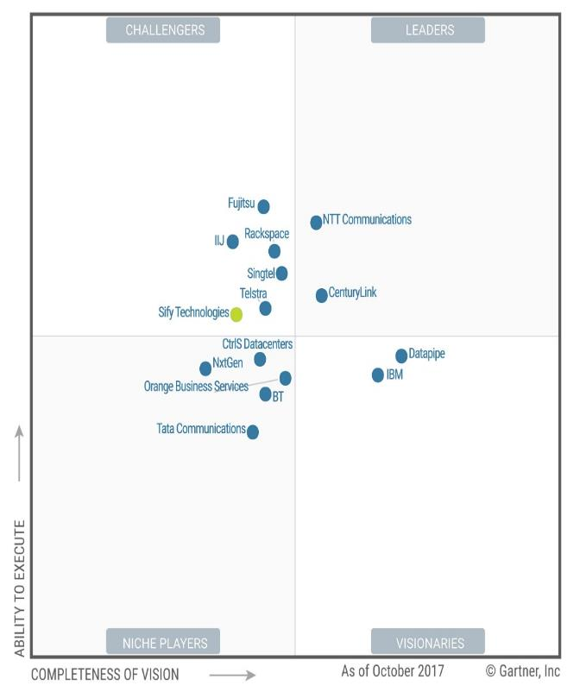

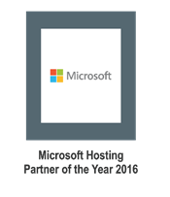
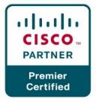
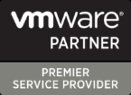


Recognitions
Partner of the year 2017
Network Transformation Services
2018
AWS Rising Partner Award
2019
Sify moves up to the challenger position in the Gartner MQ for Managed Hybrid Cloud Hosting – Asia Pacific (2017)

Slide 7
SIFY’S RELEVANCE

Slide 8
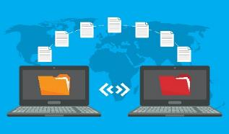





Key attributes of a DIGITAL transformation partner
Migration best practices for minimal services disruption
Provide a well-architected design for multi-cloud solution
Comprehensive security framework- preventive, corrective & detective
Multi cloud management platform on a single pane of glass
Resiliency and data protection planning and services
Digital services
AI, Data Lake, Analytics, DevOps ...

Slide 9




cloud@core
TM
ALIGNED TO OUR CUSTOMERS’ CLOUD TRANSFORMATION PURSUIT
CLOUD ENABLING
CLOUD INSPIRED
CLOUD PURE
CLOUD ENHANCED
Cloud DC
Hyper reach/Hyper scale transport
Oracle FastConnect | ExpressRoute | DirectConnect | Partner Interconnect
Software Defined Network services
Cloud build
Private | Hyperconverged | Enterprise
Security services for cloud
Migration and Implementation services
Sify CloudInfinit
  Enterprise Multi-Tenant
  Dedicated
  Hosted SAP/S4 HANA
  Azure Stack as a Service
Edge Connect Services
SD-WAN
Collaboration services on Cloud
AWS
Azure
OCI
GCP
Multi Cloud Management platform & services
Modern Applications
Kubernetes-as-a-Service
AI/ML
Forum DIGITAL
HCM Digital (iTest)
Learning Management
Internet-of-Things (IOT)
Industry Solution-as-a-Service

Slide 10


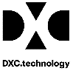






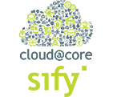



Cloud enabled digital transformation
CLOUD ENABLED DIGITAL TRANSFORMATION SPACE IN INDIA

Slide 11







Digital transformation Framework
ASSESS
MIGRATE
SECURE
MANAGE
INNOVATE
SIFY SKILLS & EXPERIENCE
End-2-end DC & Cloud migration assessment
Compute, Storage, OS , Virtualization, DB, Backup, DR, Network, Security, IT Operations
Experience on tools like Cloudamize, Device 42, TSO Logic, RISC Cloud Scape etc.
On-prem to private, hybrid, public cloud AWS, Azure, Oracle, Sify CloudInfinit-MC
Network capabilities (SD-WAN)
Cloud SI & Program Management experience
Experience on tools like Cloud Endure, Carbonite, ASR etc.
15+ years old Security Practice
70+ trained and certified resources on 30+ OEM solutions
Built 25+ captive SOCs
Cert-In empaneled
End-2-end managed services
Certified resources :550+ in DC and Cloud MS, 1800+ NMS and 250+ AMS
1200+ man years of tools and process experience
Supporting 1 mn+ tickets
Supporting 100,000+ business application users
15+ years of experience in applications practice
Skills in LAMP stack, SAP, Microsoft and Oracle apps
Skills in mobility, analytics, app modernization and AI/ML
250+ resources AMS
SIFY ASSETS
Assessment Framework
Templates
Own Network Assets
Own Data Centers
Direct Connect, Express Route, Fast Connect
Shared SOC serving 300+ customers
Security controls as a service
RIM centers @ Chennai & Hyd
NOC with own IPs (Beacon, Akash, iONI etc)
DRaaS
Investment in monitoring & management tools : CA
Investment in ITSM Tools : Service Now
BCP @ Hyderabad and Noida
Own digital IP like Forum, iTest
Multi cloud management framework
Own IP on Multi Cloud Management Platform
Continual pursuit to automate predictable operations and evolve into AIOps for managing defects

Slide 12


Sify as a transformation partner
Cloud assessment service
Recommend the to-be architecture and approach for a least disruptive and reliable migration
Workload migration service
Move from on-premise to Public and/or Private cloud
/ or
On–premise DCs to Sify’s world class Datacenters
Multi cloud managed service
Multi-cloud infrastructure and applications
Managed security services
Implement consistent set of controls to prevent security threats
Continuously monitor to detect security breaches
Tactical threat containment and automated response

Slide 13

Sify as a transformation partner
Sify’s cloud expertise extends over
All aspects of building cloud infrastructure
Managing public and hybrid cloud services
CloudInfinit CMP to provide multi cloud operational best practices
AWS/Azure/Oracle/Google cloud implementation
Delivering SaaS - ForumNXT, I-test, Safescrypt and E-learning
Leverage our network services to strengthen your cloud and digital pursuit
  Cloud connect services
  SD-WAN
  EdgeConnect services for IT + OT + People
  Network transformation services
  Cloud enabled unified communication services
  Network security services like clean connect & DDOS protect

Slide 14

Sify as a transformation partner
Investments in cloud infrastructure:
CloudInfinit (Enterprise multi tenant and private)
SAP Grid/ Exadata/ Azurestack Infrastructure
CloudInfint CMP
  Orchestration platform/ Service Now/ CA UIM
Datacenter fabric
High performance storage
High performance compute
Security platform
WAN Infrastructure such as metro rings
SD-WAN technologies
EdgeConnect technologies

Slide 15
Discovery and Assessment
Proposed Architecture with NW and Security Construct
Application and DB Migration
Cloud Operating Model
Business Continuity
Managed Services
Risk & Mitigation
EXECUTION FRAMEWORK

Slide 16
DISCOVERY AND ASSESSMENT

Slide 17




ASSESMENT Framework
Questionnaire
Deliverables
Benefits
Migration Risk Mitigation
Enhanced Productivity
Agent Less Tools
Broader & Deeper Support
Competent Experts
GI
SIFY
Asset List
Manual Inventory & Audit
Share
Participate
Validate
Approve
Collect
Observe & Analyze
Verify
Enumerate Risk
Recommend
Document
Risk Register
“Sify
Discover”
Architecture
Diagrams
Conduct
Interviews
Dependency Mapping
Conduct Workshops
Participate
Perform
Across all Discovery Parameters

Slide 18
Key Deliverables
Solution Architecture Documents
Pre Migration Checklist for Each Move Group
Post Migration Check List for Each Move Group
Landscape Sizing Document
Optimized Target Architecture
Revised LAN and WAN Architecture
Revised Security Architecture
Application Compatibility Report
App Environment Readiness Checklist (OS, DB, run-time)
Network Architecture
Access, Rights, Permission for Checklist
Backup Report Application Wise
WAN Link Planning Document
Roll Back Plan
DR Drill Calendar
Test Cases
Verification Checklist
DR Drill Calendar
Project Planning Documents
Pilot Move Group
Migration Move Groups
Migration Move Group Dates
Go/No Plan Checklist
Project Master Plan
Communication Plan
Continuous Risk Management & Risk Log
Micro Planning Timelines & Dependency Chart

Slide 19
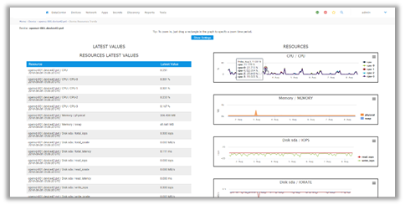
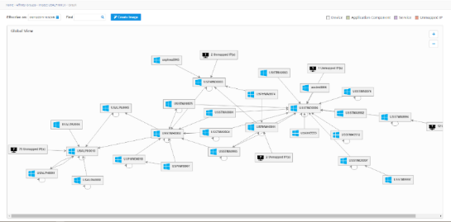
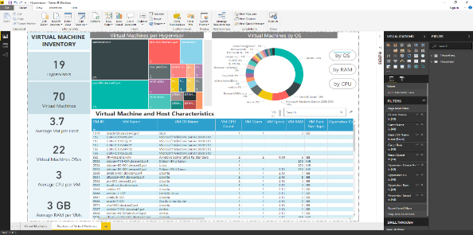
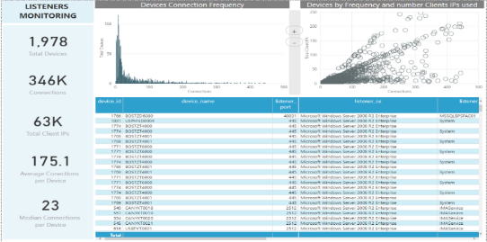
Sify Discover – Sample TOOL SNAPSHOTS
RESOURCE UTILIZATION
RELATIONSHIPS BASED ON CONFIGURATION

Slide 20
ARCHITECTURE WITH NETWORK AND SECURITY CONSTRUCT

Slide 21
CLOUD CONFIGURATION FOR NETWORK/SECURITY
AWS Account Creation
  Account specific to VPC
  Console Account-MFA (Mandated)
  All AWS account with Active Directory Integrated
VPC Configuration
  Multiple VPC- Production, Pre-Prod, Shared Services
  All these VPCs will be integrated with Transit-Gateway to support inter route as per business demand
  One Direct Connect will be common for all VPC
External Firewall
  External Firewall considered for AZ1 & AZ2
NACL & Security Group Configuration
  Configuration of NACL & Security group creation for each VPC section as per the SOP defined for each application.

Slide 22
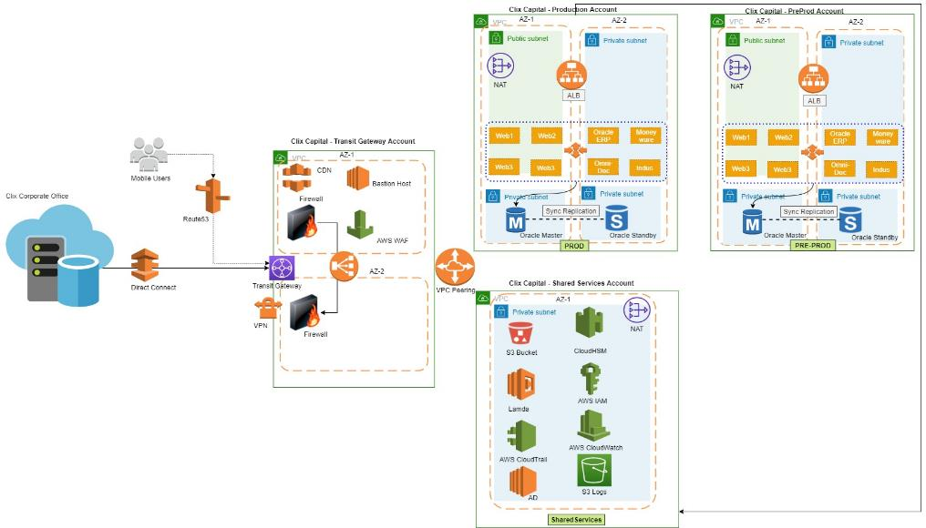
Cloud configuration for network and security (contd…)
Multi VPC with Transit Gateway
ALB considered for each VPC
Clix users data flow over DX
Route53-Hosted sites and
External Users VPN via External Firewall

Slide 23
APPLICATION AND DB MIGRATION

Slide 24
Data Center -> Cloud MIGRATION Framework
Data Center & Infrastructure Readiness
Client “ Business as Usual ” Operations & In-Flight Projects
Organizational Transition
Transition Start up
DC MIGRATION
Project Transition Cutover
Governance and Change Control
Discovery & Assessment
Migration Planning & Design
Go-to-Cloud execution
IT Optimization
at Target DC
After running 1-2 month optimization
Build application Group wise Analysis & Migration plan.
Enterprise Discovery
Discover ,Validate and highlight the environment resources & application dependency IT landscape .
IT Optimization
at Existing CLIX DC
Build target cloud : - Network, security ,Compute & PaaS
Streamwise Data migration in multi mode
Test Infra, security governance and application HA
Execute UAT test case
Change freeze in DC
Schedule application group wise differential data sync
Plan for cutover to target DC
Architecture Design & Migration Strategy
1 to 3 Months
Clean up at
Source DC

Slide 25
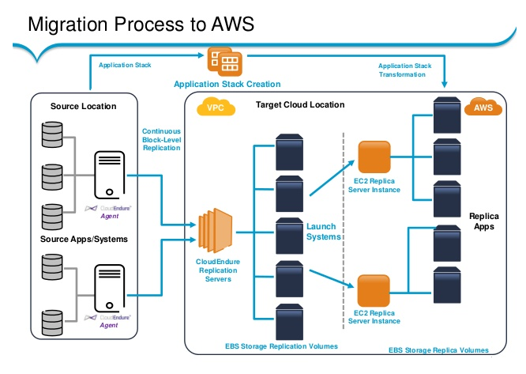
TOOL DRIVEN APPLICATION MIGRATION TO AWS
Support matrix
P2V , V2V
Physical servers (x86)
Virtualization – Vmware , Hyperv
OS – Windows , Linux , cent OS
Pre-requisites
Software agents for each server OS
Migration tool server at target
Bandwidth for data migration
Key Highlights
AS-IS migration of OS and applications along with data
Ease of deployment
Minimal switch over time

Slide 26
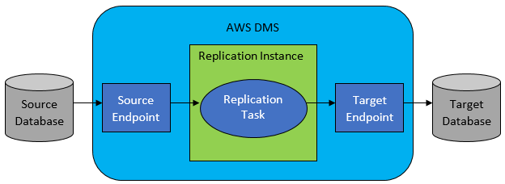
ON-PREM DATABASE TO AWS RDS MIGRATION
2
Source and Target data stores will be identified.
Endpoints configuration within AWS DMS that specify the connection information to the databases. ODBC configuration shall be configured to communicate with your source and target.
Provisioning of replication instance as AWS DMS for automatically configures with replication software.
Creation a replication task, and specifies the actual data tables to migrate and data transformation rules to apply.
1

Slide 27
CLOUD OPERATING MODEL – MULTI CLOUD MANAGEMENT PLATFORM

Slide 28














Multi cloud consumption should not require multitude of tools
Requirements for running Multi-cloud
Assessment, design, migration with continual cost and performance optimization
Consistent security across cloud platforms
Proficiency on the Resource Models / APIs for different Clouds
Understand the cost models of different clouds
Workload lifecycle monitoring and management
IP for best practices and best tools
MSS and MDR services under single pane of glass
Seamless Provisioning of workloads on any cloud
Right selection and continual monitoring for optimal cost
AIOPS Tools for holistic workload management
Multi-cloud management platform features
Notes:
Instead of the layered approach of mapping a capability with a requirement – as this is taking up a lot of real estate
We need to figure out a way of mirroring the previous slide by way of platform capabilities
THE EMPHASIS SHOULD BE ON WHY CLOUDINFINIT IS MORE THAN THE SUM OF THE PARTS – Parts being different tools for Assessment / Migration / Provisioning / Security and so on

Slide 29
Sify Multi-Cloud UX - Blueprint
Composed of cloud resources like VPC, Subnet, Instance & EIP as a single solution
Provisioned, decommissioned, managed as single unit
Ex: Sify supply chain solution ForumNXT on AWS includes the resources:
One Virtual Network and two subnets
Two application gateways
Two web servers, One App Server
Baston Host
My-SQL Database Service with HA
Blob Storage and
Auxiliary resources like
  Storage account, container
User can customize a blueprint (or build it from scratch) by
Adding / Modifying / Removing cloud resources with simple clicks
Dynamic forms are provided to enter each resource’s parameters with
  Intelligently prefilled values
Resource graph is generated
On adding a resource, the user can include:
Resource that needs to be newly created or
Refer an existing resource (say existing VPC) and build a solution
Entire blueprint with filled parameters can be saved as custom blueprint and
Used for repetitive quick deployments

Slide 30
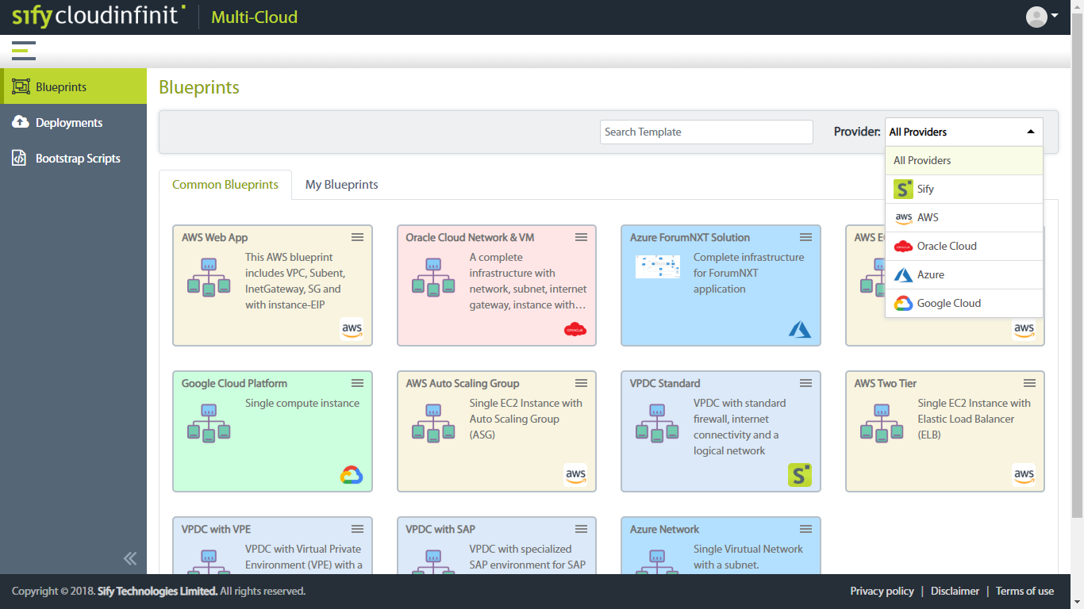
Sify Multi-Cloud UX
customize a blueprint (or build it from scratch)
Blueprint catalogue for common use-cases like
  Two-Tier/Three-Tier Web application in AWS
  Sify supply chain solution ForumNXT in Azure

Slide 31
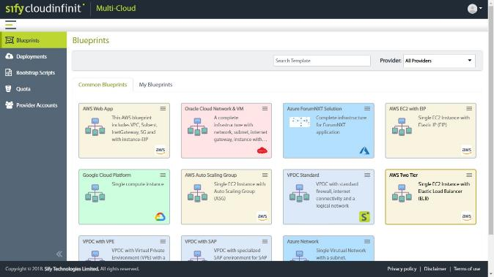
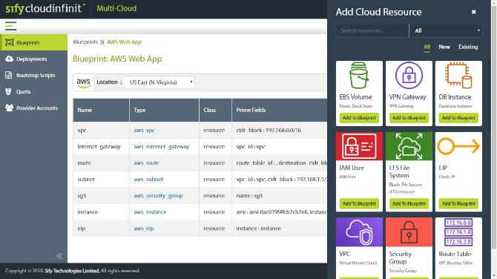
Adding/Modifying/Removing cloud resources with simple clicks

Slide 32
BUSINESS CONTINUITY PLAN

Slide 33
Sify Cloud DR Construct
MPLS/P2P
WWW
MPLS/WAN Layer Routing layer – Virtual & Multi tenant router services
Routers
External Firewalls
FW-3 tier Security Layer- Firewall layer – Virtual & Multi tenant Firewall services
Core Switches
Internal Firewalls
Access Switches
Zoned Server Farms
Computing – VMware Virtual private servers & Dedicated servers
SAN Switches
Enterprise SAN fabric and SSD Storage and NAS
Storage Farms

Slide 34





AWS DC & SIFY FAR DR Data Replication Architecture
Inactive for production
Elastic
Load Balancer
Route 53
Pre-requisites
Carbonite agents in the primary site
Carbonite console server in DR site
Carbonite management server in DR site
Work Flow
Carbonite agent is installed at each of source servers.
The agent communicates to the Carbonite Console server
Data is replicated to the DR site from primary to DR
During the fail over , final sync is performed by the Carbonite console server and VM at the DR site is brought up.
During fail back , the data is replicated back to primary site ( reverse replication.
rProxy r
Proxy
server
EC2
APP
Application Server
EC2
Master
DB
Database Native Replication
P
Data Volume
Database Server
AWS AZ
34
Sify DC
Scaled down stand-by DR
Scale up for production use

Slide 35


AWS & Sify (RPO & rto)
RPO <30 min
RTO < 4 Hr RTO dependent on number of servers ***
Connectivity 50 Mbps P2P link between AWS and Sify DR
Agent based replication will enable data replication between AWS site and Sify DR Site
Database replication shall be on native as async for continuous data replication to Sify DR
Standby environment in Sify will be scaled up for production load
Replication
Sify DC
DC
DR

Slide 36
CLOUD MANAGED SERVICES

Slide 37
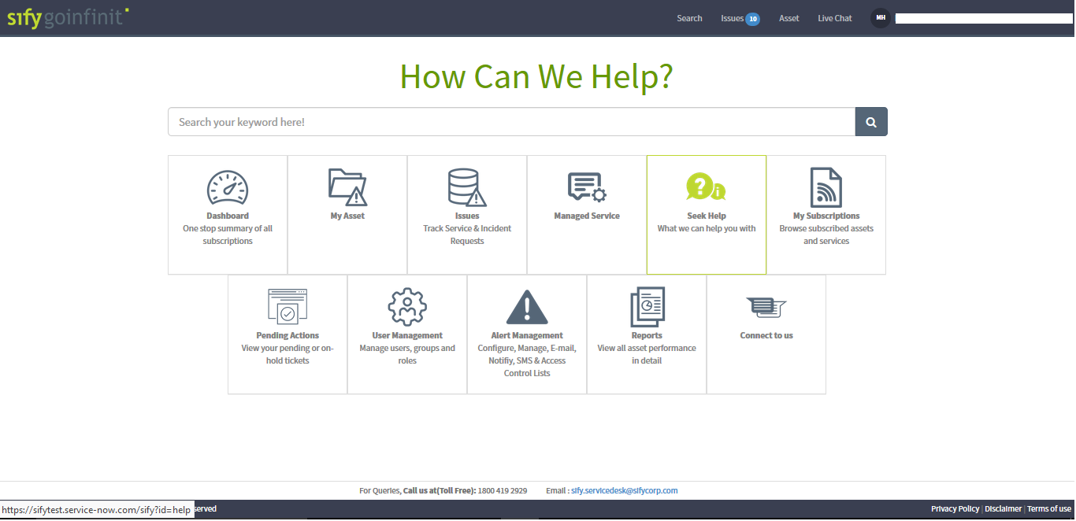
IT Service Management – Customer Experience

Slide 38
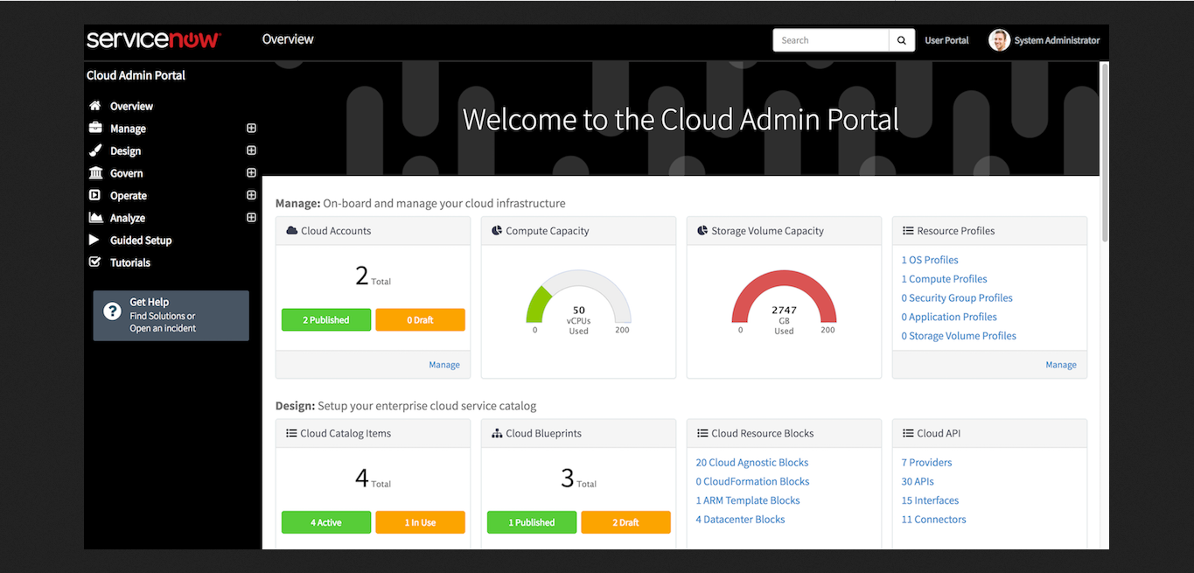
Cloud Admin Portal – reference layout

Slide 39
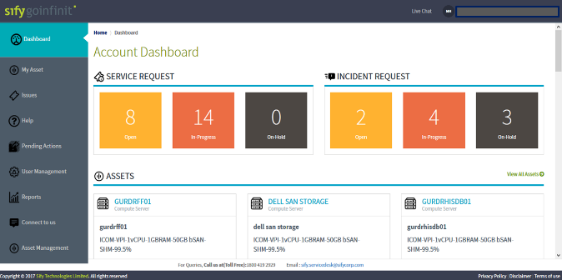
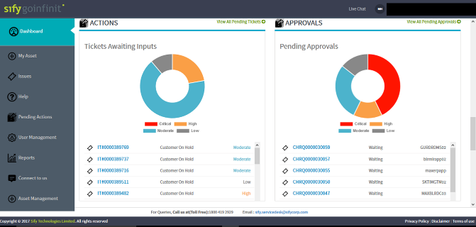
Our Tools and Automation Capabilities

Slide 40
RISK AND MITIGATION

Slide 41
Challenges AND Mitigation Plan
CHALLENGES | MITIGATION
Application usage post migration | Feature of non disruptive testing helps to test the application functionality in new infrastructure without disturbing the production setup and incremental data replication will happen at backend.
Minimum Service Disruption | Sify will work with application owners to ensure there is minimal disruption in services while switching over to Cloud, ensure end user communication is broadcasted well in advance.
Delay in Migration | Cutoff time/switchover time can be well planned in advanced and during the scheduled period all the servers will be migrated.
Availability of Client/3rd Party OEM | Sify will work with the customer to coordinate the availability of all resources according to the stakeholder matrix at various time frames in the entire project. Sify shall also send alerts and reminders to recheck the resource availability at respective times to keep related parties aware.
Network Availability | Bandwidth sizing requirement identified during the migration planning to be shared with stakeholders from Clix to estimate free capacity on the identified link when the move is planned. Necessary increments to be done in case required capacity is not going to be available during the migration activity.

Slide 42
DIGITAL INNOVATION

Slide 43



GI AWS+ | AWS digital innovation
DevSecOps
App
Modernization
AI/ML
Analytics
Sales Bot
Service Bot
Informational Bot
Application Bot
Productivity Bot
IOT Bot
Big Data
Data Visualization
Data Lake
Consulting
Infrastructure Management
Configuration Management
Deployment Automation
Cloud Infrastructure Ready
Cloud Optimize
Cloud Native

Slide 44




GI AWS+ | AWS digital innovation: AI/ML
Contact Center Bots
Chatbots for customer service
Account inquiries
Bill payment
Service update ….
Informational Bots
Chatbots for everyday consumer requests
News updates
Weather information
Game scores ….
Application Bots
Build powerful interfaces to mobile applications
Book tickets
Order food
Manage bank accounts ….
Enterprise Productivity Bots
Streamline enterprise work activities and improve efficiencies
Check sales numbers
Marketing performance
Inventory status ….
Internet of Things (IoT) Bots
Enable conversational interfaces for device interactions
Wearables
Appliances
Auto ….

Slide 45
GI AWS+ | chatbot Enables…..
Improving Customer Experience & Reducing costs
Deflecting live chats, email, and phone support through self-service automation reduces operational costs for contact center and reduced response time to customers
Supporting growth without increasing costs
By handling more customer interactions with a chatbot and deflecting the number of interactions that require a live agent, you can grow your customer base, expand your geographic footprint, and introduce new products and services without increasing your human capital costs.
Monetizing self-service
A chatbot gives you the opportunity to build and grow new revenue streams through proactive offer management and reduced shopping cart abandonment.
Improving customer loyalty
Reducing customer effort keeps customers coming back, which in turn, keeps your profitability higher as your customer lifetime value increases.

Slide 46















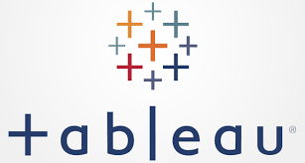


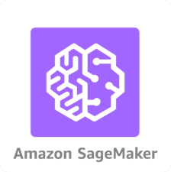
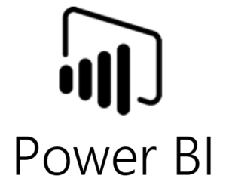





GI AWS+ | AWS digital innovation: data lake
Amazon IoT
Security Groups/ NACLs
Directory
Service
AWS IAM
Route53
AWS KMS
CloudWatch
CloudTrail
On-premise connectivity
Batch
Object Storage / Unstructured Data
Amazon S3
EC2 or ECS
AWS RDS
AWS Glue
BYOL
Time Series Data
Direct
Connect
DynamoDB
Real-time
BYOL
AWS Kinesis Firehose
Structured Data
DMS
Amazon
Redshift
ec2
AWS EMR
AWS Glue
Ingestion
Storage
Analytics
Visualization

Slide 47
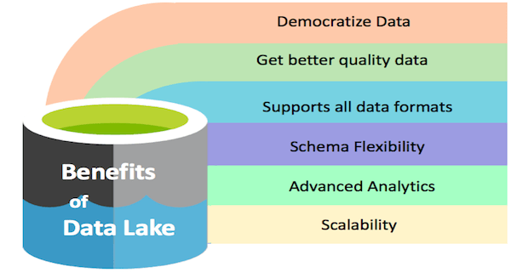
GI AWS+ | data lake Enables…..
A data lake is a centralized repository that allows to store all your structured and unstructured data at any scale. It can store the data as-is, without having to first structure the data, and run different types of analytics—from dashboards and visualizations to big data processing, real-time analytics, and machine learning to guide better decisions.
There is more data than people think
Data
Data platforms need to
grows
>10X
Every 5 years
live for
15
years
scale
1000X

Slide 48



GI AWS+ | AWS digital innovation: devops
AWS CodeStar
Source
Build
Test
Production
AWS CodeCommit
AWS CodeBuild
Third Party
Tooling
AWS CodeDeploy
AWS CodePipeline

Slide 49
GI AWS+ | devops Enables…..
TECHNICAL BENEFITS
CULTURAL BENEFITS
BUSINESS BENEFITS
  Continuous software delivery
  Less complexity to manage
  Faster resolution of problems
  Happier, more productive teams
  Higher employee engagement
  Greater professional development opportunities
  Faster delivery of features
  More stable operating environments
  Improved communication and collaboration
  More time to innovate (rather than fix/maintain)

Slide 50
GI AWS+ | AWS digital innovation: app modernization
Cloud Infrastructure ready Apps | Cloud Optimized Apps | oud Native Apps
Migrate/Lift and Shift | Modernize
Application’s Compute Target
Applications deployed to IAAS cloud environments | Monolithic or N-Tier apps deployed to PAAS app services like AWS Elastic Beanstalk or Azure App Service or container services | Containerized microservices, API gateways, serverless functions
Data target
SQL or any relational database on a VM | Managed databases on the cloud like AWS RDS/Aurora or Azure SQL databases | Fined-grain databases per microservice, based on managed cloud Databases or NoSQL databases
Advantages
No re-architecting, no new code Least effort for quick migration After moving to the cloud, it’s easier to modernize even more | No re-architecting Minimal code/config changes Improved deployment and DevOps agility lower costs for hosting and management Automation of some of the routine operation tasks taken care by the cloud platforms | Architect for the cloud, you get the best benefits from the cloud but new code is needed Microservices cloud-native approaches Modern mission-critical applications, cloud-resilient hyper-scalable Fully managed services, Optimized for scale and agility Built on deployment and DevOps

Slide 51
CASE STUDIES

Slide 52
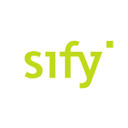




A leading insurance company looking to bring in more business agility and cost reduction
DPLI’s transformation goal: To sustain the growth and continue market differentiation, they want to launch digital services and equip themselves with an IT infrastructure that’s massively scalable and ready for cloud enhanced service development
Objective:
Why Sify was chosen?:
Sify’s value additions:
Implement integrated future ready digital infrastructure on hyper-scale Cloud
Reduce TCO
Create on demand agile IT infrastructure for easy adoption of micro services to deploy Data Lakes, IOT, AI, Containers
Having performed large scale migrations of BFSI customers to multi Cloud configurations
Customized NGIT Framework to meet Cloud requirements of DPLI-AWS Cloud to be managed out of a single management, governance and security framework
Facilitated frictionless migration of the workloads and applications to avoid vendor lock-in and realization of cost optimizations
Managing 350+ enterprise customer on Sify Cloudinfinit, Azure & AWS platforms
Partnered with AWS for hyper-scale cloud platform
Designed the cloud architecture on AWS through cloud assessment services to deliver a well-architected framework for risk free cloud migration
Migrated 100+ Instances using the proven CloudInfinit workload migration process
Providing service assurance with CloudInfinit multi cloud CMP
52
Notes:
Key message: IDRBT CHOSE SIFY TO RE-ARCHITECTURE ITS NETWORK TO FULFILL ITS SCALE, PERFORMANCE & RELIABILITY NEEDS
Have you ever imagined who manages all those NEFT transactions for RBI and its member banks? It is IDRBT who manages end to end all those transactions. IDRBT always required a trusted network partner which can help it achieve seamless operations as lacs of transactions takes place in a single day and now each & every transaction that we make between two banks lies on Sify network.
Sify with its expertise in designing, deploying and managing geographically distributed network architectures helped IDRBT with the same. For example, if there is one link in Nagpur and one link in Delhi, Sify knows how to create an architecture with which it can manage links in different geographies with 99.9975% uptime.
Sify designed a highly reliable architecture which connects RBI, member banks and data centers with single SLA so that IDRBT has the single representative for all their pain points. Sify didn’t just built the network and provided managed services but also configured valuable process additions including configuration assessment, software management, network automation and spares management.

Slide 53



Built secure hyper scale cloud infrastructure with Near and FAR DR
Before transformation:
After transformation
Customer success factors/ benefits
Infra sprawl – virtualized infra, on-prem, hosted private cloud at multiple locations
Capacity augmentation with long lead times due to lengthy procurement cycle
Inability to manage unplanned spikes
High cost due to over-provisioning
Lack of visibility on capacity utilization and performance
Absence of FAR DR
Single Sify-AWS public cloud solution for all the workloads
Low latency hybrid cloud between Sify hosted Core Insurance application and AWS public cloud
Transformation of IT from a maintenance service to a strategic business contributor
Pay-as-you go model with Auto-scalability, faster implementation
Pro-active monitoring of utilization and performance through CloudInfinit CMP
Enhanced resiliency by way of FAR DR
Drive and differentiate DPLI in its market powered by CloudInfinit transformation framework
Creating platform for upcoming projects around Data Lakes, AI, IOT
Migration of AS400 (core insurance application Life Asia is running on the same) from IBM DC & DR to Sify’s DC & DR
Managing the entire migration of public cloud & private IT infrastructure end to end
Notes:
Key message: SIFY operates, monitor and maintain INFINET network using own latest Network Monitoring Infrastructure
As over the time number of banks and transactions increased, IDRBT required far more faster and highly resilient network to fulfill its needs. IDRBT was facing issues as it had to deal with multiple vendors for its different requirements.
Sify came to the rescue and did the network transformation for them. They helped IDRBT achieve 99.9975% uptime achieved at their data centers as performance & event based resiliency network was created.
Sify became the network backbone of IDRBT and helped it run its in-house applications on the same network to member banks throughout India with single point of ownership.

Slide 54

How Max life transformed to a Digital services delivery model
MAX Life transformation goal: To revolutionize the customer engagement by digitizing it and in compliance with latest IRDA and RBI guidelines
Objective:
Why Sify was chosen?:
Sify’s value additions:
To digitize entire value chain of its business
Born-in-the-cloud Greenfield application deployment
Secure hybrid IT landscape in compliance with IRDA and RBI information security guidelines
To create a demand scalable and agile public cloud platform
Scalable and modular Infrastructure Architecture to be able to adapt to business and regulatory demands of Max Life
Auto scale to provide elastic upgrade / downgrade based per business requirement
Utility based Payment options like Pay-as-you-go
Extensive business relationship with the Max Group servicing Max Healthcare and Max Bupa
Deployed bimodal approach using Public facing workloads on AWS and Cloud Infinit
Migration of selected existing workloads from colo environment to AWS
Managed services for Sify Cloud Infinit and AWS workloads
Information security consulting, deployment and managed services for public cloud platforms
54
Notes:
Key message: IDRBT CHOSE SIFY TO RE-ARCHITECTURE ITS NETWORK TO FULFILL ITS SCALE, PERFORMANCE & RELIABILITY NEEDS
Have you ever imagined who manages all those NEFT transactions for RBI and its member banks? It is IDRBT who manages end to end all those transactions. IDRBT always required a trusted network partner which can help it achieve seamless operations as lacs of transactions takes place in a single day and now each & every transaction that we make between two banks lies on Sify network.
Sify with its expertise in designing, deploying and managing geographically distributed network architectures helped IDRBT with the same. For example, if there is one link in Nagpur and one link in Delhi, Sify knows how to create an architecture with which it can manage links in different geographies with 99.9975% uptime.
Sify designed a highly reliable architecture which connects RBI, member banks and data centers with single SLA so that IDRBT has the single representative for all their pain points. Sify didn’t just built the network and provided managed services but also configured valuable process additions including configuration assessment, software management, network automation and spares management.

Slide 55
Transforming the infrastructure allowing MLIC to focus on delivering business value
Before transformation:
After transformation
Customer success factors/ benefits
Setup was not in compliance with IRDA IT Guidelines
Lack of scalable environment to deploy new age applications
Lack of adequate security
Lack of agility
Reduced planning & deployment time
Adopted a bimodal approach allowing new age applications to leverage public cloud
Public cloud platform provided more scalability and agility for new application deployments
Holistic security controls for both the collocated and public cloud platforms
Business velocity increased to rapid customer acquisition
Able to leverage readily available digital solutions and constructs – on demand
Agile IT responding to business needs promptly
Ability to build new age loosely coupled application stacks
Huge cost savings in deploying new applications
Notes:
Key message: SIFY operates, monitor and maintain INFINET network using own latest Network Monitoring Infrastructure
As over the time number of banks and transactions increased, IDRBT required far more faster and highly resilient network to fulfill its needs. IDRBT was facing issues as it had to deal with multiple vendors for its different requirements.
Sify came to the rescue and did the network transformation for them. They helped IDRBT achieve 99.9975% uptime achieved at their data centers as performance & event based resiliency network was created.
Sify became the network backbone of IDRBT and helped it run its in-house applications on the same network to member banks throughout India with single point of ownership.

Slide 56
Challenges AND Mitigation Plan
CHALLENGES | MITIGATION
Application usage post migration | Feature of non disruptive testing helps to test the application functionality in new infrastructure without disturbing the production setup and incremental data replication will happen at backend.
Minimum Service Disruption | Sify will work with application owners to ensure there is minimal disruption in services while switching over to Cloud, ensure end user communication is broadcasted well in advance.
Delay in Migration | Cutoff time/switchover time can be well planned in advanced and during the scheduled period all the servers will be migrated.
Availability of Client/3rd Party OEM | Sify will work with the customer to coordinate the availability of all resources according to the stakeholder matrix at various time frames in the entire project. Sify shall also send alerts and reminders to recheck the resource availability at respective times to keep related parties aware.
Network Availability | Bandwidth sizing requirement identified during the migration planning to be shared with stakeholders from Clix to estimate free capacity on the identified link when the move is planned. Necessary increments to be done in case required capacity is not going to be available during the migration activity.

