Slide 1


MANAGED SERVICES PRESENTATION TO NCDEX

Slide 2

AGENDA
01
INTRODUCING SIFY
02
DATA CENTER AND CLOUD TRANSFORMATION CAPABILITIES
03
NETWORK SERVICES TRANSFORMATION CAPABILITIES
04
SECURITY SERVICE ENGAGEMENT MODELS
05
TOOLS & AUTOMATION CAPABILITIES

Slide 3
INTRODUCING SIFY

Slide 4
SIFY’S JOURNEY SO FAR…
Established HQ in Chennai
Listed on NASDAQ
Launch of MPLS service in India
Raju Vegesna takes over as Sify’s Chairman
Launch of SAP Private Cloud services and practice
Launch of business outcome based models
1995
1999
2001
2006
2013
2017
1998
2000
2004
2012
2016
First private ISP in India
First Tier3 Datacenter in India
Launch of RIM services, NOC, SOC services
Launch of Cloudinfinit services
VPEC hybrid cloud and CI containers offerings launched
Sify has surfed the wave of technology disruption from its inception

Slide 5
SIFY FINANCIALS
SIFY’S EVOLUTION
REVENUE & GROWTH
Cloud Transformation
Partner
Converged ICT Services
Provider
CAGR 19%
Managed DC and N/W Services Provider
Network/
Data Center
Service Provider
INR Crores
TELECOM SERVICES : IT SERVICES WALLET SHARE
PRODUCT REVENUE VS SERVICE REVENUE
In %
INR Crores
Notes:
Our financial journey in the past 5 years has been a true reflection of our stellar capabilities
We have transformed ourselves from a ‘Network/Data center provider’ to a ‘cloud transformation partner’
We have grown by 19% over the past 5 years with a Y-O-Y growth of almost 20%
The share of revenue from our DC centric IT services has grown over the years with the contribution rising from 34.3% in FY 2013-14 to almost 52% in FY 2017-18
The bulk of our revenue comes from services with the services revenue being 12-20 times of our revenue from products

Slide 6








BFSI Credentials
Data center Services
Network Services
35%+
Revenue from BFSI
300+ data center services projects executed in BFSI
50+ & counting
Marquee logos in BFSI
15+
network & transformation project executed
Data center migration & transition projects executed
Security services projects executed
Network Services
10000+
Public sector
Bank offices
5000+
Co-operative
bank offices
100+ BFSI Private
35+ SOC Services
80+ BFSI PSU
4500+
Private bank
offices
3000+
Public sector
Insurance co.
offices
25+ Security Engagements
20+ Security Projects

Slide 7
SIFY’S INVESTMENT IN DIGITAL AGE TECHNOLOGY
TREND
INVESTMENT
Increased adoption of cloud services
Increase in number of cloud DCs from 4 to 6
Two new cloud DCs are under implementation; 100% growth in capacity by 2020
Cloud and Software Defined Network Orchestration IP developed by Sify
Outcome focussed managed services
Service catalogue based Managed Services
Outcome focussed KPI driven SLA
Increasing demand for Utility models
All services delivered as pay-per-use in the following models
      Component Aligned
  Usage Aligned
  Business Outcome Aligned
Increasing play for service providers
Competence built up of Service Provider-led transformation in areas such as Network Integration, Hybrid Cloud & DC outsourcing
Converged services for IT & Telecom
Investment in all areas of ICT: Datacentre/Cloud, Network, IoT, Applications in service provider model built around productized services and delivered on utility models

Slide 8








ICT Services Led Transformation Leadership in BFSI (1/2)
Transformation of DC & DR along with Infrastructure refresh
Migration to Sify Data Center and Managed Services.
Transform and private build cloud – Hyper converged infra for DC & DR.
Migrate workloads to Private Cloud & Managed Services.
Transform and build private cloud & Managed Services.
Transformation of DC & DR along with Infrastructure refresh, virtualization & cloud set-up. Migration of applications from existing physical to virtualized environment and Managed Services.
DC/ DR & CLOUD
TRANSFORMATION
Consolidation and Refresh of infra for hosting the core insurance application & Managed Services.
Strategic Green Field Data Centre / Disaster Recovery Site Build + Migration + Managed Services for 5 years.
Hybrid Infrastructure – Private Cloud and Public Cloud – Sify CloudInfinit and AWS

Slide 9








ICT Services Led Transformation Leadership in BFSI (2/2)
Design, supply, integration, operations and management of 44 RBI locations,10 datacentres and 300+ Member banks secured network infrastructure in an outsourced model.
Design, implementation, integration, migration, operations and management of private network providing connectivity to members across the nation.
NETWORK
TRANSFORMATION
Design, integration, operations and management of 3,500 locations secured multi tower IT infrastructure in a managed services model.
Design, implementation, integration, operations and optimization of Security Operations Center solutions incl. SIEM, PIM, DLP, VAPT across DC & DR
Design, implementation, integration, operations and optimization of Security Operations Center supporting 30000 EPS & 1000 devices
SECURITY
TRANSFORMATION
Design, implementation, integration, operations and optimization of Security Operations Center solutions incl. PIM, DLP, VAPT, AV, MDM, AD, APT etc. across DC & DR

Slide 10
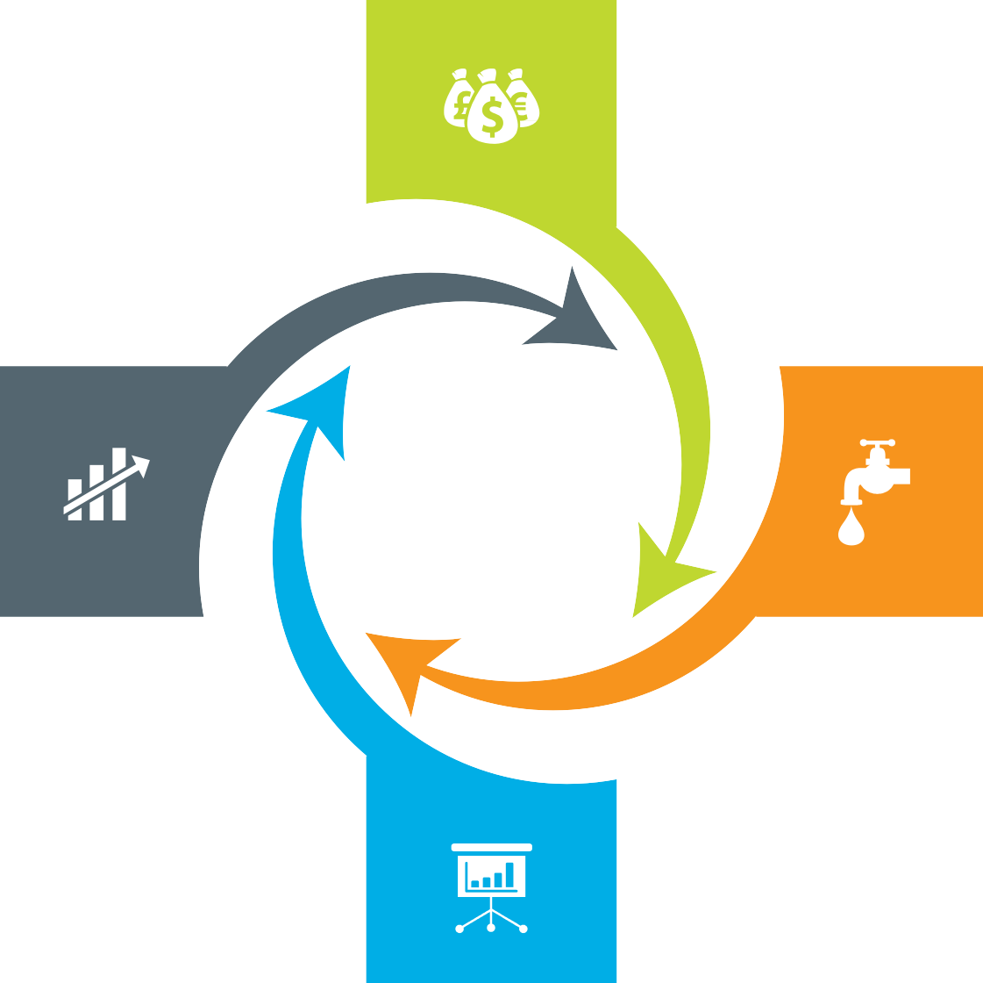
Our Engagement Models
Assets + Services Systems are owned by the client and annuity based payout for services
Outcome based Client engagement is based on defined business outcome generated by IT solutions and services
Usage based No upfront investment by client and payout is based on consumption
Component based Reduced upfront investment as client subscribes to infrastructure owned by Sify as a part of their overall infrastructure requirement

Slide 11
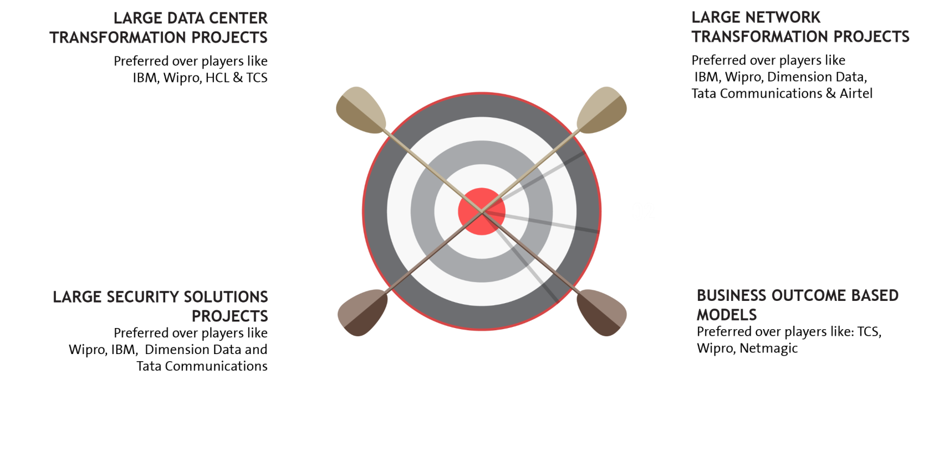

















EXECUTION CAPABILITIES

Slide 12


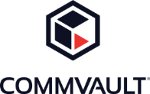









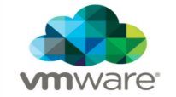














Strategic Partnerships
Technology Partners
Cloud and Acceleration Partners
Application Partners
Security Partners

Slide 13
Our People Capabilities and Strengths
550+
DATA CENTER AND MANAGED SERVICES
1800+
NETWORK
SERVICES
70+
SECURITY
SERVICES
225+
APPLICATION
SERVICES

Slide 14
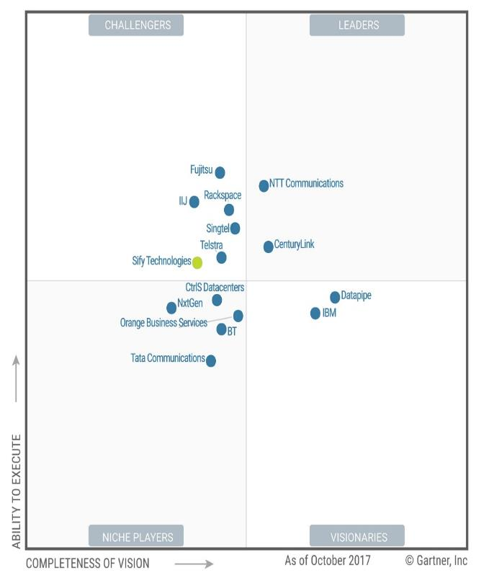

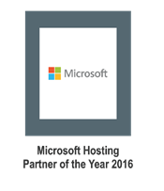
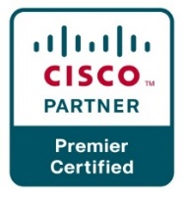
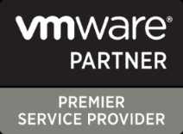

Recognitions
Partner of the year 2017
Network Transformation Services
2018
Data Center Transformation Services
2018
Sify moves up to the challenger position in the Gartner MQ for Managed Hybrid Cloud Hosting – Asia Pacific (2017)

Slide 15




cloud@core
TM
ALIGNED TO OUR CUSTOMERS’ CLOUD TRANSFORMATION PURSUIT
CLOUD ENABLING
CLOUD INSPIRED
CLOUD PURE
CLOUD ENHANCED
Cloud DC
Hyper reach/Hyper scale transport
Oracle FastConnect | ExpressRoute | DirectConnect | Partner Interconnect
Software Defined Network services
Cloud build
Private | Hyperconverged | Enterprise
Security services for cloud
Migration and Implementation services
Sify CloudInfinit
  Enterprise Multi-Tenant
  Dedicated
  Hosted SAP/S4 HANA
  Azure Stack as a Service
Edge Connect Services
SD-WAN
Collaboration services on Cloud
AWS
Azure
OCI
GCP
Multi Cloud Management platform & services
Modern Applications
Kubernetes-as-a-Service
AI/ML
Forum DIGITAL
HCM Digital (iTest)
Learning Management
Internet-of-Things (IOT)
Industry Solution-as-a-Service

Slide 16
DATA CENTER AND CLOUD TRANSFORMATION CAPABILITIES

Slide 17
Data Center and Cloud Services Driven Infrastructure Transformation Partner
Data center experience
Cloud experience
Over 250 man-years of experience in Data Centre build & operations
Own Cloud Orchestration & Management IP which is hosting 300+ customers
Designed and built 12 Tier III DC’s in India with 2 lakhs + sq. ft.
Implemented Hybrid Managed Cloud for 100+ organizations
Hosting major Enterprises, Govt, PSU, Global Cloud and Content Providers
MeitY certified CSP, STQC audit completed
Extensive experience in delivering end-to-end Data Centre services from design, implementation, operations
DC IT and technology integration experience
Service provider experience
Experience of providing IAAS/PAAS/DRAAS (300+ customers) on our Sify Cloudinfinit platform
In house team of 400+ skilled and certified resources to deliver projects
Our Cloud services offer industry-leading SLAs with guaranteed 99.95% uptime

Slide 18
Our Data Center Transformation Framework
TENETS
OFFERING
TENETS
OFFERING
Application as Service
Business Aligned
Pay per use model
SAP
Microsoft
Oracle
Sify Apps
Right Fit IT Strategy
Optimized IT and OPS
Future Ready
Discovery & Assessment
ROI Analysis
Transformation Roadmap
Apps
Transformation
IT
Modernization
Assessment
OFFERING
TENETS
OFFERING
Infra
    P – V
    V – V
  Platform
    Win8 – Win10
  Apps
    Lotus - Exchange
Agility
Autonomous
Predictive
Analytics
Change the Business
Digital IT
IOT
TENETS
}
Cloud
‘’0’’ Defect Migration
Seamless
End to end ownership
Innovation
Sify’s
DCT Framework
Migration
Security
Transformation
Infrastructure
as a Service
TENETS
OFFERING
TENETS
OFFERING
Seamless
Impregnable
Audit & Compliance
driven
Network
End Point
IT
Agility
Future Ready
Consumption
    Private Cloud
    Enterprise Cloud
      AWS/Azure/ CI
    Hybrid IT
  Backup
  DR
  Acceleration
  DC Security
OPS
Transformation
TENETS
OFFERING
Cloud Nerve Center
Shade and Dedicated Pool
End to end Management
Automation
Lean Operations
Cloud Ready

Slide 19
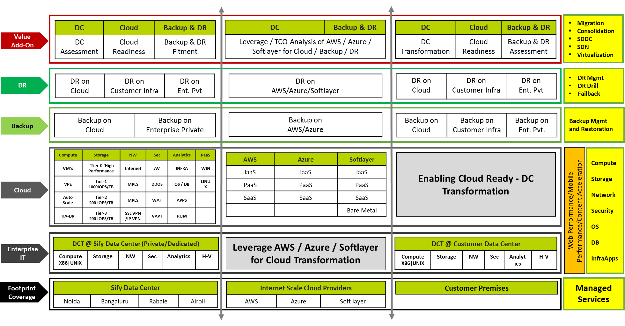
Data Center Transformation Aligned Services

Slide 20




DR SERVICES: MODELS
ON-PREMISE
SIFY CLOUD
SIFY COLOCATION
PUBLIC CLOUD
(AWS/ AZURE)
DRaaS
  DR Services through Sify’s Pre-validated architecture and tools to fulfil required SLAs
DR Build
  DR delivery model build as per Customer environment and Business Demand
DR Consultation
  Complete Assessment of environment to decide backup / DR Strategy
Managed Services
  DR Support Services for Customer’s Existing/new Setup
DRaaS
  Pay-As-You-Go Disaster Recovery as a Service
  Protect the security and continuity of critical IT service delivery
DRaaS
  Pay-As-You-Go Disaster Recovery as a Service
  Protect the security and continuity of critical IT service delivery.
DR Build
  DR delivery model build as per Customer environment and Business Demand
Managed Services
  Regular Backup & DR Support services | Profile/policy administration
DRaaS
  Pay-As-You-Go Disaster Recovery as a Service
  Protect the security and continuity of critical IT service delivery.
  Protect, replicate, recover & convert seamlessly
DR Build
  DR delivery model build as per Customer environment and Business Demand

Slide 21
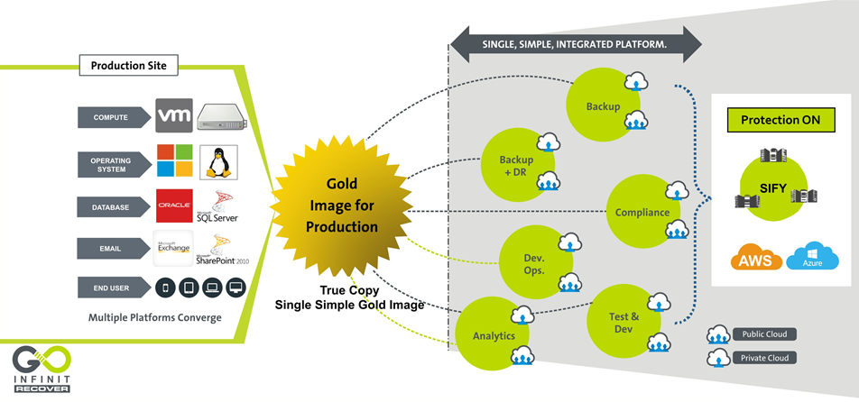
DR Services – Goinfinit Recover

Slide 22
Key References – Private (BFSI) (1/2)
Vertical | Reference Customers | Transition | DC/DR Hosting | DC IT Infra/ Private Cloud | DR IT Infra/DRaaS | Cloud | Managed Services
Insurance | Max Bupa | ü | ü | ü | ü | ü | ü
Financial Ins. | LIC housing finance corporation | ü | ü | ü | ü | ü | ü
Insurance | Avantha Ergo Life Insurance | ü | ü | ü | ü | ü | ü
 | Max Life | ü | ü | û | û | ü | ü
 | Tata AIG Life Insurance Company Ltd | ü | û | û | û | û | ü
 | HDFC Life | û | ü | û | û | û | ü
 | Apollo DKV Insurance | û | û | û | ü | ü | û
 | Aviva Life Insurance | û | û | û | ü | ü | û
 | Star Union Daichi Life Insurance | ü | û | û | û | û | ü
 | Health Insurance TPA | û | ü | û | û | û | û
Payment Gateway | Billdesk | û | ü | ü | ü | û | ü
 | Paytm | û | ü | û | û | û | û
 | YouFirst Money Express | û | ü | û | û | û | ü

Slide 23
Key References – Private (BFSI) (2/2)
Vertical | Reference Customers | Transition | DC/DR Hosting | DC IT Infra/ Private Cloud | DR IT Infra/DRaaS | Cloud | Managed Services
Banking | IndiaIdeas.com Ltd (BillDesk Payment Gateway) | ü | ü | û | ü | ü | û
 | The Thane District Central Co-op Bank Ltd. | ü | û | ü | ü | û | ü
 | Fedbank Financial Services Ltd. | ü | ü | û | û | ü | ü
 | Bombay Mercantile Bank | ü | ü | ü | ü | ü | ü
 | Axis Bank | ü | ü | û | ü | û | û
 | J&K Bank | ü | ü | û | û | û | û
 | Yes Bank | û | û | û | ü | û | û
 | The Hindustan Co-op Bank Ltd. | ü | ü | ü | ü | û | ü
 | Corporation Bank | û | ü | û | û | û | û
 | The Nagaland State Co-operative Bank Ltd. | û | û | ü | ü | û | ü
 | Bassein Catholic Co-operative Bank | ü | ü | ü | ü | ü | ü
 | Citizen Co-operative Bank | ü | ü | û | ü | ü | ü

Slide 24
Key References – PSU (BFSI)
Vertical | Reference Customers | Transition | DC/DR Hosting | DC IT Infra/ Private Cloud | DR IT Infra/DRaaS | Cloud | Managed Services
Insurance | Oriental Insurance Company Limited | ü | ü | ü | ü | ü | ü
 | General Insurance Corporation | ü | ü | ü | ü | û | ü
 | NIA | û | ü | ü | ü | ü | û
 | National Insurance Corporation | ü | û | ü | û | û | ü
Banking | Allahabad Bank | ü | û | ü | ü | û | ü
 | OBC | û | û | ü | ü | û | ü
 | State Bank of India | ü | û | û | ü | û | ü
 | UCO Bank | û | û | ü | ü | û | ü
 | Bank Of Baroda | û | û | ü | ü | û | ü
 | Andhra Bank | û | û | û | û | û | ü
 | Dena Bank | û | û | û | û | û | ü
 | Vijaya Bank | û | û | û | û | û | ü

Slide 25
NETWORK SERVICES TRANSFORMATION CAPABILITIES

Slide 26
NETWORK SERVICES TRANSFORMATION PARTNER
Integrated NOC & SOC, 24x7x365 Operations
Managed Network and Security Service
Network Integrator
Network design, platform selection, solution interoperability, seamless migration
Visibility Tools -1200+ Man Years in Tools & Process
Outcome based services which are technology centric and OEM agnostic
Supported by Advance Toolsets - CA Spectrum, Service Now, CA e-Health
Managing multi-vendor environments, single ownership, SLA driven
Design, Analysis, Planning, Deployment, Integration & Transitioning
DoP, IDRBT, NSE, Muthoot, Sanmar, DHFL General Insurance, Max Bupa
Large Project Design and Rollout Experience
Investments in Digital and Cloud Network (SMAC)
Zero Latency connectivity into Cloud Service Providers Like AWS & Microsoft Azure
Capabilities of Delivering Managed Wifi & SD WAN from Sify Cloud
Cloud and Software Defined Network Orchestration IP developed by Sify

Slide 27
NETWORK SERVICES – KEY STRENGTH
Design Experience
  Inhouse engineering design team of Service Provider class network (Sify + Customer Networks)
  Experience of high availability and scale centric network design
Deployment integration and transition
  Over 2 decades of Large Network Deployment, Integration and Transitioning experience
  Some marquee Large projects like DoP, IDRBT, Muthoot, New India Assurance
Operation and maintenance
  Project Management, Operations with a Field Team of 1300+ Trained Engineers on the field manning 400 POP Location
  Deploy Personnel for Field & NOC Operations, Fault, Change & Vendor Management
Service provider management
  360 degree engagement with all carriers (buy, deploy, manage and sell)
  99.9995% uptime on backbone achieved on the network
NOC, SOC and Systems experience
  Integrated NoC and SOC operations for the last 12+ years
  Over 600 customers in dedicated/shared or hybrid mode of management
  Visibility tools - 1200+ Man Years Experience in Tools & Process
Mature alliance and relationship with global leaders
  Sify Service Provider IP Network is built on Cisco Technologies (For last 2 decades)
  Many firsts Cisco technology implementation – CSR/WAAS/GETVPN/Optical 100G
  Over 200+ POP routers of the same family inhouse managed by Sify
  Sify Public & Private Cloud Setup on HP, Sify Storage on IBM Flash , Sify SAP ECC/HANA Platform on Cisco

Slide 28
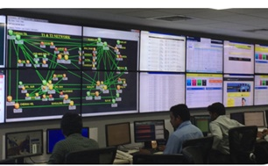
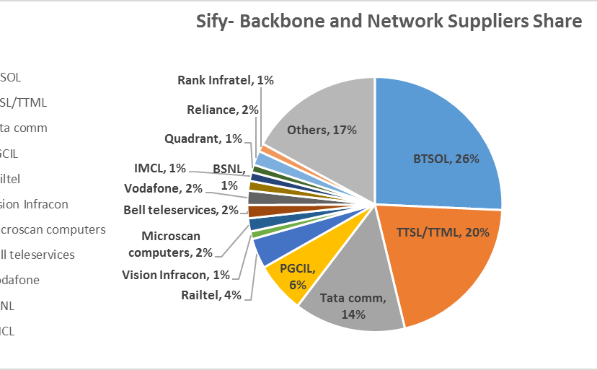
OUR NETWORK MANAGED SERVICES & OPERATIONS CAPABILITIES
Integrated NoC and SoC
24x7x365 Operations
Adherence to ITIL Framework supported by advanced toolsets
Deployment of industry standard tools
CA Spectrum, CA eHealth, ServiceNow
Detailed CRM Workflows in Oracle
Customer Portal for near-real time view and reporting dashboards
Expertise in aligning to customer-owned monitoring & ticketing tools
Expertise in API integration for infra-tools
Scale of Operations
Over 600 managed Enterprise customers
1.35 Lacs+ Enterprise connections implemented
76,000+ managed customer links
44,650+ managed CPE
Experience of managing Carrier Network Infrastructure
Service Provider Management
Engagement with over 10 NLD providers for backbone communication
Collaboration with BSNL/MTNL, Bharti, Tata Communications, Vodafone, Reliance, PowerGrid, RailTel
360 degree carrier engagement
Experience of managing multiple physical access media

Slide 29
OUR NETWORK EXPERTISE & SKILL SET
 | Total Resources | Technical skill sets | Other Training
Network engineering and solution | 47 | CCNA + CCNP + CCIE
SDN CoE | 32 | Dec Ops, Scripting, Tools, Network Management, ITIL
Central NoC | 150 | CCNA + CCNP
Service operations | 40 | CCNA + ITIL
Service operations – Field PMO and project managers | 1317 32 | PMP Prince and CCNA | Internal Training
SDM Service desk Infrastructure operations | 177 115 80 | ITIL CCNA | Internal Training Internal Training Internal Training
Deep Engineering Expertise
Deep Cisco expertise-CCNA, CCIE
Integrated SDN CoE
Advanced L2/L3 Engg
L1 teams trained in FLT on diverse media
Experience in deployment of Hybrid Management models
Project Management
PMI framework-based Project governance
Dedicated Project team for planning & Control
Integrated tools to track, monitor and report on the project
Dedicated Project Execution team and logistic teams
Extensive Field Teams
1300+ trained engineers on field, covering over 400 manned locations
Project teams that deliver customer centric projects
Business Relationship Management
Extensive Quarterly Business & Service Reviews
Proactive solution & service enhancement recommendations
Proactive Network cost optimization

Slide 30
SIFY’S MANAGED SERVICES – DIGITAL DISTRIBUTION ARCHITECTURE
NETWORK MANAGEMENT
SERVICE MANAGEMENT
MEMBERS MANAGEMENT
Network Uptime
Link Uptime
End-to-End Latency
Response & Resolution Times
Change Management
Capacity & Utilization
Call Attendance Rate
Filed Support
Service Request Completion
SLAs
24*7*365 monitoring of Network Infrastructure.
Incident, Problem and Change Management.
Software version and updates
Spares and service support
Inventory management
Network configuration and change.
Capacity and Availability management
Tools for Network monitoring and performance management.
Tools for tickets, support and reports
Change, Incident and Problem records.
Uptime/SLA and capacity reports.
Provide monitoring feeds and reports to exchange.
Periodic and on-demand reports on network health and ticket resolutions.
Setup a round the clock helpdesk
Commissioning/Migration/Decommissioning
Configuration guidelines for Members
Field management for hands and feet support
Liaison with service providers
Service provider Governance.
SCOPE

Slide 31
WAN Transformation with Sify Managed SDWAN
Deliver Customer Value, Not Just Cost Efficiency
Unify Managed services
Key enabler for Digital transformation
AGILE & FLEXIBLE
APPLICATION CENTRIC
PERFORMANCE AWARE
SOFTWARE BASED
Carrier agnostic Overlay architecture.
Multi-transport support.
Centralized control & Monitoring.
Unique topologies per segment.
Encryption, segmentation and service chains
Cloud off-ramping
Application aware routing.
Application based policies.
Application visibility & recognition.
Real-time enforcement of App SLA.
Centralized policy control.
Continuous quality assessment.& path liveliness
Consolidates multi provider WAN as a single fabric.
Faster convergence of application traffic.
Bandwidth augmentation with Active/Active utilization.
TCP optimization
Software platforms enabling physical or virtual CPE.
Zero touch provisioning.
Centralized configuration.
Agility for operations with analytics.
Interoperable with legacy.

Slide 32
Sify Managed SDWAN: Value Propositions
1
Connectivity-centric to App centric
2
Cloud Enablement
3
Difficult to simplified operations
Discover, understand needs and manage performance
Facilitate & manage performance
Automation, programmability, consolidation and agility
4
Inflexible to Flexible
5
Visibility & Analytics
6
Security
Hybrid WAN, Topologies, Physical/Virtual, convergence
Behaviours, Trends and feedback loops
Cloud perimeter branch and user security.
Managed services to drive efficiencies, lead engagements through insights and
value beyond cost economics.

Slide 33
Sify Managed SD WAN Components
BRANCH INFRA
CENTRALIZED CLOUD INFRA
  SD-WAN CPE
  Data plane component
  Deployed in each site to terminate WAN links – internet and MPLS
  Available as hardware appliance model or in VM form factor
  Standalone or HA deployment (Active-Standby)
  Various bandwidth subscription models
  CONTROLLER
  Control plane component
  Deployed in DC/DR
  High availability mode
  Complete discovery of WAN
    CPE devices
    WAN links
  Enables discovery of other spoke sites and prefix exchange
  Facilitates in IPSEC key exchange and establishment
  DIRECTOR
  Management plane component
  Deployed in DC/DR
  High availability mode
  Initial on-boarding of CPE
  Configuration of WAN
  Link configuration
  IPSEC configuration
  Dynamic and performance routing
  App aware routing
  Northbound API
  ANALYTICS
  Management plane component
  Deployed in DC/DR
  High availability mode
  Gathers visibility and reporting data of WAN
  CPE health and link monitoring
  Application fingerprinting
  Granular reporting – per site, per app, per user, user to app to WAN mapping
NOC SERVICES

Slide 34

Typical Enterprise SD-WAN TopologY
Geo-redundant Control components in HA
Director
Analytics
Director
Analytics
Controller
Controller
Cloud hosted – AWS, Azure, GCP
Google
Youtube
SD-WAN CPE
Social media
File sharing
SD-WAN CPE
Internet apps
Internet
SD-WAN CPE
SD-WAN CPE
O365
Skype for
business
DC
SD-WAN CPE
Salesforce
Oracle
SD-WAN CPE
3rd party
MPLS
Webex
SD-WAN CPE
SD-WAN CPE
Cloud based business apps
DR
SAP
CRM
SD-WAN CPE
Sify MPLS
SD-WAN CPE
ERP
SD-WAN CPE
SD-WAN CPE
On-premise Business apps
Regional offices/Branches
Multi-provider transport network
HO/DC/DR/Cloud
Application eco-system

Slide 35
Sify Managed SD-WAN FeatureS
Transport independence
  MPLS
  Internet
  3G/LTE
  DSL
Any to any IPSEC VPN
  Native IPSEC VPN support
  Any to any IPSEC VPN between sites
  Automatic rekeying
  PSK and PKI support
Real time performance monitoring
  Synthetic and inline measurement
  Uni-directional and bi-directional
  Latency, loss, jitter and MOS
  Identify performance issues on end to end WAN paths
App visibility & app aware routing
  App and sub-app discovery
  Custom app fingerprinting
  Application performance based path selection
Effective WAN load balancing
  Across multiple WAN types
  Active-Active
  Active-Standby
  Per flow and per packet
WAN optimization
  FEC
  Packet striping
  Packet replication
  TCP optimization
  App optimization – in roadmaps
Management
  Zero touch provisioning
  2FA
  Template based configuration – similar sites, feature wise
Visibility
  CPE health – CPU, RAM, IO
  Availability report – Site and link
  Link statistics
  End to end path performance
  App and sub-app performance
  Per link, per site, per app analysis
Security
  Stateful firewall
  Web filtering
  IPS/IDS
  Anti-virus
  Segmentation and multi-VRF
Subscription tier licensing and Cloud support
  Bandwidth and Feature based
  Pay as you grow model
  Public cloud presence – Azure, AWS
Centralized controller
  Cloud based
  Geo-redundant HA mode
  IPSEC and Routing control plane
  Configuration, monitoring and analytics
  Multi-tenancy
CPE
  White labelled device
  x86 based appliance
  Virtual appliance – ESXi and KVM
  Universal CPE

Slide 36
Sify Managed SD-WAN Security Features
URL
SSL
Stateful firewall
URL filtering
SSL inspection
Anti-virus
IDS/IPS
  L3 and L4 based stateful firewall
  Zone based firewall
  Application level gateway
  Local lookup – faster processing
  Master central repository lookup
  Category, reputation, whitelist/blacklist, User-ID based integration
  Actions – deny, allow, inspect, bandwidth control, time of day, HTTP redirect to captive portal
  Security package updates – refresh local URL DB
  Inspect various attributes of SSL certificates and enforces security policy
  SSL inspection policy
  Expired SSL certificates
  Untrusted issuers
  Restrict cert extensions
  Unsupported ciphers/key lengths/versions
  Action
  Drop, allow, reject client, reject server
  Blocks unwanted apps
  Prevent malware and exploits into the network
  Signature, heuristics
  Signature based file type – FTP, HTTP, SMTP, POP3, IMAP
  Blocks known and unknown network and application vulnerability
  Protocol anomaly, protocol decoder, heuristics based, malformed packets, Fragmentation attacks, signature based, custom vulnerability signatures
  Integrated DoS mitigation
  DoS profiles – Syn, ICMP and UDP floo

Slide 37
Sify Managed SD-WAN: Subscription TierS
P
Bronze
Silver
Gold
Diamond
Platinum
  ZTP
  VRRP
  OSPF – LAN
  MP-BGP – Controller
  Routing policies
  VRF
  QoS/HQoS
  Bronze+
  IPSEC transport
  Any to any IPSEC
  Stateful firewall
  Silver+
  Performance measurement – synthetic and inline
  App visibility
  App aware routing
  FEC, Packet striping & cloning
  Gold+
  CGNAT
  DoS protection
  URL filtering
  SSL inspection
  Diamond+
  IDS/IPS
  Anti-virus
  SSL decryption

Slide 38
Network References & Transformation Capabilities
Customer | Network Design | Network Build/Integration | Network Managed Services | Bandwidth Service Provider | Network Security | Network consolidation transformation | SDN | Managed Wifi
Department of Post | ü | ü | ü | ü | û | ü | û | û
IDRBT | ü | ü | ü | ü | ü | ü | û | û
National Stock Exchange | ü | ü | ü | ü | û | ü | ü | û
New India Assurance | ü | ü | ü | ü | û | ü | û | û
Oriental Insurance Company | û | û | ü | ü | û | û | û | û
Syndicate Bank | û | û | ü | ü | û | û | û | û
United Commercial Bank | û | û | ü | ü | û | û | û | û
United Bank of India | û | û | ü | ü | û | ü | û | ü
Oriental Bank of Commerce | û | û | ü | ü | û | û | û | ü
Muthoot Fincorp | ü | ü | ü | ü | û | ü | û | û
City Union Bank | û | û | û | ü | û | û | û | û
Indian Overseas Bank | û | û | ü | ü | û | û | û | û

Slide 39
SECURITY SERVICE ENGAGEMENT MODELS

Slide 40
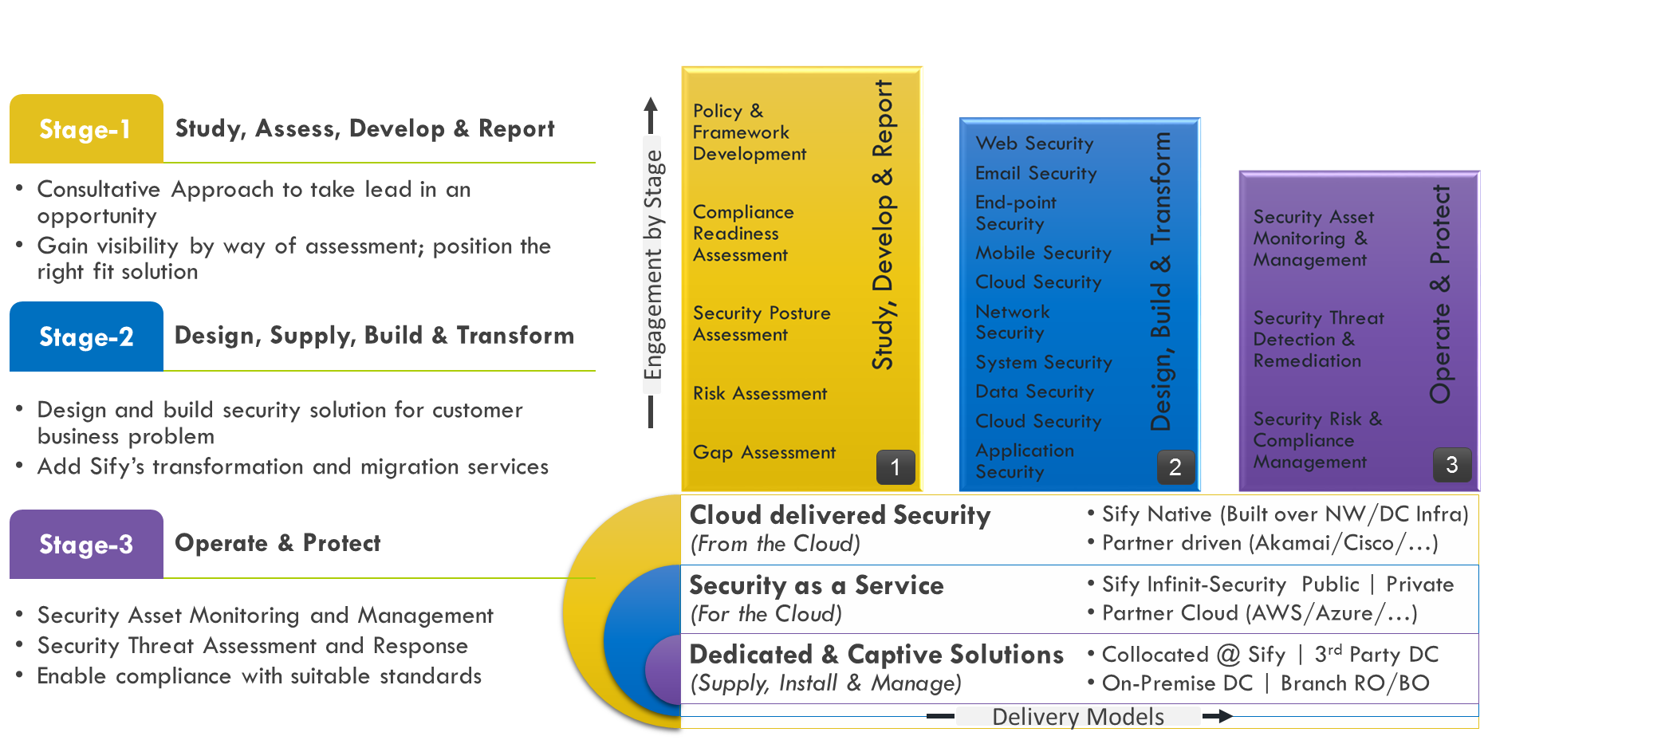
Our Security Services Engagement Models

Slide 41
Sify DDoS Capabilities

Slide 42
Security Services Execution Proof Points
Reference Customers | Information Security Consulting | Security Transformation | Professional Services | Security Operations | Incident Response | Solution Landscape
Syndicate Bank | ✓ | ✓ | ✓ | ✓ | ✓ | SIEM, PIM, DLP,VA PT, Network Forensics,
UBI | ✓ | ✓ | ✓ | ✓ | ✓ | AV, DLP,Web Security, PIM, MDM, AD, APT, DDOS, WAF
DHFL | ✓ | ✓ | ✓ | ✗ | ✗ | SIEM,WAF,DAM,PIM,DLP
CBI | ✓ | ✓ | ✓ | ✓ | ✓ | SIEM
PSB | ✓ | ✓ | ✓ | ✓ | ✓ | SIEM, PIM, WAF, APT
PNB | ✓ | ✓ | ✓ | ✓ | ✗ | DLP, PIM, Config Management
BOI | ✓ | ✓ | ✓ | ✗ | ✗ | Threat Protection
Max Bupa | ✓ | ✓ | ✓ | ✓ | ✓ | SOC, APT, Firewall, DRM
ONGC | ✓ | ✓ | ✓ | ✗ | ✗ | Web Security, Firewalls
IOCL | ✓ | ✓ | ✓ | ✗ | ✗ | Firewall, Web Security, SLB
NTPC | ✓ | ✓ | ✓ | ✗ | ✗ | SIEM, NIPS, PIM,

Slide 43
TOOLS & AUTOMATION CAPABILITIES

Slide 44
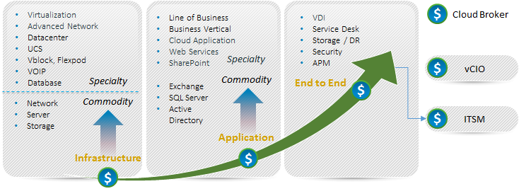
Our Tools and Automation Capabilities
Application Monitoring
SERVER MONITORING
CLOUD MONITORING
SAP
Microsoft Exchange
IBM WebSphere
Apache Tomcat
Microsoft IIS
JBoss
SharePoint
Sybase EAServer
Lotus Notes
MS Lync
MS Active Directory
Oracle WebLogic
Microsoft Windows Server
Linux/Unix
  Solaris, AIX, HP-UX, Linux, Sinix, Tru64 UNIX, Red Hat
Cisco Unified Computing System (UCS)
IBM Power Systems
Novell Open Enterprise Server
Private
  Flexpod, Vblock
Public
  Amazon, Rackspace, MS Azure, Google App Engine, Google Apps, SFDC CRM
Citrix CloudPlatform
vCloud
Cloud Monitor (Websites)
Virtualization Monitoring
NETWORK MONITORING
Database Monitoring
VMware
Citrix XenServer
Microsoft Hyper-V
Oracle Solaris Zones
IBM PowerVM
Red Hat Enterprise Virtualization
Router and Switch
Network Response Time
Cisco Qo5
Cisco IP SLA
Flow Analysis
Oracle DB
Microsoft SQL Server
Informix
IBM DB2
MySQL
Sybase
Service desk as service
Big Data & CUSTOM APPS
Storage Monitoring
VoIP / VDI monitoring
Provide Service Desk in Multitenant Model
Hadoop, Cassandra, Mongo DB
Customizable packages for open source applications or in house applications
EMC
IBM System Storage
NetApp
Cisco VoIP
Citrix XenDesktop / XenApp
Hitachi
44

Slide 45





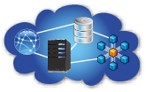
Our Tools and Automation Capabilities
UNIFIED MONITORING OF PUBLIC AND PRIVATE IT ENVIRONMENTS
FEATURES
Dashboards and Reporting
WHAT CAN WE MONITOR
Multitenancy
Dashboard & Reports
Distributed Architecture
Unified Trending
Visual Alarms & Reporting
Email Alerting
3rd Party Integration (Service Now for ITSM )
Agent and Agent less Monitoring
UMP (Portal ) available via Mobile
Application Monitoring
Server Monitoring
Cloud Monitoring
Virtualization Monitoring
Database Monitoring
Storage Monitoring.
Data Center Monitoring
Main Frame Monitoring
Response Time Monitoring
Big Data Monitoring
Basic Network Monitoring
Service Levels
End User Response Time
Performance and Availability
Events and Faults
Power
Efficiency
Network
LAN & WAN
Server
Physical & Virtual
Database
IT & Business
Application
Commercial & Custom
Cloud
Public & Private
45

Slide 46
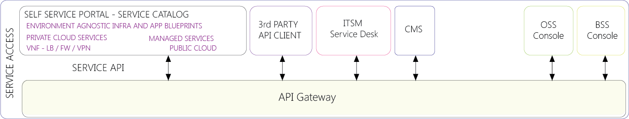
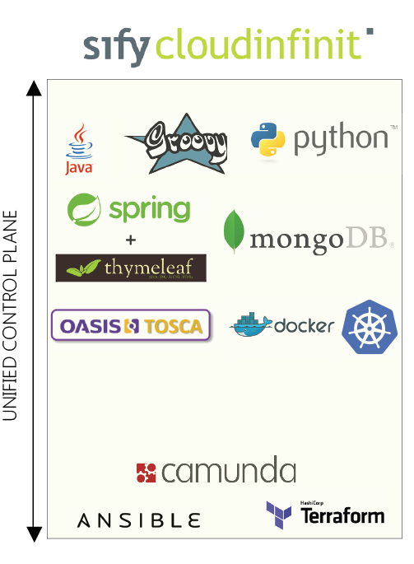

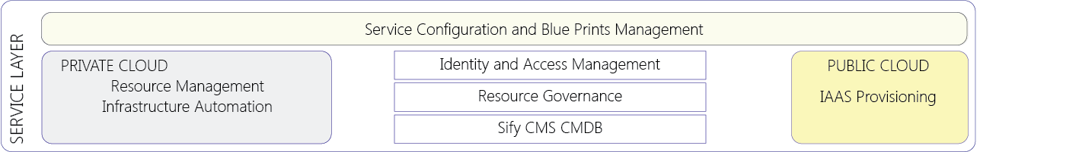
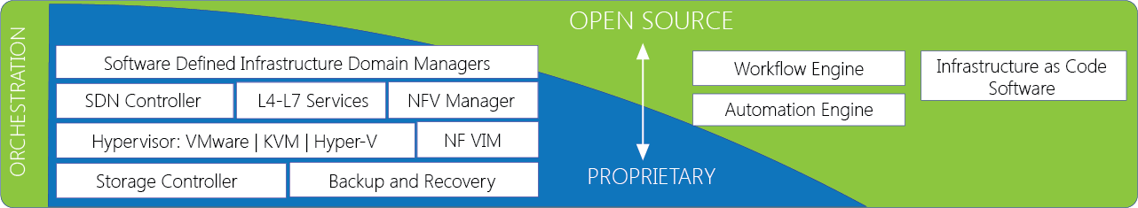
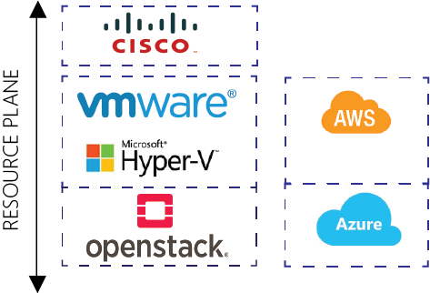
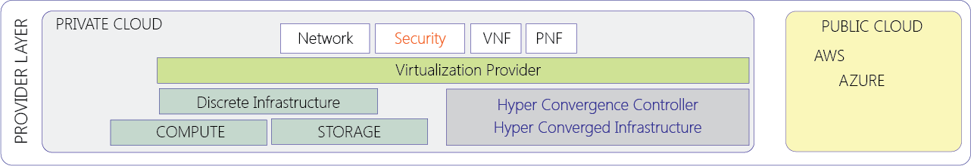
Our Tools and Automation Capabilities
46

Slide 47

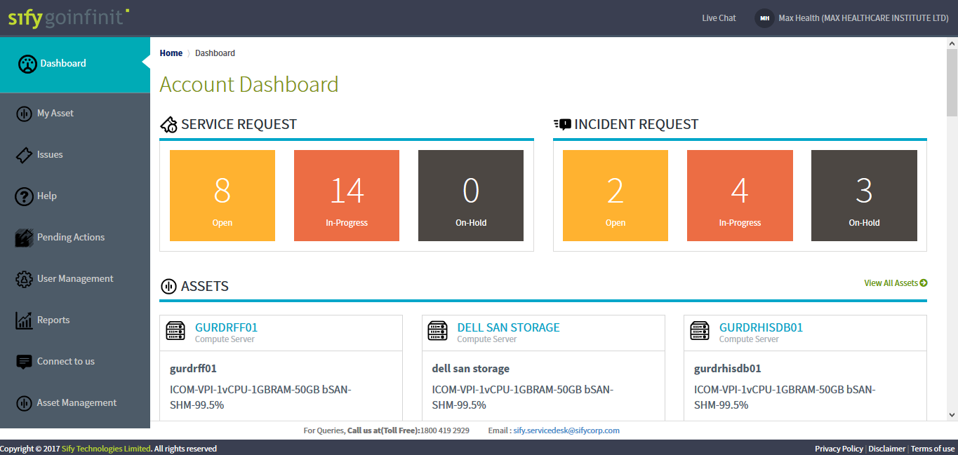
Our Tools and Automation Capabilities

Slide 48
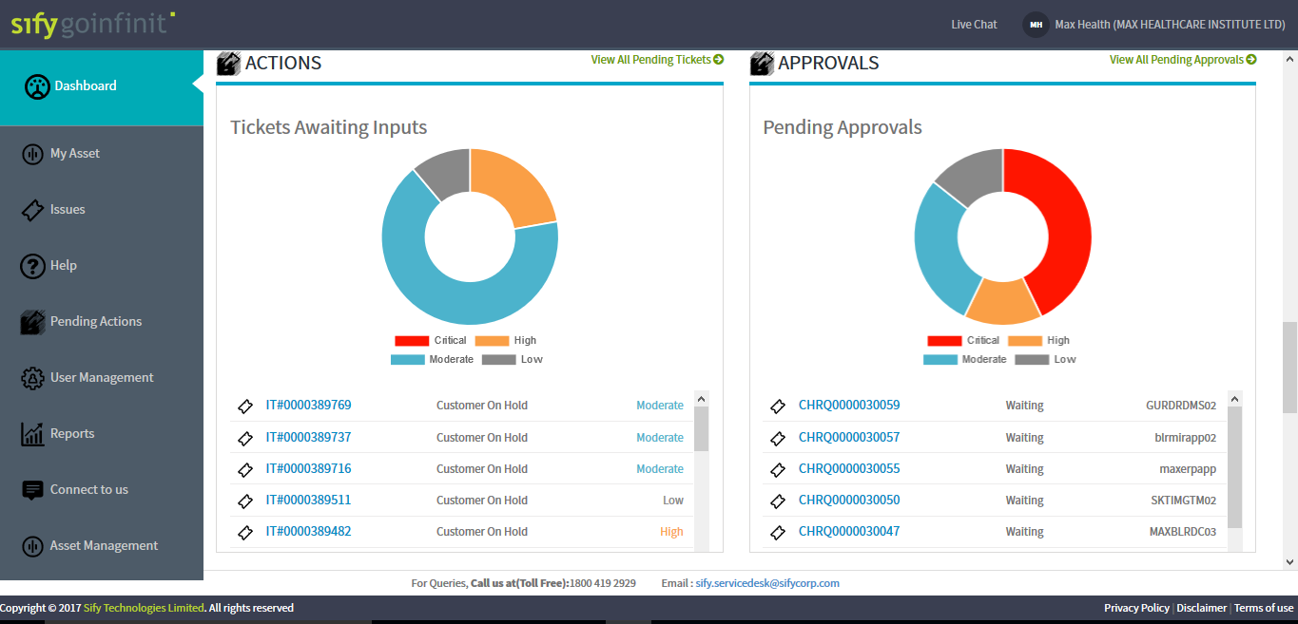
Our Tools and Automation Capabilities

Slide 50
AGENDA
1
    Sify : Managed Services for NCDEX
2
    Scope, Transition Approach, Delivery Model
3
    Operational Effectiveness
4
    Tools Stack
5
Network Assessment & Audit

Slide 51
SIFY – A NEW AGE ICT PLAYER
“SIFY is a leading integrated ICT player in India, helping customers realize value by leveraging its world class assets & services cutting across Data Centre, Cloud & Managed Services; Network Provisioning, Integration and Management Services; Application Services; and Technology Integration Services.
The sweeping technology changes that are influencing the way enterprises consume IT, allow SIFY to be in a unique position to be a partner of choice, by providing service consumption models that are aligned to the Third Platform.”

Slide 52
ICT SOLUTION – THE BIG DIFFERENTIATOR
IT Services
Large Telecom Network
DCs & Related Services
Traditional Technology Companies
Traditional Telecom Companies
Traditional Data Center Companies
Services
Companies

Slide 53
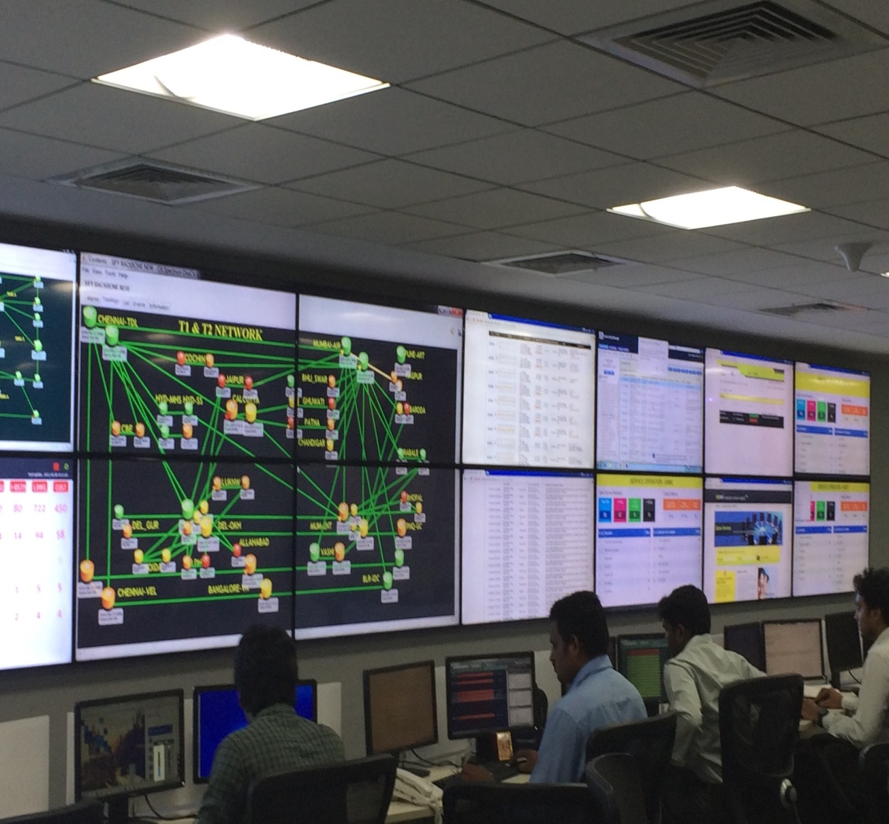
NETWORK AND SECURITY OPERATIONS CENTER
2333 POPs
Infra LINKS 1670
9000 IP/MPLS Nodes
120022 Wireless AP
250 Managed Network customers
10000 Managed WAN links
8000 Tickets
400+ Skilled people
Service desk
Managed LAN
Fault Management
Managed WAN
Perf Mgmt.
Shared NOC
SLA Management
Captive NOC
Capacity Mgmt.
Managed Infra.
Network Security
Managed Security
Regulatory Mgmt.
NW INTEGRATION
Change Mgmt.
PROJECT DELIVERY
VOICE
TELECOM
ENTERPRISE
SECURITY
PMP
ITIL

Slide 54
INDUSTRY RECOGNITIONS
CHALLENGERS
LEADERS
Magic Quadrant
for Cloud-Enabled Managed
Hosting, Asia/Pacific, 2017
Fujitsu
NT
T
Rackspace
Communications
IIJ
Singtel
T
elstra
CenturyLink
Sify
CtrlS Datacenters
Datapipe
NxtGen
IBM
Orange Business Services
B
T
T
ata Communications
O EXECUTE
Y T
ABILIT
NICHE PL
A
YERS
VISIONARIES
COMPLETENESS OF VISION
As of October 2017

Slide 55



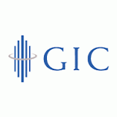































Sify – in bfsi
Banks & NBFC
Insurance
Niche Players
DC/ DR
DC/ DR + Managed Services

Slide 56
AGENDA
1
    Sify : Managed Services for NCDEX
2
    Scope, Transition Approach, Delivery Model
3
    Operational Effectiveness
4
    Tools Stack
5
Network Assessment & Audit

Slide 57
Scope understanding
NCDEX
NCDEX
Sify
Sify / NCDEX
NCDEX
Business
Interface to NCDEX Business & Sify
IT Strategy
Enterprise Design & Architecture, Policies and Standards
Overall IT Services Governance
Business Application
Development & Management
DC Ops Service Delivery Management
Web Server Management
DC Ops – Infrastructure Management
Security Management
AD/DNS/DHCP Management
Patch Management
CA UIM, NFA, & Spectrum
System (Windows, Linux, IBM-AIX) Administration
OS Hardening
Web Server Management
Virtualization Management
Messaging Services
Backup Management
VA/PT
Link Monitoring
Network Management
WAN Management
Storage management
Web-Proxy Management
Wireless Controller Management
Projects & Implementation
Transition
DC OPS – Reports
DR
Management
Tools & Automation
Vendor Management

Slide 58
ENGAGEMENT: IN SCOPE & OUT OF SCOPE (DETAILED)
In Scope Services (High Level) | Data Centre & DR Management Server MS Windows Management Server Linux Management IBM-AIX Management Active Directory Management Web Server Management Virtualization Management MS Exchange Management Google Suite Services Management Enterprise DNS Server Management Storage & SAN Switches Management Backup and Recovery Management Network Management & Administration DC-DR Drill Management Database Management – Optional WAN Management Router Management Link Monitoring Riverbed WAN optimization Management Network Security & Administration Patch Management Anti-Virus/DLP Management Web-Proxy Management OS Hardening, VA/PT for Web Server Firewall/IPS Management Websense Web-Proxy Administration Cisco ACS Management Wireless Controller Management Cisco ISE Management
In Scope Services (High Level) | Monitoring tool 24x7 IT Monitoring & Management NOC/SOC Operations MIS Reporting (Asset Sw/Hw, & SLA) ITIL Service Management Framework Request Fulfillment Incident Management Problem Management Change/Management Vendor Management Service Level Management Ticketing & Monitoring Tools Service Now 24x7 IT Monitoring & Management Tools – CA UIM, CA Spectrum, CA Network flow analysis Reports MIS Reports(Asset SW/HW & SLA)
Out of Scope | Desktop/Laptop Management Any Application Development & Maintenance Business application Database Management Mobile Device Management (including Applications) Annual Maintenance Contract Web Development Ecommerce Development Hardware/Software procurement Platform Migration CAPEX Purchase and consumable

Slide 59
Service Window
Service Window and Locations
Location | Location Count | Service Window | Support Type
Primary DC – On Premise, Mumbai | 1 | 24 x 7 | Hybrid
Near Site – Netmagic, Mumbai | 1 | 24 x 7 | Remote
Location-NOC Support | 400 | 24 x 7 | Remote/On-demand

Slide 60
Volumetric details – part 1
Approx Volumetric of infra
Service Category | Technology Covered | DC | NS | Other Locations | Total Qty
Server Management | IBM AIX | 36 |  |  | 36
 | Virtual Server - Windows OS | 129 |  |  | 129
 | Physical Server Windows OS | 47 | 2 |  | 49
 | Physical Server Windows 7 | 1 |  |  | 1
 | Virtual Server -RHEL | 107 |  |  | 107
 | Physical Server RHEL | 46 | 2 |  | 48
 | Virtual Cent OS | 26 |  |  | 26
 | Physical Cent OS | 1 | 1 |  | 2
 | Virtual Server -Suse | 2 |  |  | 2
 | Virtual Server - Ubuntu | 5 |  |  | 5
 | Other Linux | 11 |  |  | 11
Virtualisation Management | VMWare Host | 13 |  |  | 13
Database Management | MS SQL |  |  |  | 0
Microsoft & Other Standard Applications | AD/DNS/DHCP | 3 |  |  | 3
 | MS Exchange | 2 |  |  | 2
 | Google Suite |  |  |  | 0

Slide 61
Volumetric details – part 2
Approx Volumetric of infra
Service Category | Technology Covered | DC | NS | Other Locations | Total Qty
Network & Security Management | Network Switches | 114 | 2 | 9 | 125
 | Router | 32 | 2 | 400 | 434
 | Firewall | 22 | 1 |  | 23
 | IPS | 2 |  |  | 2
 | Cisco ACS | 4 |  |  | 4
 | Websense Web proxy - V5000 | 3 |  |  | 3
 | Riverbed WAN Optimisation | 1 | 1 |  | 2
Storage (TB) | IBM XIV | 126 | 113 |  | 239
 | IBM V3700 | 96 |  |  | 96
 | Netapps - FAS2650 | 174 |  |  | 174
 | Dell Compellanet | 26 |  |  | 26
Link Monitoring | MPLS |  |  |  | 400
Webserver for OS Hardening, VA/PT | IIS | 33 |  |  | 33
 | Apache | 24 |  |  | 24

Slide 62
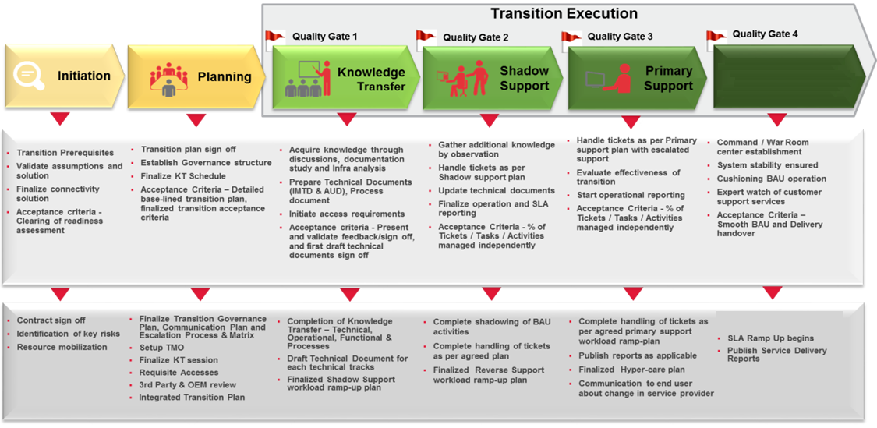
Transition methodology
STABILIZATION

Slide 63



Integrated service delivery model
Solution drivers
Hybrid managed Delivery Model
Pro-active 24x7 Monitoring and Management
Cross Leveraged Team
ITIL Service Management Framework
NCDEX Users
Risk mitigated Transition of Services
Process standardization
Single point of contact
Solution Highlights
Alerts
Service Desk (NCDEX, Kanjurmarg)
Infra. Monitoring Team (Sify, Chennai)
SMO
This Integrated Service Delivery Model provides tiered operations for onsite team with clear ownership boundaries
Level 1
Categorize, Prioritize, & Respond
Initial diagnosis Incident Escalation, Investigation
& diagnosis
Resolution and recovery, Incident closure
RCA, faults, Configuration, and Performance
Tools Hosting
Proactive Monitoring and Management
24 x 7 Management and Monitoring of tools
Configuration of tools dashboard, Process
Onsite based Integrated Service Delivery Model leveraging cross tower synergies between Service Desk and Tier-1 DC Operations
L2 Operations (Hybrid Support)
Single point of contact and SLA based Service Ownership across the entire Data Centre Network
Infrastructure
Applications Mgmt
Virtualization
Mgmt.
Business
Applications
Information Security, Regulatory Compliance
Service Management (ITIL Processes)
Consistent Service experience through Service Management Office (SMO) to implement and ensure ITIL process and compliance
NOC
monitoring
Six Sigma & LEAN
Server
Management
Vendor Mgmt.
Network Mgmt..
Messaging
services
Storage
Mgmt.
Backup
Management
Level 2
Database
Management
DC-DR Drill
Mgmt.
Security
Management
Covers range of devices from leading vendors supporting various business needs
Troubleshooting of complex issues, Root cause analysis, Documentation,
Trend analysis and forecasting
Single point of ownership – End to End SLA Based Delivery
Level 3 Operations (Remote Support)
Delivery using ITIL V3 Compliant Process framework
Level 2/3
Project Mgmt.. Infrastructure PM Support, Project Services Co-ordination & Support,
Maximizing Hybrid monitoring and management of L1 and L2 Operations with optimal presence at Onsite / Datacenters for co-ordination and touch service
Governance
NCDEX Scope
SIFY Scope

Slide 64
AGENDA
1
    Sify : Managed Services for NCDEX
2
    Scope, Transition Approach, Delivery Model
3
    Operational Effectiveness
4
    Tools Stack
5
Network Assessment & Audit

Slide 65
Solution drivers | value proposition
  Service Transition
Key Drivers
  Improved Quality
  Lowered Cost
  Innovations on
    Services
    Technology
    Process
Hybrid Support Delivery Model
Governance Encompassing the Multi Source Partners
  Sify
  Delivery Architecture
ITIL Driven
Policy Definition
Governance Focused
Cross Skilling of Resources
Innovations
  Operation methods
Monitoring Tool ( Sify Tools)
  Service Management
  Tools
Increase Operational Excellence
Technology Excellence Enabler
  Service Transformation

Slide 66


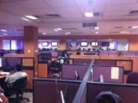







Delivery process – call flow
Self Service
As available
Remote Connect
Field Support Teams
Hands and Feet Support
Knowledge Management
USERS
English
L2/L3
Call Menu
1: DC Infra
2: Others
Sify Infra Teams
Service Desk
Number
Sify NOC
Portal
Service Desk
Call Recording/Quality
Phone/
Request Fulfillment
Event Management
Incident Management
Problem Management
Change Management
Email / Tickets
Email
Asset / Configuration management
Continuity Management
Availability / Capacity
Third Party
24x7 Global Support / ITIL Process

Slide 67
Service level agreement – response/resolution
Resolution & Response Time – DC Managed Services
Severity Levels |  | Response Time | Resolution Time
S1 – Critical |  | Immediate – within 15 min | Within 30 minutes
S2- Medium |  | Immediate – within 15 min | Within 2 hours
S3 - Planned/ Scheduled activities |  | As per agreed activity plan | As per agreed activity plan
Severity Level 1 | Critical | Service related to applications which effects intra-day trading. Messaging/Communication affected and Applications/systems related to trading
Severity Level 2 | Medium | Service related to office automation affected Service related to internal applications/ systems affected
Severity Level 3 | Planned/ Scheduled activities | All activities which are carried out under agreed planned activities Such activities has to be carried out with appropriate activity plan and necessary approvals

Slide 68
Reporting parameter AND FREQUENCY
REPORT DESCRIPTION | Frequency
Server availability | Daily, weekly, monthly
Storage availability | Daily, weekly, monthly
Network availability | Daily, weekly, monthly
Backup | Daily, weekly, monthly
Patch update | Quarterly based on schedule
Critical problem resolution time (Priority 1) | Daily, weekly, monthly
Urgent problem resolution time (Priority 2) | Daily, weekly, monthly
Customer satisfaction | Daily, weekly, monthly

Slide 69
AGENDA
1
    Sify : Managed Services for NCDEX
2
    Scope, Transition Approach, Delivery Model
3
    Operational Effectiveness
4
    Tools Stack
5
Network Assessment & Audit

Slide 70
WHY CA TOOLS
Pinpoint issues in IT
Unified view of all services
Unified view of IT
Proven and Matured Player for Delivering on Managed Services Platform
Expand to other Infrastructure Devices and Applications
Enables from moving from Reactive support to Proactive
Industry Standard Proven Tool for Large customer base and Deployments
SLA Dashboard
Dashboard of Service Availability
Excellence in Monitoring and Management – Scalable, Robust, and Ease of Mgmt.
Improved Visibility - Reducing MTTR (Mean Time To Resolve)
Better Integration among across various industry recognized tools
Plug and Play with custom probes to monitor certain features
Enables Pay-As-You-Go Model

Slide 71
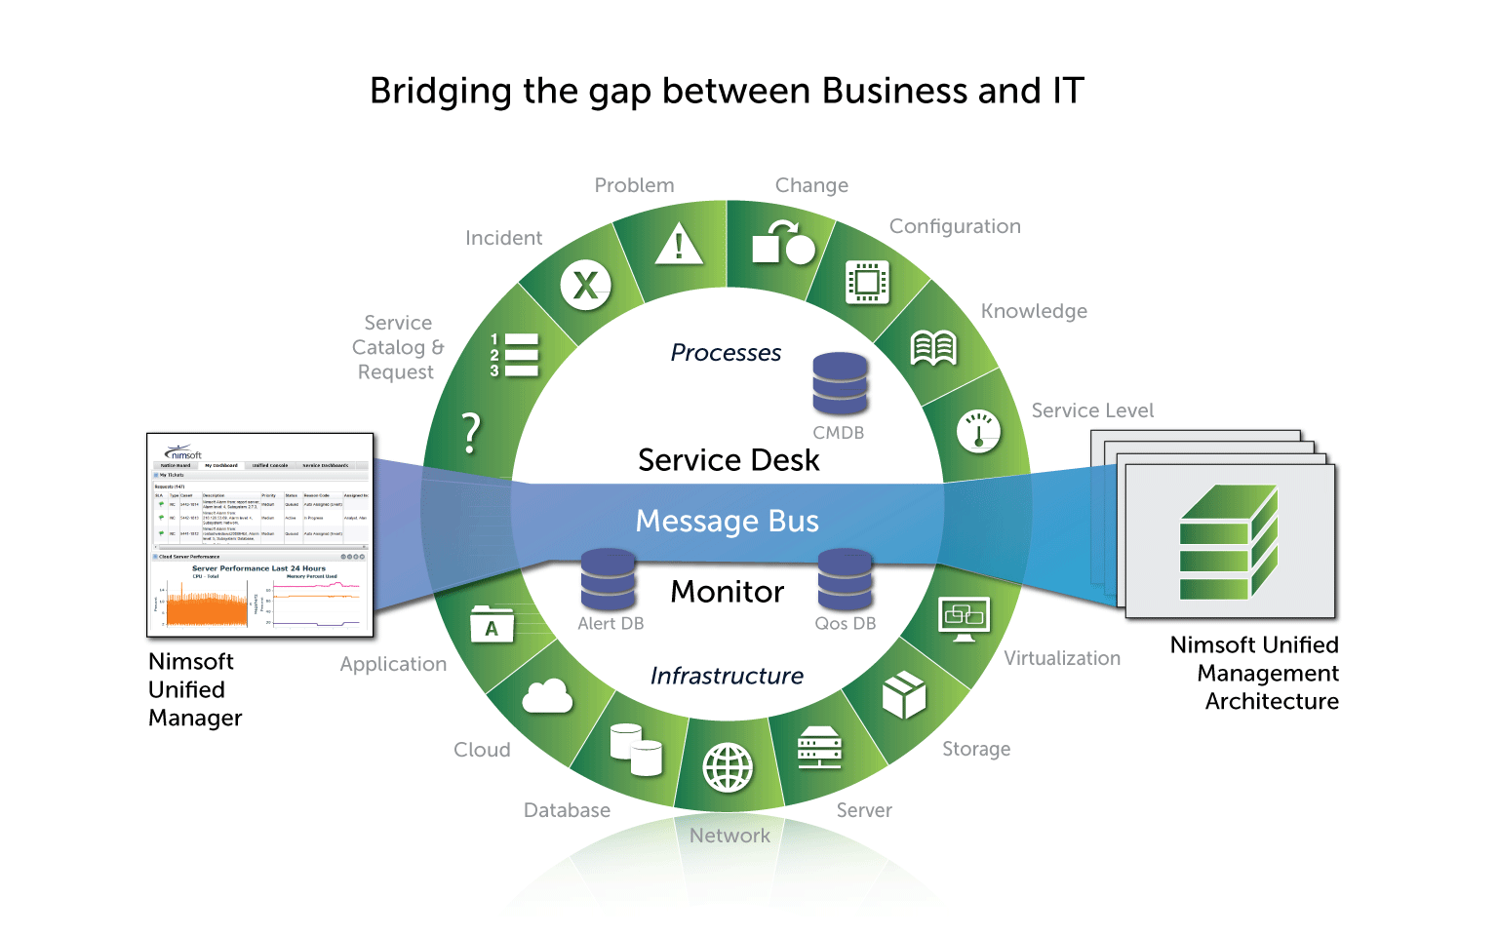
Service now itsm tool integration with ca unified infrastructure mgmt.

Slide 72
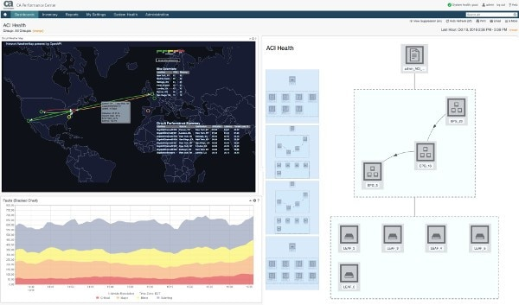
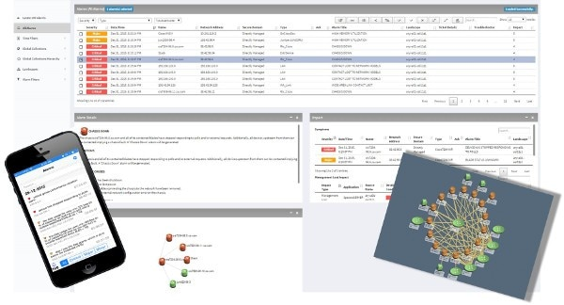
Ca network flow analysis
CA Network Flow Analysis is a network traffic monitoring solution that can help you optimize your network infrastructure for better application performance.
CA Network Flow Analysis is recognized as the industry standard for flow-based network traffic analysis in Global 4000 enterprises and large service providers.

Slide 73
AGENDA
1
    Sify : Managed Services for NCDEX
2
    Scope, Transition Approach, Delivery Model
3
    Operational Effectiveness
4
    Tools Stack
5
Network Assessment & Audit

Slide 74
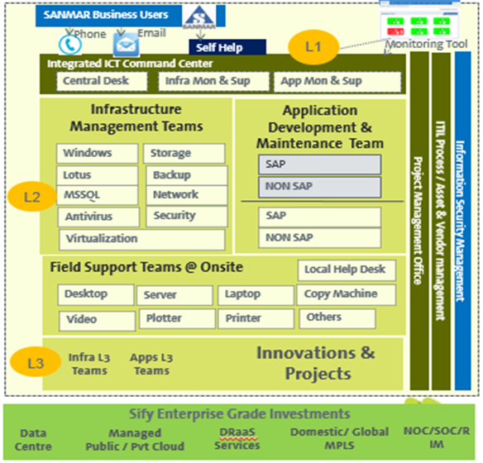
Case study #1- sanmar: it operations transformation
Chemplast Sanmar Limited is a chemical company based in Chennai, Tamil Nadu. It is part of Sanmar Group which has businesses in Chemicals, Shipping, Engineering and Metals. It has a turnover of over Rs.65 billion and a presence in some 25 businesses, with manufacturing units spread over numerous locations in India
Drivers for the Opportunity
Outdated Data Centre and DR Services
Absence of Tools & Processes
10 years locked with an incumbent and no improvements in the IT
Solution
Transition of services in 6 months
Service Desk for End User Support
Tools & ITIL Process Transformation
Asset Outsourcing & Management (2800+ Devices)
Migrate Customer Data Centre to Sify Facility
Managed Services for 3 years
IT Landscape
Data Center (1), DR(1)
  Server 150, Network 20, Firewall 2
End User Devices (2500+ Devices)
WAN Support for 25 Branches
SAP Application running on it.
Key benefits
Higher uptime of service levels
Increased customer delight
Dashboard providing a view on the IT services, assets utilization and cost
Seamless transition to Managed Services
State of the art tools, process and procedures
Secure application access through BYOD platform
Reduced cost of DC operations and improved higher uptime of infrastructure

Slide 75
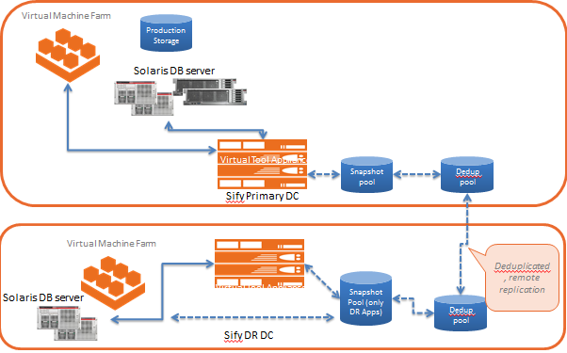
Case study #2- DC ms & transformation for max bupa health insurance
Max Bupa a leading heath insurance company, growing at a 30 % YOY rate. With a client base of 2 million. To be able to support the expected growth required to have an IT set up which is reliable, Scalable, Optimised, Secure, and always available. This initiative needs to cover the technology upgrade & transformation of the IT infrastructure and also the consolidation of the IT infrastructure and the Datacentre.
Drivers for the Opportunity
Transform the current Infrastructure to have the latest in technology, efficient and ready to scale.
Consolidate the applications infra in different data centre.
Provide high availability for the application with improved security.
Provide a round the clock monitoring and support
Solution
Built a Private Cloud for DC & DR
Migrate 100+ servers and 60 TB data migration
VMware, OVM based Hypervisors
Enabled DRaaS tool based replication and recovery at DC and DR with RTO/RPO SLA’s
Improved Security Significantly
Project Management for Implementation
Managed Services for 5 years
IT Landscape
Data Centre - 2 at Delhi, 1 at Mumbai
DR @ Bangalore
Key benefits
Business Services are continuously available
Improved Performance & Operational Efficiency
New Age DC + DR set-up
Zero Downtime Migration
Quick set up reducing planning and deployment time
Granular recovery intervals and data protection
Large Bandwidth to replicate DC data
Seamless transition to Managed Services
State of art tools, process and procedures

Slide 76
Case study #3- DC ms & transformation for gic re
GIC of India (GIC Re) was the sole reinsurance company in the Indian insurance market with over four decades of experience until the insurance market was open to foreign
reinsurance players by late 2016 including companies from Germany, Switzerland and France.
GIC Re has its registered office and headquarters in Mumbai. To be able to support the expected growth required to have an IT set up which is reliable, Scalable, Optimised, Secure, and always available. This initiative needs to cover the technology upgrade & transformation of the IT infrastructure and also the consolidation of the IT infrastructure and the Datacentre.
Drivers for the Opportunity
Transform the current Infrastructure to have the latest in technology, efficient and ready to scale.
Consolidate SAP and other critical applications infra in different data centre.
Provide high availability for the Business application with improved security.
Provide a round the clock monitoring and support
Solution
Build Hyper Converged Infrastructure for DC & DR
Migrate Infra to Private Cloud for DC & DR
Migrate Physical workload to Virtual with improved IOPS for SAP and related workloads
Migrate 50+ servers and 40 TB data migration
Vmware Suite, NSX, Orchestration Automation
Enabled DRaaS tool based replication and recovery at DC and DR with RTO/RPO SLA’s
Improved Security Significantly (SOC, SIEM etc.)
Project Management for Implementation
Managed Services for 5 years
IT Landscape
Data Centre - 1 at Mumbai
DR @ Bangalore
Key benefits
Scalable & Elastic environment to react business needs
Security, Reliability, Availability & Serviceability
Best in Class Technology
Operations Best Practices & Tools
Management, Governance & Control

Slide 77
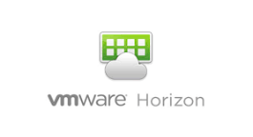
Sify transformation & innovation roadmap
Security Gaps
& Compliance Adherence
TCSAT
Knowledge Portal
VDI
HCI
BYOD
Enablement
Self Service Portal
Hybrid Cloud Enablement
Service Transformation / re-alignment
Managed Wi-Fi
SIAM
Based Delivery
QA Automation
Direct Connect
ITSM
Mobility
Sify Transformation Initiative
CRM on Mobile
Workflow Automation
Business Value
Re-calibration of Delivery Model / Technology
Mobile User Profile
(File Server)
vEngineer
Based L1 Task
ChatBot
Backup as a Service
NAC
Infra Standardization
Automation & CxO Dashboard
SOP Automation
Stabilization
Transformation Wave
H1
H2
Y2
Y3
Y4
* Some of the initiatives are factored and some others are supported by Sify on mutual agreement between both parties.

