Slide 1

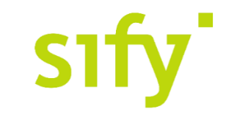

CAPABILITY PRESENTATION TO
Securities and Exchange board of
India
Oct‘18

Slide 2

ABOUT SIFY

Slide 3
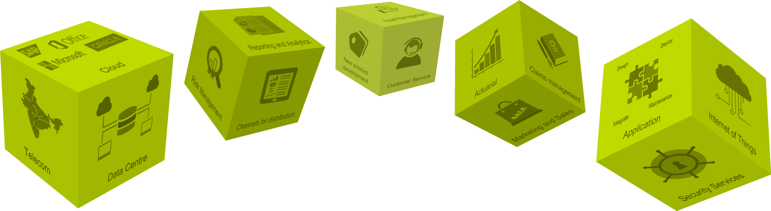
OUR PORTFOLIO OF SERVICES
SPECTRUM OF SIFY’S PRODUCT AND SERVICES
DATA CENTER TRANSFORMATION AND INFRASTRUCTURE SERVICES
HYBRID CLOUD SERVICES
NETWORK TRANSFORMATION AND CONNECTIVITY SERVICES
INTERNET OF THINGS
APPLICATION AND PLATFORM SERVICES
TECHNOLOGY INTEGRATION SERVICES
MANAGED SECURITY SERVICES

Slide 4
SIFY FINANCIALS
SIFY’S EVOLUTION
REVENUE & GROWTH
Cloud Transformation
Partner
Converged ICT Services
Provider
CAGR 19%
Managed DC and N/W Services Provider
Network/
Data Center
Service Provider
INR Crores
TELECOM SERVICES : IT SERVICES WALLET SHARE
PRODUCT REVENUE VS SERVICE REVENUE
In %
INR Crores
Notes:
Our financial journey in the past 5 years has been a true reflection of our stellar capabilities
We have transformed ourselves from a ‘Network/Data center provider’ to a ‘cloud transformation partner’
We have grown by 19% over the past 5 years with a Y-O-Y growth of almost 20%
The share of revenue from our DC centric IT services has grown over the years with the contribution rising from 34.3% in FY 2013-14 to almost 52% in FY 2017-18
The bulk of our revenue comes from services with the services revenue being 12-20 times of our revenue from products

Slide 5
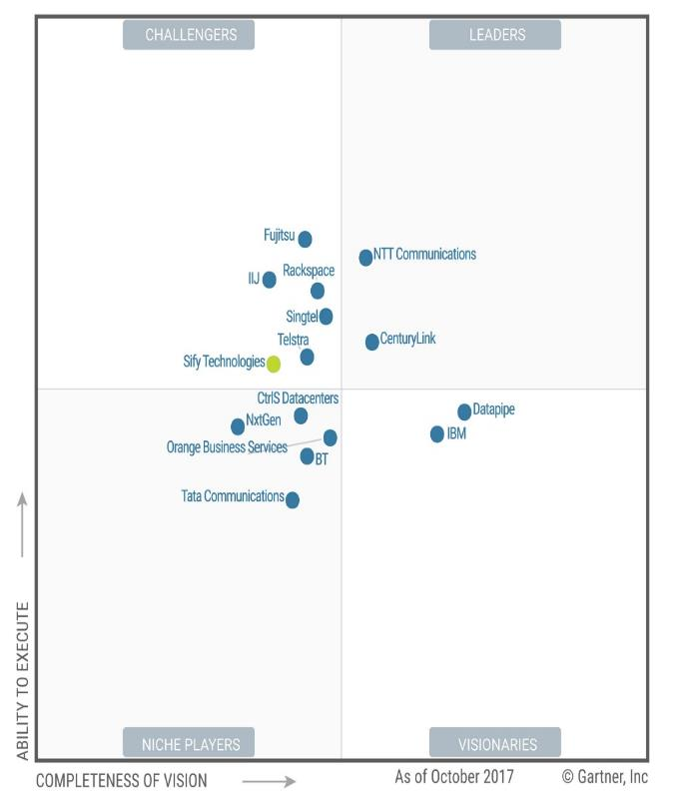

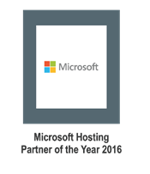
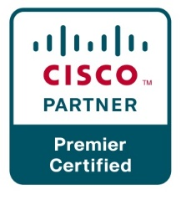
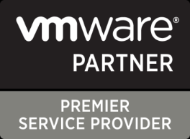

recognitions
Partner of the year 2017
Network Transformation Services
2018
Data Center Transformation Services
2018
Sify moves up to the challenger position on the Gartner MQ

Slide 6
SIFY CAPABILITES

Slide 7
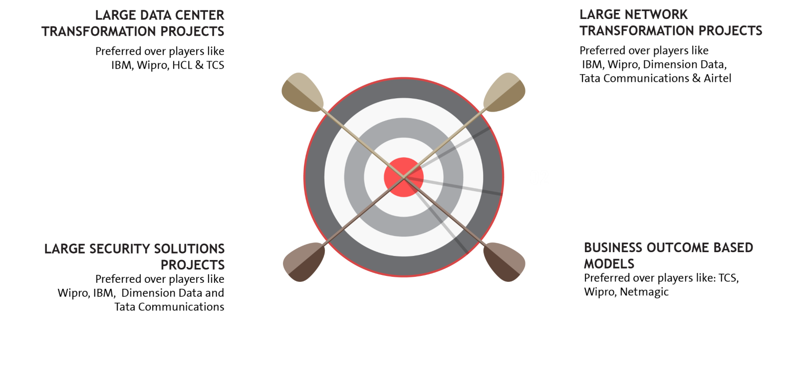
















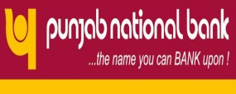


EXECUTION CAPABILITIES

Slide 8

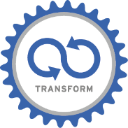






BFSI Credentials
Data center and Private Cloud Services
Network Services
35%+
Revenue from BFSI
300+ data center services projects executed in BFSI
50+ & counting
Marquee logos in BFSI
15+
network & transformation project executed
Network Services
Data center migration & transition projects executed
Security services projects executed
10000+
Public sector
Bank offices
5000+
Co-operative
bank offices
100+ BFSI Private
35+ SOC Services
80+ BFSI PSU
25+ Security Engagements
3000+
Public sector
Insurance co.
offices
20+ Security Projects
4500+
Private bank
offices

Slide 9

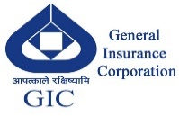
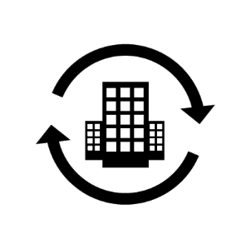

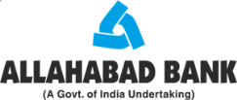
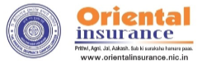


ICT Services Led Transformation Leadership in BFSI
Transformation of DC & DR along with Infrastructure refresh
Migration to Sify Data Center and Managed Services.
Transform and Private build cloud – Hyper converged infra for DC & DR.
Migrate workloads to Private Cloud & Managed Services.
Transform and build Private cloud & Managed Services.
Transformation of DC & DR along with Infrastructure refresh, virtualization & cloud set-up. Migration of applications from existing physical to virtualized environment and Managed Services.
DC/ DR & CLOUD
TRANSFORMATION
Consolidation and Refresh of infra for hosting the core insurance application & Managed Services.
Strategic Green Field Data Centre / Disaster Recovery Site Build + Migration + Managed Services for 5 years.
Hybrid Infrastructure – Private Cloud and Public Cloud – Sify CloudInfinit and AWS

Slide 10
KEY REFERENCES- PRIVATE BFSI (1/1)
VERTICAL | REFERENCE CUSTOMERS | TRANSITION | DC/DR HOSTING | DC IT INFRA/ PRIVATE CLOUD | DR IT INFRA/DRAAS | CLOUD | MANAGED SERVICES
Insurance | Max Bupa | ü | ü | ü | ü | ü | ü
Financial Ins. | LIC housing finance corporation | ü | ü | ü | ü | ü | ü
Insurance | Avantha Ergo Life Insurance | ü | ü | ü | ü | ü | ü
 | Max Life | ü | ü | û | û | ü | ü
 | Tata AIG Life Insurance Company Ltd | ü | û | û | û | û | ü
 | HDFC Life | û | ü | û | û | û | ü
 | Apollo DKV Insurance | û | û | û | ü | ü | û
 | Aviva Life Insurance | û | û | û | ü | ü | û
 | Star Union Daichi Life Insurance | ü | û | û | û | û | ü
 | Health Insurance TPA | û | ü | û | û | û | û
Payment Gateway | Billdesk | û | ü | ü | ü | û | ü
 | Paytm | û | ü | û | û | û | û
 | YouFirst Money Express | û | ü | û | û | û | ü

Slide 11
Key References – Private (BFSI) (2/2)
VERTICAL | REFERENCE CUSTOMERS | TRANSITION | DC/DR HOSTING | DC IT INFRA/ PRIVATE CLOUD | DR IT INFRA/DRAAS | CLOUD | MANAGED SERVICES
Banking | IndiaIdeas.com Ltd (BillDesk Payment Gateway) | ü | ü | û | ü | ü | û
 | The Thane District Central Co-op Bank Ltd. | ü | û | ü | ü | û | ü
 | Fedbank Financial Services Ltd. | ü | ü | û | û | ü | ü
 | Bombay Mercantile Bank | ü | ü | ü | ü | ü | ü
 | Axis Bank | ü | ü | û | ü | û | û
 | J&K Bank | ü | ü | û | û | û | û
 | Yes Bank | û | û | û | ü | û | û
 | The Hindustan Co-op Bank Ltd. | ü | ü | ü | ü | û | ü
 | Corporation Bank | û | ü | û | û | û | û
 | The Nagaland State Co-operative Bank Ltd. | û | û | ü | ü | û | ü
 | Bassein Catholic Co-operative Bank | ü | ü | ü | ü | ü | ü
 | Citizen Co-operative Bank | ü | ü | û | ü | ü | ü

Slide 12
Key References – PSU (BFSI)
VERTICAL | REFERENCE CUSTOMERS | TRANSITION | DC/DR HOSTING | DC IT INFRA/ PRIVATE CLOUD | DR IT INFRA/DRAAS | CLOUD | MANAGED SERVICES
Insurance | Oriental Insurance Company Limited | ü | ü | ü | ü | ü | ü
 | General Insurance Corporation | ü | ü | ü | ü | û | ü
 | NIA | û | ü | ü | ü | ü | û
 | National Insurance Corporation | ü | û | ü | û | û | ü
Banking | Allahabad Bank | ü | û | ü | ü | û | ü
 | OBC | û | û | ü | ü | û | ü
 | State Bank of India | ü | û | û | ü | û | ü
 | UCO Bank | û | û | ü | ü | û | ü
 | Bank Of Baroda | û | û | ü | ü | û | ü
 | Andhra Bank | û | û | û | û | û | ü
 | Dena Bank | û | û | û | û | û | ü
 | Vijaya Bank | û | û | û | û | û | ü

Slide 13
Our People Capabilities and Strengths
550+
DATA CENTER, CLOUD AND MANAGED SERVICES
1800+
NETWORK
SERVICES
70+
SECURITY
SERVICES
225+
APPLICATION
SERVICES

Slide 14
Case study #1- DC ms & transformation for gic re
GIC of India (GIC Re) was the sole reinsurance company in the Indian insurance market with over four decades of experience until the insurance market was open to foreign reinsurance players by late 2016 including companies from Germany, Switzerland and France.
GIC Re has its registered office and headquarters in Mumbai. To be able to support the expected growth required to have an IT set up which is reliable, Scalable, Optimised, Secure, and always available. This initiative needs to cover the technology upgrade & transformation of the IT infrastructure and also the consolidation of the IT infrastructure and the Datacentre.
Drivers for the Opportunity
Transform the current Infrastructure to have the latest in technology, efficient and ready to scale.
Consolidate SAP and other critical applications infra in different data centre.
Provide high availability for the Business application with improved security.
Provide a round the clock monitoring and support
Solution
Build Hyper Converged Infrastructure for DC & DR
Migrate Infra to Private Cloud for DC & DR
Migrate Physical workload to Virtual with improved IOPS for SAP and related workloads
Migrate 50+ servers and 40 TB data migration
Vmware Suite, NSX, Orchestration Automation
Enabled DRaaS tool based replication and recovery at DC and DR with RTO/RPO SLA’s
Improved Security Significantly (SOC, SIEM etc.)
Project Management for Implementation
Managed Services for 5 years
IT Landscape
Data Centre - 1 at Mumbai
DR @ Bangalore
Key benefits
Scalable & Elastic environment to react business needs
Security, Reliability, Availability & Serviceability
Best in Class Technology
Operations Best Practices & Tools
Management, Governance & Control

Slide 15
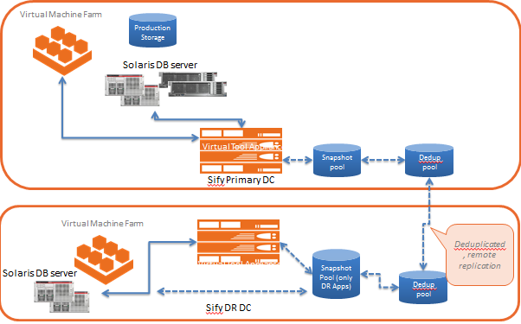
Case study #2- DC ms & transformation for max bupa health insurance
Max Bupa a leading heath insurance company, growing at a 30 % YOY rate. With a client base of 2 million. To be able to support the expected growth required to have an IT set up which is reliable, Scalable, Optimised, Secure, and always available. This initiative needs to cover the technology upgrade & transformation of the IT infrastructure and also the consolidation of the IT infrastructure and the Datacentre.
Drivers for the Opportunity
Transform the current Infrastructure to have the latest in technology, efficient and ready to scale.
Consolidate the applications infra in different data centre.
Provide high availability for the application with improved security.
Provide a round the clock monitoring and support
Solution
Built a Private Cloud for DC & DR
Migrate 100+ servers and 60 TB data migration
VMware, OVM based Hypervisors
Enabled DRaaS tool based replication and recovery at DC and DR with RTO/RPO SLA’s
Improved Security Significantly
Project Management for Implementation
Managed Services for 5 years
IT Landscape
Data Centre - 2 at Delhi, 1 at Mumbai
DR @ Bangalore
Key benefits
Business Services are continuously available
Improved Performance & Operational Efficiency
New Age DC + DR set-up
Zero Downtime Migration
Quick set up reducing planning and deployment time
Granular recovery intervals and data protection
Large Bandwidth to replicate DC data
Seamless transition to Managed Services
State of art tools, process and procedures

Slide 16
SOLUTION APPROACH FOR SEBI

Slide 17
Solution approach for SEBI
TENETS
OFFERING
TENETS
OFFERING
Application as Service
Business Aligned
Pay per use model
SAP
Microsoft
Oracle
Sify Apps
Right Fit IT Strategy
Optimized IT and OPS
Future Ready
Discovery & Assessment
ROI Analysis
Transformation Roadmap
Apps
Transformation
IT
Modernization
Assessment
OFFERING
TENETS
OFFERING
Infra
    P – V
    V – V
  Platform
    Win8 – Win10
  Apps
    Lotus - Exchange
Agility
Autonomous
Predictive
Analytics
Change the Business
Digital IT
IOT
TENETS
}
‘’0’’ Defect Migration
Seamless
End to end ownership
Cloud
Innovation
Sify’s
DCT Framework
Migration
Security
Transformation
Infrastructure
as a Service
TENETS
OFFERING
TENETS
OFFERING
Seamless
Impregnable
Audit & Compliance
driven
Network
End Point
IT
Agility
Future Ready
Consumption
    Private Cloud
    Enterprise Cloud
      AWS/Azure/ CI
    Hybrid IT
  Backup
  DR
  Acceleration
  DC Security
OPS
Transformation
TENETS
OFFERING
Cloud Nerve Center
Shade and Dedicated Pool
End to end Management
Automation
Lean Operations
Cloud Ready

Slide 18
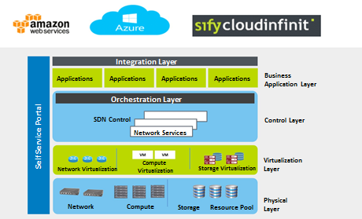
PRIVATE CLOUD SOLUTION components

Slide 19




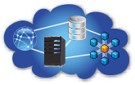

SERVICE MANAGEMENT
UNIFIED MONITORING OF PUBLIC AND PRIVATE IT ENVIRONMENTS
Application Monitoring
Server Monitoring
Cloud Monitoring
Virtualization Monitoring
Database Monitoring
Storage Monitoring.
Data Center Monitoring
Main Frame Monitoring
Response Time Monitoring
Big Data Monitoring
Basic Network Monitoring
Features
What can we monitor
Multitenancy
Dashboard & Reports
Distributed Architecture
Unified Trending
Visual Alarms & Reporting
Email Alerting
3rd Party Integration (Service Now for ITSM )
Agent and Agent less Monitoring
UMP (Portal ) available via Mobile
Dashboards and Reporting
Service Levels
End User Response Time
Performance and Availability
Events and Faults
Power
Efficiency
Network
LAN & WAN
Server
Physical & Virtual
Database
IT & Business
Application
Commercial & Custom
Cloud
Public & Private
19

Slide 20
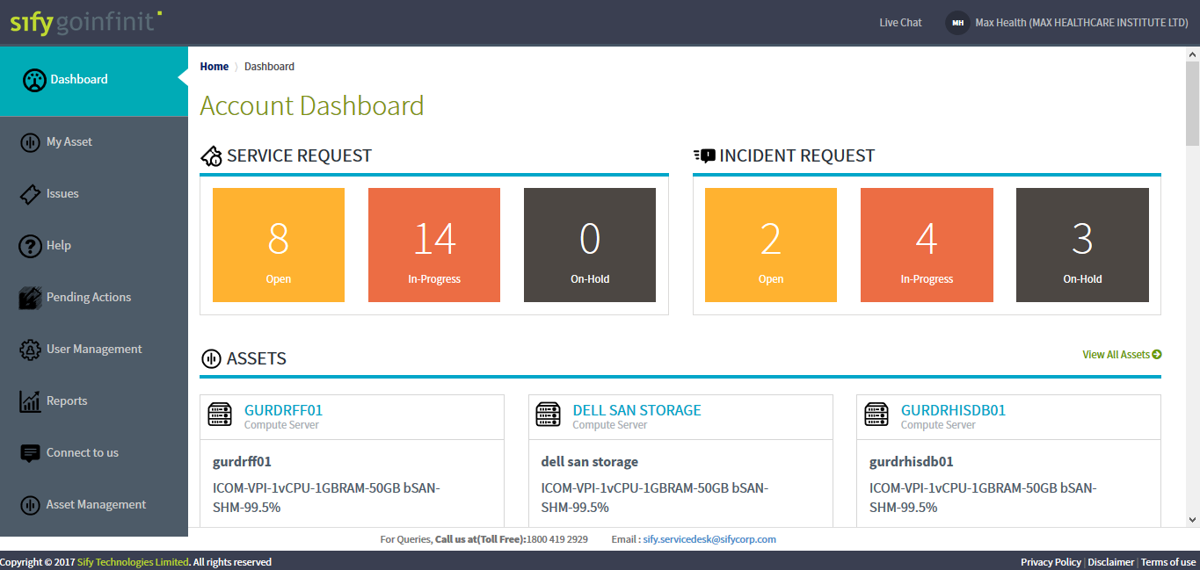
ONE TAP PORTAL

Slide 21
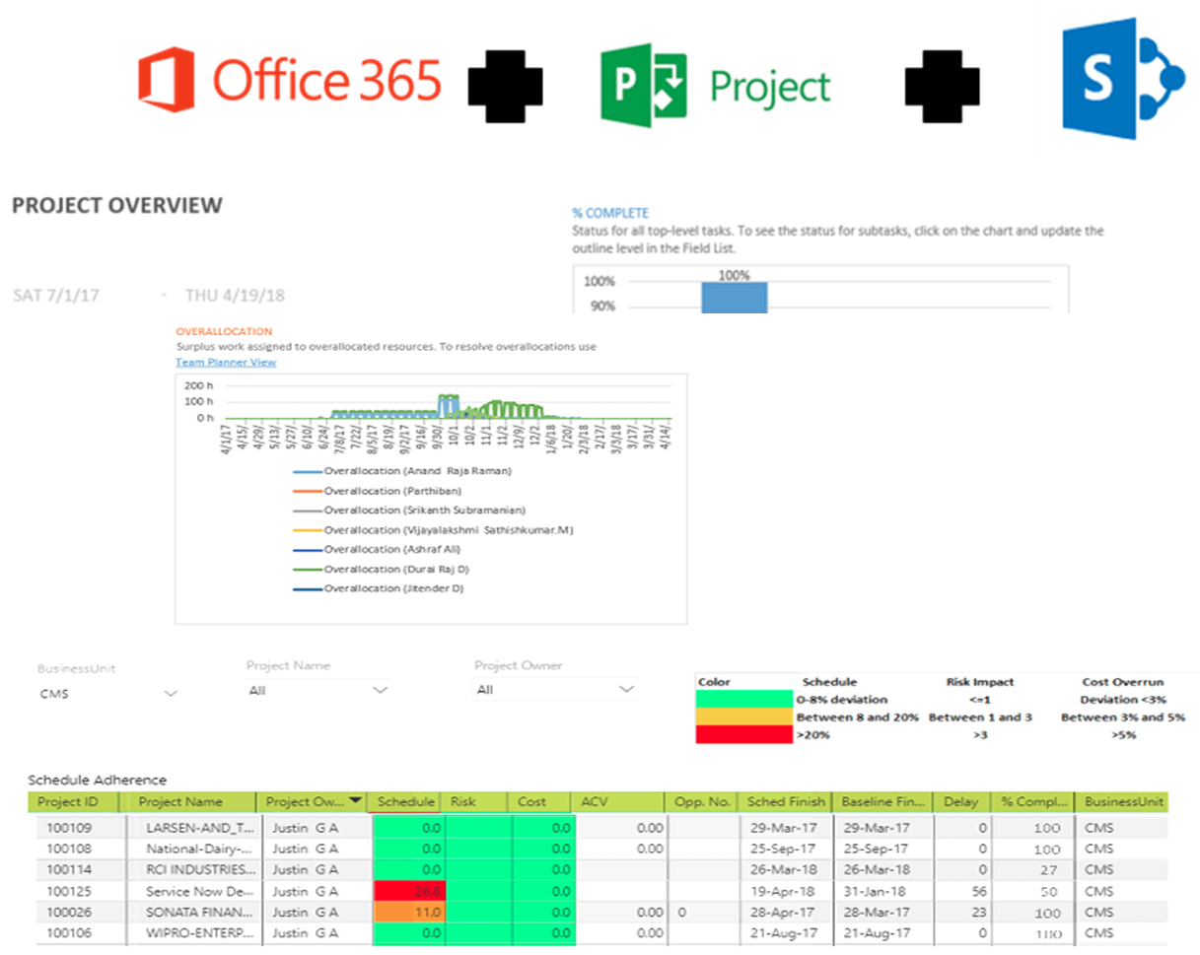
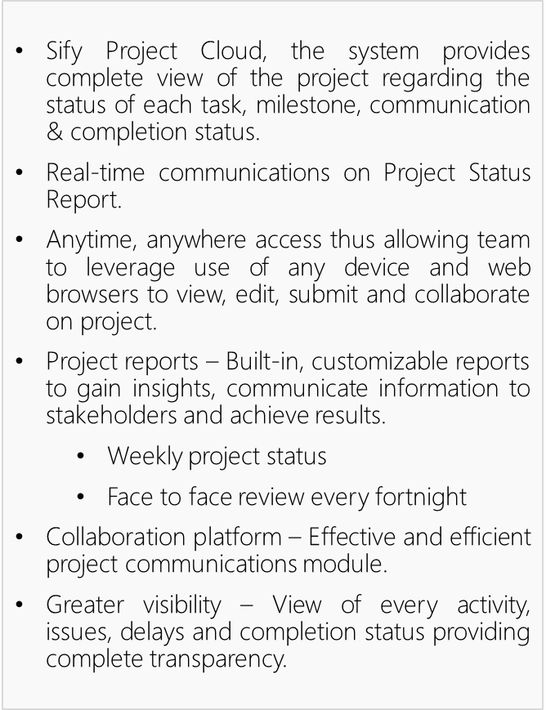
Implementation & PROJECT MGMT

Slide 22
Value proposition

Slide 23
PROPOSED SOLUTION STACK

Slide 24
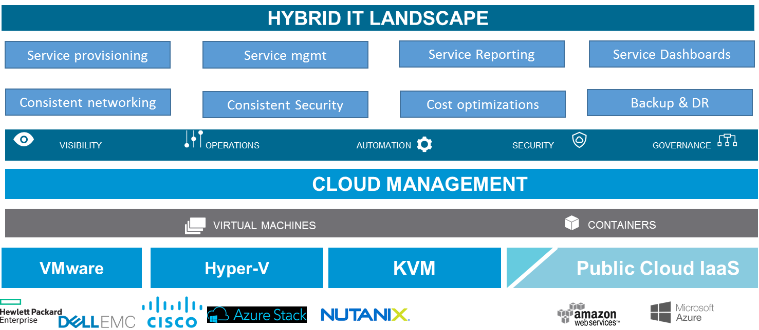
SEBI SOLUTION BLUEPRINT

Slide 25





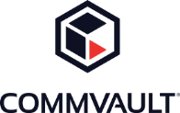


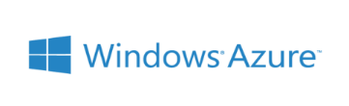
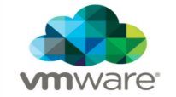






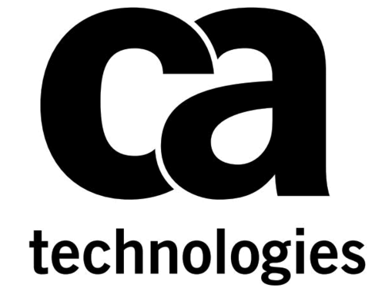








Strategic OEM Partnerships
Technology Partners
Cloud and Acceleration Partners
Software and Tool Partners
Security Partners

Slide 26
WHY SIFY FOR SEBI

Slide 27
Why Sify for SEBI?
Sify customer in Manufacturing
300+ DC Services projects executed
180+ DC Migration projects completed
Experience in Large Scale Transition
P-V, V-V, V-P
On-prem 2 Ent/AWS Cloud
Hyperscale Cloud 2 Ent Cloud
Consistent & steady Operations
Robust & Certified Processes
Onsite/remote mgt/ Hyperscale Cloud
DC partner for 5-10 years
50+ Marquee Logos
21% Revenue from Manufacturing
Best OEMs as building blocks
Integrated ITSM Tools
Gartner Acknowledged
Best in Class Platform
Network partner
45000+ offices connected
15+ Network Transformation Projects
System Engineering
In-House Cloud Mgt Platform
Security As A Service
Integrated Network Services
Application Integration
Experience on key aspects of Cloud & Data Center Services
Security partner
35+ SOC Services
25+ Security Projects

Slide 29
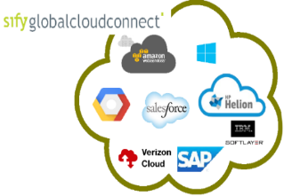







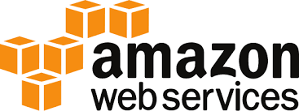


Sebi ENABLING hybrid ready future it state
SIFY CLOUD TRANSFORMATION SERVICES
UNIFIED VISIBILITY
INTEGRATED ORCHESTRATION AND MANAGEMENT
SAP , ORACLE, MS AZURE
SECURITY AND SERVICE GOVERNANCE
ENTERPRISE CLOUD
PUBLIC CLOUD
PRIVATE CLOUD
ENTERPRISE CLOUD
CLOUD INFINIT, AWS and MS Azure stack
HYPER CONVERGED/CONVERGED
PUBLIC CLOUD
PRIVATE CLOUD
Hyper Scale
Pay per Hour
Globally available
Fully dedicated
Compliance driven
Flexibility to own, outsource and buy back
Application Centric Architecture
Application Blueprint driven
Hybrid cloud ready
10 Public and Private Cloud Service providers at 30 + global locations
1. On-demand Provisioning & Simplified Management – Add on to MPLS network
2. Premium Performance / High Resiliency
SEAMLESSLY INTERCONNECTED – MPLS, INTERNET VPN EXPRESSROUTE, DIRECT CONNECT

Slide 30
Case study #1- DC ms & transformation for gic re
GIC of India (GIC Re) was the sole reinsurance company in the Indian insurance market with over four decades of experience until the insurance market was open to foreign reinsurance players by late 2016 including companies from Germany, Switzerland and France.
GIC Re has its registered office and headquarters in Mumbai. To be able to support the expected growth required to have an IT set up which is reliable, Scalable, Optimised, Secure, and always available. This initiative needs to cover the technology upgrade & transformation of the IT infrastructure and also the consolidation of the IT infrastructure and the Datacentre.
Drivers for the Opportunity
Transform the current Infrastructure to have the latest in technology, efficient and ready to scale.
Consolidate SAP and other critical applications infra in different data centre.
Provide high availability for the Business application with improved security.
Provide a round the clock monitoring and support
Solution
Build Hyper Converged Infrastructure for DC & DR
Migrate Infra to Private Cloud for DC & DR
Migrate Physical workload to Virtual with improved IOPS for SAP and related workloads
Migrate 50+ servers and 40 TB data migration
Vmware Suite, NSX, Orchestration Automation
Enabled DRaaS tool based replication and recovery at DC and DR with RTO/RPO SLA’s
Improved Security Significantly (SOC, SIEM etc.)
Project Management for Implementation
Managed Services for 5 years
IT Landscape
Data Centre - 1 at Mumbai
DR @ Bangalore
Key benefits
Scalable & Elastic environment to react business needs
Security, Reliability, Availability & Serviceability
Best in Class Technology
Operations Best Practices & Tools
Management, Governance & Control

Slide 31
Case study #2- DC ms & transformation for max bupa health insurance
Max Bupa a leading heath insurance company, growing at a 30 % YOY rate. With a client base of 2 million. To be able to support the expected growth required to have an IT set up which is reliable, Scalable, Optimised, Secure, and always available. This initiative needs to cover the technology upgrade & transformation of the IT infrastructure and also the consolidation of the IT infrastructure and the Datacentre.
Drivers for the Opportunity
Transform the current Infrastructure to have the latest in technology, efficient and ready to scale.
Consolidate the applications infra in different data centre.
Provide high availability for the application with improved security.
Provide a round the clock monitoring and support
Solution
Built a Private Cloud for DC & DR
Migrate 100+ servers and 60 TB data migration
VMware, OVM based Hypervisors
Enabled DRaaS tool based replication and recovery at DC and DR with RTO/RPO SLA’s
Improved Security Significantly
Project Management for Implementation
Managed Services for 5 years
IT Landscape
Data Centre - 2 at Delhi, 1 at Mumbai
DR @ Bangalore
Key benefits
Business Services are continuously available
Improved Performance & Operational Efficiency
New Age DC + DR set-up
Zero Downtime Migration
Quick set up reducing planning and deployment time
Granular recovery intervals and data protection
Large Bandwidth to replicate DC data
Seamless transition to Managed Services
State of art tools, process and procedures

Slide 32
SIFY’S JOURNEY SO FAR…
Established HQ in Chennai
Listed on NASDAQ
Launch of MPLS service in India
Exit Consumer Broadband/Cyber Café
Launch of SAP Private Cloud services and practice
Launch of business outcome based models
1995
1999
2001
2008
2013
2017
1998
2000
2004
2012
2016
First private ISP in India
First Tier3 Datacenter in India
Launch of RIM services, NOC, SOC services
Launch of Cloudinfinit services
VPE hybrid cloud and GI Private cloud offerings launched
Sify has surfed the wave of technology disruption from its inception

