Slide 1

SOLUTION PRESENTATION
Infibeam Datacenter , Ahmedabad
17th Oct, 2018

Slide 2
Contents
Sify a Strategic Partner for Infibeam
Architecture and Design
Implementation and Project Management
Operations and Support Methodology
Sify Value Addition
1
2
3
4
5

Slide 3



























Strategic Partnerships
Technology Partners
Cloud and Acceleration Partners
Application Partners
Security Partners

Slide 4
UNDERSTANDING OF
INFIBEAM REQUIREMENTS

Slide 5
Sify’s Understanding oF the Business Requirements
Infibeam is building an Uptime Certified Tier III 200 Rack Data Center on 26th Floor of their GIFT City, Gandhinagar Office.
Infibeam intends to expand their business as a Cloud Services Provider in India.
The current requirement is segregated in 3 Phases:-
  Phase 1- Building an Infra for the workloads running currently on AWS & managing the Infra.
  Phase 2- Create a Cloud Services Model and extend it to Infibeam’s existing client base.
  Phase 3- Extend the Cloud Services Model to public & acquire new clients.
Infibeam wants the bidding partner to build the Cloud Architecture and Manage the same across all the 3 Phases of the Project Lifecycle.
The solution proposed should be on-demand replicable and scalable.

Slide 6

REQUIREMENTS OF PHASE 1
What is the Key Idea of the Requirements?
The Main Tasks for the How To Set Up & Operate…
Proposed a Comprehensive on-prem Cloud based Service for Infibeam Self Consumption & Future Customers
Remotely Manage & Monitor the Active DC components in Infibeam DC with onsite L1 Support
To Build a Software Defined Data Center for its existing AWS workload migration with the Right Technology Selection
To Manage the SDDC with a Cloud Management Platform

Slide 7
AWS Landscape shared by Infibeam

Slide 8
Architecture Details
Solution Architecture and Detailed Design
On Premise Service Offerings
Solution Strengths
Implementation and Project Management
Operations and Management
Solution Highlights and Sify Value Addition

Slide 9
ARCHITECTURE AND DESIGN OF SDDC

Slide 10
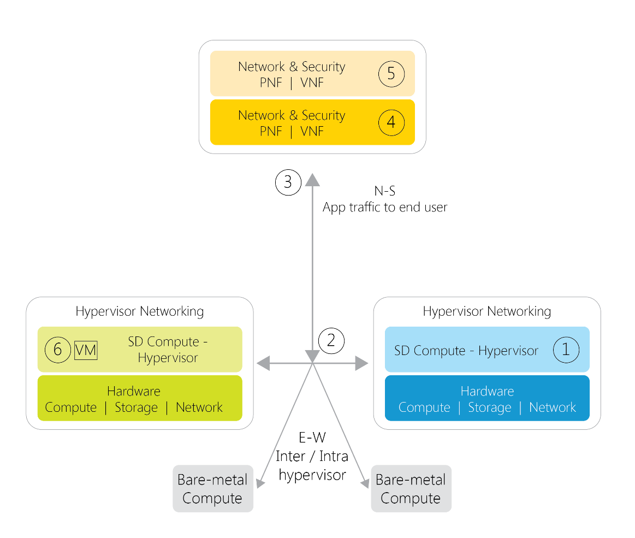
SDDC – Infrastructure Selection Criteria
Hypervisor – Industry Leading, Interoperable with SDN and CMP
SDN – Multi Hypervisor Ready, Service Chaining Capabilities with L4-L7 Vendor Solutions, tight integration with Overlay
Consistent Networking – for both East-West as well as North-South traffic and extendable to Bare Metal across all Layers
Rich Telemetry – Complete Visibility of traffic to VM with an integrated underlay
Support for PNF and VNF
Micro Segmentation – that stays with the VMs as they migrate across Clusters/PODs

Slide 11
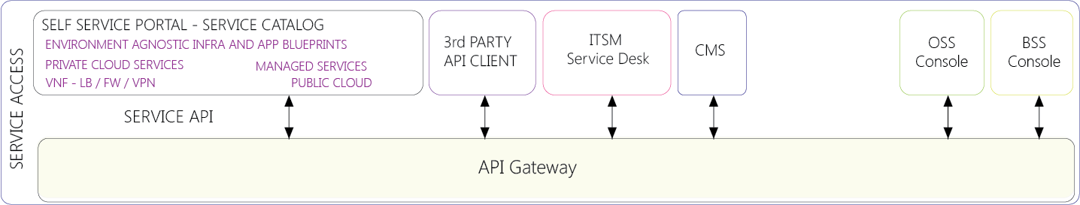
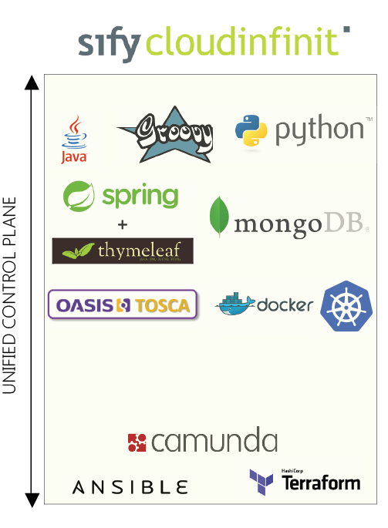

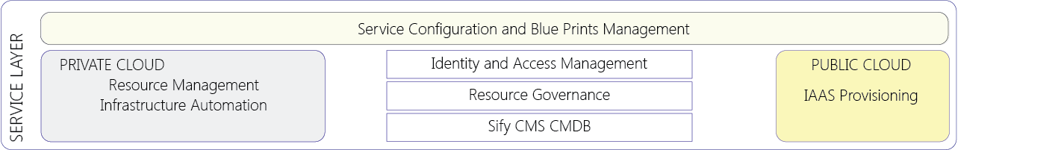
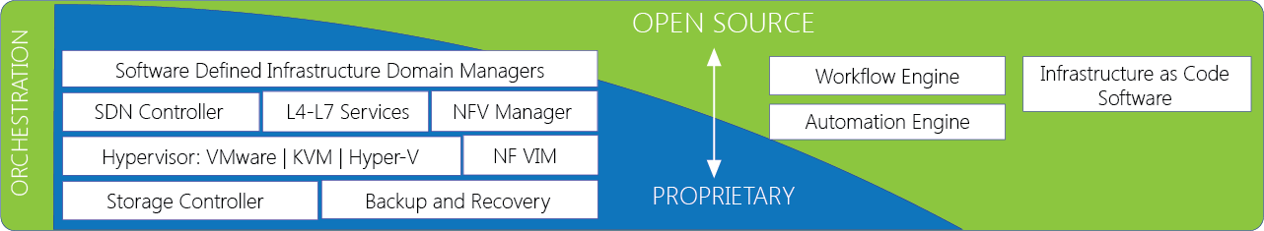
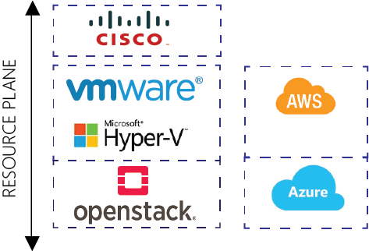
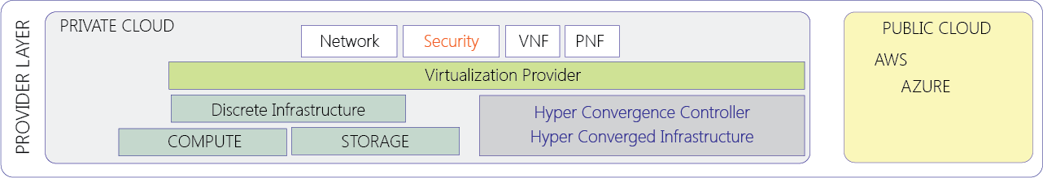
Proposed Cloud Management Platform for Infibeam

Slide 12
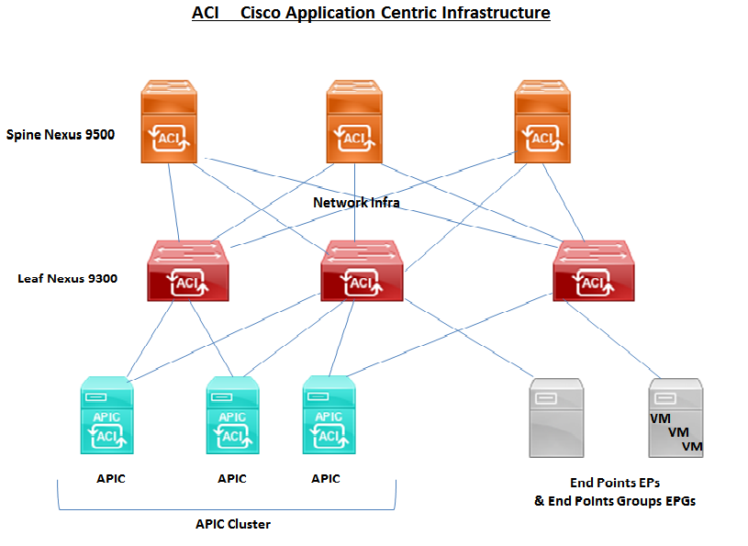
Proposed Cisco ACI for infibeam Datacenter Network
Centralized Policy-Defined Automation Management Consistent Networking
Real-Time Visibility and Application Health ScoreRich Telemetry – Complete Visibility of traffic to VM with an integrated underlay
Open and Comprehensive End-to-End SecurityMicro Segmentation
Open and Comprehensive End-to-End Security
Application Agility
Traffic optimization that improves application performance
Elimination of flooding from the fabric
Multitenancy (network slicing)
Connectivity for physical and virtual workloads with complete visibility on virtual machine traffic

Slide 13











Infibeam Datacenter Proposed network architecture
WAN/MPLS
Internet
WAN Router
WAN Router
Internet Router
Internet Router
L2 Switch
L2 Switch
LB
LB
P2P
Internal Firewall
Perimeter
Firewall
Service Leaf
Switches
OOB Firewall
SLB
OOB Switches
SLB
Core
Switches
Inline Management
Switches
Leaf Switches
APIC
40 Gig Fiber
10 Gig Fiber
Server Farm
1 Gig Copper

Slide 14

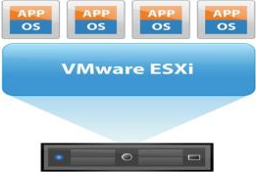
Solution-1 - Nutanix HCI Design View
10 Gb
8 Gb
4 Gb
2 Gb
Converged Network QoS
10 Gb
8 Gb
4 Gb
2 Gb
Nutanix AHV
Nutanix AHV
Nutanix AHV
HCI Cloud POD
HCI Cloud POD
Bare Metal 4 Proc
Network Switch
HCI Cloud POD
Management Network Switch
10 Gb | PROD
8 Gb | Monitoring, Mgmt, Orchestration
4 Gb | Backup
2 Gb | File Storage
25GbPS
1 GbPS
32 GbPS FC
Fabric A
Fabric B

Slide 15
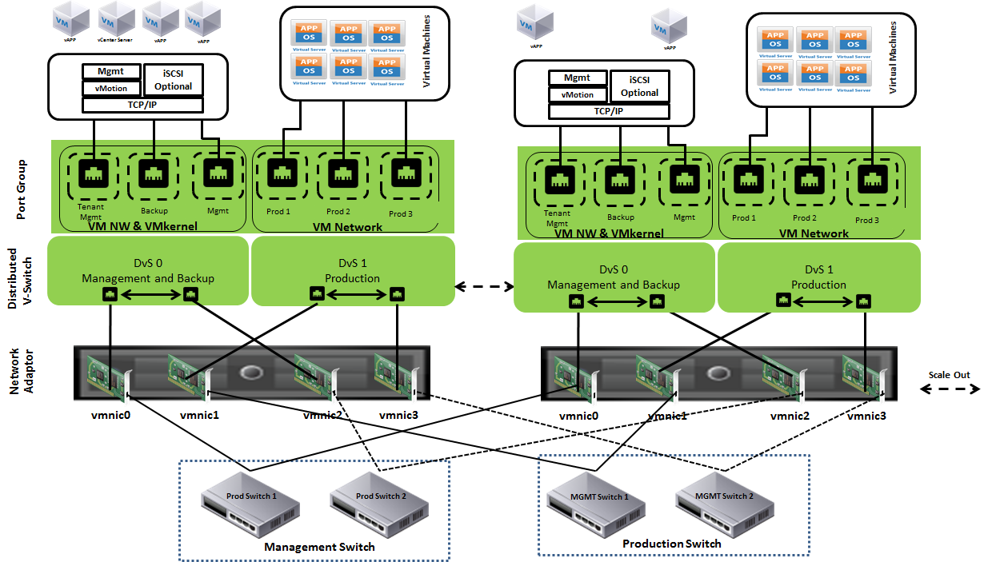
Nutanix HCi Solution – Hypervisor Design View
Clusters are created specific to OS platform e.g. CentOS, MySQL.
Resource groups are formed based on the business demand, VM priority (SLA), affinity rules and high availability rules are created in resource pool
High availability across entire virtualized IT environment
Continuous availability for critical applications on fault tolerance mode.
Folder structure is maintained for logical group of virtual machines
On Demand Scale-out architecture

Slide 16
Solution-2 Converged Infrastructure compute Design View
10 Gb
8 Gb
4 Gb
2 Gb
Converged Network QoS
10 Gb
8 Gb
4 Gb
2 Gb
Cloud POD
Bare Metal 2 Proc
Bare Metal 4 Proc
Network Switch
Management Network Switch
10 Gb | PROD
8 Gb | Monitoring, Mgmt, Orchestration
4 Gb | Backup
2 Gb | File Storage
25GbPS
1 GbPS
32 GbPS FC
Fabric A
Fabric B

Slide 17
CONVERGED Infrastructure – Hypervisor Design View
Clusters are created specific to OS platform e.g. Windows, Red-hat, Windows SQL, etc.
Resource groups are formed based on the business demand, VM priority (SLA), affinity rules and high availability rules are created in resource pool
High availability across entire virtualized IT environment
Continuous availability for critical applications on fault tolerance mode.
Folder structure is maintained for logical group of virtual machines

Slide 18
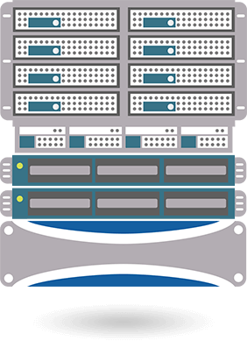




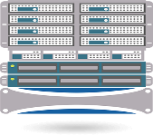
Converged Solution – STORAGE View
SAN fabric consists of director class SAN switches at core and Edge SAN switches
MDS 9710 will be deployed at core and MDS 9148 at edge layer
Server Cluster wise edge san switches grouping
POD wise Zoning on vSAN and ACL
Unified Management
Performance Monitoring & Tuning
Application-to-spindle performance and capacity monitoring, reporting and forecasting
Non-disruptive Dynamic Data Movement
Edge FC
switch
Core FC switch
Cloud POD
Enterprise Storage
Network SWITCH
Edge FC switch
Bare Metal
Unified Storage

Slide 19
Security Solutions and Controls – Addressing needs
NEED & RISK DEFINITION
SOLUTIONS
NETWORK
Intrusion Attempts
Unauthorized Access
Man in the middle attacks
Business Critical Data Disclosure to Competitors
Unrestricted third part access
Firewalls
Intrusion Detection/Prevention System
Extranet VPNs
DATABASES
Unauthorized Modification/Data.
Malicious Insiders
Password Management
Data Disclosure
Transactional Risks/Logging
Transaction Monitoring, Centralized Logging/Alerting
Strong Authentication/Password Vault
Vulnerability Exploitation
Intrusion Attempts
Integrity of Critical files.
Protection of system/audit logs
Data Manipulations
SYSTEMS
Centralized Logging/Alerting (SIEM)
ENDPOINTS
Data Theft
Configuration Management
Antivirus with FW/IP
Patch/Configuration Management Solution
End Point Encryptions Solution
APPLICATION
INFRASTRUCTURE
Exploitation of Application Level Vulnerabilities
Application Level Firewalls
MESSAGING
& CONTENT
Data Leakage Via Email and Web
SPAM/Reputation Issue
Mail Security Gateway with Anti-X features/NRS (that is RBL), Email encryption
Web Security Gateway with URL/Content Filtering

Slide 20
Propose Security Solutions
NGFW
Next Generation Firewall Capabilities.
Ease of Use
Detailed Contextual Visibility.
Intelligent Traffic Handling.
Unified Access Security.
Extensive Network Support.
Identity-Centric Enforcement.
Sophisticated Application Control.
Advanced Intrusion Protection
Web Application Firewall (Optional Sify Shared Services model)
Protects web based applications without having to change the application itself.
Protects against application specific vulnerabilities
Act as a virtual patching for the applications
Protects against secret injection attack, cross scripting, command injection attack

Slide 21
Propose Security Solutions
PRIVILEGE IDENTITY MANAGER
PIM manages, protects and controls access to all privileged accounts and makes hard-coded application credentials invisible to developers, database administrators, external vendors and IT staff.
PIM Suite creates easy to use, unified audit reports. It allows enterprises to enforce corporate security policies to ensure compliance with regulatory needs and security best practices related to access and usage of privileged accounts
Controlling Access to Privileged Accounts
Managing application and service credentials by providing solutions for securing and managing critical applications as well as Application Server accounts
Reduce IT Overhead with efficient control and less human error
SIEM- INCIDENT INVESTIGATION (Sify Shared Services Model)
Accelerates security investigations by enabling analysts to pivot through terabytes of meta-data, log data, & recreated network sessions with just a few clicks.
COMPLIANCE REPORTING
Reports, covering a multitude of regulatory regimes
Automates regulatory or governance focused reporting
UNIFIED BROWSER-BASED DASHBOARD
Browser based user interface which enables customizable analysis and monitoring user interfaces.
Monitoring, detection, investigation, and administration in a single integrated and customizable interface, driving analyst efficiency.
Customized views based on the particular roles of the security analysts.

Slide 22






Security Operations Center (On-premise / Remote)
Client
IT Infrastructure
Threat & Vulnerability Alerts
Unified Security
Portal
IT
Controls
CMDB
Central
Database
Applications
End Point Security Alerts
Security Devices
Access &
Application Security Alerts
Incident Data
Security
Analysts
- - - - - - - - - Secure Connectivity - - - - - - - - -
Reporting
Engine
Network Devices
Data Protection Alerts
Correlated Events
Operator
Console
Critical
Systems
System and Application alerts
SIEM
Service Mgmt.
Incident
Tickets
Sec. Ops
Unified Security
Portal
Log monitoring & Event Analysis Alerts
Notification
Incident Alerts/
Remediation Information
Status Reporting
Notes:
22

Slide 23
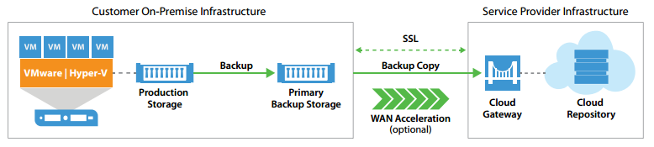
Proposed Backup Solution architecture
Datacentre Infrastructure
Enterprise-wide control
MSP-ready
Broad application protection
App-aware storage array snapshots
Strong security
FIPS-certified
Physical and virtual support
Active Directory (AD) support
Powerful catalog search
Extensive storage options

Slide 24
State of the Art Toolset for OPERATIONS & mANAGEMENT
FUNCTIONALITY | SOLUTION USED
Service Desk | Service Now
ITSM Processes - Incident Management - Problem Management - Change Management - Knowledge Management | Service Now
Network Fault and Performance Monitoring | CA Spectrum, CA PM
DC IT Monitoring | CA UIM

Slide 25
IMPLEMENTATION, PROJECT EXECUTION, OPERATIONS & MANAGEMENT

Slide 26
Project Phases
INITIATION
PLANNING
EXECUTION
CONTROL
CLOSURE/HANDOVER
  Acceptance of PO
  Contract sign-off with Infibeam
  Project & implementation Team formation
  High level Cloud Platform design, including
    Core Infrastructure (Service Provider Layer, Service Layer, Service Access layer)
    Cloud Application Platform
    On Premise Service
    Rack & Cabling design
    BOM Validation
    ITSM & Monitoring
  Release PO to vendors on solution components
  Define Acceptance testing strategy
  Define high level risk and risk mitigation policies
  Resource allocation
  Project Kick-Off meeting
  Creation of base deployment design
  Low level Cloud Platform design
    Compute
    Network
    HCI
    Storage, Backup
    Security
    CMDB
    Software Asset
    ITSM & Monitoring
  Process and Workflow design definition
  Validation of Used Cases for Cloud platform
  Acceptance Test Plan
  Development of Risk Management Plan
  Development of project quality management plan
  Development of communication Plan for project stake holders
  Facility readiness
    Rack power, cooling provisioning
    Inter & Intra Rack Cabling (OFC)
  Delivery of equipment’s and accessories
  Cloud Infra/platform setup
  Set-up of Provider Layer
    Rack Mounting, Power-on test
    I&C of all hardware stack
    I&C of Orchestration Layer
    I&C of Service Layer
    I&C of Access Layer
    I&C of EMS
    I&C of Back-up
    I&C of Patch Management & AV
  Testing of Cloud Platform & services
  1 Application deployment for Cloud service testing
  Acceptance testing (pre-FAT)
  Training
  Final Acceptance testing (FAT)
  Operation readiness
  Proactive monitoring services & helpdesk readiness validation
  O&M team deployment
  Review of actual achievement vs. planned
  Measure Performance of the team.
  Take corrective actions based on gaps identified.
  Evaluate Effectiveness of Corrective Action.
  Respond to Risk Event Triggers.
  Complete documentation
  Handover Document and manuals
  Obtain Acceptance of Project Deliverables
  Hand over to Operations Team
  Facilitate Closure
  Collect Feedback
  Document Lesson Learned
  Release project resources

Slide 27
Project Governance Organization
We recommend a 3-Tier Relationship to ensure that the Project objectives are fully met
Specific roles and responsibilities to be shared at a later stage
Executive Steering Committee
  INFIBEAM
  SIFY
Regular meetings to:
  Communicate Your strategic business direction and priorities
  Link business and IT change
  Financial oversight
  Business Transformation
Relationships at executive, management and practitioner levels.
Executive Steering Committee will have members from Infibeam & Sify senior executive staff
Steering Board has members from Infibeam & Sify program management team, legal and contract teams required for contract management.
Service Delivery Board has members from Infibeam designated service areas and Sify tower leads/ service providers and required operations management.
STRATEGIC
Steering Committee
  INFIBEAM
  SIFY
Regular meetings to:
  Review overall project plans
  Allocation of resources
  Ensure priorities are met
TACTICAL
Management of contract deliverables and functional.
Project Office
  INFIBEAM
  SIFY Project Executive
Day-to-day control:
  Execute project plans
  Ensure priorities are met
  Manage change control
A management system for reviewing, status reporting and addressing issues.
OPERATIONAL
Service Delivery
  SIFY Delivery Team
On-going Service Delivery:
  Achieve or exceed set deliverables
  Regular reporting thru Dashboard

Slide 28
Service Framework
SERVICE STRATEGY
SERVICE DESIGN
SERVICE TRANSITION
SERVICE OPERATIONS
CONTINUAL IMPROVEMENT
Strategy Management
Information Security Management
Transition Planning & Support
Service Desk*
Service Portfolio Management
Incident Management
IT Availability Management, Supplier Management
Change Management
Demand, Financial Management
Problem Management
IT Service Continuity Management
Knowledge Management
Event Management
Business Relationship Management
Request Fulfilment
Service Catalogue Management
Service Asset & Configuration, Release and Deployment Management
Access Management
Service Level Management
IT Operations Management*
Service Validation & testing
Capacity Management
Technical Management*
Continual Improvement

Slide 29
Support Organization
Infibeam Project Committee Head
Practice Head
Infibeam Project Director
Service Delivery
Head
Infibeam IT Project
Manager
Technical Delivery Manger
(Project In Charge)
Infibeam IT Leads
Cloud Lead
Systems Lead
Database Lead
Storage/Bck Lead
NW/Sec Lead
Tech Support
Cloud Engineers + EMS Engineer
Sys Admins
Database Engineers
Storage & Backup Engineers
Network & Security Engineers
Support Engineers
Infibeam
Sify Offsite

Slide 30
Project Critical Success Factors
CRITICAL SUCCESS FACTOR | STEPS TO ACHIEVE CRITICAL SUCCESS FACTORS
Understanding of Scope, Deliverables, Outcome | Involvement of Solution, Delivery, Implementation, Operation leads from day-1 in all key discussions, decision making with Infibeam team Role playing in HLD, LLD, test process/perceived outcome
Project scheduling | Ensure timely delivery of ICT Infra hardware, Licenses
Timely validation, approval on HLD, LLD, deployment strategy, policies | Approved HLD, LLD, Config documents, security / backup policy, IS/ISO/BCP policy
OEM Involvement at all stages | OEM involvement in Planning, Designing, and FAT to ensure solution workability, technological integration. OEM validation of design as Industry Best-practice (post implementation)
Acceptance, Final Test (FAT) strategy | Detailed use cases, test cases, test process and perceived outcomes
Risk management | Risk register with perceived risks, risk matrix, risk mitigation strategy, roll-back plan
Operation Transition | Selective Operation team to be part of implementation Roll-out of Helpdesk, services through helpdesk Handover to operation team for steady state support

Slide 31
Assumptions & Considerations
We have considered CSP based solution as a Option 1 & 2 which is VM based solution for IAAS platform
Compute is taken as per assumptions due to non-availability of AWS Core/Mem count per instances
Per Instances Storage is assumed due to non-availability of data from Customer End
Application IOPS are assumed and can be discussed with customer prior to finalisation of actual BoM
AWS RDS data is unavailable for sizing & is assumed for BoM creation
Application details are unavailable for profiling and are assumed to be light loaded applications
OS, App & DB licenses are assumed to be provided by Customer end. Current Operating System is Ubantu & database is MySQL
Future Infibeam customer migration to Infibeam Cloud is assumed & considered to be on Linux environment as per customer details
Remote monitoring & management services with onsite LI Support for Smart Hands
Seating Space & other IT Infrastructure for L1 Resources deployed onsite
Passive Cabling is assumed for 10 Racks

Slide 32
Exclusion
Migration of AWS Workload to Infibeam DC
Application Deployment, Management & Maintenance
DR Services
Onsite Helpdesk
Rack Supply
Power Provisioning, cooling & other DC Non-IT Facility related Services

Slide 33
Bill of Materials

Slide 34
Terms & Conditions

