Slide 1
Indusind Bank-Sify Partnership
October 2021
SIFY is a leading integrated ICT player in India, helping customers to achieve their digital ambition through cloud@core products and services,
built on its world class Data Centers, Cloud & Network assets and wide portfolio of professional and digital services
Notes:
Update on the current status of our partnership
Take feedback from NSE ( proposing to NSE for member satisfaction survey for the services we offer through 3rd party)
Update NSE on Sify’s strategic investments and how they will be useful to them

Slide 2
Session objective
To share
To understand
Sify’s relevance, skills, investments, partnerships and customer engagements across Data Center, Cloud & Digital services
Our relevance in IndusInd Bank Data center, cloud and digital transformation pursuit

Slide 3
SIFY’S JOURNEY: 25 YEARS OF TRANSFORMATION
CONSUMER FACING ISP
SHIFT TO AN ENTERPRISE SERVICES COMPANY
TRANSFORMATION INTO ICT SERVICES COMPANY
DIGITAL ICT SERVICES PROVIDER
(cloud@core)
DIGITAL TRANSFORMATION SERVICES PROVIDER
(digital@core)
Consumer internet
Enterprise adoption of internet
Social and mobile on cloud
Emergence of cloud first
Relentless push to digital first
Sify 1.0
Sify 2.0
Sify 3.0
Sify 3.0+
Sify 4.0
First private ISP in India
Launch of MPLS & Data Center services in India
Launch of Enterprise Cloud services
Launch of private and hybrid cloud services
Launch of end-to-end digital services
RELEVANCE
INVESTMENTS
ACHIEVEMENTS
GROWTH
Products and Services always aligned to market trends and customer need
Investments in line with market trend and strategic objectives
Recognized as a trend setter or leader in multiple lines of business
Consistent growth through investments and customer engagements

Slide 4
cloud@core TM ALIGNED TO OUR CUSTOMERS’ CLOUD TRANSFORMATION PURSUIT
CLOUD ENABLING
CLOUD INSPIRED
CLOUD PURE
CLOUD ENHANCED
Data Center and Private Cloud
Cloud adjacent DC for Enterprises
Hyper reach/Hyperscale NW
Data Center Interconnects
Metro-Xconnect, and Cloud connects
SD-WAN
Network transformation services
Cloud Advisory and Migration
Discovery, Assessment, Target State Architecture design services
Migration and implementation
IaaS at Cloud Data Centers
CloudInfinit Cloud Anywhere
Enterprise Multi-Tenant
Hosted Private (Dedicated)
Hosted SAP/S4 HANA
Azure Stack as a Service
Edge infra aligned to Cloud
Edge Connect Services
Security For Hybrid Cloud
Infrastructure & Services
Collaboration Services
Hyperscale clouds adjacent to Cloud DCs
AWS / GCP / OCI / Azure
Multi-cloud management platform – v5
Service catalog with IAC templates
Cloud resource lifecycle management
Integrated ITSM services
Cloud managed services
Visibility and governance dashboards
Policy engine for governance
Detailed Show back of consumption
Self service catalog driven
InfinitDIGITAL-Build services
Digital Infrastructure (Kubernetes)
DevSecOps as a Service
XaaS Headless Microservices
InfinitDIGITAL-Digital Optimization
Process automation as a Service
FinOps as a Service
InfinitDIGITAL-Digital Augmentation
Digital learning services
AR / VR, Digital Content Services
InfinitDIGITAL-SaaS
Retail Intelligence Solutions
Digital Trust and Authentication
Digital Assessment Services
Learning Management System
Infrastructure asset led services
Asset neutral digital transformation services
cloud@core delivers agility, flexibility and choices for creating hybrid cloud led digital infrastructure

Slide 5
BASIC MINIMUM CRITERIA!
RECOMMENDATIONS FOR SELECTION OF DC PARTNER
NEW DIFFERENTIATING CRITERIA!
Enterprise Experience for specific workloads
Carrier Neutral
Tier 3 or Equivalent as per Uptime Institute or TIA-942
Multiple sites and their seismic Zone rating ( Among other environmental factors)
Back up and DR Capabilities
SLA of 99.92% or greater (minimum T3 capability)
Overall Customer Feedback
Cloud Vision and Strategy
Hyperscale Partnerships: AWS, MS, GCP
Managed Services
In a single and multi-cloud environment
Cloud Experience and Depth
Cloud Mgmt., Cloud Economics (In-house IP or partnerships)
Provides Network Connectivity to Major Cloud providers
AWS/Direct Connect, MS Azure/Express Route
Interconnect services to other sites or partner ecosystems

Slide 6
Infrastructure designed and built for hybrid cloud
CLOUD DATA CENTERS
VIRTUAL PRIVATE
CLOUD
CLOUDCONNECT
Hyperscale Connectivity to AWS, Azure, GCP, Oracle
“DC inter-connect”
data superhighway to
48 on-net data centers
10 Pan-India DCs with 100 MW capacity.
Adjacent Hyperscale CSPs
Hyperscale Connectivity to AWS, Azure, GCP, Oracle “DC inter-connect” data superhighway to
48 on-net data centers
Enterprise Cloud grid available with data centers
APPLICATIONS
MULTICLOUD OPERATIONS CENTRE
NETWORK
App Modernization,
Kubernetes,
Industry Solutions as Services
Largest MPLS network (by connections)
3100+ PoPs across 1600 towns in India
Cloud, DC, Security, Network, Applications

Slide 7
Sify’s Data Center experience Snapshot
21 years of experience in Build, Own, Operate Carrier-Neutral
Data Centers
10 Data Centers
About 100 MW operational IT Power in key cities
Built To Suit capabilities
Roadmap
to add 15 Data centers with 250 MW in next
4 years
Automation & AI
AI / ML services providing intelligent BMS analytics to make informed decisions
Multiple Industries
ecosystem facilitating multiple industries, OTTs and ISPs interconnect
via portal
Truly Carrier-Neutral
More than 90% of fiber links are from non-Sify Telecom Providers
Rich Interconnect Ecosystem Hyperscale Cloud, Multiple Internet Exchanges, Content IP peering nodes & ISP Interconnect
Green Data Centers
High efficiency equipment, Operations practices,
Renewable Energy
Self-service Portal
for Cross Connects and rack space: deployment in 2-5 business days

Slide 8
SIFY ICT services KEY FACTS
700+
100+
PEOPLE
DC, Cloud & Managed Service Team
Certified Security Experts
400+
500+
70+
50+
CUSTOMERS
Enterprise Cloud clients
Data Center Clients
Private Cloud & DR clients
CDN & Cloud Security clients
50+
500+
300+
80+
PROJECTS
IT Ops Transformation projects
Datacenter services projects executed
Datacenter Migration projects
Platform Migration Projects
22K+
100K+
91k+
5000+
7 Petabyte
VOLUME
Managed Tickets per Month
Network Devices
Managed Mailbox
Security Devices
Managed Storage and Back-up

Slide 9
Data center PLATFORM across India
DELHI 01 NOIDA CAMPUS
Noida - Tower 4
25.92 MW
Mumbai 3
Rabale - T3
BTS
Mumbai 3
Rabale - T2
9.6 MW
Mumbai 3
Rabale T1
11.5 MW
Mumbai 1
Vashi
0.9 MW
Noida
Tower 1
10.8MW
Noida - Tower 2
25.92 MW
Apr 2023
Noida - Tower 3
25.92 MW
Oct 2024
MUMBAI 03 RABALE CAMPUS
Kolkata 1
1.2 MW
Mumbai 3
Rabale – T6
36 MW
BTS
Mumbai 3
Rabale – T5
38.8 MW
Apr 2023
Mumbai 3
Rabale – T4
8.1 MW
Nov 2021
Mumbai 2
Airoli
5.4 MW
Mumbai 3
Rabale – T7
36 MW
BTS
Mumbai 3
Rabale – T8
36 MW
BTS
Mumbai 2
4.8 MW
Dec 21
HYDERABAD 02 CAMPUS
Hyderabad 1
8.0 MW
Hyderabad 2
Tower 1
18 MW
Dec 2023
Hyderabad 2
Tower 2
18 MW
Dec 2024
Hyderabad 1
6.4 MW
Dec 2021
BANGALORE 02 CAMPUS
Bangalore 1
Electronic City
2.3 MW
Bangalore 2
Tower 1
9.6MW
Dec 2023
Bangalore 2
Tower 2
9.6MW
CHENNAI 02 CAMPUS
Chennai 1
Tidel Park
1.6 MW
Chennai 2
Siruseri – Tower 1
18 MW
Apr 2023
Chennai 2
Siruseri – Tower 2
18 MW
Dec 2024
Chennai 2
Siruseri – Tower 3
18 MW
Existing
95.3MW
Upcoming
96.4MW
Planning
155MW
All Power references are Design IT Power at Full Capacity
Notes:
Here are the key benefits offered by Sify’s Data centers.
Sify has over 20 years of experience in building, owning, operating pan-India Data Centers.
Sify has 9 operational Datacenters, with over 50 MW IT Power in 6 key cities; it has a roadmap to add 100 MW over the next 4 years.
Sify has 45 PAN India Edge Nodes, bringing content closer to consumers.
Sify offers a truly carrier neutral connectivity with more than 90% fiber links from non-Sify Providers.
Sify offers a Rich Interconnect Ecosystem across multiple Hyperscale Cloud Providers, multiple Internet Exchanges, Content Peering Nodes & ISP Interconnect.
Sify offers Metro cross-connect services between Data Centers within Mumbai & Delhi NCR.
Sify has a roadmap to augment 100+ MW IT power via new Hyperscale campuses, over the next 4 years.
Experience
The most experienced data center Colocation operator in India
Over 20 years of data center experience in India
9 concurrently maintainable data centers with 58.23MW critical IT capacity
Mature data center operations framework and processes
SLA performance on power availability of 100% over last 10 years
Global Data Center Design
Committed to continued expansion based on latest global design standards
Power-centric modular design to meet global standards and flexible requirements
3 new DCs commissioned in 2019; roll out in progress for 3 DCs; 7 more in planning
Future builds: Hyperscale-ready DC campus for next generation requirements
44 widely-distributed redundant mini-DCs enable network aggregation solutions
Robust Network Ecosystem
Highly interconnected data centers with extensive network access options
100% carrier neutral data centers; over 15 telecom service providers and 50 ISPs
Cloud Connect - Unified high-performance network fabric connecting 47 major DCs to the cloud
Internet exchange enables cost-effective peering for content providers, ISPs, cloud providers

Slide 10
Sify Rabale Hyperscale Data Center Campus
Hyperscale Campus consisting of 8 Data Centers
Dedicated On-premise 220 KV GIS substations for the campus: extreme high availability for power
Renewable energy vide Renewable Power Agreement
All Towers
in Rabale
campus are interconnected via in-campus Cross connect / bulk Fiber
TELCO AVIALABILITY
CLOUD PROXIMITY
Four existing Data Center Tower- I to Tower IV with 77 MW power. One tower is Built to Suit for single Hyperscale user
Tower V is being built for 38 MW power
Additional capacity can be deployed in Tower V to Tower VIII
All leading telco’s including MTNL available
Significant capacity being delivered on site for large cloud operators
AWS Direct Connect
Oracle Fact Connect
Google Interconnect
PROXIMITY TO CUSTOMERS
Significant development of Data Center capacity in Navi Mumbai
Proximity to other market participants
Reliable and proven connectivity from central Mumbai using terrestrial and utility fiber

Slide 11
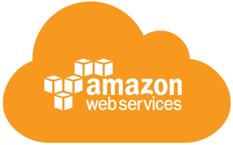
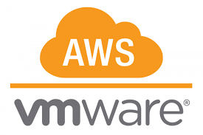
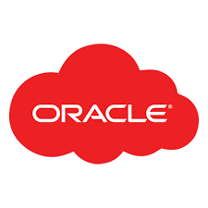
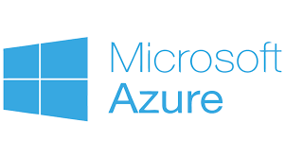
cloud adjacency: SIFY COMPLEMENTING HYPER SCALERS
Business Benefits of Sify’s Cloud Investment
Best of breed performance with Hybrid Cloud configuration
Efficient integrations with extended ecosystems
Compliance with data sovereignty
Business continuity with resilience
Simplicity with self service
Operational efficiency with reduced IT administration
Cost reduction with On-demand bursting to public clouds.
Hyperscale Clouds AT VERY LOW LATENCY
RABALE DATA CENTER (Cloud Adjacent)
Hybrid Cloud
DC INTERCONNECT
Express Route
Hybrid Cloud
Direct Connect
Sify Cloud Connect
Hybrid Multi Cloud
Partner Interconnect
Colo + Managed Services
Far DR
Direct Connect
AIROLI DC ^{(Near Cloud / DR)} - Enterprise Multi Tenant Cloud ^{AT MINIMAL LATENCY}
Colo + Managed Services
Sify CLOUDINFINIT CMP | AIOps Platform for Managed Services
FAR DR READY
HOSTED PRIVATE CLOUD + APPS AS A SERVICE
CLOUD INFINIT
SAP GRID
ORACLE EXADATA
AZURE STACK
NEAR DR
Hyderabad Data Center
Notes:
Here are the key benefits offered by Sify’s Data centers.
Sify has over 20 years of experience in building, owning, operating pan-India Data Centers.
Sify has 9 operational Datacenters, with over 50 MW IT Power in 6 key cities; it has a roadmap to add 100 MW over the next 4 years.
Sify has 45 PAN India Edge Nodes, bringing content closer to consumers.
Sify offers a truly carrier neutral connectivity with more than 90% fiber links from non-Sify Providers.
Sify offers a Rich Interconnect Ecosystem across multiple Hyperscale Cloud Providers, multiple Internet Exchanges, Content Peering Nodes & ISP Interconnect.
Sify offers Metro cross-connect services between Data Centers within Mumbai & Delhi NCR.
Sify has a roadmap to augment 100+ MW IT power via new Hyperscale campuses, over the next 4 years.
Experience
The most experienced data center Colocation operator in India
Over 20 years of data center experience in India
9 concurrently maintainable data centers with 58.23MW critical IT capacity
Mature data center operations framework and processes
SLA performance on power availability of 100% over last 10 years
Global Data Center Design
Committed to continued expansion based on latest global design standards
Power-centric modular design to meet global standards and flexible requirements
3 new DCs commissioned in 2019; roll out in progress for 3 DCs; 7 more in planning
Future builds: Hyperscale-ready DC campus for next generation requirements
44 widely-distributed redundant mini-DCs enable network aggregation solutions
Robust Network Ecosystem
Highly interconnected data centers with extensive network access options
100% carrier neutral data centers; over 15 telecom service providers and 50 ISPs
Cloud Connect - Unified high-performance network fabric connecting 47 major DCs to the cloud
Internet exchange enables cost-effective peering for content providers, ISPs, cloud providers

Slide 12
Network Highlights for INDUSIND Bank
Location
Reliable Network Access
Campus Site
MMR
Cloud Adjacency
Close proximity and low latency to Navi Mumbai DC hub (future ready location as all data center development is concentrated in this area)
Access all tenants including Hyperscaler clouds and other financial market participants via cross connects
Lower TCO as expensive network bandwidth not required
Highly resilient MMR for guaranteed telco availability
Multiple building entries provide high reliability within the campus
Sub milli second latency to 3 out of 4 hyperscalers – AWS/Oracle and GCP*
Extend workloads directly for hybrid IT via cross connects
Reliable network access at the Rabale site with multiple terrestrial fiber paths/OPGW routes from central Mumbai
Telco Availability
Easy Access to Internet Exchanges
Leverage Common Infrastructure
All telco’s already available on site with large capacities provisioned
Hassle free migration and long-term telco engagements
All leading Internet exchanges present in campus
Lower cost and improved user experience for mobile/internet users by accessing Internet exchanges for content distribution
Remote hands for network related troubleshooting
Leverage common network timing (PTP) setup

Slide 13
OPERATION SUSTAINABILITY
Safety & Security
Setting higher Benchmarks, defining road map and milestones.
Areas of focus
Process Management Automation
Facility hygiene
Safety
Security
Utility Infrastructure operation reliability
Facility Hygiene
Process Management
Renewable Power
Operation Sustainability
Renewable Power
Infra Operations
RENEWABLE POWER
Replacing of the EB units from Non-RE source with Solar Energy by establishing power purchase agreement.
Target is 75% of the total EB consumption to be replaced by Renewable Energy source.
Carbon Abetment strategy: Reduction in carbon footprint by 28% during 2021-22. Target to become RE100 (Carbon Neutral) within 5 years.
Operation Controls

Slide 14
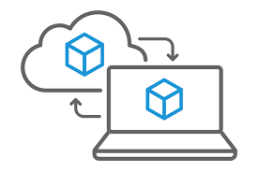
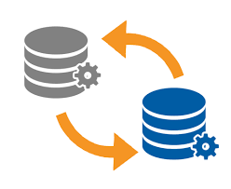
Data Center Migration options
On Prem to Hosted
Application Migration
Hosted/On Prem to Private Cloud
Hosted to Hosted
Platform Migration
Hosted/On Prem to Public Cloud
Tech Refresh
Server Consolidation
Virtualization
Infra Optimization
OTHER OPPORTUNITIES EXPLORED DURING MIGRATION

Slide 15
Sify Value additions – BEYOND THE CURRENT SCOPE
Cloud Ready Infrastructure & Services
Managed Services: Data Center & Cloud, Security, Application Services
Migration - Data Center / Public Cloud
AI/ML and RPA driven NW Transformation
Compliance & Regulatory
Compliances & Certifications
DC – DR-NDR Interconnect
System Integration Services

Slide 16
IMPECCABLE UPTIME PERFORMANCE- how we do it
Security:
Zero loss time incident, Ensuring Security Standards
Zero Trust Architecture and Security Training
Colocation Guidelines
Physical and Digital Layer
Risk Assessment & Mitigation
Safety: Zero loss time incident, Ensuring Safety culture
Infra Operations: Zero loss time incident, Tracking of capacity & process management
Safety Lab and Safety Training
Safety Awareness Rounds
Safety Excellence Program
Risk Assessment & Mitigation
Subject Matter Expert & Quality Assurance
Skillset Mapping, Training, Assessment
360o Audits to identify SPoF, End Of Life, Bottlenecks
Computerized maintenance management system
100% Uptime Since 2008
Achieving 100% uptime for the Data Center is easy, but maintaining it continuously is only possible with a sustainable model that includes strong process management and automation-supporting process strengthening.

Slide 17
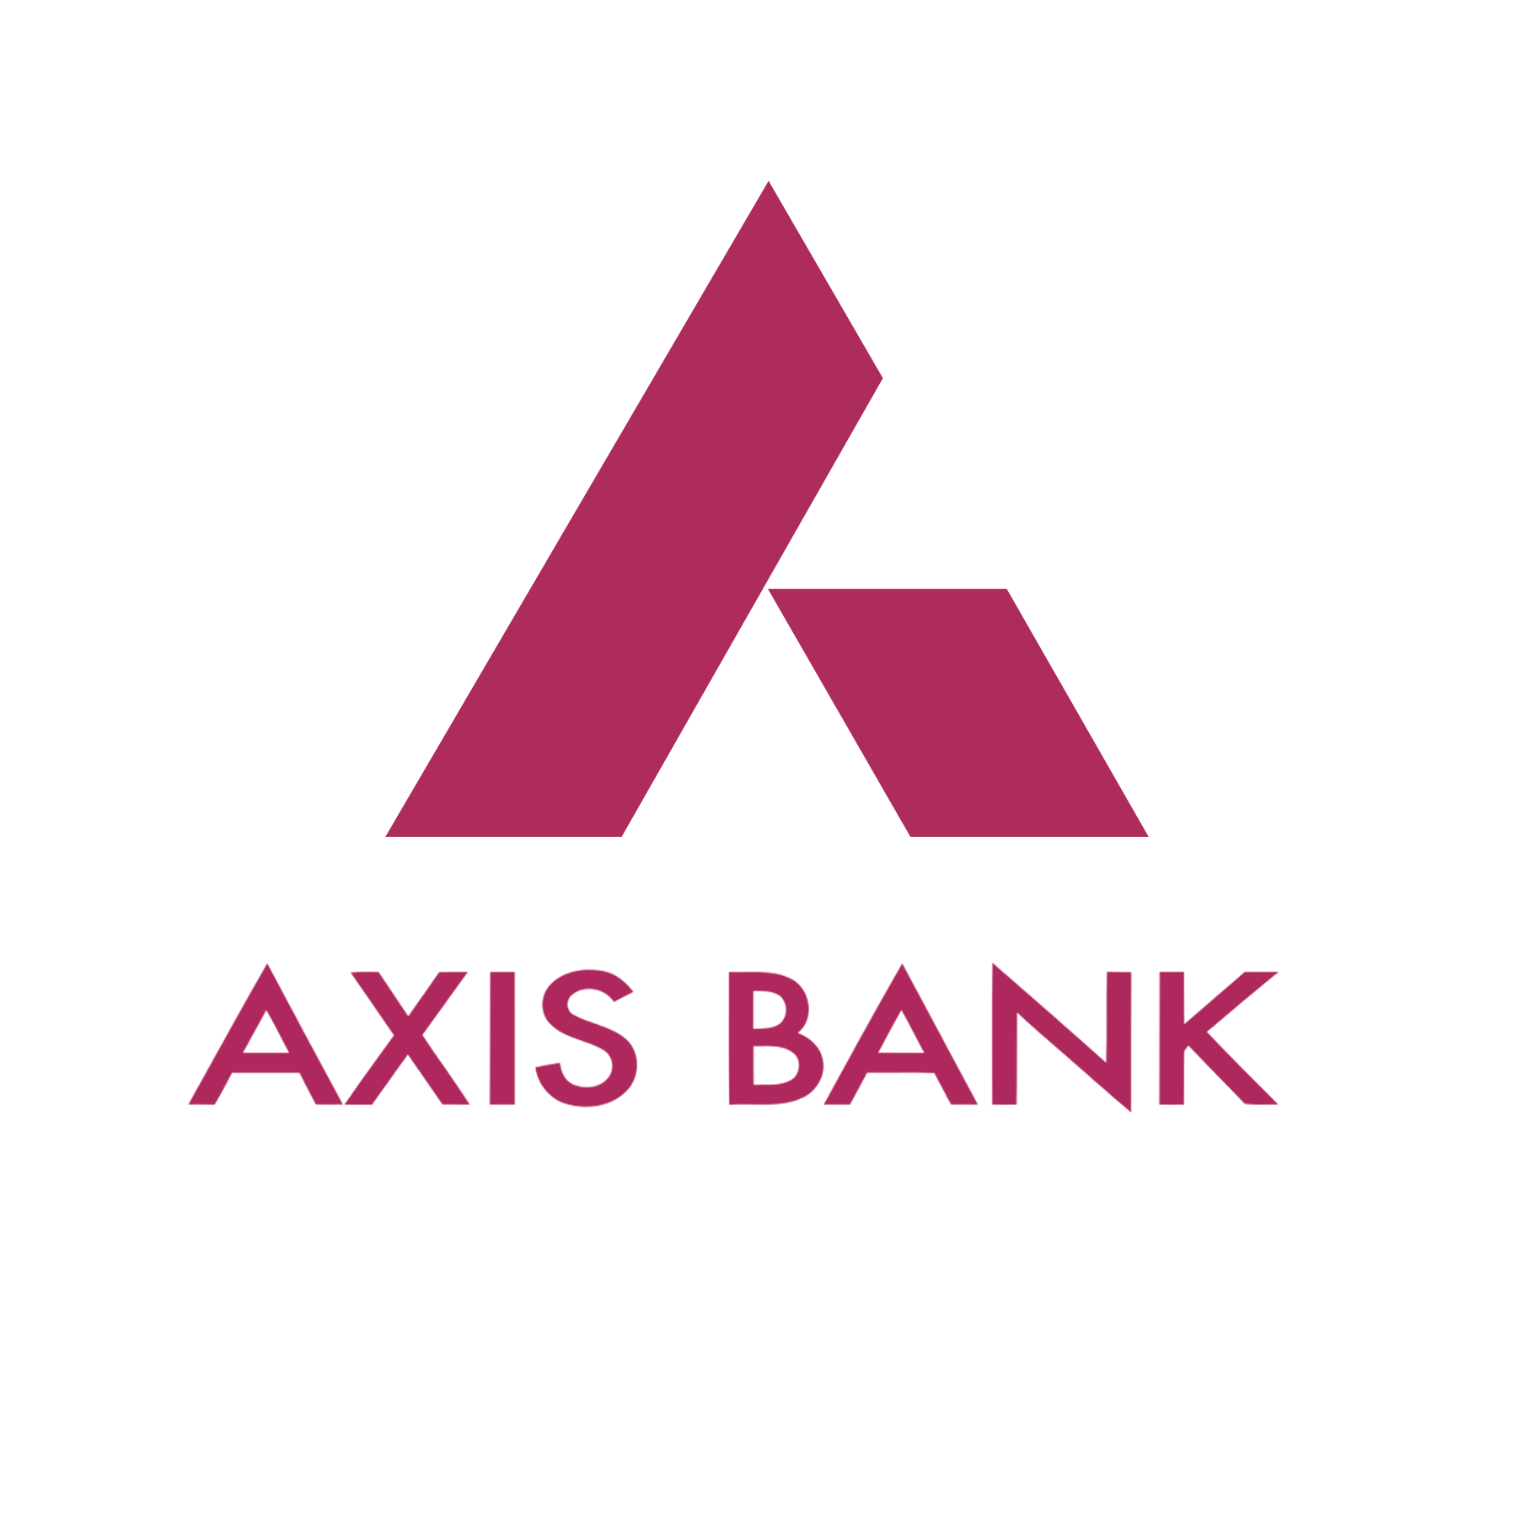
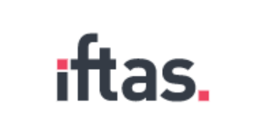
INDIA’S BFSI INDUSTRY LEADERS ARE IN SIFY DATA CENTERS

Slide 18
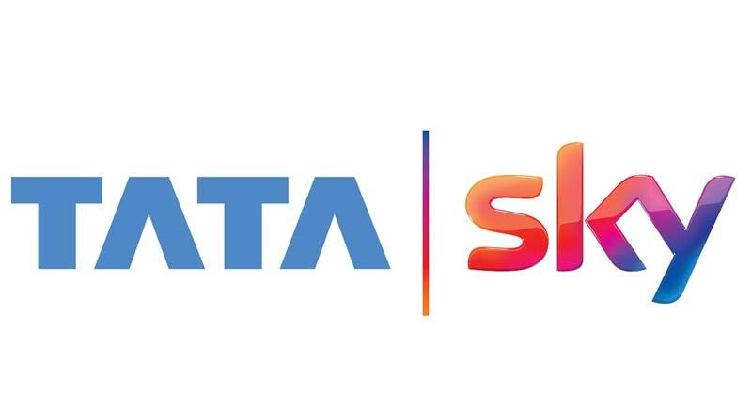
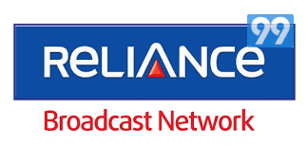
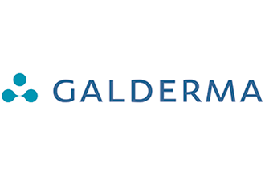
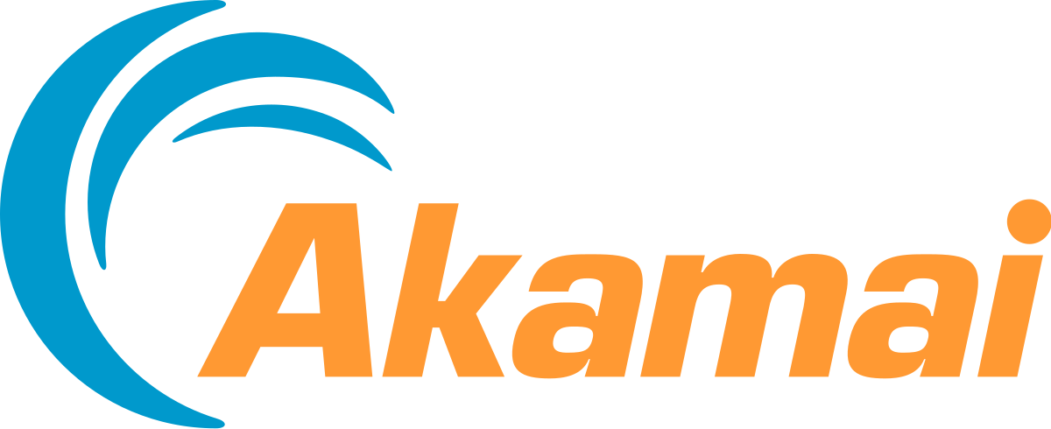
OTHER CUSTOMERS ( VERTICAL - WISE ) IN SIFY DATA CENTERS
Media & Ent
Manufacturing
Retail
IT/ITeS
Healthcare & Pharma
Others

