Slide 1

Migration and Expansion to Cloud
Hybrid and Multi-cloud Perspective
December 2020

Slide 2
AGENDA
Migration and Expansion to Cloud – Key Drivers
Global trends in consumer banking
Cloud adoption trends in banks – an outside-in view
Innovation potential with cloud adoption
Application architectures for cloud
Accelerated Cloud Adoption with Sify
2

Slide 3




Global trends in consumer banking
Banking
Industry
The new
normal
Digital
banking
Cloud adoption
in banks
NBFCs, Insurance & FinTech have adopted cloud extensively
Payment Banks & Payment Services are born in cloud
The non-banking business are applying for Universal Banking licenses
E-commerce giants are likely to divert consumer spending away from flowing through banks
It is imperative for banks to adopt a Digital-First Strategy
Mobile banking usage will continue to increase post restoration of normalcy
Some banks aggressively reduced branches
Large banks did not reduce branches due to regulatory guidance
To drive more value out of branches hybrid approach could be considered
  Introducing many digital elements for self service
  Funneling high value transactions to tellers
Neobanks (branchless, completely online) are growing in adoption
Digital identity verification systems can reduce the cost of onboarding and regulatory compliance by up to 70%
New revenue streams for established players with BaaS (banking as a service)
Demographic shift creating new largest addressable consumer groups of tech savvy millennials
The foremost reason for staying away from cloud is concern for Data Security
  It is estimated that with increasing spends
  Digital service continuity is critical and leads to spend on infrastructure availability
Cyber security spend is increasing over current norm of 9% of IT and 4% of revenue
Capital One became the first US bank to move completely to the cloud
The trend is projected to continue with acceleration of growth and consequent rise in need for infrastructure spend

Slide 4



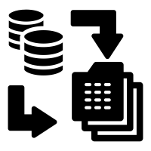




An Outside-in View | Cloud adoption trends in banks
Customer-Centric Cloud Services (Demand-side Innovations)
Technology Enablers (Supply-side Innovations)
Cloud-Native Digital Channels
Comprehensive Infrastructure as a Service
Intelligent Conversational AI, WhatsApp Banking, Self-Service Channels on Cloud (Mobile Banking/ SMS Banking)
End to End IaaS Managed Services (Assessment, Migration, Managed Services, Continuous Innovation).
High-Efficiency Customer Engagement & Servicing
Phased Migration and Business Continuity Focus
Modernize Customer Servicing Legacy Applications like Loan Origination Systems, KYC/Video KYC, Customer Onboarding, Doorstep/ Assisted Banking
Cloud-native Process Bots, Digital Workflows
Innovative, Hybrid-Cloud DC/DR Strategy (VMC on AWS, VMC on Oracle); Adoption through Non-Critical Workload (Test & Dev Environment) Migration
Customer Insights & Analytics
Integrated Platform as a Service Offerings
Customer Sentiment Analysis, Forecasting & Personalization, New Product Development
Contact Center as a Service/ Hosted Contact Center; AllOps Platform as a Service
Data-Enabled Risk Management
Analytics driven Risk & Credit Scoring, Fraud Analytics, Continuous Security & Compliance of Business Processes & Technology.
AI-enabled Software as a Service
O-365, CRM (D-365, Salesforce), HRMS, Workforce Enablement (SFS, Payday)

Slide 5
the Imperative | Multi-Cloud/hybrid-cloud is a reality
Hyperscalers
SaaS Offerings
Market Dynamics impacting choices
Partner
Ecosystem on Cloud
On-premise Cloud
Non-Hyperscale Cloud
Distributed Cloud

Slide 6


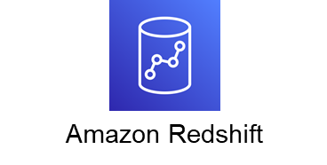

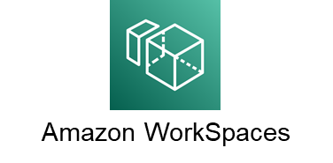

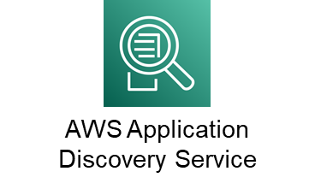














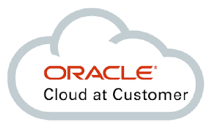
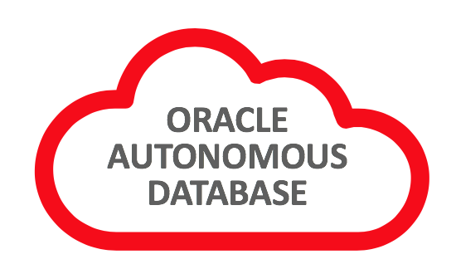

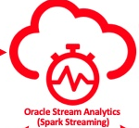

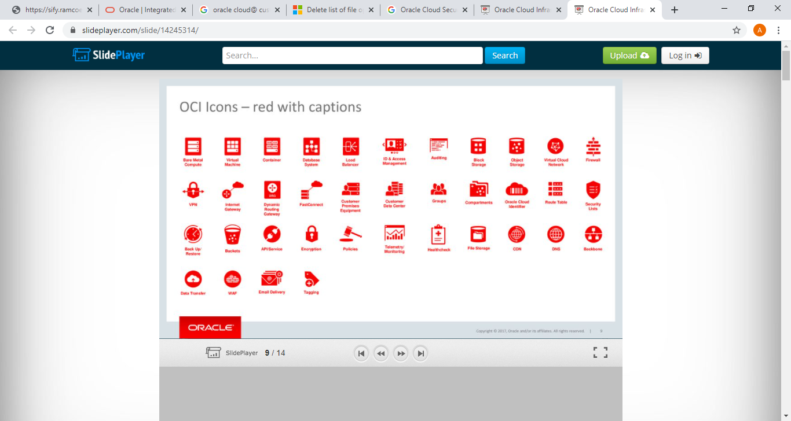

Innovation potential with cloud and cloud native services
High velocity innovation with comprehensive security and compliance coverage
Retaining the flexibility of our preferred technology platforms from datacenter to cloud is now possible
Network transformation is enabling radically different cloud access possibilities
AVS
Active Directory
Data security and compliance continue to impede the move to cloud but hybrid architectures provide options
Azure Stack
ARC
Synapse
DevOps
Shared responsibility models with ownership for data, endpoints, account and access management always retained by Customer
Security Center
Sentinel
AKS
The cloud life cycle management and keeping pace with the innovation requires newer skills in automation
The economics of cloud cost management is still an art and not enough of a science

Slide 7



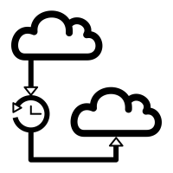

multi-cloud/Hybrid-Cloud deployment | Critical success factors
Multi-Cloud/ Hybrid-Cloud Management
Cloud
Economics
Data Gravity
DevOps automation
Continual compliance to regulations and security governance
Network Latency

Slide 8
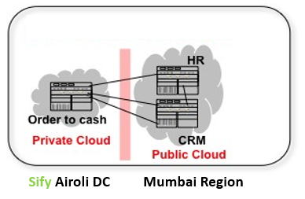
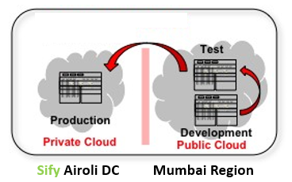
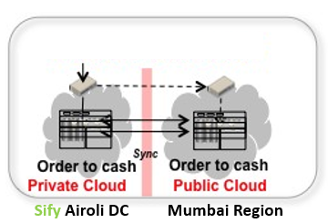
Different Types of Hybrid Cloud Solutions
Functional Distribution
Lifecycle Distribution
Workload Distribution
  Different components in separate clouds
  (e.g., CRM, HR)
  Leverage services from
  each cloud
  Standards are essential
  Separate development
  and test
  Stages of SDLC are distributed across runtime environments
  Requires Packaging
  “Cloud Bursting” and Scaling
  Identical processing spread over multiple clouds
  Relies on data consistency

Slide 9
Two types of multi cloud architecture
1
Redundant
2
Composite
Leverage supplementary external cloud APIs
Span application components across clouds
aPaaS + IaaS
Web Apps on AWS + SAP on Azure / DB from Oracle
App on IaaS 1 + Object storage on IaaS 2
Active – Active
Active – Passive

Slide 10
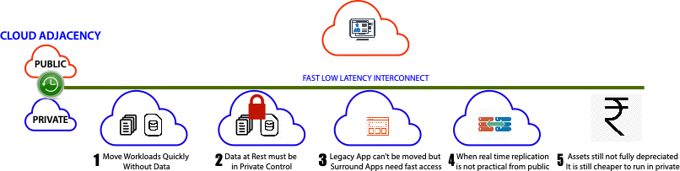
cloud adjacency Advantages for hybrid architectures

Slide 11
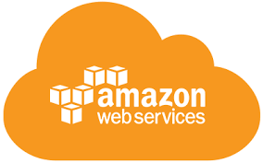
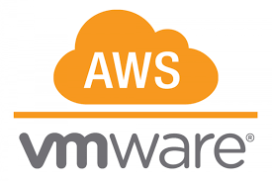
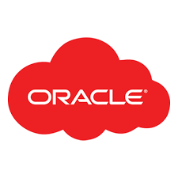
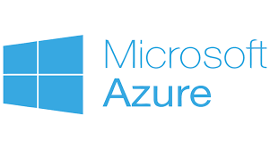



cloud adjacency: SIFY COMPLEMENTING HYPERSCALERS
Business Benefits of Sify’s Cloud Investment
Best of breed performance with Hybrid Cloud configuration
Efficient integrations with extended ecosystems
Compliance with data sovereignty
Business continuity with resilience
Simplicity with self service
Operational efficiency with reduced IT administration
Cost reduction with on-demand bursting to public Clouds.
Hyperscale Clouds AT VERY LOW LATENCY
RABALE DATA CENTER (Cloud Adjacent)
Hybrid Cloud
DC INTERCONNECT
Express Route
Hybrid Cloud
Direct Connect
Sify Cloud Connect
Hybrid Multi Cloud
Partner Interconnect
Colo + Managed Services
Far DR
Direct Connect
AIROLI DC ^{(Near Cloud / DR)} - Enterprise Multi Tenant Cloud ^{AT MINIMAL LATENCY}
Colo + Managed Services
Sify CLOUDINFINIT CMP | AIOps Platform for Managed Services
FAR DR READY
HOSTED PRIVATE CLOUD + APPS AS A SERVICE
CLOUD INFINIT
SAP GRID
ORACLE EXADATA
AZURE STACK
NEAR DR
Hyderabad Data Center

Slide 12




BENEFITS OF CHOOSING SIFY DC
Native availability of:
CloudInfinit - Public Private/ Virtual Private
SAP Grid
Azure Stack
Least latency from Hyperscale CSPs
Interconnected with 48 DCs across India
Western region Network hub
Navi Mumbai region has dense fiber connectivity with multi-TB network capacity.
Cloud Connect services to ensure workloads and data can move between Clouds quickly and effectively.
Direct Connect to AWS
ExpressRoute to Azure
FastConnect to Oracle Cloud
Cloud Interconnect to GCP
 |  | Oracle Mumbai | AWS Mumbai | Azure Central | Azure West | Azure South | GCP Mumbai | Oracle Hyderabad
Sify Rabale to Cloud Providers | Latency | <200 microsecond | <200 microsecond | < 2ms | < 2ms | 15 - 18 MS | < 2ms | 20 - 23 MS
 | Service | Cross Connect | Cross Connect | Local Loop | Local Loop | MPLS/Ethernet | Local Loop | MPLS/Ethernet
DR Bangalore – Oracle DR in Hyderabad | Latency | 25 - 28 MS | 25 - 28 MS | 25 - 28 MS | 25 - 28 MS | 15 – 18 MS | 25 - 28 MS | 25 – 28 MS
 | Service | MPLS/Ethernet | MPLS/Ethernet | MPLS/Ethernet | MPLS/Ethernet | MPLS/Ethernet | MPLS/Ethernet | MPLS/Ethernet

Slide 13






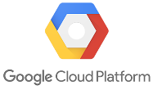
HYPERSCALER PARTNERSHIPs
AWS Partner Network member enrolled and recognised as
Advanced Tier Consulting Partner
Channel Reseller
Direct Connect Partner
One of the key AWS Direct Connect Provider in PAN India, Sify has a unique advantage of having the Direct-Connect as well as its own Metro-Cross Connect that provides connectivity at 10G+ speed
Only Partner in India who can offer Cloud Adjacent Data Center to AWS cloud by virtue of AWS cloud being hosted in Sify’s Rabale
Oracle Partner Network member for
Cloud service track
Cloud resell track
License and hardware track
One of the key Oracle Fast connect Provider in PAN India, Sify has a unique advantage of having the Fast-connect nodes terminating in its Rabale and Hyderabad DC there by reducing interconnectivity cost
Only Partner in India who can offer Cloud adjacent datacenter to Oracle Cloud by virtue of Oracle Cloud being hosted in Sify’s Rabale and Hyderabad Data Center
Only Partner in APAC who can provide “Exadata as a service”
Microsoft Gold Partner
Tier 1 CSP, LSP & SPLA Reseller
Only partner who has Infrastructure and capability around Private (Hosted Azure Stack in Sify Data Center), Public and Hybrid Cloud on Azure
One of the key Express Route Provider in PAN India and Hosting Govt. Community Cloud on Azure Stack for Maharashtra Govt
GCP Cloud Partner
Partner gains access to additional tools: Partner Sales Tool, Directory, Google University, Reseller Consoles
GCP Cloud Interconnect Partner
Sify provide secure and high performance GCP cloud network services
Partner in India who can offer Cloud Adjacent Data Center to GCP cloud by virtue of GCP upcoming cloud POD at Noida

Slide 14







Sify Multi-Cloud/Hybrid-Cloud capabilities & strengths
Comprehensive Discovery & Assessment for Cloud Migration
Controlled & Phased-Migration to Multi-Cloud/ Hybrid-Cloud
Implementation & Consolidation to arrive at a desired state architecture
Multi-Cloud Management & Service Management
Continuous & Unified Security and Compliance Automation
Hybrid-Cloud Digital Transformation (DevOps as a Service, App Modernization, K8aaS)
Cloud Economics (Hybrid-Cloud, Multi-Cloud continuous cost optimization)

Slide 15
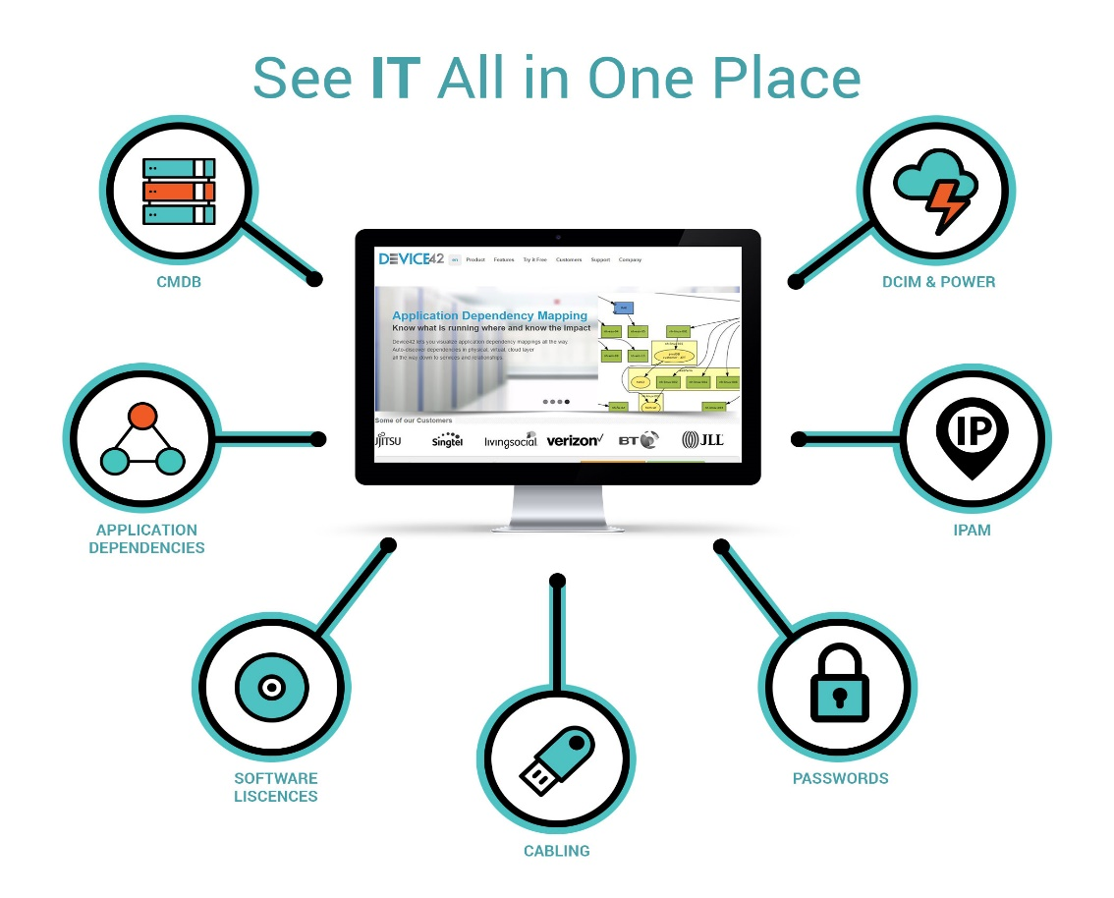




Sify assessment Discover Capabilities
Agentless auto-discovery
Broad support
  All MS, Unix, Midrange, Cloud vendors, Hypervisors
Deep support
  Hardware, virtual and application layers
CISO friendly
  Secure, behind firewall, read only credentials
  100% on premise capable / IAAS
  No data must leave the enterprise
Full, immediate access to data
  Fully documented, complete APIs
  Robust reporting and audit logs
  Cloud recommendations
Project and lifecycle models
  Convert initial discovery into self updating CMDB
  Provide accurate, current data to ITSM and DevOps
CV
HOME
DATACENTER
DEVICES
SOFTWARE
REPORTS
BOOKMARKS
NAME
IPAM
PASSWORDS
TOOLS
HELP

Slide 16
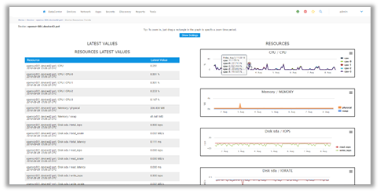
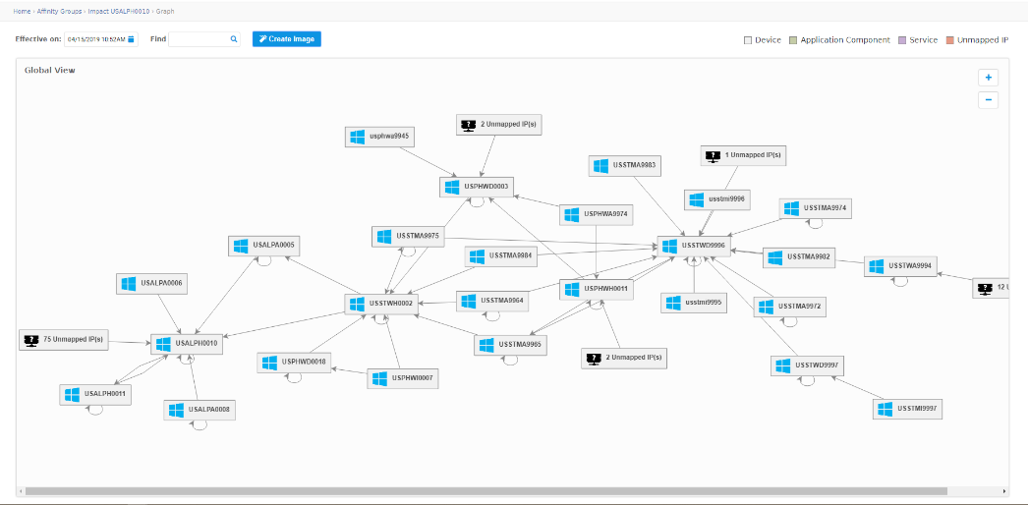
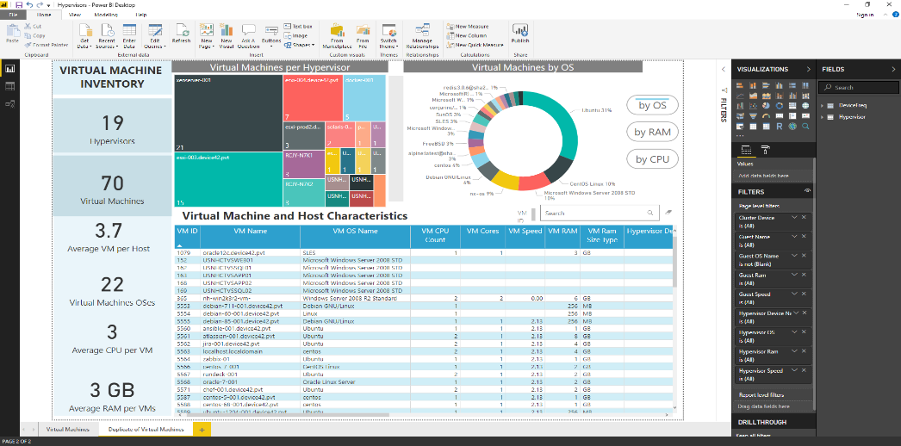
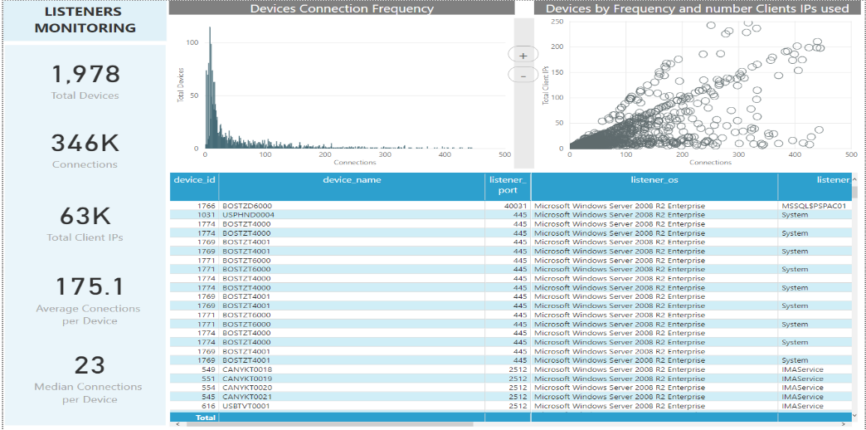
Sify Discovery – Sample dashboard and reports
Resource Utilization
Configurable Relationships

Slide 17




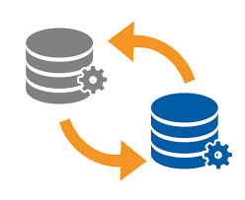
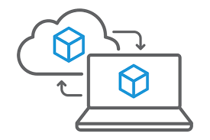
Migration capabilities
On Prem to Hosted
Hosted to Hosted
Hosted/On Prem to Private Cloud
Hosted/On Prem to Public Cloud
Application Migration
Platform Migration

Slide 18




Sify migration – best practices
Scenarios
As is Migration of data along with OS & applications
Large data migration - standby storage
Tech refresh
Lift & Shift
Online Migration
P2V , V2V migration options
Migration of Data over WAN to minimize the switchover time
Cold Migration
Delta data migration over WAN
Migration of Data over WAN to minimize the switchover time
Platform Migration
OS upgrades and application upgrade
Migration of Data over WAN to minimize the switchover time
Offline Migration
Export/Import of VM images using external drives
Suitable for migrating legacy workloads
Best Practices
Migration Challenges | Mitigation Best Practices
Application usage post migration | Application functionality test in new infrastructure with incremental data replication to prod
Minimum Service Disruption | Minimal service disruption and advance end user communication
Delay in Migration | Well planned cutoff time/switchover time in advance and during the scheduled migration period
Availability of Client/3rd Party OEM | Coordinate the availability of all resources according to the stakeholder matrix
Network Availability | Pre-emptive bandwidth requirement sizing and ensuring bandwidth

Slide 19
Cloud migration strategy framework
Phased Approach to Cloud Adoption
Wave 1
Wave 2
Migrate UAT workloads to cloud
Wave 3
Migrate Data intensive workloads to cloud
Wave 4
Migrate Digital Native workloads
Business-Critical Workloads
A truly multi-cloud/ Hyrbid-Cloud Strategy can be built before initiating the Cloud Adoption to assess the current state of Infrastructure and Application landscape. As an illustration, a potential Go-To of this assessment is listed below
  All Oracle/Windows workloads to OCI
  All RISC workloads collocated in Cloud Adjacent DC
  All Microsoft workloads to Azure/Oracle
  All Digital Native workloads aligned to Database

Slide 20
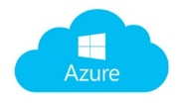



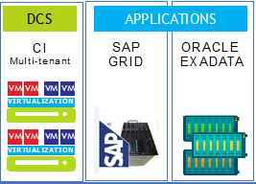

Hybrid or multi cloud security| Unified security management
Unified Security & Policy Management
Secured Key Management
Data Encryption on transit
Audited & Certified Security Controls
Physical Security
Virtual Appliances Security
Live Key Generation during deployment
Container Aware & Secure
Log intelligence monitoring & mitigation
Access Control & Authorization Policies
Role Based Access
Files, Database & Volumes
Secure Data Portability
Application Layer Security
Tokenization
AES Encryption
Public Cloud
Sify Cloud
Sify Edge / Customer DC

Slide 21



















Sify Multi-cloud – generation v
ANY | APPLICATION
 | LOCATION
 | CLOUD
Sify Managed Services
Monitor
Alert
Manage
Remediate
Support
Cloud Managed Platform
Dashboard
Automation
Security
API Driven
Integrated Orchestration
Application Templates
Sify API Engine
POD
Sify Data Centers
Public Cloud
Sify Cloud @ Edge DC
Sify Cloud @ Customer DC
Kubernetes
Sify Cloud @ Partner DC
Sify Cloud @ Customer On-Prem
Containers
Sify Cloud Connect & Edge Connect

Slide 22






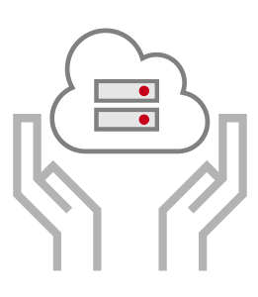







Multi cloud consumption should not require multitude of tools
Assessment, design, migration with continual cost and performance optimization
Consistent security across cloud platforms
Proficiency on the Resource Models / APIs for different clouds
Understand the cost models of different clouds
Workload lifecycle monitoring and management
IP for best practices and best tools
MSS and MDR services under single pane
of glass
Seamless Provisioning of workloads on
any cloud
Right selection and continual monitoring for optimal cost
AIOPS Tools for holistic workload management

Slide 23


















Sify Cloud management platform – generation V
Provisioning
Orchestration
Configuration
Billing / Chargeback
Systems Management
Capacity
Cost Management
Sify Cloudinfinit
Cloud Management Platform
(Action & Automation)
Cloud Administrators
Self Service
Sify Private Cloud
APIs
DevOps Management
Multi Cloud Management
Role Based Access
Automation
Blueprints
Policy Engine
Security & Compliance
App & DevOps
Dashboard
Request / Change
Event / Incident
Monitoring
Discovery
ITSM
(Engagement & Records)
All Users
Native Tools
AI / ML
CxO Users
Automation
SLA
HA / DR
Knowledge Base
Logs
Users
Core Platform
POD

Slide 24









Synergy with various clouds
Sify CloudInfinit
Native integration and support to orchestrate and control the
platform & workloads
Private Cloud
Configured to manage workloads in VMware vCenter
Sify CMP
Public Cloud
API integrated management to onboard accounts and manage from centralized Sify CMP portal
Remote Edge POD
Customer premise POD configured to manage workloads through an end point broker

Slide 25
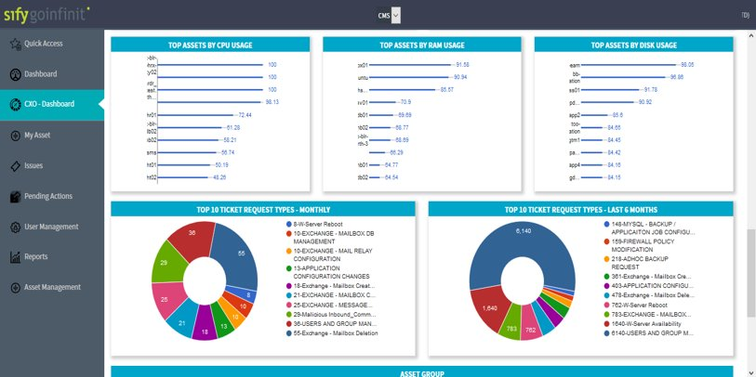
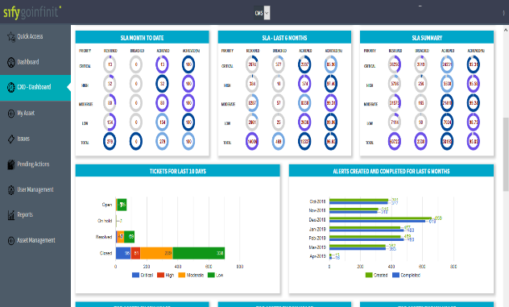
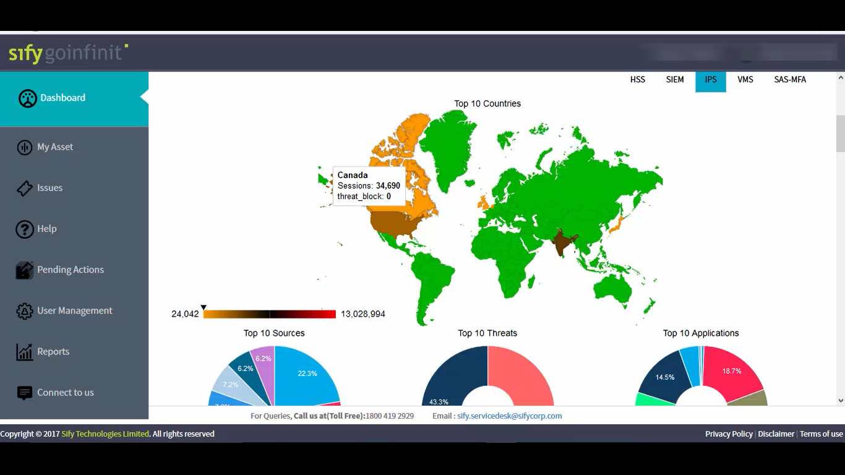
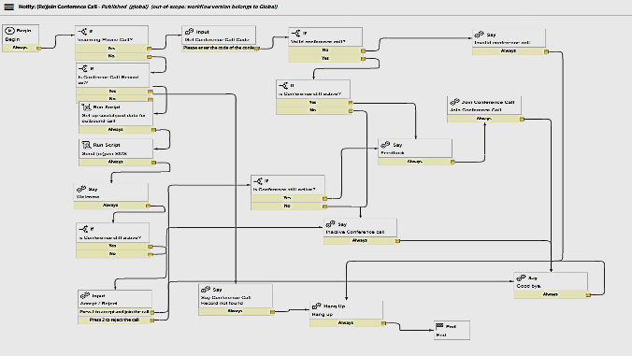
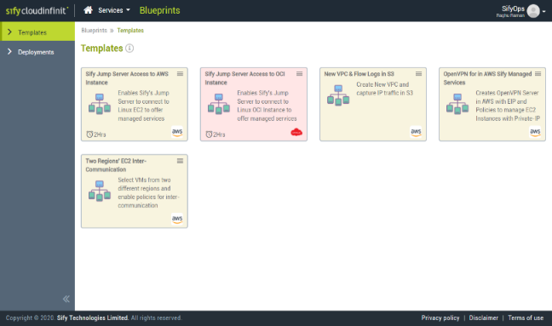
Sify Multi-Cloud/Hybrid-Cloud Dashboard
Performance
Operations
Security
Automation / Orchestration
Cloud Management Platform

Slide 26
Innovation potential with
cloud native services- Success Stories

Slide 27








NAINITAL BANK: INTEGRATED SOLUTION FOR CORE BANKING
Financial BANKING
Project Objective
Develop a Hybrid IT infrastructure to migrate Core Banking application Software. Hybrid IT – Includes Managed DC, DR, NDR , Security and Branch Connectivity.
Integrated Value and Outcome
Sify’ s value proposition built on cloud@core products and services:
Designed Private Cloud architecture for Bank CBS and hosted DC & DR on Sify Data Center.
Designing the right network architecture based on Sify SD-WAN Services & technology to meet the network SLAs in the tough hilly terrains
Leveraged Sify Managed Connectivity Services to Interconnect DC , DR , NDR data replication and branch application access.
Managing Data Center, Disaster Recover services , Network Services and security using Sify Managed Services Platform
Strong Technology Alliances and Partnership.
Value for Client
A single technology integrator for DC, DR, NDR , Hosting, SDWAN , Security , Branch Connectivity and Managed Services provider owning the end-to-end SLA of IT.
Value for Sify
A complete integrated and managed services deal of a Bank Core Banking IT, which will provide penetration into similar nature of deals in BFSI market segment.
Project Model
Capex | Opex | Consumption Model
PRIVATE CLOUD LED
Competition
RailTel, Airtel+Nxtra
Sify’s Uniqueness
Integrated value proposition built on: Sify is a single IT partner to build , host , manage the DC, DR, NDR, Branch Connectivity and security inline to the RBI audit guidelines.
Contract Duration
5 years
Contract Value
US $7.5+ Million

Slide 28

MANAPPURAM FINANCE LIMITED: DIGITAL TRANSFORMATION
Nonbanking financial
Project Objective
Implement integrated future ready digital infrastructure on hyper-scale Cloud
Integrated Value and Outcome
With the cloud@core portfolio of services, Sify is migrating the entire IT infrastructure of the Manappuram Group companies to Hyperscale cloud (Oracle Cloud Infrastructure)
for significant cost reduction by cross platform migration of Oracle DB from AIX to Intel platform
realize a proven disaster recovery capability
provide for scalability of infrastructure with business growth
enable IT as a Service by one group company with no constraints for other group companies (application users)
Value for Client
35% reduction in TCO, 3X performance increase
Sify is the one stop shop for all customer requirements right from supplying the OCI universal credits, setting up the cloud, migrating the DC and DR, providing the security infrastructure and managing the entire environment
Value for Sify
Yet another strong reference for a BFSI customer completely migrating to a hyperscale cloud with significant managed services play and profit margin
Project Model
Fully services model(vis-à-vis existing capex + services model)
CLOUD LED
Competition
IBM (incumbent), Dimension Data, Wipro
Sify’s Uniqueness
Integrated value proposition built on: Cloud adjacent DC, Hyperscale (Oracle) partnership, Cloud assessment service, DRaaS, DC and Cloud Interconnect (Sify’s own service), Security services and Migration services
Contract Duration
5 years – large annuity revenue stream
Contract Value
US $7.2+ Million

Slide 29

PRAMERICA LIFE: DIGITAL TRANSFORMATION FOR LIFE INSURANCE
LIFE INSURANCE
Project Objective
Implement integrated future ready digital infrastructure on hyper-scale Cloud
Integrated Value and Outcome
cloud@core products and services:
All cloud ready applications migrated to hyperscale (AWS)
Legacy apps and infra in cloud adjacent DC with near 0 latency
DR at a different seismic zone with hybrid deployment of post cloud infra and DRaaS from cloud@core.
Hybrid security framework for both hosted & cloud footprint.
Full lifecycle responsibility through assessment, zero downtime migration & implementation within a record timeline.
Hybrid cloud management platform for management of the Hosted Private and AWS Cloud footprint.
Value for Client
25% reduction in yearly cost, return on investments , agile digital ready infrastructure, end to end ownership by one partner, no conflict of interest with application partners.
Value for Sify
Competitive edge, full stack products and services play, significant cost control, higher revenue and margin, great reference for hybrid cloud.
Project Model
Fully services model(vis-à-vis existing capex + services model)
Competition
IBM (incumbent), DXC, Wipro, CTS, Tech M, TCS
HYBRID CLOUD LED
Sify’s Uniqueness
Integrated value proposition built on: Cloud adjacent DC, Hyperscale (AWS) partnership, Hybrid cloud management platform, DRaaS, DC and Cloud Interconnect (Sify’s own service), Security services and Migration services
Contract Duration
5 years – large annuity revenue stream
Contract Value
US $4.5+ Million

Slide 30

MAHINDRA FINANCE: DIGITAL TRANSFORMATION FOR NBFC
Nonbanking financial
Project Objective
Implement integrated future ready digital infrastructure on Hybrid cloud architecture for hosting core application and virtualizing landscape on a scalable Cloud Infrastructure with end-to-end Migration.
Integrated Value and Outcome
cloud@core products and services:
All VMware applications to be migrated to sifycloudinfinit
All non-VMware apps to move to new Private Cloud (VMware).
Old Solaris Server in DC with interconnect to Private Cloud.
Google cloud connect at near 0 latency with cloud adjacency.
High BW hyperscale networks for data replications
Hybrid security framework for both hosted & cloud footprint.
Hybrid cloud management platform for management of the Hosted Private and AWS Cloud footprint.
Value for Client
Zero defect & minimum down time during migration, TCO optimization via billing based on pay as you go model, Single point of ownership for all infra consolidations, single SLA covering the infra and network. DR as a service. Oracle instance migration to OCI over Fast Connect.
Value for Sify
Complete ownership for Infra and Network which has given wide scope for offering managed services, DR-as a service on SIFY CI. Hyper connect to OCI can be leveraged for core ORACLE app.
Project Model
Private Cloud IT Build model along with Sify Enterprise Multi-Tenant Cloud for Cloud Bursting.
Competition
CtrlS, NexGen, Netmagic, Tech Mahindra, Wipro & TCS
HYBRID CLOUD LED
Sify’s Uniqueness
The proposed Data Centre at Mumbai has a latency of less than 250 microseconds from AWS & Oracle Cloud; and less than 1 millisecond from TCS’s SaaS cloud located at CtrlS Navi Mumbai DC. Hybrid and Multi Cloud set up at the least latency, lowest connectivity cost and the best performance between the environments in multiple DC & Cloud. The same Data Centre hosts Sify’s multi-flavoured Cloud Infinit platforms ( Public, Private, Virtual Private) from where our customers can subscribe to IaaS/PaaS.
Contract Duration
5 years – large annuity revenue stream
Contract Value
US $3.6+ Million

Slide 31
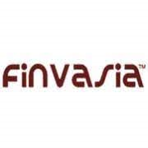
FINVASIA SECURITIES: USER EXPERIENCE TRANSFORMATION
Financial securities
Project Objective
Scalable resources, pay as you go pricing, strategic competitive advantage and Get new apps running quicker
Integrated Value and Outcome
cloud@core products and services:
Cloud ready on-line trading app migrated to hyperscale (AWS).
Multicast routers from stock exchanges in cloud adjacent DC
Stock Exchange apps convert multicast to unicast with ultra-low latency in Sify adjacent DC
Management of the Hosted and AWS cloud footprint with hybrid cloud management platform .
Value for Client
On-demand provisioning of resources for bursty on-line trading traffic, improved user experience by building near zero latency which is the cornerstone of on-line businesses, agile digital ready infrastructure, end to end ownership by one partner,
Value for Sify
Competitive edge, consistent annuity revenue stream by creating stickiness in services, full stack products and services play, good reference for hybrid cloud led digital transformation,
Project Model
Fully services model(vis-à-vis existing capex + services model)
HYBRID CLOUD LED
Competition
NTT, several AWS boutique partners
Sify’s Uniqueness
Integrated value proposition built on: Cloud adjacent DC, Hyperscale (AWS) partnership, Hybrid cloud management platform, Security services and Migration services
Contract Duration
3 years – stable and consistent annuity revenue stream
Contract Value
US $300,000+

