Slide 1


Session objective
Sify Capability Presentation – Fed Finance

Slide 2
AGENDA
Session objective
Sify’s Transition as a Digital transformation partner – Pre and Post Pandemic
Cloud@Core services
Data Center transformation - Our recommendation and business value
Competitive positioning of Sify
Execution capabilities, case studies and references

Slide 3
SESSION OBJECTIVE
To discuss Sify’s Cloud @ Core service offerings and share how it can be aligned to Fedfina’s Cloud & other Digital transformation pursuits
To share detailed insights about our Integrated Hybrid IT offerings and discuss its business value
Understand your immediate & long-term business goals and outline how we could help you achieve them

Slide 4



POINTS OF INFLECTION
Sify’s emergence as an integrated ICT Solutions and Service Provider
2012
Digitalization was aspirational
Launch of “Cloud@core”
2018-2020
(Pre-pandemic)
Digitalization is no longer “good to do”, it’s “must do” !
Acceleration of “Cloud@core”
2020 –beyond
(Post pandemic)

Slide 5




cloud@core
TM
ALIGNED TO OUR CUSTOMERS’ CLOUD TRANSFORMATION PURSUIT
CLOUD ENABLING
CLOUD INSPIRED
CLOUD PURE
CLOUD ENHANCED
Cloud Data Centres
For Enterprises and Hyperscale CSPs
Private Cloud at DC
Hyperconverged | Enterprise
Hyper reach/Hyperscale NW
Hyper Reach/Hyperscale transport
Data Center Interconnect
SD-WAN
Migration Services
Migration and Implementation services
IaaS at Cloud DCs
CloudInfinit
  Enterprise Multi-Tenant
  Dedicated
  Hosted SAP/S4 HANA
  Azure Stack as a Service
Edge infra aligned to Cloud
Edge Connect Services
Hyperscale Platforms adjacent to Cloud DCs
AWS
Azure
OCI
GCP
Multi-cloud Management platform & services
Digital Services
App Modernization
Kubernetes-as-a-Service
Digital Apps (SaaS)
Forum DIGITAL
HCM Digital (iTest)
Learning Management
Internet-of-Things (IOT)
Industry Solution-as-a-Service
Cloud@core delivers agility, flexibility and choices for creating hybrid cloud led digital infrastructure

Slide 6
BUSINESS OUTCOMES AT DIFFERENT STAGES OF CLOUD@CORE PORTFOLIO
CLOUD ENABLING
CLOUD INSPIRED
CLOUD PURE
CLOUD ENHANCED
OUTCOME
Digital First environment, new business models, new service delivery models
business outcomes
Unlock capabilities for a modern business – Agility, Flexibility, Scalability
service delivery
innovations
Increased Automation in service delivery, Complete control and enhanced visibility on cloud resource usage for better insights
technology and service delivery enhancements
Technology refresh to save costs and increase operational efficiencies with
Less hardware, Less people and Less licenses
technology outcomes

Slide 7

GARTNER’S RECOMMENDATION
-validates Sify’s portfolio & investments
CONVERGENCE OF
Data Center, Cloud And Networks

Slide 8

Basic Minimum criteria!
Gartner’s recommendations for selection of DC partner
New Differentiating Criteria!
Enterprise Experience for specific workloads
Carrier Neutral
Tier 3 or Equivalent as per Uptime Institute or TIA-942
Multiple sites and their seismic Zone rating ( Among other environmental factors)
Back up and DR Capabilities
SLA of 99.92% or greater (minimum T3 capability)
Overall Customer Feedback
Cloud Vision and Strategy
Hyperscale Partnerships: AWS, MS, GCP
Managed Services
  In a single and multi-cloud environment
Cloud Experience and Depth
  Cloud Management, Cloud Economics (In-house IP or partnerships)
Provides Network Connectivity to Major Cloud providers
  AWS/Direct Connect, MS Azure/Express Route
Interconnect services to other sites or partner ecosystems
GARTNER’S RECOMMENDATION validates Sify’s portfolio & investments

Slide 9






What are customers asking?
Assessment and discovery
Which applications should I be moving to Cloud ?
How do I execute a seamless migration without disruption in business?
Cloud migration strategy
How will my erstwhile network change in a hybrid multicloud environment?
Connecting to Cloud
Security in the cloud
How will I define the security architecture and policy when my applications will be residing in multiple Clouds and DCs?
Visibility and control
Is visibility more important than control?
Cloud cost optimization
Will my cost reduce in a hybrid multicloud model?

Slide 10









SIFY enabler of DIGITAL TRANSFORMATION
20 years of experience
in Data Centers, Network, Cloud & Managed Services
10 operational Data Centers
with 70 MW IT Power in key cities
Enterprise & Hybrid Multi Cloud
Enterprise Private Cloud grid available in Data Centres
Network
Largest MPLS Network – 3100+ POP, 1600 towns in India
Cloud Orchestration Platform
Multiple cloud orchestration from single console
Cloud Connect
Data Superhighway
48 on-net data centres
Remote Operations Centre
24x7 NOC, SOC and Managed Services
Applications & Solutions
Modern Applications
Kubernetes as a Service
Sify Value Chain – DevOps
AI/ML

Slide 11













flavor of SIFY’S integrated ENGAGEMENTS
Hybrid Cloud led
Pure Cloud Services led
Managed Hosted led
Network Services led
Services led
Data Center +
Cloud +
Network services +
Security services +
One-time services +
Multi-year Operations services​
Cloud +
Network services +
Security services +
One-time services +
Multi-year Operations services​
Data Center +
Hosted DC-IT +
Network services +
Security services +
One-time services +
Multi-year Operations services​
Network bandwidth services +
Network integration services +
Network Operations services​
SAP Migration / Implementation +
Cloud Infrastructure +
SAP DR +
Network Services +
Multi-year Application Managed Services +
Security Services +
Transformation to Hybrid IT / Digital & Cloud age network / Hybrid cloud security​

Slide 12








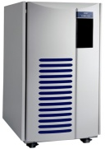
SIFY’S HYBRID MULTI CLOUD APROACH for fed finance
MMFSL OFFICES
OTHER DC – GCP, M & M
Sify RABALE DC
MPLS
Internet
Metro- X-Connect
VPE1
MMFSL
Colocation
ZONE
SIFY PRIVATE CLOUD - AIROLI
Switch
Network
Network
Load
Balancing
VNE-FW1
Perimeter
Security
Layer
VNE-FW2
Internal
Firewall
Network
NETWORK
DC NETWORK
Secure Zone
Server farm
Storage Fabric
Storage Fabric
Backup Infra
Storage Pool
Storage Pool

Slide 13

























INDIA’S BFSI INDUSTRY LEADERS ARE IN SIFY DATA CENTERS
Largest
bank in India
Largest
Pvt Bank in India
Largest
e-wallet company in India
Industry leading BFSI companies DC runs on Sify
Not to be shared, only to be shown

Slide 14






















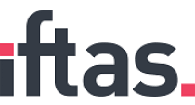

INTEGRATED ENGAGEMENTS – key references
HYBRID CLOUD LED
Managed Hosted/ PRIVATE CLOUD led​
Cloud Services led
MANAGED services led
Network services led

Slide 15
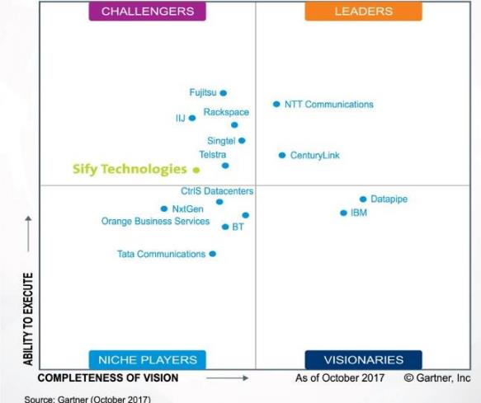







INDUSTRY RECOGNITIONS
Recognition in Market Guide for Public Cloud Managed and Professional Services Providers APAC 2020
Recognition in Critical Capabilities for Managed Hybrid Cloud Hosting APAC 2018
Recognition in Market Guide for Top Data Center Service Providers 2018
Recognition in Market Guide for Vulnerability Assessment
and Penetration Testing Consulting Services in India 2019
Recognition as a notable vendor in MQ for Data Center Outsourcing and Hybrid Infrastructure Managed Services, Asia/Pacific 2019
Major Player in
MarketScape for Cloud
Managed Services APeJ 2019
The Economic Times
Iconic Brands 2020
Hybrid Multi Cloud
Data Center Transformation Services
2018
Network Transformation Services
2018
Sify in Challenger Quadrant in Gartner MQ for Managed Hybrid Cloud Hosting APAC 2017
Hosting Partner
Leadership Recognition
Cloud Transformation (2018)
Network Transformation (2019)

Slide 16
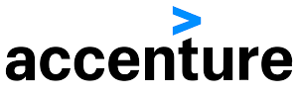















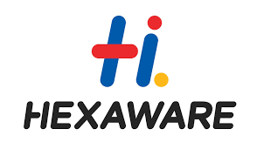






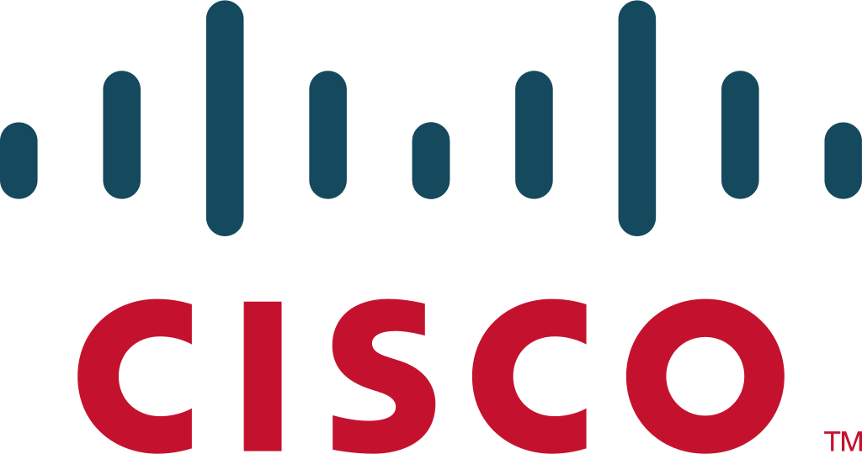
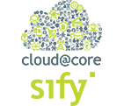






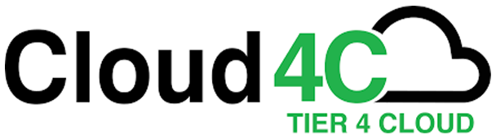


Competitive positioning in DC & cloud transformation space
Business transformation and application outsourcing companies
Data Center Hosting Service Providers
Erstwhile total outsourcing/ SI vendors
CUSTOMER
Niche digital services boutique firms
Notes:
Sify is uniquely positioned in the India Cloud Market compared to other players. With its end-to end services across cloud spectrum and its partnerships with all major Hyperscalers, Sify single handedly helps you in all your digital goals.

Slide 17


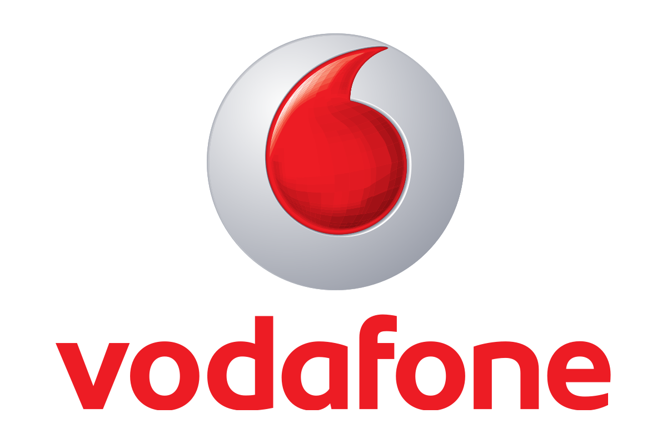








Competitive positioning in NETWORK transformation space
Pure play Telco Network Service Providers
System Integrators
Networking Partners
CUSTOMER
Telecom Tools Partners
Managed IT Services Providers / Outsourcing Partners
Notes:
Sify is uniquely positioned in the India Cloud Market compared to other players. With its end-to end services across cloud spectrum and its partnerships with all major Hyperscalers, Sify single handedly helps you in all your digital goals.

Slide 18
EXPERIENCE ADVANTAGE
500+
300+
80+
Datacenter services projects executed
Datacenter Migration projects
Platform Migration Projects
50+
230+
70+
30+
IT Ops Transformation projects
Enterprise Cloud clients
Private cloud & DR clients
CDN & Cloud Security customers

Slide 19





















EXECUTION CAPABILITIES
Datacenter
Transformation Projects
Datacenter migration
Projects
DC/DR Hosting & Colocation
DC Managed
Services Projects

Slide 20
KEY References - INSURANCE
REFERENCE CUSTOMERS | MIGRATION | DC/DR HOSTING | DC IT INFRA/ PRIVATE CLOUD | DR IT INFRA/DRAAS | CLOUD | MANAGED SERVICES
DHFL General Insurance | û | ü | ü | ü | û | ü
Pramerica Life Insurance | ü | ü | ü | ü | ü | ü
Max Bupa | ü | ü | ü | ü | ü | ü
Max Life | ü | ü | û | û | ü | ü
Tata AIG Life Insurance | ü | û | û | û | û | ü
HDFC Life | û | ü | û | û | û | û
Apollo DKV Insurance | û | û | û | ü | ü | ü
Aviva Life Insurance | û | ü | û | û | û | û
Star Union Daichi Life Insurance | ü | û | û | û | û | ü
Oriental Insurance Company Ltd | ü | ü | ü | ü | û | ü
General Insurance Corporation | ü | ü | ü | ü | û | ü
New India Assurance | û | ü | ü | ü | û | û
National Insurance Company | ü | û | ü | û | û | ü
Insurance Information Bureau | ü | ü | ü | ü | û | ü
SBI General Insurance | ü | ü | û | û | û | û
United India Insurance Co. | ü | ü | û | û | û | û
Health Insurance TPA | û | ü | û | û | û | û

