Slide 1
MANAGED NETWORK SERVICES
FOR NCPI
May 2021

Slide 2
AGENDA
NPCI requirement & current inventory
Sify approach & Value Proposition
Solution elements
Captive Setup
Shared Setup
NOC Operations & Governance
Reference projects
Responses to NPCI queries
2

Slide 3







NPCI REQUIREMENTS
Link Life Cycle Management (End to End Management)
Billing & Payments for various services providers
Asset Management including SDWAN devices
SLA Management / Service Management for Business outcome
Improved agility and adaptability of service delivery model especially in Network links
Flexible Model for NPCI member banks/Non- member participants to pick and choose offerings with required SLA
Vendor Management/ISP Management/OEM Management

Slide 4



Current INVENTORY & PEOPLE
TOOLS
INFRASTRUCTURE
PEOPLE
Tool | Tool Name
Service Desk | BMC Remedy
Monitoring* | BMC Entuity
ITSM | BMC Remedy
Automation | Scripts
Configuration Management | BMC Entuity
SD-WAN | Citrix
 | Cisco
Type | Count
Routers (Cisco & Juniper) | 947
Switches (Cisco, Huawei & Juniper) | 764
SD-WAN (Citrix) | 56
MPLS Links | 921
Total | 2688
People Deployment | Count
RCOM Hyderabad
L1 Engineers | 7
L2 Engineers | 6
STT Chennai
L1 Engineers | 7
L2 Engineers | 6
Total | 26

Slide 5





SIFY’s Approach for managed network services
Managing Centralized Network
Operations for NPCI
Recommendations on NPCI’s tool integration for unified reporting
Dedicated 24x7x365 highly skilled NOC Team
Leverage on NPCI’s Remedy ITSM to deliver unified network service management
Mgmt of existing NPCI processes for service delivery & operations

Slide 6

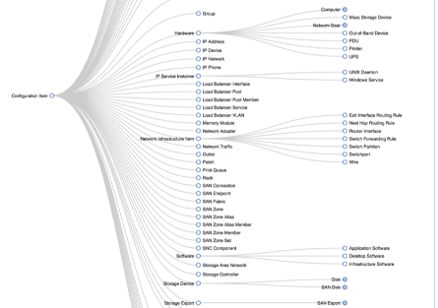
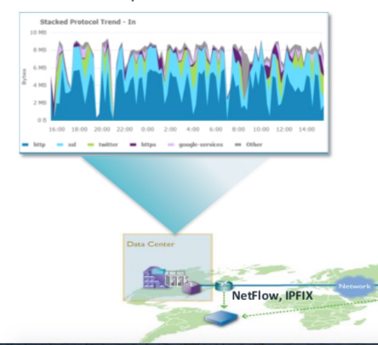
summary: PEOPLE + PROCESS + TOOLS
RESOURCES
PROCESSES
TOOLS
  43 Highly skilled resources
  Leveraging Sify's NOC expertise
  Enhanced governance
  24x7x365 operations model
  Expertise in service provider management
  Network Devices Procurement
  Billing Management
  Inventory & Asset Management
  Network Management (24x7)
  Incident, Problem, Change, Config, Capacity Management
  Service Continuity & Reporting
  BMC Software’s Technology Platform enabling
  Unified Monitoring
  Network insights
  Rich APIs database
  Custom Dashboards

Slide 7






VALUE PROPOSITION for NPCI
  Dedicated on-premise cross-skilled mix of resources to manage current NPCI asset landscape
  Leverage existing NPCI tools (Remedy for ITSM and Entuity for NMS) and SD-WAN element managers from respective OEMs
Recommendations on integration of existing toolsets to achieve unified monitoring, reporting and analytics
Reporting portal customization based on NPCI’s reporting needs & Executive dashboards based on toolset capability
Recommendations on process and workflow automations by leveraging BMC’s partnerships with leading RPA providers
Utilize Sify’s Network Transformation capabilities for WAN consolidation, possibility of network re-architecture and optimization

Slide 8
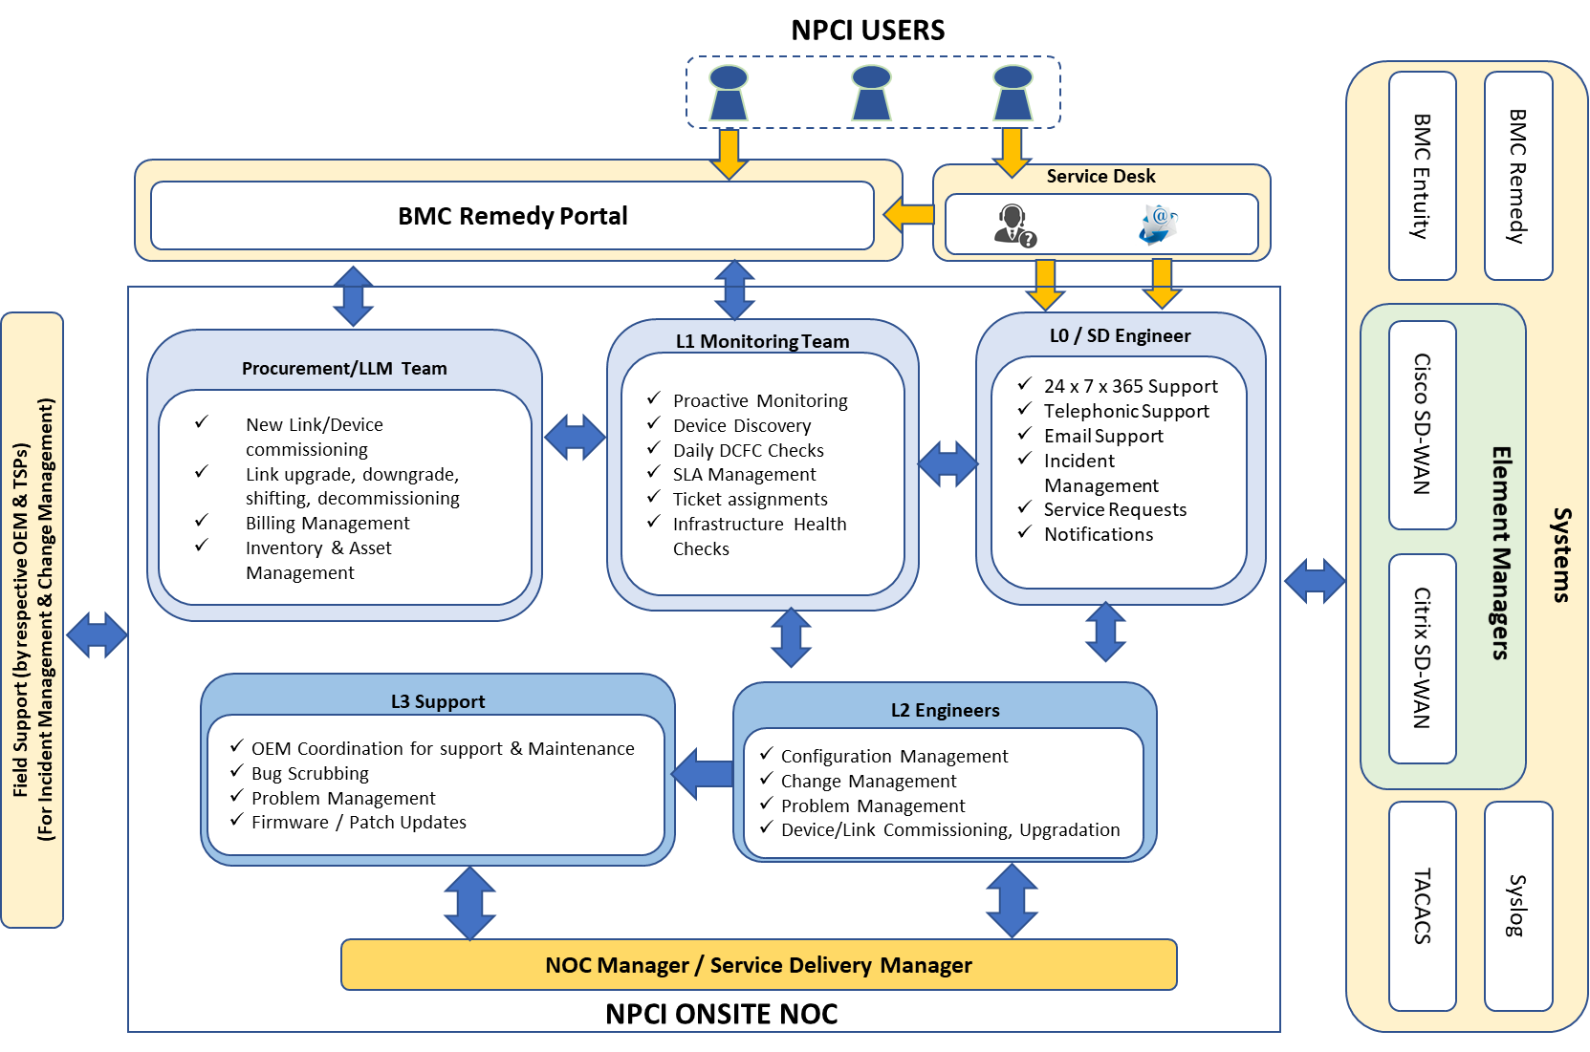
SOLUTION ELEMENTS – NOC STRUCTURE (CAPTIVE SETUP)
Onsite LLM team for:
    Link life cycle management – procurement, shifting, upgrade, disconnections
    Billing management
    Network device procurement
    Inventory & asset management
    Reporting
Onsite SD, L1, L2 & L3 teams for:
    Incident management
    Problem management
    Configuration management
    Change management
    Performance management
    Capacity management
Dedicated Operations / Service Delivery Manager

Slide 9
NOC Team structure & Hierarchy
Operations Manager (1)
L3 Engineer (5)
Procurement / LLM Team (2)
L2 Engineer (5)
L1 Team Lead (3)
L1 Engineers (17)
Service Desk (9)

Slide 10
NOC MANPOWER: CAPTIVE SETUP
Role | Shift-1 | Shift-2 | Shift-3 | General | Rotation | Total Resources
LLM / Procurement Team | - | - | - | 1 | 1 | 2
L0 Engineer/ Service Desk | 2 | 2 | 2 | - | 3 | 9
L1 Network Engineer | 4 | 4 | 4 | - | 5 | 17
L1 Team Lead | 1 | 1 | - | - | 1 | 3
L2 Network Engineer | 1 | 1 | 1 | - | 2 | 5
L3 Network Engineer | 1 | 1 | 1 | - | 2 | 5
Operations Manager | - | - | - | 1 | 1 | 1
Transition Manager | - | - | - | 0.5 | - | 0.5
Engagement Manager | - | - | - | 0.3 | - | 0.3
Total |  |  |  |  |  | 42.8

Slide 11
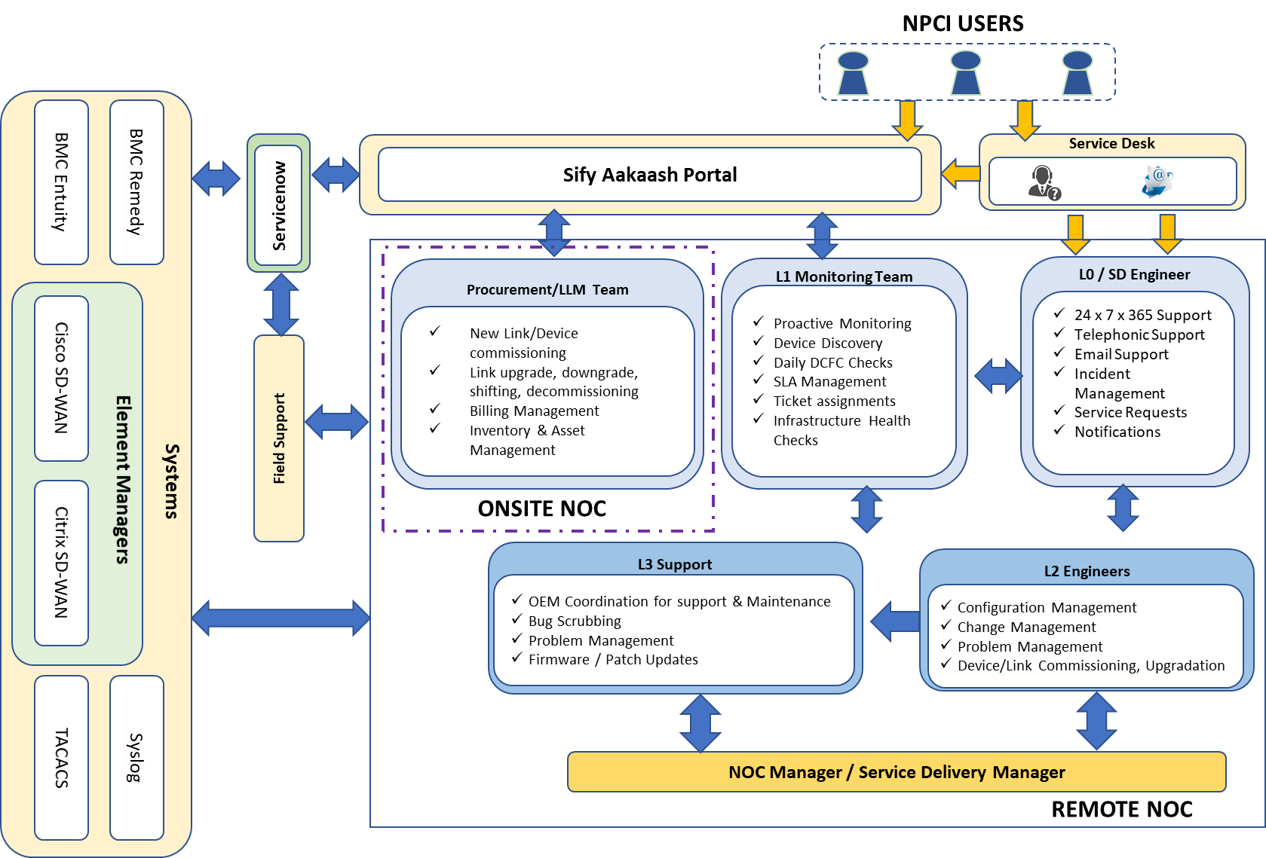
SOLUTION ELEMENTS: Shared setup
Onsite team
  Procurement / Link life cycle management
Remote team(s)
  Service desk
  L1, L2, L3 Engineers
  NOC Manager / SDM
  Field support
Requirements & Benefits
  Integration between NPCI & Sify tools
  e-Bonding with telecom service provider tools
  Use Sify’s RPA
  Retire NPCI’s tools at later date (tool’s EoS / EoL)

Slide 12
SOLUTION ELEMENTS: TEAM ROLES
NOC Manager / SDM
  NOC Operations & SLA Governance
  Operations Review
Service desk
  24 x 7 x 365 Support
  Telephonic Support
  Email Support
  Incident Management
  Service Requests
  Notifications
L1 Engineers
  Proactive Monitoring
  Device Discovery
  Daily DCFC Checks
  SLA Management
  Ticket assignments
  Infrastructure Health Checks
L2 Engineers
  Configuration Management
  Change Management
  Problem Management
  Device/Link Commissioning, Upgradation
L3 Engineers
  OEM Coordination for support & Maintenance
  Bug Scrubbing
  Problem Management
  Firmware / Patch Updates
Field Support
  Incident Management & Change Management
  Onsite Support for links & devices
Procurement / LLM Team#
  New Link/Device commissioning
  Link upgrade, downgrade, shifting, decommissioning
  Billing Management
  Inventory & Asset Management
Note: # Dedicated on-premise team

Slide 13








SOLUTION ELEMENTS: NOC OPERATIONS
Help Desk Management
Incident / Problem Management
Capacity Management
Availability Management
Change Management
Centralized Helpdesk over telephony and email
Communication channel - Call handling, query resolution & feedback
Single Point of ownership
Raise incident tickets, Assignment / Re-assignment
Interface between NPCI, OEM & TSPs
Dedicated Service Desk
Handle all trouble tickets that have been pro-actively registered
Coordinating with third party to resolve problems
Incident handling & problem resolution
Root cause analysis & reporting
Work with vendors, as applicable, for achieving the SLA
Regular reporting on Network Operations
Work with field operations to restore network outages
Network utilization & trending analysis
Threshold monitoring
Analyse forecasting
Recommend bandwidth / device upgrades
Availability Monitoring
Spare management
Fault Management
Initiate change requests
Follow-up for change approvals
Perform scheduled and emergency changes
Perform post implementation review
Carrying out approved changes in the network
Manpower &
Field Support Management
Configuration Management
Vendor Management
Link Lifecycle Management
Periodic device configuration backup
Maintain backup library
Online auditing of configuration changes
Configuration restoration
Liaison with third party for link or device failure
Link life cycle with the respective TSP teams
Coordination with OEMs for device support
Billing & SLA governance
Ensure Skilled Manpower at NPCI NOC
Onsite field support for link & device of NPCI based on service requests
Shared field support if NPCI tools are integrated with Sify NOC tools
Procurement
New link commissioning
Upgrade
Downgrade
Shifting
Decommissioning
Security Management
Security of data & process information as per NPCI policies

Slide 14
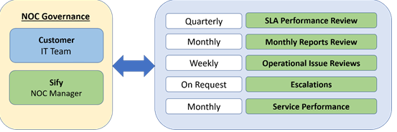





SOLUTION ELEMENTS: NOC GOVERNANCE
Onsite NOC teams measured on monthly basis in steady state of operations for:
  SLA Performance Review
  Operational
  Issues
  Escalated
  Issues
  Service Performance
  Reporting

Slide 15
REFERENCE PROJECTS

Slide 16







IFTAS: BACKBONE FOR INDIA’S INTERBANKING SERVICES
Financial BANKING
Project Objective
To set up the Digital Payment Network Infrastructure connecting RBI locations and Member Banks, for Interbank Financial settlements.
Integrated Value and Outcome
Sify was able to outclass competition in a techno-commercial evaluation model by virtue of the following:
Sify’s expertise to design , implement and operate a multi service provider environment to provide for high availability.
Ability to tightly integrate security controls into the overall Network architecture , and yet manage the complexity of interconnections between member banks and RBI payment gateways.
Integrated Play of Network Managed Service Provider & skillsets to run large scale Dedicated NOC operations for such mission critical Network.
Value for Client
Single ownership with the MSP to manage the complexity and guarantee high availability.
Value for Sify
This was a great showcase and reference for Sify for demonstrating skillsets to manage complexity, and for other Network Outsourcing opportunities.
Project Model
Managed Services led Network Outsourcing model
MANAGED NETWORK SERVICES
Competition
Airtel, Reliance Communications, Tata Communications
Sify’s Uniqueness
Integrated value of skills – NSP, Network Integrator, NOC & Managed Services, Network Transformation Services, Security Services alongside Network Infrastructure services
Contract Duration
5+2 years

Slide 17



NSE: THE WORLD’S SECOND LARGEST STOCK EXCHANGE
Financial STOCK EXCHANGE
Integrated Value and Outcome
Integrated Play of Network Managed Service Provider , Network Integrator & skillsets to run NOC operations for such mission critical Network.
Value for Client
Provided NSE a predicable model to scale operations over 40 cities from 7 city presence using Network and Edge assets. This has helped significant growth in member acquisition and lowering the cost of operations for existing members.
Digital Platform for Service Operations and member interactions between members and NSE enabled transparent and efficient operations.
Value for Sify
Monetization of network and edge assets.
Positioned Sify as a strategic partner to NSE and opened engagements in areas of Cloud and DC.
Project Objective
To transform and transition the NSE existing Network, Setup a Shared NOC & SOC, and expand the NSE footprint to acquire more members in India.
Project Scope
Complete Managed services Model for NSE
Backbone upgrade to 10Gbps
Establish virtual PoPs for Member aggregation – Leverage Sify’ s PoP infrastructure.
Faster onboarding for members resulting in rapid expansion of member network.
Uniform architecture across the network with simplified operations
Internet based Multicast to maximize Members reach
Multi provider management & NOC operations
MANAGED NETWORK SERVICES
Sify’s Uniqueness
Integrated value of skills – Network Integrator, NOC & Managed Services, Network Transformation Services including Design, Optimization and Transitioning of the Network.

Slide 18

TATA STEEL: DIGITAL NETWORK FOR INTEGRATING IT, OT & PEOPLE
MANUFACTURING
Project Objective
To establish a NOC integrating IT, OT assets to enable insights into the Network across DC, Cloud and End users.
Build and Operate a Private Network across all Campuses
Integrated Value and Outcome
Specialized skillsets and processes across NOC setup & managed services outclassed the traditional IT outsourcing model deployed by the incumbent.
MWiFi platform integration with TSL’s Access & Identity Management System (AIMS), ensured an integrated Platform for all IT, OT assets, as well as Wearable Safety devices across TSL’s workforce.
Value for Client
The NOC has enabled network orchestration and analytics for the client across his IT & OT assets, which in turn has resulted in better efficiency & control.
Sify’s Private Network has enabled large scale sensitization of plant operations leading to better efficiencies and significant cost savings.
Value for Sify
This project has given Sify deep insights & experience into future roadmap on 5G and edge computing.
TSL has also chosen Sify for migration of workloads to public cloud and integration of public cloud environment with TSL’s legacy infrastructure.
Project Scope
Hybrid management model – dedicated NOC setup in Sify DC, with onsite resources at TSL
Best-fit toolset to cater to TSL requirements of monitoring & reporting
Integration of CA tools with TSL’s ServiceNow to maintain comfort of end-users
Integration of ticketing into a single platform in the NOC
Customised dashboards, taking inputs from CA and Aruba Airwave NMS to enable timely decision making
Streamlining the operations with critical inputs from customer on a day-to-day basis
Aligning NOC operations to business requirements of TSL
MANAGED NETWORK SERVICES
Sify’s Uniqueness
Integrated value of skills - NOC & Managed Services, Edge Transformation Services

Slide 19

DEPARTMENT OF POSTS: LARGEST MANAGED NETWORK IN INDIA
Financial BANKING
Project Objective
To connect 30,000+ Post Offices across India for Digitalization of DoP
Integrated Value and Outcome
Sify was able to outclass competition in a techno-commercial evaluation model by virtue of the following:
Sify was rated as T1 because of combined value of integration, managed services and infrastructure solution richness.
Value for Client
A significant percentage of the total commercial value was Sify’s inhouse Services including Network Infrastructure Services. This resulted into lower TCO (for the client), higher EBITDA for Sify (by virtue of monetization of network infrastructure and NOC investments)
Value for Sify
This project enabled Sify’s entry into large network integration and managed services engagements vis-à-vis Sify’s earlier position in the market as a network infrastructure service provider.
Project scope
Design of the entire Department of Posts network with 30 K departmental offices with Dual service provider including DC & DR setup.
Procurement and deployment of networking components for WAN, Data Centre/DR LAN and Network Security devices
Migration , Network management & operations of the complete network infrastructure with Service Desk, L2/L3 support and zone-level field support
Set up and manage the Network Operations Centre (NOC) to provide 24x7x365 Support .
MANAGED NETWORK SERVICES
Sify’s Uniqueness
Integrated value of skills - NI, Project Management, NOC & Managed Services, Security Services alongside Network Infrastructure services

Slide 20
RESPONSES TO NPCI QUERIES

Slide 21
CONNECTIVITY MIGRATION
How Sify will take over complete NPCI setup of NPCINet connectivity including Hub links in their name along with underlying asset inventory. How the compensation for taking over asset inventory will be calculated?
Link Inventory
Asset
Currently the links are contracted by NPCI on it’s name.
Inventory
Novation/ New Contract
Sify shall execute a novation/ new contract with the individual service providers for the required bandwidth capacities.
New Sify Link ID
A new order login will be processed in Sify’s system to generate a new link ID for monitoring and billing.
New Service Link ID
Similarly, a new order will be processed by the individual service providers and a new link ID will be generated in their system.
Logical Migration
The physical media will be the same and the service providers will logically migrate the links to operate under the Sify’s new purchase order and lifecycle management.
Scenario
-
Scenario
2
-
1
Service Provider
NPCI
-
-
owned CPEs
owned CPEs
Sify takes over
Device
Sify proposes to
Management
replace the
existing SP
CPEs with new
Sify takes over
SIfy Managed
the AMC
CPEs
Management
Commercials for Scenarios 1 & 2 will be separately quoted

Slide 22
HUB LINKS MANAGEMENT FOR SCALABILITY
How the hub links will be managed and upgraded as and when required to ensure no business impact including underlying network devices and SD-WAN? Will the cost for hub links be borne by NPCI or can it be recovered from the members connecting on the same equally across all member banks/ other market participants or based on any other parameter?
Step-1
Step-2
Step-3
Hub-links migration to Sify’s name (as per process explained earlier)
Based on current usage statistics, the new links will be sized to include buffer capacity
When link utilization reaches 70% (or a mutually agreed threshold % with NPCI) of capacity consistently over a period of one month, Sify will notify NPCI and work on upgrading the capacity as per pre-defined rate card.
Sify can propose the CPE models (network devices and SD-WAN) to cater to a capacity increase of up to 30% to minimize any business impact and to facilitate any urgent link upgrades.
Charging models
  Hub links can be charged to NPCI
  Hub links can be charges back to Member Banks in the bandwidth charges (revised charges every quarter based on increased Hub link capacity). Variance will depend on new Member Banks added in a quarter.

Slide 23
SERVICE MODELS FOR MEMBER BANKS
Member Banks can avail of different models, based on SLA they prefer
99.93% site uptime - 2 CPEs on-site, with 2 last miles terminating on 2 different service provider PoPs
99.50% site uptime - with single CPE and single/ dual last miles
PE
1
PE
2
PE
Last Mile
1
Last Mile
2
CPE
CPE
1
CPE
2
Example
-
Example
2
-
1

Slide 24

ASSET AS A SERVICE
Member Banks can avail of CPEs as a service, based on bandwidth slabs.
Managed CPEs may be routers or SD-WAN devices.
The Annual Recurring Charges (ARC) will include the cost of hardware, managed services and in the case of SD-WAN, it shall include the SD-WAN licence charges as well.
The period of usage may be 7 years as specified by NPCI. In case of a short contract, or pre-termination by a Member Bank, exit charges will apply.
Recovery of assets will be Sify’s responsibility.

