Slide 1
Sify Infinit
Security Services
“Securing Your
Business Information Assets”
April 2023

Slide 2







SIFY Infinit Security Services
Customers
Sify SOC
Service Management Portal
Service Fulfilment
Service Assurance
Provisioning & Orchestration (SOAR)
Request
Event
Incident
Problem
Change
Asset Mgmt.
CMDB
Service Mapping
Monitoring / Management (MSS)
Detection (MDR)
Governance Risk & Compliance (GRC)
Tools
Performance & Availability
DAM
SIEM
UEBA
EDR
NBAD
Vulnerability Assessment
Penetration Testing
OS & Application Patch Management
Security Product Consoles
Threat Intelligence
Firewall, IDS/IPS, ATP, RA VPN, WAF, SWG, SASE. DDoS, DNS Security
NGAV
DLP, Email Security
CASB, PAM, MFA
Security Controls
User | Device
Branch | WAN
DC
Any Cloud

Slide 3
SIFY Infinit Security services catalog
Sify Colo, 3rd Party Colo, Customer DC
Sify Products and Services (IaaS, PaaS, SaaS)
MSS
MDR
GRC
NW Security
Host Security
Data Security
IAM
NextGen Firewall with IDS/IPS, Advanced Threat Protection, Remote Access VPN, Web Application Firewall, Secure Web Gateway, SASE, DNS Security
NextGen Antivirus, EDR, OS & Application Patch Management,
DLP, Email Security, Database Activity Monitoring
CASB, Privilege Access Management, Multi Factor Authentication
SIEM, UEBA, Network Detection & Response, Threat Intelligence
Vulnerability Assessment & Penetration Testing, Security Audits
Sify CI Enterprise Cloud, AWS, AZURE, OCI, GCP
OEM
Fortinet, Checkpoint, Cisco, Palo Alto, F5
CrowdStrike, McAfee, Forcepoint, Trend Micro
McAfee, Forcepoint, Trend Micro
Arcon, Cisco
Fortinet, Cisco
Rapid7, Nessus, Metasploit, Burp Suit
Service Desk
Omni-Channel, 24x7, Multi-Lingual
Tools
Service Desk/ITSM, Discovery, Correlation, Security Orchestration Automation, Operation Insights, Dashboards, AIOps, DevOps
Processes
ITSM – ITIL, ITAM, ITOM, ISO 27001, ISO 2000

Slide 4





Automation-led Sify Infinit Security services
Provisioning
Workflow
Event
Runbook
Catalog based orchestration - Creation, Self Service, Multi Cloud Management, etc.
Sequential workflow defined services and checks with or without any intervention – Service Request, Notifications, Authorization, Assignment etc.
Triggered based on one or sequence of events – Alerts from tools or APIs, Threshold violations, etc.
SOP based sequential tasks - Service Health checks & defined actions. AIOps driven for MTTD, MTTR, MTTI Reductions.

Slide 5

What makes sify a UNIQUE partner FOR Security Services
Less
Hardware
People
Licenses
Single partner for Security Services across DC/Cloud/WAN/End-User
Catalogue Driven & Optimized Hybrid SOC delivery model
Security Posture Enhancement
By implementing the right security framework
TOOLS
PROCESS
INNOVATION
Best of Breed MSSP/MDR/GRC Tools
Protect, Detect & Response Services
Productivity improvement
with Automation and Event co-relation
Full suite of ITIL service elements, process compliance
SLA based service with real time measurement & dashboards

Slide 6







Sify Security Services Value proposition & Customer benefits
Integrity | Commitment | Agility
Sify Value Proposition
Customer Benefits
Wide Product & Services Capability
Business Benefits
  Service Provider DNA – Single Partner
  Protect, Detect & Response Services
  OEM Agnostic
Protects Brand & Business Reputation
Improves Cyber Security Posture
Business Data Protection
Technology Capability & IP
Cost Benefits
Product Engineering Capabilities
NextGen SIEM Platform with Automated Response
Certified People & 100+ OEM Partnership
NextGen Security Technology Adaption
Security Controls Standardization
Security Cost Optimization
Operation Excellence
Customer Delight
Threat Hunting
Security Orchestration & Automation Response
Service Level Management & Optimization
Detect and Deter Cyberthreats
Human error reduction
Incidents, Problem Reduction

Slide 7
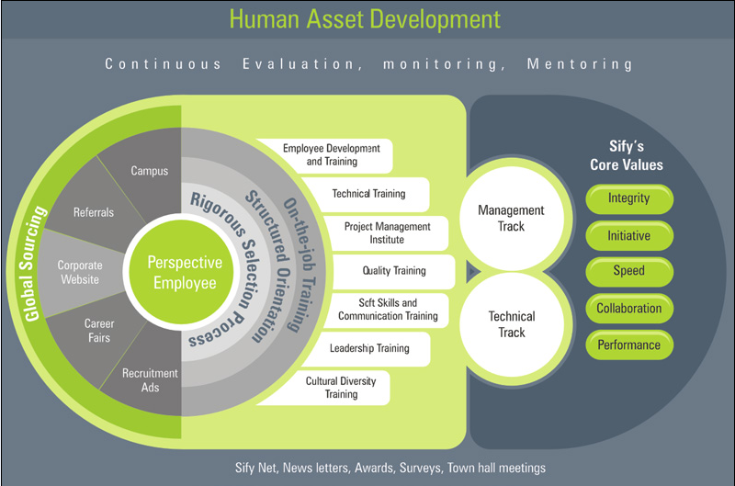
Continuous IT skill development
LMS (Success Factors) | Percipio Content Portal | ILT & VILT (Instructor Led Trainings)|OEM Training & Certification

Slide 8







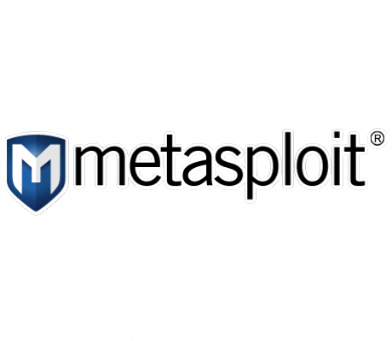




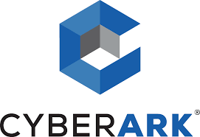

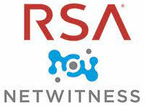





















Security Partner ecosystem: competency & Certification
Network Security
Host Security
Data Security
Mobile Security
IAM
MDR
VA & PT

Slide 9
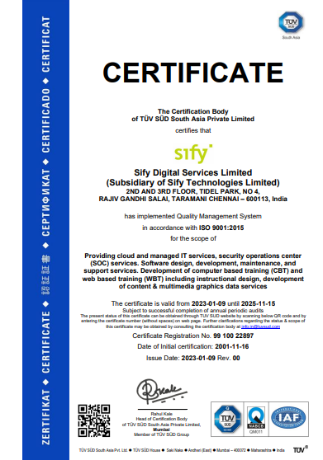
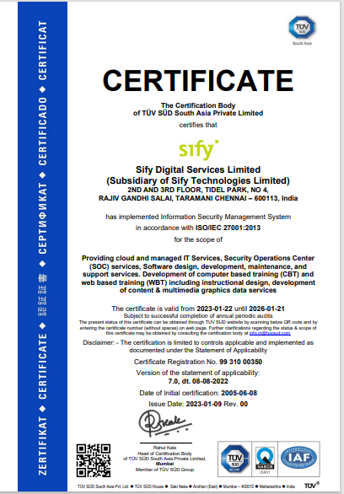
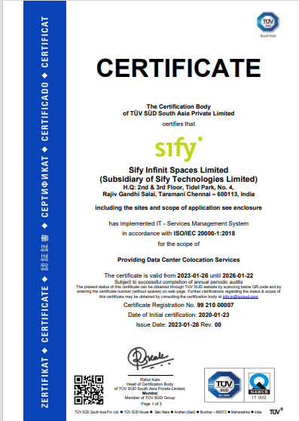
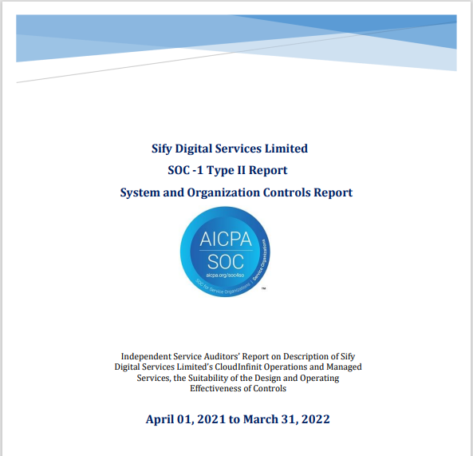
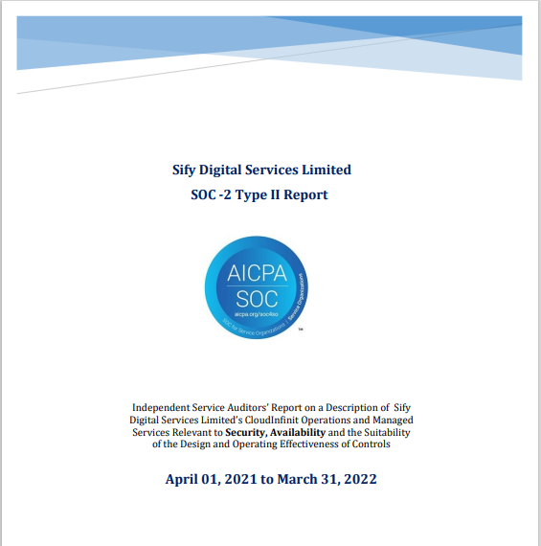
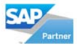
Security & Quality Compliance CERTIFICATIONS
ISO 9001
ISO 27001
ISO 20000
SOC 1 Report
SOC 2 Report
SAP Certified
In Hosting Services
SAP Certified
In Cloud Services
SAP Certified
In SAP HANA Operations Services
SAP Certified
In Application Management Services

Slide 10

Sify Infinit Security Services: Key Facts
20+
50K/Y
1 Million
30+
Security Operations Experience
Security Incidents
Alerts
OEM Solutions & Platforms Integration
250+
10+
5000+
90+
MSS (250+)
MDR Captive (10)
MDR Shared / Hybrid (15)
GRC (25)
Customers
Compliances
ISO 27001, 17, 18, ISO 9000, TL 9000, ISO 20000, MEITY, MHCE, CERT–IV-D, SSAE,
PCI-DSS-C, D, CERT-IN, SOX
IT Assets
Skilled Associates

Slide 11





SIFY AS TRUSTED Security services PARTNER
Sify is trusted by a leading manufacturer for securing their end- to-end IT Infrastructure and enhance their security posture with continuous monitoring, management and security audits
SANMAR – End to End Security Services
Sify helps a major pharmaceutical sector customer with AI & ML based Security Analytics platform and automatically mitigating threats resulting in reduced MTTD and MTTR
Micro Labs - SIEM
Sify helps secure the Financial platform hosted on public cloud accessed by several retail customers for a major NBFC with security controls at various layers along with Detection and Response services.
Manappuram
World's leading glass manufacturer secured with Machine Learning based threat detection and response technology protecting against sophisticated threats and attacks
Nippon Electric Glass - NGAV
Sify helps assess and mitigate the cyber security risks for a leading financial institute's IT estate
NSE – VA/PT

Slide 12
Thank You

Slide 13
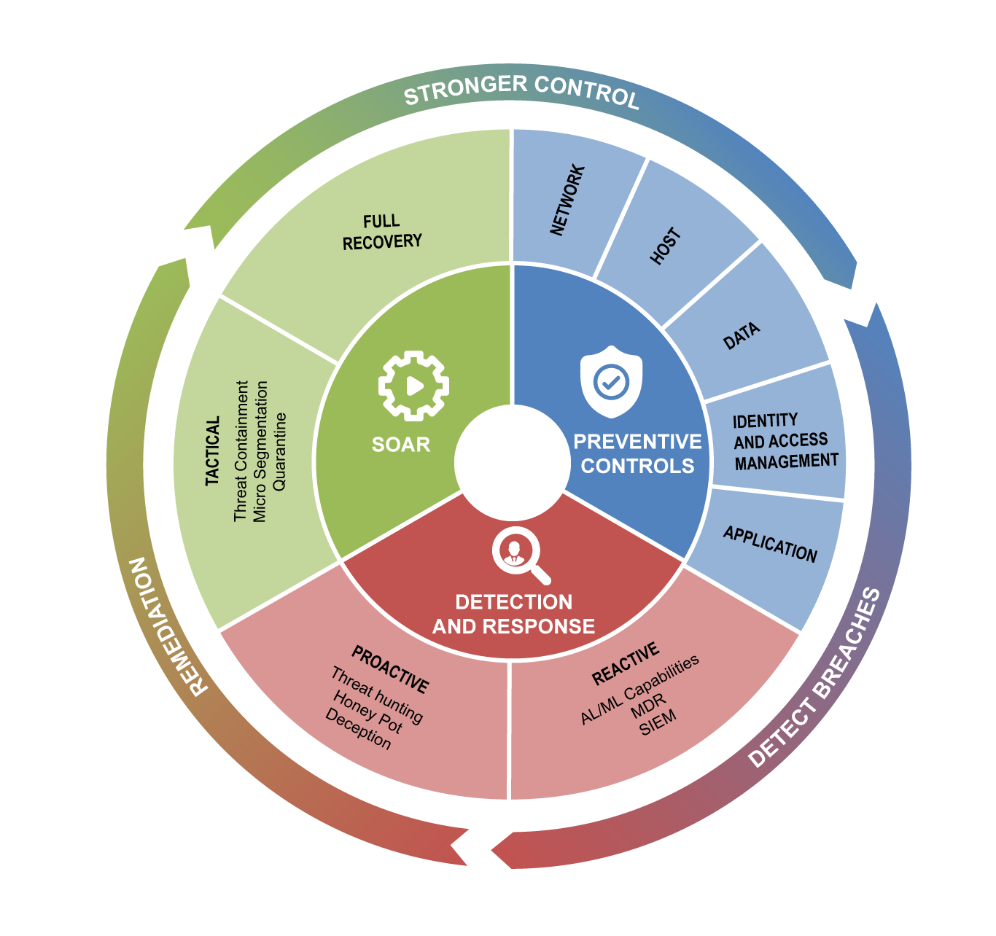
Sify Security Services
Sify takes over Customer Responsibility
Engagement by Stage
STUDY, ASSESS and REPORT
Policy framework development
Compliance readiness assessment
Security posture assessment
Gap and Risk Assessment
DESIGN, BUILD and TRANSFORM
Cloud and Network security
End point and mobile security
Identity and Access Management Security
System and Data security
Cloud and Application security
OPERATE and PROTECT
Security asset monitoring and management
Security threat detection and remediation
Security risk and compliance management
User Behavior Analytics
Security as a service for implementation and management of preventive controls - MSS
Managed Detection and Response for monitoring and management of security breaches and vulnerabilities – MDR
Governance Risk & Compliance for infrastructure covering audits, vulnerability assessment and penetration testing - GRC
Notes:
Sify helps their customers with both build and operate model as well as with the services model
With the Build and Operate model, we understand the customer requirements and then build the solution to meet the customer requirements and also help them by running the SOC operations with captive resources.
With the Services Model, we provide the remote managed services support for the customers security landscape with the help of our MSS team and also extend the Security Monitoring Services with the help of our MDR Team

Slide 14








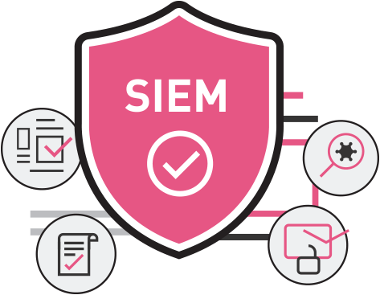



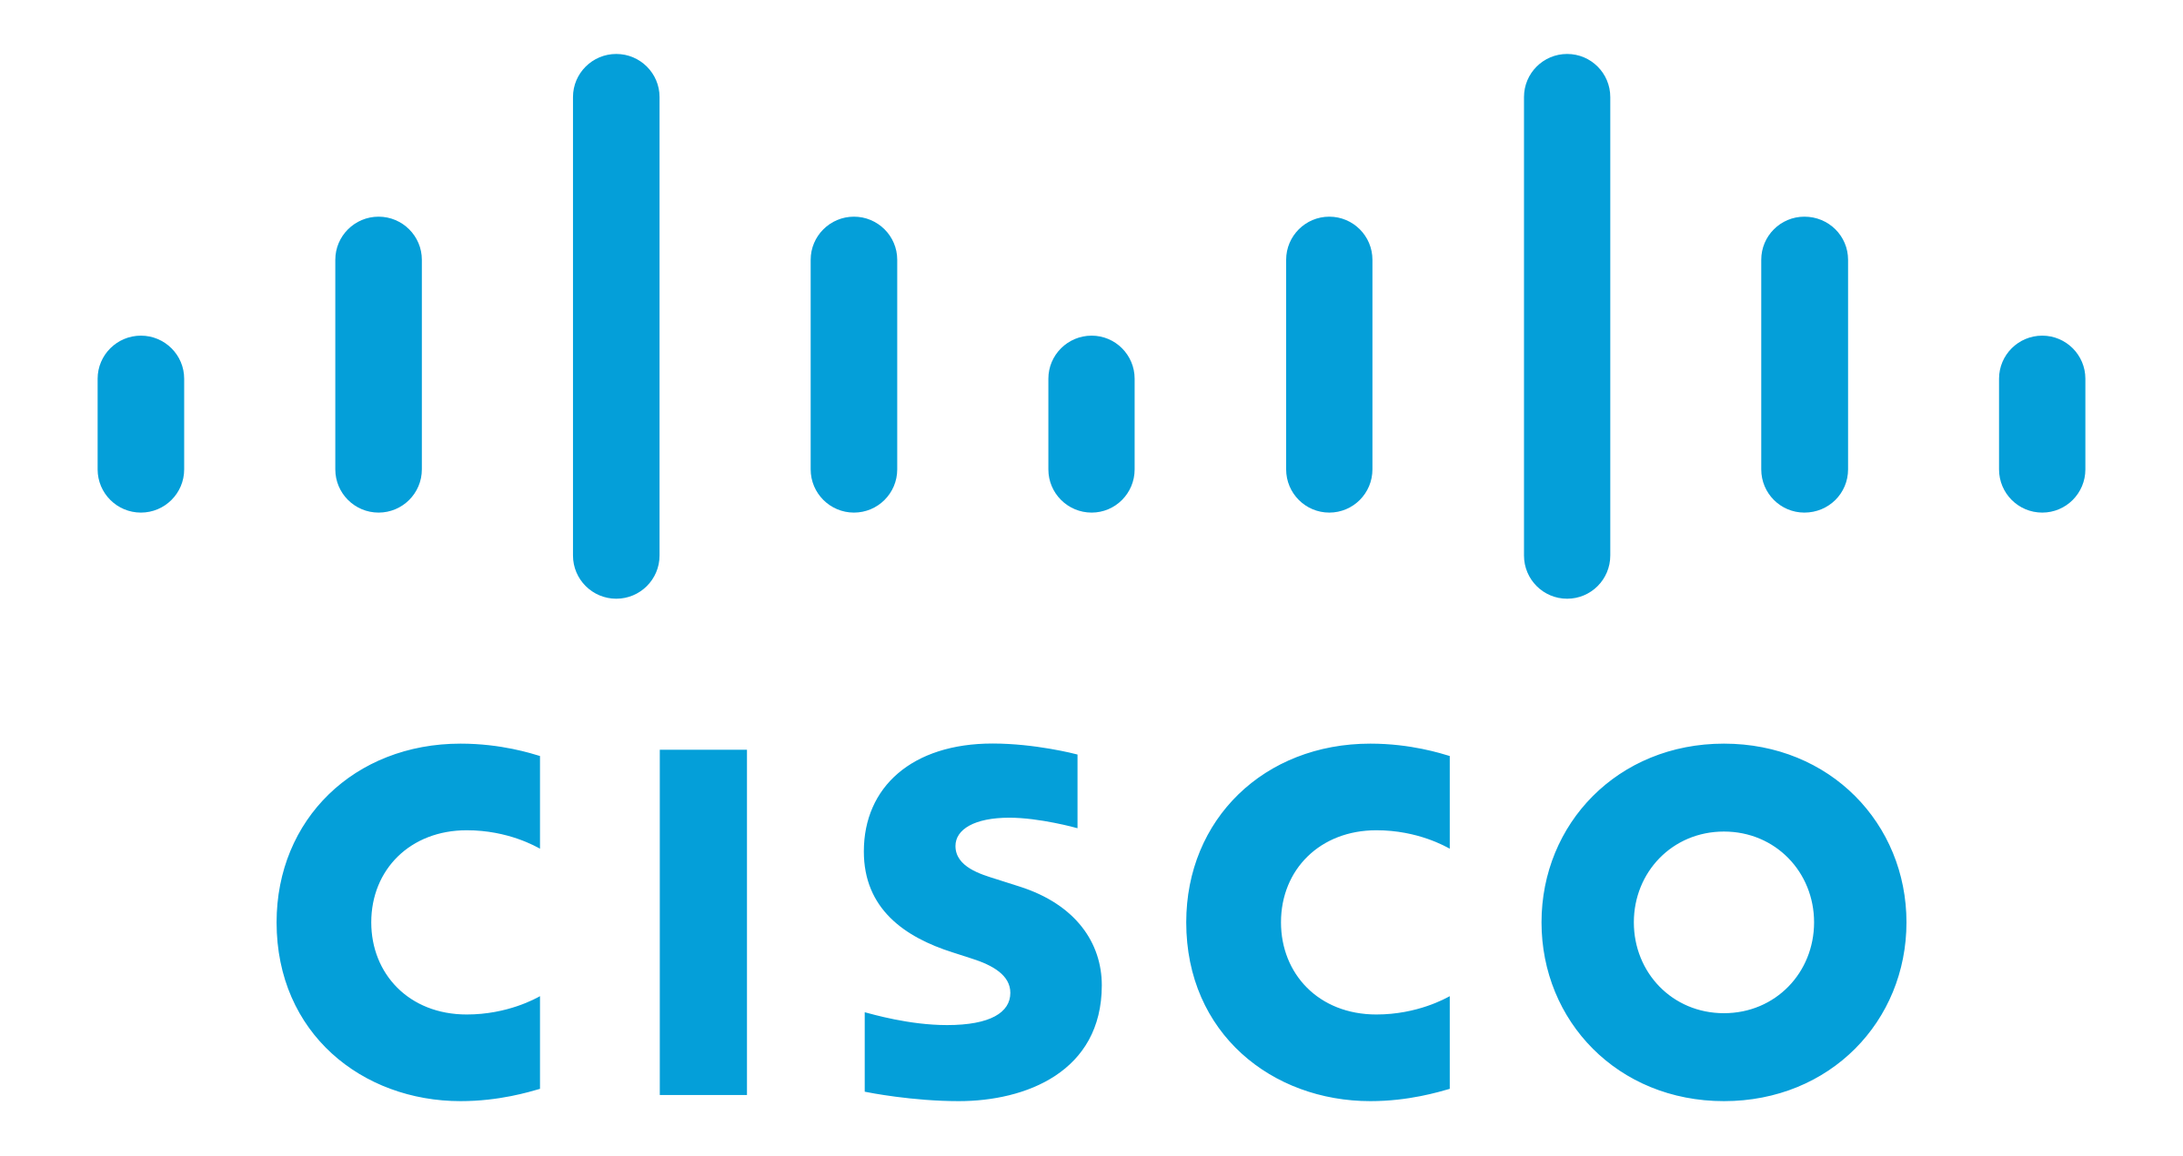



Security as a service: for the Hybrid IT
SECURITY AS A SERVICE (FROM THE CLOUD)
Privileged Access Management
DDOS
Protection
Endpoint Detection & Response
Vulnerability
Mgmt.
Multifactor
Authentication
Email security
Partner Aligned
Anti-APT
SIEM
Sify Native
Log Management
Web Security
User | Device
Branch | WAN
Cloud | DC
Notes:
Security as a Service
Sify has engineered few technologies such as Log Management, SIEM, Multifactor Authentication, Vulnerability Management, Penetration Testing, Privilege Access Management, NextGen AV and Endpoint Detection and Response and have hosted them on Sify’s cloud.
Sify has also partnered with certain OEMs and are delivering certain technologies as a service which are hosted in OEMs cloud such as AKAMAI Content Delivery Network (CDN,) Web Application Firewall (WAF), Distributed Denial-of-Service (DDoS) and also with Cisco for delivering DNS Security, Email Security, etc.,
All of these services and are being delivered as a service irrespective of customers Hybrid IT infrastructure location

Slide 15






















Security as a Service: For the Cloud
Security Services for any Cloud
Cloud Native
Security Services
Market Place
Web App
Firewall
Network
IPS
VPN GW
Privileged Access Management
Vulnerability
Mgmt.
Cloud DDOS
Protection
Endpoint Detection & Response
Log Mgmt.
SIEM
Multifactor
Authentication
Security Controls as a Service - From Sify Cloud

Slide 16

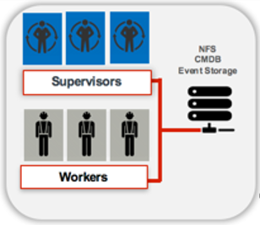




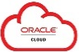







Sify MDR: Architecture
Customer Premises
(Log Sources)
Sify SIEM
Sify MDR
Cloud
Syslog
SNMP Traps
WMI
NetFlow
Incident
Monitoring
Reports & Compliance
Threat
Hunting
Threat & Vulnerability Alerts
On-Prem DC
End Point Security Alerts
Log Collector
Investigate & Respond
Collect & Normalize
Classify
& Enrich
Access &
Application Security Alerts
Email Services
Sify Security Operations
- - - - - - - - - Secure Connectivity - - - - - - - - -
- - - - - - - - - Secure Connectivity - - - - - - - - -
Data Protection Alerts
Detect & Correlate
Agents
Agent-Less
Windows Agents
System and Application alerts
Perimeter & Security Devices
Security Advisories
Threat
IOC/IOA
Log monitoring & Event Analysis Alerts
Incident Alerts/Remediation Information
Behavior Analytics
Risk
Scoring
Threat Intelligence
ITSM

Slide 17
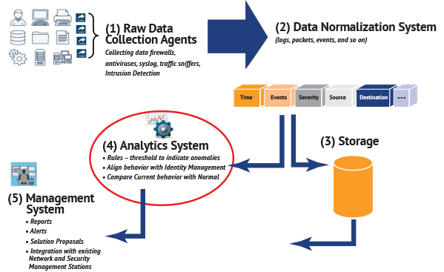
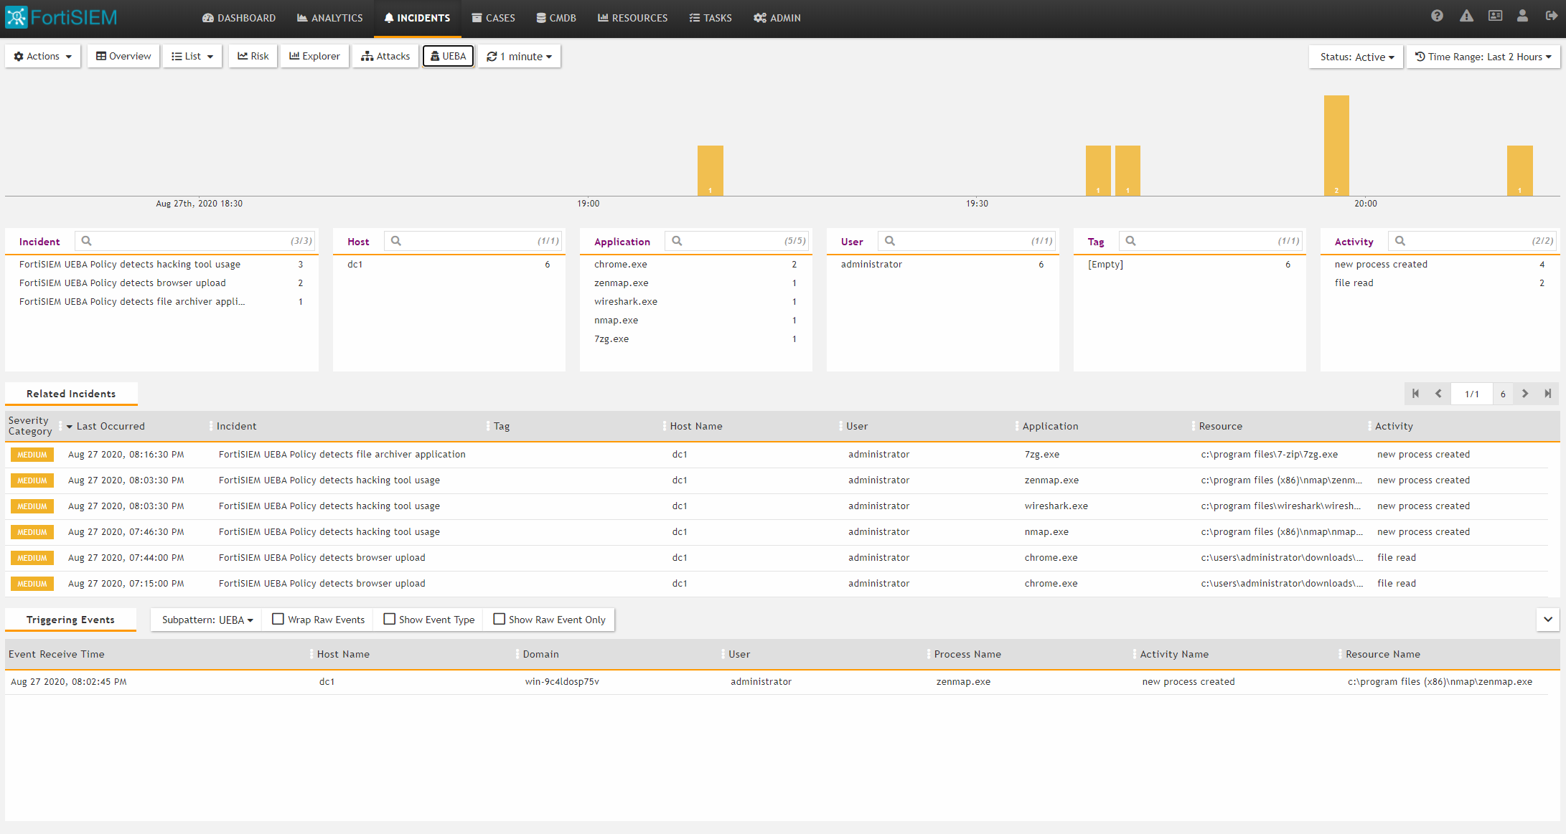
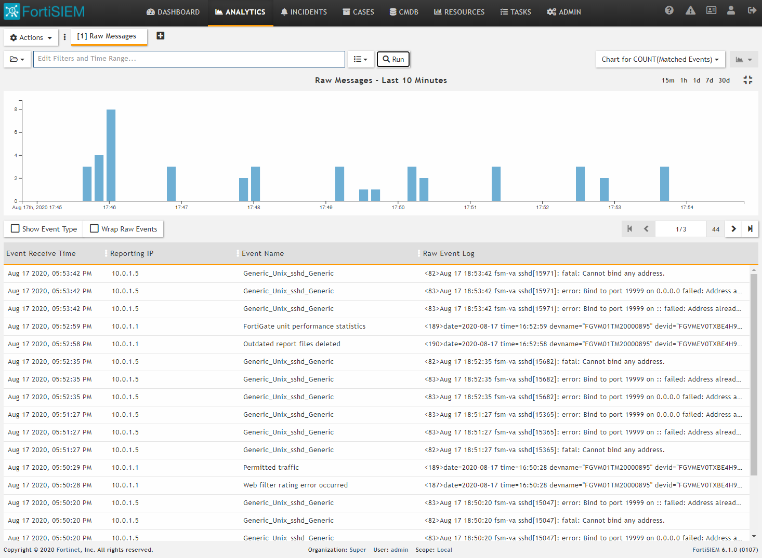
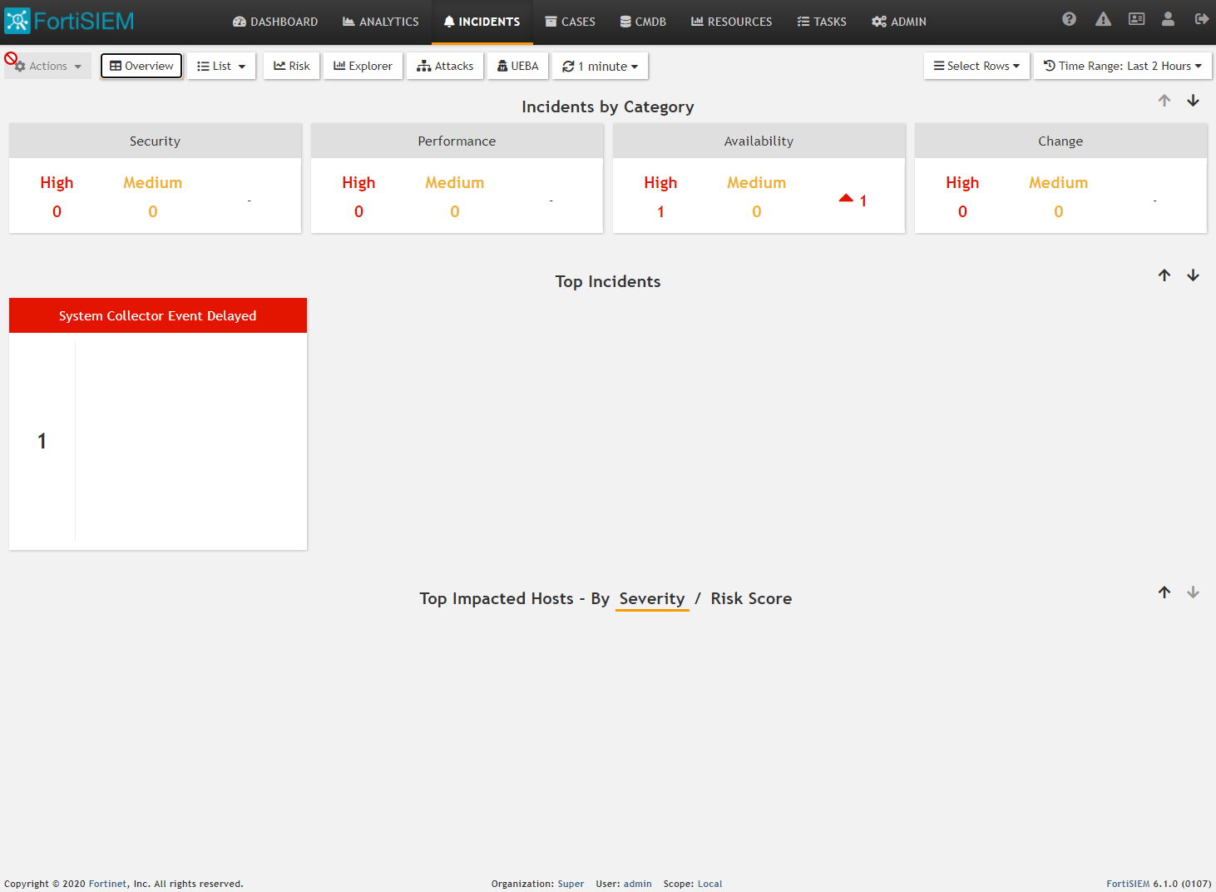
Sify MDR: UEBA & Endpoint Visibility
UEBA Dashboard
Analytics
Incidents

Slide 18

Thank You

