Slide 1
Sify Cloudinfinit (CI)
Multi-Cloud management platform
“Unified Control Across Clouds”
April 2023
Sify is the leading digital infrastructure player in India, helping customers achieve their digital ambition through cloud@core products and services, built on its world class Data Centers, Cloud & Network assets and a wide portfolio of professional and digital services

Slide 2
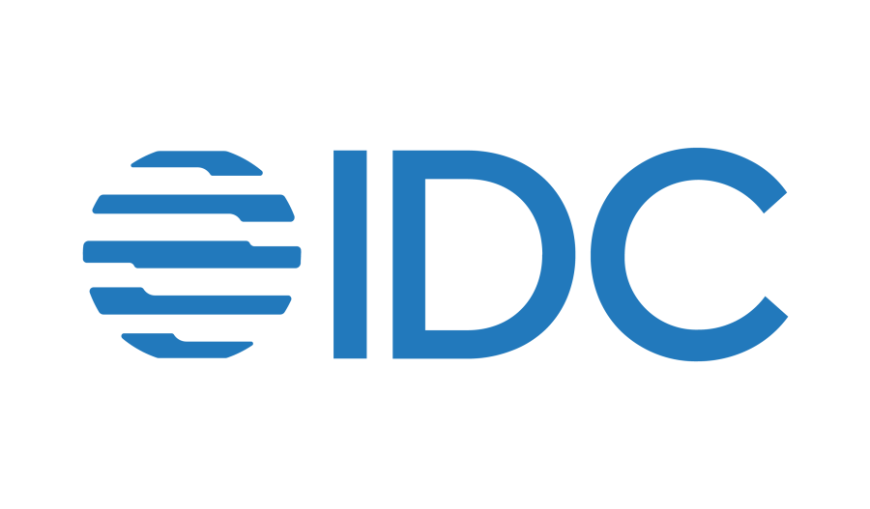
Latest IDC Prediction for cloud
IDC predicts that complexities of digital business and IT budget pressures will drive 60% of India-based 1000 organizations (I1000) by 2024 to increase FinOps maturity with granular chargebacks, benchmarking, and multiple cloud optimization.
Cost Optimization
Complexities of digital business and IT budget pressures will drive 60% of I1000 companies by 2024 to increase FinOps maturity.
Autonomous Operations
By 2027, 45% of companies will drive automation to improve resiliency, reduce repetitive IT ops tasks.
Deployment Consistency
By 2025, 75% of organizations will favor technology partners with cloud edge services and dedicated environments.
Multi-Cloud Data
By 2025, 40% of the I2000 will adopt multi-cloud platforms to enable cost optimization, reduce vendor dependencies and improve governance.
Network Transit
By 2026, 55% of enterprises will adopt cloud WANs to improve:
availability
latency
reliability
scalability
to enable cloud and edge applications.
“India organizations are maturing in their use of cloud, data & new technologies to drive greater efficiencies and deliver on innovation and value creation for the business. These will increase their focus on automation, cloud management, FinOps, sustainability & cost management,”
says Daphne Chung, Research Director of Cloud and Software, IDC. ​
“There are growing concerns though that are placing greater pressure on budgets which require organizations to ensure the greater alignment & collaboration between IT and business in order to deliver on achieving business goals.”​
Sify Confidential

Slide 3
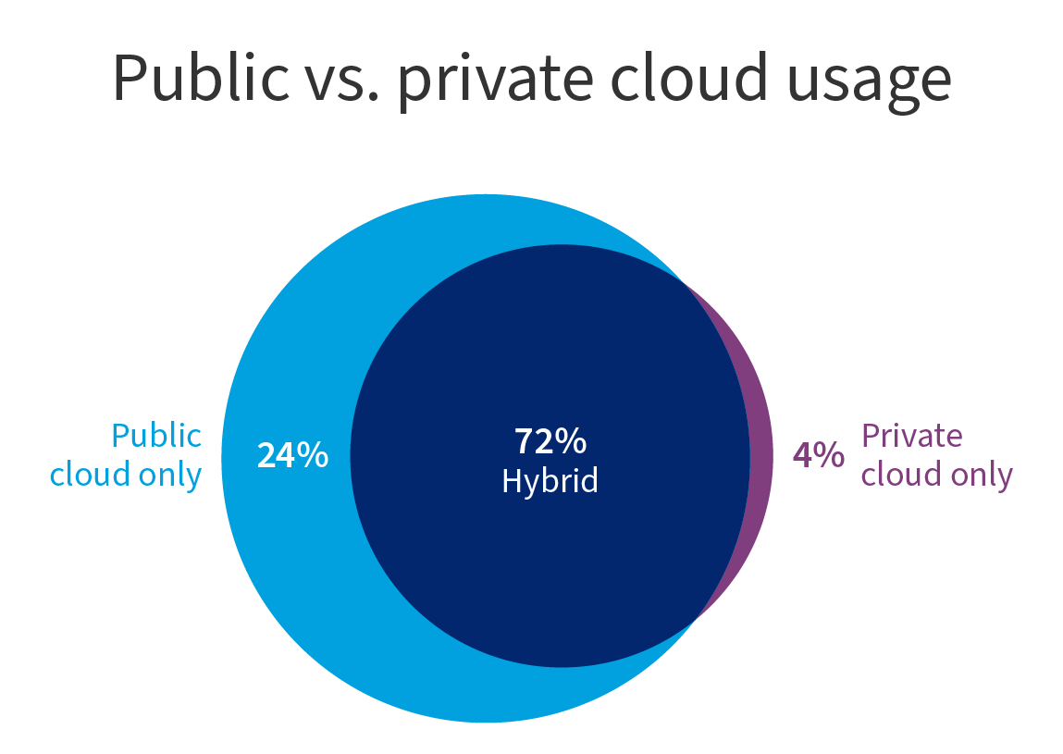
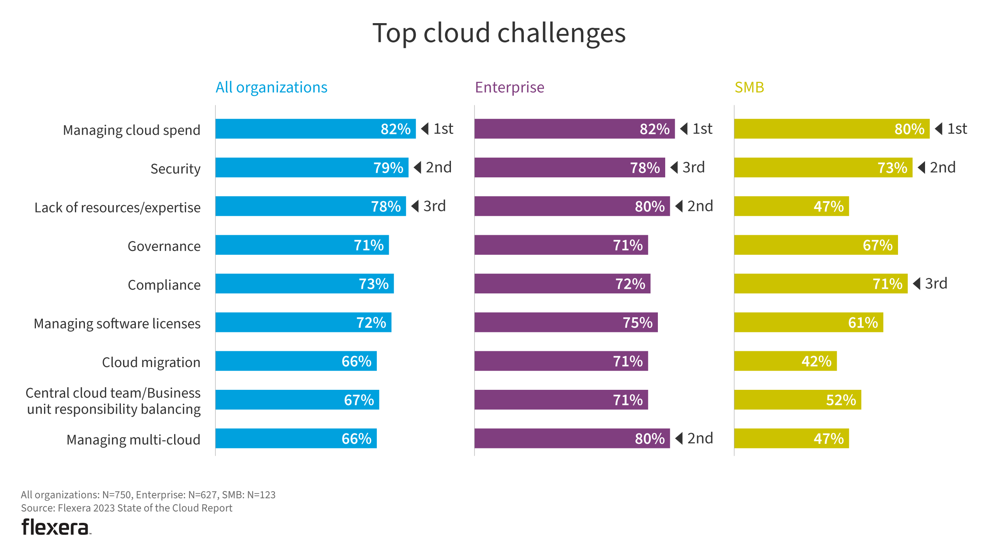
LATEST FLEXERA REPORT FOR CLOUD USAGE
Top Cloud Challenges
Public vs Private Cloud usage
24% Public Cloud only
4% Private Cloud only
72% Hybrid Cloud
Cloud cost control has become the need of the hour
Flexera State of the Cloud Report 2023- 750 Respondents
Sify Confidential

Slide 4










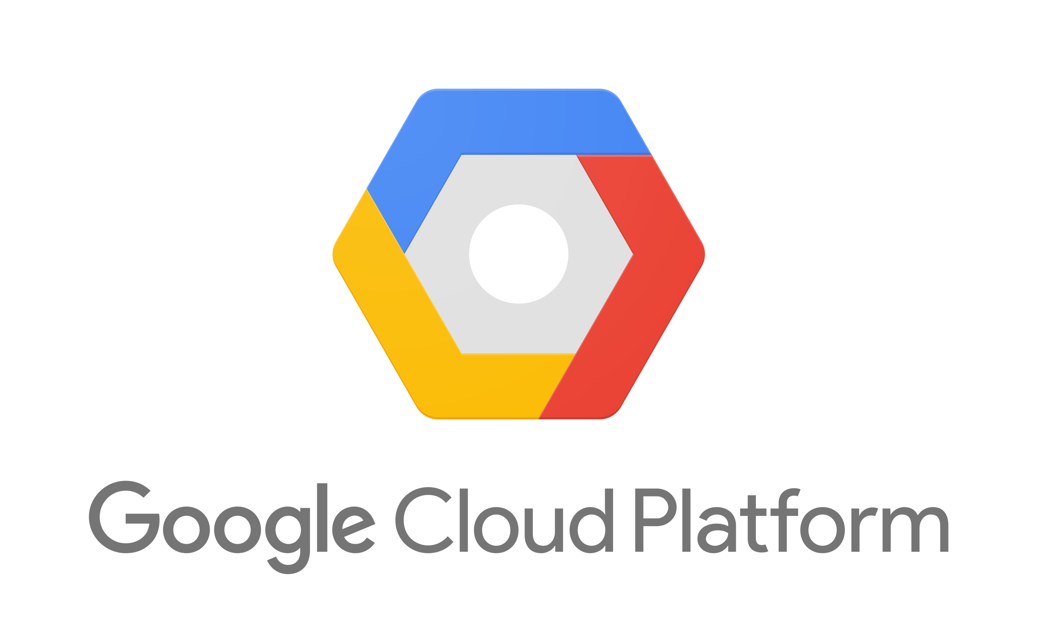
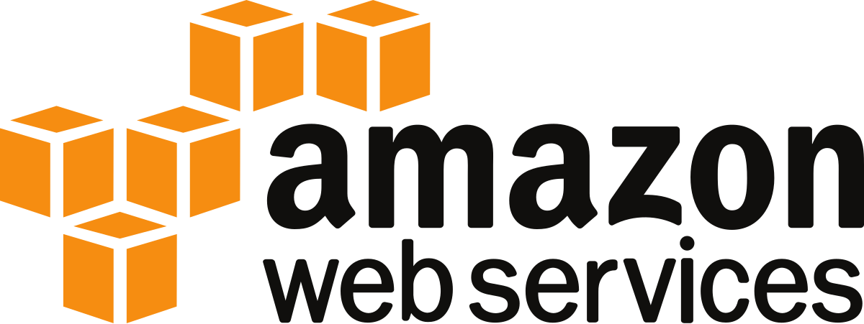
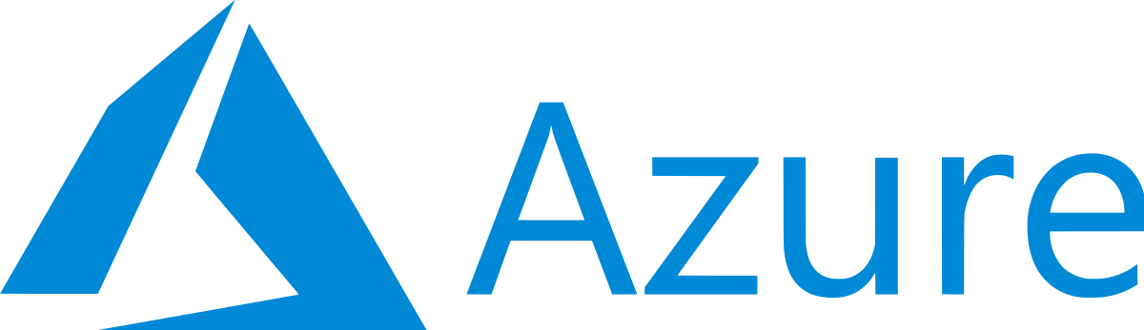

Hybrid multi-cloud deployment model
Hybrid workload placement drivers
Striking the perfect balance
Public
Cloud Drivers
Private
Cloud Drivers
Innovation
Speed
Regulatory
Data Gravity
Consumption
Scale
Performance
Existing Investment
Elastic Workloads
Fixed Workloads
Public Cloud Providers
Hybrid Cloud
Sify CloudInfinit Services
Sify Confidential

Slide 5

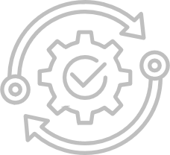

What is Sify CI multi-CMP ?
Sify Multi-CMP simplifies orchestrating, automating and managing resources and services across multiple Public cloud providers and Private clouds.
Sify Multi-CMP is designed to provide a unified interface for managing multi-cloud and hybrid cloud environments, helping organisations optimise their cloud usage, costs, and real-time observability.
Sify Multi-CMP is integrated with ITSM and Monitoring System for Service Assurance, Managed Services and SLA.

Slide 6














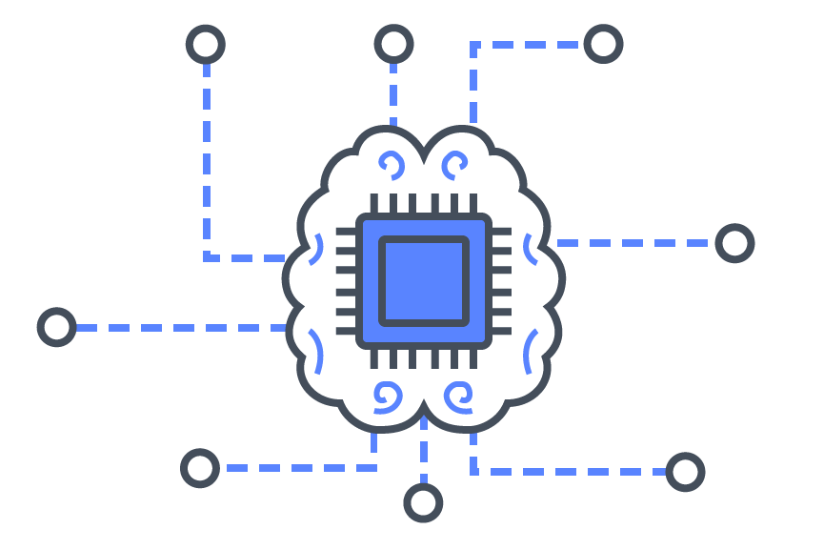





Sify multi-CMP platform: architecture - gen V
Provisioning
Orchestration
Configuration
Billing / Chargeback
Systems Management
Capacity
Cost Management
SEC
Cloud Management Platform
(Action & Automation)
Cloud Administrators
Sify CI Enterprise Cloud Powered by
Sify CloudInfinit
Self Service
APIs
SEC
Anywhere
DevOps Management
Unified Dashboard
Role Based Access
Automation
Blueprints
Policy Engine
Security & Compliance
App & DevOps
Dashboard
Request / Change
Event / Incident
Monitoring
Discovery
ITSM
(Engagement & Records)
All Users
Native Tools
AI / ML
CxO Users
Automation
SLA
HA / DR
Knowledge Base
Logs
Users
Core Platform
POD

Slide 7



Sify CI multi-CMP: KEY FUNCTIONALITIES
Resource Provisioning, Automation & Orchestration
Simplified consistent provisioning interface for Sify Cloud and Public Clouds
Resource provisioning, modification for all clouds with role-based access controls
Guest OS automation for managed services and monitoring
Multi-CMP Blueprints
Automates the process of provisioning Cloud Infrastructure resources
Predefined blueprint simplifies initial network configuration
Simplified complex network configuration like Site-To-Site VPN Connection between two clouds
Terraform based Custom Blueprints and DevOps API are fully supported
Unified Interface for Multiple Cloud Providers, Accounts, Regions
Consolidated resources listing and management across regions and accounts
Provider-specific / Resource Group based views
Instance current state like Running, Stopped with the ability to perform actions.

Slide 8

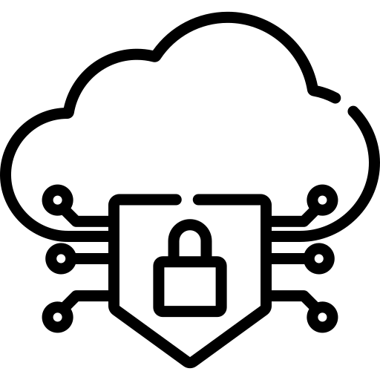

Sify CI multi-CMP: KEY FUNCTIONALITIES
Multi Cloud Visibility and FinOps
Dashboard, Reports & Analytics
Summary of Resources across accounts, regions, clouds
Comparison of cloud consumption across clouds
AI/ML driven Cloud Cost Optimization
Security & Identity
Identity Service facilitates Single-Sign-On for CMP, ITSM, FinOps Ports
Role Based Access, controls user’s access and operations on resources across clouds
Simplified firewall policy management
Integrated ITSM and Monitoring System
Public Cloud Networks are peered with Sify Network and Monitoring systems.
Monitoring Agents in instances detect anomalies, raise auto-ticket
ITSM portal simplifies user’s Service Requests & Incident Requests

Slide 9
Sify CI multi-CMP: Resource Orchestration & management
Simplified and consistence interface across the public cloud providers to manage cloud resources Network, Compute, Storage with minimal learning curve
Hybrid Multi-Cloud Visibility Dashboard
Simplified User Access Management
  Summary view of resources provisioned across accounts, regions, and clouds (Compute, Network, Storage, DB etc. )
  One interface to manage all cloud accounts with their operations like Start, Stop and Edit Tags
  View filter by region, by account, by attributes
  Role Based Access control for multi-cloud resources and its operations
  Each type of resource access like Create, Read, Update and Delete are defined as a discrete permission
  Flexible UI is provided to filter the permission set and choose them for ex: Gateway lists all types of permission for Internet Gateway, NAT Gateway, Service Gateway etc across multiple clouds
  Private and Public Cloud resources can be created, modified and decommissioned across hybrid multi-cloud
  Guest OS customization post provision like OS-Hardening, Monitoring agent installation, configuration etc.
More…
More…
More…

Slide 10
Sify CI multi-CMP: Blueprints
Predefined Terraform blueprint simplifies initial network configuration with appropriate access / firewall policies. DevOps Ready Blueprint Deployment: Blueprints (Both predefined / custom) can be accessed using REST/JSON based API calls.
A predefined blueprint simplifies complex network configurations like Site-To-Site VPN Connections between two clouds.
Sify Multi-CMP Terraform Blueprint library will support to install, configure, and manage resources
Users can upload their custom blueprint in Terraform Syntax to deploy cloud resources in Sify Multi-CMP
Life-Cycle activities like provision, update and decommission are supported by simplified API calls
Your CI/CD pipeline can incorporate Blueprint APIs for continuous delivery
Your Git repository can be specified as a source for blueprint code instead of frequently updating and uploading the code
More…

Slide 11
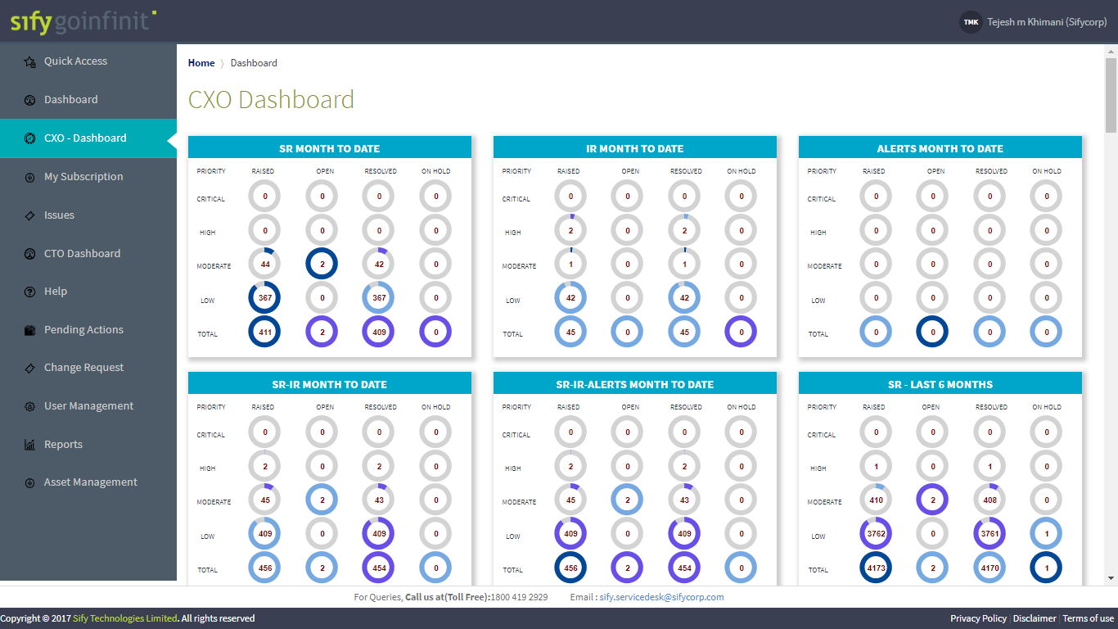
Sify CI multi-CMP: Integrated ITSM & Monitoring System
CMP is integrated with ITSM and Monitoring System for Service Assurance, Managed Services, SLA.
Cloud resources peered with Sify Monitoring systems for end-to-end observability.
Monitoring instance detects anomalies and raises automatic tickets in ITSM.
ITSM Service Requests & Incident Requests are integrated into Sify Multi-CMP.

Slide 12



Sify CI multi-CMP: FinOps Features
OBSERVABILITY
OPTIMIZATION
GOVERNANCE
Multi-cloud support
Both performance and cost data in one single pane of glass
Self-service backed by RBAC
AI/ML driven analysis for resource rightsizing
Comprehensive resource and service optimization and automation
Intelligent resource scheduling
Multi-cloud financial domains for budget control and chargeback
Effective cost allocation

Slide 13
Sify CI multi-CMP: Finops Customer benefits
Enable digital transformation with cost and performance controls. Faster time to decisions and remediations saving operational costs (OPEX) and improving profitability.
Savings ranging from 25 to 75% of total cloud spend.
Provide near real-time observability and visibility in (unexpected) cloud costs, wastes, and future trends for faster containment of cost sprawls.
Allow self-service amongst FinOps practitioners who now can manage at least 10x more cloud footprints.
Automate budget controls and policy implementations in federated organization structures, driving compliance and company policy adherence.
More…

Slide 14




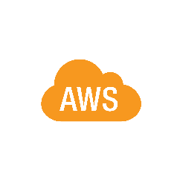

















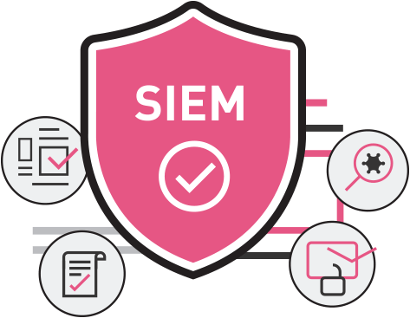


Sify hybrid multi-cloud Unified security management
Security Services Stack
for Sify DC & Cloud
Security Services Stack
for any cloud
Enterprise Cloud
Cloud native
Security services
VPDC FW
Services
Web App
Firewall
Network
IPS
VPN GW
Privileged Access Management
Vulnerability
Mgmt.
Cloud DDOS
Protection
Endpoint Detection & Response
Multifactor
Authentication
Log Mgmt.
SIEM

Slide 15
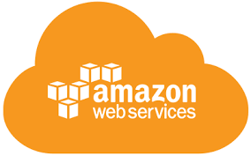
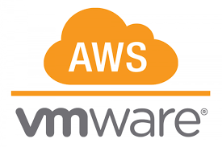
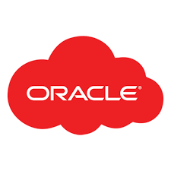
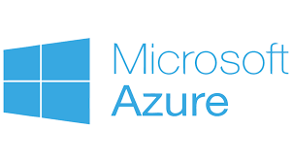

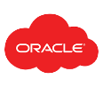


Sify Hybrid multi-cloud with cloud adjacency offering
Hyperscale Clouds AT VERY LOW LATENCY
Hybrid Cloud
RABALE DATA CENTER (Cloud Adjacent)
DC INTERCONNECT
Hybrid Cloud
Express Route
Direct Connect
Sify Cloud Connect
Colo + Managed Services
Hybrid Multi Cloud
Partner Interconnect
Far DR
Direct Connect
AIROLI DC ^{(Near Cloud / DR)} - Enterprise Multi Tenant Cloud ^{AT MINIMAL LATENCY}
Colo + Managed Services
Sify MULTI-CMP driven | AIOps Platform for Managed Services
FAR DR READY
Sify Enterprise Cloud
SAP GRID
ORACLE EXADATA
AZURE STACK
NEAR DR
Hyderabad Data Center
Business Benefits of Sify’s Cloud Investment
Best of breed performance with Hybrid Cloud configuration
Efficient integrations with extended ecosystems
Compliance with data sovereignty
Business continuity with resilience
Simplicity with self service
Operational efficiency with reduced IT administration
Cost reduction with
on-demand bursting to public clouds

Slide 16
Sify’s solution FOR different stages of customer cloud journey
Journey to cloud
Journey in Cloud
Modernization
Organizations considering Cloud adoption
Organizations in cloud looking for efficiency in operations & costs
Organizations in cloud looking forward to digital adoption
Challenges:
App stratification
Contract models- Reserve Instance & Pay as you Grow
Cloud model-IaaS/SaaS/PaaS/Public/Private
Visibility & Transparency
Cost control
Challenges:
Billshock- Increasing Opex due to excessive bills
Chargeback- Compensating more than expected
Multi-cloud management- Unable to manage multiple clouds from unified dashboard
Challenges:
App Modernization
Automation
Microservices
Cost control
Solution:
App assessment & rearchitecting
AI/ML led automation
DevSecOps & K8S
FinOps
Unified cloud dashbaord
Solution:
Assessment
Migration
AI/ML led automation
FinOps
Unified cloud dashboard
Solution:
FinOps
Unified visibility
AI/ML-Led Automation
Unified cloud dashboard
Cloud solutions have traditionally been optimized for centralized deployments
Distributed and verticalized use cases now drive cloud innovations with a demand for demonstrable business value
Sify Confidential

Slide 17






SIFY AS TRUSTED CLOUD PARTNER
A leading healthcare provider chose Sify’s Cloud@Core platform for the digital transformation of patient care services while saving 33% on cloud costs.
India’s largest power utility company chose Sify’s Cloud@Core platform with business-outcome-based model to scale their service to 25 million+ subscribers.
Sify’s integrated hybrid cloud solutions modernized 80% of the business applications of a retail giant with zero service disruption.
Global steel leader chose Sify to assess and migrate its business-critical SAP workloads to a hyperscaler at near-zero downtime.
Sify helps a life insurance major transform digitally with AI/ML, cloud-native applications, and modern DevOps toolchains by unlocking the power of hybrid cloud on a hyperscaler.
Ensured 35% TCO reduction and 3X performance to fast-track digital transformation and bring business resiliency to a major NBFC with multi cloud.

Slide 18
Thank You

Slide 19
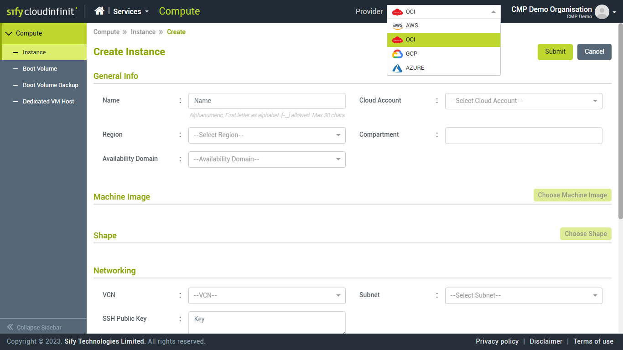
Cloud Resource Provisioning and Management
Simplified and consistence interface across the cloud providers to manage all type of cloud resources Network, Compute, Storage with minimal learning curve.
Private and Public Cloud resources can be created, modified and decommissioned from Sify CMP.
Guest OS customization post provision like OS-Hardening, Monitoring agent installation, configuration etc.
Instance information is updated in ITSM CMDB for resource life-cycle-management.
Back…

Slide 20
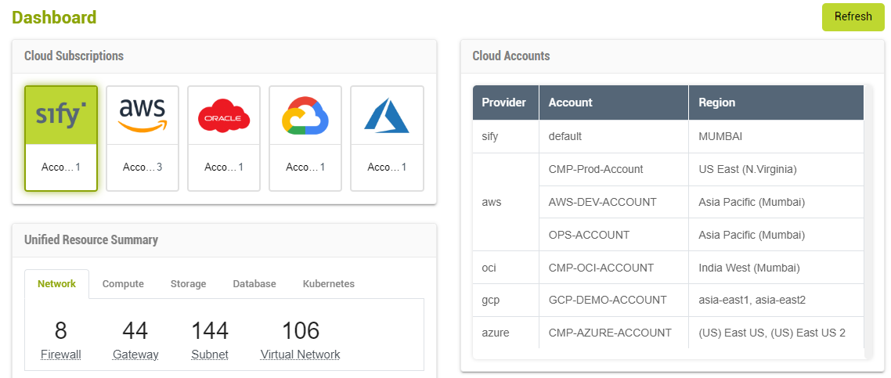
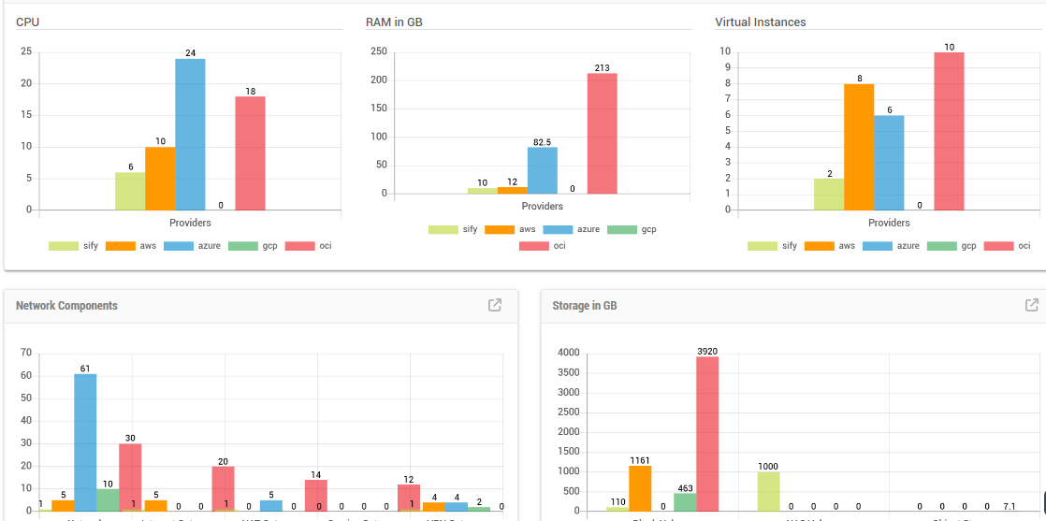
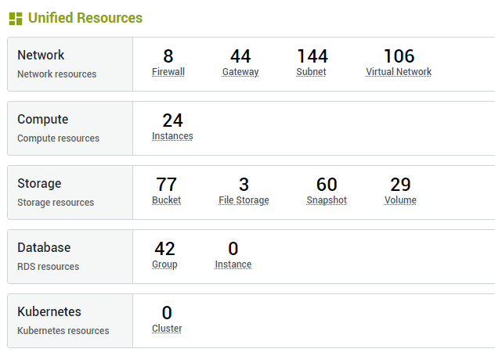
Cloud Visibility Dashboard
Summary view of resources provisioned across accounts, regions, and clouds
(Compute, Network, Storage, DB etc. )
Back…

Slide 21
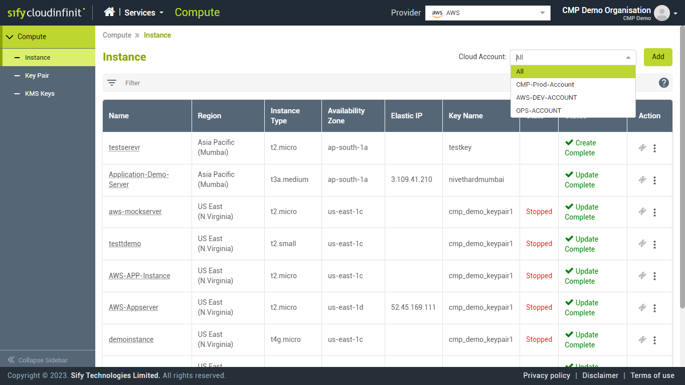
UNIFIED Interface Multi-CLOUD
Manage cloud multi-region, multi-account, multi-cloud distributed resources using a unified interface.
Consolidated view of cloud resource ex: AWS EC2 instances across all regions and AW’S accounts.
One interface to manage all cloud accounts with their operations like Start, Stop and Edit Tags.
View filter by region, by account, by attributes
Back…

Slide 22
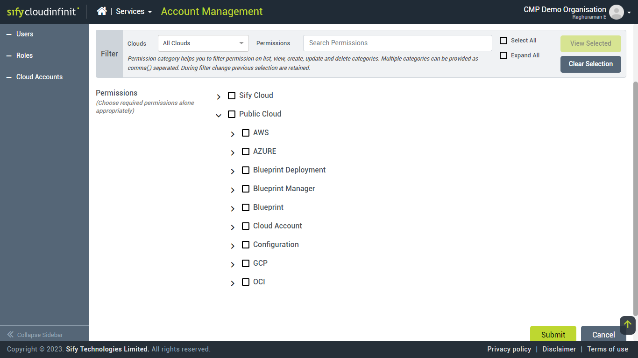
User Access Management
Role Based Access control for multi-cloud resources and its operations simplifies user access management.
Users are assigned with Role to control their access to resources across cloud.
For example, Multi-Cloud Compute Admin facilitates a user to manage all compute resources across clouds, but denies access to other resources like network, database.
Each type of resource access like Create, Read, Update and Delete are defined as a discrete permission.
Any kind of Custom Role can be defined by specifying set of required permission.
Flexible UI is provided to filter the permission set and choose them. Ex: Gateway lists all types of permission for Internet Gateway, NAT Gateway, Service Gateway etc across multiple clouds.
Back…

Slide 23
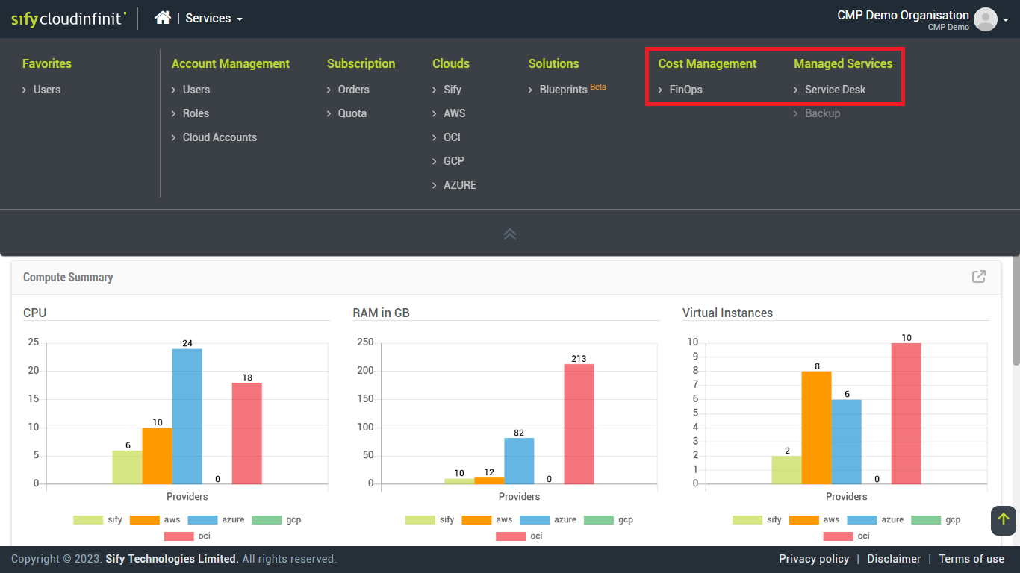
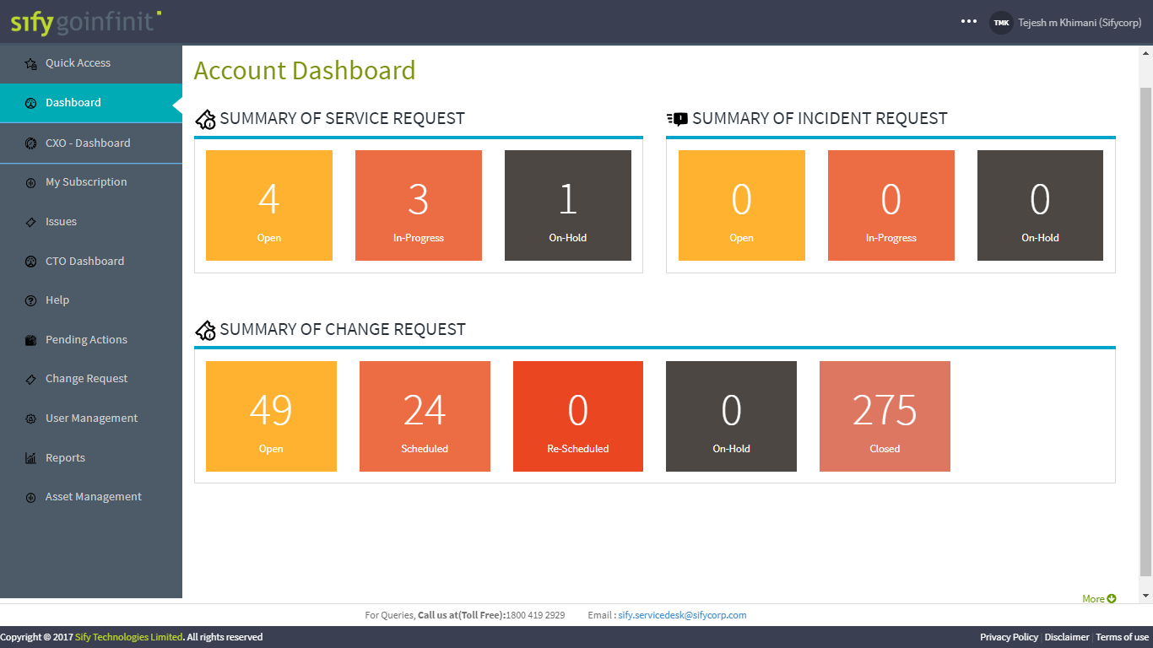
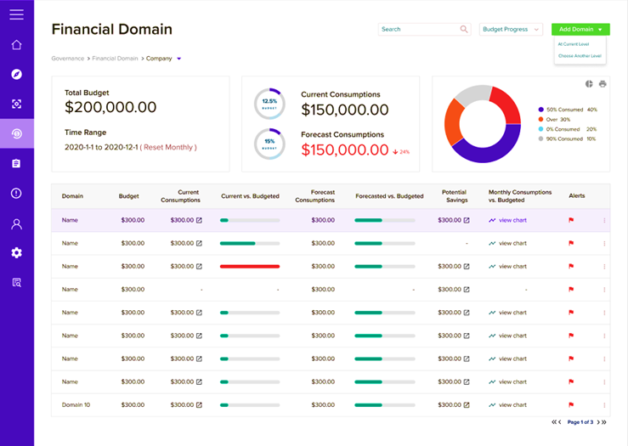
Single Sign On for CMP, FinOps & ITSM
Back…

Slide 24
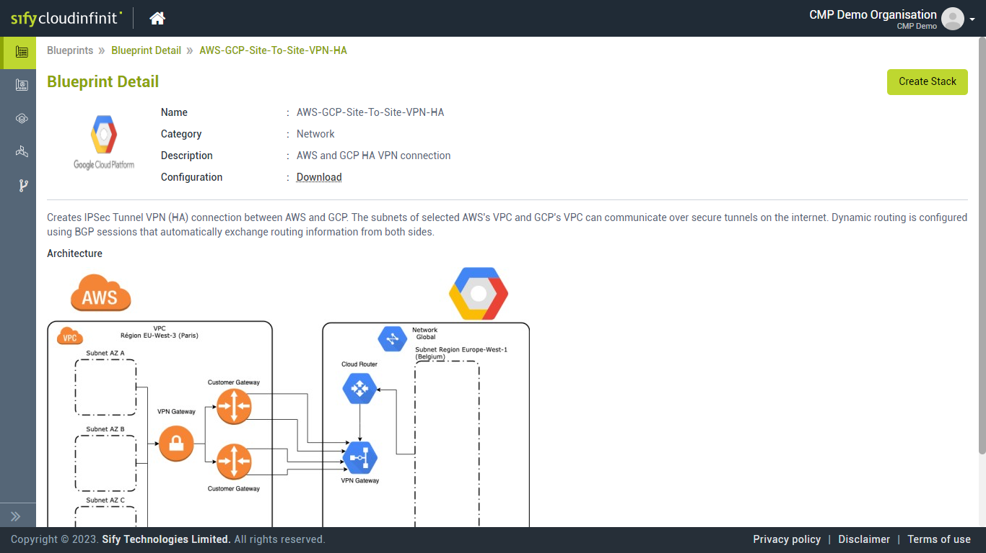
Sify CMP Blueprints 1/2
Predefined blueprint simplifies initial network configuration with appropriate access / firewall policies.
A predefined blueprint simplifies complex network configurations like Site-To-Site VPN Connections between two clouds.
Sify CMP Terraform Blueprint library will support to install, configure, and manage resources
Users can upload their custom blueprint in Terraform Syntax to deploy cloud resources in Sify-CMP
Back…

Slide 25
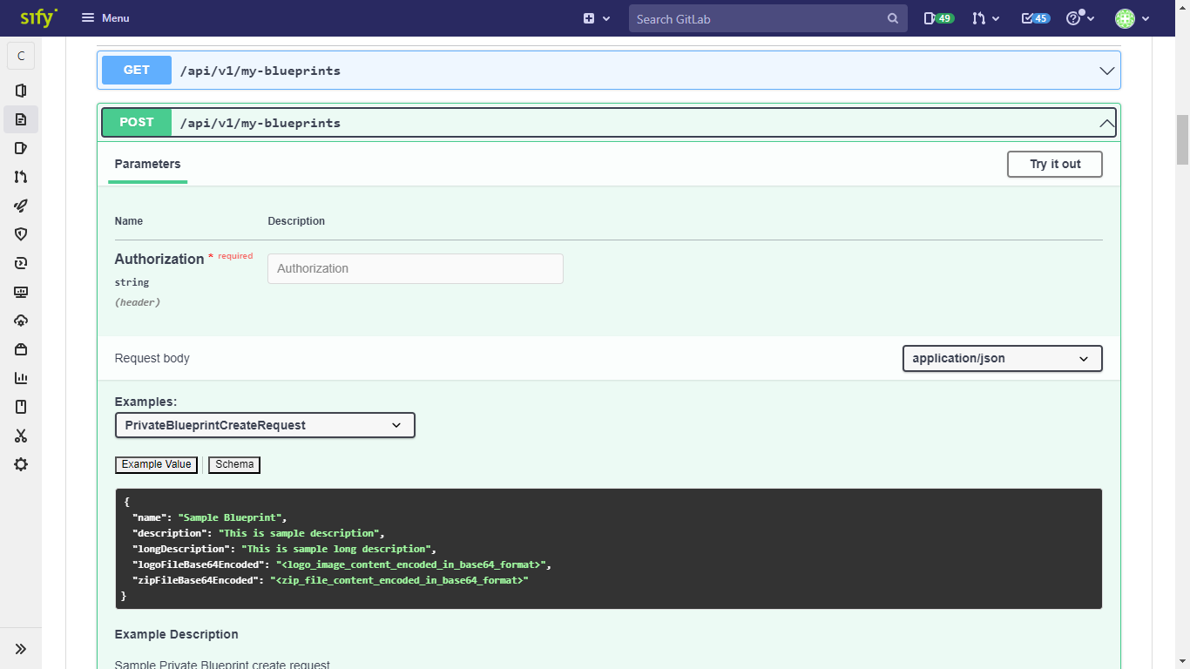
Sify CMP Blueprints 2/2
DevOps Ready Blueprint Deployment: Blueprints (Both predefined / custom) can be accessed using REST/JSON based API calls.
Life-Cycle activities like provision, update and decommission are supported by simplified API calls
Your CI/CD pipeline can incorporate Blueprint APIs for continuous delivery.
Your Git repository can be specified as a source for blueprint code instead of frequently updating and uploading the code.
Back…

Slide 26
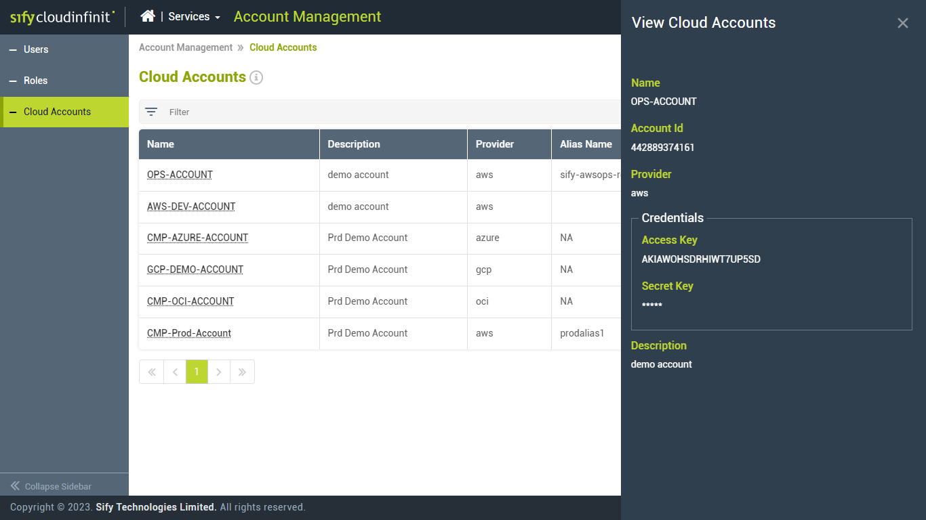
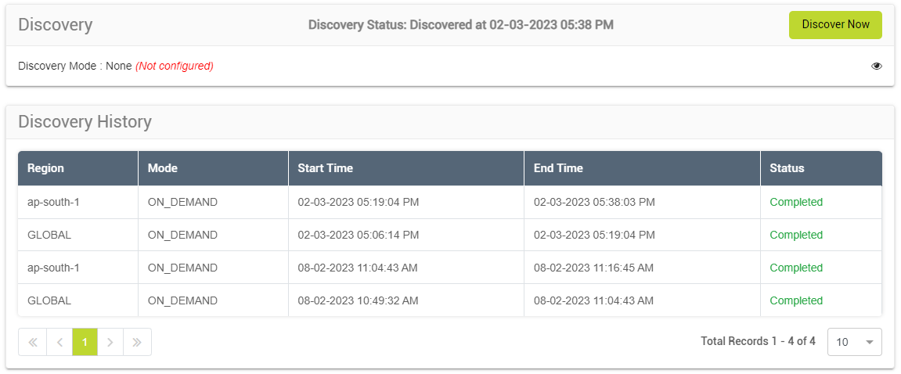
Account Onboarding, Discovery and ITSM
Bi-directional resource discovery for complete CMDB synchronization and resource governance.
For AWS Cloud, SNS Topic and subscription are created automatically to get notifications on any resource modification; For other clouds, CMP performs periodic discovery.
All resources’ current configuration is synchronized in ITSM – CMDB for Service-Assurance, and ticket functionalities.
Discovered resources are used to auto-fill input parameters in the blueprint provisioning interface.
Back…

Slide 27
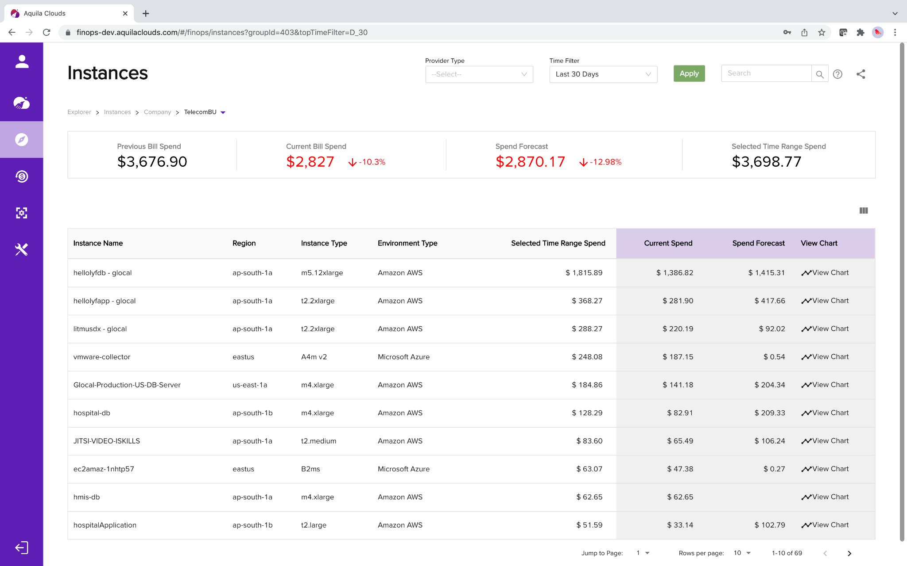
Real-time observability showing spending
Customer scenario: Cloud enterprise wants to understand their cloud consumption across different categories such as instances, storage, networking, containers, scaling groups, and services. In addition they want to understand how much cloud waste there is in each category. They used to use scripts and manual methods to figure these out, and each time it would take them months.
With Sify Multi-CMP FinOps
Large amount of pricing and utilization data are analyzed in real time showing cloud consumptions in instances, storage, networking, containers, scaling groups, and services.
Cloud waste in each category is also shown.
Users can also find cost trends and utilization trends for each resource in the drill-down.
Back…

Slide 28
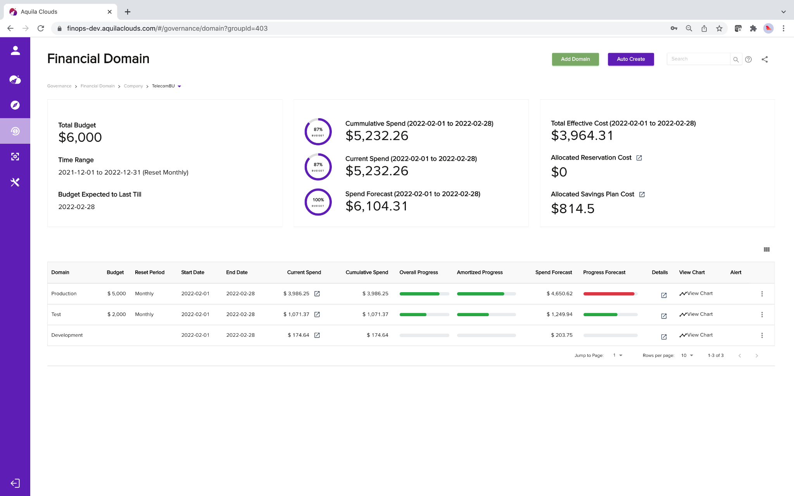
Chargeback and budgeting
Customer scenario: Government entity, which has many organizational sub-units, needs self-service reports for sub-unit level consumption for chargeback and budgeting analysis. They use multiple clouds, in particular AWS, MS Azure, Kubernetes, etc.
With Sify Multi-CMP FinOps
Administrator can easily group cloud resources (including Kubernetes constructs and cloud services) from multiple clouds using FinOps Financial Domain.
Each financial domain represents one organizational sub-unit, with chargeback/showback and budgeting capabilities. Shared cost allocation enabled.
Forecast of future consumptions.
Real-time budget alerts sent via emails or ticketing systems such as ServiceNow and PagerDuty.
Role-based control access allowing for organizational unit stakeholder(s) to self-service on FinOps to understand their consumptions and pay their share of cloud costs.
Back…

Slide 29
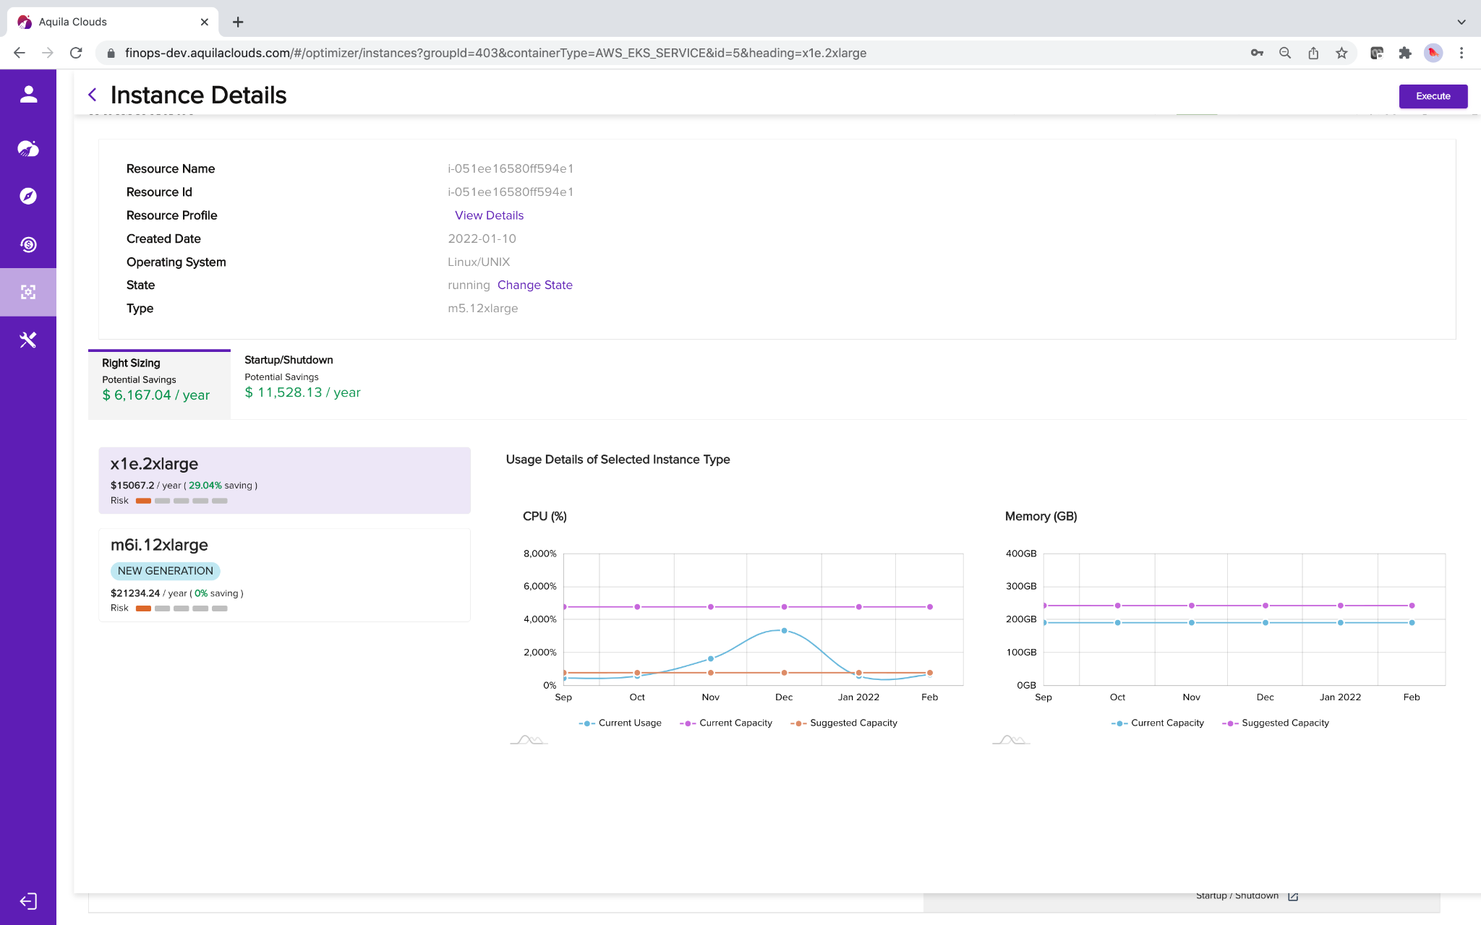
Rightsizing cloud resources
Customer scenario: After lift-and-shift from on-prem to the cloud, many cloud resources are over-provisioned. Cloud enterprises need full knowledge of utilization trends and recommendations to make the right decision.
With Sify Multi-CMP FinOps
Each instance has a few recommendations with risk level specified for rightsizing.
Users can make the determination by looking at the resource utilization trends over a chosen time period.
Rightsizing also applies to other cloud resources such as storage, containers, and more.
Back…
Notes:
Roku - $400K waste of storage per month
Glocal - % of savings for
T3 instance types -> AMD chip-set instance -> 30 - 40% of savings
ApTech - > 60% of savings

Slide 30
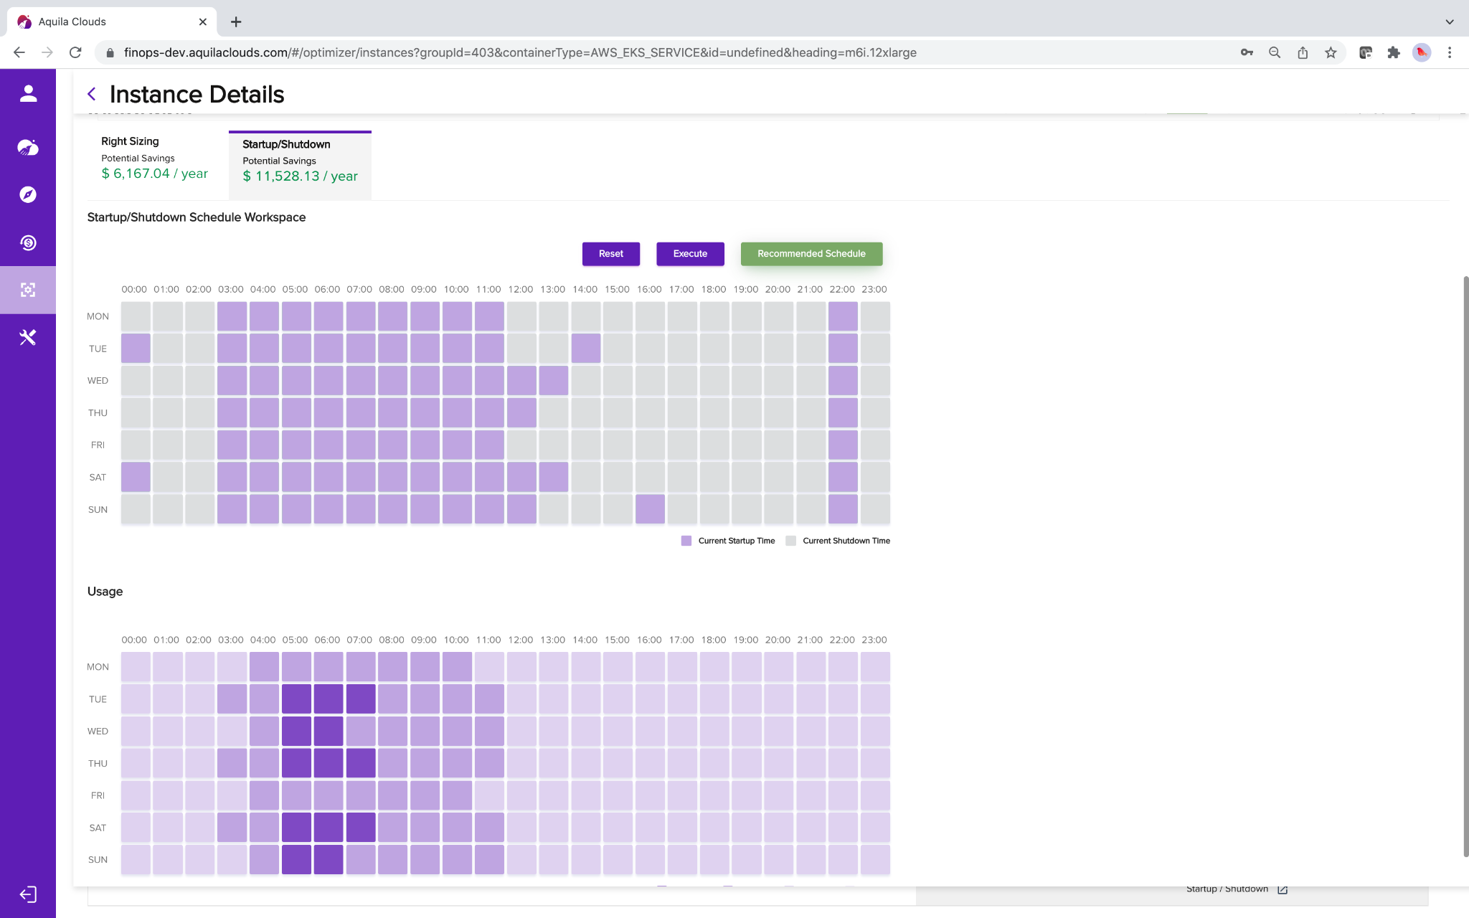
Save cloud costs on non-production environments
Customer scenario: The DevOps team leaves their non-production cloud instances on 24/7. Research shows that these instances are sitting idle about 76% of time on average. The company needs an automated way to start up and shut down the instances at proper times.
With Sify Multi-CMP FinOps
Our ML-based algorithms study the usage pattern of each of the instances and make recommendations for smart startup and shutdown schedules.
These startup and shutdown schedules can be applied on individual instances or a group of inter-related instances (Service Domains)
These schedules, once applied, automatically executes accordingly.
Home…

Slide 31

Sify Cloud transformation Framework
DISCOVERY & ASSESS
MIGRATE
SECURE
MANAGE
INNOVATE
Discover, analyze and right size the cloud applications
Choose the most relevant cloud service provider
4 R’s (Rehost / Rebuild / Rearchitect / Re-platform) for design
Optimally designed target systems
Zero or Near Zero downtime migration
Secured infrastructure meeting industry best security standards
Compliance to mandatory regulatory controls
End-to-end managed services
Integrated support across platform
Single point of management for Network, Security, OS, DB, Application & Backup
Improved support experience
Better SLA
Skilled in mobility, analytics, app modernization and AI/ML
Latest technology stack
Consultation across business IT services
Proactive technology management
Customer Objective
Facilitate smooth migration and enhance overall experience to the cloud infrastructure
Experience on assessment tools like Cloud native, infra, Cloud natural
Low-risk and high-return cloud migration strategy
Leverage expertise in Hybrid Multi-Clouds deployments with On-prem to private, hybrid, public cloud & Sify Enterprise Cloud
Experience on migration tools like CloudEndure, Carbonite, ASR etc.
Utilize established security practices
Shared SOC services leveraging experience of enterprise customers to provide cost competitive solution
Enable security controls as a service
Leverage ITIL based support experience
Utilize investment in monitoring & management tools: CA , Zabbix & ITSM Tools: Service Now
Provide SLM to improve customer experience
Ensure availability, auto-scale/right-scale, periodic recommendations
Automate predictable operations and evolve into AIOps for managing defects
Use Own IP on Sify multi-CMP a multi-cloud management platform to add more services
Be a single strategic partner in customer IT journey
Sify Solutions

Slide 32

Thank You

