Slide 1
Managed
network services Platform
April 2023

Slide 2






Business trends
and Sify’s vision
TREND 1
TREND 2
TREND 3
Technology
MS stack
Operators’ need for agility and innovation in new services
Quickly introduce new service based on emerging use cases and network architectures
Customer Experience: Intelligence and Automation in Service
Management
Need to provide self healing network services
Digital infrastructure transformation
Cloud transformation, telco-cloud, SDN, NFV, Network slicing
Team
Expertise
Vision
Transformational
services
Continue to lead the industry with a manage services portfolio that combines an open, flexible and scalable managed services stack and Sify engineering expertise in customizing and providing value add services to its customers
Notes:
Business trends heading an below content to go together and then Sify vision with the text below

Slide 3








Considerations for NextGen Managed Network Services Platform
Horizontal & Vertical scale
Flexible & Modular
Dynamic Integration
Secure by Design
Ability to easily add and managed new services and scale horizontally
Scale vertically and support fulfillment, assurance and service monitoring on new services with agility
Support a flexible set of Service Management functions through modular approach
Provide customization through dynamic and easy integration with third party tools and environments such as AI ops, IT ops and Sec Ops
In built security against vulnerabilities
Observability
Automation
Self heal
Digital Experience
Rich telemetry and data aggregation capabilities for providing and supporting observability tools , quick alerts and diagnostics
Provide automation across service fulfillment, service assurance and service monitoring
Reduce the cost of the optimization
Closed loop automation and self healing capability
Ability for end user to visualize network behavior and provision on-demand

Slide 4



MNS framework: big picture
Digital Store Front
(Automated Customer and Business Management)
APIs layer
federated
partners
End to End Service Management
Service Orchestration
Service Intelligence
Service Assurance
Sify’s Approach :
Enhanced efficiencies through
Close
Loop
Intelligent Automation
s
Integration layer
Network Management Domain
Data Services
Orchestration
Intelligence
Assurance
Control
Adaptation layer
s
Physical
Infrastructure
Virtual Infrastructure
Telco-cloud
Infrastructure

Slide 5




Key Attributes of Sify’s MNS Platform
Automation
Scalability
Flexibility
Digital CX
Sify MNS platform reduces the complexity of monitoring, managing and remediating network services while automating through intelligence and insights from network operations.
Sify platform is designed to scale horizontally to support new services and vertically to support Automated Service Assurance while monitoring for new and existing services.
Sify’s MNS platform is designed in a modular structure to support easy customization and integration with existing network operations.
Sify MNS platform comes with fully integrated Automated Customer Issue management with enhanced digital experience supporting features such as dynamic provisioning and service insight dashboards.
Notes:
MNS platform has 4 major attributes –
Intelligent Automation
Scalability
Flexibility
Enhanced Customer Experience

Slide 6
Sify’s managed Network services architecture
Service Desk
Sify Portals
ITSM
Integrated DX Layer
E-BONDING
federated
partners
Incident
FSM
Asset Mgmt.
Dashboards
Insights
Self Service
Problem
Service Req
Preventive
CMDB
Change
Workflows
3rd party Dash boards
Automation Interface
Service Analytics
Service Orchestration
Service remediation
Sify’s Intelligent Event Aggregation, Correlation, Prediction and Integration layer
Network
Configuration
Network
Remediation
Network
Analytics
Third party Telemetry Platform
(TE or similar)
Data Aggregator
Events, Alarms, Data, Config
Sify’s Adaptation layer
Metric Data, SNMP, Logs, NetFlow
Metric Data, SNMP, Logs, NetFlow
Physical
Infrastructure
Virtual Infrastructure
Telco-cloud
Infrastructure

Slide 7
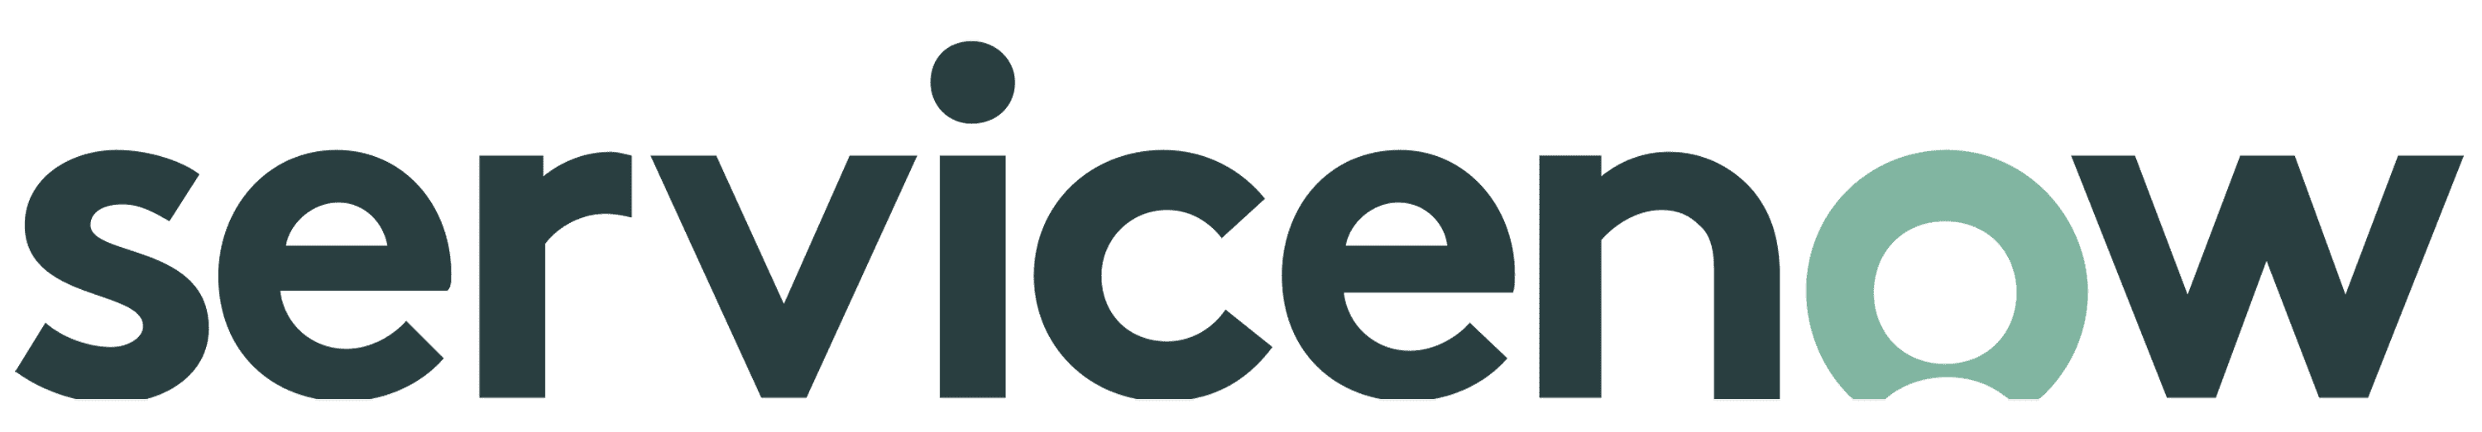


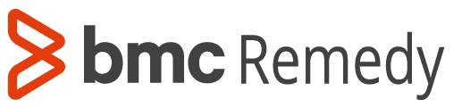
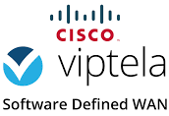
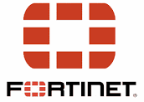





Flexible tool options for custom deployments
Service Desk
Sify Portals
ITSM
Integrated DX Layer
E-BONDING
federated
partners
Incident
FSM
Asset Mgmt.
Dashboards
Insights
Self Service
Problem
Service Req
Preventive
CMDB
Change
Workflows
3rd party Dash boards
Automation Interface
Service Analytics
Service Orchestration
(NSO or similar)
Service remediation
Sify’s Intelligent Event Aggregation, Correlation, Prediction and Integration layer
Network
Configuration
Network
Remediation
Network
Analytics
Third party Telemetry Platform
(TE or similar)
Data Aggregator
Events, Alarms, Data, Config
Sify’s Adaptation layer
Metric Data, SNMP, Logs, NetFlow
Metric Data, SNMP, Logs, NetFlow
Physical
Infrastructure
Virtual Infrastructure
Telco-cloud
Infrastructure

Slide 8






Sify MNS Platform: key modules
Multi-source Data aggregation
Service Orchestration and Automation
Predictive Learning
Data aggregation module that collects metrics, alarms and events from various network sources
Also supports APIs to interface to external telemetry systems and data aggregators
Workflow automation
Service scaling using BOTs
Self service automation tasks
Machine learning based systems to reduce noise, increase focus and aid in Root cause issues
Continuous learning systems augmented with human knowledge and context.
Predictive Analysis based on past data
ITSM Integration and Process Automation
Network Configuration and
Auto-remediation
E-Bonding and CX
Service management systems to deliver ITSM compliant service
Integration with NOC tools
Automation integration between service and networks
IT Asset Life Cycle Management
Support for configuration, revision control, comparisons and rollbacks
Automate look-up and remediation of known issues
Integrated and automated workflow across several service providers’ ITSM systems
Support for dynamic and on demand service change requestions

Slide 9


Sify MnS Platform: multi-source data aggregation
FUNCTIONALITY
CUSTOMER BENEFITS
Event Aggregation
Data Collection from different sources
(Network, Managers, other data streams)
Data capture from multiple data steams such as
SNMP, Log, NetFlow, API, etc.
Multi-cloud data gathering
Unified monitoring of distributed networks
Monitoring hybrid environments
Integrate with existing stacks

Slide 10
Sify mns Platform: auto-remediation
FUNCTIONALITY
CUSTOMER BENEFITS
Automating initial diagnostics
Pre-built libraries for known issues
Automating frequent changes in the network
Advanced Network Performance monitoring
for auto-remediation
Close loop automation
Increase in first level resolution
Reduce people dependency
Faster incident resolution
Security: Immediate action for various vulnerabilities
Network Consistency through pre-defined workflows
Play Video

Slide 11
Sify mns Platform : event correlation and prediction
FUNCTIONALITY
CUSTOMER BENEFITS
Event correlation using network topology and relationships
Anomaly Detection, Event suppression & deduplication
Event/Alarm clustering and grouping for predictive analytics
Rule based suppression of subsequent events of same incident
Unsupervised learning and anomaly detection through dynamic baselining
Probable root causes
Reduce MTTR due to quick identification of issue
Control complexity through Noise reduction
Predict outages
Capacity management
Play Video

Slide 12
Sify mns Platform: network configuration & change automation
CUSTOMER BENEFITS
FUNCTIONALITY
IOS upgradation process include precheck,
image copy, device reboot
Security vulnerability validations and configuration
changes as per standards
Golden template comparison and alerting
Config audit, comparison & differences
Bulk config backup push for any mass changes
Enforcing policies and config standardization
Security: Immediate action for various vulnerabilities
Network Consistency through pre-defined workflows
Compliance, Control and visibility
Efficient Change Management

Slide 13
Sify mns Platform: process automation
FUNCTIONALITY
CUSTOMER BENEFITS
ITSM to FSM Integration
First level remediation insights to engineer
for quick resolution
Order Fulfillment – Full Life Cycle
Service Requests for New WAN Commissioning, Upgrades, Downgrades
Asset Allocation
WAN / Device deployment and testing
Management System onboarding
Configuration validation through RPA
Increase in first level resolution
Reduce people dependency
Faster incident resolution
Security: Immediate action for various vulnerabilities
Network Consistency through pre-defined workflows
Play Video

Slide 14
Sify mns Platform: e-bonding
FUNCTIONALITY
CUSTOMER BENEFITS
Seamless ticket flow to disparate service providers’ ticketing system
Enhanced visibility and monitoring of incident status from other service providers
Integration with customer service management systems
ISP Rating
Fast resolution time on incidents
Better risk management and pro-active risk mitigation
Integrated customer service desk will enable end-to-end monitoring and control
Reduces human dependencies for creating, updating, resolving tickets between disparate ITSM systems
Play Video

Slide 15
Sify MnS Platform: Digital cx onnet and aakash
FUNCTIONALITY
CUSTOMER BENEFITS
Self service portal and on-demand provisioning of network services
Zero touch provisioning
Real-time control and visibility on network service
Unified view of customers’ mission-critical network and assets
Customized views and dashboards
Incident Management, Service Requests, Knowledgebase,
Escalation Management
Utilization Trends, Network Performance Reports,
Network Health Dashboards
SLA Management
Always available access to services enabling customers to change their service requirements with immediate turn-around times
Reduce costs for customers by eliminating the need for customer service representatives to handle routine inquiries and transactions
Utilization trends, network performance and health dashboards can help identify customer experience impacting issues and take corrective action
Play Video

Slide 16



CASE STUDY: STATE BANK OF INDIA
PROJECT SCOPE
CRITICAL SUCCESS FACTORS
Creation of the NOC, associated tools and manage the field operations
Consultancy for procurement of new solutions and their management
Management of existing solutions
Ability to visualize the relationship between various elements of the
project & orchestrate efforts
Transition an in-flight operation with minimum disruptions
Ensuring improved service levels & CSAT
Project governance
People
Processes
Tools
265 onsite NOC resources
740+ dedicated field support resources
22 Countries, 112 Foreign Offices – on-call support
Executive Sponsorship
Governance
Agility
Problem Solving

Slide 17
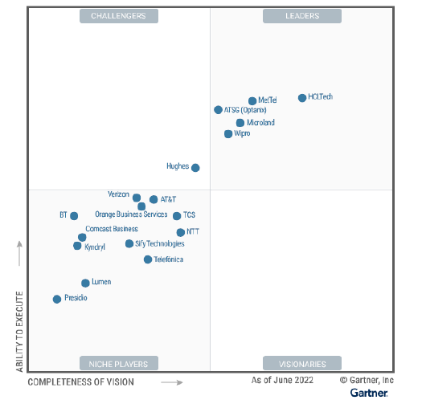
SIFY is a recognized contender among mNS leaders
As a niche player, Sify continues to provide unique value adds to its customers
Sify’s innovation driven managed services tech stack that continues to differentiate and improve customer outcomes
Sify’s thought leadership and expert consulting to augment managed services
Sify’s enviable position in the industry with world class expertise in emerging networking services
Sify Technologies
Sify is a Niche Player in
Gartner’s Magic Quadrant for MNS 2022

Slide 18

Thank You

