Slide 1
“Helping you achieve your digital ambition”
Sify Infinit Spaces
Data Center Services
April 2023

Slide 2
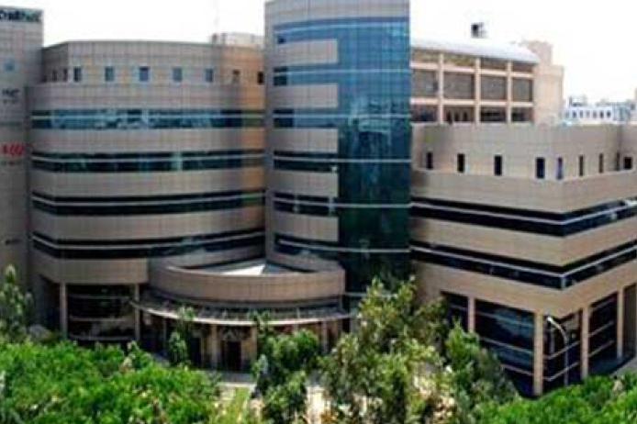
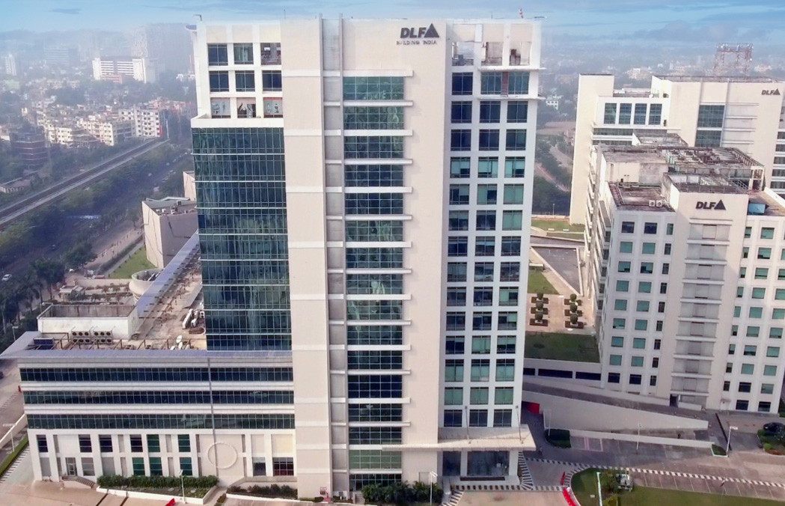
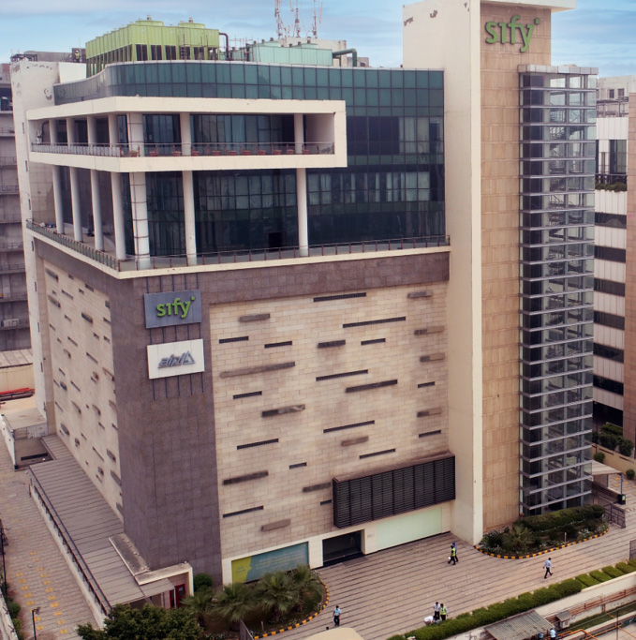
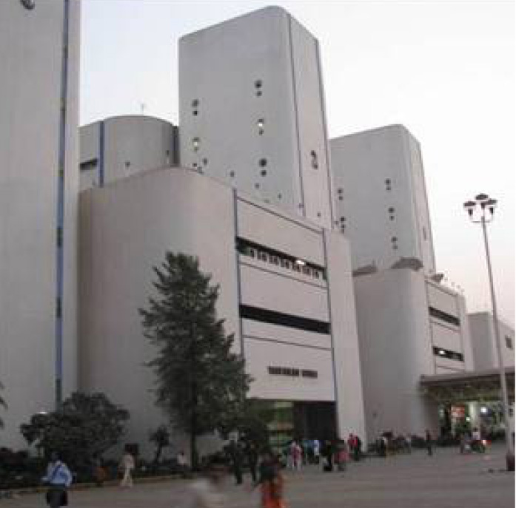
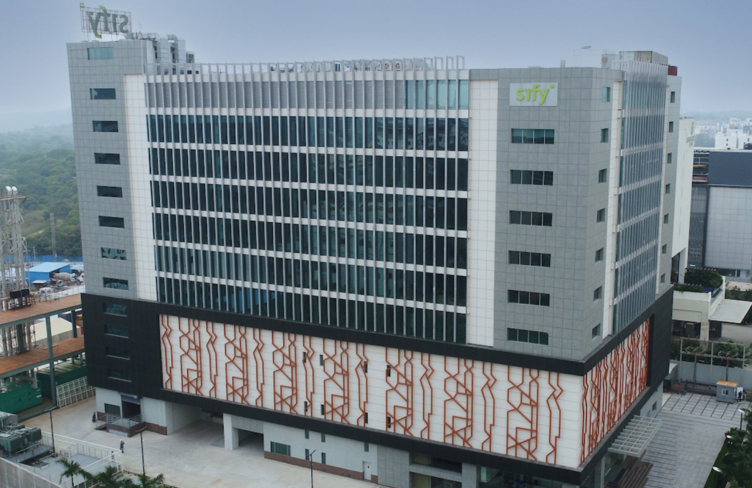
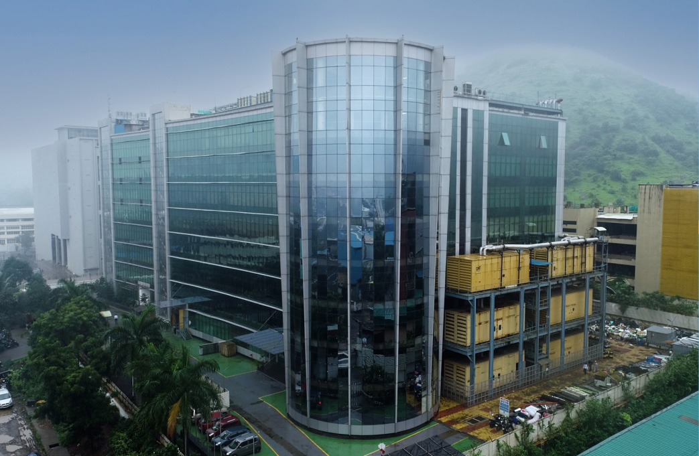
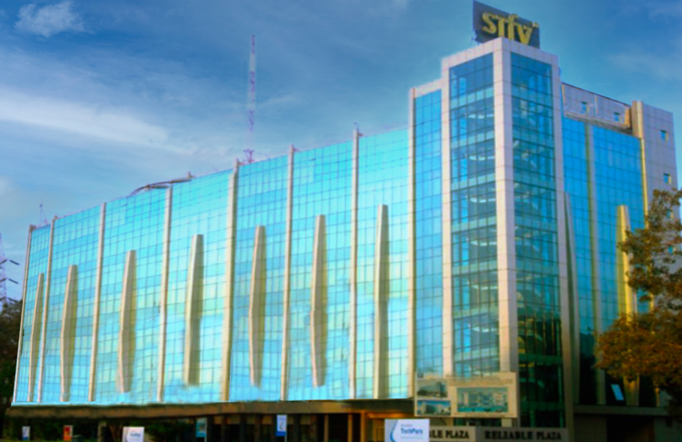
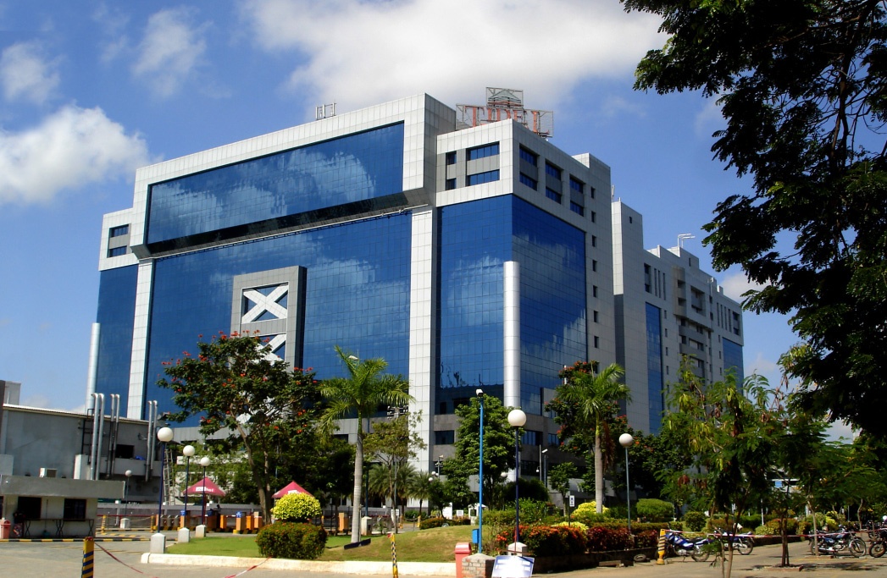
PAN INDIA DATA CENTER FOOTPRINT
BENGALURU
KOLKATA
NOIDA
VASHI MUMBAI
HYDERABAD
RABALE MUMBAI
AIROLI MUMBAI
CHENNAI

Slide 3


Recent developments
Next Gen Organization
Next Gen Data Center Services
Restructuring of Sify business into 3 separate entities
New investment of $133M (Equity & Debt) in Sify Infinit Spaces Ltd (SISL) to support $500+M Data Center expansion plan
Data Center Expansion in Mumbai, Delhi (NOIDA), Chennai, Hyderabad, and Bengaluru
(Data Center Campus development in all 5 cities)
Additional 350+ MW IT capacity over next 4 years
200 MW Renewable energy contracted; ~500MW planned to meet long-term sustainability goals
Al/ML based Automation for ease of operation, faster decision-making, avoiding human errors

Slide 4














SIFY DATA CENTERs - AN OVERVIEW
11 Pan-India Data Centers with 100 MW IT Power
Multi & Hybrid Cloud Operations Center
To Add 350+ MW capacity by 2025
600+ Premier enterprises hosted in Sify DCs
India’s trusted
Data Center Provider
200 MW Renewable energy contracted
22 years of experience serving all segments
Rich Interconnect Ecosystem
Truly Carrier-Neutral
Built to Suit capabilities
Continued investments in automation and smart BMS
Notes:
We are trusted
Then on colocation – on operational efficiencies, process oriented,
Change this to the value prop (Shombit to work on a diagram etc)

Slide 5
SIFY - Your trusted data center partner
Mission Critical Customers
22 years Operational Experience
Future-ready
Data Centers
Trusted
Partner
3 out of 4 Hyperscalers
Global OTT & social media players
India’s top 5 banks
India’s largest digital wallet
600+ customers across all major industries
99.999% uptime
Best Practices covering Safety, Security, Availability, Excellence and Cost Control
PUE & WUE prediction and optimization
Certifications: Information Security, EHS, PCI-DSS, SOC 1 SOC 2
Next Gen Data Center design
ML/AI platform enabling faster decision-making
Operational efficiency monitoring and automated reporting
Up to 79% Green Power available
Reliability for services
Flexibility for customer requirements
Scalability for future business growth
Fast track your digital transformation with agile, resilient, digital ready IT infrastructure

Slide 6

SIFY DATA CENTERS - INDIA FOOTPRINT
NOIDA 02 CAMPUS
Tower B
26 MW
Q4 2023
NOIDA 01
Noida
10.8 MW
Tower A
26 MW
Tower C
26 MW
Tower 1
11.5 MW
Tower 2
9.6 MW
Tower 3
BTS
MUMBAI 01
Vashi
0.9 MW
KOLKATA 01
2.2 MW
Tower 4
8.1 MW
Tower 5
38.8 MW
Q3 2023
Tower 6
26 MW
Q4 2024
Tower 7
20-30 MW
Q1 2025
Tower 8
20-30 MW
Tower 9
20-40 MW
HYDERABAD 02 CAMPUS
(FAB CITY)
MUMBAI 02
Airoli
5.4 MW
HYDERABAD 01
Financial Dist.
14.4 MW
MUMBAI 03 CAMPUS (RABALE)
Block 1
26 MW
Q4 2023
Additional Blocks
26-52 MW each
(including BTS)
BANGALORE 02 CAMPUS (AEROSPACE PARK)
BANGALORE 01
Electronic City
4.0 MW
Tower 1
20 MW
CHENNAI 02 CAMPUS (SIRUSERI)
CHENNAI 01
Tidel Park
3.6 MW
Tower A
26 MW
Q4 2023
Tower B
26 MW
Tower C
26 MW
Operational
In Development
Planning
All Power references are Design IT Power at Full Capacity
All Power references are Design IT Power at Full Capacity
This is copyright material and limited to the purpose it is currently serving
Notes:
Here are the key benefits offered by Sify’s Data centers.
Sify has over 20 years of experience in building, owning, operating pan-India Data Centers.
Sify has 9 operational Datacenters, with over 50 MW IT Power in 6 key cities; it has a roadmap to add 100 MW over the next 4 years.
Sify has 45 PAN India Edge Nodes, bringing content closer to consumers.
Sify offers a truly carrier neutral connectivity with more than 90% fiber links from non-Sify Providers.
Sify offers a Rich Interconnect Ecosystem across multiple Hyperscale Cloud Providers, multiple Internet Exchanges, Content Peering Nodes & ISP Interconnect.
Sify offers Metro cross-connect services between Data Centers within Mumbai & Delhi NCR.
Sify has a roadmap to augment 100+ MW IT power via new Hyperscale campuses, over the next 4 years.
Experience
The most experienced data center Colocation operator in India
Over 20 years of data center experience in India
9 concurrently maintainable data centers with 58.23MW critical IT capacity
Mature data center operations framework and processes
SLA performance on power availability of 100% over last 10 years
Global Data Center Design
Committed to continued expansion based on latest global design standards
Power-centric modular design to meet global standards and flexible requirements
3 new DCs commissioned in 2019; roll out in progress for 3 DCs; 7 more in planning
Future builds: Hyperscale-ready DC campus for next generation requirements
44 widely-distributed redundant mini-DCs enable network aggregation solutions
Robust Network Ecosystem
Highly interconnected data centers with extensive network access options
100% carrier neutral data centers; over 15 telecom service providers and 50 ISPs
Cloud Connect - Unified high-performance network fabric connecting 47 major DCs to the cloud
Internet exchange enables cost-effective peering for content providers, ISPs, cloud providers

Slide 7
CITY-WISE BUSINESS VERTICALS AND DRIVING FACTORS
© Sify Technologies Ltd - Confidential

Slide 8
MUMBAI city
Business Verticals
Driving factors
About Mumbai
Financial capital of India
BFSI
E-Commerce and Retail
Media & OTT
Hyperscale Data Center
A true Global city with GDP (PPP) of $606 billion with 9.1% growth Rate (2021).
Major Contributor to India GDP which is currently average of 6.16%
Hub of all Banking and Financial Institutions, Major stock exchanges
Largest Media & Entertainment hub,
Major retail companies, Hospitality & services industry
Direct & easy access to EHV power grid for stable power in last 10 to 12 years
8 Cable Landing Stations in Mumbai driving trans Atlantic traffic to NY & LA
Hyperscale Compute & network nodes, OTT players, e-Commerce players
Diverse local and international IP transit
Choice of multiple Data Centers within city for Availability Zone / Near DR
Compliance to security requirements like ISO 27001, PCI-DSS
Travel & Tourism

Slide 9
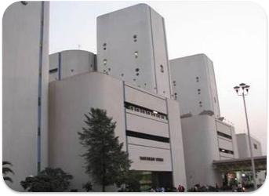
SIFY Mumbai 01 DATA CENTER – vashi
First Commercial Data Center to offer Colocation as a Service in India
Addressing Near DR solution with latency <1ms with Airoli and Rabale Data Center
Close proximity to NIXI POP, its 1 floor below Sify Data Center
Customer gets low latency ISP peering and reduced international hops
Located in the Commercial hub of Navi Mumbai
VAT 251, Infotech Park, 5th Floor, Tower 2,Vashi Railway Station Complex Navi Mumbai - 400 703

Slide 10
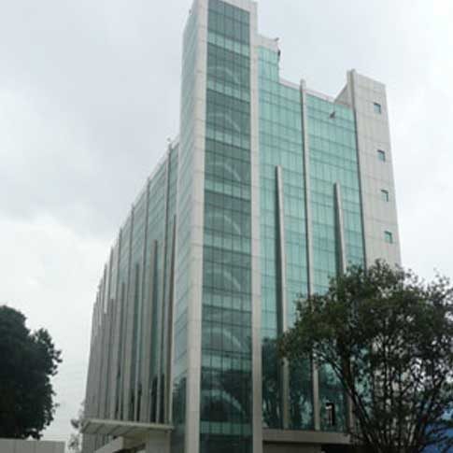
SIFY Mumbai 02 DATA CENTER – airoli
Addressing biggest market segments like BFSI, E-Commerce & Retail, Media & Ent
Facilitates Private Cloud/Hybrid cloud Platform
Major portion of the Data Center will be a private cloud deployment
Near DR for Data Center projects
Failover to public cloud services (Airoli- Rabale as Data Center and near Data Center site) with <1ms latency
Reliable Plaza, K10,Thane Belapur Road, Navi Mumbai -400710

Slide 11
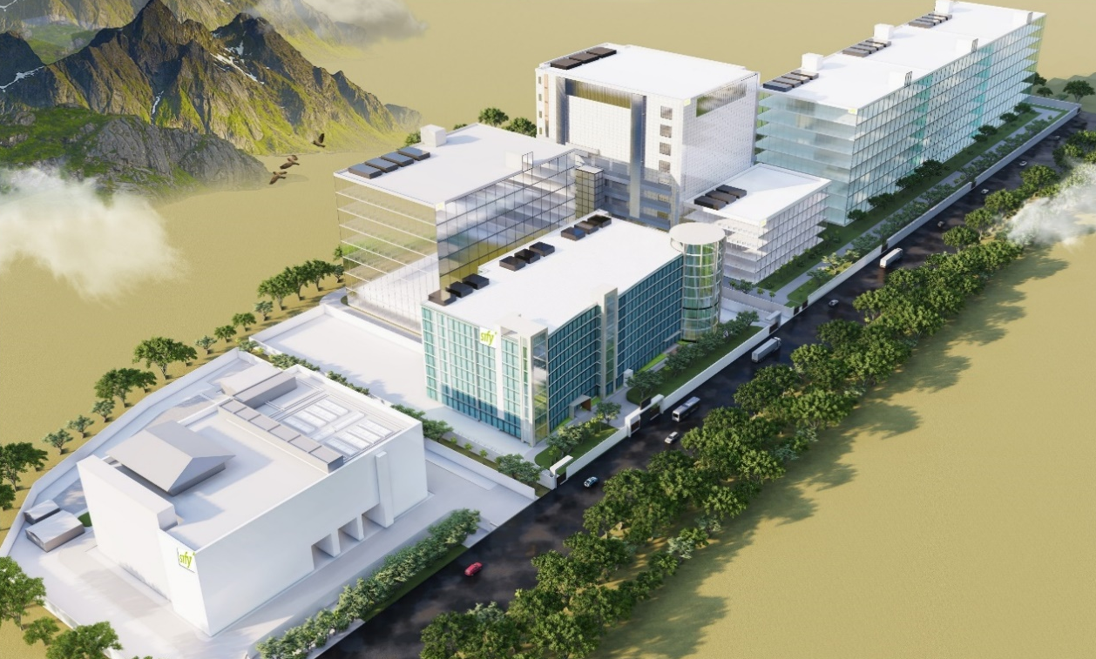
SIFY Mumbai 03 mega data center campus – rabale
10
8
7
Tower No. | Status | MW IT Capacity | RFS
1 | In Operation | 12 | Live
2 | In Operation | 10 | Live
3 | In Operation | BTS | Live
4 | In Operation | 8 | Live
5 | Construction | 38.8 | Aug-23
6 | Permitting | 26 | Q4 2024
7 | Permitting | 26 | Q1 2025
8 | Design | 20-30 | 2025
9/10 | Design | 20-40 | 2026
5
6
9
4
1
2
Sify’s MUMBAI 03 mega campus supports a robust ecosystem of multiple Hyperscalers, Network Nodes, Enterprise Customers, IP Exchanges, and ISPs scalable up to 200MW IT capacity​
Dedicated 100 KV and 220 KV substations for
high availability power
Up to 79% renewable Energy
Cloud onramp to 3 cloud providers
3
Plot No. R-847 , T.T.C Industrial Area, Rabale, Navi Mumbai, 400 701 | 73°0'50.96''E 19°8'49.83''N

Slide 12
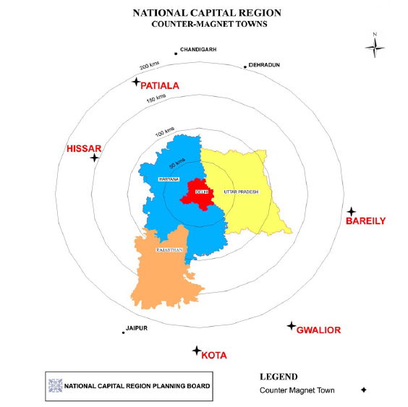
DELHI (NATIONAL CAPITAL REGION)
About Delhi/NCR
E-Governance and smart city projects
Delhi (NCR) has a GDP of $ 272 billion (2021)
Upcoming civil Infrastructure is a big driver in Noida
Driving factors
SEZs and Industrial hubs.
OTT players, network nodes, CDN
Manufacturing & Automobiles are major business
Government and Public Sector Companies
Highest number of regional eyeballs in the country,
As per the 2021 master plan, the National Capital Region
surrounding regions will be in focus for high investments
Business Verticals
Government
Public Sector companies
Automobile and ancillary
Manufacturing
OTT, CDN and Content providers

Slide 13
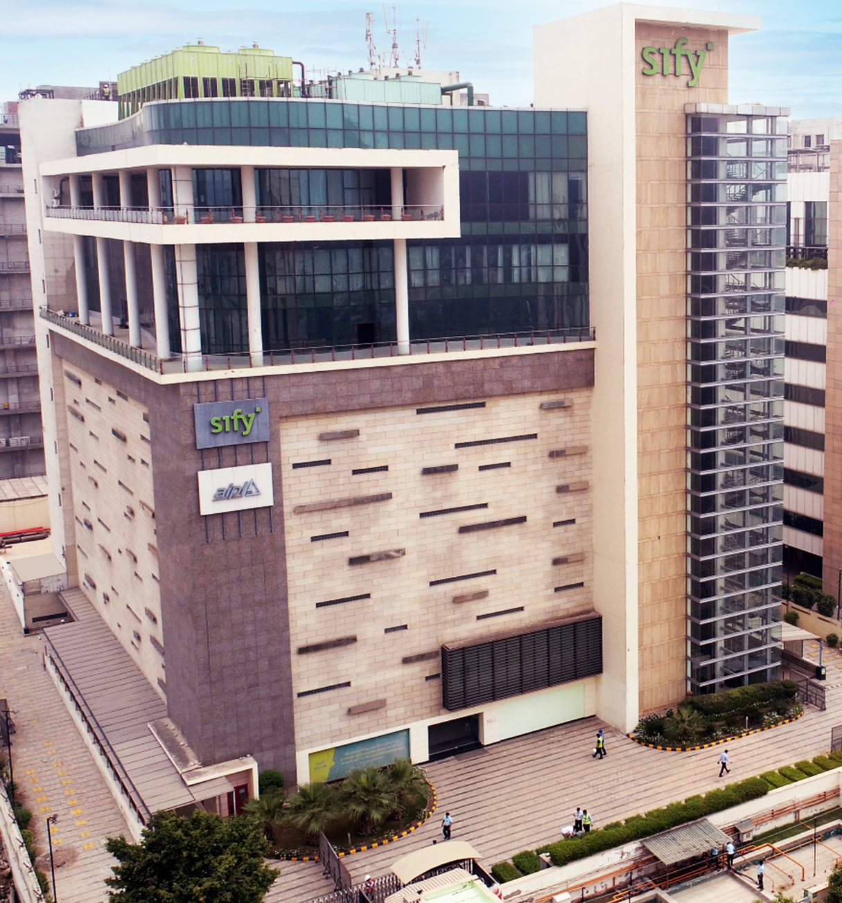
SIFY noida 01 DATA CENTER
Highly Interconnected Data Center in North India
Cloud connect nodes (Hyperscaler presence)
Cloud Adjacency to Hyperscale Clouds for very low to minimal latency
Wide range of customer business vertical deployments
Connect to NOIDA 02 via robust 4 path network
OTT, ISP and Internet Exchanges, Multi telecom eco System
Plot No. B07, Sector 132,Gautam Budh Nagar, Noida - 201 301 UP, India

Slide 14
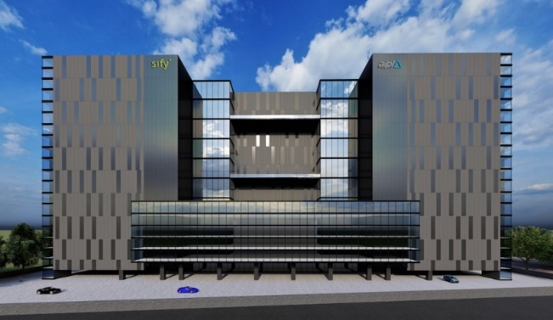
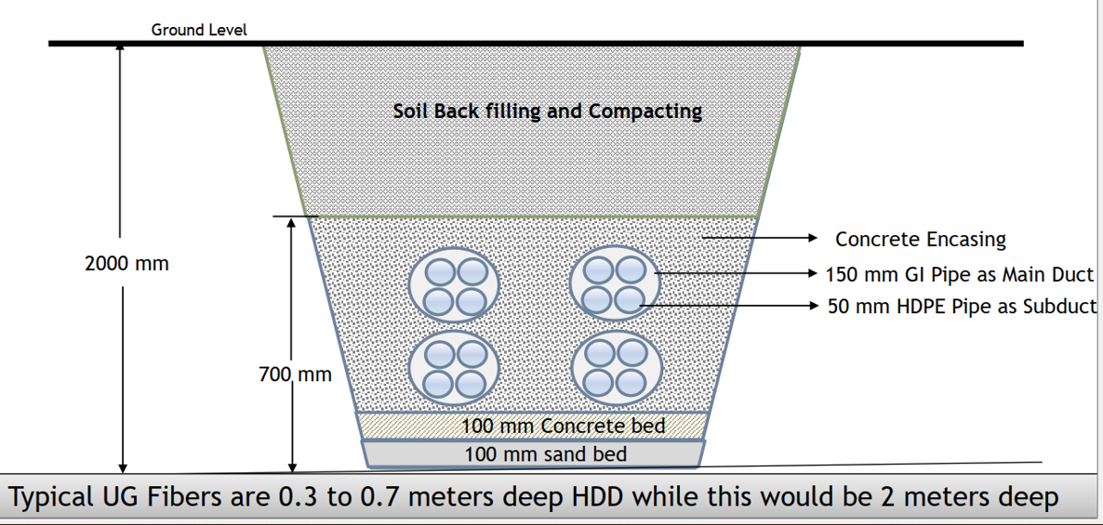
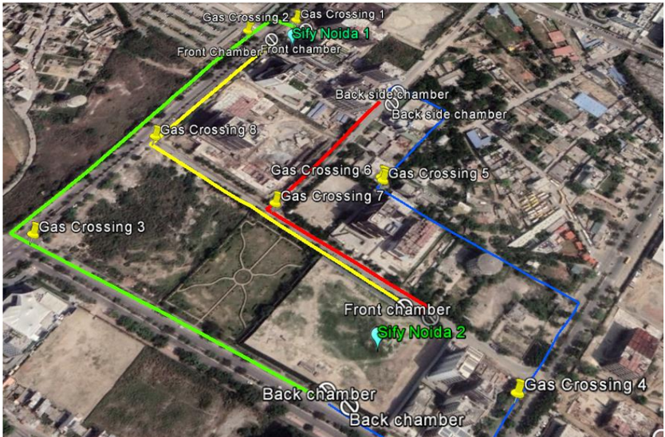
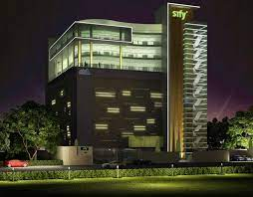
Sify NOIDA 02 Hyperscale Campus
Three Towers of 26MW each;
common office and logistics space
Tower B is multi-customer Tower; supports horizontal or vertical expansion
All towers are Hyperscale-Ready; Tower A/C can be deployed as dedicated BTS
Dedicated on-premise 220 KV substation
for high availability
Noida 01 to Noida 02 fiber route
4 secure underground conduits with concrete enclosure at 2000 mm depth
for high capacity
and resilience
Note: Gas Pipelines cross at 1 meter depth; this avoids any disruption from future digging
Path-1 (Red) – 600 meters
Path-2 (Yellow) – 800 meters
Path-3 (Green) – 1200 meters
Path-4 (Blue) – 1200 meters
Ready by June 2023
NB-11,12,13 Sector 132, Noida, Gautam Budh Nagar,
Uttar Pradesh | 28°30’43.97"N 77°22'21.63"E
Notes:
Shift the images around – so the underground image doesn’t look right below the building.
Distinguish between the tower and interconnect between the tower

Slide 15
CHENNAI city
About Chennai
Business Verticals
Automobiles
Driving factors
GDP (PPP) is $ 76.6 Bn (2021)
Automobile, software services, medical tourism, hardware manufacturing and financial services.
OTT, Hyperscale Network nodes and above business verticals are drivers for Data Center
Cable Landing Stations in Chennai driving trans Pacific traffic to South East Asia & US
Availability of stable and high capacity power
Proximity to internet exchanges
The Cable Landing Stations on contribute to its strategic importance in Data Centers.
Manufacturing
IT/ITES
Hospital & Health care Services

Slide 16
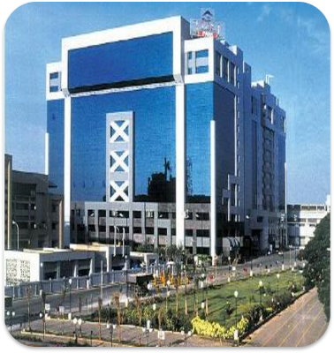
SIFY Chennai 01 DATA CENTER – tidel park
NIXI POP is present in Data Center
Located on Chennai IT Expressway
Network Interconnect for ISPs
Colo + Managed services for BFSI, manufacturing, IT services and other verticals in the region
Preferred site for CDN node
Highly interconnected Data Center
Tidel Park, #4, Rajiv Gandhi Salai, Taramani, Chennai - 600113,TN,India.

Slide 17
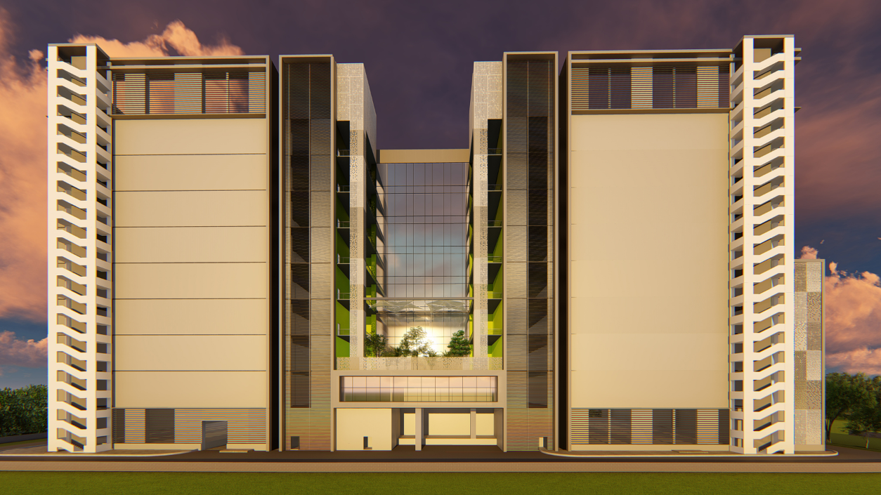
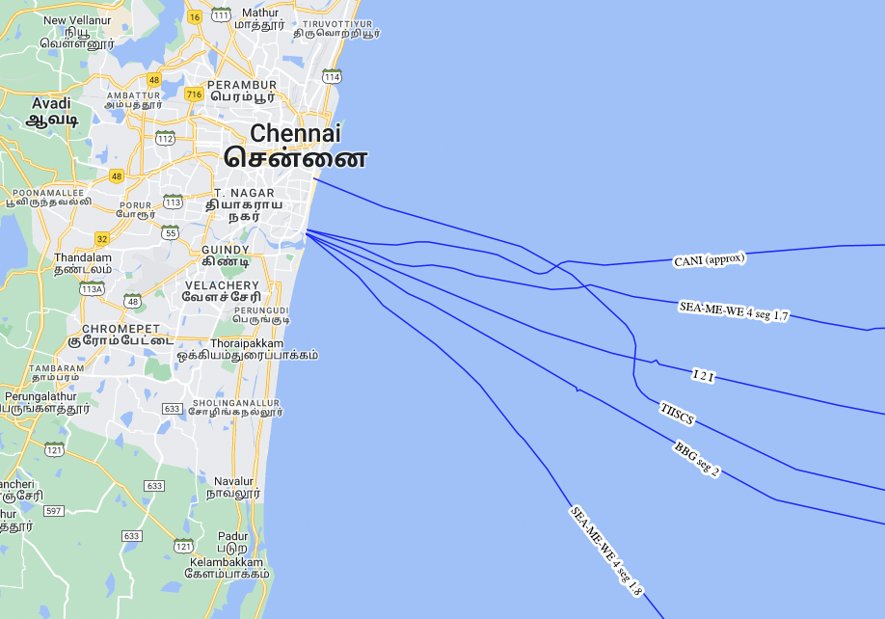
Sify Chennai 02 Data Center Campus – SIRUSERI with Integrated CLS
Other CLS
H11/A, Sipcot IT Park, Siruseri, Tamil Nādu, 603 103.
Hyperscale DC campus designed for
78 MW IT capacity
Dedicated on-site
220 KV GIS substation
All Towers interconnected incl. Bulk Fiber
Four fiber entry paths;
Multiple telcos
Integrated Cable Landing Station for Transpacific fiber access
Sify CLS
CLS is away from port, fishing zones, oil blocks and all existing subsea cables
Built on stilt structure, all equipment to be on Level 2 and 3
Initial power is 700 KW; to be ramped per requirement
800-1000 Tbps capacity
Notes:
WIP
CLS story coming from Harsha/ Ajay

Slide 18
HYDERABAD city
About Hyderabad
Business Verticals
BFSI
Favorable for Data Center and Disaster Recovery sites due to highly stable Seismic Zone
Driving factors
Young city with dynamic governance for effective policy implementation.
Major industries are Pharmaceuticals & life sciences,
Fastest growing IT & ITeS destination in industry India, Outsourcing of films & movie development.
Hyperscale Compute & network nodes, OTT players, Media houses and above business verticals are drivers for Data Center
Software development
Pharmaceuticals
IT-ITES
Favorable destination of IT/ITES companies due to availability of resources
Hospitals
Low cost of power compared to other Tier I cities
Its GDP is $ 163 billion with 15.6% YOY increment. (2022)

Slide 19
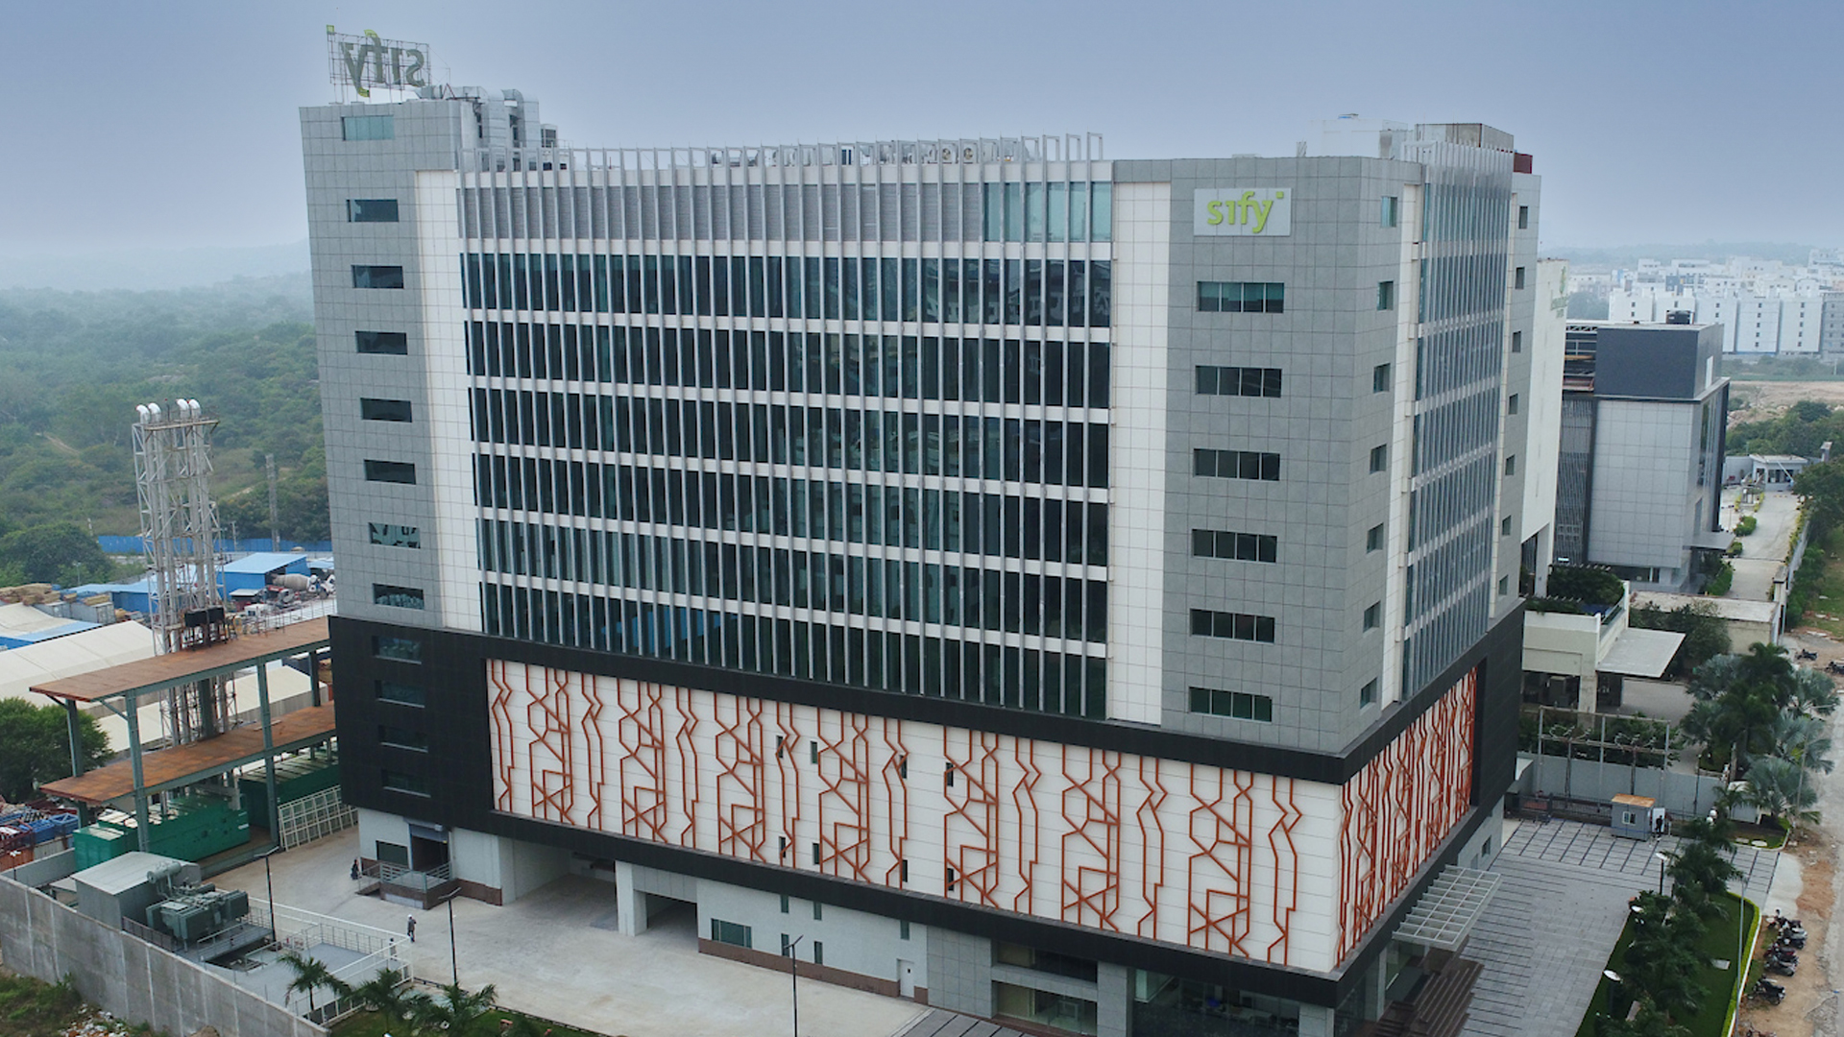
SIFY Hyderabad 01 DATA CENTER – financial district
The strategic position of this data center enables it to service the nearby IT hub in Hyderabad for various Data Center-based services.
Located at the Financial District (an SEZ and IT Corridor, by Govt of Telangana)
Hyperscale Cloud nodes
Large Banking and Financial Services customers
Access to utility services, essential and emergency services
Presence of major telecom service providers
Power feed from Dual utility Substations
Survey No 115, Financial District, Gachibowli, Nanakaramguda, Telangana-500089.

Slide 20
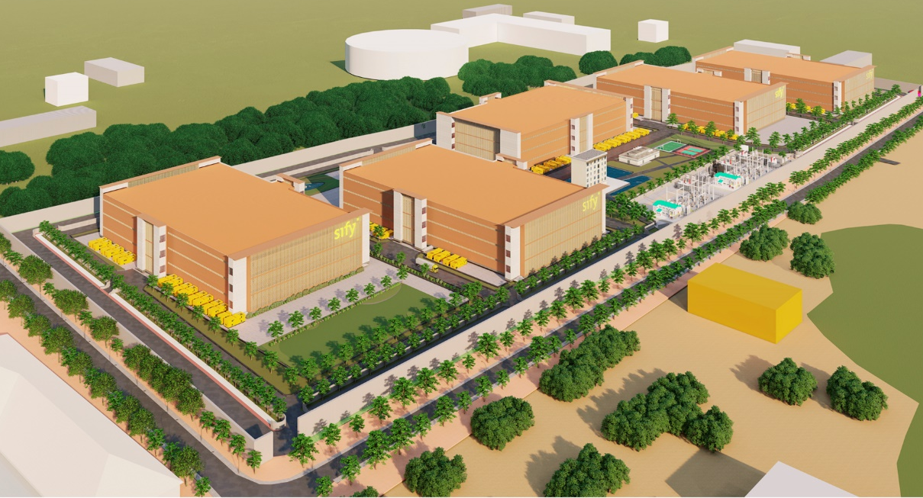
Sify HYDERABAD 02 Low-Rise mega Campus – fab city
50-acre campus for 5 Data Center blocks –
each block can host up to 52-60 MW
Options for ground-only warehouse type block or G+2 RCC block (7-8 meters height)
Enables unlimited scaling of power without space constraints and reduced complexity
Ideal for BTS requirements or seamless migration from Colo to BTS
Integrated campus network and metro network via utility tower fiber highway
Access to Dark fiber to Major IT parks in IT corridors in Madhapur and Financial District
Low Latency access to 30+ IT parks, Multi-tenant buildings and DCs in Hyderabad
​
Survey 50, Raviryal Village, Fab City, Ranga Reddy District, Telangana 507169 | 17°11'43.3"N 78°30'20.8"
Notes:
Remove the singular photo and show the campus.
PP to get from Roopesh
New photo added by PP

Slide 21
Bengaluru city
About Bengaluru
Business Verticals
BFSI
Driving factors
Bengaluru has a GDP of $ 236 billion (2022)
Driving factors
Mostly Hi-tech, Software development, R&D setups
High base of IT& ITeS companies, they have small in-house data centers. With arrival of cloud, expansion is high so large Data Center capacities are getting created
Bengaluru is a preferred locations for Disaster Recovery sites from other cities
E-Commerce & Retail
IT/ITES
Favorable destination of IT/ITES companies due to availability of skilled IT resources
E-commerce companies
Growing retail and e-Comm. as population grows
Work friendly climatic Conditions
Hitech
Research and development

Slide 22
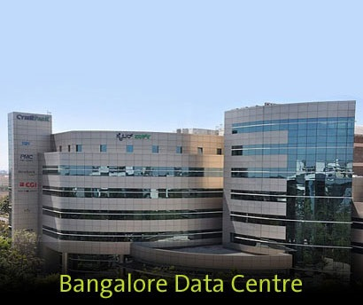
SIFY bengaluru 01 DATA CENTER – electronic city
Addressing biggest market segments like BFSI, E-Commerce & Retail, Media & Entertainment
DR for most BFSI and other business verticals
Major portion of the DC will be a Colo and Private Cloud deployment
NIXI POP is present in Data Center, Good ISP interconnect
Unit No A/303, 3rd Floor, Cyber Park, Plot no 76, 77. Electronic City Phase 1
Bangalore 560 100

Slide 23
KOLKATA city
About Kolkata
Business and Technology Hub in North east
Driving factors
Major industries are mid size corporates in Manufacturing, chemicals
Fastest growing hub including North east India (7 states) and other states in eastern India
Ideal Service delivery location for SAARC countries. Nepal, Bhutan and Bangladesh are in focus
GDP of Kolkata is $ 150.1 Billion (2021)
Favorable conditions for manufacturing as close vicinity to natural resources like coal and iron
Central city for a fast growing large multi state region
Business Verticals
Manufacturing
Small & Mid sized industry
Mining
New cable landing station in Dighi.

Slide 24
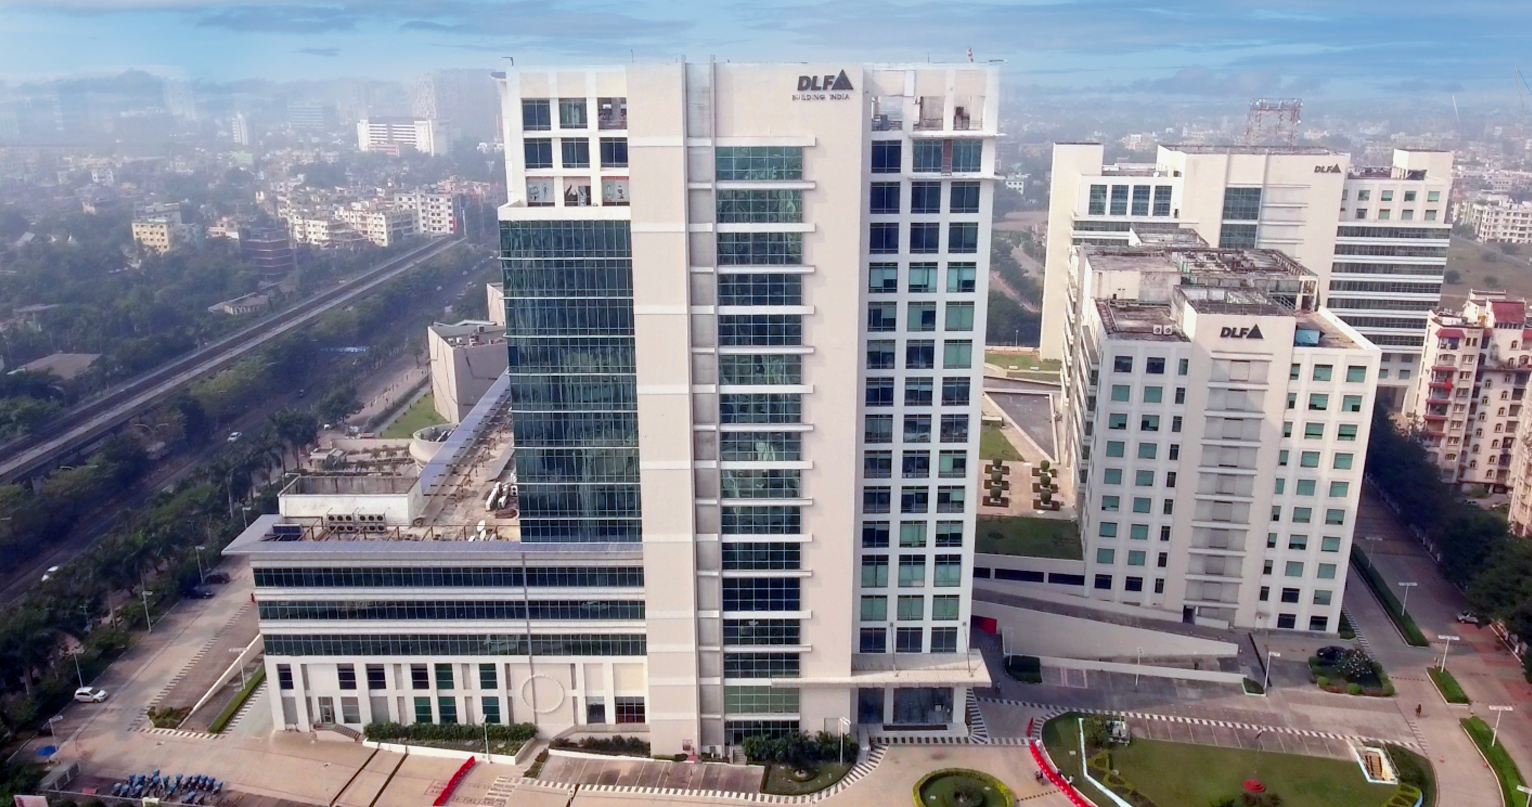
Sify Kolkata 01 DATA CENTER – new town
Caters to the East, North-east India and SAARC countries.
Underground Pathway for both Power and Networking.
Newtown is a newly established Town in North Kolkata.
Dual Sub-station Connectivity for higher Availability and Reliability.
Access to dense fiber to Major IT parks across IT corridors in Madhapur and FinCarrier Neutral Data Center.
Diverse Fiber Entry Routes.
Sify Infinit Spaces Ltd, DLF-1, 2nd Floor, Tower C, Newtown, Kolkata - 700156, West Bengal, India.

Slide 25



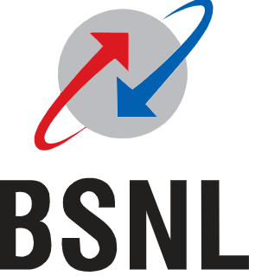
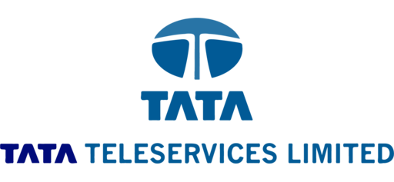
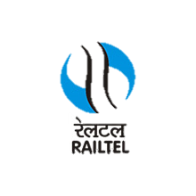



Carrier neutral TELCO PRESENCE across all sify data centers
Carrier Availability
Sify
Airtel
Tata Communications
Reliance Jio
Vodafone
PGCIL
BSNL
Tata Teleservices Ltd
Railtel

Slide 26
Sify Data Center Colocation – service offerings

Slide 27
CAPACITY offering
Data Center space is
offered as KW Capacity
E.g. 100 KW, 3 MW etc

Slide 28
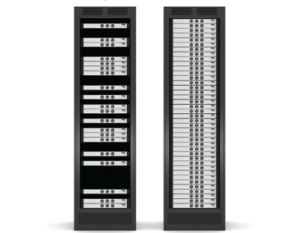
Capacity Offering (including Rack Space):
Rack space with bundled Rated power (in KVA):
Capacity provisioning is based on rated power of equipment in KVA.
Each rack comes with 2 runs of 1 phase 32-amp power sockets and 16 ports in rack PDU.
Deliverables include rackspace, capacity provisioning in KVA, and power consumption.
Customers can choose from a Shared Rack or Multiple Dedicated Racks.
Rackspace with Consumed Metered Power (in KW):
Subscription is based on fixed consumed capacity provisioning.
Power charges will be as per usage at actuals.
Each rack comes with 2 runs of 1 phase 32-amp power sockets and 16 ports in rack PDU.
Deliverables include rackspace and capacity provisioning in KW.
Power is billed as per usage.

Slide 29
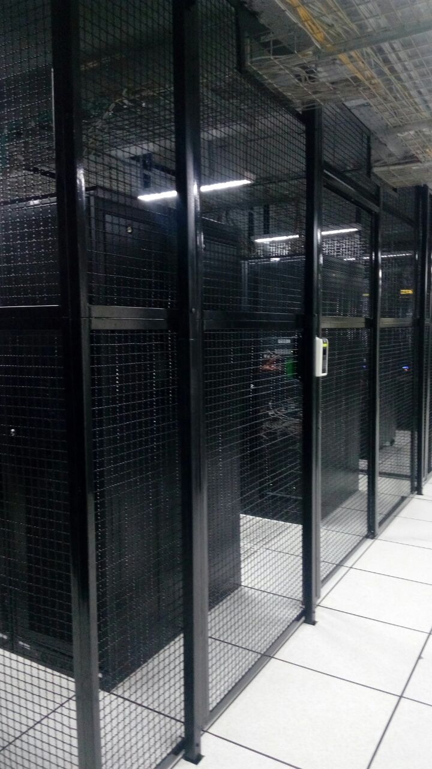
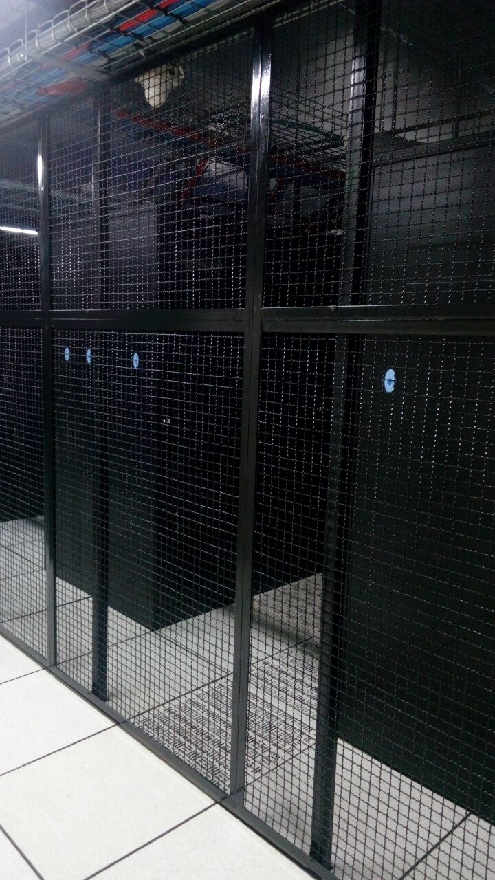
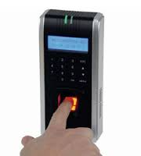
Cage, Biometric access
Cage
Sify Secure-Cage
Cage from slab to slab
Tamper proof bolts for all fixtures
Biometric access on cage door

Slide 30
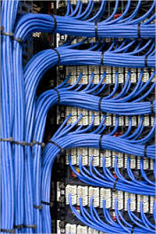
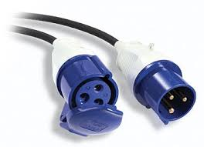
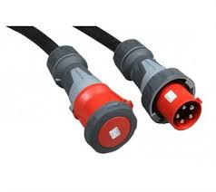
Power and Network cabling
Power Cabling :
Single phase 32 amp
Three phase 32 amp
Inter-rack Network Cabling: Cabling between various server/ network racks
  Ethernet - CAT 6, CAT 6A
  Fiber cabling
  Based on 24/48 ports per rack

Slide 31
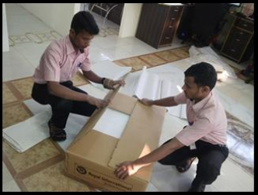
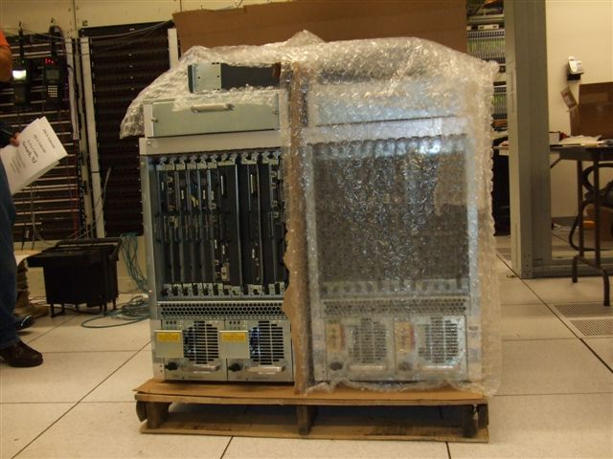

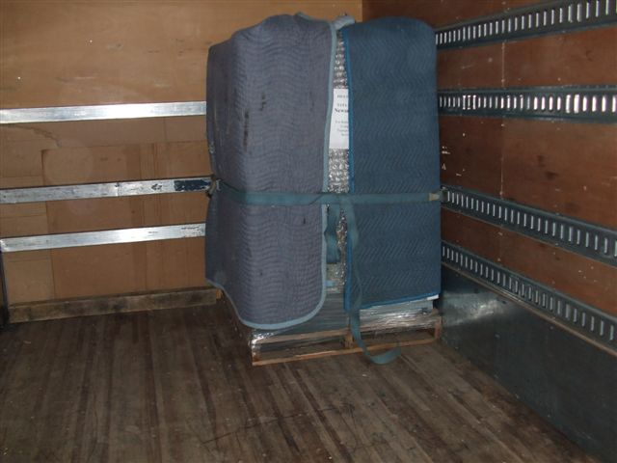
Physical IT Migration
Seamless movement of customer’s IT devices from in-house or third-party data center to Sify data centers.
Packaging and transportation from existing location to Sify Data Centers
Mounting of devices in racks in new location.
Power ON and testing the devices

Slide 32
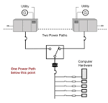
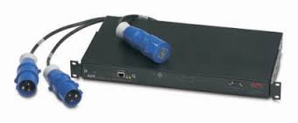
Static Transfer Switch
Static Transfer Switch (STS) for single power sourced devices
UPS A
UPS B
STS
server
UPS A
UPS B

Slide 33







Sify DC Colocation - Value added services
Secure Dedicated Cage with Biometric access control and Dedicated CCTV
Shared/Dedicated Seating space at @ Co-hosted site
Structured/ Passive cabling between devices/ racks
Fire-safe Vault facility/ Space for Tape storage
Cross Connect Services –
Fiber / Copper as per requirement
Physical Lift & Shift of IT Equipment from existing site to Data Center
Other Value-Added services :
Remote/Smart Hands Support
Storage/ Staging space
Racks with I-PDU and biometric access control, STS if required
On-site Tape rotation/ Off-site Tape storage etc.

Slide 34
SISL Sales Support
DOCUMENTS
WEBSITE
Data Center Presentations (each location)
Acceptable Usage Policy (AUP)
Hosting Services Agreement (HSA)
Data Center Product Catalogue
Customer Acquisition Form (CAF)
Updated Data Center Positioning Content
Virtual Tours
Data Center site specific Videos
Sify Data Center positioning video
Fact Sheets for each Data Center
Brochures for each Data Center
Customer testimonials
Website Tour https://www.sifytechnologies.com/data-center/

Slide 35
Probing points for colocation pitch
Reduce costs/on-premise data centers too expensive
Improve infrastructure and application scalability
Improve infrastructure or data center resiliency/availability (e.g., deploying new disaster recovery environments, achieve higher uptime)
Eliminate compliance concerns over on-premise data center/infrastructure
Improve infrastructure or data center security
Refactoring existing applications for performance and efficiency
Staffing/management
skill shortages
Staffing/management resourcing limitations
Shifting IT strategy away from Capital Expenditures (owning infrastructure) to Operational Expenditures

Slide 36



ESG FOcus
Data Center MEP
Sustainable Processes
Green Power Contracts
High efficiency for Equipment even at low utilization levels.
Selection of equipment with high energy saving parameters.
Right redundancy levels
ASHRAE Guidelines
ISO 14001 Environmental Certification
Carbon abetment policy
Low PUE, WUE
Contracted 200 MW Green power via Power Purchase Agreements
Additional nation-wide Green power for future projects
Notes:
Tweak content/ make more crisp
Add NW services with Anoop

Slide 37
Transforming Data Center Management with Automation
REALTIME VISIBILITY
MEASURABILITY
Operations: Land, Building, POD, People and Process
DC Infrastructure Assets: Active and passive information
Resource Utilization
  Space – Rack space
  Power – Grid power, DG, UPS, RE, Power Exchange
  Cooling
  Cross-connects
Operations: Condition or SOP based monitoring
Resource capacity utilization & trend analysis: Time based (Daily, Weekly, Monthly etc.) and Facility wide comparative analysis
KPI based service contract renewals
Usage based Infrastructure resource planning
PREDICTABILITY
EFFICIENCY
Failure & Downtime: MTBF, MTTR, RCA and Service TAT
Maintenance, Service & Support requirements
  Preventive Maintenance of assets
  AMC Contract realization
Demand forecasting and capacity planning
Capacity Utilization
  Rack Space burn down or consumption efficiency
  Power Utilization Efficiency (PUE) [ Grid/ RE ]
  DG Power fuel efficiency
  UPS Power efficiency( Load requirement vs Backup time)
  Water Utilization Efficiency
  DC Carbon Footprint
Service & Support efficiency
Notes:
MTTR : Mean time to recover
MTBF : Mean Time Between failure
RCA : Root cause Analysis
TAT : Turn Around Time

Slide 38

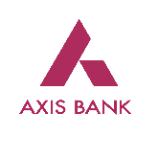

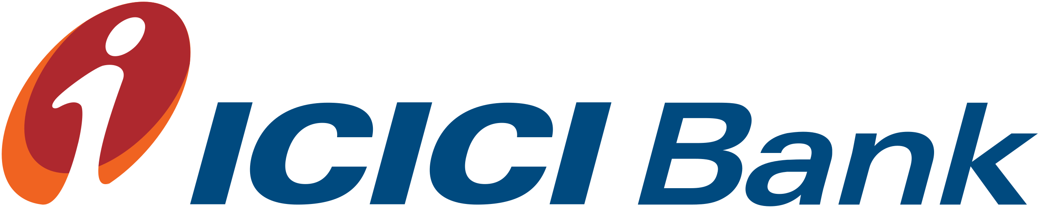















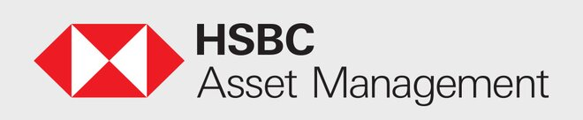






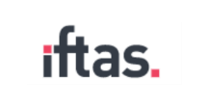






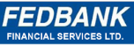

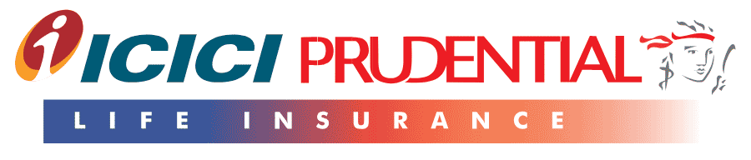

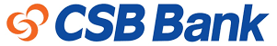


INDIA’S bfsi LEADERS ARE in Sify data centers
BFSI
Multiple Big Brands across BFSI industry chose Sify Data Centers as part of their Cloud journey
Notes:
Kotak to be highlighted, axis to be replaced with kotak and yes bank to be placed down.

Slide 39











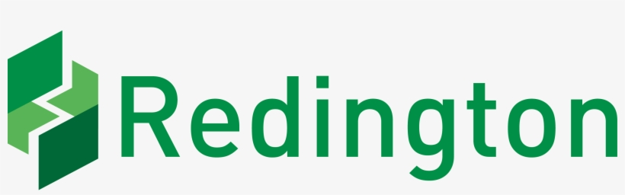



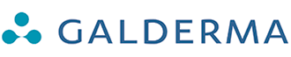

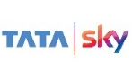


















Other INDUSTRY LEADERS from india in sify data centers
OTHER INDUSTRIES
More than 600 Brands across industries chose Sify Data Centers as part of their Cloud journey

Slide 40

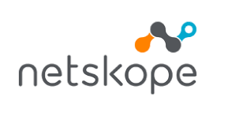






















SIFY data center global CUSTOMERS
HYPERSCALE CUSTOMERS (3 OUT OF 4 GLOBAL CLOUD PROVIDERS)
OTT AND CONTENT PROVIDERS
GLOBAL ORGANIZATIONS

Slide 41
Case Studies

Slide 42



A leading BANK relies ON Sify FOR SMOOTH BANKING
To ensure connectivity and system resiliency for business operations
BANK’S OBJECTIVES
WHY SIFY WAS CHOSEN
SIFY’S VALUE ADDITIONS
To procure an integrated Network services and DC solution.
Robust and resilient network.
To co-locate primary DC, Disaster Recovery Center & Near DR.
Seamless transition to SD-WAN from legacy MPLS Network.
Single point of control for Integrated DC, Network & IT Security, IP Telephony
Strong track record and interlocks with large OEMs for SD-WAN, SDN, NAC and IP telephony solutions in 1500+ locations.
Ability to work with other service providers
Comprehensive understanding of requirements
Nationwide robust network presence
Bandwidth on demand
Completely redundant Pan India WAN Network Solution with 1500+ locations and 3000+ links
Onsite NOC solution with monitoring tools and On-Prem resources
High-speed, high-bandwidth redundant network for replication across all data centers (existing and new)
42
Notes:
Punjab & Sind Bank

Slide 43



improved branch availability & optimized bandwidth utilization at 1500+ locations
BEFORE TRANSFORMATION
AFTER TRANSFORMATION
CUSTOMER SUCCESS BENEFITS
Single link at all locations, front-ended by Wipro Limited.
Traditional MPLS VPN network of 1500+ branches.
Centralized banking solution on Finacle.
Co-located traditional DC Network at Mumbai and NOIDA.
Network connectivity from two operators.
Upgrade to latest technology solution with SD-WAN & SDN.
Robust edge-to-edge security.
Sify as single point of control for Integrated DC, Network & Security.
Improved branch availability, optimized bandwidth utilization, and increased application performance.
Improved end-user application experience and customer satisfaction.
Greater business agility and responsiveness.
43
Notes:
Punjab & Sind Bank

Slide 44
Win Theme:
Cloud Transformation
Notes:
Mahindra & Mahindra financial services

Slide 45
Sify accelerates the Cloud Journey of a leading financial services provider with its Hybrid IT Solution
Transformation goal: Enhance customer experience and operational efficiency by leveraging digital technologies on an agile, scalable and resilient IT infrastructure
OBJECTIVES
WHY SIFY WAS CHOSEN
SIFY’S VALUE ADDITIONS
Migrate and integrate complex IT landscape operating on multiple hypervisors to a scalable
Optimize TCO.
Dedicated high-speed network for access to GCP-hosted applications.
Retain same network subnet between on-prem DC, DR and co-located DC.
Sify has experience and assets for large-scale BFSI migrations to Hybrid IT
Comprehensive cloud-centric services and managed services
Prompt support and strong financial position of Sify.
Consultative approach and record time delivery (4 months) despite pandemic lockdown.
End-to-end hybrid IT implementation using multiple migration methodologies.
Private cloud using HCI environment and Sify CloudInfinit for VMware virtualization and server management.
Provisioning of temporary setup to eliminate risk of downtime.
Strategically planned downtime during lift and shift to Sify Airoli DC.
Platform managed services included in implementation.
45
Notes:
Mahindra & Mahindra financial services

Slide 46
Seamless transformation in record time with Sify data centers
BEFORE TRANSFORMATION
AFTER TRANSFORMATION
CUSTOMER SUCCESS BENEFITS
Difficulty in scaling up space and power - inhibiting DC expansion & business growth.
Management in silos for different workloads in a multi-hypervisor architecture.
Non-redundant infrastructure setup for applications - lacking the redundancy of a clustered environment
Challenges in replicating the DC and DR.
Hardcoded IPs in legacy applications - changing them was not possible.
Poor application performance with existing equipment which was due for tech refresh.
Customized Hybrid IT architecture and hybrid migration (P2P + P2V) to meet business application demand.
Low latency network between co-location setup and other DC provider for accessing core applications as a LAN extension.
Dedicated network switches for Sify CloudInfinit connectivity & uplink to MMFSL co-located infrastructure.
Migration links (2 Gbps) between customer premises and Sify DC using Overlay Tunnel Virtualization (OTV) protocol to have the same LAN extension.
Scalable and redundant IT infra ensuring high availability and performance of applications.
Reduction and rationalization of TCO with infrastructure solution on as-a-service model.
Unabated transformation despite pandemic restrictions due to the swift execution and closure by the Sify team within 4 months.
Better productivity and customer experience owing to uninterrupted operations and nominal downtime of applications.
Brought the customer closer to DC consolidation and cloud-native capabilities with Sify’s Cloud Adjacent Data Centers.
46
Notes:
Mahindra & Mahindra financial services

Slide 47




carrier-neutral data center and cloud connectivity solutions help US-based cloud contact center company build footprint in India
Cloud contact center software
Project Objective
To build the first point of presence in India and help the customer to provide services in the Indian market, by providing colocation services at Noida.
Integrated Value and Outcome
Data center services and connectivity to cloud at Sify's Noida facility to achieve cloud adjacency
Sify’s unique value proposition and ecosystem helped customer to take the right decisions.
Sify provided secure and reliable infrastructure, timely procurement of equipment as per client requirement.
The project was completed within given timelines and helped customer to start their operations in India.
Value for Client
Sify provided secure infrastructure, followed the client's global standard of implementation as per the scope shared, and achieving it within the timeline provided. This has further incurred trust and the client has further planned for its expansion in same facility.
Data center & cloud services
Sify’s Uniqueness
Sify’s value proposition and competitive pricing.
Connectivity to cloud, carrier-neutral facility and 24x7 onsite support
One-stop-shop solution for customer needs
Project Model
Colocation with Cloud connect and high resiliency network access
Notes:
Customer name – NICE
Title
Breaking barriers to market entry through robust and secure IaaS
Description
Comprehensive, carrier-neutral data center and cloud connectivity solutions help US-based cloud contact center company build footprint in India

Slide 48


Enhancing User experience through faster content streaming
Over the top customer
End-to-end CDN services and edge data center connectivity enable global OTTs improve performance and reach
Project Objective
To enable a Content Delivery Network for better user experience
Integrated Value and Outcome
Data Center products and services:
Colocation service at multiple locations
Connectivity to edge data centers to reach maximum end users
Data centers at different seismic zones provide 100% uptime and availability
Stringent security at Sify Data Centers
Full life cycle responsibility through assessment, audits and following best policies and compliances
Implementation of project within a record timeline
Value for Client
Digital-ready infrastructure to cater to future needs, with Sify managing end-to-end services
Project Model
Colocation with extremely robust Network access
Data Center services for OTT’s
Sify’s Uniqueness
Integrated value proposition: Data Center, Internet Exchanges, carrier neutrality and connectivity to 50+ edge data centers to reach maximum eyeballs
Notes:
Customer Name: Netflix
Title
Enhancing UX through faster content streaming
Description
End-to-end CDN services and edge data center connectivity enable global OTTs improve performance and reach

Slide 49
THANK YOU
Sify is the leading digital infrastructure player in India, helping customers achieve their digital ambition through cloud@core products and services, built on its world class Data Centers, Cloud & Network assets and a wide portfolio of professional and digital services

Slide 50
Win Theme:
Data Center Transformation
Notes:
Sun Pharma

Slide 51
Sify helps large generic pharmaceutical BRAND gain resiliency and Availability
Transformation Goal: To keep IT secure & business ready, reduce the cost of IT operations and enhance customer experience.
COMPANY’S OBJECTIVES
WHY SIFY WAS CHOSEN
SIFY’S VALUE ADDITIONS
Resilient and secure infrastructure with minimal disruption.
Modernized and consolidated IT infrastructure for business agility.
Co-locating captive DC to a secure DC location.
Reduced TCO and 100% uptime assurance.
Sify's extensive experience with large/complex migrations.
Unique cloud adjacent data centers with deterministic connectivity to Hyperscalers.
Compliance with stringent regulations and global compliances.
Consultative approach to build the right business case for the customer.
Completed UAT and Production Setup migration in 20 days with minimum disruption.
Physical lift and shift + migration to 2 sites in 3 days.
Provision for a "Parallel Setup" to ensure near-zero downtime.
Additionally, owned IT service assessment, management and governance.
51
Notes:
Sun Pharma

Slide 52
Seamless transformation in record time with Sify data centers
BEFORE TRANSFORMATION
AFTER TRANSFORMATION
CUSTOMER SUCCESS BENEFITS
Lacking scalability, agility, and availability in IT infrastructure.
Existing DC at Gurugram not financially viable to run from on-premise.
Applications demanded high-performance storage while IT infra reached end of support cycle.
Most of IT budget used for keeping the lights-on.
Existing challenges with cable congestions and cooling efficiency.
Cost savings due to capex vs opex pricing model and simplified cabling.
Dynamic management to meet application needs.
Improved availability, security, and overall reliability of IT landscape.
Better application performance with new infrastructure.
Cloud-ready IT Infrastructure ensuring resiliency and security for future business endeavors.
Huge savings and high ROI over next 5 years with new DC setup.
Achieving business agility with consolidated IT infrastructure.
Re-routing funds from savings towards strategic plans such as Pharma R&D.
No disruption due to natural calamities such as earthquakes.
52
Notes:
Sun Pharma

Slide 53

Thank You

