Slide 1
Sify
IT Managed Services
“Empowering Your Business, Simplifying Your IT”
April 2023

Slide 2



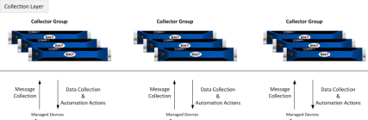
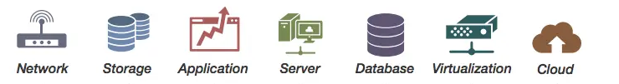

Sify IT Managed Services (IMS) platform
Customers
Sify Delivery Team
Customer KYC
Service Management Portal
Service Fulfilment
Integrated
Provisioning, Orchestration & Service Assurance – Sify Multi-CMP
Opportunity Display
Request
Event
Incident
Problem
Change
Asset Mgmt.
CMDB
Service Mapping
Configure, Price & Quote
Sify Monitoring Tool
Data Store
System Tools
Discovery & Mapping
Monitoring
Business Services Dashboard
Automation
Event Management
AIOps
Data
Visualization
Order Management
Billing & Invoicing
Backup
Polled
Logs
Agents
API
Patch Management
Syslogs
VA / PT
AV
SIEM
API
Agents
Business Support Systems
DR
Any Cloud
Operations Support Systems

Slide 3
SIFY IT managed services catalog
Sify Colo, 3rd Party Colo, Customer DC
Sify Products and Services (IaaS, PaaS, SaaS)
OS
[Windows / AIX// Linux]
Application
[IIS, Apache, Tomcat, AD, Exchange]
Middleware
[JBOSS, WEBLOGIC, WEBSPHERE ]
Data Base
[ORACLE, MSSQL, MYSQL]
Containers
Security
Compute
Storage
Network
Backup & DR
DevOps
MSS/MDR/GRC
Hardware Mgmt.,
Hypervisor Resource Mgmt., Monitoring, Version Mgmt., Firmware Upgrades, Patch Mgmt. & OS Tasks.
Application Mgmt., Controller Mgmt., SAN & NAS Mgmt., QOS & Tier Mgmt., RAID Mgmt., Firmware Mgmt..
Middleware stack mgmt., Switch & LB Mgmt., Monitoring, Firmware Upgrade, Patch Mgmt.
Database Mgmt., Fine Tuning, DB Jobs mgmt., Back Up
Platform & Schedule Mgmt., Restorations, DR Configuration & Management
Kubernetes Cluster Mgmt., CI/CD Pipeline configuration, SerivceMesh configuration and monitoring
Monitoring, Configuration,
Platform Management - Version, Firmware Upgrade, Patch Mgmt.
Sify CI Enterprise Cloud, AWS, AZURE, OCI, GCP
Dell/ HPE/Cisco/
Azure Stack / Nutanix
Hitachi/HPE/IBM
Cisco / Nexus/ F5
VMware, Suse
Fortinet, F5, Cisco, CrowdStrike,
Arcon
OEM
Commvault, Carbonite
Device
Type
Rack Servers, Blade Servers, HCI, Virtualized, Azure, SAP
Block Storage, NFS Storage,
ISCSI
Router, Switch, ACI Fabric
Load Balancer
VTL, Tape Library
Tanzu, Rancher
FW, WAF, IPS,IDS, AV, MFA, PIM,
Service Desk
Omni-Channel, 24x7, Multi-Lingual
Tools
Service Desk/ITSM, Discovery, Automation, Orchestration, Correlation, Operation Insights, Dashboards, AIOps, DevOps
Processes
ITSM – ITIL, ITAM, ITOM, ISO 27001, ISO 2000

Slide 4





Automation-led IT managed services
Provisioning
Workflow
Event
Runbook
Catalog based orchestration - Creation, Self Service, Multi Cloud Management, etc.
Sequential workflow defined services and checks with or without any intervention – Service Request, Notifications, Authorization, Assignment etc.
Triggered based on one or sequence of events – Alerts from tools or APIs, Threshold violations, etc.
SOP based sequential tasks - Service Health checks & defined actions. AIOps driven for MTTD, MTTR, MTTI Reductions.

Slide 5
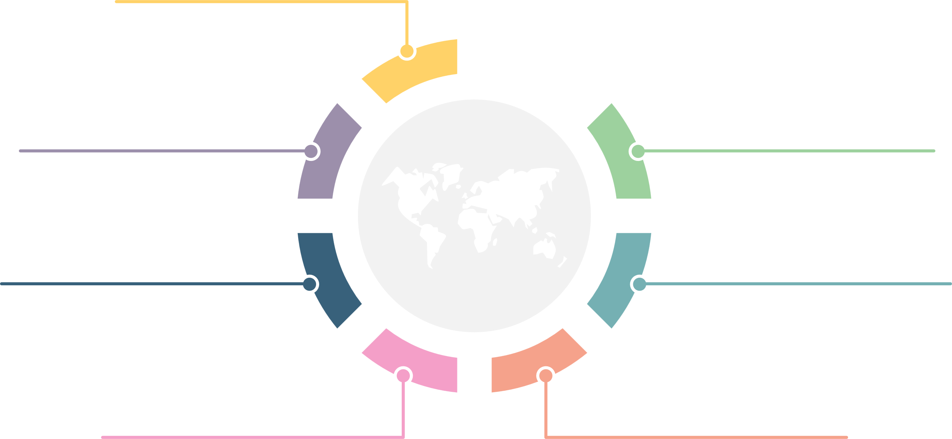
What makes sify an IMS UNIQUE partner
Less
Hardware
People
Licenses
Single partner for Managed Services across DC/Cloud/NoC/SoC/EUS
Partner to address future Transformation initiatives with AIOps driven platform
Catalogue Driven & Optimized Hybrid delivery model
TOOLS
PROCESS
INNOVATION
Best of Breed MSP Tools,
Proactive monitoring, Single Pane of Glass
Productivity improvement
with Automation and Event co-relation
Full suite of ITIL service elements, process compliance
SLA based service with real time measurement & dashboards

Slide 6








Sify IMS: Value proposition & Customer benefits
Integrity | Commitment | Agility
Sify Value Proposition
Customer Benefits
Wide Product & Services Capability
Business Benefits
  Service Provider DNA – Single Partner
  Sify Cloud (CI) – Private / Public Cloud
  Network & Data Center Services
  Security Services
Quick to Market
Digital Initiatives
Business scale
Brand Protection
Technology Capability & IP
Cost Benefits
Product Engineering Capabilities
Sify Multi-CMP
Certified People
100+ OEM alliances and Partnership
Technology Adaption
Technology Standardization
Technology Optimization
AIOps driven Operation Excellence
Customer Delight
Proactive assurance by Predictive analytics Tooling & Automation
Service Level Management & Optimization
Incidents, Problem Reduction
Human error reduction through automation
Increase Speed and Agility in Resolution

Slide 7
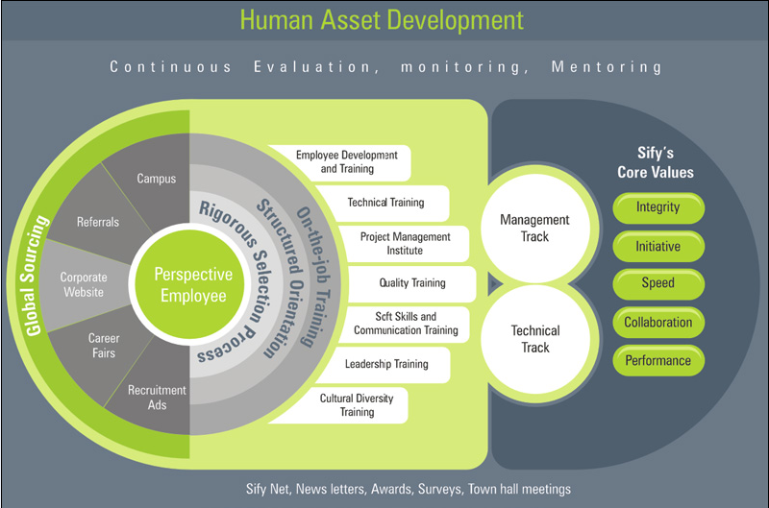
Continuous IT skill development
LMS (Success Factors) | Percipio Content Portal | ILT & VILT (Instructor Led Trainings)|OEM Training & Certification

Slide 8
CONTINOUS SERVICE IMPROVEMENTS: it modernization
Increase Maturity on Optimization & Proactiveness
Increase Maturity on Predictiveness
Transition
Process
KT & Shadow
Open ticket closure
Enrichment of Knowledge Repository
Process Documentation
Business Alignment
Business Process Integration & customization
Crisis Mgmt. process
Capacity Management Reporting
Incident Prediction
Governance Model
Incident Prediction
SLA baselining
SLA Dashboards
Incident Reduction
SLA Framework
SIP execution and Impact analysis
Problem Reduction
CMDB Schema Updates
Productivity Improvements
Assessment & Audits & Best practice implementation
Tools
Automation
Setup Tools
Monitoring KPI Fine Tuning
Monitoring Analytics
Automation Charter Planning
Automation Rollout
Reporting and Dashboards
Multi Cloud Management - Sify Multi-CMP
Integration to Dashboards
Management Dashboard improvement
Tech
Preventive Maintenance
In-Flight project takeover & closure
Tech Optimization on Footprint
AIOps
DC Optimization & Migration
Hybrid IT Deployment Business Plans

Slide 9
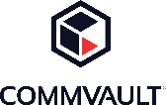
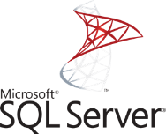

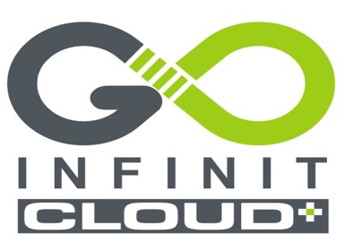

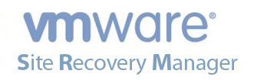
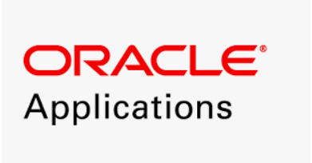



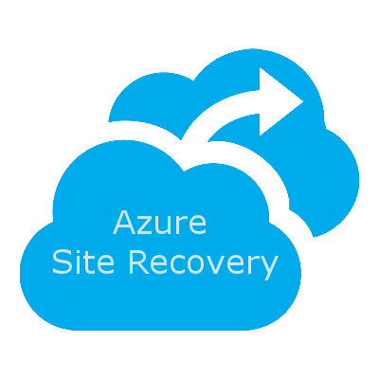
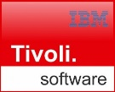
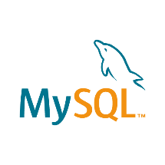



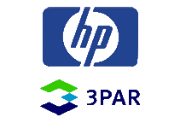





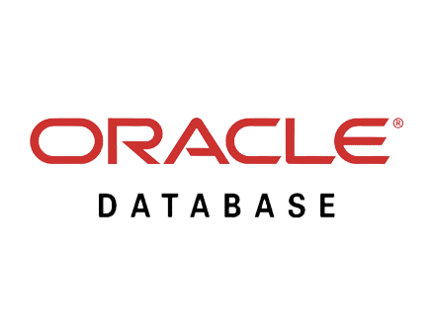



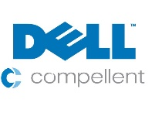

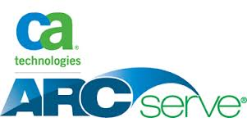

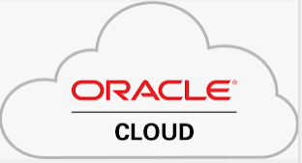






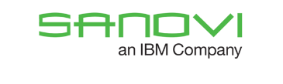




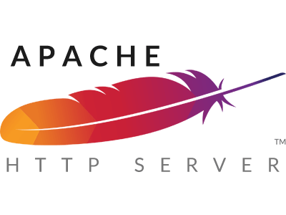
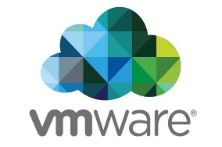

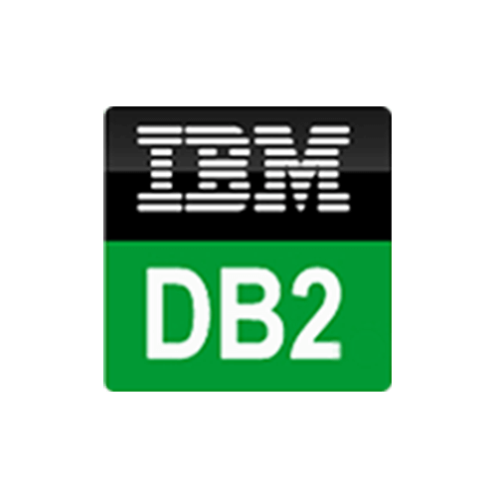
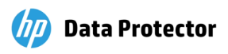
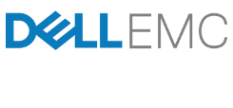




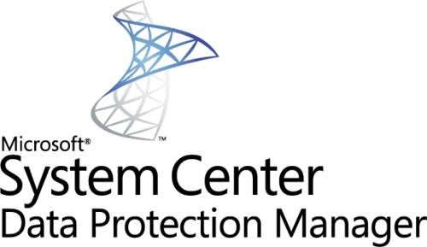
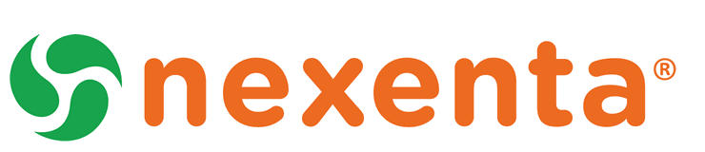


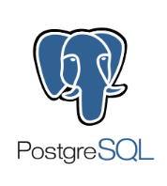










Technology competency & Certification: DC & Cloud
OS & Applications
Backup
Database
Storage
Cloud
Network
Tools

Slide 10
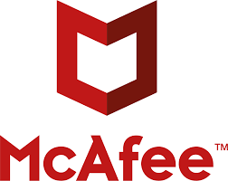



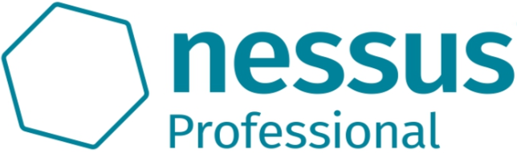


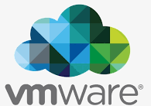
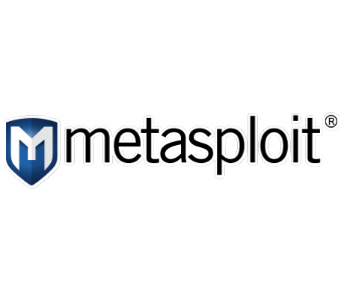
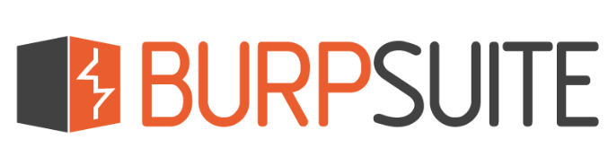

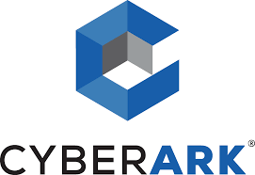
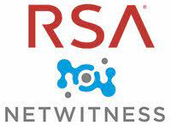


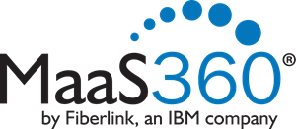


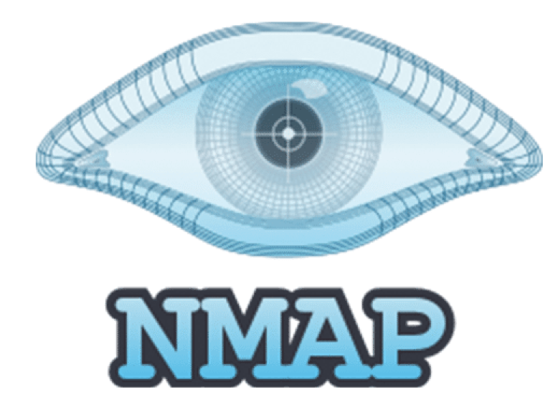

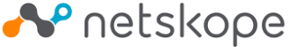
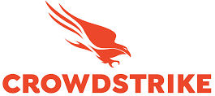











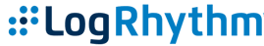




Technology competency & Certification: Security
Network Security
Host Security
Data Security
Mobile Security
IAM
MDR
VA & PT

Slide 11
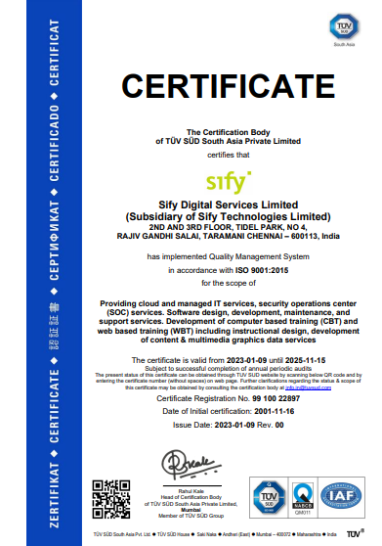
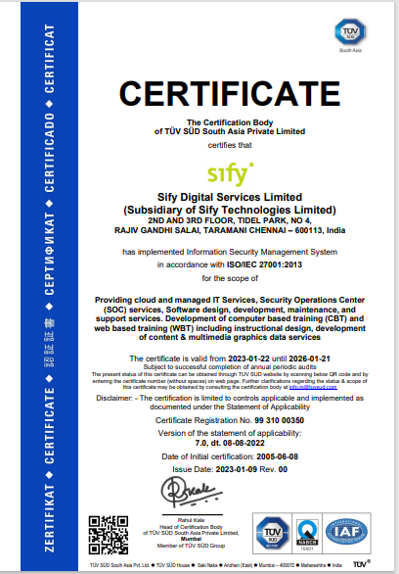
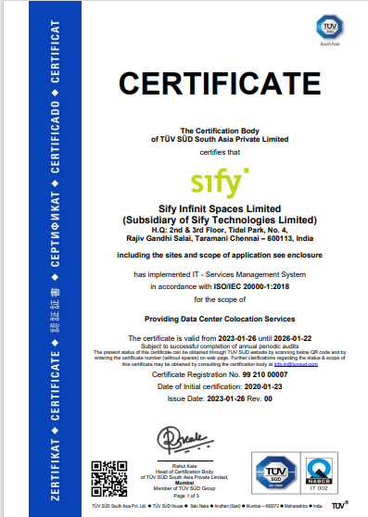
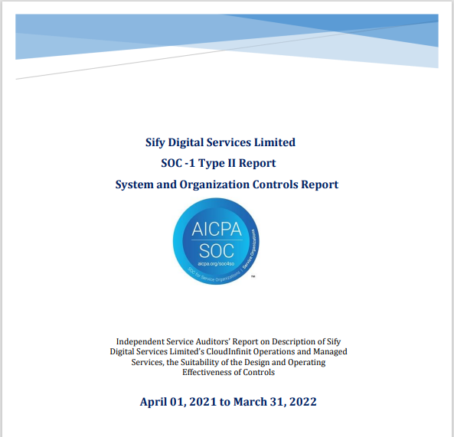
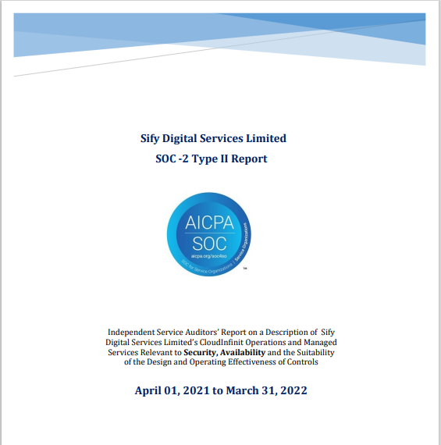
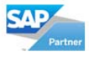
Sify quality, security & compliance certifications
ISO 9001
ISO 27001
ISO 20000
SOC 1 Report
SOC 2 Report
SAP Certified
In Hosting Services
SAP Certified
In Cloud Services
SAP Certified
In SAP HANA Operations Services
SAP Certified
In Application Management Services

Slide 12






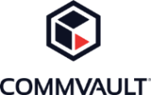




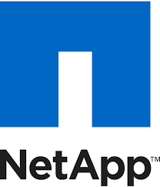





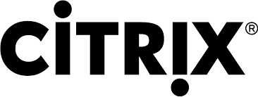








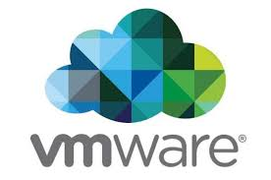





SIFY’S Partner ECOSYSTEM
CLOUD
SECURITY
APPLICATION
infrastructure
Digital@Core

Slide 13


Sify IT Managed Services: Key Facts
700+
900+
150+
Global
PEOPLE
DC, Cloud & Managed Services Team
Network Experts
Certified Security Experts
PRESENCE
India (HQ) | USA | UK UAE | Singapore
500+
600+
700+
70+
50+
CUSTOMERS
Cloud clients
Data Center Clients
Network Clients
Private Cloud & DR clients
CDN & Cloud Security clients
50+
500+
300+
80+
PROJECTS
IT Ops Transformation projects
Data Center services projects executed
Data Center Migration projects
Platform Migration Projects
35K+
100K+
75K+
5000+
7 Petabyte
VOLUME
Managed Tickets per Month
Network Devices
Managed Mailbox
Security Devices
  Managed Storage and Back-up

Slide 14






SIFY AS TRUSTED IT Managed services PARTNER
A leading healthcare provider chose Sify’s Digital@Core platform for the digital transformation of patient care services while saving 33% on cloud costs.
India’s largest power utility company chose Sify’s Cloud@Core platform with business-outcome-based model to scale their service to 25 million+ subscribers.
Sify’s integrated hybrid cloud solutions modernized 80% of the business applications of a retail giant with zero service disruption.
Global steel leader chose Sify to assess and migrate its business-critical SAP workloads to a hyperscaler at near-zero downtime.
Sify helps a life insurance major transform digitally with AI/ML, cloud-native applications, and modern DevOps toolchains by unlocking the power of hybrid cloud on a hyperscaler.
Ensured 35% TCO reduction and 3X performance to fast-track digital transformation and bring business resiliency to a major NBFC with multi cloud.

Slide 15

Thank You

